Slide 1


Adapting to
the “New Normal”
Stefano Venturi
VP, Public Sector European Markets

Slide 2


Emerging From the Storm
The “New Normal”
Fragile macro-economic recovery
Less financial leverage
Lower/shifting consumer spending
More/faster disruption
Source: Cisco IBSG 2009
Notes:
Today, I’d like to tell you about something we at Cisco are calling the New Normal. And all of you in Local Governments are going to feel the impact of it as much as anyone. It looks like we are coming out of a huge economic crisis and although things are starting to get better none of us should expect that things will return to the way it was.
So What is the New Normal?
we see the New Normal being a result of:
a fragile macro-economic recovery
less finacial leverage compared to before the crisis
lower and shifting consumer spending
and more and faster disruptions – which are often enabled and accelerated by IT
All of this applies both to the Private Sector but also the Public sector. Business as usual, will not be a winning strategy.
In the New Normal change will become more risky, but doing nothing will lead to failure.

Slide 3



The New Normal
The Efficiency Challenge
The Climate Change Challenge
Increased Competition
Cost Cutting
Improved Productivity
Reduced impact on the environment
The “New Normal”
The Agility Challenge
Connected World
Rapid Pace of Change
Notes:
There are three challenges we need to address
The first one is The Efficiency Challenge (Click)
The most obvious changes are economic – private sector organizations like Cisco have squeezed down on costs in response to the global recession, but even as the world economy starts to grow again, we know that markets are going to remain very competitive and that we will need to stay lean. The public sector is also facing a period with a strong emphasis on cutting costs and improving productivity. In some countries this may not have happened as quickly as in the private sector, but it is certainly going to be a key issue over the next three or four years. (Click)
But it is not just about economic change. The Credit Crunch showed what it means to live in a highly interconnected world. It’s a vibrant world that can create huge value, but it is also a world where change happens very quickly. The Credit Crunch was about the accelerated pace of change in the world economy, but swine flu illustrates the same point in relation to health and the speedy worldwide ban on carrying liquids onto airflights does so in the area of public safety. This is the Agility Challenge. (Click)
The last challenge is perhaps one that some people have lost sight of over the last 18 months, but which I am sure many of you are very aware. (Click) The Challenge of Climate Change. The New Normal is a world where organizations have to be leaner and more productive, it’s a world where they have to be agile and better equipped to respond to change, but it is also a world where they have to radically reduce their impact on the environment.
I think these are the three top challenges for public and private sector organizations alike and I think technology has a central role to play in tackling each of them.

Slide 4

Local Government Trends & Challenges
Positive impact of stimulus packs & EU funds
Looking for cost control & green initiatives
Focus on ROI
Improving internal and external communication
Increasing communities attractiveness
Notes:
4
So how is this New Normal shapping up for Local Government? Let’s take a look at some of the trends and challenges being faced.
1. Positive impact of stimulus packs & EU funds
Governments and Central Bank are taking actions to restore economy
ICT investments and fast broadband development on the top of the European agenda
Wide range of EU structural funds & instruments available for communities
2. Looking for cost control & green initiatives
Local authorities are going to cut down administrative cost, increase interest in savings
Green investment will enable to reduce cost and meet energy-efficiency standards at the same time
Growing need for network integration, information sharing and openness.
3. Improving internal and external communication
Increasing interoperability solutions for public administration, digitalisation of internal processes, barrier free communication
Collaboration tools (Gov 2.0) to improve interaction with citizens and businesses
4. Increasing communities attractiveness is necessary
Cities are focusing on making their community a more attractive place to invest and live
Communities want to make their place safe to live, where people do not afraid (currently, one person in six feels that crime or vandalism is a problem in their neighborhood).
There is a growing focus on facilitating the tourism market and increasing tourism attractiveness
Cities are interested in reducing traffic congestion & time to travel, mainly by parking and traffic management and reducing number of commuters (telework, smart work centers)
5. Focus on ROI
Public Investments are prioritized on short term and clear returns on investment
Focus on technologies, solutions, .. That apply to this principles
New business models with public private partnerships
So the focus in Local Governments is very much the same as the focus we’re seeing across all industry’s and we’re also seeing the industry look to Technology to provide solutions that address these challenges. There are a number of fantastic examples of local government organizations that are already using technology to address these challenges. Let’s take a look at a few.

Slide 5





New Ways of Working Together In Local Government
Local and state government in Germany
Guldborsund Municipality in Denmark*
Rivas Vaciamadrid Municipality in Spain
City of Luxembourg*
Drancy Municipality in France*
Notes:
One Number Access for All Public Services - D115 Citizen Services by local and state government in Germany
Virtual Citizen Service and Virtual Reception by Guldborsund Municipality in Denmark (TelePresence and DMS)
Solution Details: Virtual Reception- Cisco Physical Security, Cisco DMS, Cisco telepresence / Virtual Citizen Service -
One City Infrastructure for All Public Services - Digital City 2010 by Rivas Vaciamadrid Municipality in Spain
Solution Details: MAN 48 buildings, ip video surveillance, uni- and multicast publications, ip traffic light management, building automation, ip tv, online & mobile civil works management
Mobility Services Platform including an application platform that provides citizen, commuters, and tourists services– Hotcity by City of Luxembourg
Solution Details: mobility application platform, city wide outdoor wireless network, mobility civil services, tourist services, indoor / outdoor guestnet, traffic monitoring, smart phone apps,
Cross-Municipal Collaboration by Drancy Municipality in France (TelePresence for collaboration between 3 mayors and 3 municipalities) their vision is to offer TP as a service to their local SMBs

Slide 6


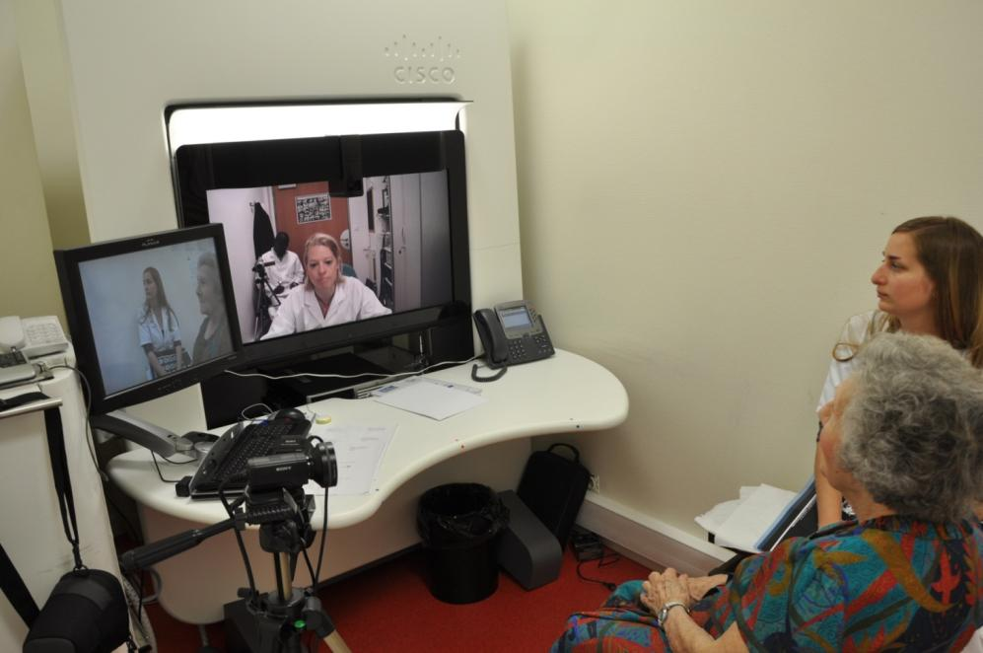


New Ways of Ageing & Living Well
HealthPresence
Notes:
Now, in the last few minutes I’d like to share 3 more examples of Public services that are addressing the 3 challenges I’ve been speaking about: Efficiency, Agility and Green. Let’s start with Efficiency.
I’ve seen many clear demonstrations of how the public services are embracing the power of IT to improve future services and address current challenges.
Particularly in HealthCare, Network-based technology is helping reduce barriers that have traditionally prevented patients from gaining access to specialist healthcare. HealthPresence provides ability to introduce new models of specialist care. We have several very good examples of HealthCare organizations implementing the technology to provide better access to services but let me mention just a couple of examples
1- In Paris, they’ve launched a new service that delivers Healthcare without boundaries by connecting hospitals and patients.
It provides specialized healthcare services from one hospital to another, connecting doctors to patients quickly when it is needed without added appointments or travel time between hospitals.
HealthPresence provides a much needed rapid service that reduces risk to the patients from added delays in appointments with specialists.
Reducing time and costs due to transport either of patients or doctors allows Healthcare to increase its availability and quality of service – innovative example of addressing the Efficiency Challenge
2- Nottingham University Hospital is using network-based communications system to significantly improve its Emergency Department (ED) operations and streamline patient care.
Key benefits of the new solution include:
A reduction in the patient journey time of 23 per cent for adult patients and 33 per cent for paediatric patients
An increase in the productivity of doctors treating minor injury patients equating to a potential time saving of over seven hours per day, or one doctor per year – a total annual cost saving of nearly £77,000
A full return on investment in the new technology realised in just 14 months
In addition, clinical and nursing staff have benefited from improved interdepartmental communication and a more collaborative working environment, both of which have boosted staff morale
3-The Scottish Centre for Telehealth held extensive trials at the Aberdeen Royal Infirmary in Scotland to assess the efficacy of HealthPresence, as well as patient and caregiver satisfaction, with very satisfactory results.

Slide 7

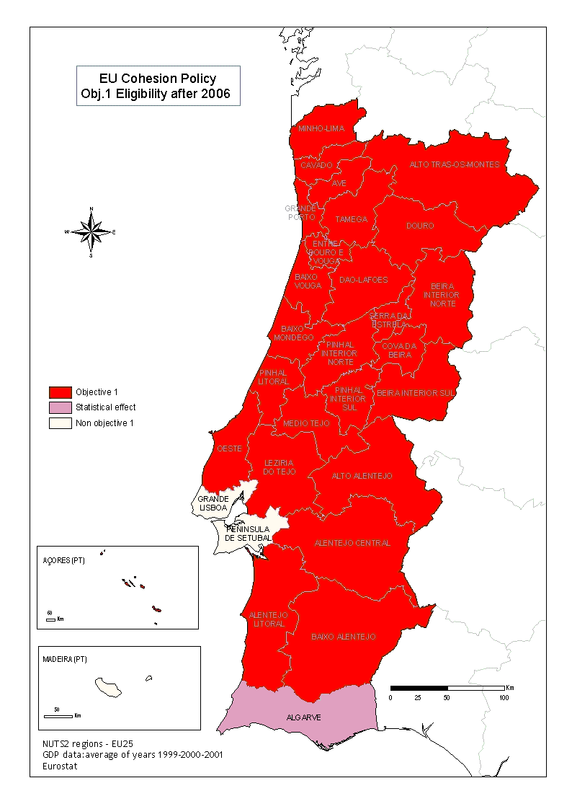
New Ways of Learning
Connected Schools Portugal
Notes:
Let’s take a look at using technology to address the Agility Challenge.
The Portuguese Connected Schools project is a very good example of this.
The vision of this project was to place Portugal amongst the top 5 European countries in terms technological modernization of education
1222 schools are now interconnected– one of the larges connected schools projects to date
Administration is now interconnected with Internet access in classrooms is now available so they are now exploring new ways of using the network for educational purposes
Considering now to utilize the network for 2 additional areas
1- network for Energy and environmental management
2- Virtual Learning Environment: Collaboration, Video for a blended learning environment
Solution Details:
First Phase – Minimum of 48Mbps to all major schools
Administration: Email and some telephony for teachers
Portals for students, staff and parents
Internet in the classroom to teach employability in schools
(Internet access in the classroom will allow them to practice researching information on Google etc to allow them to develop the skillset to find jobs.)
Vocational training
Second Phase – Applications over the network
Now in Pilot
Test potential applications that can be deployed
Sustainable Energy Management (including Energywise)
Anecdotal 33.4% energy saving in pilot
Helps towards Carbon Reduction Commitments
Introduces cost saving
Third Phase – Networked Learning Environment
Aspirational – probable execution 2012
Encompassing Learning Environment, collaboration, video

Slide 8

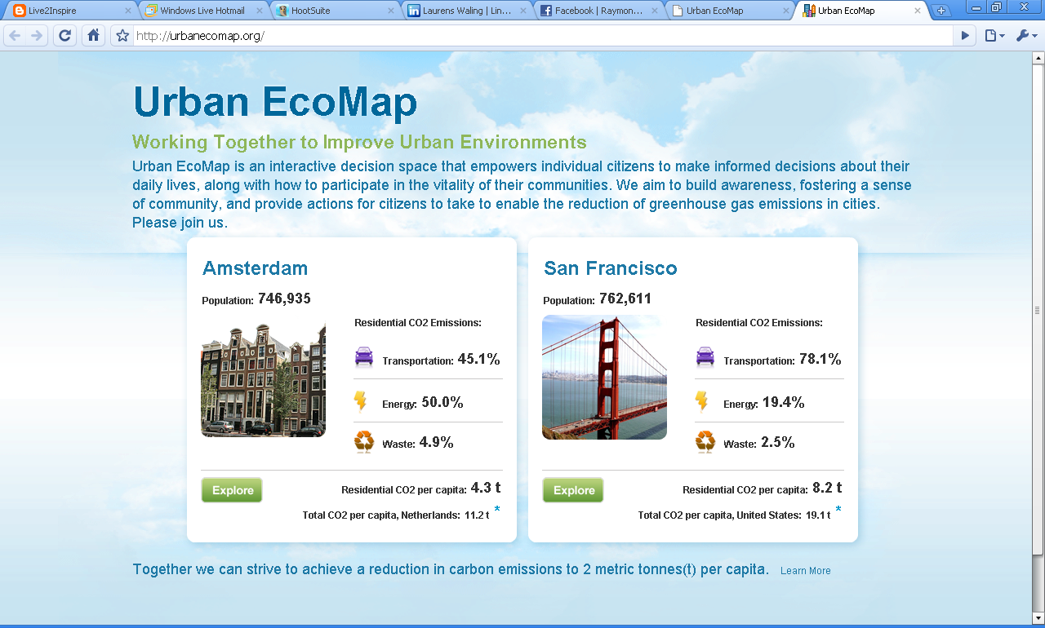
New Ways of Changing Behavior and Awareness
Notes:
What about the Climate Change Challenge? Technology can help us in multiple areas in relation to the environment. From TeleWorking to Standardizing how we Measure our Impact on the Environment.
This example of the ecomap currently used in both San Francisco and Amsterdam takes technology to the next level and really demonstrates the power of collaboration.
In order to influence the changes in behavior needed to address our climate change challenge the City and County of San Francisco took the lead to develop a collaboration, visualization, and measurement tool for greenhouse gas emissions from city activities.
They’ve developed an open source collaboration web 2.0 platform that will enable citizens and businesses to see the collective results of their individual climate change behaviours, aggregated by district, to take actions to mitigate environmental impacts, and track the results of these actions.
Individuals and Businesses can see the impact of their Transportation, Energy and Waste decisions. They can also get new ideas of how to reduce the impact as well share their own ideas. The ecomap even helps plan bike routes around the city to encourage a more green approach to transport.
Amsterdam is also using the ecomap - with plans to expand this out to other cities around the globe.
Background
CUD prototype. 10+ cities in North America, Europe, and Asia are engaged, with the City and County of San Francisco taking the lead.
http://www.connectedurbandevelopment.org/connected_and_sustainable_ict_infrastructure/eco_map/multim
www.urbanecomap.org

Slide 9


Adapting to the New Normal
The Efficiency Challenge
The Climate Change Challenge
Driving
Innovation!
The Agility Challenge
Notes:
All of these examples I’ve discussed today involve doing things in new ways. If we are to meet the three challenges that I highlighted, we need to innovate. We all know that driving change is never easy, but if we want to meet those challenges, we need change the way we do things. And above all, we should not sit back and do nothing.

