Slide 1
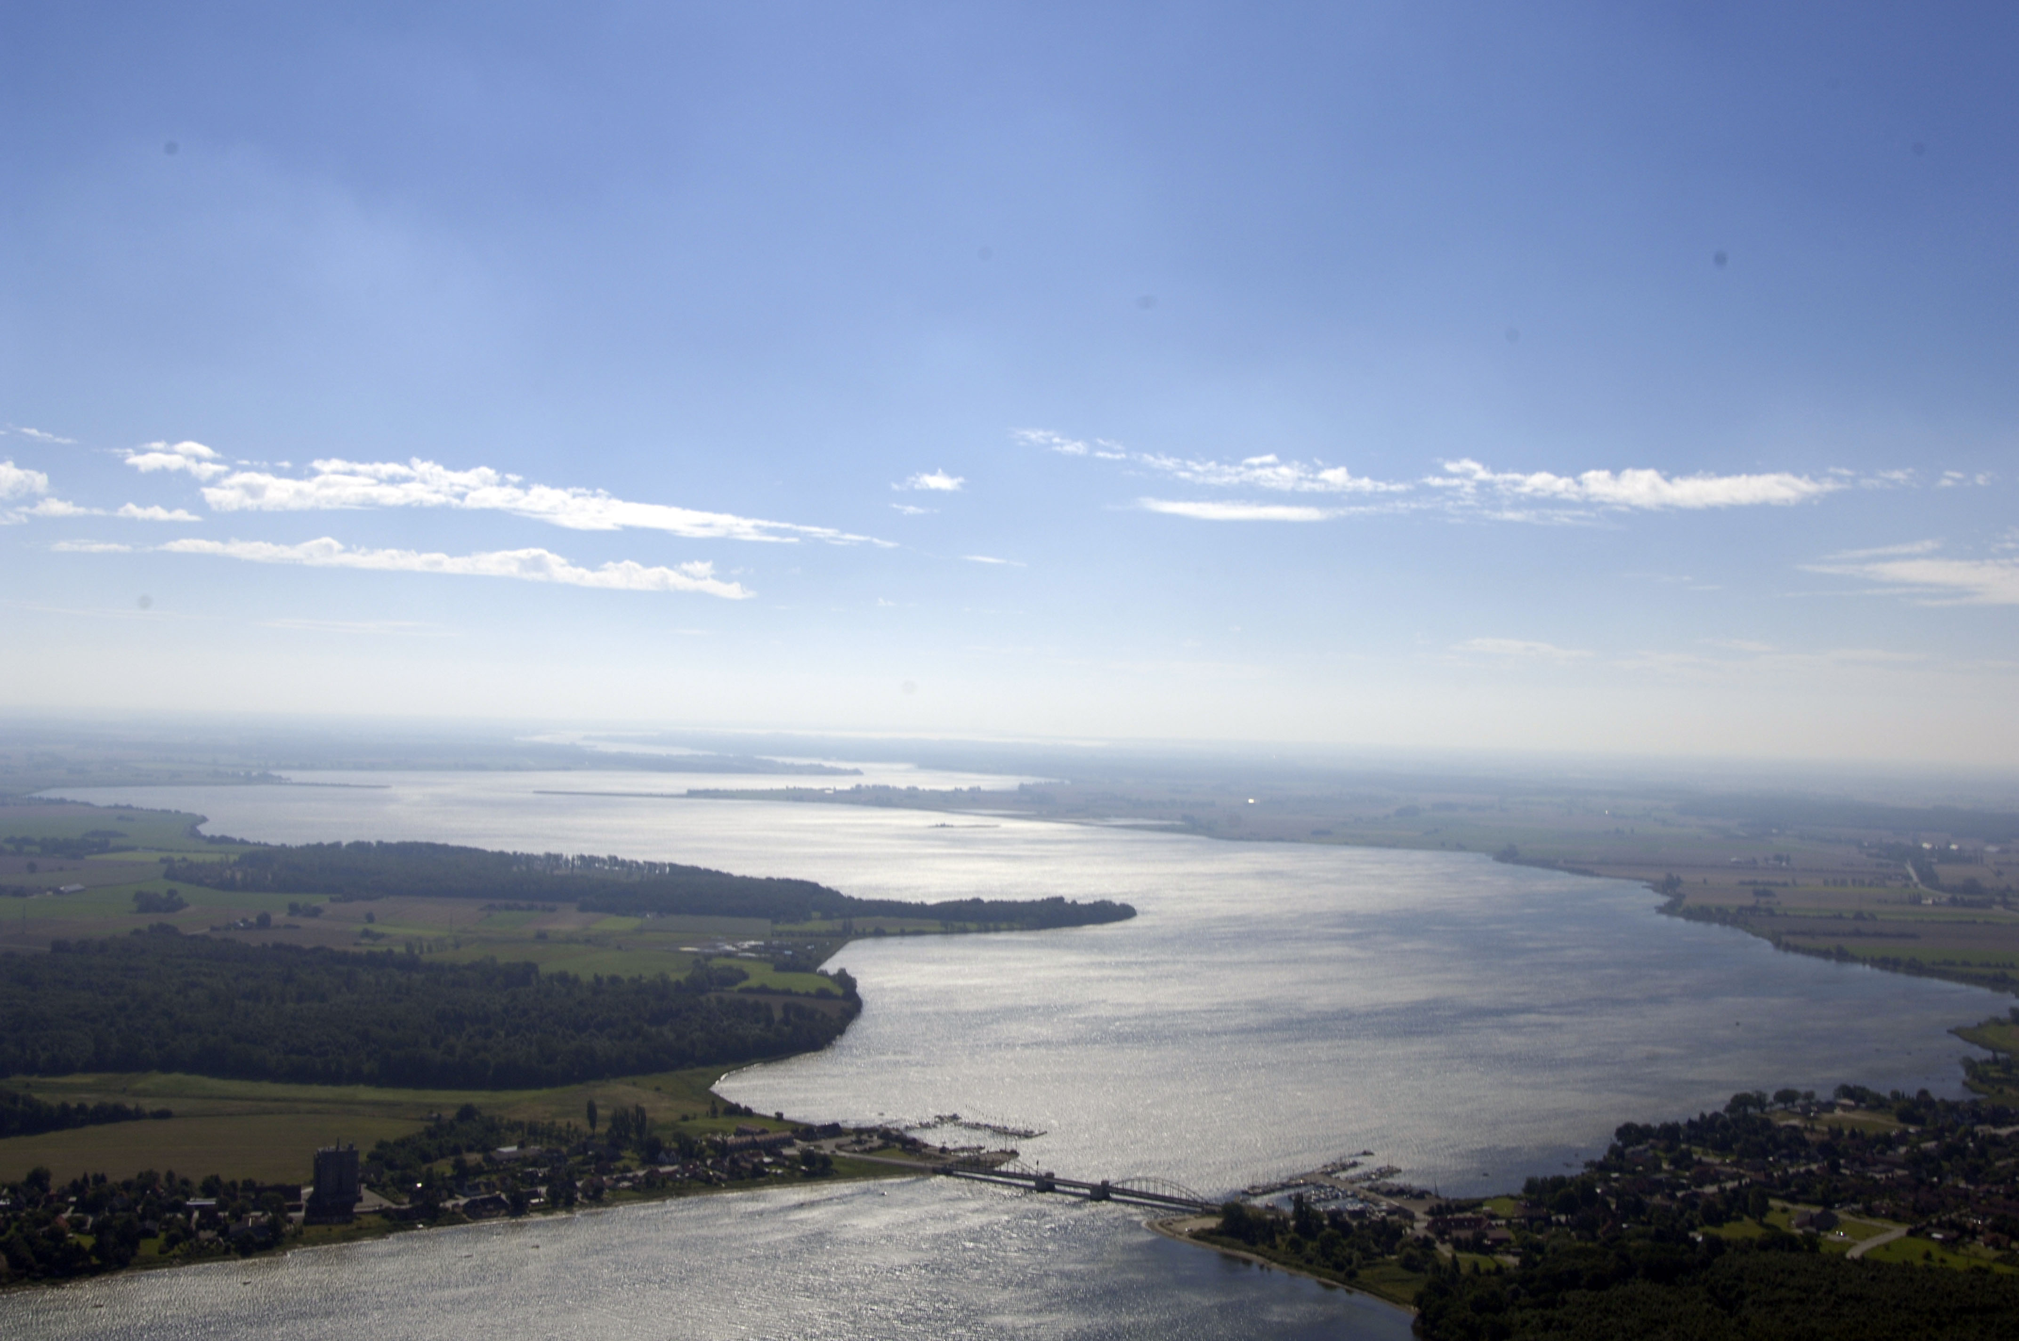
VIDEO OPERATED
CITIZEN SERVICE
City Manager
Ib Østergaard Rasmussen
Guldborgsund Municipality

Slide 2
ONE MUNICIPALITY
SIX SERVICECENTRES

Slide 3
CITIZEN SERVICE POLICY
”Citizen shall experience service at the highest level and always be meet by competent personal. Regardless of which Service Centre they contact, citizens should be offered the same help and guidance”

Slide 4
OUR CHALLANGES
How can we stay closely connected with our citizens and be present in their local environment, as stated in our vision?
How can we best manage our resources, cut expenses and maintain the professional expertise whilst offering the same level of services to our citizens at all six locations?

Slide 5
BACKGROUND AND CONTENTS OF THE PROJECT
  A desire to be renowned for used state of the art, advanced technology
  Unmanned video operated Citizen Service Center
  Unmanned video operated reception at Town Hall
  Units are operated by the same Call Centre
  Longer openings hours with less personnel

Slide 6
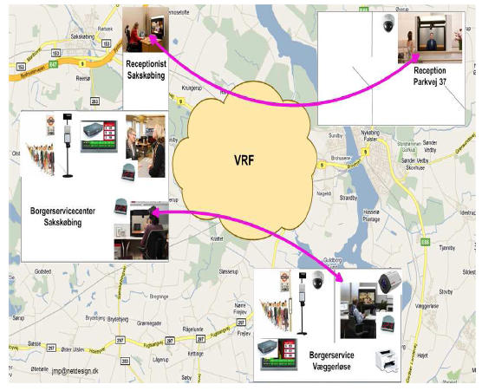

NEW INFRASTRUCTURE

Slide 7
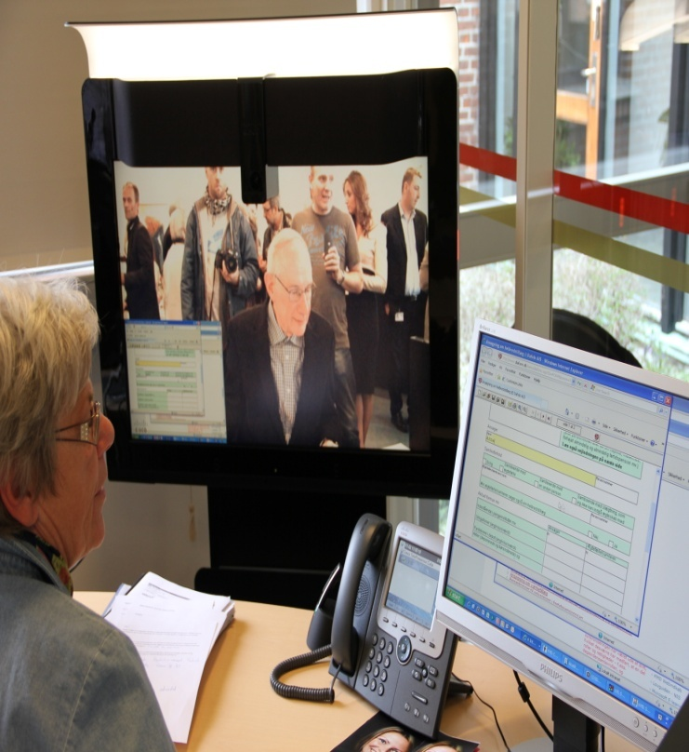
CALL CENTRE SAKSKØBING
Phone calls to the Citizen Service Centre
Switchboard for the entire administration
Virtual receptionist for Town Hall
Personal appearances at the Citizen Service Centre
Video operated remote attendance for Citizen Service in Væggerløse
SMS/chat-services
Foto: Cisco

Slide 8


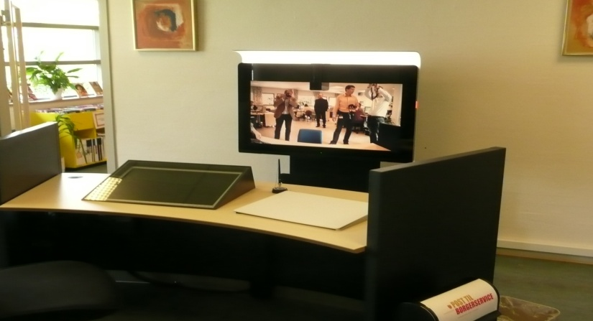
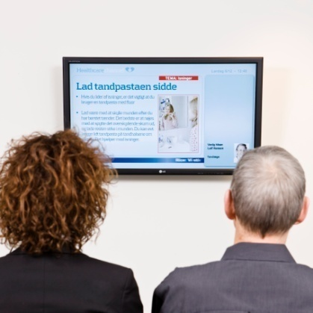
VIRTUAL CITIZEN SERVICE
Call Centre in Sakskøbing
Citizen Service in Væggerløse
Front Desk
Foto: Cisco

Slide 9

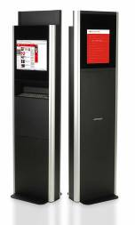
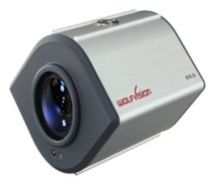
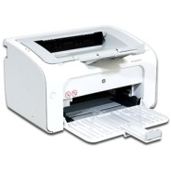
WHAT DO THE CITIZENS MEET?
Seating arrangements for the citizens
Queuing system
Document camera, surveillance
camera, scanner and printer
Foto: Cisco

Slide 10
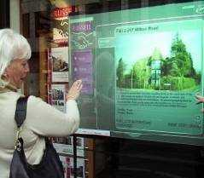
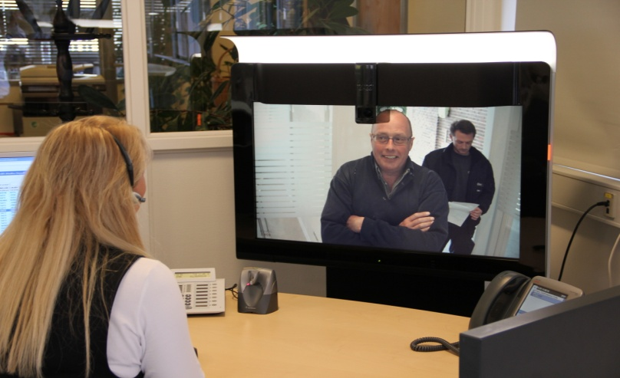
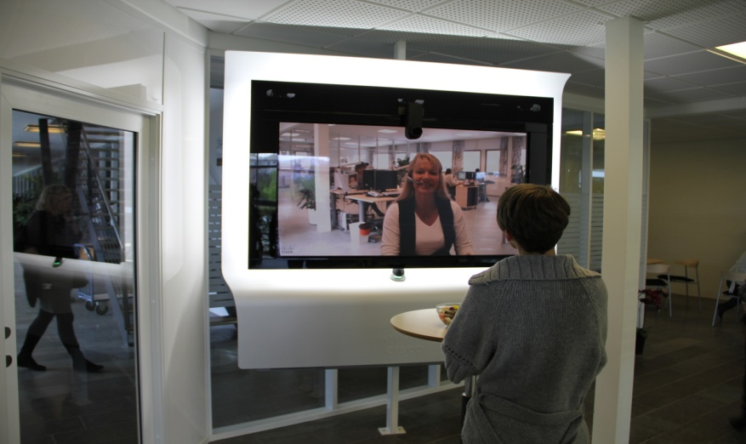

THE VIRTUAL RECEPTIONIST
Call Centre in Sakskøbing
Waiting area with information board
Virtual reception at City Hall
Foto: Cisco

Slide 11

ACCESSIBILITY
We wish to be accessible to all our citizens
Consequences:
  Automatic door opening
  All citizens are seated

Slide 12
POSSIBLE THREATS
Employees resistance to new workflow and organizational changes
Political pressure to ensure, that citizens are still served at all the previous locations. Meeting citizens face-to-face!
Skepticism amongst Works Committees and Labor Unions, that the new system will lead to cutbacks.
Citizens may feel that the level of service is lowered.
Pratical difficulties with operating the technical solution.

Slide 13
COMMUNICATION IS THE ANSWER!
Recruiting a ”digital pilot”
Frequent communication with employees
Frequent communication with citizens
Citizens are given opportunities to learn more about the new system
Sharing knowledge and experiences with other authorities in the same position

Slide 14
CRITERIA FOR SUCCESS
  That citizens find the video operated Service Centre satisfactory.
  That a significant number of citizens use the unmanned Citizen Service Center.
  That employees thrive with the new ways of servicing our citizens.
  That case-flows are efficient.
  That the quality of our case management does not suffer from the changes.

Slide 15



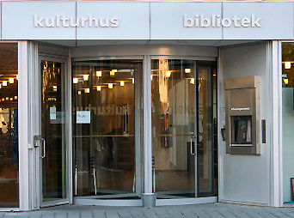


FUTURE PERSPECTIVES I
Sagsbehandler

Slide 16
FUTURE PERSPECTIVES II
2010-prices (in 1.000 kr.) | 2011 | 2012 | 2013 | 2014
Cost reduction | 550 | 1.100 | 1.100 | 1.100
Staff reduction | 2,25 jobs | 4,5 jobs | 4,5 jobs | 4,5 jobs
Investment* | 2.700 | 0 | 0 | 0
*) Estimated
We are already planning on new investments in order to harvest further efficiency benefits.

Slide 17

QUESTIONS?

