Slide 1

Driving Social Innovations Towards An Innovation Society:
Smart+Connected Communities
Anil Menon
President
Globalisation and Smart+Connected Communities

Slide 2















Biggest Economic & Social Shifts in History
Aging
Shrinking
Hypergrowth
Elderly (65+ yrs.)
 | 2000 | 2050
World | 6.8% | 16.2%
USA | 12.4% | 21.6%
China | 6.8% | 23.3%
Sweden | 17.2% | 24.1%
Canada | 12.6% | 25.5%
Netherlands | 13.6% | 25.6%
Switzerland | 15.4% | 26.0%
Europe | 14.8% | 27.4%
Poland | 12.2% | 29.9%
Singapore | 7.2% | 32.6%
Germany | 16.4% | 32.5%
Italy | 18.4% | 33.3%
S. Korea | 7.3% | 34.2%
Japan | 17.2% | 37.8%
2050 Estimate | million | % Decline from 2000
Portugal | 10.0 | (2%)
Europe | 691.0 | (5%)
S. Korea | 44.0 | (5%)
Slovakia | 4.9 | (9%)
Hungary | 8.9 | (13%)
Germany | 70.5 | (14%)
Poland | 32.0 | (17%)
Japan | 101.6 | (20%)
Russia | 116.0 | (21%)
Romania | 17.2 | (22%)
Ukraine | 35.0 | (28%)
Bulgaria | 5.3 | (33%)
2050 Estimate | million | % Growth from 2000
World | 9,149.9 | 50%
India | 1,613.8 | 55%
Bangladesh | 222.4 | 58%
Egypt | 129.5 | 85%
Philippines | 146.1 | 88%
Saudi Arabia | 43.6 | 110%
Pakistan | 335.1 | 126%
Nigeria | 289.0 | 132%
Iraq | 63.9 | 160%
Ethiopia | 173.8 | 165%
Congo | 147.5 | 190%
Yemen | 53.6 | 195%
Afghanistan | 73.9 | 260%
Niger | 58.2 | 428%
* World Population Prospects: The 2008 Revision, United Nations Population Division

Slide 3

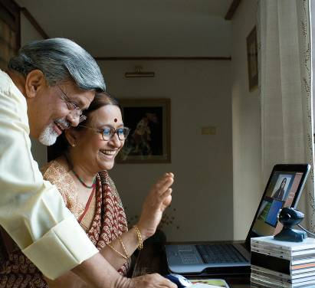

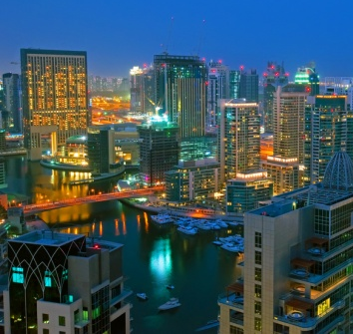
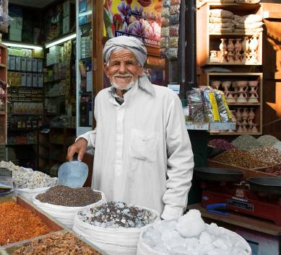
Four Megatrends That Will Change The World
Developed Countries’ Labor Forces Substantially Age
and Decline
Population Growth Increasingly Concentrated in Emerging Countries
Economic Power Shifts to Developing Nations
World’s Population Becomes Urbanized
Source: Council on Foreign Relations, Jan.- Feb. 2010

Slide 4

“The strategic and economic policies of the 20th century are obsolete, and it is time to find new ones.”
Council on Foreign Relations, Jan.- Feb. 2010
“This is the Urban Century.”
Ban Ki-moon, Secretary-General, United Nations
“Technology has become the engine of globalisation.”
World Bank
“A rebalancing of the world’s social and economic powers is accelerating at an unprecedented rate.”
Wim Elfrink

Slide 5
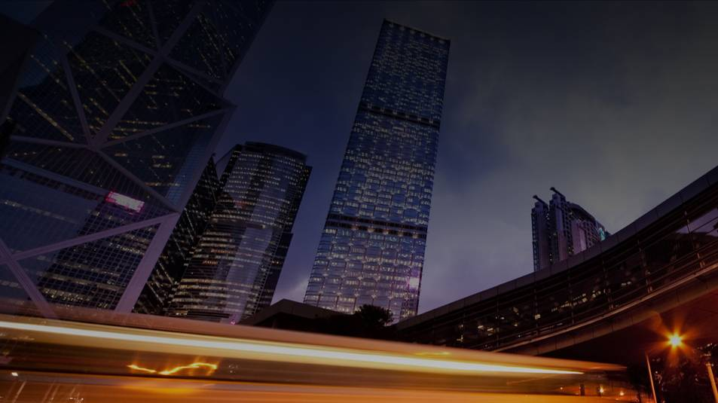
Drivers of Economic and Social Transformation
Hypergrowth
Aging / Shrinking
700+ million urbanized
3 billion will be connected
Revitalization of cities, states, countries
S+CC
Mobility will be the platform
Connected Life
New business models & ecosystems
Everything As A Service
Affordable and scalable capacity planning
The Network as the Transformational Platform

Slide 6
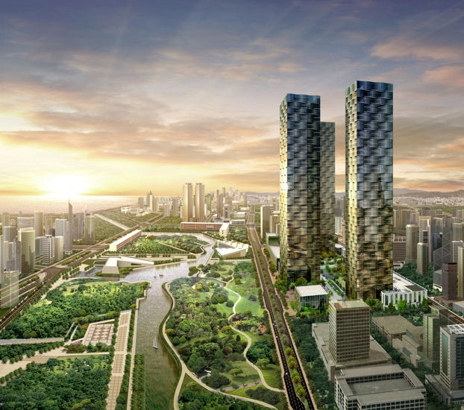
Running a Village, City, Community, Country, the World on Networked Information
Sustainability Services Delivered by Technology
Social
Environmental
Economic
Enhanced quality of life for citizens
Protecting the world
for future generations
Continuous job and business growth

Slide 7





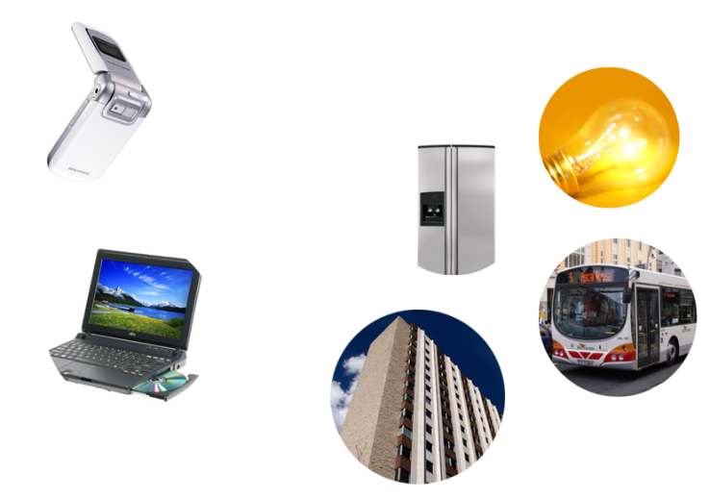
Internet of Things: Magnitudes Bigger
14
Billion
300 Million
2001
2002
2003
2004
2005
2006
2007
2008
2009
2010
Source: Forrester Research
Notes:
Transition: What’s different, what’s driving these changes? Much of it … being driven by the global network … everything is becoming connected
In 2001… 300 million devices connected…
Primarily what you’d expect… computers, cell phones, PDAs
By 2010, in just two years… predicted that 14 billion things will be connected
Not just talking cell phones anymore…
Cars, buildings, security cameras … toilets (nutrition example)

Slide 8


The Industrialization of the Internet…
Internet of Things
Business
Consumer
Industrial
5%
Collaboration
4%
Productivity
3%
The Network as the
Platform
Internet of Things
2%
Video
1%
Virtualization/
Data Center
Phase 1
Phase 2
Phase 3
1997
1999
2001
2003
2005
2007
2009
2011
2013

Slide 9

Network Increasingly the Platform
for Many Different Technologies
Business
Consumer
Industrial
Wireless
Video
Real Estate
Physical Security
Transportation
Sports
Utilities (Energy)
Healthcare
Education
Government
Security
Storage
Networked
Home
Voice
The Network as the Platform
Physical Internet
Virtual Internet
Physical Internet

Slide 10
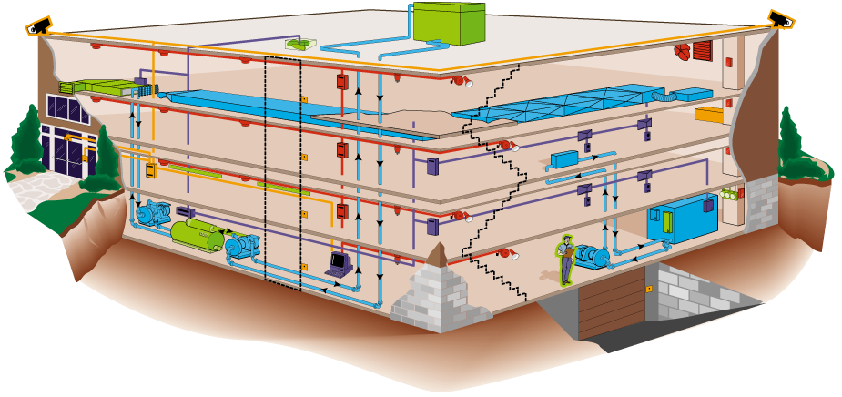

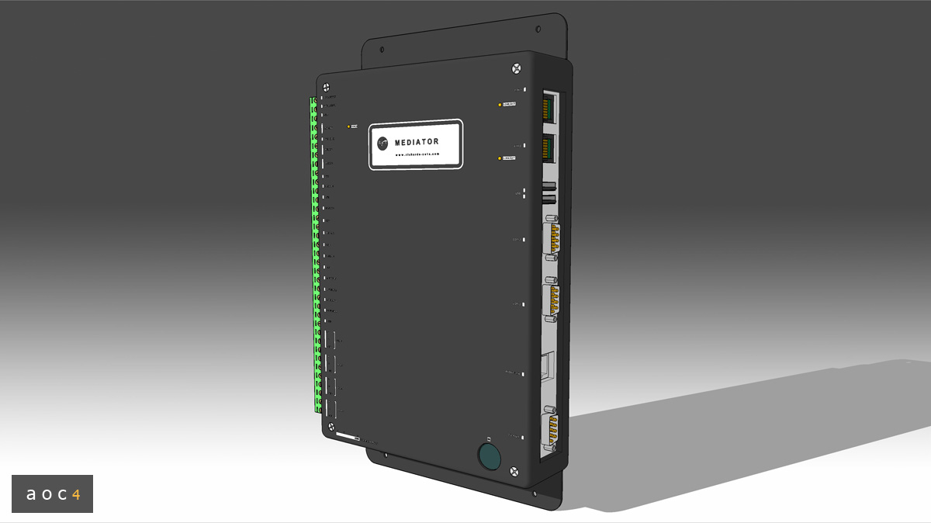

Example: One Building… Multiple Industries, Technologies
Indoor
Air Quality
Services
Air Handling
Unit Controllers
Exhaust
Fans
Cooling
Towers
Elevators
Air
Filters
Smoke
Detectors
Zone
Control
Panels
Lighting
Halon
System
Diffusers
Cameras
Heating
Units
VAV
Units
Cooling
Coils
SolarPV
Dozens of Building Systems
Fans
Dampers
Lower Operating Costs
Cameras
New Services Revenues
Intrusion
Detectors
Less Environmental Impact
Card
Readers
Electric, Gas, Heating
Access
Management
Controllers
Managed on One IP Network
Pumps
Fire Alarm
Panels
Rack/Server IDF→PDU
Parking
Garage
Thermostats/
Humidistats
Vending Machines
Chillers &
Boilers
Operators
Station
Water Systems
Chemical
Water Control
Computer Room Air Handlers
Equipment Vintages from
15 Years to Present is Common
Notes:
10

Slide 11
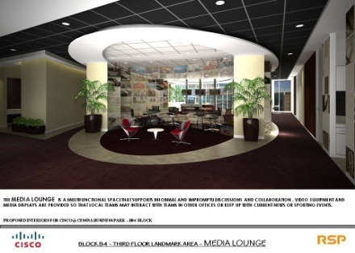
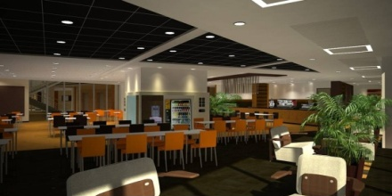
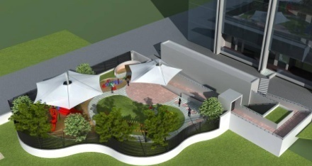
The Banyan Building: Built for Sustainability
Environmental
Economic
    Above LEED Standards:
    Annual Payback of:
    25% above for lighting energy
    27% above for water consumption
    31% above for cooling energy
    Enhanced air quality by 30%
    OpEx savings of -15%
    Employee productivity of +9%
    Energy efficiency of +30%
Social
Collaboration Areas
Cafeteria
Child Care Centre

Slide 12

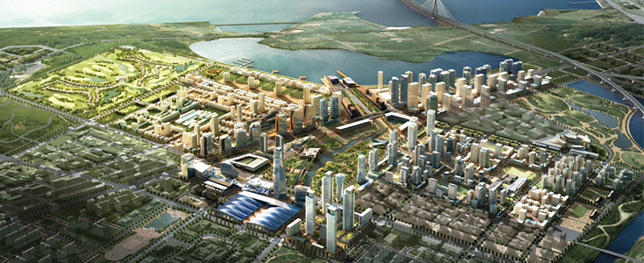

Songdo IBD - “One of the World’s Greenest Cities”
100 million square foot new city on 1,500 acres
Commercial 40 million SF
Residential 35 million SF
Retail 10 million SF
Hospitality 5 million SF
Public Space 10 million SF
Six design goals for sustainability
Mandate for LEED Certification on all new buildings
EED-ND Pilot Program focused on neighborhood connectivity, access to transit, energy efficiency in building design, efficient infrastructure

Slide 13



Technology Will Be Consumed As Services
1.
2.
3.
Service Delivery Platform

Slide 14

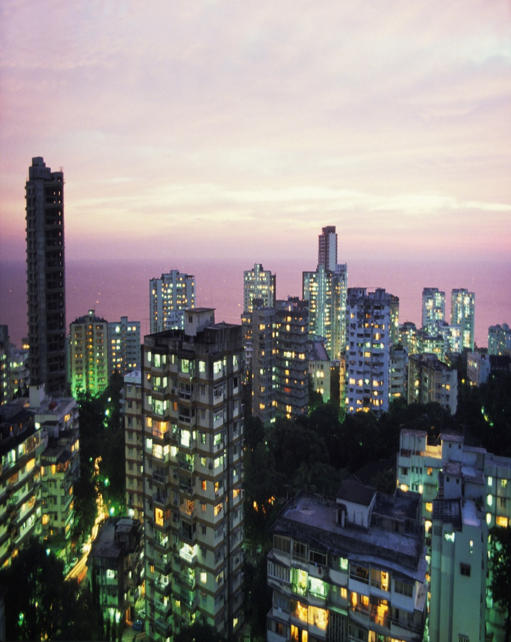
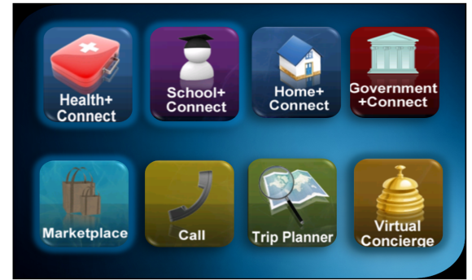




Services Delivered Directly to the Home
via Interactive, Hi-Def TelePresence

Slide 15




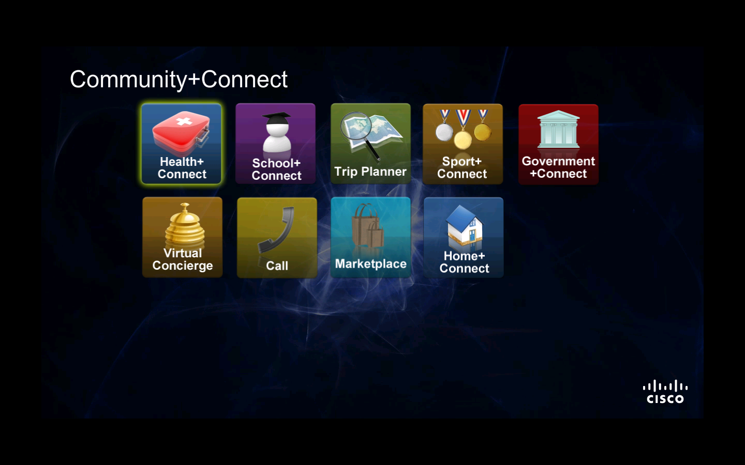

Delivering New Services
To Citizens in New Ways

Slide 16
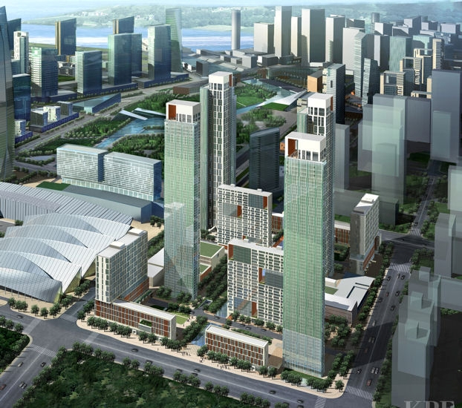
Services Create New Revenue Streams
$50
$10
$15
$10
$5
per month
$15
$5
$10
$10

Slide 17
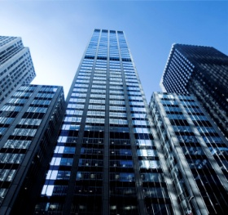



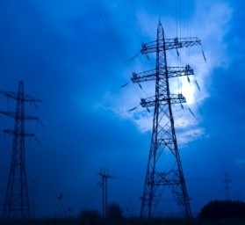
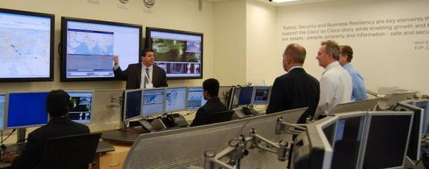
One Common Infrastructure to
Address Many Different Issues
Notes:
Community Exchange Centre

Slide 18



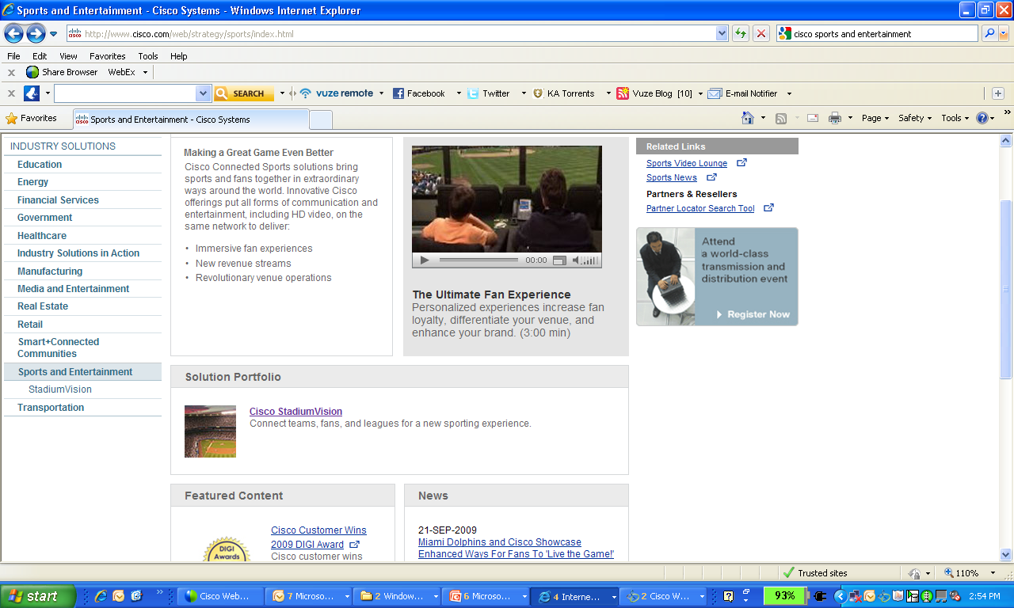



Services create new revenue, employment and environmental sustainability
Connected
Health
Sports &
Entertainment
Learning
Energy Management
Cloud
Computing
Innovation
Connected
Neighborhood
of the Future
Safety &
Security
Child
Day Care

Slide 19

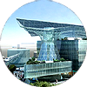








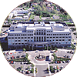





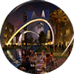
Smart+Connected Communities Worldwide
Proof of Concept
Greenfield Cities
Revitalisation
Kuwait:
Al Hamra Tower
Abu Dhabi:Masdar
Toronto
Seoul: Personal Travel Assistant
South Korea: Songdo
San Francisco
Amsterdam: Smart Working Centres
China: Chongqing
Barcelona
Cisco on Cisco
India: Lavasa
Holyoke
NYC: Yankee Stadium
Colorado: Connected Communities Initiative
Singapore: EPIC
Qatar: Gate Building

Slide 20

http://www.twitter.com/Anil_Cisco

