Slide 1

Welcome
This session is part of our on-going Cisco Unified Access Webinar series.
To see previously recorded sessions please join our community.
Join the Community: www.cisco.com/go/talkandlearn

Slide 2
Turnkey Provisioning with Cisco Prime Infrastructure
Chris McGuyer
Sr. Business Development Manager
Chirag Desai
Technical Leader

Slide 3
Cisco Prime
Mini-Suites Accelerate Customer Transitions
Automate management to increase value and efficiency
Common architectural components to reduce costs
Common look and feel to help customers move across architectural plays
Deliver on the Cisco Advantage
Customer Transitions
Multi-Domain Management
Packet/Optical Convergence
Cloud Transition
BYOD Transition
IPv4 to IPv6 Transition
Make customer transitions quick and efficient
Notes:
The Prime for Service Provider portfolio is aligned around mini-suites that deliver capability to help customers make their transitions, both IT and business, quickly and efficiently. These transitions include:
Multi-domain and technology management, enabled by Prime Fulfillment and our assurance solutions
Packet and Optical convergence including carrier packet transport
Cloud transition including managing the supporting infrastructure, data centers, virtualized systems and cloud delivery as part of an end-to-end service
Bring your own device transition in the enterprise and in the home – the increasing number of mobile devices is driving the need for visibility and management
IPv4 to IPv6 transition is required for service providers as they update the networks and deliver new services to their customers
These are just examples of the transitions that Cisco Prime supports. Prime has also been architected for lower startup and ongoing management costs with common architectural components, integrated workflow and a common user experience. The Prime solutions provide visibility and automation to make management of service provider solutions lower cost, repeatable, while improving the subscriber experience.

Slide 4

Cisco Prime for IT
Simplify deployment and management of Cisco® services, technologies and platforms…
Unified Access
One Management
Converged
Voice and Video
Virtualized
Network-Compute-Storage
Borderless
Convergence
Collaboration
Consolidation
Cisco Advantage
Data Center
Notes:
So what is Cisco Prime for IT all about.
Cisco Prime for IT simplifies the deployment and management of Cisco services, technologies and platforms. It does this by helping IT to achieve operational excellence, automate lifecycle management and utilize the “cisco advantage”. Too many times in talking with IT professionals we hear that Cisco you have great technologies that really differentiate you in the marketplace, BUT they are just too hard to implement. If you look at technologies such as; Energywise, TrustSec, MediaNet, Auto Smartports, Virtual Switching Systems just to name a few, customers and IT don’t KNOW how to enable them. For example, if I wanted to deploy Trustsec, where do I start, is my network ready for trustsec, how do I know, how do I set it up, if it is too hard to enable a key feature, technology platform or service, YOU WON”T USE IT. Cisco Prime helps YOU enable these key Cisco differentiated features and services. It provides a set of products tied to the key enterprise architectural plays – borderless, collaboration and data center.

Slide 5
Cisco Prime Infrastructure
Overview

Slide 6
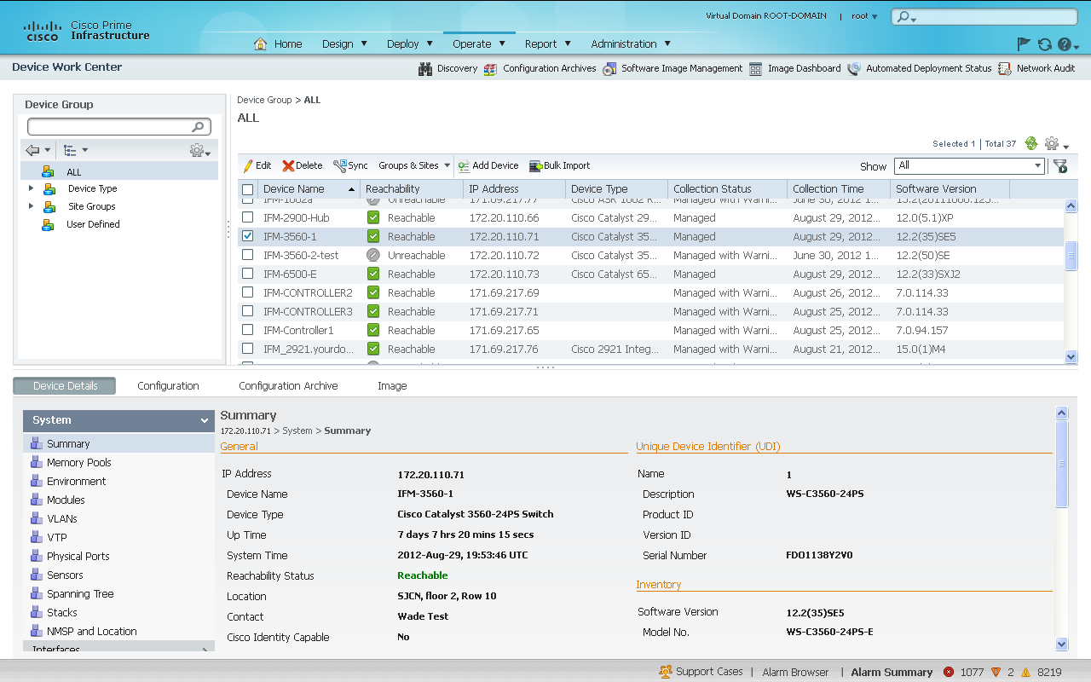
Lifecycle
End-to-End Lifecycle Management
Centralized Discovery, Inventory, Configuration Management, SWIM, and Proactive/Reactive Monitoring
Accelerated Troubleshooting of Wired/Wireless Infrastructure Issues
Greater device coverage: 3850/5760 (including templates and guided workflows), ASAs, IOS-XR and IDU
Customizable out-of-the-box Cisco best practices and validated design configuration templates for wired/wireless devices
Unified Access Management and Client Tracking
Infrastructure lifecycle reports - EoX, Contract, PSIRT
Plug & Play for Automated Deployment
3rd party device support
Notes:
Talking points to differentiate what was possible with LMS and what is possible with Prime Infrastructure:
LMS’s support was limited to full lifecycle management for wired devices and limited support for controllers. No support for AP or radio management. User tracking in LMS is limited to wired clients alone

Slide 7
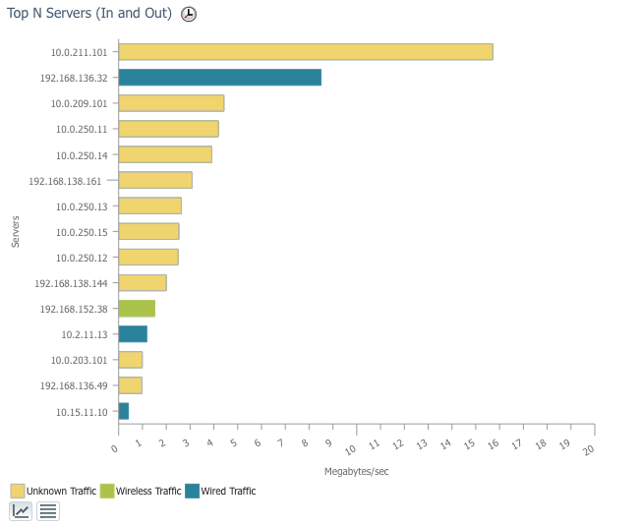
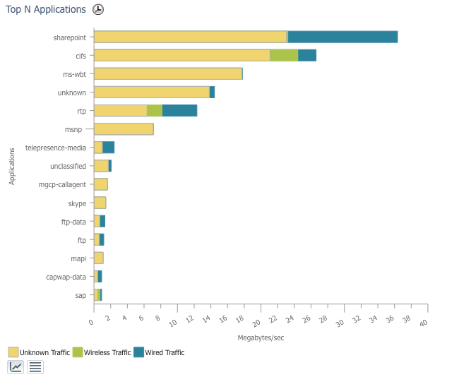
Assurance
Application Visibility and End User Experience
End-to-End Visibility for Service-Aware Networking
    By applications, services and end-users
Out-of-the-Box Support for Cisco Advanced Instrumentation
    Netflow, Flexible Netflow, AVC, NBAR, PA, Medianet, etc.
Simplified End-to-End Visibility for Faster Troubleshooting
    Normalizes, correlates and aggregates data sources
Automated Baselining with Dynamic Thresholds
NBAR2 Custom Application Support
Multi-NAM Management
Service Health Dashboard
Notes:
Talking points to differentiate what was possible with LMS and what is possible with Prime Infrastructure:
LMS’s support was limited to full lifecycle management for wired devices and limited support for controllers. No support for AP or radio management. User tracking in LMS is limited to wired clients alone

Slide 8
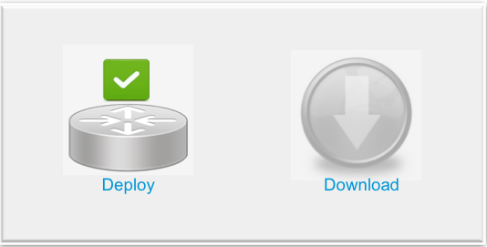
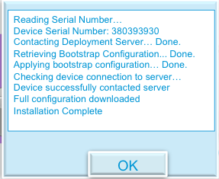





What is Plug and Play
Overview
Provides a quick and easy error-free way to configure devices in remote offices
Removes the need for technical personnel onsite
Remote device gets “bootstrap” configuration from admin (USB iPhone, iPad)
Remote device connects to Cisco Prime™ Infrastructure server through DMZ and retrieves full configuration
NOC
Cisco Prime
PnP Gateway

Slide 9
Using Plug and Play vs. Pre-Staging for Cisco Integrated Services Routers (ISRs)
Plug and Play can give savings of millions of dollars
 |  | Number of sites to deploy
 | $cost/device pre-staging or bootstrapping | Mid-Market Commercial | Enterprise/ Commercial Select | Global Enterprise Theater
 |  | 500 | 5000 | 10,000
Conservative/ low cost | $50 | $25,000 | $250,000 | $500,000
Realistic | $150 | $75,000 | $750,000 | $1,500,000
Large Enterprise Operations | $300 | $150,000 | $1,500,000 | $3,000,000

Slide 10
Plug and Play of ISRs with Cisco Prime Infrastructure
Plug and Play (Zero-Touch Deployment) does not require CLI skills
Cisco Integrated Customized Services (CICS) which loads a custom factory config in the ISR and is available for all ISRs
    Installer only connects LAN/WAN cables at the site
USB stick to bootstrap the ISR
Installer connects LAN/WAN cables and a USB stick at the site. Available for ISRs with CVO/ZTD
New Cisco Prime Plug and Play App (available with Prime Infrastructure 1.3 for Windows PC or iPhone/iPad)
      Installer connects LAN/WAN cables + a USB console cable and a Laptop/iPhone/iPad Application to bootstrap the ISR at the site
New CCP Express (GUI which optionally is installed in the ISR)
      Installer connects LAN/WAN cables + a PC over Ethernet to the LAN port and brings up CCP Express to bootstrap the ISR at the site
1
2
3
4

Slide 11



Plug and Play Gateway Architecture
Branch Location
DMZ
Network Operations Center (NOC)
Enterprise or SP
Internet
Router/Switch supporting Plug and Play (with Cisco CNS)
Plug and Play Gateway
Prime Infrastructure
Two Deployment options:
Plug and Play Gateway in a DMZ (w/ PI 1.3): devices connect to over the Internet without exposing Prime Infrastructure (see picture above)
Plug and Play Gateway integrated into Prime Infrastructure (w/ release PI 2.0)

Slide 12


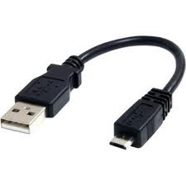
PC/iPhone App based Plug and Play zero-touch config for the installer
3
Branch Location
DMZ
Network Operations Center (NOC)
Enterprise or SP
3G
https
Plug and Play App
USB Console cable
Remote ISR
Plug and Play Gateway
Prime Infrastructure
ISE
Radius or
LDAP or
AD or
DES/One-Time-Password
ISP Network (MPLS/ Internet)
1) Installer connects the console cable ISR to Plug and Play App
2) Installer enter PIN and clicks “Download” and it download is from the Prime over 3G/Wifi
3) Plug and Play Gateway validates the credentials of the installer
5) Plug and Play App receives the bootstrap config (WAN config + CNS commands) from Plug and Play Server an puts it in the ISR through the console
4) Prime Infrastructure registers the Serial number of that device and sends the ISR bootstrap config
Installer clicks on “Deploy”. The App connects to the router via console and:
Saves the current config
Applies new config
Validates the CNS was deployed
Backs-up the new config
Available for all ISRs. Windows PC or iPhone/iPad supported with Prime Infrastructure 1.3
7) ISR connects to Plug and Play Gateway using CNS and request its full config

Slide 13
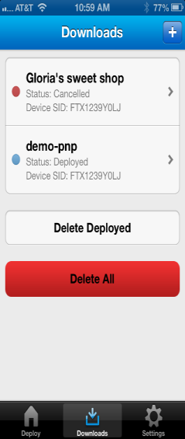
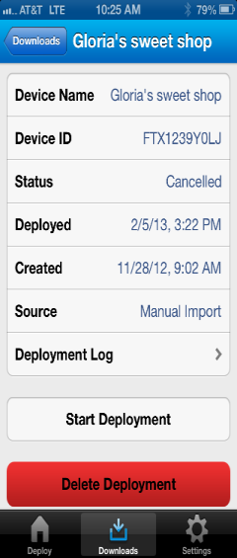
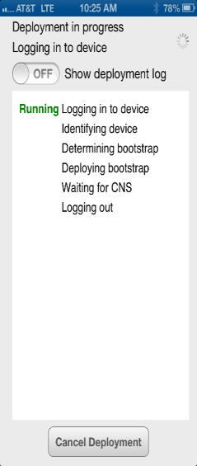
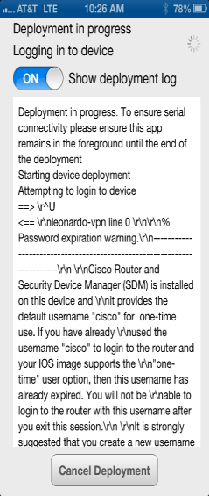
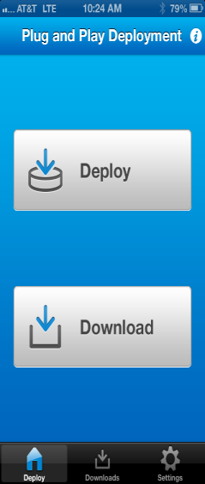
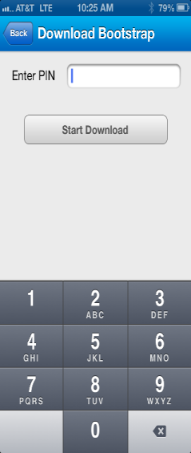
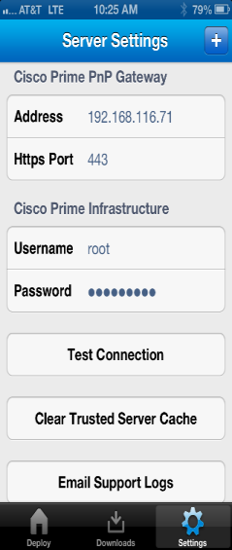
Plug and Play iPhone App
3
Option 1
Pre-specified the trusted list of Device Serial Number in Prime Infrastructure
Option 2
User is prompted for PIN for that location/device site
PnP App reads the Device Serial Number through the console cable and registers it in Prime Infrastructure via 3G
Server Setting of the
Plug and Play Gateway

Slide 14
Summary of Plug and Play
Technology Review
Pre-Provisioning
In Prime Infrastructure
Network administrator creates the device PNP automated deployment template in Cisco® Prime Infrastructure
Installation
At the end-location
Installer connects the device in its final location
Administrator specifies the name of the device, desired configuration, and image, and optionally the device serial number and a bootstrap configuration
A deployment PIN number is generated and emailed to the installer
Installer starts the provisioning by entering the location PIN. The PnP App will register the device serial number using the deployment PIN with PnP Gateway
PnP App bootstraps the device
Installer monitors the deployment status

Slide 15

Why Prime Infrastructure?
The Cisco Advantage
Single pane of glass for management of wired and wireless networks
Out-of-the-box templates to deploy advanced features and instrumentations in Cisco IOS devices
Out-of-the-box integration with MSE and ISE provides location, profile and other information needed for user access troubleshooting
Plug & Play significantly simplifies the staging and deployment of new routers and switches
AVC embedded in Cisco devices provide the instrumentation to quickly visualize & troubleshoot application experience
Cisco Prime Infrastructure supports new devices, OS and modules the day they are released by Cisco
Unique reports show devices impacted by security advisories and End-of-Sale/End-of-Life notifications
Application Program Interfaces (APIs) allow easy integration with existing OSS
Why
Prime?
        Achieving unparalleled time-to-value for Cisco
        equipment and technologies

Slide 16
Prime Infrastructure
Additional Resources

Slide 17
Every Week* | Prime Demo Series Topic | Same Time | Same Place
Every Monday | Cisco Prime LMS | 11:00 AM PST San Jose Time (90 Min) | www.tinyurl.com/primedemo No Registration Required
Every Tuesday | Cisco Prime Collaboration Assurance & Provisioning
Every Wednesday | Cisco Prime NAM & NGA
Every Thursday | Cisco Prime Infrastructure (including Assurance)
Americas
Edition
* Exceptions: US Public Holidays and Cisco Shutdown
Every Week* | Prime Demo Series Topic | Same Time | Same Place
Every 2nd Thursday | Cisco Prime Infrastructure Lifecycle Mgmt & Assurance | 12:00 PM Singapore Time (90 Min) | www.tinyurl.com/prime-APJC No Registration Required
Every 2nd Thursday (alternating week) | Cisco Prime Collaboration Assurance & Provisioning
APJC
Edition
Prime Demo Series
Open to Customers, Partners and Cisco People
* Exceptions: Indian Public Holidays and Cisco Shutdown
Day | Prime Demo Series Topic | Same Time | Same Place
See Schedule (bi-weekly) | Cisco Prime Infrastructure (including Assurance) | 9:30 AM GMT (90 Min) | www.tinyurl.com/prime-emear Registration Required
 | Cisco Prime Collaboration Assurance & Provisioning
EMEAR
Edition
Free Trial Software
www.cisco.com/go/nmsevals
Latest Prime Demo Series agenda will always be posted at www.cisco.com/go/prime-demo

Slide 18

For More Information
Cisco Prime
www.cisco.com/go/prime
Cisco Prime Infrastructure
www.cisco.com/go/primeinfrastructure
Prime Demos, VoDs, Online Training, Evaluations
www.cisco.com/go/prime-demo

Slide 19
Demo

