Slide 1

Just Switch It for Routing/WAN Services
Migration Program
November 2015
Notes:
Cisco Intelligent WAN:
WAN Demands Continue to Grow, and Yesterday’s Architecture (20 years) will not scale.
Today we’ll discuss how to drive evolutionary changes in your architecture to support both new business opportunity and drive costs
We realize applications will need to be hosted from anywhere – private, public, hybrid and even locally – and may even move.
During this session, you will learn how IT can fully utilize their WAN investments with highest performance, reliability, and security.
And. significantly lower OpEx that will not only pay for any investment refresh, but also free up resources for business innovation
Delivers and uncompromised user experience over any connection (any app over any transport from anywhere), allowing the business to right-size their network with IT simplicity and low TCO.

Slide 2
Agenda
Message to Sales, Partners and Customers
Program
Objectives
Bundles, Promotions

Slide 3
Program Objectives

Slide 4
Why Is This important?
$4 billion market
15% of your quota
IWAN can increase deal by 300%
(AX + UCS-E + Akamai)
Risk for competitive encroachment
Engage now and stay on the offensive
$5B+ install base >= 5 years
80% market share in most markets
Leverage your relationships
Gain wallet share with WAN services
New SDN competitors,
well funded by VCs
Significant threat
to your customer retention

Slide 5

ISR Refresh Opportunity
Return Sensitivity Analysis
Geo | Unit Count | Est Value to Cisco | 3% | 5% | 8% | 10%
America | 1,670,376 | $2986M | $90M | $149M | $239M | $299M
EMEAR | 1,142,517 | $1168M | $35M | $58M | $93M | $117M
APJC | 533,830 | $576M | $17M | $29M | $46M | $58M
GET | 222,078 | $318M | $10M | $16M | $25M | $32M
$5 Billion ISR Technology Refresh

Slide 6
Message to Sales, Partners, and Customers

Slide 7

Emerging Branch Demands
Changing Application Landscape
Up to 80% of Employees
and Customers Reside Here*
Cloud
Data Center
Applications are Moving to the
Data Center and Cloud
Branch
Branch
Internet Edge is Moving to the Branch
* Source: Lippis Consulting
Pressures on the WAN
Cloud
Mobility
High BW Apps
50
6X
2/3
%
of CIOs Expect
to offer Business Applications via the Cloud by 2015
More content is being consumed by mobile devices
Of Branch Traffic
will be Video
Notes:
But consider this…80% of users are not in the campus, they are at the branch.
As more customers transition their applications to cloud and as the mobility trend continues to accelerate with higher bandwidth applications, the pressure increases on the weakest link of the network – the WAN
Gartner are saying that the budget is moving to the branch to delivery the experience and thus productivity of users

Slide 8



Why Talk to Your Customers About an Upgrade Now?
Digital Transformation
Large Install Base
Ready for Refresh
Significant
Revenue Potential
LOB relevance
Enable IT to accelerate innovative business initiatives
Cloud, mobility and new applications require WAN
to evolve
Cisco advantage
Cisco access routing 80%+ market share
Majority of equipment over 5 years old
Up to 300% upsell
AX bundles and Akamai can double or triple deal size
New consumption models give you easier entry points
Notes:
So this creates a significant convergence point. We can have timely conversations (not only at IT) about how to affect their top line numbers
We also own the market...they have incentive and drive to stay with the vendor they have already chosen.
Most of all, its a huge opportunity to go deeper and wider into the account. By clothing the router deal, not only do we become more integral into their network, but we can increase the deal by 2 to 3 times the original deal. AND you block out competitors for years.
Digital Transformation:
Ability to talk about innovative trends to LOB’s within enterprise
Savings costs with IWAN a compelling case for businesses
Large Install Base:
Cisco Access Routing 80%+ market share
Use migration services to start conversation
Mobility & Security Top of Mind
Revenue Potential:
Small element $ of a sale but the most critical
AX bundles can double or triple deal size at branch
Cisco & Competitor Install Base ready for
New consumption models give you easier entry points
----- Meeting Notes (10/21/14 09:43) -----

Slide 9




Why Customers Will Need to Refresh at the Branch
Cost
Constraints
User
Experience
IT
Simplicity
Growing
Threats
20-50% Annual Bandwidth Growth¹
The exponential growth of data traffic and no additional budget
78% Execs Require Digital Transformation in Two Years²
User productivity and customer satisfaction suffering
68% of Execs State Technology Is Not Evolving Fast Enough²
As networks grow in complexity, IT needs automation and flexibility
The expanded threat surface (mobility, Internet) requires
best of breed security³
Need to elevate and scale branch defense
Gartner, Forecast Analysis: Worldwide Enterprise Network Services, Q2 2014 Update
MIT Sloan Management Review, 2013 Digital Transformation Global Executive Study
Gartner: “Bring Branch Office Network Security Up to the Enterprise Standard, April 2013
Notes:
----- Meeting Notes (10/21/14 09:43) -----
A more focused view from customers show these pain points.
1. Cost. There is only so much that throwing more bandwidth can do...its simply not sustainable.
2. User experience - when customers are looking at new ways to interact with a customer (retail or banking) such as dwell time, or students (classrooms) or even healthcare (clinics)...lag, jitter and disconnects are just not acceptable. You will lose that customer forever.
3. These networks can get super complex...especially when we are talking about adding services and trying manage it all.
4. None of this works with out security. The surface area is now much wider than ever with lots of ingress points.

Slide 10
Cisco ISR 4000 Series Advantage
Lower Cost
and Complexity
Improved User Experience
Flexibility with Performance
Integrated
Security
Maximize WAN Investment
Enable a secure, hybrid WAN architecture with IT simplicity
Increase WAN capacity 2-4X with dual path design and optimization
Automated provisioning for faster deployment
Predictable OpEx spend, license portability, investment protection
Uncompromised Experience
Visibility into 1000+ applications for capacity planning and prioritization
Load balance application traffic with path selection using real-time analytics
Improve application performance and offload WAN with L4-7 optimization and intelligent caching
Architecture for IT Agility
4-10 times performance increase as the ISR G2
Minimal performance impact as network services and throughput increases
Local compute resources for applications, data back up and analytics
Pay-as-you-grow: buy what you need today and upgrade anytime
Advanced Threat Defense
Industry leading advanced threat defense
Scale secure direct Internet access across branch sites with consistent policy enforcement
Superior encryption performance for secure WAN
Notes:
----- Meeting Notes (10/21/14 09:43) -----
The New platform directly maps to the challenges we talked about.
1. Cost Savings ( not only CapEx...but also the OpEx examples of MPLS going to direct Internet) some as much as 70% - (and third party applications we can allow for cloud based mgmt. as well on premise...we have examples of reducing deployment from 6 mos to 1 day)
2. User experience by allowing AVC - prioritizing traffic, PfR - prioritizing the lanes, WAAS - local content caching, (Increase dwell time by 30% in retail stores, 100% offload with student download of study content)
3. Seperating and Data and Control planes means that no degradation (also with our management APP, 4. Security...incorporating best of breed security with sourcefire on UCS.
4. Incorporating best of breed security with Sourcefire on UCS

Slide 11






New Cisco ISR 4000 Series
NEW
  ISR 4451
  1-2Gbps
NEW
  ISR 4431
  500-1000 Mbps
  ISR 4351
  200-400 Mbps
NEW
NEW
  ISR 4331
  100-300 Mbps
  ISR 4321
  50-100 Mbps
Purpose Built Application Centric Infrastructure
Notes:
* Q2 CY2014

Slide 12
ISR G2 to ISR 4000 Performance Improvement Lab Tests…
ISR 3945 vs. ISR 4431
@20% CPU
@54% CPU
@33% CPU
Radically Different, More Predictable Performance Curve on ISR 4000
The Heavier the Services, the Higher Performance Delta Between Platforms

Slide 13
Why ISR 4000
Better Application Performance…
 | Cisco 4000 Series Integrated Services Routers | Customer Benefits | First-Generation (Cisco 1800, 2800, and 3800 Series (EOL)) | Generation 2 (ISR G2) (Cisco 1900, 2900, and 3900 Series)
Higher Bandwidth With Next Gen Architecture | Multicore architecture with dedicated internal services plane (Industry’s First) | Appliance like service performance. No Truck Rolls | X | X
 | Up to 2Gbps Services Performance | Minimal performance impact as network services are added | Up to 50 Mbps | Up to 350 Mbps
 | Higher Ethernet Ports Density up to four 10/100/1000 | Enable easier transition from the traditional WAN I/O to Ethernet | X | X
 | Increased Per Slot and Inter-slot backplane bandwidth (10 Gbps) | Backplane Architecture for increased WAN Capacity | X | X
 | 10G Module Support (4451-X) | High Speed (WAN / LAN) Connectivity | X | X
Higher Density Voice | 8 Port T1/E1 Module Support (NIM form factor) Voice modules with PVDM onboard | Increased T1/ E1 Scale (up to 40) Ease of Management and Deployment | X | X
Flexible H/W Options | Support for High Performance 1RU Platform with Redundant Power and OIR capabilities | Customers benefit in space constrained Branch | X | X

Slide 14
Why ISR 4000
Simplified and Secure Branch Architecture
 | Cisco 4000 Series Integrated Services Routers | Customer Benefits | First-Generation (Cisco 1800, 2800, and 3800 Series (EOL)) | Generation 2 (ISR G2) (Cisco 1900, 2900, and 3900 Series)
Pay as You Grow | Pay-as-you-grow performance and services | Increase capacity with a remote performance-on-demand license upgrade. No Hardware Upgrade | X | X
Next Gen Operating System | Modular IOS-XE Operating System | Designed for Higher Scale and Performance. Support for Virtualized Services Framework | X | X
Simplified and Secure Branch | Dedicated virtualized compute resources AppNav for Services Stitching | Ease of Service Deployment with Zero Footprint, No Truck Roll | X | X
 | Integrated compute with Cisco UCS E-Series servers | Local compute resources for applications, data backup, and analytics | X
 | Embedded IP Security (IPsec) VPN hardware acceleration | High-performance encryption for secure WAN | X | X
Better Business Continuity | Support Online Insertion and Removal OIR | No Downtime when replacing NIMs | X | X

Slide 15














Competitive Overview
Security and Application Optimization
Good Enough Competitors
WAN
Start-Ups
Key Vendors
Strategy
“Good enough”
Price/Performance
Service or VPN overlay
Over-the-top of the WAN
SD-WAN simplicity
VPN Automation
Controller-based
Limitation
Frequent refresh
No Intelligent Path Control
No App Optimization
Multiple Appliance Complexity
Primitive routing and path control
Only WAN-focused
Unproven
Notes:
Traditional vendors - these are actually the easier ones to compete against. No IPC and no application optimization - so now way to dynamically bond WAN paths and protect application performance.
Security & APM vendors - UTM vendors that are adding path control, APM vendors that are adding path control and VPN overlays. Trying to match the IWAN solution architecture. What customers are finding is that it is very difficult in practice to build path control over the top of the router if you only have rudimentary routing capability on the appliance. These folks will lead with a fancy GUI but in the end cannot match our end-to-end architectural approach and breadth of use cases.
SD-WAN - biggest challenge to date. Let me focus on Viptela. Well funded startup that is pitching a controller-base SD WAN strategy. The have proprietary, automated secure VPN deployment capability and what we think is an embedded BGP route reflector in the controller for distributing prefix and next hop information to the branches. They don;t have path control, but they are probably working on it. We see them focussed on our large enterprise accounts in GET and commercial.
They attack us on DMVPN key management, scalability and automation. We can hit back at Viptela by focussing on our an architectural approach, delivering business outcomes. Viptela only delivers a small part of IWAN. And we are responding to the Viptela threat. By the end of calender 2015, we will deliver an automated PKI solution in the APIC-EM IWAN app that deliver a secure, automated bootstrap of our ISR branch routers into the IWAN network - the secure bootstrap establishes trust and allows for PnP download the IOS image and config the VPN overlay, PfR and other IWAN capabilities. It eliminates the use of Preshared keys for DMVPN and takes away a major competitive advantage for Viptela.
Talk to your customers about this - talk to them about PfRv3 which is a true domain controller for selecting paths within the Enterprise WAN. Capabilities like these are being virtualized and will move into the controller in future releases of IWAN. Talk to them about an end-to-end approach that delivers full use cases and business outcomes. We can and we are winning against Viptela in the market today.

Slide 16
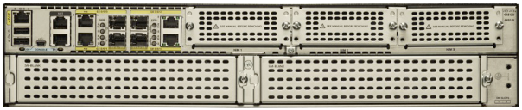

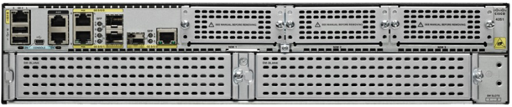


Cisco ISR 4000 Series Comparison
Entity | ISR 4451 | ISR 4431 | ISR 4351 | ISR 4331 | ISR 4321
Performance | 1 Gbps–2 Gbps | 500 Mbps–1 Gbps | 200 Mbps–400 Mbps | 100 Mbps–300 Mbps | 50 Mbps–100 Mbps
Migrate From ISR | 3945E / 3925E / 3945 | 3945 / 3925 | 2951 | 2911 / 2921 | 1921 / 1941 / 2901
CPU Architecture | 4 core control / services 10 core data plane | 4 core control / services 6 core data plane | 8-core CPU (4 Data, 1 Control, 3 Service) | 8-core CPU (4 Data, 1 Control, 3 Service) | 4-core CPU (2 Data, 1 Control, 1 Service)
Rack Units | 2 | 1 | 2 | 1 | 1(Desktop)
#NIMs | 3 | 3 | 3 | 2 | 2
#SMs | 2 | 0 | 2 | 1 | 0
FPGE | 4 GE plus 4 SFP | 4 GE plus 4 SFP | 3 GE plus 3 SFP | 2 GE plus 2 SFP | 2 GE plus 1 SFP
Power | Dual internal AC or DC (Redundant Power) | Dual internal AC or DC (Redundant Power) | Single internal AC or DC | Single AC | Single AC
Control/Services Memory | Base 4 GB; Max 16 GB (2 DIMM slots) | Base 4 GB; Max 16 GB (2 DIMM slots) | Base 4 GB; Max 16 GB (2 DIMM slots) | Base 4 GB; Max 16 GB (2 DIMM slots) | Base 4 GB; Max 8 GB (2 DIMM slots)
Data Plane Memory | 2 GB | 2 GB | Included Above | Included Above | Included Above
Notes:
The Cisco 4451 is suggested for migration from the existing Cisco 3925E and 3945E routers. It offers 1-Gbps performance, upgradable to 2 Gbps, in a 2-rack-unit (2RU) form factor with 3 network interface module (NIM) slots and 2 enhanced service module (SM-X) slots. It includes an option for redundant power.
● 4-core processors (1 control and 3 services processors)
● 10-core data plane
● Single or double-wide Cisco UCS E-Series support
● Up to 16-GB control and services memory
The Cisco 4431 is suggested for migration from the existing Cisco 3925 and 3945 routers. It offers 500-Mbps performance, upgradable to 1 Gbps, in a 1RU form factor with 3 NIM slots and no SM slots. It includes an option for redundant power.
● 4-core processors (1 control and 3 services)
● 6-core data plane
● Up to 16-GB control and services memory
The Cisco 4351 is suggested for migration from existing Cisco 2951 routers. It offers 200-Mbps performance, upgradable to 400 Mbps, in a 2RU form factor with 3 NIM slots and 2 SM slots.
● 8-core CPU with 4 data-plane cores, 1 control-plane core, and 3 cores dedicated for services
● Single or double-wide Cisco UCS E-Series support, and up to 16-GB control and services memory
The Cisco 4331 is suggested for migration from the existing Cisco 2911 and 2921 routers. It offers 100-Mbps performance, upgradable to 300 Mbps, in a 1RU form factor with 2 NIM slots and 1 SM slot.
● 8-core CPU with 4 data-plane cores, 1 control-plane core, and 3 cores dedicated for services
● Single-wide Cisco UCS E-Series support, and up to 16-GB control and services memory
The Cisco 4321 is suggested for migration from the existing Cisco 2901 and 1941 routers. It offers 50-Mbps performance, upgradable to 100 Mbps, in a 1RU desktop form factor with 2 NIM slots and no SM slots.
● 4-core CPU with 2 data-plane cores, 1 control-plane core, and 1 core dedicated for services
● Up to 8-GB control and services memory

Slide 17
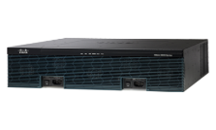

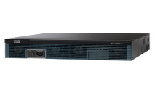

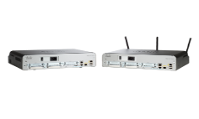
ISR G2 → ISR 4000: Migration Options
3945E (350 Mbps)
4451 (1 or 2Gbps)
3RU
2RU
3925E (250 Mbps)
3RU
3945 (150 Mbps)
4431 (500 or 1000 Mbps)
3RU
1RU
3925 (100 Mbps)
3RU
2951 (75 Mbps)
4351 (200 or 400 Mbps)
2RU
2921 (50 Mbps)
2RU
2RU
4331 (100 or 300 Mbps)
2911 (35 Mbps)
1RU
2RU
2901 (25 Mbps)
4321 (50 or 100 Mbps)
1RU
1RU
Desktop
1941 (25 Mbps)
2RU

Slide 18
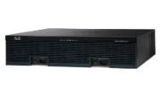
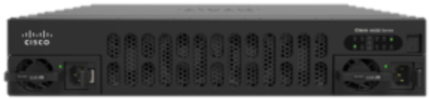
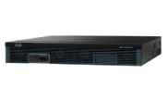

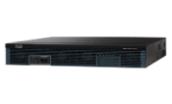
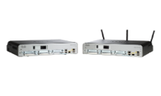
ISR G1 → ISR 4000: Migration Options
3845
3825
2RU
4451-X
3RU
1RU
4431
2RU
2851
2RU
4351
2RU
2821
2811
1RU
4331
2801
1841
1RU
Desktop
1RU

Slide 19
Details of Bundles and Promotions

Slide 20
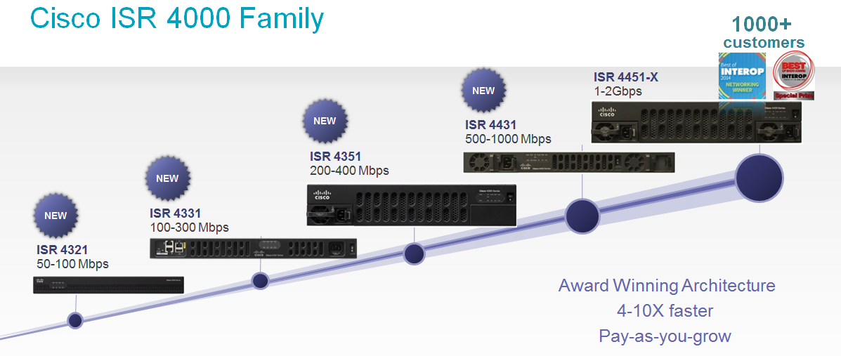
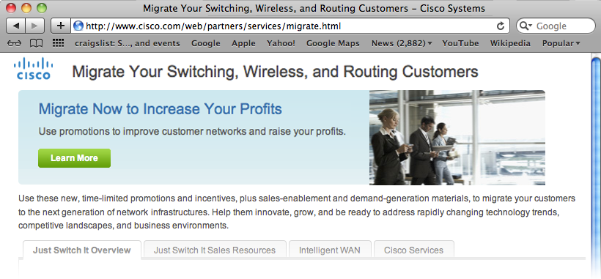
“Just Switch It” (JSI) Installed Base Migration Program
Opportunities
Architectural Transitions
  Intelligent WAN with Akamai Connect
  Converged Branch Infrastructure
Platform Transitions
  Cisco ISR 4400 series
  Cisco ISR 4300 series
  Cisco UCS-E series
Services
  Security, Voice
  Application optimization (WAAS)
  Intelligent Application caching (Akamai)
JSI Program
TMP Simplification
  Aggressive credits—
  8% to 12% for Cisco-to-Cisco
  14% to 18% for competitive trade-in
  No need to return or destroy gear—new “Certificate of Non-Use”
New Offers
  Converged Infrastructure bundles—up to 25% off a la carte
  4 Core server <= $2K
  Stackable with IWAN breakaway program and VIP
Comprehensive
  10% TMP credits for Cisco Services
  6 months deferred payments with Cisco Capital

Slide 21
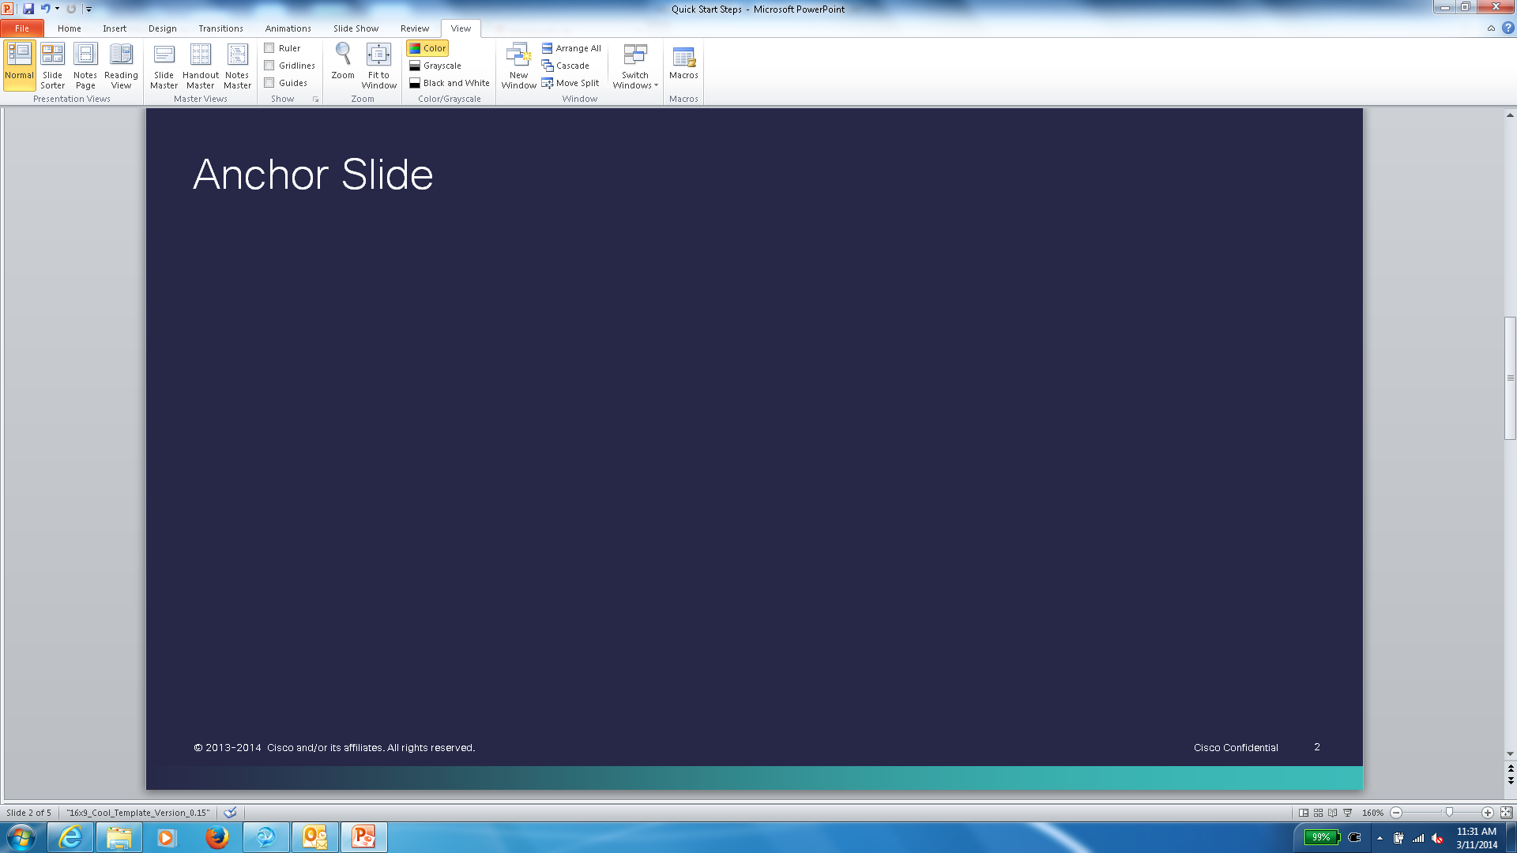
Converged Branch Infrastructure ISR 4000 Bundles
NEW
Nov 2014
ISR4451-AX-BUN
ISR4451-AXV-BUN
ISR4351-AX-BUN
ISR4351-AXV-BUN
  ISR 4451-X-AX/K9 Router
  UCS-E140S-M2/K9 Module (4 Core server with 1TB HDD)
  Redundant power supply option
  ISR 4451-X-AX/K9 Router
  UCS-E140S-M2/K9 Module (4 Core server with 1TB HDD)
  Redundant power supply option
  UC license
  ISR 4351-X-AX/K9 Router
  UCS-E140S-M2/K9 Module (4 Core server with 1TB HDD)
  ISR 4351-X-AX/K9 Router
  UCS-E140S-M2/K9 Module (4 Core server with 1TB HDD)
  UC license
À la carte Price - $28,700
À la carte Price - $34,100
À la carte Price - $17,200
À la carte Price - $22,600
Bundle Price $24,000
Bundle Price $27,000
Bundle Price $14,000
Bundle Price $17,000
TMP eligible
IWAN breakaway
VIP eligible
Std. Disc. Cap
ISR G1 and G2 Refresh
Customer Visible Offer
Valid Through FY15
Americas
EMEAR
APJC

Slide 22
Completely Refreshed Technology Migration Program (TMP)
Accelerate Migration of Older Products
Completely Revamped, Simplified, Most Aggressive Ever
Discount on Technical Support Attach through TMP
NEW
14-18% List Price Reduction
Competitive Trade-In
10% for Technical Services
18% for ISR 4400, ISR3900- Accelerate
14% for ISR 4300, ISR 2900, ISR1900, Cisco 890 - Enable
8-12% List Price Reduction
Cisco Trade-In
10% for Technical Services
12% for ISR 4400, ISR3900- Accelerate
8% for ISR 4300, ISR 2900, ISR1900, Cisco 890 - Enable
Completely Revamped for Simplification
Consistent Accelerate & Enable Categories with VIP
Fixed Price Reduction vs. Trade-in SKU Based
Certificate of Non-use in lieu of Physical Return
TMP eligible
IWAN breakaway
VIP
Accelerate/Enable eligible
Edge and Access Routing Refresh
Valid Through FY15
Americas
EMEAR
APJC

Slide 23
IWAN 2.0 Breakaway Promotion
Sell Cisco ISR 4000 Family for Intelligent WAN Solution
Accelerate Routing Services
Eligible products
Cisco ISR 4400 series AX/AXV bundles, Cisco ISR 4300 series AX/AXV bundles, Cisco ISR 3900 series AX/AXV bundles, Cisco ISR 2900 series AX/AXV bundles
Cisco ISR 1900 series AX bundles
and Cisco UCS-E series bundles
5%
Extra Discount Over OIP, TIP, SIP
Sell Cisco ISR 4000 family AX/AXV bundles, Cisco ISR G2 family AX/AXV bundles and Cisco UCS-E series bundles
Utilizes Standard OIP, TIP, SIP Programs
No Separate Promo Code Required
* May vary across regions/geos
TMP eligible
IWAN break-
away
VIP eligible
Std. Disc. Cap
ISR G1 and G2 Refresh
Valid Through Q2FY15
Americas
Not available in EMEAR
Not available in APJC

Slide 24
VIP-24: Value Incentive Program—
Post Sales Backend Rebate for Partners
Partner Incentives to Sell Latest Generation Products
10%
Rebate
All AX Bundles,
ISR 4K w/services,
4G LTE, UCS
E-Series M2
2%
Rebate
ISR G2 w/services,
Base ISR 4K,
UCS E-Series M1
Just 2 Rebate Categories (Enable and Accelerate)
Consistent Rebate Percentages for Enable and Accelerate Across Routing, Switching & Wireless
Gold Kicker Now Available on Routing, Switching & Wireless Products in the Accelerate Category
Accelerate: 10% across Routing * Enable: 2% across Routing
TMP eligible
IWAN break-away
VIP
Accelerate/Enable eligible
Edge and Access Routing Refresh
Valid Through Q2FY15
Americas
EMEAR
APJC

Slide 25
Distribution-Led Migration Program (DLMP) for SMB
Migration Program for Distributors for the First Time
Enable Trade-Ins for Deals under $25K
Up to
Trade-In Discount
Discount Based on SKU Bought,
Not the Trade-in SKU
Competitors and Cisco’s Old Products for Trade-In
18%
Disti Branded, Disti Priced, Disti Executed
Simple and Quick Trade-In Process
No Deal Registration Required for Resellers
No Need to Ship Returned Equipment, - Cisco Picks up
Only 2% Discount on Certificate of Destruction * Must be a Cisco Registered reseller or higher
No
TMP
NO IWAN Break
away
NO VIP
Edge and Access Routing Refresh
Valid Through FY15
Americas
EMEAR
Not available in APJC
Notes:
Move this out to disti deck
Process to register a TMP deal

Slide 26
ISR 4451-X-AX Deployment
10 Sites, 1 ISR 4451-X-AX at Each Site
Bill of Material
10 ISR4451-X-AX/K9
Total
Product List Price
$230,000
Std. OIP Price
$115,000
After IWAN Breakaway
$103,500
After TMP Credits
$75,900
Net Partner Price
$75,900
Partner’s Standard Price (OIP) : $115,000
Partner’s New Price (JSI) : $75,900
34% Better
Plus VIP Backend Rebates Up to 10%

Slide 27
Services Can Help
Additional 10% Discount on Technical Support Services through TMP
NEW
  SMARTnet, Smart Net Total Care, Smart Care, Partner Support Service
  Limited time only – expires July 30, 2015
Collaborative and Professional Services to Pave the Way
  Build business case for migration / upgrade
  Reduce network and device configuration time up to 90% and post-migration verification time by 60-70%
Support Contract Transfers
  Credit awarded for services contracts active at least a year on older products
  Can be applied to support service contract on newest-gen Cisco product

Slide 28
Cisco Capital Benefits
Cisco
Partner
End-User
Control financing footprint
Accelerate Deal Closure
Increase Deal Size—30%avg
Competitive differentiator
Protects margin
Be a trusted Advisor
Drives deal growth
Enables total solution selling
Increases account control
Enables sales
Expands customer conversations
Increases cash flow and profitability
Conserves capital
Preserves credit
Improve ROI
Match payment to benefit
Enables total solution financing
Avoids technology obsolescence
Manages equipment lifecycle

Slide 30
Model Comparison—At a Glance
Feature | 4321 | 4331 | 4351 | 4431 | 4451
Form Factor | 1 RU Desktop | 1 RU | 2 RU | 1 RU | 1 RU
Integrated WAN Ports | 1 GE/SFP; 1 GE | 1 GE/SFP; 1 GE, 1SFP | 2 PoE GE/SFP, 1GE/SFP | 2 PoE GE/SFP, 2GE/SFP | 2 PoE GE/SFP, 2GE/SFP
Performance | 50 Mbps, Upgradable to 100 Mbps | 100Mbps, Upgradable to 300Mbps | 200Mbps, Upgradable to 400Mbps | 500Mbps, Upgradable to 1Gbps | 1Gbps, Upgradable to 2Gbps
Management Port | 1 GE (Integrated Out of Band)
Network Interface Module (NIM) | 2 | 2 | 3 | 3 | 3
Enhanced Services Module (SM-X) | N/A | 1 Single Wide | 2 Single or 1 Double Wide | N/A | 2 Single or 1 Double Wide
Integrated Services Card (ISC) Slots | 1 (PVDM 4)
Server Virtualization Platform (UCS E-Series) | N/A | 2 or 4 Cores Single-wide | 2 or 4 Cores Single-wide, 6 or Core Double-wide | N/A | 2 or 4 Cores Single-wide, 6 or Core Double-wide
Local Conferencing | Yes
Cisco Unified Survivable Remote Site Telephony Support | Up to 50 | Up to 100 | Up to 750 | Up to 1200 | Up to 2000
Cisco Unified Communications Manager Express Support | Up to 50 | Up to 100 | Up to 250 | Up to 350 | Up to 450
Cisco Unified Border Element (CUBE) (SIP/H.323 Sessions) | 100 | 400 | 1000 | 3000 | 6000
Digital Voice and Video (T1/E1 Channels) | Up to 240 | Up to 360 | Up to 720 | Up to 720 | Up to 1200
Analog/BRI Voice | Up to 8 Ports (FXS, FXO, E/M, BRi) | Up to 12 Ports (FXS, FXO, E/M, BRi) | Up to 20 Ports (FXS, FXO, E/M, BRi) | Up to 12 Ports (FXS, FXO, E/M, BRi) | Up to 20 Ports (FXS, FXO, E/M, BRi)
IPv4 Routing Protocols | RIP v1/v2, EIGRP, OSPF, BGP, PBR, PfR
Multicast Routing Protocols | PIM-SM, mroute (static route), and MLD
IPv6 Routing Protocols | EIGRP, RIP, OSPFv3, IS-IS, BGP and PBR
PoE Support with PoE Boost | 260W | 530W | 990W | 500W | 950W
Route Optimization | PfR
Network Contention Control | QoS, HQoS
Application Visibility | NBAR v2
WAN Optimization | ISR-WAASS | ISR-WAAS, WAAS on UCS E-Series | ISR-WAAS, WAAS on UCS E-Series | ISR-WAAS | ISR-WAAS, WAAS on UCS E-Series
Akamai Connect | N/A | Yes | Yes | Yes | Yes
Cisco Application Centric Infrastructure | Application Performance Infrastructure Controller (APIC) with Enterprise Module

Slide 31
ISR G2 → ISR 4000: Migration Options
3RU
3945E
3925E
2RU
4451-X
3RU
3945
3925
1RU
4431
2RU
2951
2RU
4351
2RU
2921
2911
1RU
4331
1RU
2901
1941
1RU
Desktop
Pricing subject to change

Slide 32
ISR 4451-X-AX Deployment
10 Sites, 1 ISR 4451-X-AX at Each Site
Bill of Material
10 ISR4451-X-AX/K9
Total
Product List Price
$230,000
Std. OIP Price
$115,000
After IWAN Breakaway
$103,500
After TMP Credits
$75,900
Net Partner Price
$75,900
Partner’s Standard Price (OIP) : $115,000
Partner’s New Price (JSI) : $75,900
34% Better
Plus VIP Backend Rebates Up to 10%

Slide 33
ISR 4351-AX Deployment
10 Sites, 1 ISR 4351-AX at Each Site
Bill of Material
10 ISR4351-X-AX/K9
Total
Product List Price
$53,000
Std. OIP Price
$26,500
After IWAN Breakaway
$23,850
After TMP Credits
$19,610
Net Partner Price
$19,610
Partner’s Standard Price (OIP) : $26,500
Partner’s New Price (JSI) : $19,610
26% Better
Plus VIP Backend Rebates Up to 10%

Slide 34
ISR 4331-AX Deployment
10 Sites, 1 ISR 4331-AX at Each Site
Bill of Material
10 ISR4331-X-AX/K9
Total
Product List Price
$120,000
Std. OIP Price
$60,000
After IWAN Breakaway
$54,000
After TMP Credits
$44,000
Net Partner Price
$44,400
Partner’s Standard Price (OIP) : $60,000
Partner’s New Price (JSI) : $44,400
26% Better
Plus VIP Backend Rebates Up to 10%

Slide 35
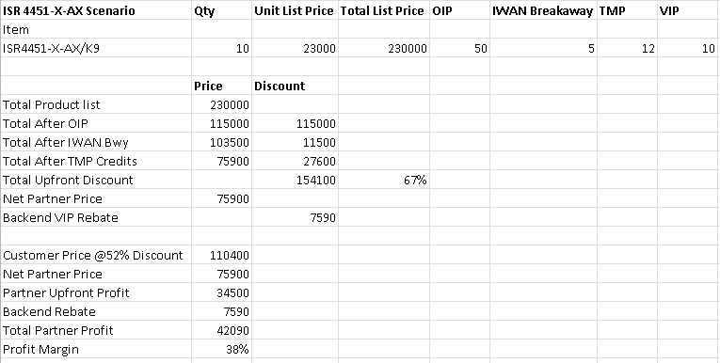
ISR 4451-AX Deployment

Slide 36
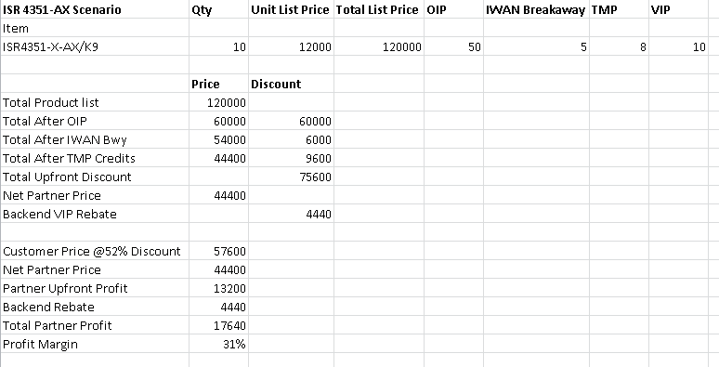
ISR 4351-AX Deployment

Slide 37
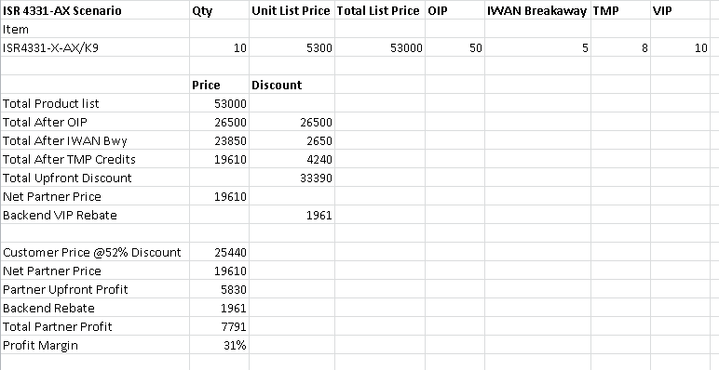
ISR 4331-AX Deployment

Slide 38
Model Comparison—At a Glance
Feature | 4321 | 4331 | 4351 | 4431 | 4451
Form Factor | 1 RU Desktop | 1 RU | 2 RU | 1 RU | 1 RU
Integrated WAN Ports | 1 GE/SFP; 1 GE | 1 GE/SFP; 1 GE, 1SFP | 2 PoE GE/SFP, 1GE/SFP | 2 PoE GE/SFP, 2GE/SFP | 2 PoE GE/SFP, 2GE/SFP
Performance | 50 Mbps, Upgradable to 100 Mbps | 100Mbps, Upgradable to 300Mbps | 200Mbps, Upgradable to 400Mbps | 500Mbps, Upgradable to 1Gbps | 1Gbps, Upgradable to 2Gbps
Management Port | 1 GE (Integrated Out of Band)
Network Interface Module (NIM) | 2 | 2 | 3 | 3 | 3
Enhanced Services Module (SM-X) | N/A | 1 Single Wide | 2 Single or 1 Double Wide | N/A | 2 Single or 1 Double Wide
Integrated Services Card (ISC) Slots | 1 (PVDM 4)
Server Virtualization Platform (UCS E-Series) | N/A | 2 or 4 Cores Single-wide | 2 or 4 Cores Single-wide, 6 or Core Double-wide | N/A | 2 or 4 Cores Single-wide, 6 or Core Double-wide
Local Conferencing | Yes
Cisco Unified Survivable Remote Site Telephony Support | Up to 50 | Up to 100 | Up to 750 | Up to 1200 | Up to 2000
Cisco Unified Communications Manager Express Support | Up to 50 | Up to 100 | Up to 250 | Up to 350 | Up to 450
Cisco Unified Border Element (CUBE) (SIP/H.323 Sessions) | 100 | 400 | 1000 | 3000 | 6000
Digital Voice and Video (T1/E1 Channels) | Up to 240 | Up to 360 | Up to 720 | Up to 720 | Up to 1200
Analog/BRI Voice | Up to 8 Ports (FXS, FXO, E/M, BRi) | Up to 12 Ports (FXS, FXO, E/M, BRi) | Up to 20 Ports (FXS, FXO, E/M, BRi) | Up to 12 Ports (FXS, FXO, E/M, BRi) | Up to 20 Ports (FXS, FXO, E/M, BRi)
IPv4 Routing Protocols | RIP v1/v2, EIGRP, OSPF, BGP, PBR, PfR
Multicast Routing Protocols | PIM-SM, mroute (static route), and MLD
IPv6 Routing Protocols | EIGRP, RIP, OSPFv3, IS-IS, BGP and PBR
PoE Support with PoE Boost | 260W | 530W | 990W | 500W | 950W
Route Optimization | PfR
Network Contention Control | QoS, HQoS
Application Visibility | NBAR v2
WAN Optimization | ISR-WAASS | ISR-WAAS, WAAS on UCS E-Series | ISR-WAAS, WAAS on UCS E-Series | ISR-WAAS | ISR-WAAS, vWAAS on UCS E-Series
Akamai Connect | N/A | Yes | Yes | Yes | Yes
Cisco Application Centric Infrastructure | Application Performance Infrastructure Controller (APIC) with Enterprise Module

