Slide 1
Securing Your WAN Infrastructure
Enabling the Hybrid WAN Webinar Series
Presenter: Elisa Caredio, Product Manager
Host: Robb Boyd, Techwise TV
Date: Thursday 22nd January 2015, 10am PST

Slide 2
Enabling the Hybrid WAN Webinar Series
6th November 2014 How to Deliver Uncompromising Branch Application Performance
16th December 2014 5 Ways to Lower Your Branch Costs
22nd January 2015 Securing Your WAN Infrastructure
5th February 2015 Ask Cisco: Deploying a Hybrid WAN Infrastructure
18th February 2015 Simplify Management of Your Branch Infrastructure
Visit Cisco Online Events:
http://www.cisco.com/web/learning/le21/le39/featured.html#technology_broadcasts_networks

Slide 3


Your Presenters
Elisa Caredio
Robb Boyd
Product Manager
Techwise TV

Slide 4
Todays’ Session: What You Will Learn
Why secure your WAN infrastructure
Benefits of Transport Independent Design using DMVPN
Why secure Direct Internet Access
Best practices for Threat Defense and Compliance
Key Takeaways

Slide 5
Why secure your WAN infrastructure

Slide 6







Why Secure Your WAN Infrastructure
Hybrid WAN Transport
IPsec Secure
MPLS (IP-VPN)
Private
Cloud
Virtual
Private
Cloud
Branch
Internet
Direct Internet
Access
Public
Cloud
Secure WAN transport for private
and virtual private cloud access
Leverage local Internet path for
public cloud and Internet access
Transport Independent Design ensures consistent VPN Overlay across transition
Certified strong encryption
Comprehensive Threat Defense with IOS Firewall/IPS
Cloud Web Security (CWS)
for scalable secure direct
Internet access
Notes:
So how do we leverage low-cost internet transport in a WAN access strategy?
So today it is active/standby so what we’re going to show you is how to move to active/active and get more capacity for your WAN for a lot less money
And now if your leverage internet for WAN transport, why not use for direct internet access - for you employees to access public cloud with better performance and offload your guest user directly for security.
You’re going to increase you WAN capacity very cost effectively and improve performance by sending the right flows to the right places.
-----
First we want secure transport overlay certainly on the internet path and perhaps for consistency and design simplicity we want this on our MPLS/IP access as well
Maybe then we want to route some of our less critical flows across the internet transport, we want to do that selectively and be able to revert back to MPLS leg if performance degrades
Maybe we want load balancing of best effort traffic across both links to help offload traffic from MPLS VPN access
And further, for traffic that we know is destined to Public cloud servicesfor employees like Google, Salesforce.com, Office365 etc or Guest Users directly to the internet, maybe we want to leverage Local internet access to offload these flows from the WAN altogether
So now you use your internet connection, not just as a backup, but as a real component of your over WAN
Combining these elements, with the right network technlogies to optimize the flows will help reduce overall WAN transport BW requirements and improve application performance by directing the right flows to the right places.
Let’s see how...

Slide 7
Trends in the Threat Defense Market
Data loss
Compliance (economy)
Disruption (0.5% to 2.5% revenue loss)
Why enterprise security?
2012 - 100M malware samples
2013 - 200M samples (McAfee)
Short lifecycle
Threats!!!
Visibility
Intelligent solutions are 10 times more valuable
Changing consumption models
Appliance to Integrated
On premise to SaaS

Slide 8
“By 2016, 30% of advanced targeted threats - up from less than 5% today - will specifically target branch offices as an entry point.”
Gartner: “Bring Branch Office Network Security Up to the Enterprise Standard”, April 2013

Slide 9







Intelligent WAN Deployment Models
Dual MPLS
Hybrid
Dual Internet
Internet
Public
Enterprise
Public
Enterprise
Public
MPLS
MPLS+
Internet
Internet
MPLS
Branch
Branch
Branch
Highest SLA guarantees
Tightly coupled to SP
Expensive
More BW for key applications
Balanced SLA guarantees
Moderately priced
Best price/performance
Most SP flexibility
Enterprise responsible for SLAs

Slide 10
Benefits of Transport Independent Design Using DMVPN

Slide 11




Flexible Secure WAN Design Over Any Transport
Dynamic Multipoint VPN (DMVPN)
Transport-Independent
Flexible
Secure
Simplifies WAN Design
Dynamic Full-Meshed Connectivity
Proven Robust Security
Easy multi-homing over any carrier service
Single routing control plane with minimal peering to the provider
Consistent design over all transports
Automatic site-to-site IPsec tunnels
Zero-touch hub configuration for new spokes
Certified crypto and firewall for compliance
Scalable design with high- performance cryptography in hardware
Branch
Data Center
Internet
WAN
ASR 1000
ISR
MPLS
ASR 1000

Slide 12



Cisco IWAN Transport Independent Design
Using Dynamic Multipoint VPN (DMVPN)
Proven IPsec VPN technology
  Widely deployed, large scale
  Standards based IPsec and Routing
  Advanced QOS: hierarchical, per tunnel and adaptive
Flexible & Resilient
  Over any transport: MPLS, Carrier Ethernet, Internet, 3G/4G,..
  Hub-n-Spoke and Spoke-to-Spoke Topologies
  Multiple encryption, key management, routing options
  Multiple redundancy options: platform, hub, transports
Secure
  Industry Certified IPsec and Firewall
  NG Strong Encryption: AES-GCM-256 (Suite B)
  IKE Version 2
  IEEE 802.1AR Secure unique device identifier
Simplified IWAN Deployments
  Prescriptive validated IWAN designs
  Automated provisioning – Prime, APIC, Glue
IWAN HYBRID
Data Center
ISP A
SP V
DMVPN
Purple
DMVPN
Blue
Internet
MPLS
Branch

Slide 13

Hybrid WAN Designs
TRADITIONAL HYBRID
IWAN HYBRID
Active/Standby
WAN Paths
Primary With Backup
Active/Active
WAN Paths
Data Center
Data Center
Two IPsec Technologies
GETVPN/MPLS
DMVPN/Internet
ASR 1000
ASR 1000
ASR 1000
ASR 1000
One IPsec Overlay
DMVPN
ISP A
SP V
ISP A
SP V
DMVPN
GETVPN
DMVPN
MPLS
Two WAN Routing
Domains
MPLS: eBGP or Static
Internet: iBGP, EIGRP or OSPF
Route Redistribution
Route Filtering Loop Prevention
DMVPN
Internet
MPLS
Internet
One WAN
Routing Domain
iBGP, EIGRP, or OSPF
Branch
Branch
ISR
ISR

Slide 14
IWAN Transport Independence
Consistent deployment models simplify operations
IWAN Dual MPLS
IWAN HYBRID
IWAN DUAL INTERNET
Data Center
Data Center
Data Center
ASR 1000
ASR 1000
ASR 1000
ASR 1000
ASR 1000
ASR 1000
ISP A
SP V
ISP A
SP V
ISP A
DSL
ISP C
Cable
DMVPN
DMVPN
DMVPN
DMVPN
Internet
DMVPN
DMVPN
MPLS
MPLS
Internet
MPLS
Internet
ISR
Branch
ISR
Branch
ISR
Branch
Notes:
14
Not only simpler, but same design over any transport - internet, 3G/4G or even MPLS!

Slide 15
What is Dynamic Multipoint VPN?
Cisco IOS Software Solution for Building IPsec and GRE VPNs in an Easy, Dynamic and Scalable Manner
Two Proven Technologies
Major Features
Next-Hop Resolution Protocol (NHRP)
Creates a distributed mapping database of VPN (tunnel interface) to real (public interface) addresses
Multipoint GRE tunnel interface
Single GRE interface to support multiple
GRE/IPsec tunnels and endpoints
Simplifies size and complexity of configuration
Supports dynamic tunnel creation
Configuration reduction and no-touch deployment
Passenger protocols (IP(v4/v6) unicast, multicast, and dynamic routing protocols)
Transport protocols (IPv4 and IPv6)
Remote peers with dynamically assigned transport addresses
Spoke routers behind dynamic NAT; hub routers behind static NAT
Dynamic spoke-spoke tunnels for partial/full mesh scaling
Wide variety of network designs and options
Redundancy Options (Intra and Inter – DMVPN)
Segmentation with VRFs and SGT

Slide 16
DMPVN and IPsec
IPsec integrated with DMVPN, but not required
Packets Encapsulated in GRE, then Encrypted with IPsec
  Both IKEv1 (ISAKMP) and IKEv2 supported
NHRP controls the tunnels, IPsec does encryption
Bringing up a tunnel
  NHRP signals IPsec to setup encryption
  IKEv1 and IKEv2 authenticates peer, generates SAs
  IPsec responds to NHRP and the tunnel is activated
  All NHRP and data traffic is Encrypted
Bringing down a tunnel
  NHRP signals IPsec to tear down tunnel
  IPsec can signal NHRP if encryption is cleared or lost
IKEv1/IKEv2 Keepalives monitor state of spoke-spoke and spoke-hub tunnels
FIPS-140 certified and Suite-B strong encryption support
Notes:
Crypto is the first operation on the wire…everything else goes through the tunnel and is secure

Slide 17
DMVPN Example
Dynamic
unknown
IP addresses
Physical: dynamic
Tunnel0: 10.0.0.11
Spoke A
.1
192.168.1.0/24
Branch
192.168.0.0/24
Internet
.1
Physical: 172.17.0.1
Tunnel0: 10.0.0.1
LANs can have
private addressing
Physical: dynamic
Tunnel0: 10.0.0.12
Static known
IP address
Spoke B
.1
192.168.2.0/24

Slide 18
DMVPN Example
Static Spoke-to-hub tunnels
Physical: dynamic
Tunnel0: 10.0.0.11
Spoke A
.1
192.168.1.0/24
Branch
192.168.0.0/24
Internet
.1
Physical: 172.17.0.1
Tunnel0: 10.0.0.1
Physical: dynamic
Tunnel0: 10.0.0.12
Spoke B
.1
192.168.2.0/24

Slide 19
DMVPN Example
Static Spoke-to-hub tunnels
Dynamic Spoke-to-spoke tunnels
Physical: dynamic
Tunnel0: 10.0.0.11
Spoke A
.1
192.168.1.0/24
Branch
192.168.0.0/24
Internet
.1
Physical: 172.17.0.1
Tunnel0: 10.0.0.1
Physical: dynamic
Tunnel0: 10.0.0.12
Spoke B
.1
192.168.2.0/24

Slide 20








IWAN Automated Secure VPN
Available
1H2015
Embedded Trust Devices
Deploy, Search, Retrieve, Revoke
Intelligent Branch
AX
4G
DC
Resilient WAN POP
Secure Boot Strap
IWAN App, Prime, 3rd Party
Campus
Metro-E
Automatic Configuration and Trust Establishment
Enterprise WAN Core
Configuration Orchestration
AX
Dynamic VPN Establishment
APIC
MPLS
Key and Certificate Controller
Large Site
Automatic Session Key Refresh (IKEv2)
AX
ISP
Trust Revocation
Branch
Optional External Certificate Authority
Notes:
APIC-EM -> Application policy infrastructure component, centralizes operations
Once DMVPN is up and running, no need for APIC-EM
Built in CA which will be called the “Trust Manager”
Backup / Restoration Capabilities with Secure Database Mirroring
Integrated IWAN Workflow -> make it disappear
Reasonable Alerts that are self mitigating issues.
Opportunities to leverage “Trust Manager” for other machine identity needs.

Slide 21
Cisco Intelligent WAN
Transport Best Practices
Private peering with Internet providers
  Use same Internet provider for hub and spoke sites
  Avoids Internet Exchange bottlenecks between providers
  Reduces round trip latency
DMVPN Phase 3
  Scalable dynamic site-to-site tunnels
  Separate DMVPN per transport for path diversity
  Per tunnel QOS
  NG Encryption – IKEv2 + AES-GCM-256 encryption
Transport Settings
  Use the same MTU size on all WAN paths
  Bandwidth settings should match offered rate
Routing Overlay
  iBGP or EIGRP for high scale (1000+ sites)
  Single routing process, simplified operations
  Front-side VRF to isolate external interfaces
IWAN HYBRID
Data Center
ISP A
SP V
DMVPN
Purple
DMVPN
Blue
Internet
MPLS
Branch

Slide 22
Securing Direct Internet Access

Slide 23







Securing the WAN
Direct Internet Access
IPsec VPN
IPS
Corporate
Network
Firewall
Branch
Internet
Public
Direct Internet
Access
Secure WAN transport for branch to head quarters connectivity
Leverage local Internet path for public cloud and Internet access
TD techniques provide the additional protection needed for DIA
Improve application performance (right flows to right places)
Reduced bandwidth consumption
Notes:
The primary advantages of DIA are reduced bandwidth requirements at your headquarters, reduced network hops and latency due to direct routing, and better optimization from Internet-based content delivery network (CDN) solutions.

Slide 24


Securing the LAN
Branch
IPsec VPN
IPS
Corporate
Network
Firewall
Internet
Public
Guest Network
Direct Internet
Access
Guest devices are connected to separate VLAN/SSID
Traffic from guest VLAN is directly routed to Internet
Traffic is inspected as it traverses the branch router

Slide 25
Elevating Branch Protection
Protection from External Threats
Detect and contain threats from compromised devices in the branch network using Cisco ISR platforms
  Zone Based Firewall is the starting point
  Industry leading threat defense using Snort and Cloud Web Security
Distributed threat defense with centralized management
  Make every branch detect threats on its own network, with central management and monitoring
Safer guest access
  Guest network and devices on it are better protected now

Slide 26
Best Practices for Threat Defense and Compliance

Slide 27
Cisco ISR with IOS Integrated Threat Defense
Firewall, VPN, IPS and Web Security
For enterprises with distributed branch offices
Cost-effective secure network infrastructure solution that provides multi layered security and meets compliance requirements
Cisco ISR with Integrated security features
  Virtual Private Networking
  Zone-Based Firewall
  Web Security
  Intrusion detection and prevention
Lower TCO and investment protection
Built on industry leading and proven open source components
Helps to achieve PCI compliance
Centralized management for network and security features

Slide 28





Zone-Based Firewall
Integrated Network Defense for ISR and ASR1000 Routers
Firewall Perimeter Control
  External and internal protection: internal network
  is no longer trusted
  Protocol anomaly detection and stateful inspection
Securing Unified Communications
  Call flow awareness (SIP, SCCP, H323)
  Prevent DoS attacks
Flexible Deployment Models
  Split Tunnel-Branch/Remote Office/Store/Clinic
  Internal FW – International or un-trusted locations/segments, addresses regulatory compliances
Integrates with other IOS services
  Works with IPS, VPN, ISR Web Security
  Works with SRE/ISM and WaaS Express
Management Options and Flexibility
  Supports CLI, SNMP, CCP, and CSM
  Supports Cisco Configuration Engine
Key Benefits
Secure Internet access to branch, without the need for additional devices
High performance with throughput up to 200Gbps
Control threats right at the remote site and conserve WAN bandwidth
Interoperability with Cloud Web Security
Hacker
ASR1K
Branch Offices
Worms Choking WAN
Corporate Office

Slide 29




Zone-Based Firewall
Examples of Zones
Internet
DMZ
WAN
Guestnet
Trusted
Self
Voice
BYOD

Slide 30
Zone-Based Firewall
Firewall Zone Rules
Interfaces assigned to one of the Zones
Traffic flows unrestricted between interfaces of same Zone
Traffic between two zones are blocked by default
Zone to Zone polices needs to be defined to allow traffic flow between zones
VLAN1
✖
✔
Internet
VLAN1
Zone: Inside
Zone: Outside

Slide 31

Cloud Web Security (CWS)
Formerly ScanSafe
Cloud Based Premium Service
  Real Time scanning of HTTP HTTPS web content
  Robust, fast, scalable and reliable global datacenter infrastructure
  Flexible deployment options via Cisco attach model and direct to cloud
  Support for roaming users
  Centrally managed granular web filtering policies, with web 2.0 visibility and control
  Close to real-time reporting with cloud retention, as part of the standard offering
Key Benefits
Strong protection
Separation of SecOps vs. NetOps
Complete control
High ROI
Single management for thousands of endpoints/sites

Slide 32
Cloud Web Security (CWS)
Secure Internet Access
IWAN IPsec VPN for Private Cloud Traffic
Firewall & IPS/IDS to protect Internet Edge
WAN1
(IP-VPN)
Private
Cloud
WAN2
(Internet)
Branch
Secure Public Cloud and Internet Access
Public
Cloud
ISR Connector to
CWS Firewall towers
CWS
Internet
Web Filtering, Access Policy, Malware Detect

Slide 33



Cloud Web Security (CWS)
Web Reputation
Advanced Threat Protection
AMP
Malware Signature
CTA
File Reputation
File Behavior
Cloud
File Retrospection
Application Visibility & Control
Web Filtering
Threat Analytics
Roaming Users
Headquarters
Branch Office

Slide 34


Cloud Web Security (CWS)
Web Filtering and Application Visibility and Control (AVC)
URL Filtering & Web Reputation
Application Visibility and Control
Identification and classification of applications (1000+ apps) e.g. iTunes, Facebook
Granular policies to control micro-applications (75K+) e.g. Farmville on FB or Videos on FB
Control user interaction with the application
Reduce Disruptions From
Distracted Users
Legal Liabilities
Data Loss via Web Traffic and Web Applications
URL database covering
over 50M sites worldwide
Real-time dynamic categorization for
unknown URLs
Cisco Web Reputation is integrated with CWS and protects against a broad range of URL-based threats

Slide 35
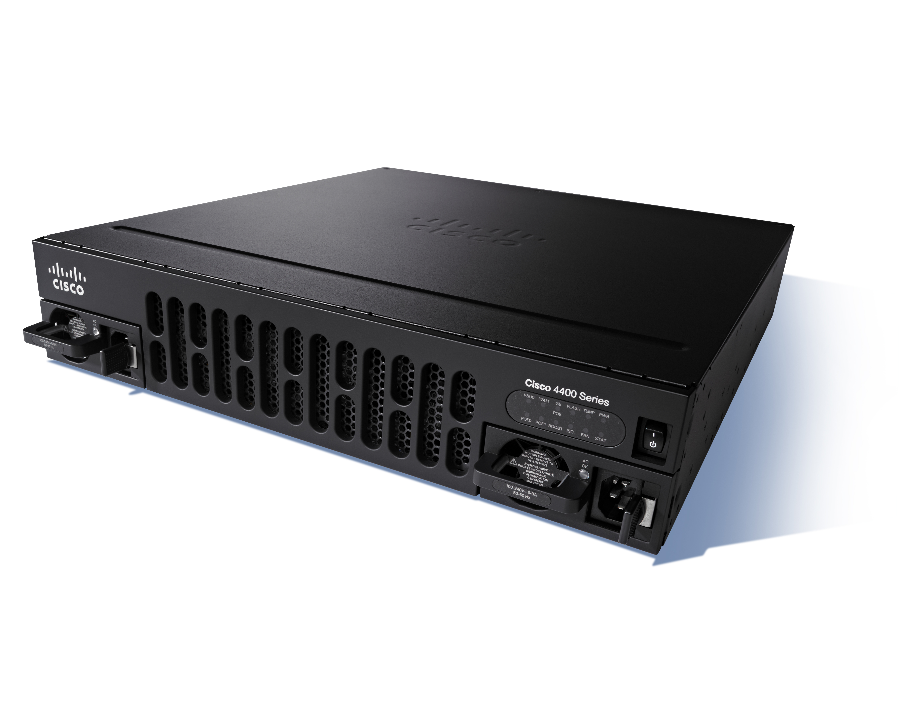

Snort Intrusion Detection and Prevention
Available
Summer
2015
Snort Benefits
Industry recognized IDS/IPS
Cisco APIC Common ACI Architecture
Meets PCI Compliance
APIC for datacenter
APIC - Enterprise Module
Cost effective IDS/IPS for the Branch
Scalable management with APIC-EM
Cisco ISR 4K
Snort

Slide 36
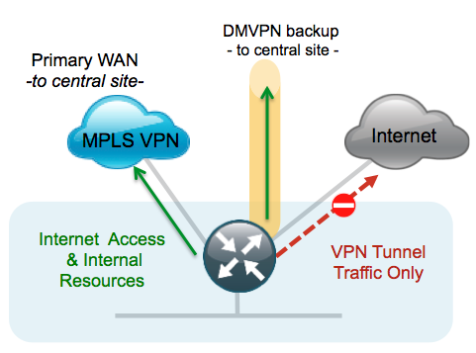
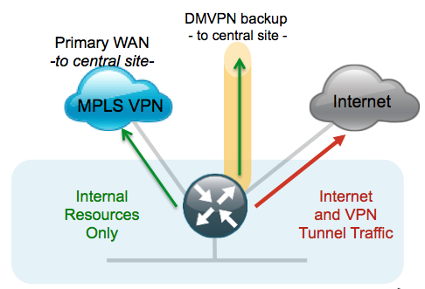
Snort Intrusion Detection and Prevention
Available
Summer
2015
Use Cases
Branch Threat Defense with Central Internet
Snort is inspecting all traffic either on inside or outside interface; ZBFW enforces access control and is applied first
Snort is protecting the branch against internal and external threats
Threat Defense for Local Direct Internet Access
Snort is inspecting all traffic on ether inside or outside interfaces. We can apply different policies (guest users, corporate users, etc.)
Snort and CWS are positioned to secure Internet access within the branch

Slide 37
Snort Intrusion Detection and Prevention
Available
Summer
2015
Deploying Snort
Deployment Workflow
  Device provisioning
  Licensing
  ISR 4K Container OVA installation
  Container service activation
  Enabling IPS/IDS
  Enable Snort configuration
  Reporting
  Signature updates
Major Components
APIC-EM
  Orchestrate device provisioning
  OVA installation and configuration
Cisco Signature Store or Local Server for signature updates
Alert Server for log collection
Cisco APIC Common ACI Architecture
APIC for datacenter
APIC - Enterprise Module

Slide 38
Snort Intrusion Detection and Prevention
Available
Summer
2015
Key Functionality
Snort integrated into Cisco IOS XE and application container
Supported on ISR 4000 Series
IPS/IDS functionality
Centralized management using APIC-EM (Enterprise Module)
Log collection via external tools
Ability to whitelist signatures
Signature update mechanism using local update and via APIC-EM

Slide 39
Key Takeaways

Slide 40

Security Management
APIC-EM IWAN App manages and orchestrates IWAN DMVPN
  DMVPN simplified profiles are applied and DMVPN configuration and provisioning is automated
APIC-EM SNORT App configures Snort on the ISR4K
  Monitoring capabilities will be added in the future
Other security components can be managed via several tools, including Cisco Prime Infrastructure

Slide 41
Secure your Hybrid WAN…
DMVPN for secure connectivity across the WAN
  Proven large-scale IPsec VPN technology
  Flexible and secure
  Automated prescriptive IWAN designs
CWS and ZBFW for Direct Internet Access
  Cloud based, single management technology for URL filtering and malware protection with AMP
  ZBFW for perimeter control
SNORT
  Cost-effective light-weight threat defense
  PCI compliance at the branch

Slide 42
More Information
Cisco Intelligent WAN
  www.cisco.com/go/iwan
Cisco Application Policy Infrastructure Controller
  www.cisco.com/go/apic
Cisco Integrated Services Routers
  www.cisco.com/go/isr
Cisco Router Security
  www.cisco.com/go/routersecurity

