Slide 1

An Introduction to:
Application Centric Infrastructure
<Speaker Name>
<Speaker Title>
<Date>
Notes:
Slide

Slide 2

Agenda
Data Center Trends – State of the Network
An Introduction to Application Centric Infrastructure
ACI Building Principles – Security & Openness
Getting Ready for the Intercloud
Evolve Existing Network Investment to be Application Centric
Taking the Next Step

Slide 3
Data Center Trends –
State of the Network
Notes:
Slide 37

Slide 4

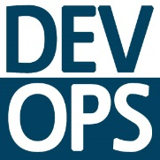
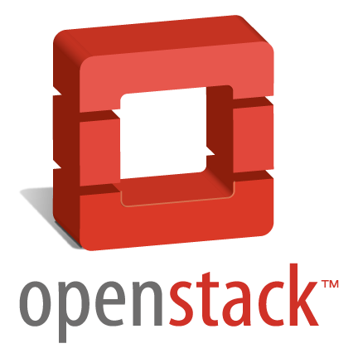


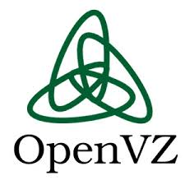

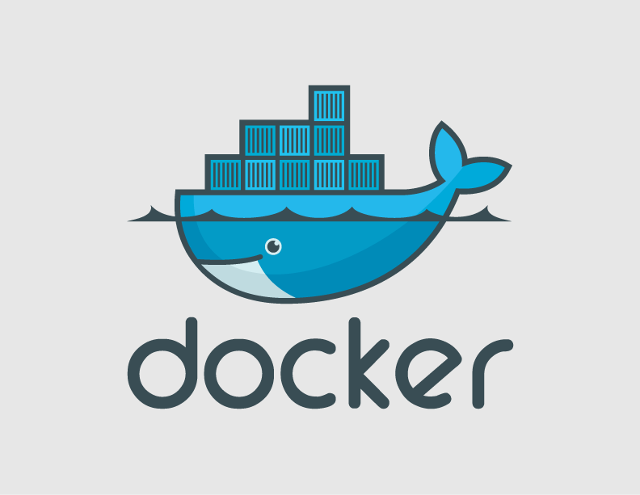
New Data Center Trends
Application Trends
Big Data
Web 2.0 / DevOps
Public / Private Cloud
InterCloud
25% CAGR—Big Data¹
45% Multi-Hypervisor⁴
2/3rd of all Workloads in Cloud by 2017
10G LoM³
75% Bare-Metal²
Linux Containers
Impact on IT Infrastructure
1 Cisco Global Cloud Index
Design and Scale
Operations Model
Consumption Model
2 IDC Worldwide Virtual Machine 2013-2017 Forecast
3 HP
4 Information week 2013 Virtualization Management Survey
Notes:
Slide 14

Slide 5
New Data Center Trends & The Network
As these new trends impact IT infrastructure…
Network
The network, which is based on requirements of a prior set of trends, has challenges
New Solutions
Creating opportunities for new solutions
Trends

Slide 6
Current State of the Network
Security
Network Services
Routing
Subnet 192.168.10.1 / 24
Subnet 192.168.10.2 / 24
Subnet 192.168.10.3 / 24
VLAN 100
VLAN 200
VLAN 300
Network constructs are tightly coupled dictating physical and logical topology.

Slide 7
Artificial Ties To Logical Constructs
Applications
Other Services
Load-Balancing
VLANs are coupled with locality and device
Addressing is coupled with VLANs
Network services are tied to addressing
Changes in any construct require changes in the rest
Subnet .10/24
Security
Routing
VLAN 100

Slide 8
Traditional SDN Models - Challenges
NW Apps
App 1
App 2
App 3
OpenFlow simply centralizes control of existing complexity
Complexity
Network Virtualization moves network constructs to virtual machines leaving complexity intact
Network
Networks were designed to drive the needs of application connectivity
As applications grew, expanded and changed complexity grew.

Slide 9
Policy Based Model – A Better Approach
App 1
App 2
App 3
The policy driven fabric model first abstracts network constructs, removing complexity, then drives infrastructure based on application needs.
Complexity
App 1
App 2
App 3
Network
Network

Slide 10
Policy Based Fabric - Advantages
App 1
App 2
App 3
Web
App
DB
Web
App
DB
Web
App
DB
Network
Rather than looking at the applications as individual network end-points, policy is driven viewing the application as a whole; the grouping of end-points and connectivity policies that makes up an application or service.

Slide 11
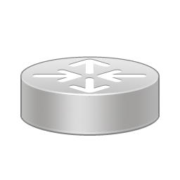
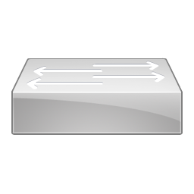



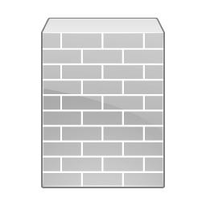


Network Infrastructure: State of Affairs
Two Types of Languages
Application Language
Network Language
?
Application tier policy and dependencies
Security requirements
Service level agreement
Application performance
Compliance
Geo dependencies
Etc.
VLAN
IP address
Subnets
Firewalls
Quality of service
Load balancer
Access lists
    Requires an Application Centric Infrastructure

Slide 12

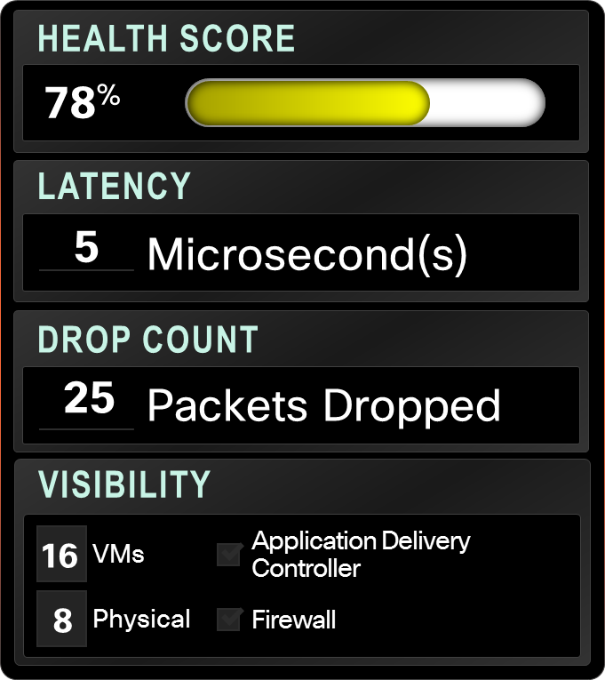
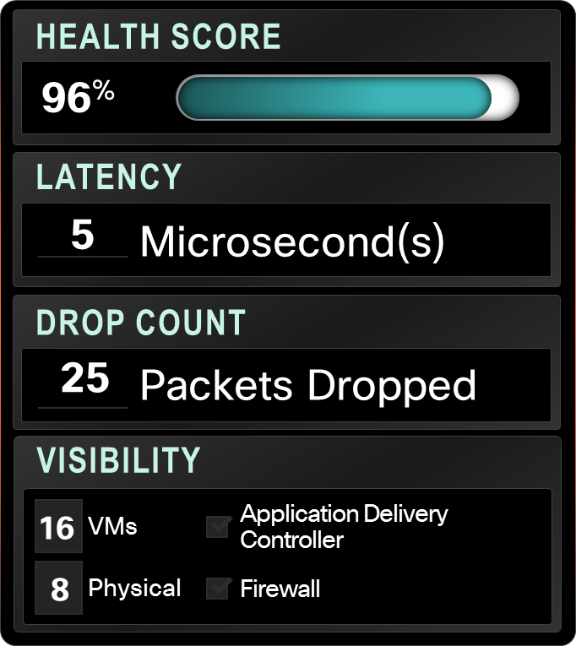






ACI Vision
Rapid deployment of applications onto DC and Cloud deployments with scale, security and full visibility
HEALTH SCORE
78%
LATENCY
5
Microsecond(s)
Tenant
Application
HEALTH SCORE
96%
DROP COUNT
25
Packets Dropped
LATENCY
5
Microsecond(s)
VISIBILITY
16
VMs
Application Delivery Controller
DROP COUNT
25
Packets Dropped
8
Physical
Firewall
Physical Networking
Hypervisors
and Virtual Networking
Compute
L4–L7
Services
Storage
Multi DC
WAN and Cloud
VISIBILITY
16
VMs
Application Delivery Controller
8
Physical
Firewall
    Enabled by physical and virtual integration

Slide 13

Cisco – Leading The Data Center Transformation
Fabric
Computing
Application
Centric Infrastructure
The Next Wave
Unified Fabric
#1 in DC Networking
#1/2 in Unified Computing
#1 IT Infrastructure
Open
Networking
People
VM-Fabric
Integration
IoE
Process
Things
Data
InterCloud
Network
Network
Compute
Storage
Access
Apps
Policy
LAN
SAN
2008
2009
2014

Slide 14
An Introduction to Application Centric Infrastructure
Notes:
Slide 37

Slide 15








What Customers Asked For
Low latency, High Transaction Processing Capabilities
40G Aggregation
Scale and Performance
Availability with
Multi-tenant scale
Secure Multi-
tenant cloud
Scalable
multi-tenancy
Future Proof Investment in
SDN, Open Solution, 10/40G
Scale 10/40/100G
Open
Policy Automation
Multi-Tenant Security
Telemetry
Investment
Protection
End-host scale for v4/v6
Solution based on
Openness, Service Agility
CTC
Physical AND Virtual
Open, Extensible
Framework,
Multi-hypervisor Support
Agility, Automation
Programmability, Telemetry, Troubleshooting
Notes:
We listed to a lot of our customers to help us define next-generation capabilities, (including many of our technology partners like NetApp and Symantec). These are across a variety of different segments from large scale providers, to enterprises and commercial customers.
BUILD
Several common patterns emerged from these requirements which are highlighted here

Slide 16

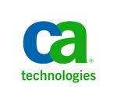









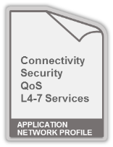







Application Centric Infrastructure Components
ACI
Ecosystem Partners
Automation
Hypervisor Management
Enterprise Monitoring
Orchestration Frameworks
Systems Management
OVM
Centralized Policy Management
Open APIs, Open Source,
Open Standards
Application
Network Profile
APIC
Nexus 9000 Fabric
Physical Networking
Hypervisors and Virtual Networking
Compute
L4–L7
Services
Storage
Multi DC
WAN and Cloud
End Points
Physical & Virtual
Nexus 7K
Nexus 2K
Integrated
WAN Edge

Slide 17
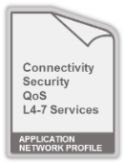

Cisco Application Centric Infrastructure:
Building on the Transformative Approach of UCS
Network
SME
Security
SME
Application SME
Physical Networking
Hypervisors
and Virtual Networking
Compute
L4–L7
Services
Storage
Multi DC
WAN and Cloud
APIC
Nexus 7K
Nexus 2K
Integrated
WAN Edge
Subject Matter Expert Define Policies
Policies Used To
Create Application Network Profile Templates
Automated policy configuration across the infrastructure
Life cycle management for day 1, day 2 operations
1
2
3
4
SYSTEMS APPROACH:
Rapid Deployment of Applications with Scale, Security and Full Visibility

Slide 18
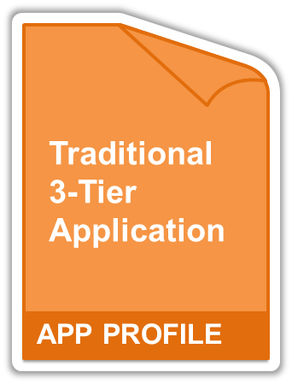




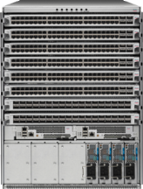
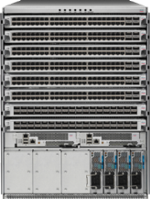




Agility: Any Application, Anywhere—Physical and virtual
WEB
app
db
f/w
ADC
ADC
Extensible Scripting Model
APIC
SLA
QoS
Security
Load
Balancing
Connectivity Policy
Security Policies
QoS
Application L4..7 Services
Storage and compute
APP PROFILE
HYPERVISOR
HYPERVISOR
HYPERVISOR

Slide 19
What ACI Brings You
1
Operationally Simple
Lowest TCO
Zero-touch provisioning
APPLICATION-
CENTRIC
POLICY MODEL
2
Performance and Scale
Health Metrics
Visibility / Telemetry
PHYSICAL + VIRTUAL
3
Open Source - APIs - Standards
Secure Multi-tenancy
3rd Party Integration
OPEN AND SECURE

Slide 20


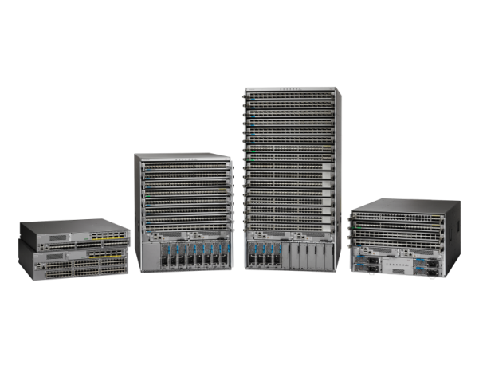
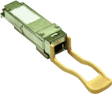
Foundational Switching Platforms for the Next Decade
Nexus 9000
1/10/40/100G
Industry Leading Price/Performance, Port Density:
Fastest 10G/40G /100G Platform with Merchant+
Programmability/ Open APIs: Linux Containers, Python, Power Shell, Puppet, Chef…
Ideal for DevOps!!
1011
0010
15% Better Power & Cooling–2.8X Better Reliability
Innovation Object Model, No Backplane, No Midplane, Health scores
Standalone / ACI Ready
$ Multi-million Savings 40/100G on Existing Cables using BiDi Optics. Non disruptive migration to 40G
Notes:
Slide 17

Slide 21
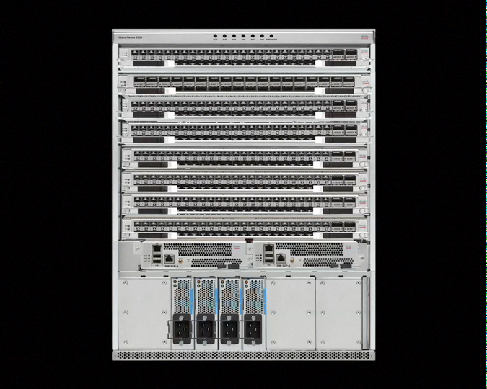
Cisco Nexus 9000 Series Benefits: Innovation
Merchant + ASIC Approach
Innovation in Cisco® ASICs
Price
Cost Structure
Power Efficiency
State of the Art
Backplane Free Design
Performance
Industry-leading price/
line card bandwidth
Port Destiny
20% Higher
Programmability
for 1 GB to 1/10GBASE-T and 10 GB to 40 GB migration 50% fewer ASICs
Non-blocking Density
JSON/XML API
Linux Container for
customer apps
1.92 Tbps per slot
100 G ready
15% greater power
and cooling efficiency
Cisco Nexus® 9000 Series
Price
Performance
Port Density
Programmability
Power Efficiency
Notes:
The Cisco Nexus 9000 Series delivers software, hardware, and system innovation.
• Merchant + ASIC approach
Using merchant plus some customization in its ASIC delivers much higher performance than competitors.
• A state-of-the-art backplane-free design optimizes airflow and reduces energy requirements.
• Industry-leading price/performance in line card bandwidth. The Cisco Nexus 9000 offers 1.92 Tbps per slot and is 100G-ready.
• Pricing cost structure: for 1G to 1/10GT
and 10G to 40G migration with 50% fewer ASICS
• It offers 15% greater power and cooling efficiency
• Port density is nonblocking and 20% higher
• It’s also programmable, with a JSON/XML API and a Linux container for customer apps

Slide 22

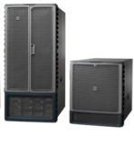
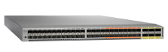
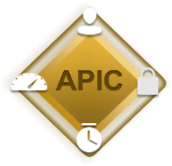

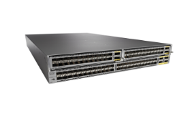
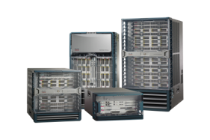

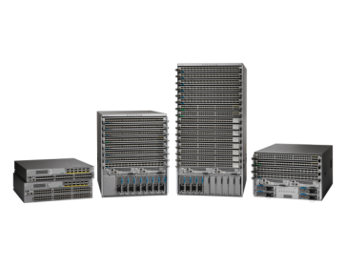



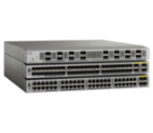
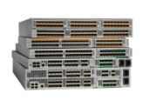

The Nexus Data Center Switching Portfolio
10G/40G/100G
Application Centric Infrastructure (ACI)
10G/40G
Virtual
Cisco
Nexus 1000V & AVS
Nexus 2300
Nexus 3100
Nexus 5600
Nexus
6000
Nexus 7000
Nexus 9000
One Operating System—NX-OS
Operational Simplicity
Architectural Flexibility
Open/ Programmable
Resilience
and Scale
Investment Protection
Notes:
The Cisco Unified Fabric Switching portfolio offers one of the broadest data center LAN and SAN switching portfolios in the industry spanning from the Hypervisor to the data center core. Cisco Unified Fabric provides the flexibility of high-performance, highly available, highly-scalable networks to serve diverse data centers needs including the lossless requirements to carry storage traffic (FC, FCoE, iSCSI, NAS) over a simplified infrastructure based on 10Gb Ethernet.
All platforms in the portfolio run on a common operating system - NX-OS. Having a single operating system across every element of the data center network, provides operational and functional consistency with tight integration across the unified fabric significantly simplifying operations and providing a foundation for accelerated innovations.
Cisco Prime Data Center Network Manager (DCNM) is the single management system for Nexus and MDS product families, delivering simplified operations and better control.

Slide 23
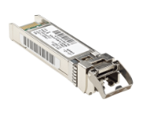
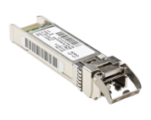


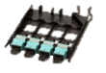
Accelerate Your Transition to 40G:
40-Gbps BiDi Optics Preserve Existing 10-Gbps Cabling
10-Gbps Optical Link
Jumper cable
Patch panel
Trunk cabling
(100m)
Patch panel
Jumper cable
+US$6259*
US$4059
Savings
(list) per
40-GBPS link
Traditional 40 Gbps Optical Link—Complete Replacement
+US$2200*
40 Gbps BiDi Optical Link—Reuse All 10 Gbps Cabling and Patch Panels
Significant Transceiver Savings
Source: Corning OM3 cable and patch panel list prices, Cisco® 40G BiDi list price, and competitor 40-Gbps SR4 list price

Slide 24



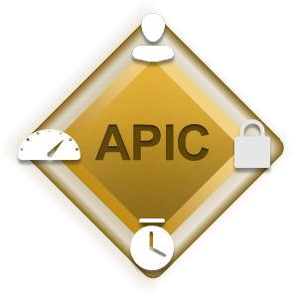

Cisco APIC: Delivering the Industry’s Best SDN Solution
Centralized Point
of Management, Automation and Policy Enforcement
CISCO
APIC APPLIANCE
  POLICY: Application Centric Network Policy
Now
Shipping!
  VISIBILITY: System-Wide Visibility, Telemetry, Health
Flexible Cluster Size – Highest Scale
Highest Resiliency (N+2)
Engineered for Performance
  OPENNESS: Open Northbound and Southbound
Integrated Overlay (Physical/Virtual)
  SECURE: Security and Performance @ Scale
  EXTENSIBLE: Hypervisors, L4-7 Services Integration/Chaining, (Compute & Storage - Future)

Slide 25

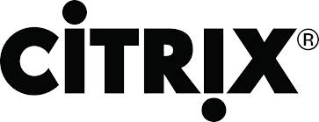




Opening ACI Policy with OpFlex
  Opflex Protocol + Ecosystem
OPEN SOURCE
Open source implementation
available to anyone
APIC
STANDARD
Upcoming OpFlex standard through IETF
OpFlex
L4-7 Device
ECOSYSTEM
Broad, growing vendor support including
hypervisor, network, and L4-7
Hypervisor
Switch
    DELIVERING INVESTMENT PROTECTION BY
    ALLOWING ANY DEVICE TO INTEGRATE WITH CISCO ACI
Notes:
(This scripted slide is part of the ACI Core “Ease” Message presentation – if seen by itself, the script might not make sense)
Lets talk about open. And specifically how we opened up the internal policy distribution of the ACI fabric to the broader eco-system.
The policy model, which is created in the APIC shown here, requires a framework to be distributed amongst all components inside a fabric. There was no existing protocol that we found suitable for this task, which is why we created Opflex together with a number of partners.
OpFlex is not specific to ACI. It is submitted to the IETF as a draft, and a number of eco-system vendors have committed support to implement it. The Opflex code is being made available to the open source community. There are several open source project where OpFlex will be implemented, namely in OpenStack as well as in OpenDaylight.
Opening up the internals of ACI is very important to us. The broader the eco-system, the better it is for customers and in the end everybody wins.
Open to us in this case means that you can decide to build an OpFlex enabled appliance that can participate in an ACI fabric yourself. You do not need to ask us for permission, you do not need us to release a specific version of OpFlex to you. It is open… you decide if, when and how you participate.
Note to presenter: The Vmware NSX way is different. You need to ask Vmware for permission, they need to give you the specific OVSDB code extensions, and you potentially have to pay them (according to their licensing agreement). That is not open. That is closed for something that happens to have the name OVSDB (Open Vswitch data base).

Slide 26










APIC Programming Interfaces
Hypervisor Management
Enterprise Monitoring
Systems
Management
Orchestration
Frameworks
Automation
Applications
NORTHBOUND PROGRAMMABILITY LAYER
OVM
Open REST APIs Support Integration With Any Software
APIC
SOUTHBOUND PROGRAMMABILITY LAYER
OpFlex: Open Fabric Attached Device API Supports Integration with Any Network Device
Notes:
(This scripted slide is part of the ACI Core “Ease” Message presentation – if seen by itself, the script might not make sense)
But not only are we open on the south side – the internals of the ACI fabric. We are also open on the north side. The side where people use the single API to interface with the entire ACI system.
That interface is a documented Open RESTful API that support JSON and XML. Any vendor can talk to it – and we fully expect that as with UCS which has the same, that most vendors will implement against this API. The API gives people full access to the data-model inside ACI and exposes everything. Nothing is hidden, everything is driven via this API.
Open to the north, open to the south.

Slide 27

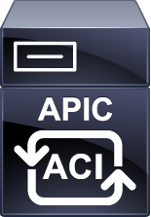
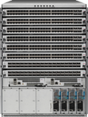




Service Automation Through Device Package Integration
Cisco ACI + F5 BIG-IP
F5 Device package
for APIC
Rapid Deployment of Applications with Scale and Security
Application-centricity to Visibility and Troubleshooting
Open Source Application Policies
Common Operational Model through Open APIs
DB
Hypervisor
DB
DB
Hypervisor
Hypervisor
WEB
WEB
WEB
APP
WEB
APP
WEB
Physical Networking
Hypervisors
and Virtual Networking
L4–L7
Services
Multi DC
WAN + Cloud
Storage
Compute
BIG-IP
Physical and/or Virtual
ACI Slide Source: Cisco
Notes:
With ACI – Big IP joint solution, we overcome the challenges we saw in the previous slide, namely inflexibility of configuring L4-L7 services and insertion
Cisco APIC directly configures L4-L7 devices via policies (via the southbound interface of APIC)

Slide 28
Service Automation Through Device Package Integration –
Cisco ACI + Citrix NetScaler
NetScaler Device Package
APIC provides extendable policy model through Device Package
APIC
APIC administrator can import NetScaler Device Package
APIC– Policy Manager
Device Package contains XML file defining Device Configuration Model
Configuration Model (XML File)
Script Engine
APIC - Script Interface
Once imported, APIC can configure NetScaler functions and parameters
Python Scripts
Device scripts translates APIC API callouts to device specific callouts
Notes:
Services are used to operating in a specific manner. We call this the “Traditional mode” of operation:
In the Traditional mode, services are inserted with VRF/VLAN stitching, WCCP redirect, Policy-based routing (PBR), etc.
Challenges
This complexity and lack of automation can make the network services more brittle.
Configuring new services for deploying a new application takes days/weeks
Removing configuration from service devices, e.g. firewall rules, when an application is retired is difficult
Auto scale out of services based on load

Slide 29


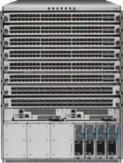

ACI Benefit: Secure Multi-tenancy at Scale
APIC
Policy
Engine
Advanced Role Based Access Control
Import / Export Policy via API
(Support for External Policy Engines)
Policy Separated from Network Forwarding
Automated Services Chaining
Encrypted Controller Communication
Complete Isolation with
Full Scalability and Security
Centralized Compliance and Auditing
Engineering
Sales
HR
Finance
Legal
Marketing
Enabling a Dynamic Enterprise Without Compromise

Slide 30



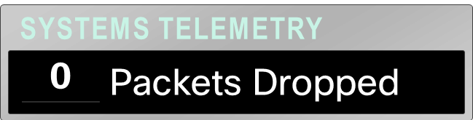

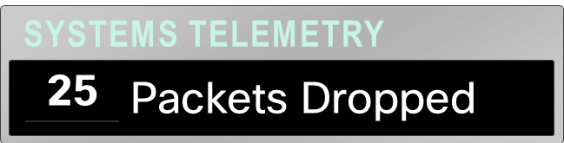
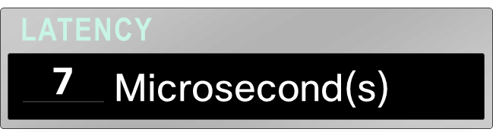
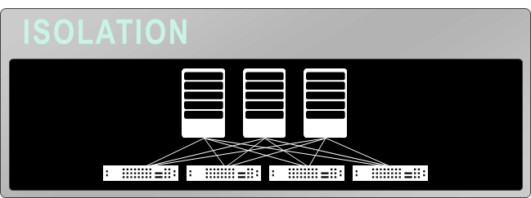
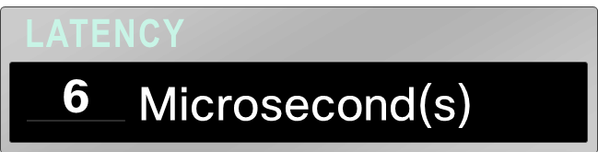
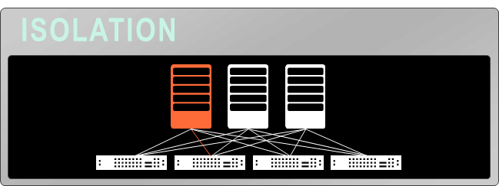
ACI Benefit: Deep Telemetry — Application and Tenant
Tenant
Tenant 1
Tenant 2
APIC
Tenant 3
Tenant 4
TENANT
APP
Notes:
One of the core design principles behind ACI was to provide complete visibility into the infrastructure – physical and virtual.
Cisco APIC is designed to provide application and tenant health at a system level by using real-time metrics, latency details, atomic counters, and detailed resource consumption statistics
If you application is experiencing performance issues, you can drill down easily into the lowest possible granularity – be it at a switch level, line card level, port level.
We have atomic counters – That essentially enable you to get consistent view of your counters anywhere within the fabric.
The holistic approach to correlate virtual and physical and tie that intelligence at an application or tenant level ensures that troubleshooting becomes extremely simple across your infrastructure, through a single pane of glass

Slide 31





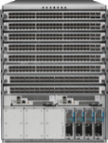




ACI Benefit: Delivering Time to Application Agility
Policy Automation
Application Policy Language
Common Policy Framework and Platform for All IT Teams
STORAGE
SECURITY
WEB
WEB
APP
APP
DB
F/W
L/B
l/b
DB
F/W
ADC
ADC
COMPUTE
NETWORK
APPLICATION
CLOUD
Service
Request
Application
Available
ARCHITECT
DESIGN
COMPUTE
STORAGE
SECURITY
NETWORK
TIME
Notes:
Collaborate in designing the policy
At the same time the SME built over decades is not lost in trouble shooting/debugging operational aspects of each layer
Non disruptive
How policy based automation framework of ACI cuts down the application deployment time
Typically we spend lots of time from service request to service availability
With ACI’s collaborative dev-ops model, we cut down a lot of the dead spaces and timelags (animation shows this)

Slide 32


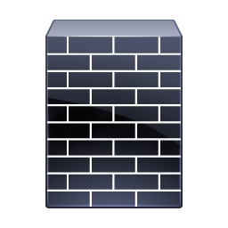


UCS Director: Orchestrating DC Infrastructure
UCS Director
Application Catalog includes compute, network and storage requirements
APIC
UCS Manager/Central
COMPUTE WITH FLASH
NETWORK
STORAGE
WEB
app
db
Storage
Storage
Web Tier
App Tier
DB Tier
Single tool to provision and manage existing Nexus fabric & ACI fabric
Automated provisioning of Network, Compute, Storage, L4-7 Services, Virtualization
Support for FlexPod, Vblock, VSPEX

Slide 33
Lowering TCO – with ACI
Process Simplification
Cost Savings
PRE-ACI
POST-ACI
PRE-ACI
POST-ACI
  41%
  Translate Setup and Policy
Cost Savings
OPEX
  Network and Policy Instantiate
  Network Operations
CAPEX
Weeks
Minutes
*Based on Cisco IT Projections
Notes:
1. We expct the calender time to provision and operate the network to shrink from weeks to minutes.
a. Again this is not just configuration of virtualized network devices. It includes the initial planning work of translating policy to network set-up, instantiaiton and testing both the physical and virtual network.
The Total Cost of Operations savings to be reduced by over 4o%.
This includes Opex categories (Network provisioning and Operations/Management) and Capex category of Hardware, power and space from traditional network to ACI.
The majority of the 41% comes from Opex (provisioning and Operations).

Slide 34
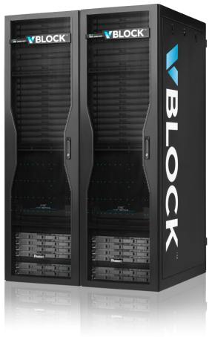
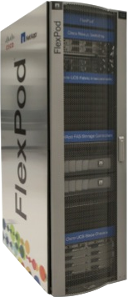


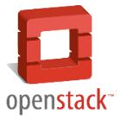
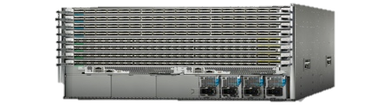




















Flexibility to Consume ACI
Standalone
Integrated Infrastructures
ACI Fabric
  Enhanced Device Level Orchestration / Programmability
  Converged
  Building Blocks
  Tight APIC
  Integration
Device Packages
ACI-READY
ACI-READY
Notes:
Extend DevOps Model - support for Existing 2-Tier/3-Tier Models
Leverage Existing Tools
Integrate with Open Source Efforts

Slide 35



Industry Backing & Growing List of Customer Wins
“Cisco continues to dominate the data center switching market."
Northland Capital Markets October 2014 CIO Survey
“Cisco continues as the clear leader as customers look to deploy SDN."
Morgan Stanley October 2014 CIO Survey
“We believe Cisco will win the SDN/White Box battle."
Equity Research October 2014
“Symantec is an early adopter of Cisco's ACI, leveraging the technology within our own Agile Data Center. Cisco ACI brings the scalability and efficiency we need while enabling us to truly bring next generation networking capabilities to our customers.”
Jon Sanchez, Director of Data Center Services, Symantec
Notes:
ADD
Driving Business outcomes

Slide 36

Key challenges customer solved with ACI
Fully-automated deployment
Infrastructure scalability
Power Efficiency (Cooling huge cost)
Mobility
Huge Capex saving
Operations Simplicity
ACI – Customer Use Case
Sungard Availability Services provides cloud computing, disaster recovery as a service and managed hosting service globally.
A multi-tenant cloud solution utilizing ACI open API (CloudStack); integrated tenant security and segmentation; ACI Fabric deployed at 7 sites.
Start to finish time: 2 weeks
Key services Sungard will deliver via ACI:
New global public cloud service
Disaster recovery as a service
SAP as a serivice

Slide 37
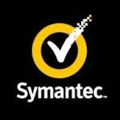
Key challenges customer solved with ACI
Infrastructure scalability & stability Shared resources / multi-tenancy
Operations Simplicity
Faster roll-out of services
ACI – Customer Use Case
Symantec is a leading security solutions provider.
New IT Datacenter with single fabric shared across tenants; blueprint for future scale-out to support ongoing DC consolidation; utilized a multi-tenant ACI Fabric deployment.
Key services Symantec will deliver via ACI:
Next generation IT data center with 50,000 hosts
First site live in September 2014; three more live by end of year

Slide 38

ACI – Customer Use Case
Acxiom Corporation is a marketing technology and services company with offices in the United States, Europe, Asia, and South America. Acxiom offers target advertising campaigns, score leads including multichannel marketing, addressable advertising, and database management.
New Scalable IT DC Infrastructure with ACI Fabric shared across tenants; Leveraging multi-tenant ACI Fabric deployment; Integration with Acxiom AOS (Audience Operating System)
Key services Acxiom will deliver via ACI:
Scalable and dynamic AOS SaaS deployment model
Multichannel marketing, advertisement campaigns with Acxiom SaaS
Seamless integration of private and public Cloud infrastructure
Workload mobility
Key challenges customer solved with ACI
  Elastic and Scalable Infrastructure
  Automation of L4-7 Services
  Multi-hypervisor support
  Capex savings
  Reuse of 10G fiber infrastructure for 40G core
  Operations Simplicity
  Energy Efficiency

Slide 39
ACI Building Principles – Openness & Security
Notes:
Slide 37

Slide 40






Open and Secure Networking is Important
OPEN SOURCE
WITH ADVANCED SECURITY
☑
Policy
☑
RBAC
OPEN STANDARDS
+
☑
Encryption
NSH
VXLAN
OpFlex
☑
Auditing
OPEN INTERFACES
☑
Tenant Isolation
JSON
XML
REST
OpFlex
Notes:
Designed for Open →
ISL (Inter Switch Link) – 802.1pq
Private VLANs -> 802 equiv std
VXLAN ->
HSRP -> VRRP
MPLS

Slide 41
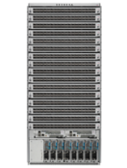

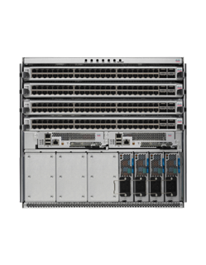
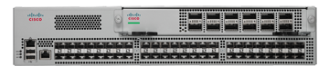

Cisco Open OS Strategy
MERCHANT OR CISCO : White Box Economics De-Risked
FLEXIBLE HW & SW: Via Cisco SDK
Open NXOS
Nexus 9000 & 3000
1G / 10G / 25G / 40G / 100G
OPEN NXOS: LINUX / Puppet / Chef / Python
SECURE: LXC Containers for 3rd Party Apps
ADAPTABLE : NX-API / Object Model / Packages & RPM

Slide 42














Open NX-OS
POAP
ONIE
NXAPI
PXE
Linux/Python Daemon
Package and Application Management
Standard Open Interfaces
Adaptable NXOS
Server Management Tools
Package and Application Management
Standard Open Interfaces
Automation and Visibility
Server Management Tools
BootStrap and Provisioning
Automation and Visibility
BootStrap and Provisioning
Adaptable NXOS
EASE OF OPERATIONS
MODULAR
OPEN
3rd PARTY APPS
PROGRAMMABLE
READY FOR DEVOPS

Slide 43

Cisco Joins Open Compute Project
October 2, 2014: Cisco signed OCP membership @ gold status
Cisco-wide membership, not just INSBU
Key focus areas of the Network Project:
  ONIE - Open Network Install Env.
  ONL - Open Network Linux
  SAI – Switch Abstraction Interface
  CPAL – Control Plane Abstraction Layer

Slide 44
A Look at What Cisco has Published to Date
NX-API
ACI API
SDK to OCP E/O CY14
ACI Toolkit
Orchestration
API’s / SDK
OpenStack Neutron
OpenStack Neutron Blueprint - Group Policy Abstractions
Security, Policy, & Visibility
Policy
OPFLEX – IETF
iVXLAN – IETF – Data Path
OVSDB Support – ODL & OVS vSwitches & pSwitches
SDK to OCP E/O CY14
Automation: Logical to Concrete
Devices / DataPath

Slide 45


















Open: Choice and Investment Protection
OPERATIONAL MODELS
APPLICATION
RICH ECOSYSTEM
Scripting/Languages
IT Automation
OpenSource
Integrated ACI Approach
Hypervisors
RESTful APIs, Python etc.
NETWORK
SECURITY
L4-L7 Services
Automate
Management
OpFlex
CLOUD
Security
Storage
Operational Choice—Service Provider, Enterprise, Commercial

Slide 46





Trends Impacting Datacenter Security
EVOLVING
THREATS
NEW APPLICATIONS (PHYSICAL, VIRTUAL
AND CLOUD)
NEW TRAFFIC TRENDS
Source: Cisco Global Cloud Index, 2012
Notes:
Lets start by looking at the major trends that is shaping datacenter security
First we are seeing attacks that are getting increasing sophisticated.. With the move to cloud and multiple tenants, the attack surface are increasing. Many of these attacks have no known signatures. Visibility is increasing important to combat new wave of attacks.
Virtualization causes new security challenges in the datacenter. As VMs are moved across datacenter, the security policies need to move with the VMs/workloads. New big data applications that are not virtualized also need to be secured across datacenter.
These applications are changing traffic patterns from north-south to east-west. Existing perimeter centric security architecture is optimized for north-south datacenter traffic.

Slide 47
Key Datacenter Security Requirements
COMPLIANCE
RISK MITIGATION
AUTOMATION
How do I maintain compliance
in the cloud and mobile era?
How do I pro-actively detect
and mitigate new attacks?
How can I simplify
management across my IT?
Notes:
These trends we discussed are driving datacenter security requirements.
First and foremost, organizations are required to continue to comply with regulations such as PCI, HIPAA as they adopt cloud and virtualization.
Second, organizations need to ensure that they have adequate safeguards, processes and people in place to mitigate new advanced security attacks in virtualization and cloud environments.
Last but not least, manual device-centric approach to managing security is proving to be not only error-prone but also in-secure. According to Gartner, 95% of security breaches in firewall is due to mis-configurations. Organizations are looking to automate security across their heterogeneous infrastructure and reduce complexity.

Slide 48


The Right Security Architecture For Nextgen Data Center
PERIMETER CENTRIC
Manual and Complex
Static Topology
Error-Prone
Limited Places
VIRTUALIZATION
CENTRIC
No Physical Support
Management Complexity
Limited Visibility
VM
VM
VM
APPLICATION CENTRIC
Any workload and any place
Automated
Full Visibility
Notes:
It is important to choose the right security architecture to address the organization requirements.
Current datacenter security model has been largely perimeter centric. It is often compared to M&M– hard on outside and soft inside. Perimeters create trust boundaries between external and internal networks. One of the issues with perimeter centric model is that it is complex to configure as security service needs to be “inserted” in the application flow at select points in the network that can become choke points. It is not uncommon for customers to have million ACLs configured in the firewall. Often, these ACLs arent de-commissioned as applications are removed because of un-certainity of potential impact upon removal. Also, the (re)configuration of these ACLs needs to be done manually as applications are moved around in the datacenter. While we still need perimeter security devices, relying solely on perimeter centric model has several issues in the new world of cloud, application mobility and east-west traffic.
An alternate approach proposed for datacenter security architecture is virtualization centric architecture. In this architecture, security is enforced in the virtualized host software layer (in the hypervisor). Given a datacenter can have over 70% of bare metal servers running non-virtualized workloads including new big data applications, non-x86 mainframe applications etc – this architecture doesn’t fully address the security needs of datacenter for all workloads. It also results in increased management complexity due the need to manage policies in physical and virtual network separately. It offers limited visibility only at the virtual network layer.
A new approach to datacenter security architecture is to focus on the applications that need to be protected and automate enforcement of security policies anywhere in the datacenter (both in fabric and endpoints) across the entire application lifecycle. This approach offers a consistent way to secure physical and virtual applications anywhere in the datacenter while automating policy and ensuring compliance. It also leverages deep visibility provided by the rich set of telemetry data from the network fabric which helps in accelerating threat detection and response.

Slide 49

Application Centric Policy Model For Security
WEB
app
CRM
APP
db
Contract
Contract
f/w
ADC
ADC
OUTSIDE
WHAT COMPONENTS BRING SECURITY TO AN APPLICATION POLICY?
Endpoint Group:
A set of endpoints (VMs/servers) with
the same policy
Contracts:
A set of rules governing communication between endpoint groups
Service Chains:
A set of network services between endpoint groups
Notes:
At the heart of application centric approach is the policy abstraction model. A key abstraction in the application centric policy model is the concept of End Point Groups (EPG) and Policy Contracts.
To understand this better, lets put this in the context of a 3 tier application with web, app and database tier.
An End Point Group (EPG) is a collection of end-points that have common policies. In our scenario of the 3 tier app, we have each tier of the application defined as particular EPG (Web EPG, App EPG, and DB EPG). EPGs enable policies to be de-coupled from the underlying physical or logical topology (e.g., network interfaces, IP subnets).
Contracts are policy rules that specify how communication occurs between EPGs and any advanced L4-7 services required (specified as “service chains”). While EPGs provide the security segmentation within a tenant of Cisco’s ACI multi-tenant environment, contracts can be seen as ACI’s “security constructs” as they can have multiple subjects, each of these with particular filters and associated actions plus optional labels to it.
In the case of our simple 3 tier app, we have contracts that state that any traffic from outside must go through network firewall and ADC (for e.g., with web app firewall) before the traffic is allowed to web tier. Same way, we can have a contract that states that only connections from web tier are allowed to app tier and the traffic must pass through a ADC..

Slide 50

ACI Policy Model For Physical And Virtual Workloads
DATA CENTER MICRO-SEGMENTATION IN ACI USING EPG AND CONTRACTS
ACI micro-segmentation provides security for east/west traffic
Supports physical and virtual workloads
Automated on white-list application centric policy model
L4-7 Security Device Integration and Policy Automation
Enables visibility and troubleshooting
Virtual
Virtual
Physical
Notes:
Data center micro-segmentation can provide enhanced security for intra-data-center east-west traffic. To holistically address the needs of datacenter, micro-segmentation must support both physical and virtual workloads, automated based on white list application centric policy model, interoperate seamlessly with bare metal servers, multiple hypervisors, L4-7 security services and support tight integration between logical and physical network for provisioning and troubleshooting

Slide 51

Security Strategic Imperatives With ACI
COMPLIANCE-DRIVEN
THREAT-FOCUSED
PLATFORM-BASED
Policy based Compliance,
Integrated Deep Visibility
ACI Group Policies,
Isolation and Segmentation
Open Security Framework,
L4-7 Automation
Endpoint
Network
Virtual
Cloud
Notes:
To effectively address security requirements that we outline earlier (i.e., compliance, risk mitigation and automation), we have identified 3 key strategic imperatives for security across our products including ACI.
These are:
Compliance-driven: Compliance driven ensures that security capabilities we are offering in ACI addresses datacenter network security requirements needed to comply with industry regulations such as PCI. It is important to not think of compliance as a just a point to time concept. Organizations need to continuously assess whether they are in compliance. We are enabling this in ACI by providing deep visibility in the fabric required for continuously verifying and assessing compliance.
2. Threat-focused: It is important to focus security measures on specific threats in the context of a particular application. For e.g., a web application needs to be protected from targeted attacks such as malformed input parameter, SQL command injection etc. Isolation and segmentation of tenants and applications in cloud environment is important to protect from new threats (attacks on a tenant by another, attacks on a infrastructure by a tenant) in multi-tenant cloud environments.
3. Platform-based: Platform based approach enables our customers to integrate their existing security investments and unifies management as opposed to having to deal with multiple fragmented management silos. It enables security teams to focus on automating policy across multiple devices and services as opposed to a device centric fragmented approach
ACI addresses all these security imperatives across endpoints, network, virtual, physical and cloud. We will look into more detail on how ACI addresses these strategic security imperatives.

Slide 52
Opflex: An Open Protocol Enabling Better Security
OPEN TO ANY SECURITY DEVICE VENDOR
OPEN POLICY MODEL
(IETF RFC*)
OPEN SOURCE
(POLICY END POINT)
NG Firewall, IDS/IPS,
Web App Firewall, etc.
Better Security
Through Collaboration
Open source protocol implementation that can be used by any policy end point for security
vSwitch
Switch
Firewall
* http://tools.ietf.org/html/draft-smith-opflex-00

Slide 53






ACI Offers Open Security Framework
And Broad Security Ecosystem
Broad Ecosystem enables Choice,
Investment Protection and supports Defense in Depth Security Strategy
SECURITY APPLICATIONS
(Compliance, SIEM, Security Analytics etc.)
Open REST APIs
APIC
Open Standard
OPFLEX
Open Device
Interface
END-TO-END LAYERED SECURITY ENFORCEMENT
ACI
Fabric
Firewall
IDS / IPS
DDoS
Host
Notes:
ACI is a platform that offers open APIs and integrations with broad eco-system of partners to automate security policy enforcement and enable rich suite
of security applications. This enables customer choice, investment protection and defense in depth security strategy using best of breed security technologies.
ACI offers open REST based APIs that can be used by applications such as Splunk, SIEM to provide security intelligence based on real-time network traffic data and detect attacks
ACI offers device package interfaces and OPFLEX (open standard submitted to IETF and endorsed by multiple vendors such as MSFT, RHAT, F5, Citrix) to enforce policies across various devices.
NOTE:
Cisco offers ASA 55xx firewalls and ASAv virtual firewall appliances integration with ACI at FCS
F5 offers SSL off-load (certs needs to be updated outside of APIC)

Slide 54


ACI Addresses Data Center Security Requirements
VM
VM
VM
VM
VM
Security Expressed in Application Language
L4-7 Service Automation, Open Eco-System
Simplified Policy-based Segmentation
Visibility, Analytics, Forensics
Automate Compliance, Centralized Audit
Centralized Security Across Physical and Virtual
Notes:
To summarize, ACI offers:
1.Security policies defined in the language of Applications
a.Policies are in terms of EPGs and Contracts a language natural to application owners and not in terms of IP and MAC addresses
b.Natural language of expression for the Application owners
2. Simplified Policy based Segmentation
a. Segmentation is enforced via EPGs and contracts that map to a specific application tier rather than having to deal with millions of ACLs that are kept as organizations aren’t sure of the impact of removing them
3.Built in Security Life Cycle Management
a.Security Policies tied to application life cycle – Application mobility or VM mobility non issue. Policies track the VMs as they move. APIC automatically cleanup up policies when application is decommissioned.
b.Automated Security (virtual/physical) Appliance Service Chaining. Example:
-Firewalls, Web App Firewalls, Intrusion Prevention/Detection, Forensics/Logging, Data Leak Detect/Prevent Appliances, etc
c. Open eco-system enables choice, investment protection and defense in depth strategy
4.Superior Security Visibility
a.Policy counters and logging support in hardware
b.Atomic counters for reactive forensics
c. Accelerate detection of attacks early in the life cycle
5.Automate Policy Compliance and Audit: near Real Time Risk Assessment
a. via APIs compliance software can detect missing policies, policies that are violated etc.

Slide 55
Getting Ready for the Intercloud
Cisco Confidential
Notes:
Slide 25

Slide 56
Cloud Promises A Variety of Business Benefits
Source: 2013 IDC Services Group Survey: U.S. Professional Services Opportunities Related to Cloud Services, Doc #239862, March 2013, 2013 Cloud Professional Services Survey, N = 421, IDC
Notes:
Once again, the top business case for cloud services remains about lowering IT costs, yet slightly fewer respondents indicated this compared with last year’s survey.
However, for 2013, the response “Better and faster access to data and information” gained on the top response yet stayed in second place and indicating again support for the argument that the move to cloud services is about more than cost takeout.
Operational savings (beyond IT) rounded out the top three most popular responses, with essential the same score as last year.
Four responses showed an increased percentage of responses compared with last year: “Increased flexibility in app. Dev,” “Standardization/automation of processes/systems,” “Increased sales/revenue,” and “Improved application testing”. The rest showed slightly fewer responses. For both slight increases and decreases, both business and IT factors were included.

Slide 57
To Deliver The Benefits of Cloud, IT Is Increasingly Acting As A Broker Of Services
IT Planning will Increasingly…
…take place with direct involvement of third-party vendors^{[1]}
…involve
stakeholders from LOBs^{[1]}
Business-IT Value Creation:^{[1]}
IT leaders will need to reimagine what it means
to partner with the business and share in value creation; this extends to funding mechanisms, budgeting, metrics, planning, governance models, and all aspects of how IT is managed
76%
IT will act as a “broker” of cloud services across internal and external clouds for LOBs^{[1]}
By 2016, 80% of the IT budget will be based on providing a broad portfolio of IT and business services. ^{[2]}
[1] Cisco-Intel Customer Study
[2] IDC Worldwide CIO Agenda 2014 Top 10 Predictions, doc #244647, December 2013
Notes:
The primary market research studies we conducted earlier this year further substantiate the increasing role that LOB managers have on IT organizations. This is driving some of the dynamics we just discussed.
LOBs now have a greater ability to access IT solutions outside of the traditional enterprise IT value chain, creating “shadow IT” initiatives. And how can IT respond? IT is increasingly transitioning towards an IT service broker role, taking advantage of multiple sourcing options to become an intermediary of cloud services offered to line-of-business consumers. To add value, IT leaders must adapt, especially in the areas of collaboration, innovation, and value creation - Source: ‘Impact of Cloud on IT Consumption Models’ Cisco study in partnership with INTEL, Aug 2013
76% of respondents believe IT will act as a “broker,” or intermediary, of cloud services, orchestrating the planning and procurement process for LOBs across internal/external clouds – Source: ‘Impact of Cloud on IT Consumption Models’ Cisco study in partnership with INTEL, Aug 2013
Cisco sees IT organizations transitioning to new roles as trusted brokers of IT services—and therefore brokers of Cloud Services. This model enables IT to add value to one or more public or private cloud services on behalf of its users. IT does this by dynamically aggregating, integrating, and customizing the delivery of cloud services to best meet the needs of the business.
Becoming brokers of IT services is one way for IT organizations to retain control, increase transparency of public cloud service usage and become more relevant all at the same time. This “strategic flexibility” enables greater levels of agility, transparency, and speed of deployment to unlock innovation and help LOB leaders achieve strategic business objectives.

Slide 58
Optimizing Build vs Buy Decisions
KEY DECISION CRITERIA
Value Add
Cost
Time to Deploy
Risk Profile
Experience
BUILD Attributes
BUY Attributes
Core to business differentiation
Mission critical/operational advantage in cost/risk/scale/speed
User experience: customer
Core value prop of vendor
Many deployments on a global scale
User experience: employee
Core to business differentiation
Mission critical/operational advantage in cost/risk/scale/speed
User experience: customer
Core value prop of vendor
Many deployments on a global scale
User experience: employee
Notes:
In other words, when formulating their sourcing strategies, IT organizations repeatedly face service-by-service, “build-versus-buy” decisions. What does that entail?
You can see on the slide an example of what that would mean. IT needs a plan. Needs a set of governance principles or criteria that allow the evaluation of the service based on its strategic profile to the business, cost, time to market, risk and the experience the IT department intrinsically has when building or buying that particular service.
Is the service core to the business? What are the key KPIs in terms to time to market, value, sustainable differentiation etc..
To solve the “build versus buy” equation when sourcing their IT services, IT needs to evaluate cost, risk, and agility requirements to determine the right sourcing strategy.
This “strategic flexibility” enables greater levels of agility, transparency, and speed of deployment to unlock innovation and help LOB leaders achieve strategic business objectives.
You can see how with a set of a criteria, with a plan with a collaborative approach between business and IT the relevance of the IT organization is not questioned.
But the story doesn’t end here.

Slide 59
Driving A Transition From Private To Hybrid Clouds
Cloud
Infrastructure
Cloud Options
Enterprise and
Commercial
Private
Hybrid
(Control)
Public
(Low Cost)
SaaS
Service
Provider
Hosted/
Managed
Partner Clouds
(High Value)
Notes:
Gold Deck Script:
We believe that cloud will enable you to capitalize on changes and transform them into business opportunities. We’ve been growing our cloud capabilities for several years – organically and through acquisitions-to serve both businesses and providers.
We have a proven track record of building and acquiring expertise, like Cloupia (now UCS Director), to deliver the cloud capabilities that the market demands and allowed us, along with our partners, to build the private cloud practices that we have today.
We’re #1 in Cloud Infrastructure (Synergy). We’re also the #1 Player in Private Cloud strategy (Forrester). It’s a validation of our vision and ongoing commitment to be your strategic partner on your journey to the cloud
In the SaaS space, some of the key acquisitions we’ve made include WebEx (one of the largest SaaS businesses in the market, growing at 20% YoY last quarter), Meraki (which doubled its customer base in 1 quarter), and Cloud Web Security (ScanSafe).
And with our Provider Partners, we’ve built a sizeable infrastructure business in cloud service provisioning. We have 62 Hosted Collaboration Providers in the market today with 3 million HCS seats available and 61 Partners offering IaaS. (CLICK)
But this is just the start. This second phase is being driven by hybrid clouds, for which we’re #1 in Hybrid Cloud infrastructure (Synergy).
Business customers want a hybrid cloud model today that gives them control over workload migration and security. Our Intercloud Fabric software products offer that control, flexibility, security, and agility in the hybrid cloud. We’re the “Major Player” in professional services (IDC) for technical insights, strategic planning for building clouds.
More customers are looking inside and outside the business to take advantage of large scale public cloud offers for their workloads. So we’re expanding our partner cloud ecosystem to provide differentiated high-value offerings to our customers.
Original Script:
Cisco’s cloud evolution is rapidly moving into the second phase of implementation to reflect the pace of change in the market.
Cisco has been building cloud capabilities for several years. We have a proven track record of building and acquiring expertise, like Cloupia (now UCS Director) , so that we can deliver the cloud capabilities that the market demands. That allowed us, along with our Partners to build the practices that we have today in the Private Cloud.
Our commitment to Cloud has been rewarded with multiple Industry accolades. We’re #1 in Cloud Infrastructure (by Synergy). We’re also the #1 Player in Private Cloud strategy (by Forrester). This serves as an independent validation of Cisco as a strategic partner for Cloud, offering a platform and a place to start that gives us an incredible conversation to have with customers.
SaaS. Some of the key acquisitions we’ve made are: WebEx one of the largest SaaS businesses in the market, growing at 20% YoY last quarter, Meraki, which doubled its customer base in one quarter and Cisco Cloud Web Security (the ScanSafe acquisition).
With our Provider Partners, we’ve built a sizeable infrastructure business in cloud service provisioning. We have 62 Hosted Collaboration Providers in the market today with 3 million HCS seats available and we have 61 Partners offering IaaS.
(CLICK)
We’re #1 in Hybrid Cloud infrastructure (by Synergy). Enterprise customers want to deliver a Hybrid Cloud model today that gives them control over workload mobility and security. Our Intercloud Fabric^{T} solution offers that Hybrid Cloud flexibility and agility to move at cloud speed. We’re also the “Major Player” in professional services (by IDC) providing technical insights for building clouds.
Customers also want to combine delivery models that are available and take advantage of the large scale public cloud offers that might be appropriate for commodity workloads.
This year, we’ve been building the groundwork for our second phase by introducing a host of new Partner cloud services to bring about the value-based workloads we believe our Partners can deliver from their versions of Public Cloud.
(CLICK)
The vision that we are kicking off is connecting all these clouds together through technology and innovation. This distributed cloud architecture will embrace the collaborative portfolio we deliver today with HCS and WebEx and its future extensions. It’s going to require a huge amount of mobility, as we connect interactions between machine-to-machine, machine-to-people and people-to-people.
The Cisco Cloud in conjunction with our partner ecosystem will serve as the #1 platform for building the Internet of Everything and will contribute to building the Intercloud.
This is something that we believe we can only achieve together with our Partners.

Slide 60







Navigating A World Of Many Clouds Where Management and Visibility Become Challenging
365
5-10X
VISIBILITY
Cloud services typically purchased without IT involvement (Cisco)
Enterprise
Private
Clouds
Enterprise
Private
Clouds
90%
COST
Percentage of IT expenditures spent outside of IT budget by 2020 (Gartner) ^{[1]}
Enterprise
Private
Clouds
50%
RISK
Global 1000 companies that will have customer data stored in the public cloud by 2016 (Gartner) ^{[2]}
[1] Gartner Press Release
[2] Gartner Press Release

Slide 61










Cisco Has Seen This Before and We See Intercloud As The Next Phase In This Evolution
Internet
Intercloud
Islands of Isolated PC LAN Networks (1990s)
The Internet
World of Isolated Clouds (2000s)
The Intercloud
Intercloud
Multiple LANs using
multitude of protocols
Connected using Industry
Standard IP protocol
Each Cloud is custom
built with no consistent APIs
Connected for application
acceleration with Open APIs
The Internet
The Intercloud
IP Based | Open Standards
Web-scale Architecture | API Driven Automation | Open, Secure, Hybrid
Notes:
We know how to fix this
We’re going to do for cloud what we did for data. You couldn’t move data between the networks – they weren’t connected. Cisco unified those worlds
The world of cloud today is a world of isolated clouds. There’s no workload or data portability.
“Amazon is hotel California – you can never leave, and that data is staying there”
Our vision is to connect all these clouds together into the Intercloud - whether private, public , or hybrid through technology and innovation
Intercloud is going to connect these clouds together in the same way we connected data together.
No one cloud model or single cloud approach, such as the massively scalable clouds from Amazon, Google or Microsoft will win alone in this space

Slide 62
Through Our Work With Thousands Of Clients Globally, We Know Success Requires…
Visibility
Gaining visibility to the cloud services your organization is using today
Optimizing environments (private/hybrid/public/hosted) and geographies for workload deployment to manage cost, availability,
and data sovereignty
Cloud Sourcing Strategy
Ensuring your private clouds are hybrid-cloud ready: providing workload portability and management to optimize usage and cost through open standards and application-centric infrastructure; and software tools to integrate data, apps and processes.
Hybrid-Cloud Readiness
As-a-Service Options
Leveraging “as a service” options to free up capex and
focus on your core business processes
Security
Deploying dynamic, cost-effective security solutions to enable
changing business models while protecting business reputation

Slide 63





Cisco Intercloud Fabric Provides Workload Portability Across Clouds
No Vendor Lock-In
Expanding Cloud Provider Ecosystem
Any Hypervisor to Any Provider
Heterogeneous Infrastructure
Customer
Open
Choice
Cisco
Intercloud Fabric
End-to-End Security
…
Unified Workload Management and Governance
Workload Mobility Across Clouds
Notes:
Ovale software …. Look at Rob’s Slide (homogeneous .. Etc..)
Deepu slides – more providers etc… add other service providers

Slide 64






Cisco’s Cloud Enablement Platform Provides Control and Management
INTELLIGENT AUTOMATION FOR CLOUD Private Cloud, PaaS (DevOps), Hybrid Cloud
UCS DIRECTOR Centralized infrastructure control point for data center
UCS CENTRAL
APIC
UCS MANAGER
Manages heterogeneous data centers and converged infrastructure
Manages multiple UCS Domains
Manages ACI Fabric
Controller for
network automation
Manages Single
UCS and Invicta domain
Notes:
Management tools and products are what will simplify the definition and deployment of these policies while providing automation, management and control. Cisco has a number of management tools available that are closer to the infrastructure or at level where infrastructure begins to come together. For instance, UCS Manager, discussed earlier in the presentation, brings together networking, computing and storage managers in the configuring UCS and UCS Invicta. Network managers will be able to leverage the APIC for policy configuration of the network elements. For IT groups that want to bring all of these components under one pane of glass, UCS Director provides the automation of the entire IT infrastructure through APIs into UCS Manager and the APIC. For many IT groups, this is the limit of what they might need to do. For customers who want to take the next step into a building and delivering cloud services, Intelligent Automation for Cloud delivers the portal, service catalogue and orchestration elements for delivery of cloud services.

Slide 65



ACI Vision Will Drive Consistent Policy Across All Cloud Deployment Models
Private
Managed
Hosted
Public
Workload portability with choice, consistency, control and compliance

Slide 66



And Delivers Tangible Benefits For Business Applications
Without ACI
With ACI
New Application
New Application
Simpler
App
requirements
IT administrators
IT admins work in silos.
IT admins work at
the application level.
Faster
Days
Hours
There is no shared
architectural model.
Shared model for
policy automation.
Efficient

Slide 67


Cisco & Partners: Building The Intercloud With The Cloud Services You Use Today
Native Cloud
Applications
Big Data
and Analytics
Enterprise
Workloads
Collaboration
and Video
Enterprise
Private
Clouds
WebEx
Portal
Meraki
HCS
Security
Intercloud
IaaS
Partner Clouds
Cloud Services and Applications
Analytics
Intercloud Fabric
PaaS
HANA aaS
APIs
APIs
Microsoft
Suite aaS
Public
Clouds
OpenStack
vDesktop aaS
APIs
DRaaS
IOE aaS

Slide 68

Only Cisco Can Deliver The Flexibility, Connectedness & Control For Success In The Intercloud
Security, Data Sovereignty
& Choice
Application
Centric
Infrastructure
Expansive
Ecosystem
Intercloud
Cloud-focused
Network
Services
Cisco SaaS
Applications
and Leading
ISVs
Intercloud
Fabric
Notes:
We are implementing our strategy by enabling businesses and service providers to build hybrid-ready private clouds, by offering ready-to-consume public cloud services, and by combining public and private clouds through the Cisco® Intercloud suite of solutions. We intend to provide you with increased business agility, innovation, and efficiency while reducing TCO and risk.
Our cloud offerings are being delivered with a distributed network and security architecture designed for high-value application workloads, real-time analytics, and excellent scalability. We will capitalize on our partner-centric approach with deep and broad partner relationships to deliver differentiated cloud services. Cisco is focused on the industry-unique combination and integration of the following key areas that will drive differentiation for our cloud offerings:
Choice of consumption models: Choose how to deploy cloud capabilities based on your own applications, SLAs, security needs, and business objectives. You can build your own cloud, buy software as a service (SaaS), or select partner-hosted services from cloud providers, or take a hybrid IT approach and fuse on-premises and cloud resources. The Cisco Cloud portfolio and our extensive partner ecosystem are designed to increase your choices and support flexible cloud services sourcing strategies.
Intercloud infrastructure: Successful clouds should rest on a modular, scalable, and fabric-based common platform for physical, virtual, and cloud services. A common platform simplifies operations and management capabilities. Open and secure Intercloud workload migration is also an important requirement. Cisco Integrated Infrastructure brings together best-in-class data center technologies to simplify and accelerate deployment of cloud services. Additionally, our policy-based unified platform—which includes Cisco Open Network Environment (ONE), service management and orchestration, provisioning, and element management—enables organizations to offer an application-centric platform for the development of cloud services.
Intercloud applications: Demands from users and the benefits of the cloud are changing the way IT deploys applications. Businesses want the ability to enjoy the best of on-premises solutions and the best of the cloud. Cisco enables customers to use the best solutions, and extend them to all. Connect and collaborate your way—across multiple applications and platforms, using any consumption or deployment model, with confidence and without compromise. Cisco brings together clouds and fuses cloud-based applications with on-premises applications, making them manageable and secure. This is all about putting the power of the world of many clouds to work for you with industry-leading cloud-based collaboration, network management, and web security solutions.
Interoperability and open standards: An open, standards-based approach to cloud gives you the opportunity to build on a robust ecosystem of industry-leading technologies and avoid being locked into a single vendor or platform. Through participation in OpenStack—a community-led open source project backed by thousands of community members and hundreds of strategic technology partners—Cisco enables a cloud platform that helps enterprises transform their data centers.
Security: You require end-to-end security and you may have extensive compliance requirements across your cloud deployments—public, private, and hybrid. We can help you plan your cloud journey, identify “shadow” cloud deployments, reduce exposure to security risks, and securely extend your IT services across multiple clouds.
Intercloud Applications - We are a top Software as a Service (SaaS) vendor, and have been since 2007.
Intercloud Infrastructure - We are the overall leader in the Cloud Infrastructure Equipment Market.
Intercloud Infrastructure - We enable open and highly-secure migration of cloud workloads across heterogeneous environments.
Intercloud Infrastructure - We offer a unique application-centric, scalable, policy-based infrastructure strategy and portfolio to support cloud workloads.
Security - We have a market-leading security portfolio for cloud.
Open Standards and Interoperability - We are committed to Open Standards and Interoperability.
Open Standards and Interoperability - We apply our decades of experience and successful track record of connecting heterogeneous systems to the Intercloud — a connected cloud of clouds.
Choice of consumption Models – Unlike other vendors we support quite well a range of private/hybrid/public cloud deployments and a partner ecosystem along with them

Slide 69

Cisco Is Top Ranked For Cloud Strategy In Forrester Wave ™
The Forrester Wave™: Private Cloud Solutions, Q4 2013
1
Evaluated private cloud management software
    Cisco Intelligent Automation for Cloud (IAC) for cloud management
    Cisco UCS Director for infrastructure management
Strong roadmap, strategic vision, partnerships
    Received highest score in strategy
    Top 3 for strong current offering*
One of two vendors with:
    Breadth and depth of functionality, and admin control
    Intuitive, straightforward, and powerful user interface
    Low price entry-point supports range of needs
2
3
Source: The Forrester Wave™: Private Cloud Solutions, Q4 2013, November 25, 2013
  The Forrester Wave™ is copyrighted by Forrester Research, Inc. Forrester and Forrester Wave™ are trademarks of Forrester Research, Inc. The Forrester Wave™ is a graphical representation of Forrester's call on a market and is plotted using a detailed spreadsheet with exposed scores, weightings, and comments. Forrester does not endorse any vendor, product, or service depicted in the Forrester Wave. Information is based on best available resources. Opinions reflect judgment at the time and are subject to change.
* Note: Evaluation based on software shipping as of April 2013. New software versions have significant enhancements in functionality.
Notes:
This Forrester evaluation was based on 62 different in-depth criteria, and included more than 100 customer interviews.
Forrester evaluated 10 leading commercial software solutions for private cloud (does not include hardware infrastructure or embedded software).
Cisco was clearly the leader for strategy: “… it is Cisco's strong road map and strategic vision that earns it top marks for strategy”
Cisco tied for #3 (with BMC) in current offering, just behind HP and Microsoft. The report evaluated Cisco IAC version 3.1.1 and Cisco UCS Director version 3.4.1. New versions of both products make our current offering stronger than the versions evaluated a couple of quarters ago.
Cisco was ranked significantly higher than IBM, VMware, CA, Citrix, and others.

Slide 70
Evolve Existing Network Investment to be Application Centric
Cisco Confidential
Notes:
Slide 25

Slide 71









Enterprise/Commercial Phase 1:
Add Nexus 9000 to Existing Nexus 2000-7000 Fabric
Deploy standalone Nexus 9000 into existing Nexus fabric to add network capacity.
Existing
Nexus 2K-7K Fabric
What You Need:
40G BiDi Optics
Nexus 9000 Switches & Bundles
Nexus 9000
N1Kv

Slide 72
Enterprise/Commercial Phase 2:
Add ACI Starter Kit
Deploy ACI Fabric in parallel with existing Nexus fabric. Connect via L2/L3.
Existing
Nexus 2K-7K Fabric
ACI
Fabric
What You Need:
APIC
ACI Starter Kits
APIC
40G BiDi Optics
L2 or L3 Connection
Nexus 9000 Bundles & ACI S/W License
APIC
Nexus 9000
N1Kv

Slide 73

Enterprise/Commercial Phase 3:
Extending ACI Policy to Servers on Existing Fabric
Deploy/upgrade AVS & Remote Leaf N9300 in existing Nexus fabric.
  Extend ACI Policy model over existing Nexus fabric, allowing apps on existing Nexus fabric to realize benefits of ACI.
Existing
Nexus 2K-7K Fabric
ACI
Fabric
What You Need:
APIC
L2 or L3 Connection
Additional Nexus 9000, APICs, optics, leaf licenses
PROFILE
APIC
*Nexus
9300
Nexus
9000
ACI POLICY
AVS
AVS
*Remote Leaf s/w 2H CY15

Slide 74




Cloud Provider Phase 1:
Add Nexus 9000 to Existing Nexus 2000-7000 Fabric
Deploy standalone Nexus 9000 into existing Nexus fabric to add network capacity.
Leverage existing APIs, cloud orchestration/automation tools
Existing
Nexus 2K-7K Fabric
What You Need:
40G BiDi Optics
Nexus 9000 Switches & Bundles
Pack
Nexus 9000
N1Kv

Slide 75

Cloud Provider Scenario 2:
Add New Nexus 9000 Standalone VXLAN-based POD
Deploy New Nexus 9000 VXLAN-based Pod for Workload Mobility and Multi-Tenancy,
leveraging common Automation Tools/APIs
Map Tenants into L3 VRFs or L2 VXLAN Segments
Existing
Nexus 2K-7K
Fabric
What You Need:
New Nexus 9000 VXLAN Fabric
Pack
Nexus 9000 Switches, Bundles & Enterprise Services Package
40G BiDi Optics
N9K-based standalone VXLAN Multi-Tenant Fabric
Nexus 9000
N1Kv
N1Kv
N1Kv

Slide 76
Cloud Provider Scenario 3:
Migrate or add new ACI POD
Deploy New ACI POD for complete policy-based infrastructure automation
Leverage existing Orchestration/Automation tools
Map Tenants into L2 or L3 Outside EPGs
Existing
Nexus 2K-7K
Fabric
New ACI Fabric
What You Need:
Pack
ACI Starter Kits
APIC
40G BiDi Optics
Nexus 9000 Bundles & ACI S/W License
APIC
Nexus 9000
Policy-driven ACI Fabric
N1Kv
AVS
AVS

Slide 77
Use Cases Summary
What To Look For
Benefits We Bring In
How We Enable Transition
High density, non-blocking 10G ports
ToR bundle
N9300 ToR and F3 40G N7K module bundle
ACI Starter Kit POD
ACI Starter Kits
Expanding capacity
Enterprise/
Commercial
Introducing ACI PODs
Agility and IT automation
Extending ACI policy over existing fabric
Investment protection, automation and agility
Scalable multi-tenancy, agility and automation
Programmatic APIs, open standards, IT automation. Deployment flexibility
Cloud Providers

Slide 78
Taking the Next Step
Cisco Confidential
Notes:
Slide 25

Slide 79














Nexus 9000—One Product, Different Applications
Common Building Blocks
EXISTING 3/2-TIER DESIGNS
Nexus 9K in Existing PODs
Overlay
Ready
6K Migration
DEV OPS
Application Agility
DC Core
DC PODs
Catalyst
6000
Nexus
9000
Datacenter Core, Aggregation or EOR Platform
Open APIs, Open Source, Open Standards
Nexus OS
VXLAN Bridging
and Routing
ACI
Some of the features listed have not ECed and are pending engineering feasibility
Notes:
Spectrum of choice

Slide 80



Easing the Transition to Nexus 9000 and ACI Solutions
Starter Bundle Usage Recommendations
Nexus 9000 Starter Bundle
Nexus 9500 End of Row Bundles
ACI Starter Bundle
Targeted for Customers New to the Nexus 9000
4 available Options:
  Commercial (Fibre or Copper-based)
  Small or Medium sized PODs
Perfect for Catalyst 6500 DC migration opportunities
4 available Options:
  Redundant and non-redundant configurations
  NX-OS and ACI-ready option
For customers new to ACI
Perfect for Lab Environments
Great for Small/Medium Business Deployments
4 available Options

Slide 81
Keys to Success – Cisco Services
We Can Help You Get Started with
Software Defined Architecture In Several Ways,
Depending on Where You Are in Your Journey
Create a Secure and Optimized Application Centric Infrastructure
Prepare Your IT Environment
Get Started
Optimize and
Operate
Cost-effectively
balance availability
and performance to support and secure
new capabilities.
Test the waters, develop
a plan, begin your journey toward IT agility and align to business outcomes.
Troubleshoot ACI ecosystem with case management to reduce
time to resolution
ACI Assessment and Design Services
ACI Starter Kits
Solution Support
for ACI
Notes:
Depending on where you are in your cloud journey, we can help in several ways:
STRATEGY SERVICE FOR CLOUD
We can guide you in defining the right cloud strategy for your business. We discuss your enterprise’s readiness and priorities for cloud, and identify gaps and actions to work towards your desired state business objectives.
DATA CENTER OPTIMIZATION SERVICE
If you have top priorities around cost reduction and are unable to invest in new projects until those are taken care of, our engineers can help you analyze the performance data and configurations of your data center and associated technologies and provide strategic guidance, to retune the data center and avoid network incidents; overall, improving your data center infrastructure and driving costs down.
ASSESSMENT SERVICE FOR CLOUD CONSUMPTION
Is your company using public clouds, but you have limited visibility and control to do much about it? We can help provide a complete picture of your public cloud usage, enabling informed decisions to mitigate risk, manage costs, and increase business agility.

Slide 82

Cisco Services For ACI

Slide 83
Thank You

Slide 84
Appendix
Cisco Confidential
Notes:
Slide 25

Slide 85




Nexus Data Broker
Tools
Tap/SPAN Aggregation
Production Network
With Cisco Nexus Data Broker
Java and REST
Cisco Nexus
Data Broker
Custom
Tools
Central Tapping
Point
OpenFlow
Filtering and Forwarding
Traffic to One or More Monitoring Tools
Cisco Prime™
NAM
SPAN
Video Monitor
OpenFlow-Enabled
Cisco Nexus Switches
Optical
Taps
Cisco Nexus Data Broker replaces the Purpose-Built Matrix Switch with Cisco Nexus Switches for scalable and cost-effective Tap/SPAN Aggregation

Slide 86
Key challenges customer solved with ACI
Infrastructure scalability
Power Efficiency (Cooling huge cost)
Mobility
Multi-hypervisor support by design
Huge Capex saving
Operations Simplicity
ACI – Customer Use Case
A leading Integrated Telecommunication Service Provider in Middle East region.
15+ data center consolidation to 2 new green field data centers designed to host new cloud services using Cisco Nexus 9000 switches and a multi-tenant ACI Fabric deployment.
Key services customer will deliver via ACI:
Pay TV packages to commercial & residential customers
Corporate IT
Hosted messaging & collaboration solution
Voice & video services
Telecom / mobile & data services

Slide 87
Customer is a U.S.-based financial services company headquartered in New York, the major business of which is an online discount stock brokerage service for self-directed investors.
New Scalable IT DC Infrastructure with ACI Fabric shared across tenants; Leveraging multi-tenant ACI Fabric deployment;
Key services customer will deliver via ACI and Nexus 9000s:
High Performance in Market Data Environment
Ease of deployment of trading applications
Advanced Secure Multi-Tenancy
ACI – Customer Use Case
Key challenges customer solved with ACI and Nexus 9000s:
  High Performance ACI Fabric
  Simplified Operational Model
  Automation of L4-7 Services
  Lower TCO: CapEx Savings, Power Efficiency
  40G RDMA over Ethernet in Market Data Environment

Slide 88
Key challenges customer solved with Nexus 9000s
Scalable Data Center 10G / 40G/ 100G infrastructure
Future Proofing for SDN
Sustain changing network needs for the next 7-10 years
Leveraging 10G Fiber infrastructure for 40G core
Power Efficiency (Cooling huge cost)
ACI – Customer Use Case
Customer is organized in 20 higher education schools and colleges with more than 40,000 students and faculty.
3+ data center consolidation to 2 new green field data centers designed to host new applications and cloud services using Cisco Nexus 9000 switch deployment.
Key services customer will deliver with Nexus 9000s:
Pay TV packages to commercial & residential customers
Corporate IT
Hosted messaging & collaboration solution
Voice & video services
Telecom / mobile & data services

