Slide 1
Get your Cisco Partner User ID
Register

Slide 2
Cisco Partner User ID (CCO) - Benefits
Partners and their employees registered on cisco.com receive valuable information about Cisco, its products & its services.
They also have access to a variety of sales, marketing and training tools.
For more information on the benefits, click here
Notes:
http://www.cisco.com/en/US/applicat/cdcrgstr/applications_overview.html

Slide 3
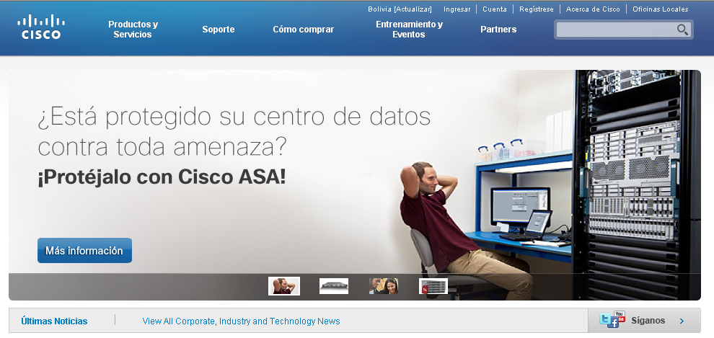
CCO – First steps
Enter www.cisco.com and click on Register

Slide 4
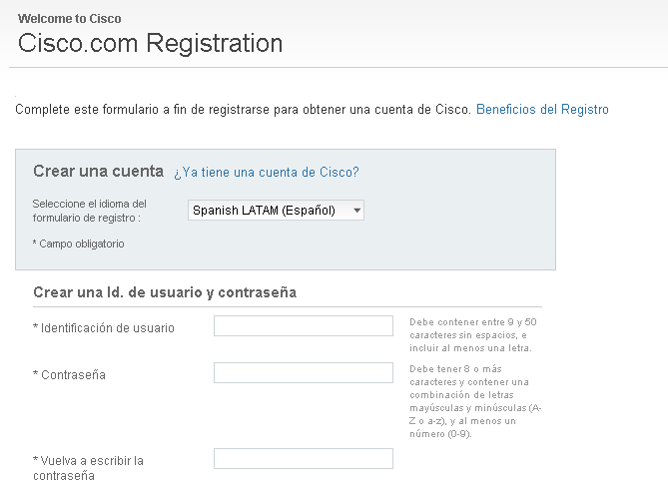
CCO – Registration Form
Select English as your language and start to fill in the registration form
email@email.com
email@email.com
userID
password
password
password
password

Slide 5
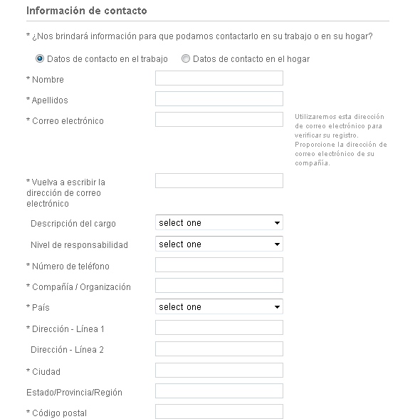
CCO – Registration Form
Click on Work contact details (datos de contacto en el trabajo)
*Mandatory Fields
Note: We recommend you fill in all fields so your Cisco experience is more personalized and so that you only receive information you are interested in
First name
Last name
email@email.com
userID
City
password
12345
password

Slide 6
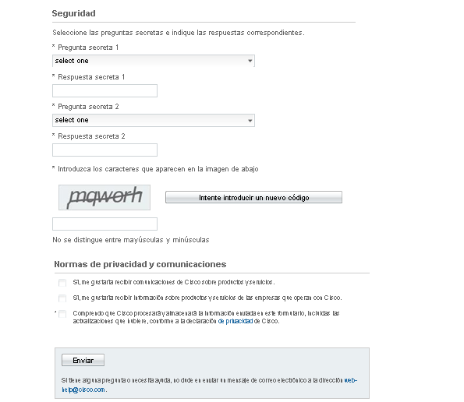
CCO – Registration Form (cont.)
Complete the security questions. This step is extremely important as it will be needed to access your CCO account if there is a problem
Click on: Yes, I wish to receive notices from Cisco about Products and Services
Accept the terms and conditions
Click on send
email@email.com
email@email.com
userID
password

Slide 7
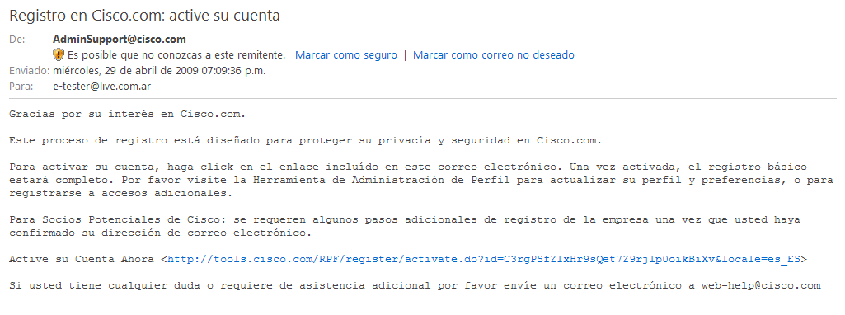
Account activation
Wait for an email confirming your registration and click on the link provided to complete the activation of your account

Slide 8
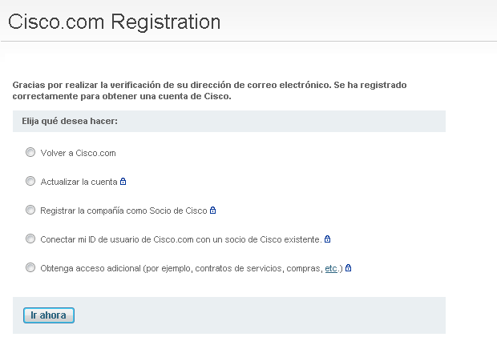
Associate a user ID with a Cisco partner
Once your basic access has been confirmed you will be asked if you require any additional access
Select: Connect my Cisco.com user ID with an existing Cisco partner
Log in using your new CCO user ID and password. It might take a few minutes for cisco.com to recognize the new account. If so, try again a few minutes later

Slide 9
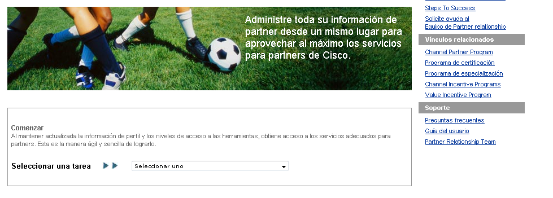
Associate a user ID with a Cisco partner
Enter Partner Self Service www.cisco.com/go/pss
Select Associate myself with a Company on the drop down menu.
Enter your CSCO ID in the relevant field and click on submit
Your company administrator must approve the request
You will receive an approval email and receive partner access within 48 hours

