Slide 1
UCS INSIDER
Gunnar Mende
Product Sales Specialist – Data Center / Virtualisierung gumende@cisco.com
Oktober 2012

Slide 2
Agenda
09:30 – 10:00 Registrierung / Kaffee
10:00 – 10:15 Begrüßung (Gunnar Mende)
10:15 – 11:30 UCS Update (Hardware- & Softwarenews) (Ralf Eberhardt)
11:30 – 12:15 Cisco Tools für Angebotserstellung (Gunnar Mende)
12:15 – 13:00 Mittagessen
13:00 – 14:00 Wie kann Magirus den Angebotserstellungsprozess unterstützen?
Wie bin ich mit Magirus erfolgreich? (
(Markus Bote / Sascha Pfeiffer - Magirus)
14:00– 14:15 Zusammenfassung / Ende (Gunnar Mende)

Slide 3
UCS Kennzahlen – Jan. 2013 Start: August 2009
17.800+
50%+
UCS Kunden
Aller Fortune 500 Unternehmen
70+
16%+
Weltrekorde
Anwendungsbenchmarks
Nummer 3 Weltweit
$2Mrd
22%+
Jahresumsatz
Nummer 2 in den USA

Slide 4
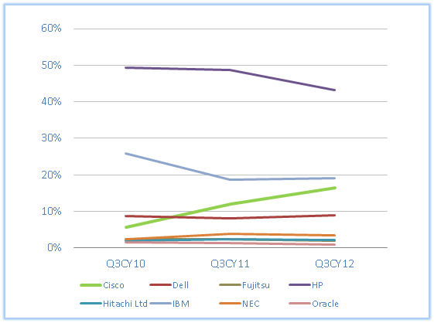
They Said It Couldn’t Be Done
Worldwide X86 Server Blade Market Share
UCS impacting growth of established vendors like HP
Legacy offerings flat-lining or in decline
Cisco growth out-pacing the market
Market Appetite for Innovation Fuels UCS Growth
UCS #3 and
climbing
Customers have shifted 16.5% of the global x86 blade server market to Cisco and over 23% in North America (Source: IDC Worldwide Quarterly Server Tracker, Q3 2012 Revenue Share, November 2012)
Source: IDC Worldwide Quarterly Server Tracker, Q3 2012 Revenue Share, November 2012
Demand for Data Center Innovation Has Vaulted Cisco Unified Computing System (UCS) to the #3 Leader in the Fast-Growing Segment of the x86 Server Market
Notes:
Graph shows vendor revenue shares for three quarterly periods: Q3CY10, Q3CY11,Q3CY12.
Since UCS first recorded IDC vendor revenue in Q3CY09, HP has lost 7.1% share (50.3% in Q3CY09 to 43.2% in Q3CY12) and IBM has lost 10% (29.1% to 19.1%).
Cisco N.America share in Q3CY12 x86 blades was 23.3%.

Slide 5
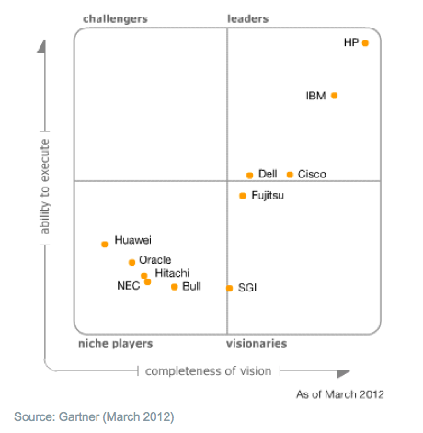
Gartner Magic Quadrant – Blade Server

Slide 6
UCS Referenzen
„Vorteilhaft für Cloud Computing ist eine übergreifende Virtualisierungsstrategie, die Server, Speicher, Netzwerk und Anwendungen in einheitlicher Weise adressiert.“
Michael Flachsel, Leiter Infrastrukturdienste im IT-Service Center der TU Berlin
http://www.cisco.com/en/US/netsol/ns944/networking_solutions_customer_success_stories_list.html

Slide 7
SmartPlay Five Promotions

Slide 8
Terms and Conditions
 | Promos | Solution Paks | Expansion Paks
Quoting Expiration Date | January 26, 2013 | January 26, 2013 | January 26, 2013
Ordering Expiration Date | February 23, 2013 | February 23, 2013 | February 23, 2013
Qty Limit per Customer / Quarter | B-Series: 5 C-Series: 20* | 5 | 10
New Account Breakaway | Yes | Yes | Yes
OIP | No | Yes | Yes
SIP | No | Yes | Yes
TIP | No | Yes | Yes
VIP | No | No | No
DSA | No | No | No
Try and Buy | No | No | No
*Change for Q2

Slide 9
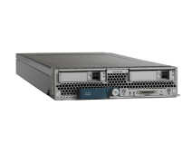
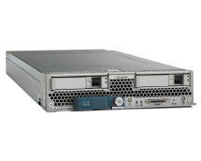
B-Series SmartPlay Five Promotions
Part Numbers:
UCS-SP5-ES-B22 (Diskless)
UCS-SP5-ES-B22HD (w/ HDD)
UCS-EZ-ENTS-B22 (Expansion Pak)
Part Numbers:
UCS-SP5-EV-B200 (Diskless)
UCS-SP5-EV-B200HD (w/ HDD)
UCS-EZ-ENTV-B200 (Expansion Pak)
Part Numbers:
UCS-SP5-SC-B200 (Diskless)
UCS-SP5-SC-B200HD (w/ HDD)
UCS-EZ-ENSC-B200 (Expansion Pak)
Part Numbers:
UCS-SP5-PR-B200 (Diskless)
UCS-SP5-PR-B200HD (w/ HDD)
UCS-EZ-PERF-B200 (Expansion Pak)
Specifications:
(2) 6248 Fabric Interconnects
(1) 5108 Chassis w/ Dual 2208XP Fabric Extenders
(2) B22 M3 Blades
Dual Intel® Xeon® 1.90Ghz Processors
48 GB Memory
VIC 1240
Optional 300 GB HDD
Specifications:
(2) 6248 Fabric Interconnects
(1) 5108 Chassis w/ Dual 2208XP Fabric Extenders
(4) B200 M3 Blades
Dual Intel® Xeon® 2.00Ghz Processors
64 GB Memory
VIC 1240 and VIC 1280
Optional 300 GB HDD
Specifications:
(2) 6296 Fabric Interconnects
(2) 5108 Chassis w/ Dual 2208XP Fabric Extenders
(4) B200 M3 Blades
Dual Intel® Xeon® 2.00Ghz Processors
128 GB Memory
VIC 1240 and VIC 1280
Optional 300 GB HDD
Specifications:
(2) 6296 Fabric Interconnects
(1) 5108 Chassis w/ Dual 2208XP Fabric Extenders
(4) B200 M3 Blades
Dual Intel® Xeon® 2.90Ghz Processors
256 GB Memory
VIC 1240 and VIC 1280
Optional 300 GB HDD
B22
Entry
B200
Value
B200
Scale
B200 Performance

Slide 10
C-Series SmartPlay Five Promotions
Part Number:
UCS-SP5-C22E
Part Number:
UCS-SP5-C24V
Part Number:
UCS-SP5-C220E
Part Number:
UCS-SP5-C240V
Specifications:
Dual Intel® Xeon® E5-2420 1.90Ghz Processors
32 GB Memory
MegaRAID 9265CV-8i PCIe Card
Dual 300-GB SAS HDD’s
Specifications:
Dual Intel® Xeon® E5-2450 2.1Ghz Processors
32 GB Memory
MegaRAID 9265CV-8i PCIe Card
Dual 300-GB SAS HDD’s
Specifications:
Dual Intel® Xeon® E5-2650 2.0Ghz Processors
64 GB Memory
LSI 2008 SAS RAID Card
Broadcom 5709 Quad-Port 1 GbE w/ TOE iSCSI NIC
Specifications:
Dual Intel® Xeon® E5-2665 2.4Ghz Processors
64 GB Memory
MegaRAID 9266CV-8i PCIe Card
Cisco UCS P81E VIC
C22
Entry
C24
Value
C220
Entry
C240
Value
Part Number:
UCS-SP5-C22V
Part Number:
UCS-SP5-C24P
Part Number:
UCS-SP5-C220V
Part Number:
UCS-SP5-C240P
Specifications:
Dual Intel® Xeon® E5-2440 2.40Ghz Processors
32 GB Memory
MegaRAID 9265CV-8i PCIe Card
Dual 300-GB SAS HDD’s
Specifications:
Dual Intel® Xeon® E5-2470 2.3Ghz Processors
64 GB Memory
MegaRAID 9265CV-8i PCIe Card
Dual 300-GB SAS HDD’s
Specifications:
Dual Intel® Xeon® E5-2650 2.0Ghz Processors
64 GB Memory
MegaRAID 9266CV-8i PCIe Card
Cisco UCS P81E VIC
Specifications:
Dual Intel® Xeon® E5-2680 2.7Ghz Processors
64 GB Memory
MegaRAID 9266CV-8i PCIe Card
Cisco UCS P81E VIC
C22
Value
C24
Performance
C220
Value
C240
Performance

Slide 11
C-Series + Fabric SmartPlay Five Solution Paks
Part Number:
UCS-SP5-ES-C220
Part Number:
UCS-SP5-EV-C220
Part Number:
UCS-SP5-EV-C240
Part Number:
UCS-SP5-PR-C220
Part Number:
UCS-SP5-PR-C240
C220 Specifications:
Dual Intel® Xeon® E5-2650 2.0Ghz Processors
64 GB Memory
LSI 2008 SAS RAID Card
Broadcom 5709 Quad-Port 1 GbE w/ TOE iSCSI NIC
C220 Specifications:
Dual Intel® Xeon® E5-2650 2.0Ghz Processors
64 GB Memory
MegaRAID 9266CV-8i PCIe Card
Cisco UCS P81E VIC
C240 Specifications:
Dual Intel® Xeon® E5-2665 2.4Ghz Processors
64 GB Memory
MegaRAID 9266CV-8i PCIe Card
Cisco UCS P81E VIC
C220 Specifications:
Dual Intel® Xeon® E5-2650 2.0Ghz Processors
64 GB Memory
MegaRAID 9266CV-8i PCIe Card
Cisco UCS P81E VIC
C240 Specifications:
Dual Intel® Xeon® E5-2665 2.4Ghz Processors
64 GB Memory
MegaRAID 9266CV-8i PCIe Card
Cisco UCS P81E VIC
Nexus 3K Specifications:
Nexus 3048
Nexus 3064PQ Accessory Kit Included
Nexus 2K Specifications:
Nexus 2232PP w/ 16 FET
10G Line Extender for FEX
Nexus 2K Specifications:
Nexus 2232PP w/ 16 FET
10G Line Extender for FEX
Nexus 5K Specifications:
Nexus 5548 UP w/ 32 10GbE Ports
Nexus 5K Specifications:
Nexus 5548 UP w/ 32 10GbE Ports
UCS FI Specifications:
48-Port UCS Fabric Interconnect w/ Unified Ports
12 port licenses
UCS FI Specifications:
48-Port UCS Fabric Interconnect w/ Unified Ports
12 port licenses
C220
Nexus 3K
C220
Nexus 2K
UCS FI
C240
Nexus 2K
UCS FI
C220
Nexus 2K
Nexus 5K
C240
Nexus 2K
Nexus 5K

Slide 12
Cisco-NetApp FlexPod Solutions
ExpressPod Small | Medium
FlexPod IP Storage
Citrix VDI-in-a-Box
Balanced | Performance
VDI
Converged Infra
Cisco Unified Communications on UCS
Complete Infrastructure: B200 TRC
Single Blade: B200 TRC
Single Rack: C220 TRC | C240 TRC
Big Data Solution
Starter Half-Rack Solution
Business Analytics
UC on UCS
Cisco-EMC VSPEX Solutions
VSphere Solution: 50-125 VM’s
Hyper-V Solution: 50-100 VM’s
Single-Wire Management Ready
C220 Value (M)
C240 Value (M) | C240 Perf (M)
Converged Infra
Promos
Price Drop: All C-Series Promos
Term Change
QTY Limitation : All C-series → 20
Price Drop
Q2 Updates – November 2012

Slide 13
UCS New Account Breakaway Promotion
At-A-Glance (15th Oct 2012 – 26th Jan 2013) for EMEA
Promotion Goal
Provide a compelling partner incentive for UCS Specialized partners:
To capture new UCS customers through partner-hunted deals
Increase partner hardware margin by 70% - 85%
Develop a new recurring revenue stream
Promotion Period
Deal Registration Period: until 26th July 2013
Bookings Period: 6 months after registration, or July 27 2013 (whichever comes first)
Higher discounts on UCS products - only applies to eligible UCS SKUs
Higher discounts for UCS Smart Play promotional bundles
Services are not eligible for this promotional bonus
Discount can apply to follow-on orders in same deal for 180 days
Partner Incentive
To qualify as a UCS New Account, Cisco must confirm that:
Customer Account has not previously purchased any UCS systems
Account/Deal is solely Partner-hunted and developed
Deal is fully approved in CCW
Deal does not conflict with a registered CCW OIP/TIP/SIP, PSPP deal
Max of (20) New Accounts can be initially registered per Partner-Company
Account/Deal Eligibility
Partner Requirements
Partner must be UCS Specialized (UCT, DCA, or ATP-DCUC)
Partner must register deal in CCW using ‘UCS New Account Breakaway’
Cisco AM and Program team confirm deal qualifies as a new UCS account
Theater promotion governance team confirms that deal meets qualification and does not conflict with a currently approved CCW deal (including OIPs)
Notes:
13
Partner Program Enrollment
www.cisco.com/go/ppe
http://tools.cisco.com/WWChannels/PPP/home.do?actionType=home

Slide 14
seriously we sell servers.
http://www.ciscoquicklinks.com

Slide 15
UCS Link Collection
All About UCS – ciscoquicklinks.com
UCS Smart Play Bundles
UCS Case Studies
Data Center Success Stories
YouTube Kanal – Cisco Germany
Cisco Commerce Workspace (CCW)
Cisco Interactive 3D Model for UCS

