Slide 1
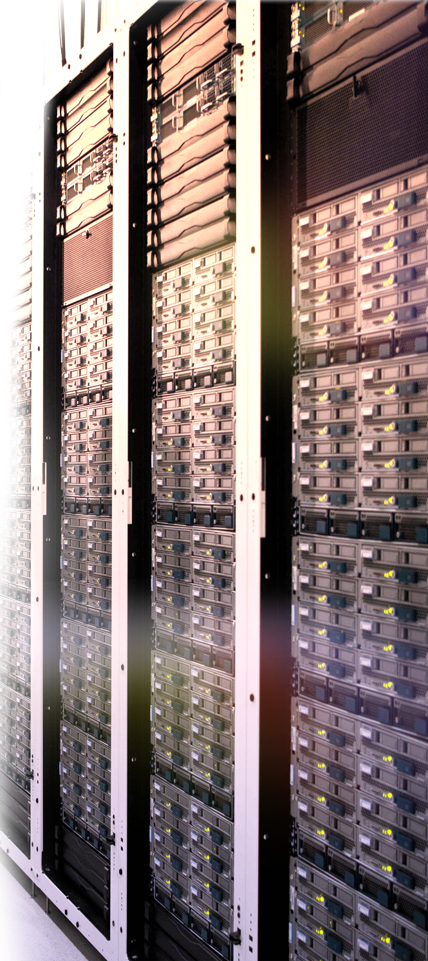
UCS C系列 解决方案集锦

Slide 2



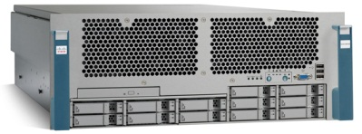

UCS M3机架式服务器家族
 | C22 M3 | C24 M3 | C220 M3 | C240 M3 | C260 M2 | C420 M3 | C460 M2
RU | 1 | 2 | 1 | 2 | 2 | 2 | 4
Cores | 16 | 16 | 16 | 16 | 20 | 32 | 40
DIMMs | 12 | 12 | 16 | 24 | 64 | 48 | 64
Max GB | 192GB | 192GB | 512GB | 768GB | 1TB | 1.5TB | 512GB
Disk | 8 x 2.5” or 4 x 3.5” | 24 x 2.5” or 12 x 3.5” | 8 x 2.5” or 4 x 3.5” | 24 x 2.5” or 12 x 3.5” | 16 x 2.5” or 32 x SSD | 16 x 2.5” | 16 x 2.5”
LoM | 2 x 1Gb | 2 x 1Gb | 2 x 1Gb | 4 x 1Gb | 2 x 1Gb + 2 x 10Gb | 2 x 10Gb | 2 x 1Gb + 2 x 10Gb
PCIe Slots | 2 x PCIe | 5 x PCIe | 2 x PCIe 3.0 | 4 x PCIe 3.0 | 6 x PCIe 2.0 | 6 x PCIe 3.0 | 10 x PCIe 2.0
Internal Storage | USB Port | USB Port | USB Port FlexFlash | USB Port FlexFlash | USB Port FlexFlash | USB Port FlexFlash | eUSB

Slide 3
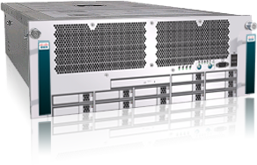



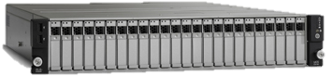
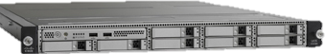
UCS C系列使用场景简介
UCS C460 M2
RAS and Performance Optimized
UCS C260 M2
UCS C240 M3
数据库
业务整合
虚拟化
扩展性
UCS C220 M3
数据库
业务整合
虚拟化
UCS C24 M3
数据仓库
应用中间件
Collaboration
大数据
关键业务
UCS C22 M3
分布式数据库
应用中间件
Collaboration
Performance Optimized
大数据应用
简单存储
企业级
Web/IT 基础架构
代理 / 缓存
Price / Performance Optimized
Notes:
Cisco offers a broad portfolio of rack servers to fit different data center environments. Each product addresses varying workload challenges through a balance of processing, memory, I/O, and internal storage resources.
Mission-Critical
On the high end are servers optimized for performance and reliability in mission critical deployments such for virtualization and large database applications. The C460 M2 and C260 M2 servers are based on Intel’s E7 processors and offer the largest memory and I/O expansion.
Cisco UCS C460 M2 High Performance Rack Server This high-performance rack server is a four-socket, four-rack unit (4RU) enterprise-critical server for data-demanding applications and bare-metal and virtualized workloads.
Cisco UCS C260 M2 Rack Server This rack server is one of the industry's highest-density and most expandable two-socket, two-rack unit (2RU) servers. It is designed for enterprise-critical workloads ranging from storage serving to online transaction processing (OLTP) and data warehousing.
Enterprise-Class
The C220 M3 and the C240 M3 are versatile work-horses based on Intel’s 2S EP processors, and offering a balanced architecture and configuration flexibility through large memory footprints, multiple PCI slots, and lots of internal storage.
Cisco UCS C240 M3 Rack Server This 2RU server is designed for both performance and expandability over a wide range of storage-intensive infrastructure workloads, from big data to collaboration.
Cisco UCS C220 M3 Rack Server This one-rack unit (1RU) server offers superior performance and density over a wide range of business workloads, from web serving to distributed database.
Scale-Out
The C22 M3 and C24 M3 are cost-optimized servers based on Intel’s 2S EN processors, delivers a balanced price/performance feature set to address quick deployment of scalable IT infrastructure and scale-out applications.
Cisco UCS C24 M3 Rack Server This 2RU, 2-socket rack server is designed for both outstanding economics and internal expandability over a range of storage-intensive infrastructure workloads, from IT and web infrastructure to big data.
Cisco UCS C22 M3 Rack Server This 1RU, 2-socket rack server design combines outstanding economics and a density-optimized feature set over a range of scale-out workloads, from IT and web infrastructure to distributed applications.

Slide 4

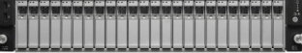


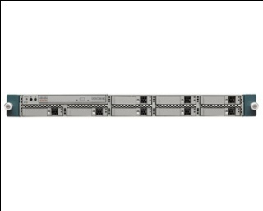
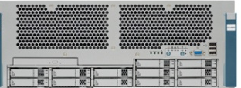
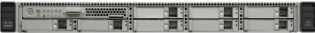
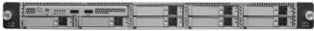
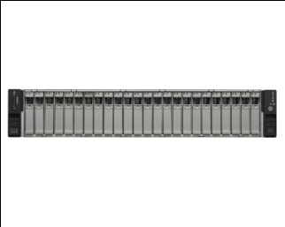

UCS C: 性能与创新
业界唯一的无状态计算的机架式服务器
统一计算
无状态计算的模块
  集中定义和部署Network/storage/server 策略
统一管理刀片和机架式服务器
  可以在刀片和机架上使用相同的Service profile
  统一的固件管理和部署
通过整合数据和管理流量减少端口费用
统一计算的入门产品
比刀片更低的初始费用
第三代计算平台
业界领先的 Adapter-FEX 和 VM-FEX 技术
性能与创新
多个性能测试的世界纪录
集成的平台管理，不需要host agents
与UCS整合的优势
作为独立服务器的优势
Notes:
4
C-series provide a range of benefits, whether deployed in a stand alone management environment or integrated into a UCS domain.
Performance and innovation
Our rack servers are designed for performance and innovation. We have achieved many world record performance benchmarks that we’ll review later in the presentation. We were also one of the first rack server portfolios in the industry to deliver agentless management to improve stability and security.
Entry Point to Unified Computing
The C-series servers are an entry point into the UCS compute model, with a lower initial price point than blade servers. Our 3rd generation platforms continue to leverage Cisco VIC, Adapter FEX, and VM FEX technology to bring the fabric all the way to the virtual machine. We’ll review these technologies later in the presentation.
Unified computing
With UCSM integration, the C-series servers are the world’s first stateless rack servers where network, storage, and server policies are centrally defined, deployed, and maintained. UCS blade and rack servers can be managed with the same domain, where the same server same server profile or ‘personality’ can be assigned to either a blade or rack server. And with the centralize management of USCM, C-series servers can take advantage of auto-discovery, fault & monitoring, FW version control & deployment. And to complete the integrated environment, UCS Fabric Extenders can consolidate network & storage traffic for so blades and racks can be deployed in the same rack.

Slide 5
有效降低TCO
Cisco C240 + UCS 优势架构 vs. HP DL380e + 传统交换模式
Total Cost of Ownership Comparison
Total Savings/Expense: Cisco UCS Infrastructure
$4,500,000
$1,200,000
$4,000,000
$1,000,000
$3,500,000
$3,000,000
$800,000
$2,500,000
$600,000
$2,000,000
$1,500,000
$400,000
$1,000,000
$500,000
$200,000
$0
$0
New Competitive Environment
Cisco UCS Environment
Hardware + Warranty Costs
Additional Operating Savings
Server Administration
Additional Capital Savings
Software Maintenance and…
Hardware Capital
Power & Cooling
Software Capital
Capital Cost
Capital Cost
Operating Cost
Operating Cost
Notes:
The UCS advantage is realized in savings to both capital and operational expenditures. This TCO analysis compares 16 legacy rack servers and traditional switching environment to 16 C-Series server deployed in a UCS domain. The savings add up quickly.
UCS and unified fabric consolidate switches, HBAs and NICs, saving real estate, power cooling, warranty and procurement costs. Savings = $1,020,000
Hardware + Warranty Costs savings = $42,500
Server Productivity savings = $102,000
Power and Cooling savings from less equipment = $175,000
Savings from Software Expense (HP iLO) = $63,840
This TCO analysis was done using the UCS TCO-ROI Advisor Tool located here:
http://wwwin.cisco.com/marketing/datacenter/programs/business_value.shtml

Slide 6
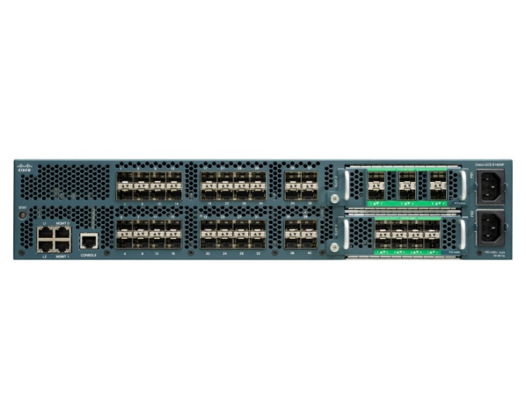
TCO: 如何节约
UCS和统一架构整合存储和网络流量*
节约硬件: 更少的交换机（独立的FC和以太网交换机），HBA和网卡
更少的硬件意味着可以节约:
    机房空间，能源和冷却费用，维护成本，采购成本
嵌入式的CIMC管理平台不需要额外的费用
通过利用UCS service profiles 这样的无状态计算特性，简化了管理员的工作，减少硬件维护费用
UCS 6100 or 6200
UCS 6100 or 6200
*减少 66% 线缆
From traditional model
2 cables for management
2 cables for interconnect
2 cables for FC (external data source)
To single-wire with UCS
2 cables for management + interconnect + FC
Nexus 2232
Nexus 2232
Single-wire from server to FEX coming fall 2012
C-Series server

Slide 7
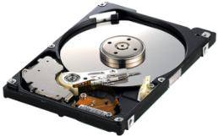
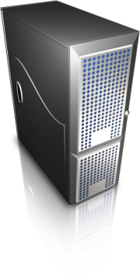


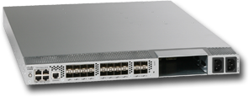
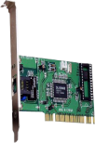


TCO: 如何节约
通过使用UCS Service Profiles减少硬件维护和软件管理成本
自动化的自服务模式，减少应用部署的时间
RAID settings
Disk scrub actions
Number of vHBAs
HBA WWN assignments
FC Boot Parameters
HBA firmware
FC Fabric assignments for HBAs
SAN
QoS settings
Border port assignment per vNIC
NIC Transmit/Receive Rate Limiting
VLAN assignments for NICs
VLAN tagging config for NICs
LAN
Number of vNICs
PXE settings\
NIC firmware
Advanced feature settings
Remote KVM IP settings
Call Home behavior
Remote KVM firmware
Server UUID
Serial over LAN settings
Boot order
IPMI settings
BIOS scrub actions
BIOS firmware
Notes:
Stateless computing brought to rack servers
With the integration into the UCS ecosystem, our C-Series servers are the world’s first stateless rack servers.
Legacy rack servers require configuration in 3 primary areas:
The Server: its identity, the adapters it needs to be populated with (their numbers and types, FC/Ethernet), the configuration on those adapters and finally the firmware revisions the different server components like BIOS, Service Processor, Adapters etc.
Storage: whether to use local storage or not, SAN related settings and firmware revisions.
And finally the Network configuration relating to VLANs, QoS for each link and the firmware revisions on related components.
These collectively represent the hardware “state”. Cisco is introducing a concept of hardware “state” abstraction that allows the separation of the state from the physical hardware it is running on. This allows physical servers to become interchangeable hardware components.
A service profile is the ability for you to define a software logical server that has the properties, from a hardware standpoint, of a physical server, and having the ability to apply that logical server onto a physical server . The physical server takes on the service profile attributes. Service profiles and their comprehensiveness, flexibility, repurposeability and portability are one the biggest advantages offered by UCS servers.
What the service profile offer much more than identity management. Service profile contain a comprehensive set of a variety of server attributes including the identities of MACs and WWNs, low-level BIOS firmware, BIOS settings, boot order, the BSC or CIMC firmware and drive controller firmware. A service profile encapsulates up to 125 attributes in a software model that is applied to a physical server.
The service profile is built on policies which are system definitions of attributes for networking, storage parameters, for boot and host firmware, etc. The result is one-time consistent configurations, making server pre-provisioning easier and automatic, reducing the time it takes to build a server from weeks down to hours. In addition, service profile flexibililty enable rapid physical server migration, and repurposing, making IT more flexible and responsive to their end-users.
In both non-virtualized environment doing a failover from one physical server to another or in a virtualized environment doing capacity management for ESX or Xen or KVM cluster, this statelessness of service profiles allows rapid server migration. Service profiles also allow resources pooling which group resources by category, type or capability.

Slide 8
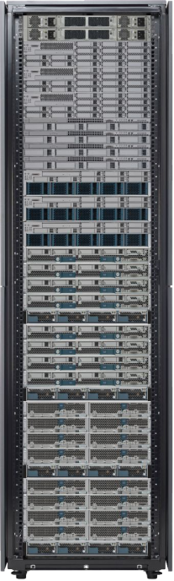
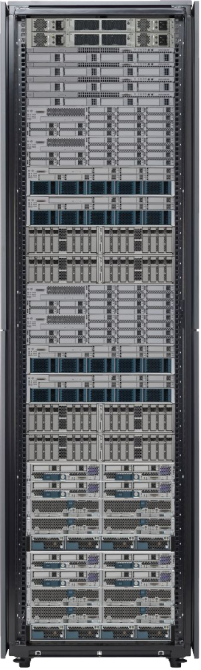
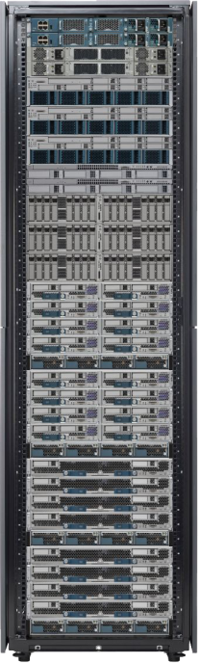
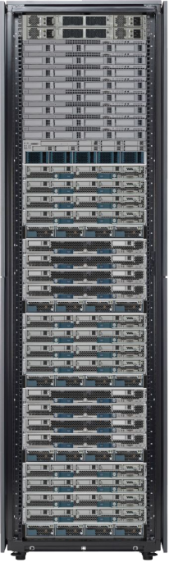
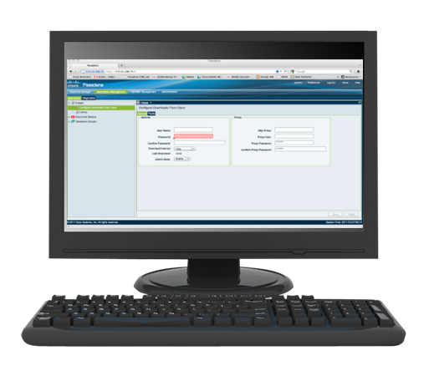
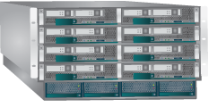
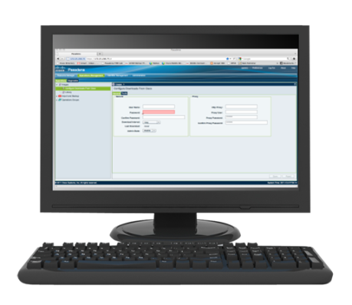

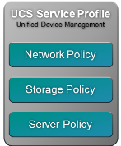
统一管理
将UCS统一管理的优势延伸到机架服务器上
UCS Manager
Unified Management
A Single Unified System
For Blade and Rack Servers
UCS Service Profile
Unified Device Management
Service Profile: HR_App1
VNIC1
MAC: 08:00:69:02:01:2E
HR_WEB_VLAN (ID=50)
VNIC2
MAC: 08:00:69:02:01:2F
HR_DB_VLAN (ID=210)
HBA 1 and 2
WWN: 5080020000075740
WWN: 5080020000075741
VSAN ID: 12
Boot Order: SAN
BIOS Settings:
Turbo On
HyperThreading On
Network Policy
Storage Policy
Server Policy
C-Series Rack Optimized Servers
B-Series Blade Servers
A major market transformation in unified
server management
Benefits of UCS Manager and Service Profiles brought to rack optimized servers
New Nexus Fabric Extender topology reduces cost, increases scale of rack server connectivity within Unified Computing
Add capacity without complexity
Notes:
Extending the benefits of UCSM to C-Series servers
Our blade customers have enjoyed the benefits of the Cisco Unified Computing System, that unites computing, network, storage access, and virtualization into a cohesive system designed to reduce total cost of ownership (TCO) and increase business agility. The industry's first converged data center platform, the Cisco UCS delivers a programmable infrastructure that simplifies and speeds enterprise-class application and service deployment in bare-metal, virtualized and cloud-computing environments. The Cisco UCS Business Advantage derives from the system's simplified, converged architecture and its automated, centralized management.
Now this same technology has been extended to C-series rack servers, bringing stateless computing to the rack server environment. In addition, both blade and rack servers can be managed within the same UCS domain, eliminating compute silos of legacy data centers. C-series servers consolidate network and storage traffic onto a single FCoE interface, which connects to Cisco Fabric Extenders at the top of the rack. Fabric Extenders extend the I/O fabric between the Cisco UCS 6100 and 6200 Series Fabric Interconnects to the blade chassis and now to C-series servers.

Slide 9

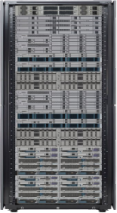
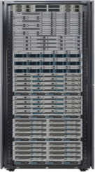
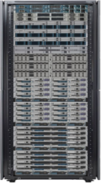
UCS: 内置的刀片和机架服务器自动化管理
集成的, 基于策略的基础架构管理
Uplink port configuration, VLAN,
VSAN, QoS, and EtherChannels
Server port configuration including
LAN and SAN settings
Network interface card (NIC)
configuration: MAC address,
VLAN, and QoS settings;
host bus adapter HBA configuration:
worldwide names (WWNs), VSANs,
and bandwidth constraints;
and firmware revisions
Unique user ID (UUID),
firmware revisions,
and RAID controller settings
Service profile assigned to server,
chassis slot, or pool
Storage
SME
Server
SME
Network
SME
Uplink port configuration, VLAN,
VSAN, QoS, and EtherChannels
Server port configuration including
LAN and SAN settings
Uplink port configuration, VLAN,
VSAN, QoS, and EtherChannels
Server port configuration including
LAN and SAN settings
Network interface card (NIC)
configuration: MAC address,
VLAN, and QoS settings;
host bus adapter HBA configuration:
worldwide names (WWNs), VSANs,
and bandwidth constraints;
and firmware revisions
Network interface card (NIC)
configuration: MAC address,
VLAN, and QoS settings;
host bus adapter HBA configuration:
worldwide names (WWNs), VSANs,
and bandwidth constraints;
and firmware revisions
Unique user ID (UUID),
firmware revisions,
and RAID controller settings
Service profile assigned to server,
chassis slot, or pool
Uplink port configuration, VLAN,
VSAN, QoS, and EtherChannels
Server port configuration including
LAN and SAN settings
Network interface card (NIC)
configuration: MAC address,
VLAN, and QoS settings;
host bus adapter HBA configuration:
worldwide names (WWNs), VSANs,
and bandwidth constraints;
and firmware revisions
Unique user ID (UUID),
firmware revisions,
and RAID controller settings
Service profile assigned to server,
chassis slot, or pool
Unique user ID (UUID),
firmware revisions,
and RAID controller settings
Service profile assigned to server,
chassis slot, or pool
Uplink port configuration, VLAN,
VSAN, QoS, and EtherChannels
Server port configuration including
LAN and SAN settings
Network interface card (NIC)
configuration: MAC address,
VLAN, and QoS settings;
host bus adapter HBA configuration:
worldwide names (WWNs), VSANs,
and bandwidth constraints;
and firmware revisions
Unique user ID (UUID),
firmware revisions,
and RAID controller settings
Service profile assigned to server,
chassis slot, or pool
1
根据业务定义策略
2
通过策略创建service
profile templates
3
通过Service profile
templates 创建
service profiles
4
自动将service profiles 与某个硬件关联，成功部署服务器
Notes:
Certainly there are usage models where C-series servers will be stateful (Big Data, for example) however there are still benefits to the UCSM model. For example, managing network, adapter and server as one via Service Profiles, Policies, Pools, and Templates to speed time to deployment.

Slide 10
Cisco 技术最大化硬件使用率
FI6100 or FI6200
FI 6100 or FI 6200
一根线连到FI，减少端口支出
Nexus 2232
Nexus 2232
通过UCS Manager管理 Nexus 2232
激活无状态计算
在一个UCS域里同时管理刀片和机架服务器
Gb LOM
Cisco VIC
Cisco VIC技术提高了性能和可扩展性
Adapter FEX可以在一块物理网卡上创建 128 vNICs 或 vHBAs
VM FEX 为每个虚拟机在物理交换机上分配一个虚拟接口
CIMC
OS or Hypervisor
Single-wire from server to FEX coming fall 2012
Mgmt Traffic
Data Traffic
(LAN and FCoE)
Notes:
With the innovations that make up the UCS ecosystem, data center managers realize cost savings through infrastructure efficiency enabled by technologies such as Adapter FEX and VM FEX.
VM FEX
VM-FEX technology helps enable a consistent operational model and visibility between physical and virtual environments; it simplifies enforcement of security and network policy when moving virtual machines across hosts.
Cisco Virtual Machine Fabric Extender collapses virtual and physical networking into a single infrastructure. Data center administrators can now provision, configure, manage, monitor, and diagnose virtual machine network traffic and bare metal network traffic within a unified infrastructure. Cisco VM-FEX enables each VM to get a dedicated interface on the parent switch. With Cisco VM-FEX all VM traffic is sent directly to the dedicated interface on the parent switch. VM-FEX also brings near bare metal performance gains by offloading the hypervisor of I/O related cycles. Cisco VM-FEX eliminates the software-based switch in the hypervisor and the solution works across the most popular hypervisors such as VMware ESX and RedHat KVM.
Adapter FEX
Adapter FEX extends the fabric to the servers, and partitions the server adapter into multiple, logical virtual Network Interface Cards (vNICs) and virtual Host Bus Adapters (vHBAs). It then consolidates multiple 1 Gigabit Ethernet NICs and Fibre Channel HBAs into a single 10 Gigabit Ethernet FCoE adapter.
With Adapter FEX, you benefit from reduced capital and operating expenses, highly secure hardware-based traffic separation, and in-depth traffic visibility. In addition, your data center server environments can cost-effectively scale with your business needs.
Fabric Interconnects
Cisco UCS 6200 Series provides the management and communication backbone for the Cisco UCS blade and rack servers. Blade and rack servers attached to the Cisco UCS 6200 Series Fabric Interconnects become part of a single, highly available management domain. In addition, by supporting unified fabric, the Cisco UCS 6200 Series provides both the LAN and SAN connectivity for all blades within its domain.

Slide 11
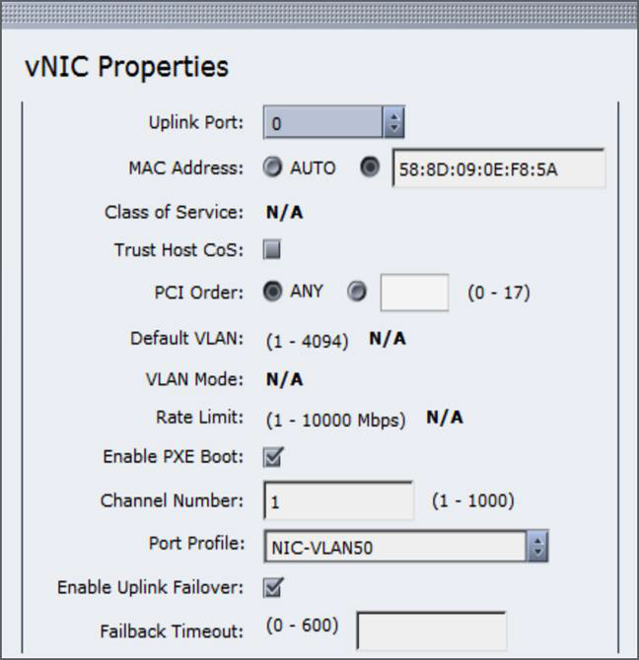
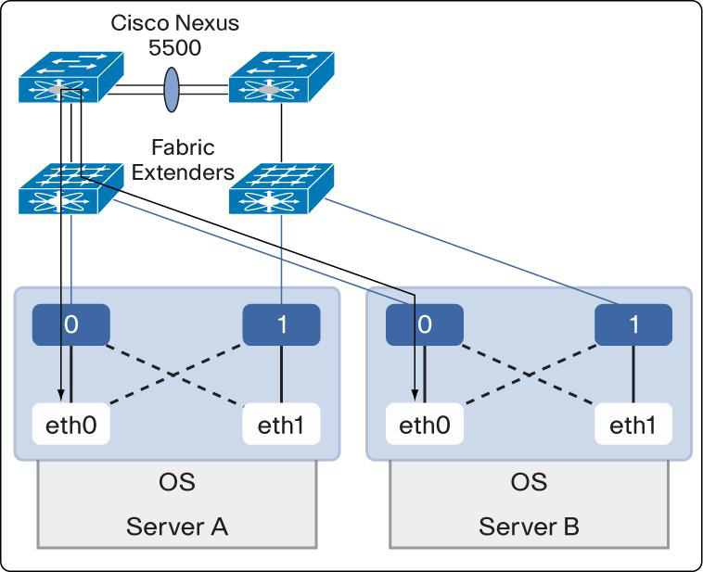
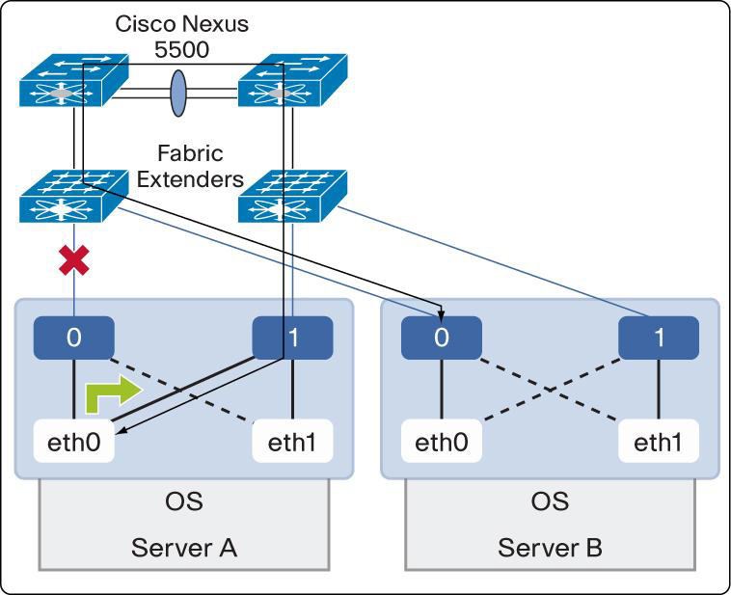
UCS –C有哪些特别之处? Palo卡 +Nexus 5k
网线断了，数据却不断
打个勾就行，方便！
Notes:
文字说明：

Slide 12
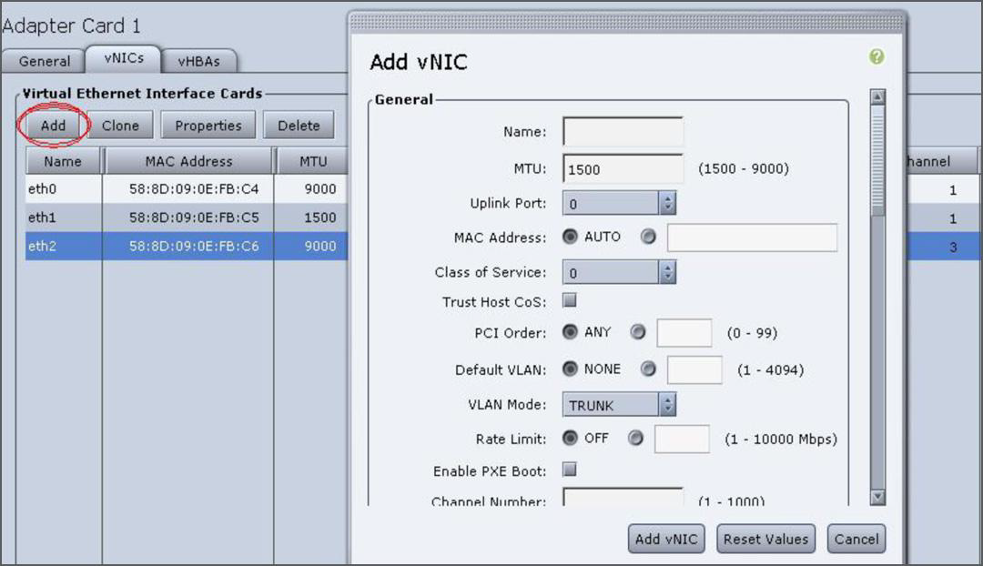
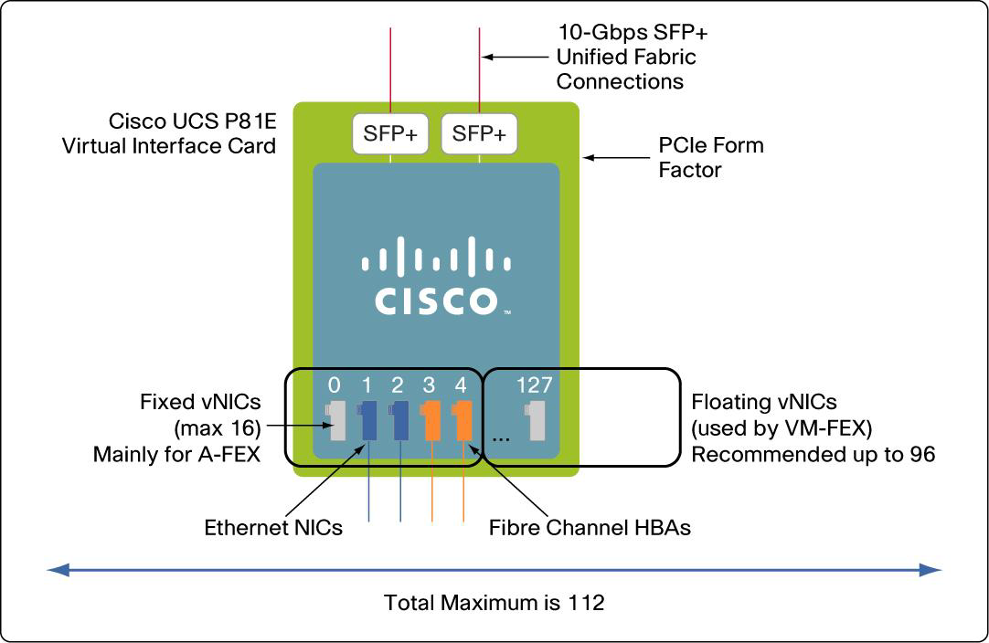
UCS –C有哪些特别之处？
-对虚拟机的精细化管理
最多可以添加到128个

Slide 13
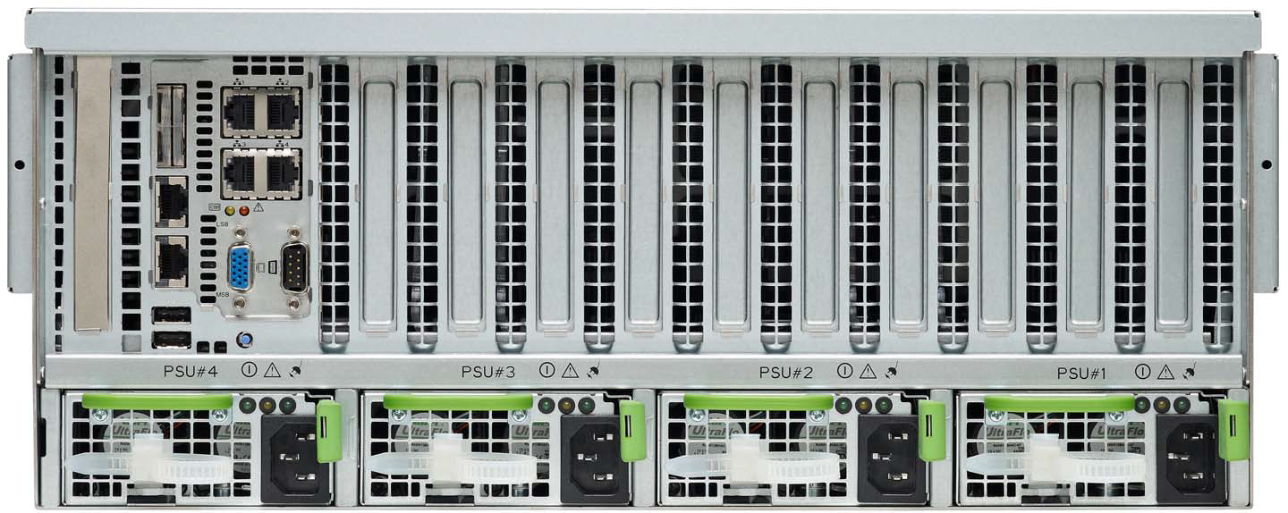
UCS –C460有哪些特别之处？
网卡 ---既支持光口又支持电口，业界唯一！
特别是还支持硬件端口冗余，光口走不通走电口！

Slide 14
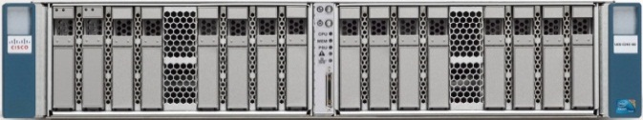
Cisco Integrated Management Controller (CIMC)
集成了 ‘Agent-less’ 的带外远程管理
Customer Benefits
UCS Management Solutions
嵌入式管理解决方案
  不需要 host agents
  不需要额外的License费用
为独立管理和UCSM模式提供了一致的服务器定义方式
  XML API (UCS Programmatic Interface)
  SNMP
带外管理
支持脚本 – 可扩展大型管理
统一管理
Power Shell
ISV Integration
  MSFT SCOM/ SCCM
  HP Operations Manager
  Zenoss
  Aliris – Deployment Server
Feature Details
XML API & SNMP
Firmware 管理
BIOS 配置
导出技术支持数据
支持Power Shell
RAID Controller, Battery Backup Unit, Storage Media Configuration and Monitoring
All FRU Components
CIMC
Embedded on Server
GUI
CLI
Notes:
C-Series servers are not required to be part of a UCS domain, and can be deployed in a stand-alone management model. All the tools available for the stand-alone environment are available for free, with no additional license fees required that eat away at cap ex dollars. The C-Series management tools provide a simple, reliable, and secure management environment for single server or one-to-many management models.
Starting with remote management, the CIMC ASIC is embedded on every C-Series server. This remote management interface on C-series Servers allows “Lights out” remote management to configure, monitor and control C-Series servers.
C-Series servers were the first rack servers in the industry to provide agentless management for increased security and stability. Since there is no OS software required, there is no open SNMP port on the OS and no downtime required for updating OS agents.
Standard CIMC features simplify server deployment, monitoring, and control- and don’t require additional license fees for operation.
Flexible interfaces to CIMC let you access server management via a CLI or GUI interface. Virtual media support makes remote CD and DVD drives appear as if they are locally available. IPMI 2.0 is used for out-of-band management through third-party enterprise management systems
Future XML support:
About Cisco UCS Manager XML API
The Cisco UCS Manager XML API is a programmatic interface to the Cisco Unified Computing System. The API accepts XML documents through HTTP or HTTPS. Developers can use any programming language to generate XML documents that contain the API methods. Configuration and state information of the Cisco UCS is stored in a hierarchical tree structure known as the management information tree, which is completely accessible through the XML API.
The API model is recursively driven and provides major functionality for application development. For example, changes can be made on a single object, an object subtree, or the entire object tree. With a single API call, changes can be made to a single attribute of an object, or to the entire Cisco UCS structure, including the configuration of chassis, blades, adapters, polices, and most other hardware and software components.
The API operates in forgiving mode. Missing attributes are substituted with default values (if applicable) that are maintained in the internal data management engine (DME). The DME ignores incorrect attributes. If multiple managed objects (MOs) are being configured (for example, virtual NICs), and any of the MOs cannot be configured, the API stops its operation. It returns the configuration to its prior state, stops the API operation that listens for API requests, and sends a fault notification.
The API leverages an asynchronous operations model to improve scalability and performance. Slower API processes are nonblocking so that faster processes can proceed. A process receives a success message upon a valid request, and a complete message when the task is finished.
Full event subscription is enabled. After subscribing, any event notification is sent along with its type of state change.
Updates to MOs and properties conform to the existing object model, ensuring backward compatibility. If existing properties are changed during a product upgrade, they are managed during the database load after the upgrade. New properties are assigned default values.
Operation of the API is transactional and terminates on a single data model. Cisco UCS is responsible for all endpoint communication, such as state updates; users cannot communicate directly to endpoints. In this way, developers are relieved from the task of administering isolated, individual component configurations.
The API model includes the following programmatic entities:
•Classes—Define the properties and states of objects in the management information tree.
•Methods—Actions that the API performs on one or more objects.
•Types—Object properties that map values to the object state (for example, equipmentPresence).
A typical request comes into the DME and is placed in the transactor queue in FIFO order. The transactor gets the request from the queue, interprets the request, and performs an authorization check. After the request is confirmed, the transactor updates the management information tree. This complete operation is done in a single transaction.

Slide 15
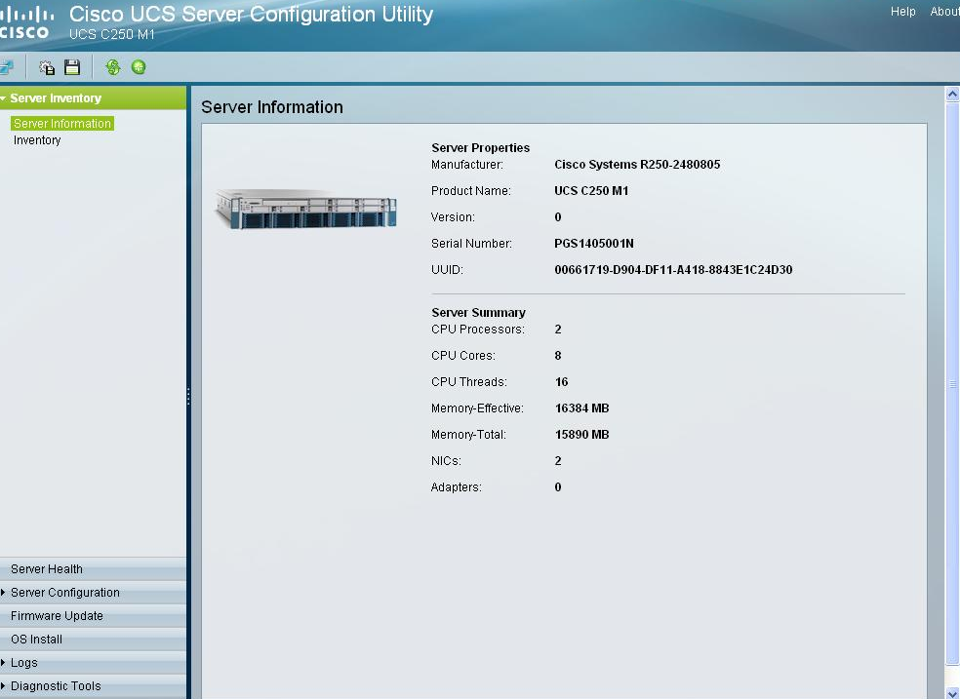
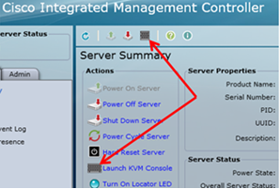
简单的服务器部署和固件管理工具
For Individual or One-to-Many Server Access
Server Configuration Utility (SCU)
  加速部署的强大工具
  无人值守的操作系统安装
  配置RAID引导顺序
  服务器状态和离线诊断
  自动从cisco.com获得驱动程序更新
Host Upgrade Utility (HUU)
简单的固件和系统软件升级
  BIOS
  CIMC
  LOM
  RAID Controller
  Cisco VIC
Notes:
In addition to embedded remote management, C-Series servers have straight-forward deployment and firmware upgrade tools to simplify server deployments and ongoing management.
SCU is a bootable utility providing deployment and configuration tools. For example, SCU manages OS installation, helping free up valuable server administrator time. SCU can be used for RAID configuration and boot order configuration as part of initial server setup. Server inventory and offline diagnostics increase visibility for monitoring server health and status. Scriptable RAID configuration for mass deployment is available using the LSI MegaCLI tool.
Upgrading server firmware can be time consuming and problematic. The Host Upgrade Utility simplifies firmware and system software updates using a menu driven interface. HUU can be used to upgrade:
Cisco Integrated Management Controller (CIMC)
System BIOS
LAN on motherboard (LOM)
RAID controllers
Cisco VIC

Slide 16
UCS的性能：3年内 63 项/次世界纪录
两年内创下63项世界纪录并持续增加
最佳CPU性能
SPECfp_rate_base2006 X86 2-socket B200 M1
SPECint_rate_base2006 X86 2-socket B200 M1
SPECfp_rate_base2006 X86 2-socket B200 M2
SPECint_rate_base2006 X86 2-socket
B200 M2
SPECfp_rate_base2006 X86 4-socket C460 M1
SPECfp_rate_base2006 X86 2-socket C220 M3
SPECfp_base2006
X86 2-socket
C220 M3
SPECint_rate_base2006 X86 2-socket
B200 M2
SPECfp_rate_base2006 2-socket
C260 M2
SPECint_rate_base2006 2-socket
C260 M2
SPECint_rate2006
X86 4-socket
C460 M2
SPECint_rate_base2006 X86 4-socket C460 M1
SPECint_rate_base2006 X86 2-socket C220 M3
最佳虚拟化平台
VMmark 1.x
2-socket B200 M1
VMmark 1.x
2-socket B200 M1
VMmark 1.x
2-socket B250 M2
VMmark 1.x
Overall C460 M1
VMmark 1.x
Overall C460 M1
VMmark 1.x
Blade Server B440 M1
VMmark 1.x
2 –socket Blade B230 M1
最佳云计算性能
VMmark 2.1
2-socket Blade B200 M2
VMmark 2.1
4-socket C460 M2
VMmark 2.1
Two–node 4-socket C460 M2
VMmark 2.0
Overall B200 M2
VMmark 2.1
Overall C460 M2
最佳企业级应用性能
Oracle E-Business Suite Ex-large Model Payroll Batch B200 M2
Oracle E-Business Suite Medium Model
Order-to-Cash B200 M2
Oracle E-Business Suite Xtra Large Model Payroll Batch B230 M2
Oracle E-Business Suite Xtra Large Model Payroll B200 M3
TPC-C
Oracle DB 11g & OEL
C250 M2
TPC-H 1000GB
Microsoft SQL Server
C460 M2
TPC-H 300GB
VectorWise
C250 M2
Oracle E-Business Suite Medium Model Payroll Batch B200 M2
Oracle E-Business Suite Medium Model Payroll Batch B200 M2
Oracle E-Business Suite Large Model
Order-to-Cash B200 M3
SPECjEnterprise2010 Overall B440 M1
SPECjEnteprise2010
2-node B440 M2
TPC-H 100GB
VectorWise
C250 M2
最佳企业级中间件性能
SPECjAppServer2004
1-node 2-socket C250 M2
SPECjbb2005
X86 2-socket B200 M2
SPECjbb2005
X86 4-socket C460 M1
SPECjAppServer2004
2-node B230 M1
SPECjbb2005
X86 2-socket B230 M1
SPECjbb2005
X86 2-socket C220 M3
SPECjbb2005
X86 2-socket B230 M1
SPECjbb2005
2-socket C260 M2
SPECjbb2005
2-socket B230 M2
SPECjbb2005
2-socket B230 M2
SPECjbb2005
4-socket B440 M2
最佳高性能计算
SPECompMbase2001
2-socket B200 M2
SPECompLbase2001
2-socket B200 M2
LinPack
2-socket B200 M2
LS-Dyna
4-socket C460 M1
SPECompMbase2001
4-socket C460 M1
SPECompMbase2001
4-socket C460 M1
SPECompMbase2001
2-socket C240 M3
SPECompMbase2001
2-socket B200 M2
SPECompLbase2001
2-socket B200 M2
SPECompMbase2001
2-socket B230 M2
SPECompLbase2001
2-socket B230 M2
SPECompMbase2001
4-socket C460 M2
SPECompMbase2001
4-socket C460 M2
SPECompLbase2001
2-socket C220 M3
Cisco UCS Benchmarks that held world record performance records as of date of publication
Notes:
Yellow is for C

Slide 17

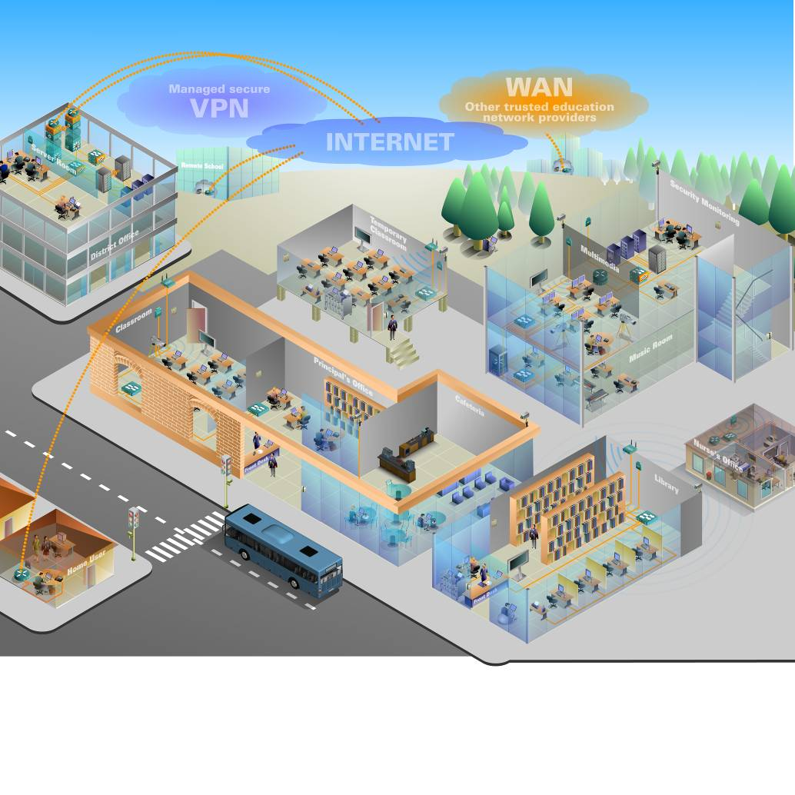

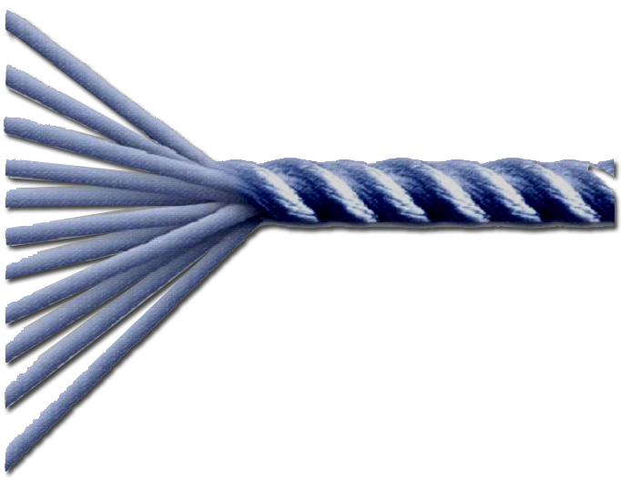

UCS C+Nexus 改变过去服务器与网络分离的思路 …
Nexus +UCS黄金搭档
VM on UCS C
VDI on UCS C
BigData on UCS C
SAP on UCS C
Microsoft on UCS C
Notes:
UCS C + Nexus 将过去分离的、孤立的网络, 单机服务器系统有机地集成在一起，通过统一的平台，相互互补，形成一系列很好的解决方案。
1）VM on UCS C（各种VM的应用, 如UC on UCS, WAAS on UCS, wireless on UCS等）
2) Mini VDI on UCS C -典型解决方案
3) C220/C240作为NAS存储（安装FreeNas作为管理套件或者结合Redhat-RS 整体存储解决方案，提供高性能NAS解决方案）
4) Oracle 数据库 on C460
5) HPC 高性能计算类型的应用，采用Nexus + UCS C的组合有良好的性能

Slide 18
C系列解决方案集锦
基于 VMware/Hyper-V的私有云解决方案
EMC VSPEX 适用于中小型企业的服务器虚拟化解决方案 - 50-125 个虚机
FlexPod Entry solution 使用IP共享存储的 VMware 和 Hyper-V解决方案
VDI
Citrix VDI-In-a-Box 解决方案 (300个桌面)
Business Analytics
Big Data solutions - 部署，管理和监控
SAP HANA 中小型设备
Microsoft SQL Server Fast Track 使用 EMC的解决方案
Applications
Microsoft Exchange 2010 in a box
Microsoft SharePoint 2010 in a box
基于 “Windows Storage Server”的Microsoft Server
与UCS整合的优势
作为独立服务器的优势
Notes:
Cisco has a number of Rack Server Solutions that have been tested and made available both through Smart Play Bundles as well as on Cisco.com
We have rounded out our solutions portfolio to include integrated solutions like VSPEX and FlexPod, key business applications like VDI and business analytics SAP HANA and Big Data.

Slide 19
VM on UCS C
服务器虚拟化解决方案

Slide 20

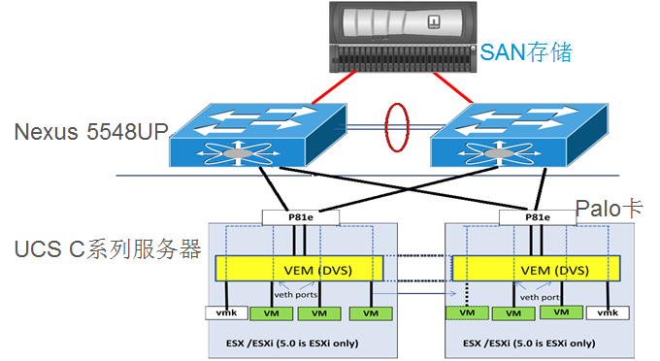
VM on UCS C 解决方案概述
解决方案概览
适用场景
基于UCS机架式服务器设计的虚拟化服务器解决方案
使用 N5K作为网络和存储的接入，实现统一网络架构
VM-FEX技术提供了针对虚拟化的优化
支持多种虚拟化平台：Vmware，Citrix ，MS Hyper-V
中小型用户的应用虚拟化平台建设
关注虚拟化安全和管理
是虚拟化平台的入门级解决方案
不适合使用刀片服务器的场景
架构优势
硬件架构
  N5K将以太网和存储网络整合在一起
  VIC卡可以虚拟出256块vNIC或vHBA，满足 用户不同的应用需要
  支持FCoE，减少用户布线和管理
  虚拟化优化
    简单硬件环境下实现虚拟化感知的网络
    Cisco VIC卡的虚拟技术可以对每台虚拟机设置独立的带宽和QoS
    N5K通过VM-FEX技术可以识别每台虚拟机的网络流量，并实现针对虚拟机的安全和管理

Slide 21


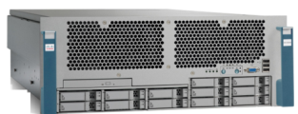
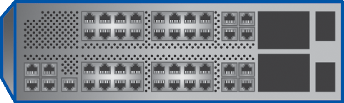


UCS C 虚拟化平台提供虚拟机的安全与精细管理
SQL Server虚拟机
CRM虚拟机
方案优势：
  简单硬件环境下即可实现虚拟化感知的网络设计和实现
  VIC虚拟网卡可划分出多个网卡，每个网卡单独设置带宽和优先级，和每个虚拟机直接相连
  VIC虚拟网卡最多可虚拟出112个设备，多达16个静态网卡和96个动态网卡，单台服务器即可支持足够数量的虚拟机
  Nexus 5548 通过VM-FEX网络虚拟化感知技术，可识别每个虚拟机的网络流量，增强VM的安全性并进行精细管理
  降低风险和成本，同时提高IT灵活性
Exchange虚拟机
IIS 虚拟机
VMware
UCS C服务器+VIC卡
Nexus 5548交换机
光纤存储
ERP
HR
CRM
Notes:
21

Slide 22
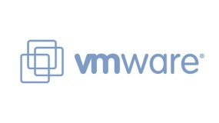

VSPEX – VMware解决方案
解决方案概览
方案详述
基于VMware ESX的私有云解决方案
使用 EMC® VSPEX™ 的服务器虚拟化解决方案可支持 50, 100, 125 个虚拟机
使用了 Cisco Unified Computing System, Cisco Nexus switches, VMware vSphere 5, EMC Storage 以及 Next-Generation Backup
所有的解决方案都使用C220 M3
低端解决方案 (50个虚机) 使用了千兆交换 (N3K)
高端解决方案 (125个虚机) 使用万兆交换 (N5K)
ESXi 5.0 从本地磁盘启动
vPC连接EMC存储阵列, 通过N1K的port-profile实现流量的负载均衡和高可用
Adapter FEX技术
其它信息
EMC
VNXe 3100/3300/ VNX 5300
Storage
详细信息 请访问以下链接：CVD, RA, DG
  http://www.cisco.com/go/vspex
  https://powerlink.emc.com
建议配置
  V50: UCS-SP5-ES-C220 + UCS-SP5-C220E + 2 x A03-D600GA2, plus N1Kv
  V100: UCS-SP5-PR-C220 + 8 x A03-D600GA2, plus N1Kv
  V125: UCS-SP5-PR-C220 + UCS-SP5-C220V + 10 x A03-D600GA2, plus N1Kv
Nexus
3048/5548
Access Switch
Virtualized App Servers
VM
VM
VM
VM
Cisco UCS C220 M3 Servers
VMware VSphere 5.0
Notes:
The Cisco solution for EMC VSPEX using VMware vSphere 5.0 provides an end-to-end architecture with Cisco, EMC, VMware, and Microsoft technologies that demonstrate support for up to 50, 100 and 125 generic virtual machines and provide high availability and server redundancy.
This solution uses the Cisco UCS C220 M3 Rack-Mount Server, Cisco Nexus 3048UP/5548UP and 1000v switches, Cisco Adapter FEX technology, EMC VNXe3100/3300™ array and VMware vSphere 5 to provide storage and server hardware consolidation. The new virtualized infrastructure is centrally managed, allowing efficient deployment and management of a scalable number of virtual machines and associated shared storage.

Slide 23
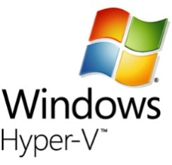
VSPEX – Microsoft Hyper-V 解决方案
解决方案概览
方案详述
基于Microsoft Hyper-V的私有云解决方案
使用EMC® VSPEX的服务器虚拟化解决方案可支持 50, 100个虚拟机
使用了Cisco Unified Computing System, Cisco Nexus switches, Microsoft Hyper-V, EMC Storage 以及 Next-Generation Backup
所有的解决方案都使用C220 M3
低端解决方案 (50个虚机) 使用了千兆交换 (N3K)
高端解决方案 (125个虚机) 使用万兆交换 (N5K)
Microsoft System Center 2012
基于iSCSI 的存储访问
通过vPC 实现负载均衡和高可用
Adapter FEX 技术
其它信息
EMC
VNXe 3100/3300
Storage
详细信息 请访问以下链接：CVD, RA, DG
  http://www.cisco.com/go/vspex
  https://powerlink.emc.com
建议配置
  M50: UCS-SP5-ES-C220 + UCS-SP5-C220E + 2 x A03-D600GA2
  M100: UCS-SP5-PR-C220 + 8 x A03-D600GA2
Nexus
3048/5548
Access Switch
Virtualized App Servers
VM
VM
VM
VM
Cisco UCS C220 M3 Servers
VMware VSphere 5.0
Notes:
The Cisco solution for EMC VSPEX using Microsoft Hyper-V provides an end-to-end architecture with Cisco, EMC, and Microsoft technologies that demonstrate support for up to 50 and 100 generic virtual machines and provides high availability and server redundancy.
This solution uses the Cisco UCS C220 M3 Rack-Mount Server, Cisco Nexus 3048UP/5548UP switch, EMC VNXe3100/3300™ array and Microsoft Hyper-V to provide storage and server hardware consolidation. The new virtualized infrastructure is centrally managed, allowing efficient deployment and management of a scalable number of virtual machines and associated shared storage.

Slide 24




Flexpod Entry System – 中端市场解决方案
解决方案概览
方案详述
FlexPod Entry System的目标是中端市场，是针对小型业务设计，使用基于IP的共享存储的高性价比的解决方案
可以支持多种虚拟化场景
FlexPod Platform
Cisco UCS C系列机架式服务器
NetApp FAS2240 存储
支持iSCSI启动
FlexPod 的优势
针对各种应用规模
灵活性和扩展性
系统性能以及较低的TCO
减少系统风险，加快应用部署
其它信息
详细信息 请访问以下链接：CVD, RA, DG
  http://www.cisco.com/go/flexpod
  http://www.cisco.com/en/US/solutions/ns340/ns414/ns742/ns743/ns1050/landing_flexpod.html
建议配置
  UCS-SP5-ES-C220
  UCS-SP5-ES-C220 + 2 x UCS-SP5-C220E + 4 x A03-D600GA2
Notes:
The FlexPod Entry System is right sized for the Mid-Market Enterprises. It is suited for enterprises with ~500 to ~1000 users workloads.
This is a natural evolution of the regular enterprise FlexPod, but targeted towards the value based segment of the mid-market enterprise.
It introduces the C Series rack mount servers from Cisco and the smaller FAS 2240 storage systems from NetApp. This bring the same benefits
of Flexibility of multiple hypervisor support (e.g. VMWare, Hyper-V, Xenserver etc..) along with the workloads that enterprises run in their data center
at a lower TCO for entry of a FlexPod in a data center.

Slide 25
典型虚拟化应用
--经济型虚拟桌面解决方案 VDI

Slide 26
VDI虚拟桌面业务驱动
新的IT服务架构
  企业机构新建或搬家时快速恢复工作环境
  跨企业内部构建的新部门
  跨企业的员工转换
  员工高流动性或存在大量临时雇员、季节性雇员的环境
  当员工拥有津贴可自主购买个人IT设备的环境
更安全的IT架构
  提升共享式终端用户的独立性与安全性
  允许员工在家办公使用个人设备安全访问企业系统
  允许现场员工使用企业敏感数据时无移动设备被盗导致数据丢失的风险
  当工作场所发生问题时，为员工提供安全访问企业数据的方法
简化IT运维
  桌面机远程访问的可靠性与可用性
  快速为系统打补丁
  统一的新应用部署和软件分发
  统一防病毒和防火墙安全策略
更可靠的IT服务
  当工作场所由于火灾，漏水，刑事调查，恶劣环境而无法进入时，员工可
  以通过虚拟桌面访问业务数据，保证业务活动的持续进行

Slide 27














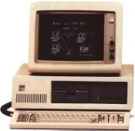
传统Client-Server架构使用模式
个人电脑
软件即服务
Web Presentation
Zoho
媒体播放器
浏览器
Sharepoint
Live Meeting
Data
邮件系统
Webex
Yahoo
办公软件
网络或
云
客户端
数据中心
Notes:
Transcript:
This is the history of my use of computers. I had that ugly old telephone and an IBM back in the '80s. And I had Office and I was able to use Office. And then with the network I got printing and then eventually I got email over the network and I was really happy about that, though, not anymore. And then Web browser came up and that allowed all these like very consumer-based content providers to occur. And then they got Rich Media with Adobe and Media Players and you start seeing Google with YouTube. But then over time you can see in the animation of the slides that more and more sites are becoming business-related, so like the Zohos and the WebExes and the SharePoints. So business sites have grown over time and this is sort of where we are today.
Author’s Original Notes:
In my career, the desktop started with a phone. Later, I got a PC with office that had a direct attached printer. Eventually, a network was created so that we could share printers. The Internet started and I got email. To centralize data, in some cases enterprises deployed file servers in lieu of unsecure local personal computer storage. Netscape created the browser and yahoo was all that. Microsoft came to market and added the media player for free. The likes of Google took off to find information. Webex and Microsoft live meeting were created to offer cross company collaboration. More recently, Google, Zoho, and others have recreated Office and Outlook in a web interface. At the same time, network access is growing with more availability through 3g/4g networks and access on planes and trains. We now have applications on the desktop that are also available in the cloud. The general application strategy of most organizations is cloud when you can and local when you must. Large companies like GE are outsourcing DNS, security proxy, and email to SAAS providers. It’s not long before they use SAAS providers for Office functions. If Cisco is to remain relevant in SAAS, we need to consider offering Microsoft Office like functions in Webex SAAS through partnership or acquisition.

Slide 28


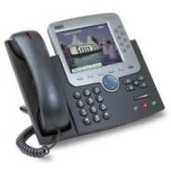
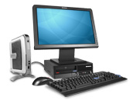
桌面虚拟化VDI实现方式
虚拟桌面
软件即服务
Zoho
媒体播放器
Web
浏览器
Sharepoint
Live Meeting
Data
邮件系统
Webex
Display Presentation
客户端显示
Yahoo
网络或
云
客户端
数据中心
Notes:
Transcript:
And the way the applications run, we're storing data with -- WAAS does this -- storing data into the data center towards the cloud.
Author’s Original Notes:
The cost to manage the blob of local applications we call the PC desktop, enterprises are looking to centrally virtualize the desktop and present the applications through a display protocol. This accomplishes centralization of data and lower cost management of the productivity applications installed on the desktop. Along with centralizing the desktop, the browser also ends up in the data center. Display protocols are challenged to deliver the browser rich media experience. As a result, display protocol vendors are racing to out of band deliver the portions of the browser experience that are not well delivered within a display protocol. In reality, a display protocol rich media experience will never be good as the local rich media experience.

Slide 29


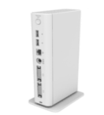
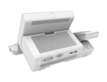



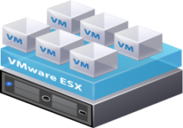
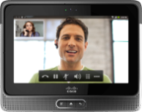








思科桌面虚拟化(VDI)端到端解决方案
虚拟化的数据中心
支持虚拟化的终端设备
CUPC
MS Office
Video
虚拟化的网络
Microsoft OS
虚拟化的终端设备
Desktop Virtualization Software
Cisco
Zero Client
分支机构网络
数据中心网络
Hypervisor
ISR
FC
Business Tablets
Thin Clients
Cisco
WAN
Nexus
Virtual QUAD
Virtual CUCM
Hypervisor
Cius
瘦客户端生态环境
WAAS
ASA
ACE
Broker
Cisco UCS
vWAAS
实现端到端安全，可靠的桌面资源分配
VSG
Notes:
Architectural viewpoint; start on the left
What we are going to have in our virtualized collaboration workspace is a set of our own devices and an ecosystem. We have partnerships established with some of the key vendors: Wyse, Devon IT and Igel. In the thin client market, there are two leading vendors and they share market, and then there a few others. The two that are splitting the majority of the market are Wyse and HP. We’re partnering mostly with Wyse.
In the network, one focus is performance optimization. There is a set of software on the desktop in the datacenter, and a little bit on the endpoint and between them is a desktop virtualization protocol. No industry standard right now. Citrix has ICA. VMware has PC over IP. And Microsoft likes RTP. We’re focused on these big three. Our product will be available next summer, and that will be VDS, virtual desktop service.
All packets are put together in a single stream and encrypted. Much of our network magic around quality of service, we can’t see inside those strings. With VDS, we’re working with partners to get certified to be able to look inside those desktop protocols and start applying intelligent network capabilities.
WAN acceleration is part of that.
Other pieces include policy. Because I’ve separated my access from my virtual desktop, the corporate can apply policy when you connect. If I’m in the building, I get access to all my applications. When I’m remote, on my iPad, the network knows I’m not inside the building and I might get access to some but not all of my applications. Can restrict financial data, for instance.
In the data center, at the storage level we’re partnering with EMC and NetApps for storage. We’re using UCS, with that running things like QUAD and CUCM. On top of that, hypervisor and desktop virtualization software, and then windows. We’re putting that all together and validating in an end to end system and providing the design guide to allow the customer to stand all that up and do it quickly and easily.

Slide 30



小于500桌面端：Citrix VDI-in-a-Box
解决方案概览
方案详述
Citrix VDI-in-a-Box 将连接代理，负载均衡，桌面配置，高可用性和管理功能集成到一台服务器中，实现All-in-One VDI, 易于安装和管理。为用户提供完整的使用体验
面向小于500用户的使用环境
业内最低的每桌面费用
OS可以采用免费版的
高性价比配置
基于C220 M3，使用 Intel Xeon E5
配置192 GB 内存 (可扩展至 512 GB)
可支持100 users，1.5G RAM / User
通过RAID实现内部冗余机制
高性能配置
基于C260 M2 ，使用Intel Xeon E7
配置256 GB内存 (可扩展至 1T)
可支持150 users，1.5G RAM / User
通过RAID实现内部冗余机制
其它信息
详细信息 请访问以下链接：CVD, RA, DG
  http://www.cisco.com/go/citrix
  XenServer 免费试用版下载：https://try.citrix.com/store?Action=DisplayPage&Locale=en_US&SiteID=citrixtr&id=QuickBuyCartPage
解决方案完整版: http://www.cisco.com/en/US/solutions/collateral/ns340/ns517/ns224/ns955/ns1099/citrix_solution_ov.pdf
UCS C-Series Rack-Mount Server
Notes:
This solution provides a simple and cost-effective way for small and midsize businesses (SMBs) to leverage the benefits of desktop virtualization. It is particularly well-suited to businesses with less than 500 employees, uniform workload requirements, and no plans for expansion.
The Citrix VDI-in-a-Box software integrates virtual application connection brokering, load balancing, desktop provisioning, high-availability, and management functions into a single package that runs on Cisco UCS servers with local or shared storage. Citrix VDI-in-a-Box also delivers anytime, anywhere application access with built-in support for Citrix HDX technology, which provides a rich user experience by optimizing network and virtual application performance.
The Citrix VDI-in-a-Box solution can be deployed on Cisco UCS servers in a single-node, multi-node, or multi-node with shared storage network design. In any of these designs, the servers can be implemented in either a Performance or Balanced configuration.

Slide 31



扩展到500个 or 以上桌面端 - FlexPod
服务器配置
5 x Cisco UCS C260 M2 Server 高配, 2 x Cisco UCS P81E VIC
网络和存储
2 x Cisco Nexus 5548 UP
NetApp FAS2240 存储
软件支持
虚拟化：Vmware vsphere， Citrix XenServer， Microsoft Hyper-V
VDI：Citrix XenDesktop， Vmware View
数据库：Microsoft SQL Server 2008 R2 Enterprise
管理：Vmware Virtual Center， Microsoft Systems Center
更多信息
http://www.cisco.com/en/US/solutions/ns340/ns414/ns742/ns743/ns993/landing_dcVirt-vdi.html
Virtual
Desktop #1
Virtual
Desktop #500
Hypervisor
AD Server
Infra
Network
SQL
Server
Nexus
5548 UP
Virtual Center
Cisco UCS C260 M2
Citrix Provisioning Server
Storage
1 GE (infra)
10 GE (NFS)
可以选配GPU来满足某些特殊用户的需求

Slide 32
VM on UCS C 丰富的技术文档支持
  VM-FEX技术和相关产品的解释性文档
    Palo卡的文档：http://www.cisco.com/en/US/prod/collateral/ps10265/ps10493/data_sheet_c78-558230_ps10279_Products_Data_Sheet.html
    VM-FEX的文档：
    http://www.cisco.com/en/US/netsol/ns1124/index.html
    虚拟化感知网络的文档：
    http://www.cisco.com/en/US/prod/collateral/modules/ps10277/ps10331/white_paper_c11-618838_ns1124_Networking_Solutions_White_Paper.html
  VM-FEX的实施文档，解决用户对实施的困扰
    VM-FEX和VMWare的文档：http://www.cisco.com/en/US/solutions/collateral/ns340/ns517/ns224/ns944/vm_fex_best_practices_deployment_guide_ns1124_Networking_Solutions_White_Paper.html
    VM-FEX和VMWare的排错文档：
    http://www.cisco.com/en/US/solutions/collateral/ns340/ns517/ns224/ns944/basic_troubleshooting_vm_fex.html

Slide 33
大数据解决方案 (Big Data)

Slide 34

大数据解决方案
解决方案概览
方案详述
^{完整的软硬件集成解决方案，满足大数据的需求}
^{高性能，可扩展性，可用性和可管理性}
^{整个系统为最苛刻的应用提供了可预测的带宽和延时}
^{快速部署}
经过验证的数据中心架构, Cisco UCS C系列服务器使用 Intel® Xeon® 处理器
通过简化基础架构和模块化建设来减少总拥有成本 (TCO)
通过 Cisco NX-OS系统来提供业务的弹性和连续性
能兼容现有的运行和管理模式，易于部署
Cisco Nexus 5500 加上 Nexus 2200 交换机在不牺牲性能的前提下降低总拥有成本(TCO)
更易于管理
其它信息
多种协同解决方案: Hadoop, Cloudera, Oracle NoSQL
Cisco on Big Data: http://www.cisco.com/go/bigdata
建议配置
  UCS-EZ-BD-HC – High Capacity
  UCS-EZ-BD-HP – High Performance
Notes:
The new approach to managing big data is based on a "shared nothing" architecture for distributed data storage with enormous scalability. This model incorporates new building blocks with the information-processing power to accommodate big data. One size no longer fits all; enterprises must determine which building blocks to use, where, and how - and how to integrate them into current business models, data strategies, and network infrastructures.
This is a complete solution for Big Data that allows performance, scalability, availability and manageability. Based on simple infrastructure and a building block approach, this solution uses Cisco UCS-C-Series Rack-Mount Servers with Cisco Nexus 5500 Platform and Cisco Nexus 2200 Series Fabric Extenders to deliver low TCO and ease of management without sacrificing performance.

Slide 35













大数据解决方案
Big Data
Enterprise Applications
UCSM
部署，管理，监控
Cisco Tidal Enterprise Scheduler
Hadoop Connectors
可扩展的多数据中心架构，用于灾难恢复和保障业务连续
Availability Backup Snapshot
UCS
机架式服务器
UCS
刀片服务器
存储阵列

Slide 36
SAP HANA解决方案

Slide 37


SAP HANA 解决方案
解决方案概览
方案详述
中等规模 (4路, 512 GB)
Cisco UCS C460 M2
2.4 GHz Intel Xeon E7-4870 CPU
16GB DDR3-1066MHz RDIMM
300 GB SAS Drive
LSI MegaRAID Controller 9260-8i
FusionIO 320GB MLC PCI-X card
MINI规模 (2路, 128 GB)
小规模(2路, 256 GB)
Cisco UCS C260 M2
2.4 GHz Intel Xeon E7-2870 CPU
8GB DDR3-1333MHz RDIMM
600 GB SAS Drive
100 GB SSD Drive*
LSI MegaRAID Controller 9261-8i
SAP High-Performance Analytic Appliance (HANA) 提供了对SAP商业系统的实时访问，并利用内存计算架构统计分析业务流程
Cisco 与SAP一起提供了差异化的，可扩展，高安全的端到端解决方案，同时降低了部署风险，系统复杂度和总拥有成本
其它信息
Cisco SAP解决方案: http://www.cisco.com/go/sap
Cisco Design Zone 里的SAP设计: http://www.cisco.com/en/US/solutions/ns340/ns414/ns742/ns743/ns751/landing_sap.html
建议配置
  UCSC-C260M2-HANA - Small
  UCSC-C460M2-HANA - Medium
Notes:
SAP HANA provides a flexible, cost effective, real-time approach for managing large data volumes, allowing organizations to dramatically reduce the hardware and maintenance costs associated with running multiple data warehouses and operational and analytical systems. Cisco and SAP provide differentiated, scalable, highly secure end-to-end solutions, while reducing deployment risks, complexity, and total cost of ownership (TCO). There are 3 sets of bundle available – XS Size, S Size and M Size based usage and capacity required.

Slide 38
微软(Microsoft) on UCS解决方案

Slide 39


SQL Server 数据库
解决方案概览
方案详述
减少硬件测试和调优过程
提供更好的数据仓库性能
降低总拥有成本，更好的性价比，可管理性，快速部署能力
行业标准的硬件
基于Cisco UCS 机架式服务器，可工作在独立环境或者作为UCS统一架构的一部分
使用EMC VNX系列存储设备, 提供了更好的性能水平，数据保护，合规性，更易于管理
针对中小型企业和大型企业配置
满足企业数据仓库的需求
在使用SQL Server 2008 R2 Enterprise时，支持8T到40T的数据压缩功能
其它信息
Cisco 的Microsoft 解决方案 http://www.cisco.com/go/mircosoft
Cisco, EMC 对MS SQL 解决方案白皮书: http://www.cisco.com/en/US/solutions/collateral/ns340/ns517/ns224/ns944/emc_fast_track_reference.pdf
Notes:
Microsoft SQL Server Fast Track is a joint solution with EMC. This is a medium and large enterprise configuration designed to meet a broad range of data warehouse requirements, scaling from 8 up to 40 terabytes using compression capabilities in SQL Server 2008 R2 Enterprise.This solution is based on Cisco UCS C-Series Rack-Mount Server with Cisco Nexus 5000 Series switches, designed to operate both in standalone environments and as part of Cisco unified Computing System.

Slide 40


Exchange 2010 – 企业级邮箱
解决方案概览
方案详述
在Cisco UCS 240 M3 上部署
1 / 2 Datacenter (Active/Passive)
基于站点恢复的技术的高可用
1500 Mailboxes
    User Profile: 每天每个邮箱发送/接受150个邮件
    2GB 邮箱
    启动Exchange Active Sync
    客户端: Outlook 2010 缓存模式
2200 Mailboxes
    User Profile:天每个邮箱发送/接受100个邮件
    1 GB 邮箱
    客户端: Outlook 2010 缓存模式
2 RU 服务器最大可支持 3700 和邮箱
硬件网卡绑定
使用Hyper-V虚拟化部署
  3 Mailbox Server虚拟机
  3 CAS/Hub虚拟机
  3 Domain Controller 虚拟机
物理Exchange Server部署
  3 台服务器运行集成的 Mailbox, Hub & CAS
  3 Domain Controller 虚拟机
当单台服务器故障或服务器下线维护时对应用性能没有明显影响
其它信息
Cisco 的Microsoft 解决方案 : http://www.cisco.com/en/US/netsol/ns1154/index.html
白皮书:
http://www.cisco.com/en/US/solutions/collateral/ns340/ns517/ns224/ns955/ns963/MS_ENT_Challenges_UCS_Exchange.pdf
Virtualized l Server Topology
Physical Server Topology
Notes:
Need Info

Slide 41

Microsoft SharePoint 2010
解决方案概览
方案详述
Microsoft SharePoint Server 2010环境包含了用来提供核心应用和提供服务的各种服务器，它们组成SharePoint Farm，为用户提供不同的功能
这是一个典型的三层架构的应用，每一个Sharepoint的应用层 (Web, Application, 和 Database)都部署独立的服务器
万兆以太网，统一架构网络与企业级 x86机构服务器
刀片服务器 - Intel Xeon E5系列处理器
通过提高虚拟环境的可扩展性，性能和操作控制实现完全的虚拟化
通过统一网络访问SAN 和 NAS存储.
Cisco UCS Manager管理软件
Cisco UCS 6200 系列:
  高性能的统一网络架构，线速，低延时，不丢包的万兆以太网和FCoE
  UCSM实现统一管理
  针对虚拟化的优化，支持VM-FEX技术
其它信息
Cisco 的Microsoft 解决方案: http://www.cisco.com/go/mircosoft
白皮书: http://www.cisco.com/en/US/solutions/collateral/ns340/ns517/ns224/ns955/ns963/MS_ENT_Challenges_UCS_Sharepoint.pdf
Notes:
This is a Microsoft SharePoint Server 2010 Environment comprising of various servers which collectively hosts the core applications and provide services, termed as SharePoint Farm is responsible for providing various functions to its users. The solution is based on a three-tier architectural topology in which the SharePoint tiers (Web, Application, and Database) are deployed using independent servers responsible for each tier.

Slide 42
经济型存储(Storage)解决方案
-- C240

Slide 43

Windows Storage Server
解决方案概览
方案详述
UCS 单点管理
端到端的万兆网络和QoS
VM-FEX技术支持Windows 2012 Hyper-V
通过UCS VM Port Profiles ( VLAN, QoS, MTU)实现统一的网络管理
与 UCS VM-FEX网络配置和策略整合，更好地支持虚拟机的实时迁移
Hyper-V 虚拟交换机接入到物理交换，提供了更高的带宽和更低的延时
支持多种存储协议.
  iSCSI block storage
  SMB file storage
万兆上行链路的故障切换功能
  Windows 2012 NIC teaming
Windows 2012 存储空间
  SSD存储的性能优化
  SATA存储的空间优化
  使用15K SAS的iSCS同时满足性能/空间优化需求
其它信息
为 MS Win Server 2012 准备的解决方案
白皮书在9月底交付
Notes:
Need Info

Slide 44
配置建议

Slide 45
建议配置

Slide 46
建议配置

Slide 47

UCS C460 M2 解决方案
UCS C460 M2机架服务器满足数据中心大量关键应用需求
UCS C460 M2
高性能机架服务器
适用于企业级的计算和内存密集型关键业务
虚拟化
VDI/VXI虚拟桌面解决方案
应用服务器虚拟化
云计算服务
数据库/消息
企业级关键应用
大型数据库
内存/处理性能密集型应用
内存/处理性能密集型HPC，ERP应用
企业关键应用
Notes:
47
Fix the bullets…migrate to live directly…redundant partner logos……
Slight variation…duplicate, make bigger and legible…different are the headlines…
EDITS to graphics:
1st col., 3d group: Memory Intensive Apps > Memory-Intensive Apps; Memory Intensive HPC Apps > Memory-intensive HPC apps; Memory Intensive ERP Apps > Memory-intensive ERP apps
2d col., 1st group: Performance-intensive VM’s > Performance-intensive VMs; High consolidation opportunities > Many consolidation opportunities; Widen the scope of virtualization > Wider scope for virutalization
2d col., 2d group: Enterprise/Mission Critical > Enterprise/Mission-critical; Large Single Instance Database > Large single-instance database
2d col., 3d group: Memory/Processor Intensive Apps > Memory/Processor-Intensive Apps; Memory/Processor Intensive HPC, ERP Apps > Memory/Processor-intensive HPC, ERP apps; Enterprise/Mission Critical > Enterprise/Mission-critical

Slide 48

Cisco UCS C460M2: 最好的虚拟化性能
VMware VMmark 2.1 benchmark测试最新世界纪录由UCS C460 M2创造
VMware VMmark 2.1 benchmark测试包含最重要的几项VMware ESX的功能，如： DRS; vMotion; Svmotion (Storage vMotion)
VMware® VMmark™ 2.1 benchmark 测试值： 35.06 @ 35 tiles
是第二名的测试结果的121%!*
UCS C系列一共创造了11项Vmmark世界纪录
VMware VMmark 2.1 测试配置
• 4节点 UCS C460 M2服务器群
• 10核Intel Xeon E7-4870 CPUs—共 160 个核
• Nexus 5K交换机作为接入
• EMC VNX存储
前所未有的云计算环境的虚拟化能力和强大的可扩展性

Slide 49





2 x C460 +N5K +SAN
-传统双机备份H/A部署方式
standby
C460
active
active
standby
IP 交换机
FC SAN交换机
N5548 FCoE交换机
SAN存储
SAN存储
传统方式
CISCO UCS
Notes:
传统的DB部署方式：采用OS等级的HA，2个节点 –active /standby

