Slide 1
Sales Collaboration Platform
New Enhancements & Capabilities
May 20th, 2013

Slide 2
SCP May Release Content
Mobile Application
New View of Target Prospect Lists
Enhanced PSR Assignment
Uploading Partner Leads into SCP
Bulk Assignment of Leads and Target Prospects

Slide 3
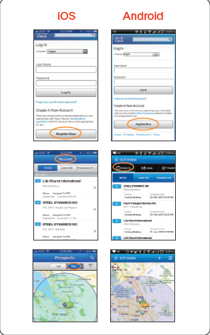
Cisco Sales Collaboration Mobile Application
Take the Platform with you when you leave the office by using the SCP mobile app, available for Apple iOS (*) & Android smart phones and tablets
SCP Mobile
An extension of your desktop – intuitive and easy to use
Easy to download from iTunes and Google Play
Download the Android SCP Mobile app from Google Play
Download iOS SCP Mobile app from the App Store
New in May – Local Language Support
Americas Supported Languages
English, Spanish (*), French (*), Brazilian Portuguese
Partners can visit Sales Collaboration Platform page in Partner Central
(*) Apple iOS only supports European Spanish & French

Slide 4
SCP Target Prospect List View
View your Target Prospects by Geography, Target Architecture, Propensity to Buy, Wallet or Industry
SCP users can now choose to view their Target Prospects by:
Geography
Target Architecture
Propensity to Buy
Wallet
Industry
Once you chose your view, you can still click on any column header to sort Target Prospects displayed

Slide 5
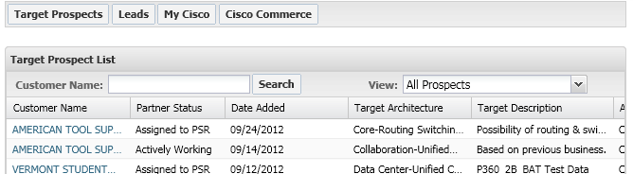
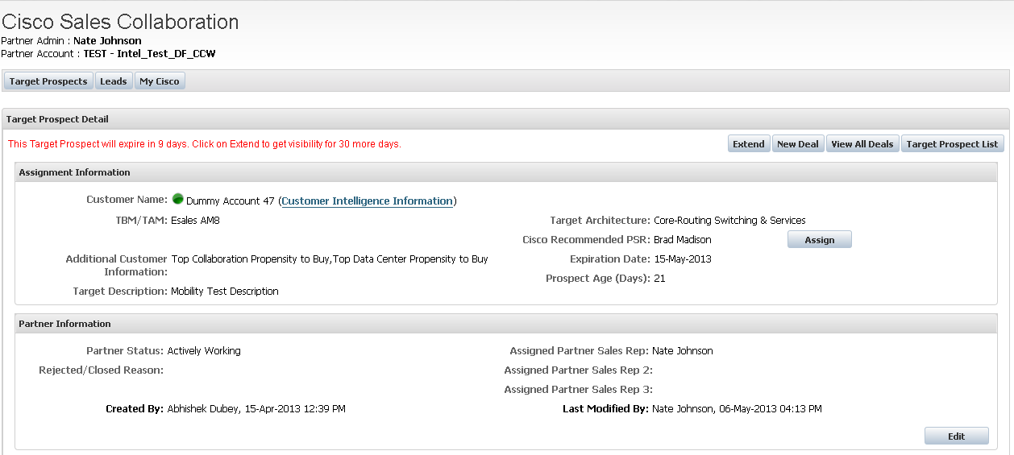
Enhanced PSR assignment by PA
1) Partner Admin opens a Target Prospect from the SCP Home Page
2) Check if your Cisco Sales contact has recommended a PSR
3) If you would like to assign the Target Prospect to the PSR who has been recommended just click on “Assign” button
4) If you would like to assign the Target Prospect to another PSR just click “Edit” button and assign as usual

Slide 6
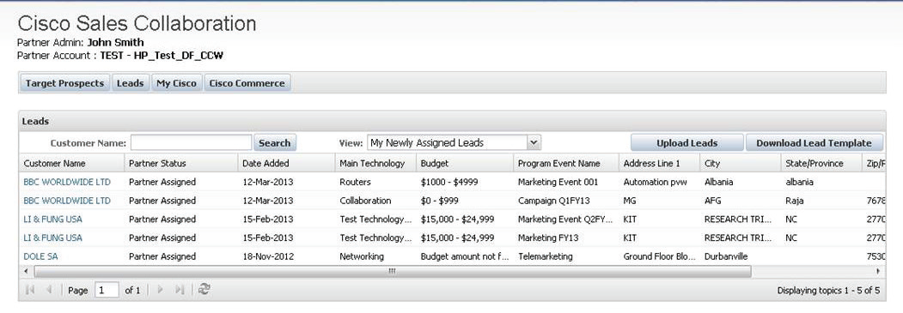
Partner Lead Upload
1) Select the “Download Lead Template” from the Leads tab in SCP and follow instructions to populate required data
2) Go back to the Leads tab in SCP and select the “Upload Leads” button and follow the prompts
Note: You will be given the option to download Lead Upload Results. View this file to identify any rejected records. Correct and repeat the process

Slide 7
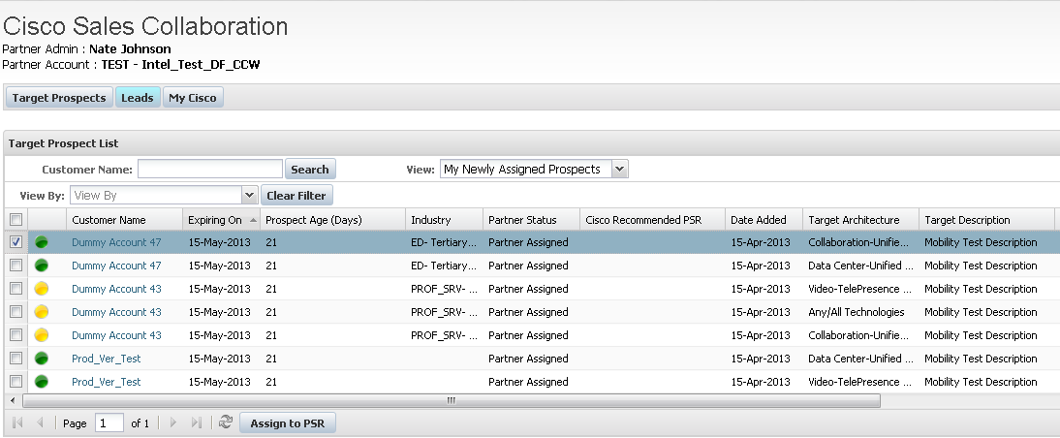
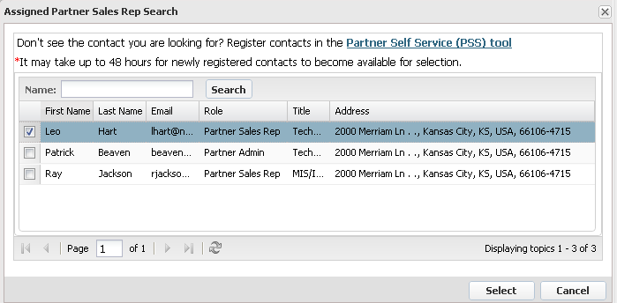
Bulk assignment of Leads & Target Prospects to PSR
1) Partner Admin views “My Newly Assigned Prospects”
2) Click the Target Prospects that you wish to Assign / Share with your PSR
3) Click Assign to PSR
4) Select PSR from list
5) Click on “Select” button - All selected Target Prospects will now be shared with the chosen PSR

Slide 8
Cisco Support & Resources
Please reach out to your Cisco Partner Account Manager or Territory Manager; the Platform is designed for you to work together.
For Technical Support Using the Platform
  Please contact the Partner Relationship Team (PRT)
For Technical Support Using SCP Mobile
  Contact SCP Mobile email support: scp-mobility-support@cisco.com
Information, Training, and Videos
  View and/or download resources at Cisco Sales Collaboration Platform

