Slide 1
Cisco Sales Collaboration Platform Partner Introduction
Speaker Name
Speaker Title
Date
Helping Partners Take the Lead
Notes:
Use this deck as an overview introduction to the Platform for Partners, particularly during the onboarding process. Can also be used internally. Add/remove slides as appropriate to the Region and situation - e.g. In Participation & Next Steps section.

Slide 2
Agenda
Cisco’s Partner Led approach
Overview of the Sales Collaboration Platform
Features and Benefits
Participation and Next Steps
Q&A
© 2012 Cisco and/or its affiliates. All rights reserved.
Cisco Confidential
2

Slide 3
What is Cisco Partner-Led?
Cisco’s go-to-market model which empowers and rewards Cisco Partners to lead customer engagements in mid-sized and small businesses.
© 2012 Cisco and/or its affiliates. All rights reserved.
Cisco Confidential
3
Notes:
Scene-setting. One sentence description of Partner Led.
Presenters can call out Mid size or SMB Public Sector or SP in the voice over.

Slide 4
Agenda
Cisco’s Partner Led approach
Overview of the Sales Collaboration Platform
Features and Benefits
Participation and Next Steps
Q&A
© 2012 Cisco and/or its affiliates. All rights reserved.
Cisco Confidential
4

Slide 5
The Cisco Sales Collaboration Platform is a new way for Cisco to work closely with our partners to accelerate growth by sharing leads, prospects and customer intelligence, where available, with partner sales teams. The Platform integrates with Cisco Commerce Workspace (CCW) to track leads and prospects through to deal creation.
Notes:
So, what is Cisco’s vision for the Sales Collaboration Platform? .... We’ve invested in this global platform because we want to collaborate even more closely with our partners, to become even better at driving incremental revenue through your pipeline.

Slide 6
Acceleration Through Collaboration
Cisco Sales Collaboration Platform
Accept and Assign to Sales Rep
Target Prospects
Uncovered Prospects
Early Opportunity Engagement
Suggested Marketing Campaigns
Integrated Lead and Prospect Management
Tracking to Deal
Receive Leads and Prospects with Customer Intelligence*
Engage with Customer and Update
Cisco Provided Leads
Partner Provided Leads
Close Business
Convert to Deal with One Click to CCW
*Where available
Notes:
We have the opportunity to improve the effectiveness and profitability of partner sales teams through early account engagement with Cisco sales and the use of customer intelligence, which includes wallet data and suggested marketing campaigns. Essentially, by integrating our teams and efforts from the start - and throughout the sales cycle - we believe that together we can accelerate and increase revenues. CCW is Cisco Commerce Workspace.

Slide 7
Key Partner Benefits
Target Prospect Engagement focus on high-potential accounts
Early Visibility of Opportunities for early account engagement
Lead and Prospect Management improved business visibility
Joint Progress Tracking improved sales planning and resource management
One-Click Convert to Deal simpler process, less data entry
Accelerating opportunities through collaboration
Notes:
You’ll want to know what’s in this collaboration for you…..
The earlier sales engagement and focus on high potential accounts (Target Prospects & Leads).
The potential new business from Uncovered Accounts.
The integrated process for simplified deal creation.
The potential for reduced channel conflict from improved sales planning and resource allocation.
CM: Need to verify that this is the actual view of the partner; not sure that all this is visible to the partner.

Slide 8
Platform Users/Partner Two Sales Collaboration user types
Target Prospects
Accept and Assign to Sales Rep
Uncovered Prospects
Receive Leads and Prospects with Customer Intelligence*
Early Opportunity Engagement
Suggested Marketing Campaigns
Integrated Lead and Prospect Management
Tracking to Deal
Engage with Customer and Update
Cisco Provided Leads
Partner Provided Leads
Close Business
Convert to
Deal with One
Click to CCW
*Where available
Partner Admin (PA)
Partner Sales Rep (PSR)
Enrolls your company in the Platform.
Grants access to your PSRs and other employees.
Responsible for accepting or rejecting leads and prospects for your company.
Assigns leads and prospects to your PSRs.
Sales people at your company.
Accept/reject, and update leads and prospects in the Platform.
Enter deals in Cisco Commerce Workspace (CCW).
For some partners, this is a sales administrator role.
Partner Admin can also perform the role of the Partner Sales Rep
Notes:
We’ll talk about this in more detail at the end, but for now I wanted to explain that you’ll have two different User Types on the Platform. In essence, the Partner Admin performs functions for your company and the PSR does the actual sales tasks. However, the Partner Admin can do both. You can have more than one Partner Admin and many PSRs.

Slide 9
Agenda
Cisco’s Partner Led approach
Overview of the Sales Collaboration Platform
Features and Benefits
Participation and Next Steps
Q&A
© 2012 Cisco and/or its affiliates. All rights reserved.
Cisco Confidential
9

Slide 10
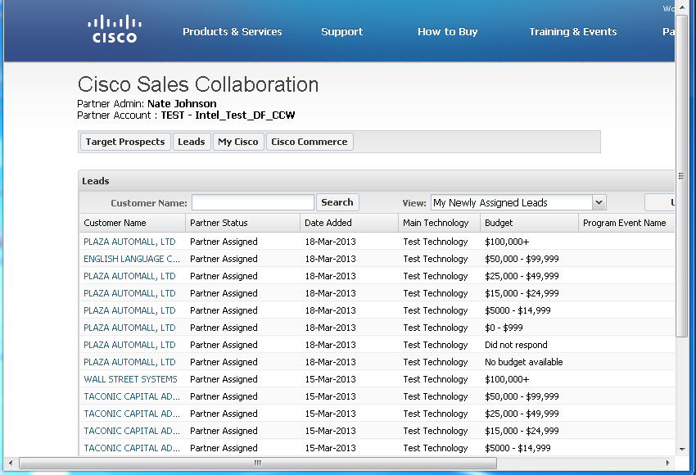
Leads
A company/account that has expressed an interest in a Cisco solution, and that is qualified by Cisco, a vendor, or a partner, to have budget, need, and timeline.
Sales Collaboration
Cisco will upload leads to the Platform, to the Partner Admin
Partner assigns Sales Rep, engages with customer and converts to Deal in CCW.
Partner can upload their own leads, assigned to a Sales Rep.
Partner Benefits
Improved Collaboration
Faster Routing to Partner
Faster Conversion of Leads to Deals via CCW
Notes:
And likewise with Leads, we should be able to act faster on valuable Leads, tracking progress through to success. Where available, CI can also be attached to Leads. As always, processes vary in Regions.

Slide 11
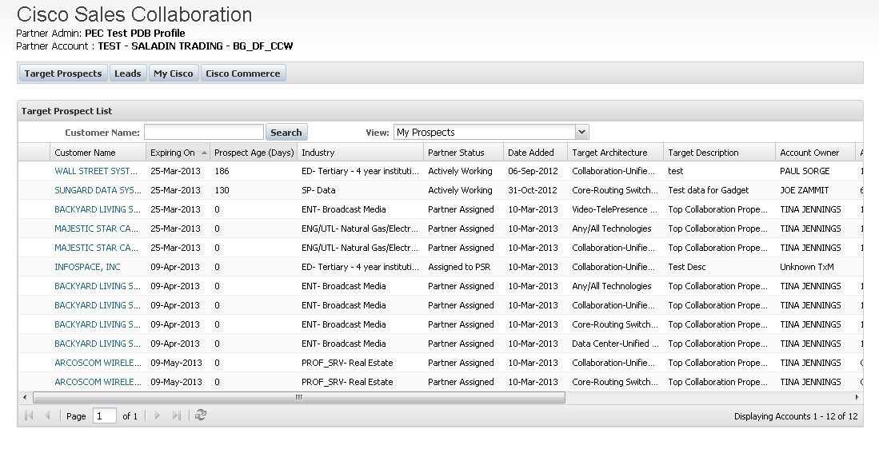
Target Prospects
A company/account that, based on intelligence and analytics, has high potential to generate sales opportunities for one or more technologies or solutions.
Sales Collaboration
Cisco will identify and upload high potential account lists, with available Customer Intelligence (CI) where available
Partner assigns Sales Rep, engages with customer and converts to Deal in CCW.
Partner Benefits
Allocate your teams to high-potential accounts.
Engage early with the customer
Alignment with Cisco Sales Teams
Notes:
This is where together we can get ahead of the game - by sharing Target Prospects so that you can focus your sales teams on the accounts with the most potential for success. And get in early.

Slide 12
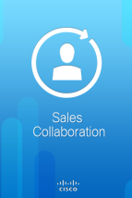
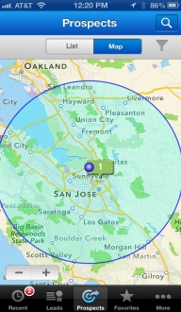
Cisco Sales Collaboration Mobile
Take the Platform with you when you leave the office by using the mobile app on iPhones and iPads (iOS) and Android phones and tablets
SCP Mobile
An extension of your desktop.
Easy to download from Apple and Google appstores.
Familiar views of leads and prospects
View records in a Map View
Create a Favorites list.
Accept and assign records as usual.
Create notes, tasks and events on the go.
Partner Benefits
Receive and work on Cisco prospects and leads using powerful mobile features.
Notes:
And you won’t have to leave the Platform behind when you leave the office! Take advantage of the easy to use mobile app to continue receiving and working on leads and prospects with Cisco. Keep all your communications about leads & prospects in once place by adding notes, tasks and events - avoiding multiple emails. Use the additional mobile features of map views and the favourites list.
CM: Canada will not be releasing this until May given that local language is not available
Leave in, but make sure to mention this will be coming in may
CM: need confirmation with US and LATAM team. may want to do a small launch for this capability

Slide 13
Agenda
Cisco’s Partner Led approach
Overview of the Sales Collaboration Platform
Features and Benefits
Participation and Next Steps
Q&A
© 2012 Cisco and/or its affiliates. All rights reserved.
Cisco Confidential
13

Slide 14
Participation and Next Steps
Your Cisco sales contact will support you during onboarding:
To identify and enroll your users
Training – from Enrollment to using the Platform
Ensuring Target Prospects and/or Leads are available for you in the Platform
Ongoing planning, sales and review engagement
Joint tracking and reviews
Download resources at: www.cisco.com/go/salescollaborationplatform
Technical Support at: www.cisco.com/go/prt/
Notes:
Localised instructions …

Slide 15
Participation and Next Steps Two Sales Collaboration user types
Target Prospects
Accept and Assign to Sales Rep
Uncovered Prospects
Receive Leads and Prospects with Customer Intelligence*
Early Opportunity Engagement
Suggested Marketing Campaigns
Integrated Lead and Prospect Management
Tracking to Deal
Engage with Customer and Update
Cisco Provided Leads
Partner Provided Leads
Close Business
Convert to
Deal with One
Click to CCW
*Where available
Partner Admin (PA)
Partner Sales Rep (PSR)
Enrolls your company in the Platform.
Grants access to your PSRs and other employees.
Responsible for accepting or rejecting leads and prospects for your company.
Assigns leads and prospects to your PSRs.
Sales people at your company.
Accept/reject, and update leads and prospects in the Platform.
Enter deals in Cisco Commerce Workspace (CCW).
For some partners, this is a sales administrator role.
Partner Admin can also perform the role of the Partner Sales Rep
Notes:
So now you could start thinking about who you’ll want to use the Platform - i.e. the people who will work hand-in-hand with Cisco sales.
Remember the Partner Admin is the person who enrolls your company in the Platform and grants access to other employees and contacts. They accept or reject and assign Leads and Target Prospects to (PSRs). They can also perform the functions of the PSR.
The PSRs are sales people at your company. They accept or reject and update Leads and Target Prospects in the Platform, and enter deals in CCW.
You can have more than one Partner Admin and many PSRs.

Slide 16
© 2012 Cisco and/or its affiliates. All rights reserved.
Cisco Confidential
16

