Slide 1
The latest and greatest
Advantage Now
Cisco Sparkのご紹介
シスコシステムズ合同会社
2016 年10月 6日
Brand team
Released: March 2016
Making our PowerPoint simpler and more distinctive.

Slide 2
Organization Health
「Agile」である事が求められている
上位1/4に属する企業の 70% は Agile
強い
Start-up
Agile
23%
70%
スピード
Trapped
Bureaucratic
5%
17%
弱い
強い
安定性
Source: Mckinsey & Company: Why Agility Pays, Research Study, December 2015
McKinsey & Company, Dec 2015 http://www.mckinsey.com/insights/organization/why_agility_pays
Notes:
McKinsey & Co: http://www.mckinsey.com/insights/organization/why_agility_pays; December 2015
New research by McKinsey shows an analysis on a study of 37 management practices and the incremental contributions of specific organizational and leadership characteristics to the health, positive and negative. This is based on surveys of over 2 million respondents at over 1000 companies. The research shows that the trick for companies is to combine speed with stability.
McKinsey describes companies that combine speed and stability as “Agile”.
Speed measured by (respondents observations)
a) how often leaders made important decisions quickly
b) organizations adjusting rapidly to new ways of doing things
Stability measured by (respondents observations)
Organizations implementing clear, operational goals and metrics
Setting clear standards and objectives for work
Establishing structures that promote accountability
Designing jobs with clear objectives
Devising processes to document knowledge and ideas
[Give a couple of customer examples]
In 4 of the 37 practices—financial management, financial incentives, capturing external ideas, and involving employees in shaping a company’s vision—speed and stability had a particularly striking impact.
70% of companies who ranked in the top quartile of organization health are Agile.

Slide 3
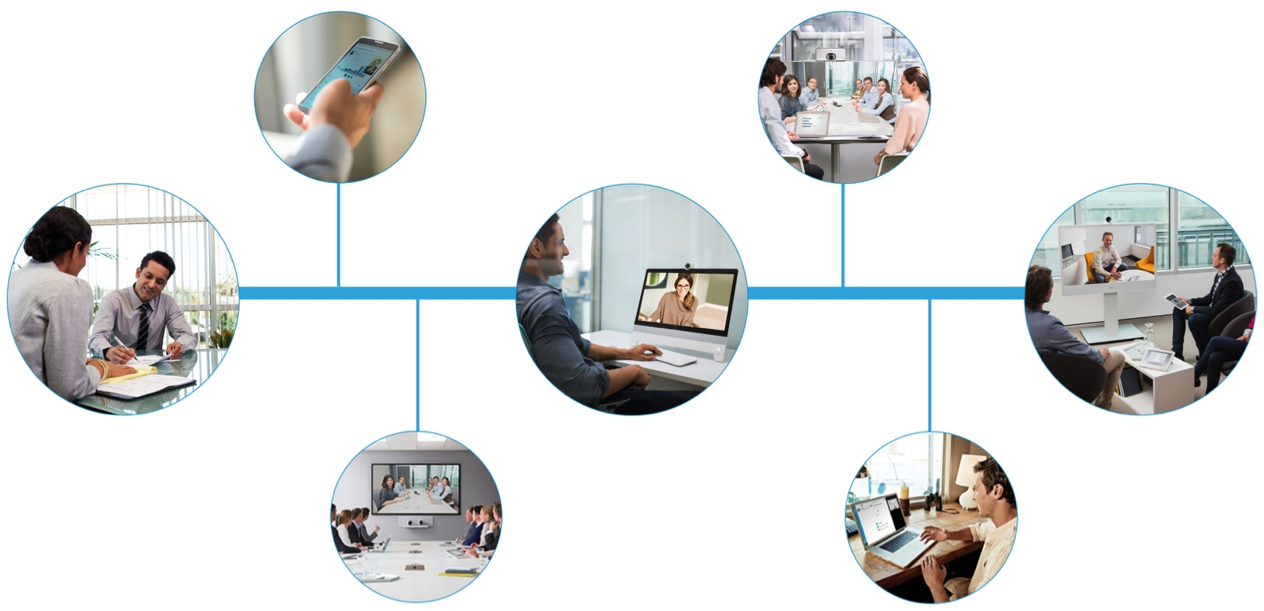
対応できる俊敏な組織・チーム作りのために
モバイルでの 会議
対面での F2F会議
個人での会議
チームでの
会議
途切れないワークフロー
© 2016 Cisco and/or its affiliates. All rights reserved. Cisco Confidential
3
Notes:
Collaboration is about continuous workflow
A constant loop of ongoing collaboration – Anywhere, Anytime and Any Device.
From the pocket to the boardroom - One solution does not fit all – Cisco is the only one in the market who can deliver this.

Slide 4
仕事場における必須ツールに
電話
メール
グループ コラボレーション
2018年までに50%のグループ コラボレーションとコミュニケーションは モバイルでのグループ コラボレーション アプリ経由で実行される - Gartner
Notes:
Email and call Control have been the go-to-tools for business for decades. It makes sense, we all sat in our office at our desktop and our phone and email gave us a way to collaborate and share content easily with anyone we worked with- even people outside of our company. We spent more of our time between these two and if they went down we couldn’t get any work done. Email is sticky because discussions get started there and content is shared.
But we all know this is changing- workers no longer sit at desks, we’re out working all over the world.
And so email moved with us, to the new tiny computer we keep in our pocket. That’s great…except that this new tiny computer in my pocket also does a bunch of things. It can make calls, and video calls, it can send SMS messages- it has enabled so many new ways of communicating.
Control points evolve based upon how people work and the tools they have available to them. It’s already shifting.
The second piece of evidence is: the booming success of Slack. And, I don’t mean just in terms of active users. I mean in terms of engagement. When users are active on Slack, they are really active. It is an incredibly sticky platform. 320 minutes on a weekday? Holy cow – that’s 6 hours!! HOURS!! Users who use slack, they LIVE there. And whenever users live somewhere, that place becomes a centerpoint of control where everyone else wants to integrate.

Slide 5
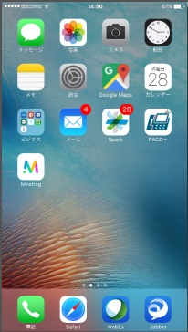
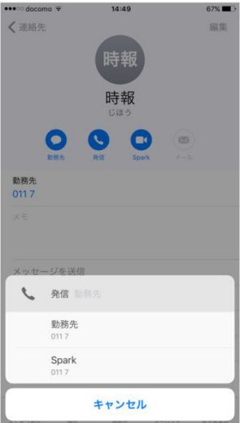
Cisco Spark
場所/ デバイスに依存せず、いつでも簡単に
チームやグループで コラボレーション。
電話（外線・内線）、仮想会議室への接続も可能。
電話帳からSparkで発信

Slide 6
デモ

Slide 7
でも、 Sparkってただのチャットツールだよね？
違います

Slide 8
チャットは機能の一部にすぎません
一般のビジネス チャット
Cisco Spark
テキストによるチャット、資料共有がメイン
自社内のグループに限定
情報が湯水のように流れ後から検索しにくい
通信のみ暗号化
外部サービスとの連携が不可
デバイスの仕様変更により不具合が多い
社内にある電話やテレビ会議とはつながらない
チャット、資料共有、仮想会議室へ接続、ソフトフォン、カレンダー
部門やプロジェクト単位、社外メンバーを入れたグループも作成可能
情報のマーキング、自分あて、部屋、人単位での強力な検索機能
通信、データを全て暗号化
100を超えるサードパーティと提携（MS, Box , サイボウズなど）
Apple と提携をしユーザの利便性を向上
電話をかけたり会議に参加をしたり１つのアプリに集約

Slide 9
Cisco Spark サブスクリプション
無償版
無制限の ルーム作成 と参加者
1:1 および グループ メッセージング
ファイル共有
1:1ビデオ電話
3名までの
ビデオ会議
10 サービス との統合
モバイル カレンダー 連絡帳の統合
オンライン
セルフ サポート
エンドツゥエンド
の暗号化
有償版
M1 | M2 | M3
ビジネス メッセージング | ビジネス メッセージング と ベーシック ミーテイング | ビジネス メッセージング と アドバンスト ミーテイング
無償版の全ての機能 + ライブサポート ルームの管理、管理ポータル AD, MS Exchange, CUCM(Call) 連携 | M1の全ての機能 + 25名までのビデオ会議 | M2の全ての機能 + WebEx Meeting Center (200名/会議) Personal Meeting Room Collaboration Meeting Room Cloud
Notes:
Spark offers are structured around how teams work. If you are an organization in the midst of a shift to an agile team transition, you are probably evaluating tools that are mobile centric and focus on persistent messaging and file sharing. Spark automatically comes equipped with that functionality and administrators now have the option to further secure the messaging experience with the Message subscription. It enables:
Room moderator capability to ensure that users can “lock” rooms to control who can add other people
Indicators next to the room name in rooms where there are external participants, giving users added levels of insights as to who is in their rooms so they can use discretion when sharing content
Unlimited integrations with other applications and services
Single Sign-On (SSO) to require company-approved passwords that adhere to corporate security standards
Active Directory sync for real-time management of employee lifecycle changes and access to data
Live support
Note: A compliance export is also available so a designated company representative can obtain a log of company messages and files in the event of a court ordered subpoena
There is also a meetings focused offer. What steers a customer to one offer over another is: do you expect your teams to use real-time meetings? With the Message and Meet offer, real-time meetings become available right in rooms. Teams of up to 25 can meet and share screens right in the moment – right when they need to gain rapid alignment and accelerate decision making from any device. Additionally, Cisco delivers WebEx, the market-leading conferencing solution. WebEx licenses are part of our meetings-focused Spark offer. WebEx can integrate up to 1000 global audio and video users and includes a vast array of meeting tools and host controls. With the Message and Meet offer, teams now have a secure persistent team collaboration experience AND access to a top conferencing tool for larger, more structured meetings where key information needs to be disseminated to a broad set of teams and stakeholders.
Localization:
English (US and UK), Chinese (Simplified and Traditional), Danish, Dutch, French (France), German, Indonesian, Italian, Japanese, Korean, Norwegian, Polish, Portuguese (Brazil), Russian, Spanish (Spain and Latin America), Swedish, and Turkish.
Support
Online Support content localized in English (US), Chinese (Simplified and Traditional), French, German, Japanese, Korean, and Spanish (Latin America).
Telephone support will match WebEx support availability. TS language line available for real-time translation of local languages. For full list of countries, see: https://support.webex.com/MyAccountWeb/needsupport.do?userType=ht.
Availability: Service and subscription availability: www.cisco.com/go/spark-availability
View the Cisco Spark ordering guide for detailed and up-to-date information on pricing and packaging.
Cisco Spark Product capabilities, subscription packages, and availability are subject to change.

Slide 10
3
Cisco Spark オファーの全体
日本で未販売
日本で販売
C3
追加
C2
M3 のすべて プラス
Cloud Calling*
ビジネス クラスの音声とビ デオ
モビリティ
ボイス メッセージング
ルームの
登録
ルーム エンドポイントの Spark クラウドへの接続
C1
M2 のすべて プラス
Cloud Calling*
ビジネス クラスの音声とビデオ
モビリティ
ボイス メッセージング
2
M1 のすべて プラス
Cloud Calling*
ビジネス クラスの音声とビデオ
モビリティ
ボイス メッセージング
会議
音声
有料のダイヤルインと
コールバック
M3
M2
M1
M2 のすべて プラス
WebEx 活用ミーティングの開催（外部参加者との画面共有可）
パーソナルミーティング ル ーム
スケジュール設定された会議
1
M1 のすべて プラス
25 パーティ間の会 議の開催（他の Spark ユーザとの 画面共有可）
無償版の全ての機能
ライブサポート
管理ポータル
AD,MS,Exchange,CUCM (call)連携
追加
センター
イベント
トレーニング

Slide 11
CUWP Cloud
パートナー向けプログラム
無償でM3相当（Spark、WebEx EE200、CMR Cloud）のライセンスを最大250ID提供
Cloud Calling*
CUWP Cloud Web Page
http://www.cisco.com/go/cuwp
CUWP On-Premises with CUCM
M3
Add-ons
Business Messaging & Advanced Meetings
Business-class Messaging
1:1 and 3-party video calling with screen sharing
Join Spark and SIP-based meetings
Host WebEx-powered meetings with screen sharing and with external participants
Personal Meeting Room
Scheduled Meetings
Additional Centers Included (Event, Training, and Support) – EE CAP200
Conference Audio
Toll Named User included
additional options available at additional cost
Business-class Messaging
1:1 and 3-party video calling with screen sharing
Join Spark and SIP-based meetings
Everything in M1, and:
Host 25-party meetings with screen sharing with other Spark users

Slide 12
Cisco Spark公式サイト（こちらでSparkの無償アカウントを申請可能です）
www.ciscospark.com
Cisco Sparkパートナー向けコミュ二ティ サイト
https://communities.cisco.com/community/partner/collaboration/spark
SaaS Program 公式Webサイト
http://www.cisco.com/web/JP/partners/sell/technology/uc/cloud_collaboration.html#~3
Cisco Spark/SaaSサブスクリプション リセール パートナー プログラム
に関するお問い合わせ先：
コラボレーションアーキテクチャー事業
谷内健治 keyanai@cisco.com （Kenji Yanai）- Spark Me!

