Slide 1
Cisco Infinite Video Platform at CES 2017
Cisco Knowledge Network
Adam Davies, Yoav Schreiber
January 31, 2017

Slide 2
Video Trends @ CES 2017
Convergence
Screen technology
Voice Control
Automotive
VR/AR

Slide 3
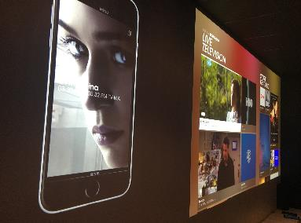
Video Industry Impact
Consumers will demand great image quality
Expectation that everything will be connected – intelligently
Content discovery is now defined by metadata, and may not be visual
Anywhere that Can have a screen Will have a screen
Security is not negotiable

Slide 4
Video Consumption Shifting to IP and Mobile
Millennials consume 2x more mobile video than 25-39 year olds
Millennials view 70% of TV online
Video will drive 82% of IP traffic by 2020
Mobile video traffic will increase 11x by 2020
Source: Cisco VNI, Nielsen, Deloitte

Slide 5
Money is in Premium Content, Live TV
$400 Billion Global Pay-TV Market
Pay-TV Provider Advantages
Reliable Video Quality
Low Distribution Cost
$180
$220
BILLION
BILLION
Robust Security
Premium Linear/Live Content
Dominant Business Model
Source: IHS, MAGNA
Notes:
http://www.campaignbrief.com/2016/06/magnas-latest-update-forecasts.html
IHS
70% of viewing is traditional TV; 30% is digital (Nielsen, others…)

Slide 6
Customer Loyalty Highest in OTT
OTT Provider Advantages
Net Promoter Score (2015)
100
Personalized Experiences
More promoters than detractors
+50
Reach All Devices
US Cable and Telco
0
Rapidly Launch Services
More detractors than promoters
-50
On Demand/Long-tail Content
New Business Models
-100
Source: Satmetrix US Consumer Net Promoter study
Notes:
http://blog.satmetrix.com/2015-consumer-nps-benchmarks-study-part-iii-entertainment-telecom

Slide 7
Reinvent TV: Exceed Broadcast and OTT
ACCELERATE GROWTH
INCREASE SPEED
IMPROVE EFFICIENCY
Video quality everywhere
Personalize linear content
Win new segments
New features across your base
Confidently innovate with data
Secure new business models
Reduce cost to reach all devices
Simplify operations across legacy and new
Flexibly scale infrastructure
Personalized Experiences
On Demand/Long-tail Content
Premium Live/Linear Content
Reliable Video Quality
Reach All Devices
Rapidly Launch Services
Real-time Insight
Robust Security
Low Distribution Cost
Dominant Business Model

Slide 8
Paving the Path to Reinvent TV
Content First
IP First
Device First
Keep advantage of premium content
Deliver broadcast quality video over IP
Rapidly launch across devices
Notes:
Differentiate with premium content experiences: enhancements with IP, data, personalization
Video quality everywhere without compromise:
All devices are first class citizens: launch new experiences on legacy; extend legacy models to IP

Slide 9
Cisco Infinite Video Platform
Video Provider
Cisco Infinite Video Platform
Infrastructure Operations
Service Operations
Business Operations
Linear Video
On-demand Video
Cloud DVR
Content Discovery
Metadata Services
Business Services
Processing Services
Security Services
Consumer Applications
Analytics

Slide 10
Infinite Video Platform Differentiation
One Platform for All Devices
Best Video Experience
World-Class Scale
Uncompromising Security
Publish any experience to any device
Deliver across legacy and new
Best ABR video quality with intelligence across network, encoding, and clients
Differentiate your brand with UX flexibility
Built to scale for the largest video SPs globally
80+ deployments, 60+ customers, 30+ trials, 20+ partners
Global community of customers contributing to our roadmap
World’s leader in video security and cyber security
Protect video content, applications and infrastructure from all threats
Best of breed and architectural approach

Slide 11
Infinite Video Platform at CES
New at CES 2017
One Platform for all Devices
Migration
Best Video Experience
Quality of Experience
World-Class Scale
Service Creation
Uncompromising Security
Advanced Watermarking

Slide 12
One Platform for All Devices Migration from Deployed Infrastructure to Next Gen Experiences
Advanced experiences to existing devices
IP Networking efficiencies and cost advantages
Preserve CapEx investment in infrastructure and STBs
Video Provider
Cable & Telco
Cisco Infinite Video Platform
Personalized and interactive experiences on existing STBs
Cloud-first design and service velocity to existing STBs
Broadcast-centric experiences on deployed STBs
ABR to MPEG transport stream conversion
Hard-coded client software stack on existing STBs
Deployed STBs only receive broadcast streams
Infrastructure Operations
Service Operations
Business Operations
Linear Video
On-demand Video
Cloud DVR
Content Discovery
Satellite
Metadata Services
Business Services
Processing Services
Security Services
Consumer Applications
Analytics
Notes:
This slide is a build…
Advanced experiences to legacy: Virtual channels to enrich existing guide/UI experience by inserting new experiences; Virtual guide replacements of existing guides; DTH gateway to bridge DTH and IP worlds.

Slide 13
One Platform for All Devices Migration from Deployed Infrastructure to Next Gen Experiences
Advanced experiences to existing devices
IP Networking efficiencies and cost advantages
Preserve CapEx investment in infrastructure and STBs
Video Provider
Cable & Telco
Cisco Infinite Video Platform
Personalized and interactive experiences on existing STBs
Cloud-first design and service velocity to existing STBs
ABR to MPEG transport stream conversion
Infrastructure Operations
Service Operations
Business Operations
Linear Video
On-demand Video
Cloud DVR
Content Discovery
Satellite
Metadata Services
Business Services
Processing Services
Security Services
Consumer Applications
Analytics
Content First
IP First
Device First
Notes:
This slide is a build…
Advanced experiences to legacy: Virtual channels to enrich existing guide/UI experience by inserting new experiences; Virtual guide replacements of existing guides; DTH gateway to bridge DTH and IP worlds.

Slide 14
Personalized Kids Profile
Support multiple profiles, customized to user
Kids profile – simplified UX
Flat hierarchy, no difference between linear and on demand
Fits ages 3-6, decisions based on images only
Content is age appropriate with parental control
Designed with our customers
Notes:
The Infinite Video Application supports multiple profiles that can be customized per user.
For kids, for example, we came up with a simplified User Experience where all the content is easily accessible:
Flat hierarchy
Content is filtered to only show relevant shows
No differentiation between linear and on demand content.
We have worked with the following assumptions:
Age between 3 and 6 years old
Don’t know how to read Decision based on images only
Not comfortable with complex information architecture & back navigation
Parental control / filtered content. Content is age appropriate
The Kids UX was designed with our customers to incorporate to their understanding of this sector

Slide 15
Win New Business Segments
UX applications that match requirements
Interface, content, and associated features
Millennials UX application
Between 12 and 20+ years olds
Tailored for OTT viewing consumption
Binge watching, Multi screens, multi subscriptions, (Youtube, Netflix, ...)
On Demand Viewing Experience – Little appetite for Live TV
High influence from the community & social environment
Could be packaged with a mobile or data service
Notes:
Infinite Video Platform helps you to attract new business segments with UX applications that match their requirements from the perspective of interface, content, and associated features.
In partnership with one of our customers (YES), we have configured a separate UX application that is tailored for OTT viewing consumption and could be packaged with a mobile or data service. This offering includes a narrow scope of content (skinny bundles).It can either be integrated as part of the main offering or marketed as separate offering.
This type of offering is perfect for attracting Millennials and for establishing brand recognition with your service, particularly with respect to:
Between 12 and 20+ years olds
Video services high consumption binge watching
Multi screens, multi subscriptions, (Youtube, Netflix, ...)
Love series
On Demand Viewing Experience – Little appetite for Live TV viewing. Reality TV and Sports are main driver for Live.
High influence from the community & social environment
The experience is centered around Movies and TV shows.
The user will see their current shows and content they possess.
Content recommended by their friends and our recommendation engine will also be focused in our categories.
On the STB they will also get direct access to their preferred OTT Apps like Netflix, Youtube…

Slide 16
Best Video Experience Smart Streaming: Video QoE at Scale
Differentiated Video QoE
Keep Subs with QoS
Optimize Network Cost
Smart ABR: quality aware ABR bit rate decisions
QoE optimizations
ABR QoE: reduce latency for multicast ABR streaming
Video quality for every ABR segment
Network resource utilization: CDN, access networks
Video QoE delivered: Quality, failures, stalls, ramp-ups
Encoders
Perceptual Video Quality Assessment
Networks
Multicast ABR Streaming
Clients
ABR Video Experience
Content First
IP First
Device First
Notes:
Cisco Smart Streaming:
End to end capabilities/control: Only IVP has the breadth of offering: encoder, network, client that lets you control video QoE e2e
Analytics/visibility – big data: Only IVP offers extensive analytics across these components to monitor the video stream quality e2e
Offer capabilities to improve VQ: Only IVP includes a range of technologies like LL Multicast ABR, converged IP Core, client instrumentation, etc to truly deliver
The highest quality, low cost, best security streaming over IP.
We call this Cisco Smart Streaming and this will enable IP video to exceed broadcast and OTT, helping SPs who focus on content, IP and devices first win in this market.

Slide 17
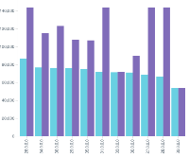
Traditional ABR: Inconsistent Video QoE
Standard ABR clients, request segments by adapting to current bandwidth estimates
Outcome:
Wasted bandwidth: delivering ABR profiles that don’t necessarily improve video QoE
Poor video QoE consistency: low-quality ramp-up
Available Bandwidth
ABR Segment Selection
Profile 1 (8 Mb/s)
Profile 2 (6 Mb/s)
Profile 3 (4 Mb/s)
Profile 4 (3 Mb/s)

Slide 18
Smart ABR: Better Video QoE
Influence client ABR segment selection to improve quality of video for delivered bit rate
Use perceived video quality in addition to raw bit rate
Improve video QoE for all ABR clients with available network bandwidth
Outcomes:
Improve video quality fulfillment: deliver better picture quality
Increase video QoE consistency: Eliminate low-quality ramp-up, failures, stalls
Available Bandwidth
ABR Segment Selection
Perceived Video Quality
Profile 1 (8 Mb/s) | 9 | 8.75 | 8.45 | 8.45
Profile 2 (6 Mb/s) | 8.6 | 8.70 | 8.40 | 8
Profile 3 (4 Mb/s) | 7.5 | 7.8 | 8 | 7.7
Profile 4 (3 Mb/s) | 6.4 | 6.7 | 7 | 6.8
SVQ = 8.70
SVQ = 7.80

Slide 19
ABR QoE: Reduce Multicast ABR latency
Accelerate delivery and playback of ABR segments to reduce latency with broadcast
Differentiate with better QoE for ABR delivery
Examples:
Low latency with broadcast
Rapid channel change
HTTP Chunked Encoding
Multicast ABR
Client Playback
Start playing segment before receiving all packaged chunks
Request last ABR segment for playback
Deliver segment before packaging completed
Optimize network bandwidth utilization with Multicast ABR streaming
Content First
IP First
Device First

Slide 20
World-Class Scale Converged IP Video Core
Existing Investments Limit the Advantages of IP
Encode
Video infrastructure duplicated across ABR and legacy
Limited visibility across silos to ensure video quality
Cable & Telco
Stat Mux
Legacy STB
ABR networks scale inefficiently
Existing access networks can’t flexibly scale
Deployed STBs can’t receive ABR
Device-based business models don’t extend to IP
Multicast Network
Legacy Access Network
Scramble
Satellite
Transcode
Package
IP/ABR Access Network
ABR Client
Unicast CDN
Mobile
Encrypt

Slide 21
World-Class Scale Converged IP Video Core—Innovations
End-to-End Visibility
Cost-Efficiently Scale
Evolution to IP
Legacy STB
Cloud native software architecture for video
End-to-end video quality awareness
Resilient multicast ABR distribution
Dynamically scalable access network VNFs
ABR conversion to MPEG
Advanced watermarking
Mobile policy integration
Unicast CDN
Access Networks
ABR Client
ABR Transcode
General Purpose Cloud Compute
ABR 2 TS
Multicast ABR
ABR Package
Converged Service Provider
Stat Mux
Scramble
ABR Encrypt
Virtual CMTS
Virtual EPC
Content First
IP First
Device First

Slide 22
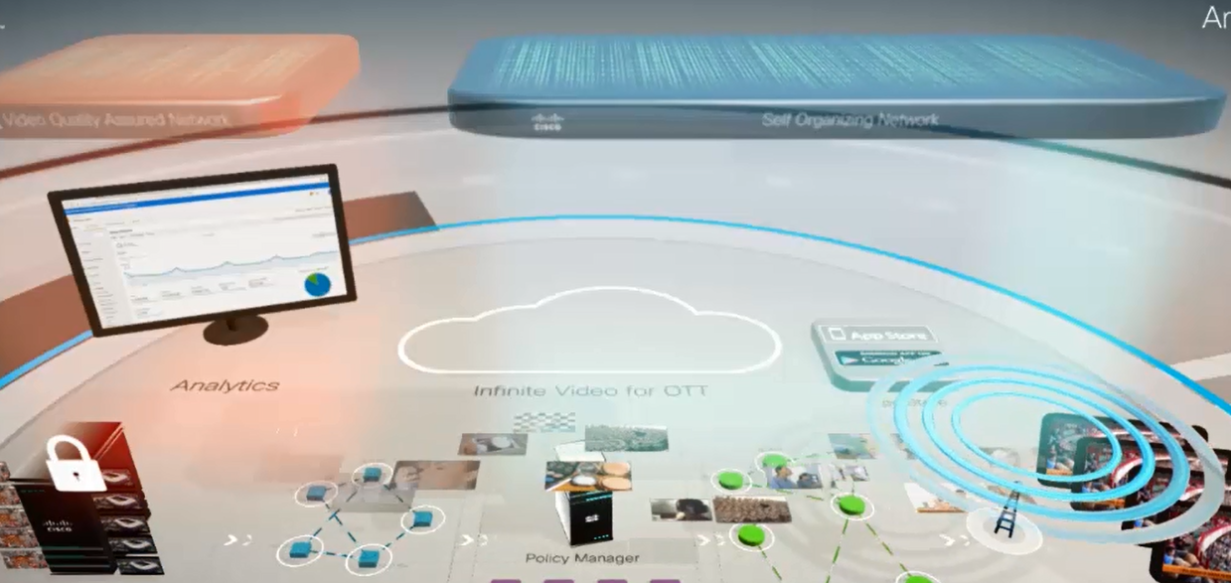
World-Class Scale Converged Mobile Video
Fast
Application
Creation & Deployment
Quality Assured Network
Customer
Insight
Content Preparation
Integrated Policy Management
Proactive Network Management

Slide 23
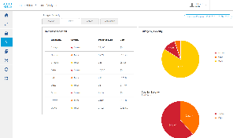
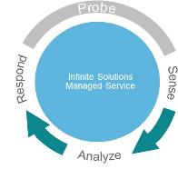
World-Class Scale Reinvent Service Creation
Identify Opportunity
Create Experience
Deploy the Service
Data driven and personalized
Content preference
Target audience
Premium and on demand
Modular functionality aaS
UI, streams, third party
Quality, speed, proved
Cloud design
DevOps, A/B testing
IP First
Content First
Device First

Slide 24
Infinite Video Platform Labs Program
Agile development approach
Enable our customers to participate in defining the future of video
Showcased one of the first participating service providers: Yes
YesBOT
Enables subscribers to chat in natural language
Personal viewing recommendations based on interest
Tightly integrated with the big screen experience
Notes:
Cisco is launching the Infinite Video Platform (IVP) Labs enabling all IVP customers worldwide to define together the future of the consumer video experience.
IVP Labs allows participating customers to test new features with users before making them generally available. Customers and end users can provide crucial feedback to make these features, and the IVP roadmap, more relevant.
IVP Labs leverages IVP’s agile development approach, built in A-B testing capabilities, developers’ toolkit and modular micro-service–based architecture that enable fast, incremental delivery of value to its customers
Cisco created a community where our customers can directly contribute to shape the IVP roadmap, and help define the future of video.
IVP Labs demonstrates Cisco’s commitment to a common code base that continuously expands capabilities while improving quality based on continuous feedback from users.
YES, Israel's leading provider of multichannel television via satellite, is one of the first operators to take advantage of IVP Labs.
Yes developed with a third party (BOTique), a BOT system, enabling subscribers to chat in natural language via their Facebook account, get personal viewing recommendations based on their interest.
Cisco leveraged the IVP developer’s toolkit to integrate “YES BOT”, providing complimentary big screen experience via the IVP UX to the recommendations received during the chat.

Slide 25
Uncompromising Security for Video
Security Services
Advisory | Implementation | Managed | Operational
Video Content & Revenue Security
VideoGuard™ Everywhere
Best-of-breed products and services
Holistic architectural approach
Industry leading security intelligence
Comprehensive
Video Service Protection
Anti-piracy Solutions
Integrated
Combined video security and cybersecurity capabilities
Unified threat visibility and intelligence
Conditional Access
Streaming Piracy Prevention
Multi-DRM
Security Policy
Security Intelligence & Visibility
Security Analytics
Infrastructure Security
Ecosystem support for partners across broadcast, media and service provider
Easy integration with open APIs
Open standards and open source
Open
Next Gen Firewall
DDoS Protection
Next Gen Intrusion Prevention
Email Security
Policy and Access
Web Security
Cloud-based operations
Unified solution for any network / screen
Full life cycle services support from advisory to operations
Advanced Malware
Network Behavior Analysis
Simple

Slide 26
Uncompromising Security Advanced Watermarking Solution
Locate
Identify
Verify
Eliminate
Locate illegal streams automatically and/or with OpSec
Identify piracy sources with advanced watermarking techniques
Verify pirates’ IDs by sending unique commands to suspicious sources
Eliminate the piracy by deactivating subscriber access to content

Slide 27
Advanced Watermarking Solution Real-Time Online Piracy Elimination
Fast
Very short injection and detection times
Imperceptible Covert watermark; does not disrupt viewer experience
Robust Hard for pirates to remove; multiple techniques available

Slide 28
Infinite Video Platform in Action
80+ deployments with 60+ customers
30+ active customer trials
40+ consumer devices supported, and growing
20+ partners on the Platform
Deployed across Cable/Telco/OTT/DTH Operators, Broadcasters
Across end-to-end platforms, Security, Video Processing & Distribution

Slide 29
OnPrime TV
Content Partnerships
Cloud Platform
Device Roadmap
Content Service
Reach niche demographic segments
Infinite Video Platform
Feature roadmap with DevOps
Rapid Device Onboarding
Apple TV launch
Android, Amazon, Roku
Video Provider
Cisco Infinite Video Platform
Infrastructure Operations
Service Operations
Business Operations
Linear Video
On-demand Video
Cloud DVR
Content Discovery
Metadata Services
Business Services
Processing Services
Security Services
Consumer Applications
Analytics
Content First
IP First
Device First

Slide 30
Want to know more?
http://www.cisco.com/go/infinitevideo
Visit us at Mobile World Congress
http://blogs.cisco.com/sp
@CiscoSPVideo
addavies@cisco.com, yschreib@cisco.com

