Slide 1
A Practical Approach for Migrating DCI to 100G Transport
Cisco Knowledge Network Series
Matt Lopoukhine Sushin Suresan Al Kiramoto Rich Leahy
BDM PM CSE CSE
March 7, 2017

Slide 2
SP Market Trends
Cloud Scale Networks
Central Office Transformation
Use Cases for Migrating to 100G Networks
Opportunities that 100G Offers
Hardware and Software Innovations for Supporting Cloud Scale Networks
Data Center Interconnect
100G Optical Solutions
Notes:
Welcome: Thank you for joining us today. My name is Matt Lopoukhine,I am a senior BDM w/ our GSP Optical Architecture organization, I am joined today by Sushin Surean - PLM, Al Kiramoto - CSE, & Rich Leahy – CSE..
Today we will discuss A Practical Approach to Migrating Data Center Interconnect to 100G Transport solutions.
With continuous growth in IP, video, and cloud-based Services, we see exponential bandwidth growth in packet networks, driving the need for higher speed interfaces and transport requirements in routers, switches and optical transport networks. As a result, Networks are in the midst of a major transition to 100G, and companies are looking for solutions to handle the explosive growth of network traffic. Migrating to a faster, higher capacity, DWDM transport network, particularly for metro and data center networks, is critical for data-intensive businesses.
Our session today will look at what Cisco offers for end-to-end capability and support for the migration to 100G and beyond. We will review SP Market Trends, discuss Cloud-scale network solutions, CO Transformation strategies, and review use cases for migrating to 100G networks and overall system architectures for DC/inter-office and high speed transport solutions.
We will discuss Cisco’s hardware and software innovations for supporting cloud-scale networks and highlight the NCS 1000, a scalable DWDM transport solution for data center interconnect.
With that said, I’d like to now turn it over to Sushin….

Slide 3
SP Market trends

Slide 4
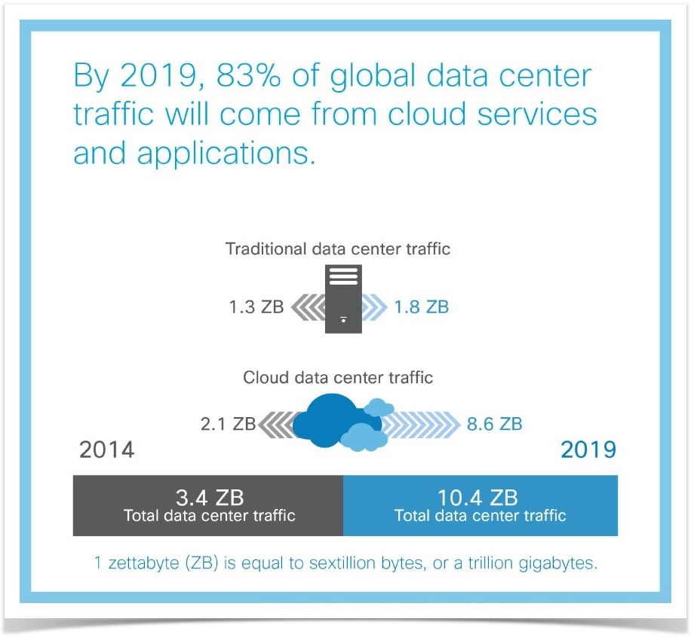
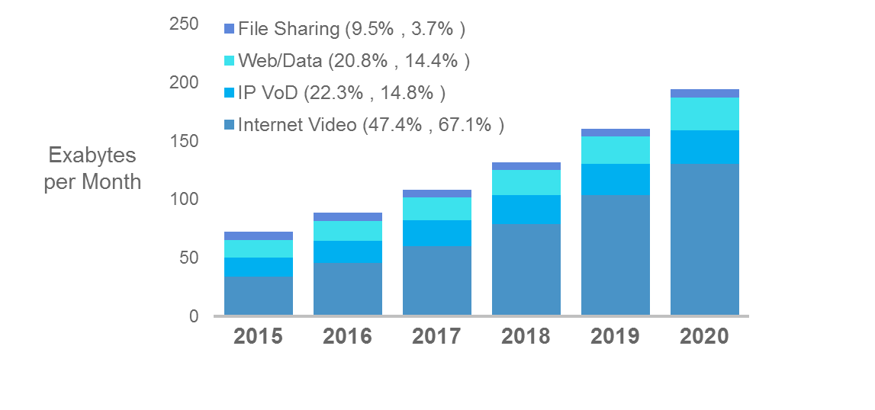
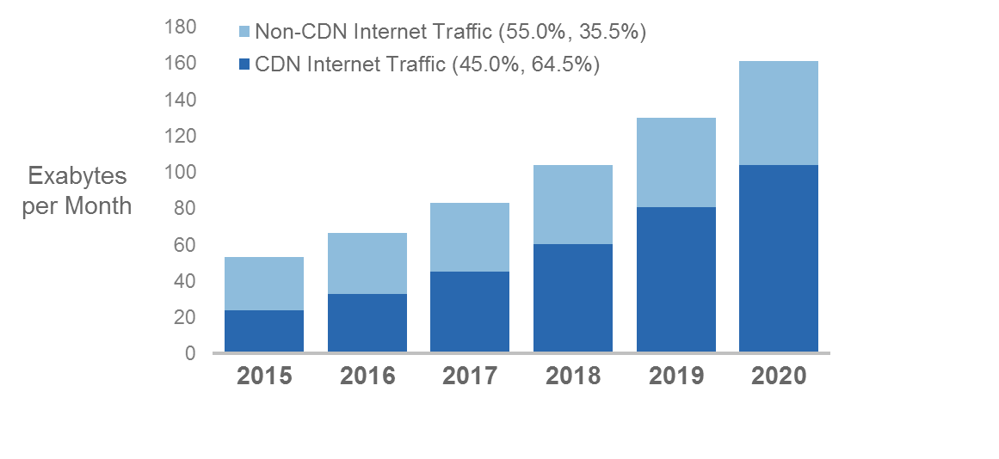
Service Provider Key Business Drivers
Source: Cisco Global Cloud Index
Source: Cisco VNI Index
More enterprises move to the cloud
Need to optimize for video
Notes:
Facebook has 4 Billion video streams a day and 70% are directly up-loaded.
YouTube – average mobile session is 40 minutes.
Netflix has 125 million hours of viewing daily.
Netflix drives 36% of download traffic on the internet*. Use AWS infra with its own CDN network for delivery.
They have deployed 1000s of locations with OCAs to minimize impact on ISP traffic. 60+ IX locations and 50+ peering locations.
https://media.netflix.com/en/company-blog/how-netflix-works-with-isps-around-the-globe-to-deliver-a-great-viewing-experience

Slide 5
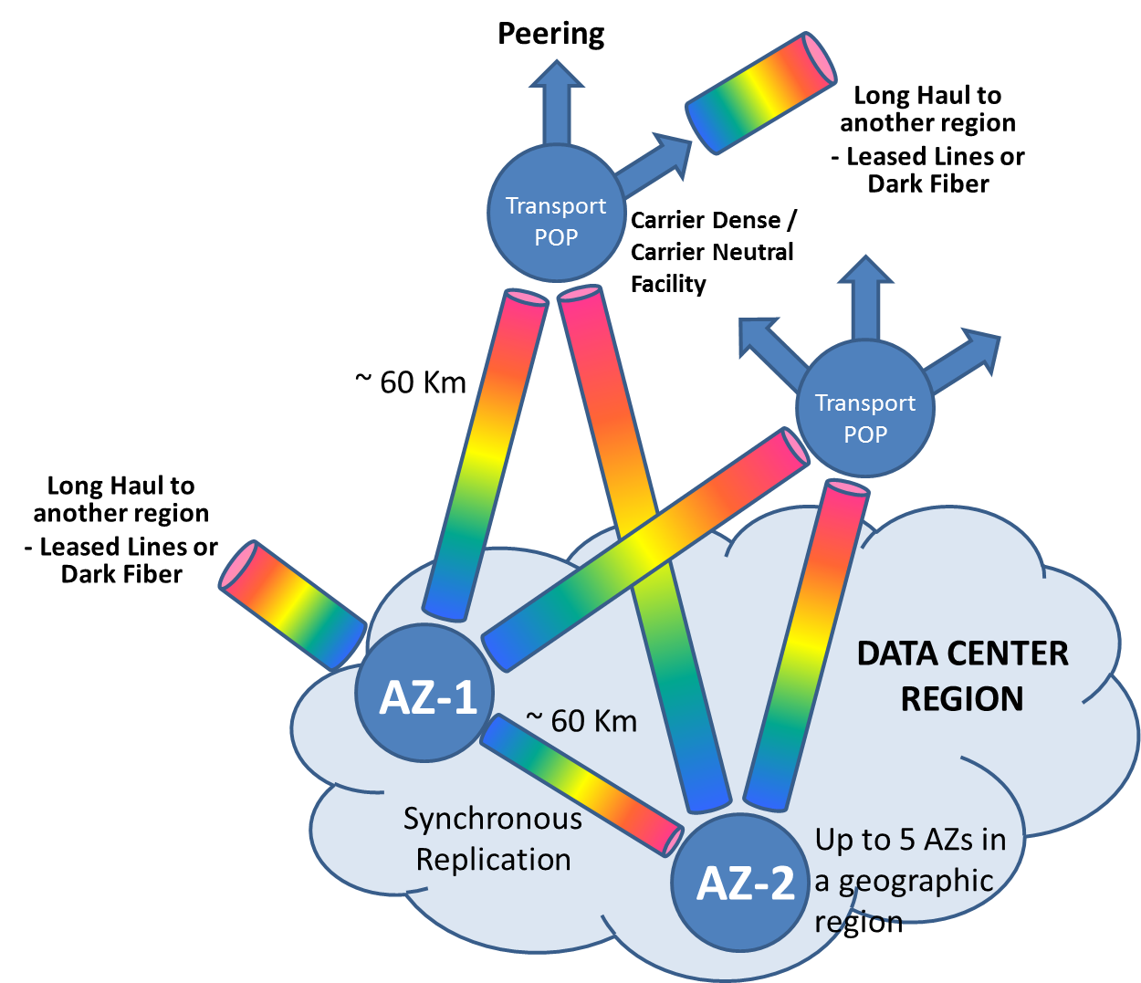
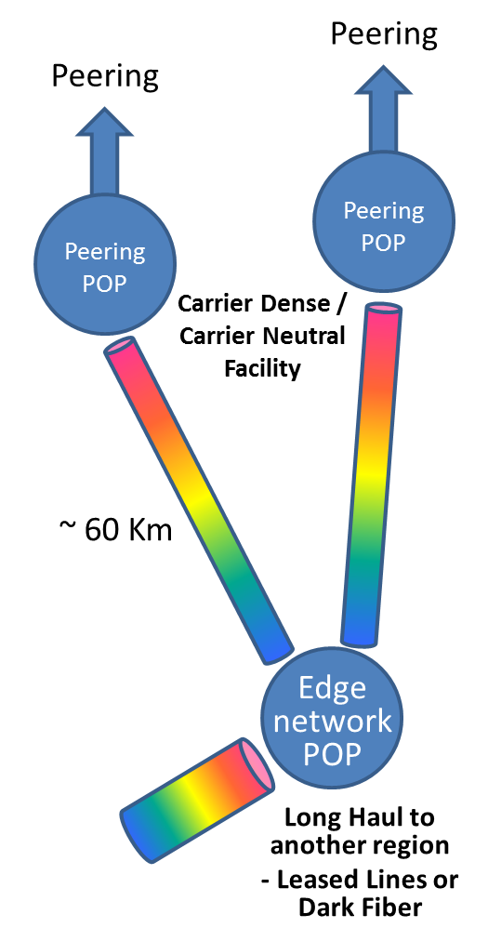
Where Does The Capacity Go?

Slide 6
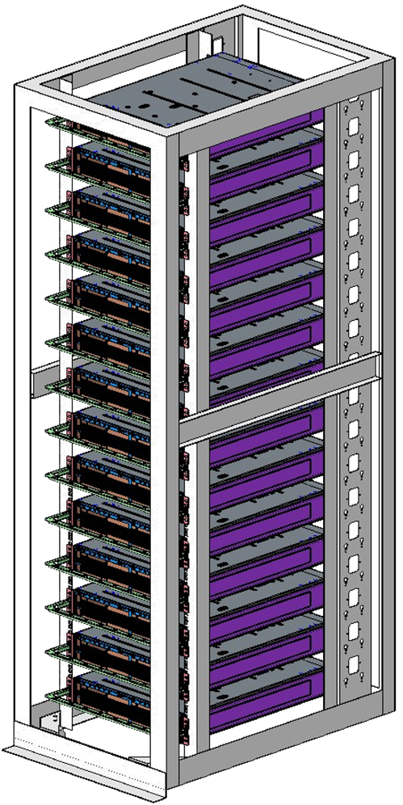
Mechanical Optimization
“Server” Like
Front to back airflow.
  Straight-through cooling
0 to 40 degrees ambient
600mm deep
Maximize capacity
      @ minimum foot print
      @ lowest cost per bit
Deploy at scale

Slide 7


Cloud Scale Companies Goals
Web-model
Carriers
Enterprise
CAPEX & OPEX
Price, space, power, automation & real-time mon
CAPEX & OPEX
Price, Interop, Simplification
OPEX
Ease of Use, Automation
Small operations teams
Optical expertise
LH, metro networks, COLOs – rapid scale
Dev-Ops with in-house n/w mgmt and analytics
Large operations teams
Optical expertise
Complex, large networks
Interop, compliance important
In-house n/w mgmt
Small operations teams
Limited Optical expertise
Simple networks
Outsource n/w mgmt or ability to automate in-house

Slide 8

Central Office Transformation
The Emergence of the “Front End” Datacenters
Telco
Copper
Fiber
Internet
Ethernet
over Fiber
G.FAST
PON
OLT
Core
Aggregation
Cable
Coax
Fiber
DOCSIS
3.1
R-PHY
Node
Access
Router
“Back End”
Data Center
fewer
larger
Ethernet
over Fiber
Caching Engines
+
“Front End”
Data Center
multiple
smaller
Radio over
Ethernet
Mobile
Subscriber-facing processes pushed closer for new service opportunities and better user experience
Remote
Radio Head
(RRH)
CSR
or NID
Notes:
Hello everyone
Thanks Sushin for the market trends information.
I will talk to you about the trends we see on the more traditional ILEC and CLEC Service Provider space.
I am a consulting Systems Engineer and have been working with many CLEC’s and ILEC’s in the United States.
The biggest trends I see here, which are very similar to what is happening worldwide, are:
Exponential Bandwidth growth with new apps and over the top video
New technologies being adopted like G.Fast, DOCSIS 3.1 and the increased adoption of new Radio access devices
Content delivery networks growing, caching engines pushed as close as possible to the subscribers for better user experience
Highest growth seeing on the Access and Aggregation layers.
The problem now is how to fulfill the end customer’s expectations of fast connections while still keeping the same or less amount of revenue.
Everyone is looking for a solution for this. The common answer is automation and adoption of Cloud Scale principles like Sushin described, but in a different way.
We see the Central Office Transformation into mini Datacenters, meaning , the creation of what we are calling here “Front End” datacenters.
This is why 100G is so important - there is a big need for ultra-fast connectivity not only between the Datacenters, but also between the new multiple small “Front End” and fewer larger “Back End” datacenters

Slide 9
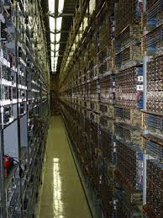

Central Office Transformation
Increased value of your Central Office locations
NetConf / YANG
Spine
and Leaf
Central Office Re-designed as a DC (CORD)
Virtualization of services (00s not 000s)
5G and virtual Evolved Packet Core (vEPC)
Network Function Virtualization (NFV)
DSL
G.Fast
PON
OLT
To Metro
To Access
100G
Servers running
VNFs & CDNs
100G
Notes:
Central Offices are going to have increased value now:
They have been built for 5x9s uptime
They have dual power feeds and multiple diversely routed fiber feeds
They have Temperature control rooms
They are designed for Natural disaster survivability
… very similar to large DC’s
One great example is the Central Office Re-architected as a Datacenter initiative (aka as CORD). It promises to re-invent the Central Office as a Datacenter.
IHS Markit, a technology research firm, found in its latest “Routing, NFV, and Packet-Optical Strategies Global Service Provider Survey” that 70% of respondents plan to deploy CORD in their smart COs by end of 2017
We learned in the past year that, contrary to the Main Datacenters, SP’s will run virtualized services there, but not at the same scale. It will be dozens perhaps hundred of applications, not thousands. So, simplicity is key for this to work.
With 5G coming, one of the top applications to run is the virtualized packet core (vEPC), which will provide better economies of scale, agility and better end user experience
Lastly, it is part of the Network Function Virtualization strategy for many SP’s. Run virtual services where it makes more sense, at the branch, at the CO or centralized in the DC. We believe a considerable amount of virtual services will be deployed here.
Applications will be orchestrated and will be placed where it makes more sense, hence why fast connectivity is required between the Front End and Back End DC’s.
You will hear toward the end of this session Rich present a use case for 100G Metro enabled with our NCS5500 and / or our 400G Xponder cards.
With that, I will hand it over back to Sushin for the 100G use case in large Datacenters.

Slide 10
Use Cases for Migrating to 100G Networks

Slide 11
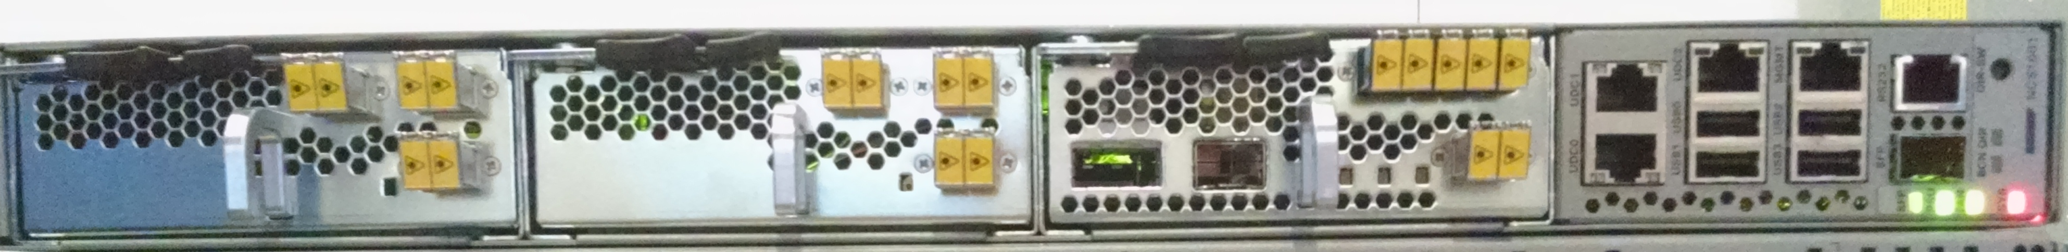
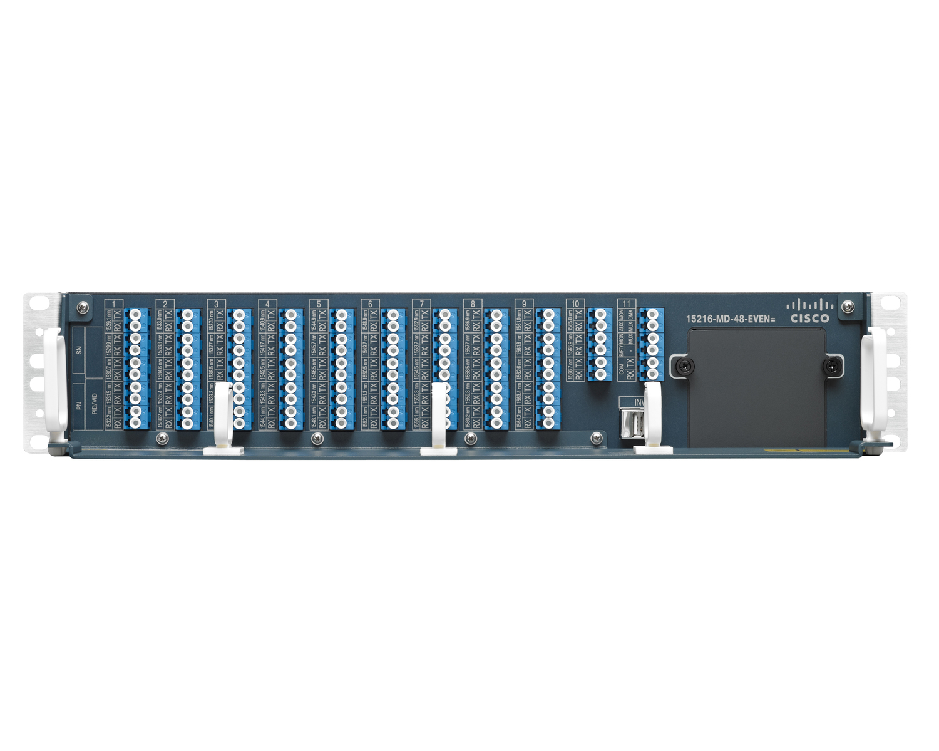
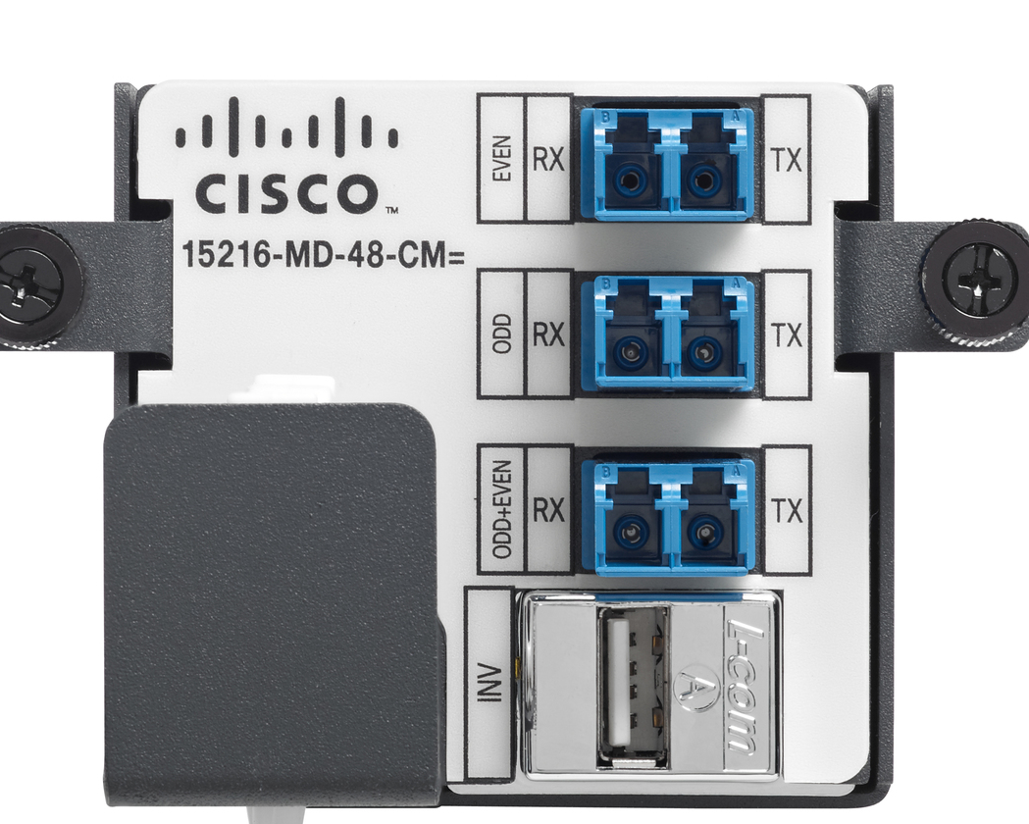
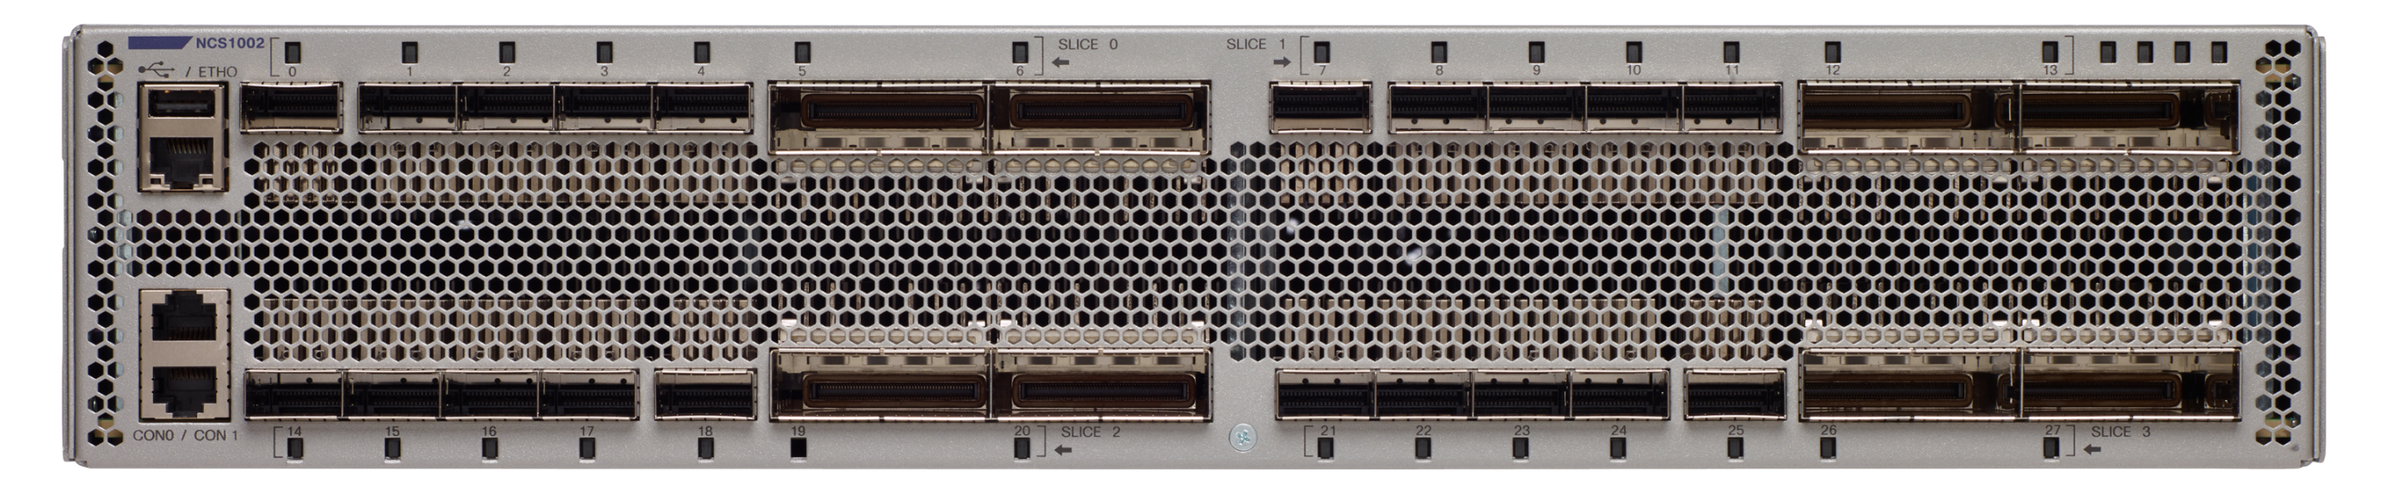
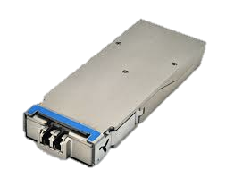
DWDM for Cloud Scale Networks
NCS 1000 solution
Cisco NCS 1001
Amplifiers + Protection + Channel Monitoring
IOS-XR
15216-MD-48-EVEN=
Cisco 15216 Mux-Demux
96 channels
Passive
15216-MD-48-ODD=
Cisco NCS 1002
8 250G MXP/TXPs
IOS-XR
Point-To-Point metro optimized DWDM Transport Solution

Slide 12
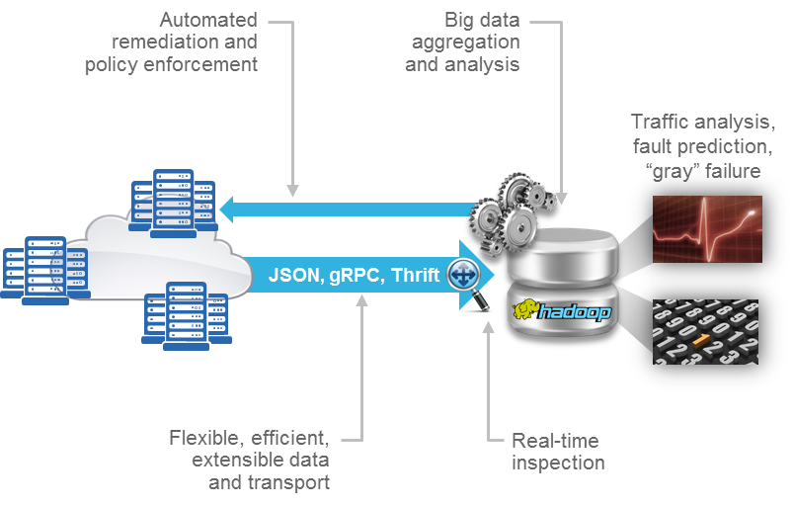
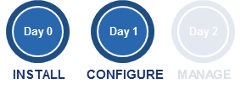
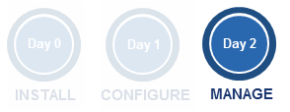
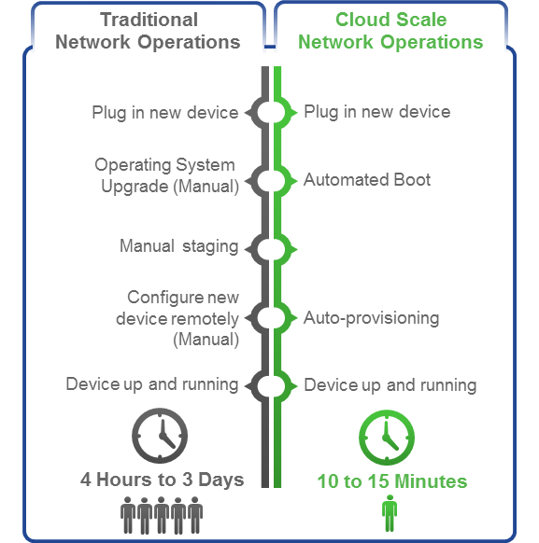
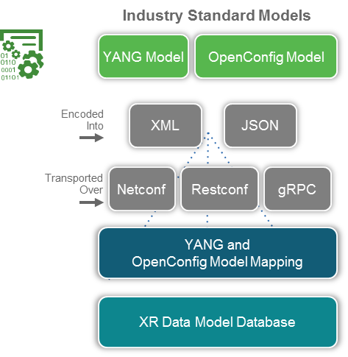
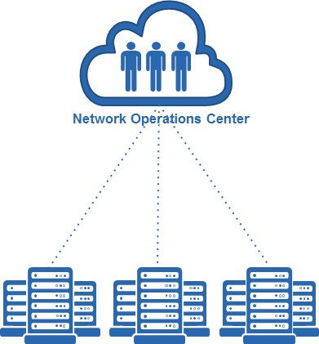
Cloud Scale Manageability
Focus on automation
Notes:
With traditional networking operations, new device onboarding is not automated.
Several steps are required with a high level of manual intervention.
The entire process can take from several hours to a few days as different teams are involved and need to work on specific steps sequentially.
With Cloud Scale networking operations, new device onboarding is fully automated.
Server like bootstrapping and Zero Day Provisioning.
Customers can leverage the same tools they currently use for bootstrapping servers.
- iPXE: industry standard high performance, network based booting.
- Standard Linux scripting (shell scripts, Python etc.) for auto-provisioning
Device onboarding time is now reduced to 10-15 minutes.
Fully automated device onboarding helps to recover from a disaster faster.
******************************
With traditional networking operations, on-going management of the network infrastructure is done either:
- through manual configuration – Command Line Interface
- through CLI scripting
Drawbacks:
- manual configuration leads to many errors. According to the Yankee Group, 62% of network downtime is due to human errors.
- CLI scripts are complex to develop and are very sensitive to any changes in vendor’s OS resulting in script failures
This is too slow and cumbersome for large scale demands.
With Cloud Scale networking operations, automation at scale is key.
We are providing models and APIs that allow deep integration with XR
Enable automation @ scale and allow the development of value added services by our partners and customers.
Flexible Model Driven APIs: Any model/Any encoding/Any transport - industry’s widest set of structured data model driven high performance APIs
Support of industry standard OC/IETF Models
Support for an extensive set of 100+ IOS-XR native YANG based data models
Cultivate a rich partner based eco-system around XR
Industry leading open-source support for the Yang ecosystem:
Yang Development Kit (YDK): Auto-generate model driven APIs from Any Yang Model for Python & C++.
Model Mapping SDK: Any model, including customer specific can be mapped to Native XR models. Complete flexibility in terms of Dev-Ops and APIs.
Ytool: GUI tool to interactively use Yang Models.
With this automation, customers will be able to fast-track and simplify their operations
****************
With traditional networking operations, visibility into network infrastructure is partial and not real time.
Along with massive scale, there are new demands being placed on the network in terms of application SLA, security, and optimal cost efficiency.
SNMP cannot scale to provide the massive amounts of network operational data that is needed to intelligently align the network to application performance and optimization goals:
- frequency of polling can’t be significantly increased as this would consume too much network devices CPU
- access to an incomplete set of operational data
To get better visibility, multiple mechanisms need to be used leading to greater complexity as the retrieved data come in different formats and have to be processed for post-treatment.
Reactive analysis is the norm here.
With Cloud Scale networking operations, visibility is getting near real-time and control is significantly increased giving service providers actionable insight.
Action insight is made possible with the use of Telemetry
Model Driven Telemetry is allowing Full access to network operational state
No-more SNMP sub-setting and scale issues, screen scraping
All data is normalized and pushed out.
- 5-10x performance, consistent response times.
Resolution and precision that is not achievable with SNMP.
- Allows our customers to quickly correlate and trouble shoot network issues.
Ability to subscribe to a set of specific data, that are pushed at a configurable cadence – down to 30s.
Push of data can also be event-based, e.g. interface down, CPU above a certain threshold
*********************

Slide 13
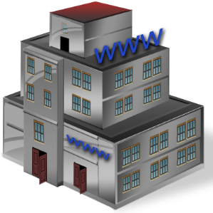


Cloud Scale Security
Datacenter to Datacenter multi terabit encryption
Encrypt everything that goes out of the Data Center.
Add-On solution in front of a router or switch.
10GE/40GE/100GE AND 100G/200G DWDM.
MACSEC encryption:
  AES-256 encryption, MKA key agreement, EAP-TLS authentication
  CAK key roll-over in 300 seconds. 4 simultaneous keys available.
  MUST & SHOULD encrypt options.
  CLI, netconf YANG, SNMP management.

Slide 14
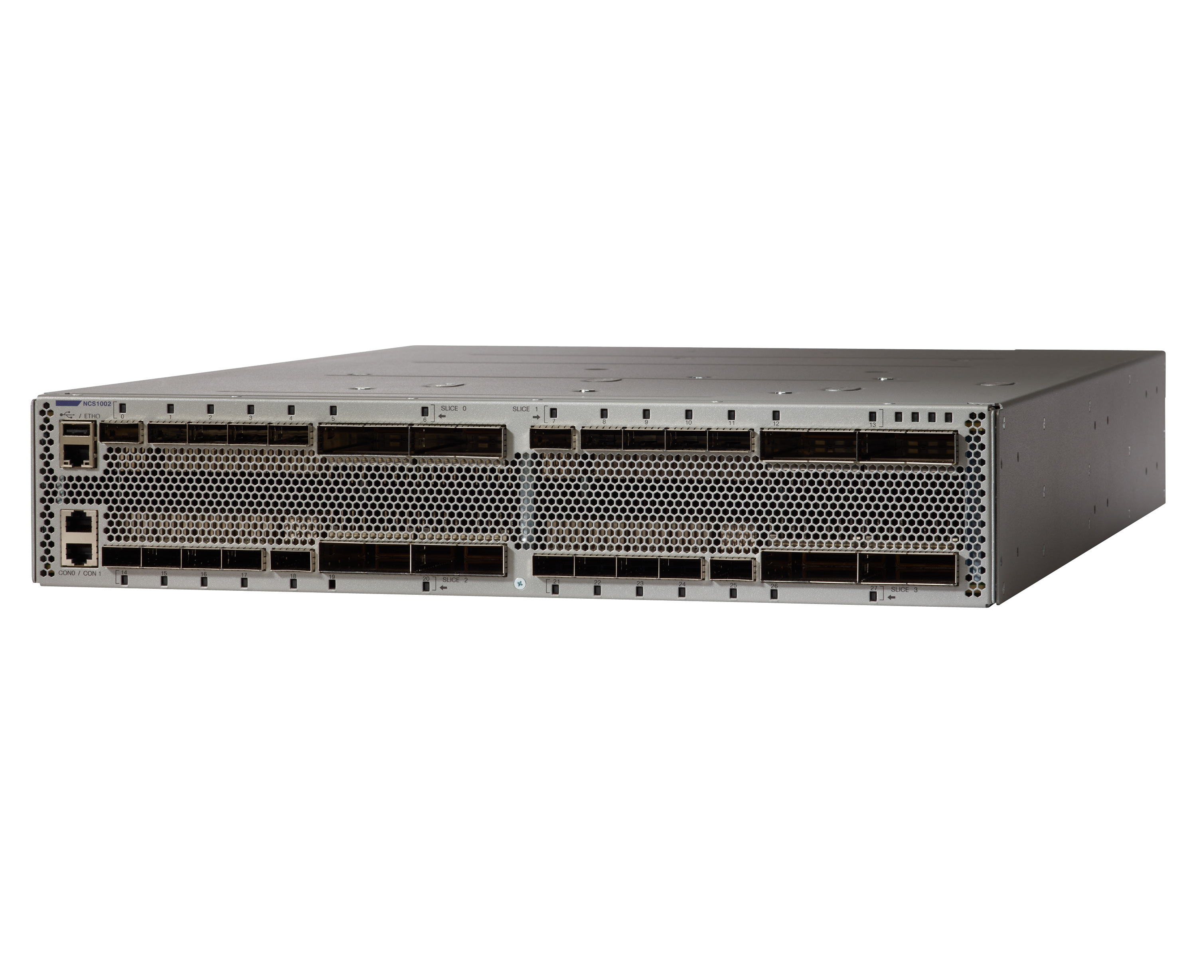
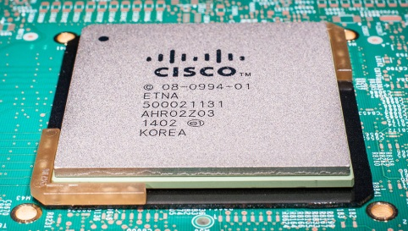
DWDM for Cloud Scale Networks
NCS 1002 - First to 250G DWDM Pluggable Transport
100G
200G
9.6Tbps 4000Km +
19.2Tbps 800Km
250G
24Tbps 500Km
State of the art 28nm integrated ASIC
Multiple Line rates – Distance vs reach trade-off
Soft Decision FEC – Double the reach
Nyquist shaping – ~30% more capacity
Pluggable
Field replaceable
Deferrable
Thermal efficiency

Slide 15
Cloud Scale Performance
More capacity per fiber pair with 250G per wavelength
2Tbps
32Gbaud 200G16QAM
Same 50Ghz spectral grid can be used with both 200G & 250G rates.
Typical 32GBaud/s 16QAM gives 200G per channel.
40GBaud/s 16QAM gives 250G per channel.
To achieve 250G, Cisco operates its DSP at a higher speed and relies on a unique calibration algorithm to make the DSP+CFP2 system operate at 40GBaud/s.
50Ghz
500Ghz used
2Tbps
40Gbaud 250G16QAM
50Ghz
400Ghz used
25% more capacity available!

Slide 16
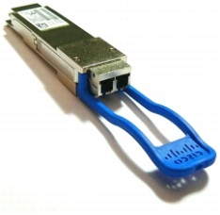
DWDM for Cloud Scale Networks
Pay as you grow model
4 independent slices that are accessible to the user day 1.
Capacity can be turned up in increments of 200G/500G by buying the corresponding client and trunk optics.
A licensed version of NCS1002 hardware is available – this provides per slice licensing options for 200G/250G/encryption.
2x 250G
1x 200G encryption

Slide 17
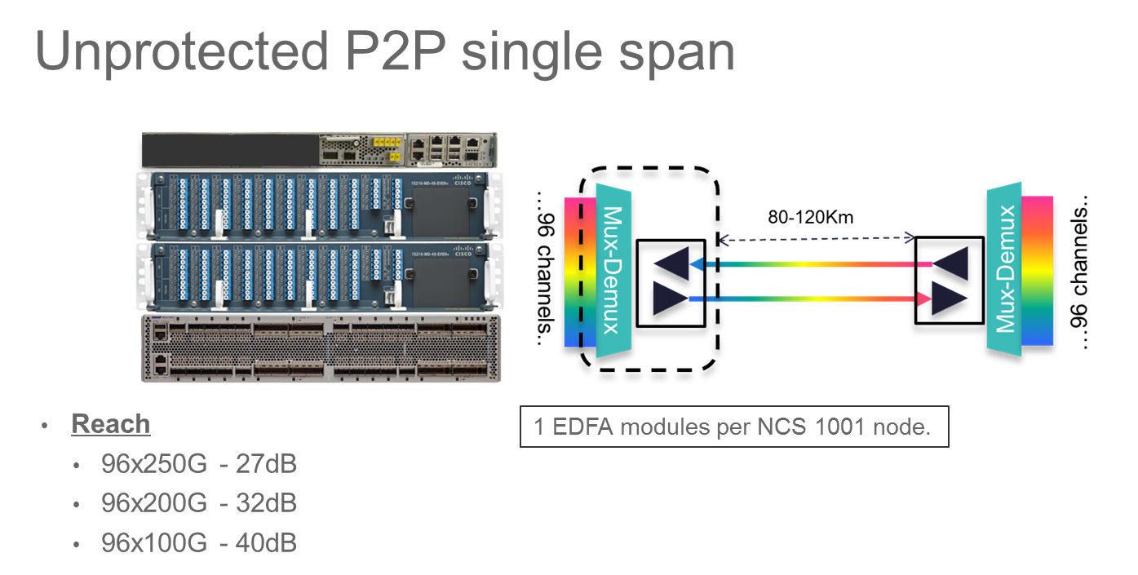
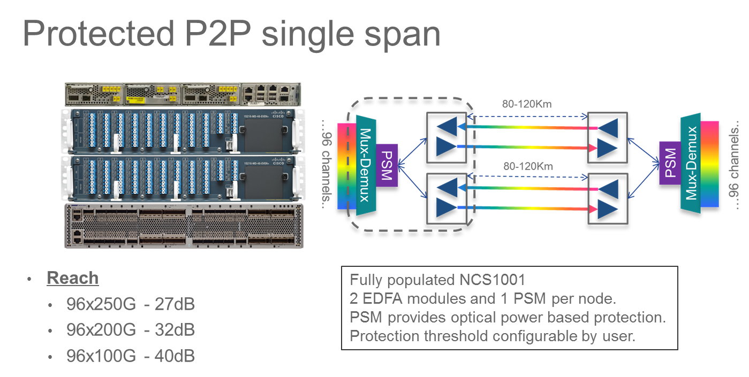
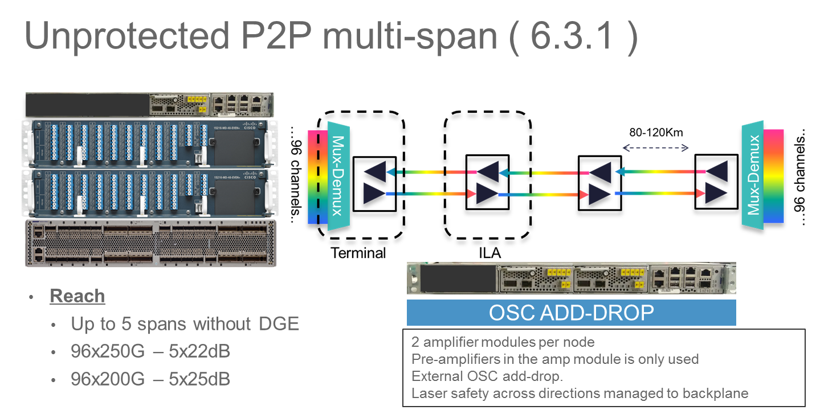
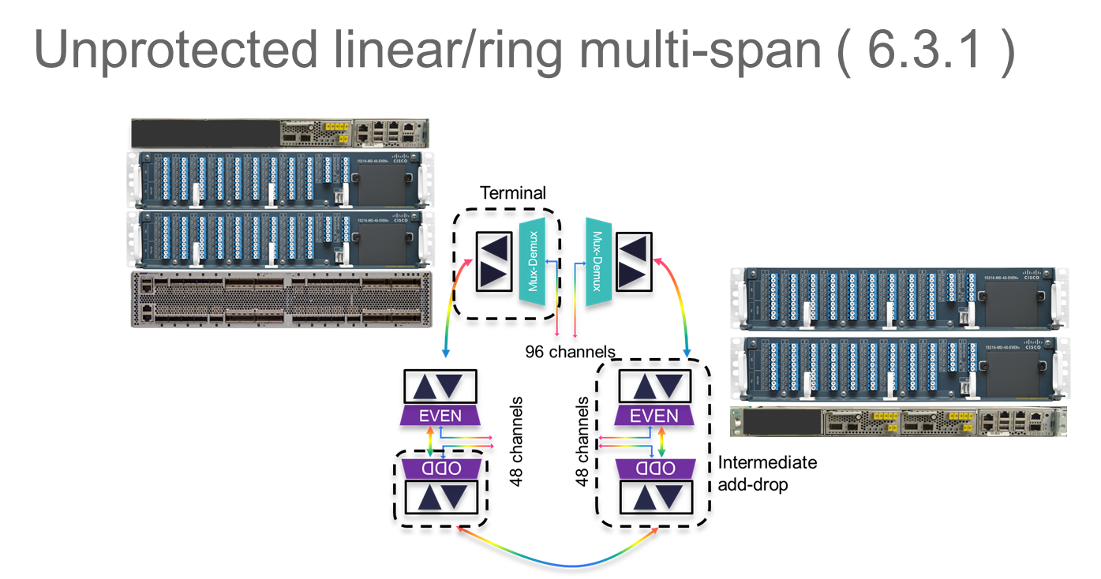
DWDM for Cloud Scale Networks
NCS1002 + NCS1001 use cases

Slide 18
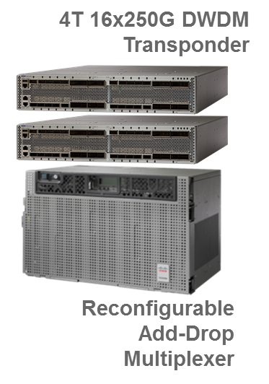
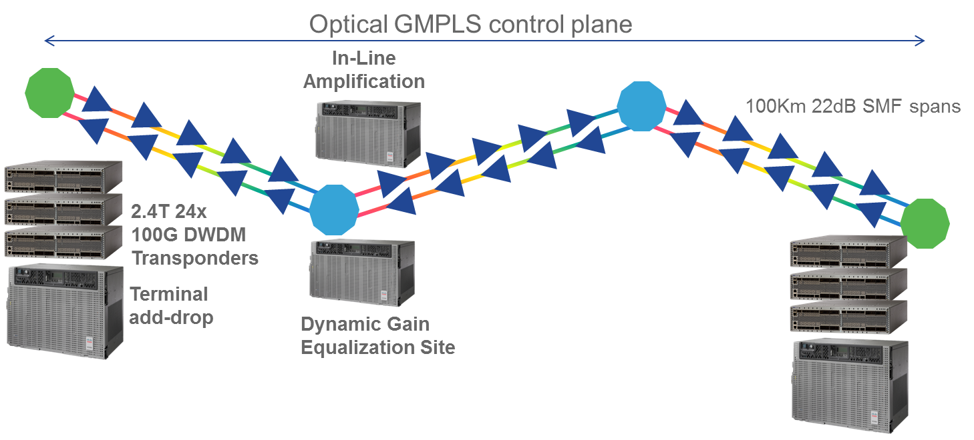
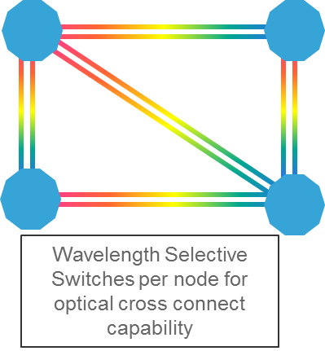
DWDM for Cloud Scale Networks
NCS1002 + NCS2K Use Cases
Mesh Metro DWDM networks
Long Haul DWDM networks

Slide 19
DWDM for Cloud Scale Networks
NCS1002 for Long Haul
8x100G QPSK per box
100G QPSK can run 4000+ Km.
NCS 2K line system OR as Alien over 3rd party line system.
CFP2 transmit power : -1.5dBm and +2dBm options.
Grid-less (+/- 0.1Ghz) and 50Ghz fixed-grid support.
EPN-M for E2E management of NCS1K + NCS2K system

Slide 20
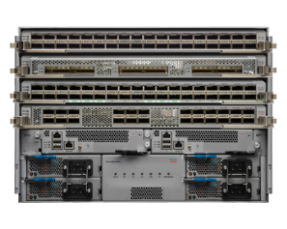
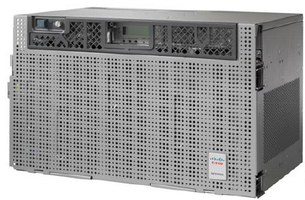
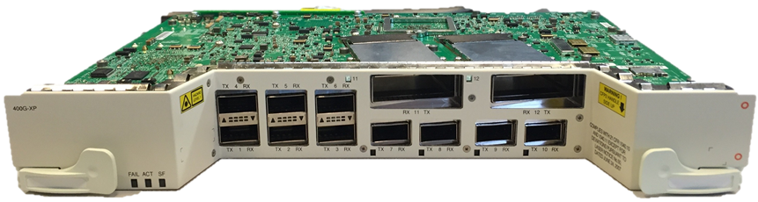
Integrated DWDM Solution
100G Metro-enabled with NCS5500 and NCS2000
Flexible Solution Architectures
  IPoDWDM leverages integrated DWDM optics in NCS5500
  Hub-and-Spoke leverages NCS2K + 400G Xponder
  Leverages common CFP2-ACO optics
6 Port 100/150/200GE with MACsec
Integrated IPoDWDM
NCS5504
NCS5504/8/16
100G/150/200G DWDM LINE SYSTEM
Large
“Front End”
Data Center
“Back End”
Data Center
NCS2000
NCS2000
100G/150G/200G DWDM LINE SYSTEM
400G Xponder
Small
“Front End”
Data Center
“Back End”
Data Center
NCS2000
NCS2000
Notes:
With distributed Front-end and Back-end DCs:
- there will be a need to support a variety of transport solutions.
- these solutions need to support a variety of 10G/100G/200G with the ability to encrypt the data “in-flight”.
- they can run as an alien wavelength on a common DWDM line system
One method is to leverage DWDM optics directly integrated into the DC router, typically restricted to 10G and 100G interfaces.
- this bypasses the traditional method of connecting a grey optic to a transponder
- 6x100G DWDM Coherent linecard saves in space, power and short reach pluggables
- Decrease operational complexity – simpler is better
- Reduce TCO - low power and footprint while increasing fiber capacity, possible automation with colorless, contentionless and omnidirectional capability
- Quick response to changing demands – 10/25/40/100/200G services delivery
Another method is to leverage an existing Cisco transport network with 400G crossponder and 100/200G transponder solution.
- The benefit to this approach is a clearly defined separation of the transport and router layers of the network.
- Another is direct alarm propagation and correllation between layers.
- Another is ability to scale the transport capabilities beyond 100G.
- This also allow forthe use of grey 100G optics in the router, as typically router ports with DWDM are more expensive than pure optical transport ports.

Slide 21
Final Thoughts
Cloud Scale networks
Central Office transformation
100G DCI with NCS1000
100G Metro with NCS5500 and 400G Xponders
Call to action
  Think of traditional CO architectures in terms of redefined Data Centers
  Identify where migration to 100G is most imperative
  Connect with Cisco’s Data Center and Optical resources
Notes:
Cloud scale DCs are measured in Petabytes, ZetaBytes and Exobytes.
- This kind of scale drives the need for CO modernization towards a DC-centric model.
- Which in turn drives the need for transport scale between datacenters in terms of 100G, 200G, 400G pipes.
- All of these solutions are available with the NCS1K, NCS2K and NCS5K platforms.
So what next?
- Think of your traditional CO architecture as a stepping stone towards redefining the acrchitecute to a DCI model.
- ID where 100G is required between data Centers, but recognize that there are trasport solutions for 200G and 400G in high-density areas of the network.
- Reach out to your Cisco sales and engineering resources to help model not only what the CO of the future looks like for you, but equally as important, to map out a robust migration strategy to leverage the latest in Cisco’s DCI solution sets.

Slide 23
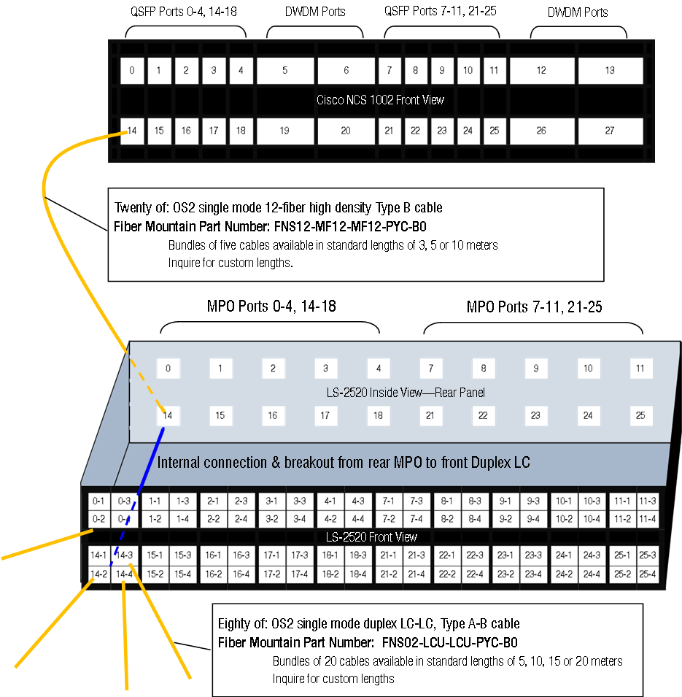
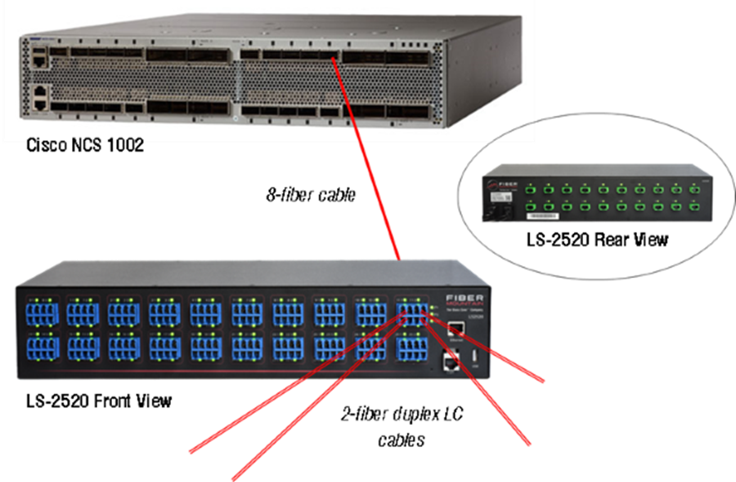
DWDM for Cloud Scale Networks
10G breakout panel
Intelligent Break-Out Panel.
Visible to NCS1002 over rear RJ45 port or LAN.
LED status control from NCS1002.
Port to port mapped to NCS1002 – 80x10GE LC ports in 2RU

