Slide 1
Very Fast and Flexible Cloud/NFV
Solution Stacks with FD.io
Jerome Tollet, Frank Brockners (Cisco)

Slide 2

Solution Stacks – A User Perspective:
Above and below “The Line”
Service Model
WorkFlow Topology
App Intent
Service Provisioning
Workload Placement
Service Configuration
VM Policy, Network Policy
Service Provisioning, Service Configuration
Service Chaining, Service Monitoring
Auto Recovery, Elastic Scaling, Workload Placement, Service Assurance
Service/WF Life Cycle Manager
VM/Container Policy
Service Monitoring
Auto Healing
Elastic Scaling
Virtual Machine/Container
Life Cycle Manager
Phys./virtual Network Control
Group Policy, Chaining
High-Performance
Flexible Feature Paths
Network Controller;
IO Abstraction & Feature Path
Hypervisor/Host//Container
Compute
Network
Storage

Slide 3
“The 20th century was about invention, the 21st is about mashups and integration”
Toby Ford
FD.io Mini-Summit Sept, 2016

Slide 4





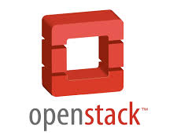


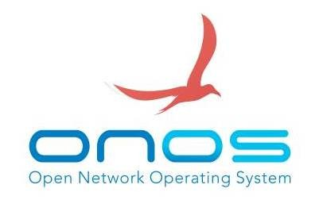

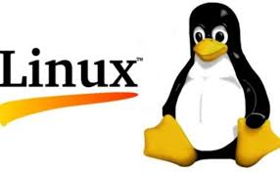





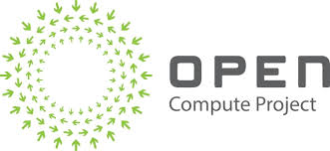
OpenSource Building Blocks
PaaS
Application Layer / App Server
Additional
PaaS platforms
Cloud Infra & Tooling
Network Data Analytics
Orchestration
VIM Management System
Network Control
Infrastructure
Operating Systems
IO Abstraction & Feature Path
Hardware

Slide 5

Composing the NO-STACK-WORLD
Application Layer / App Server
The “No-Stack-Developer”
Network Data Analytics
OPNFV
Compose
Deploy
Test
Evolve
Iterate
Orchestration
VIM Management System
Network Control
Operating Systems
IO Abstraction & Feature Path
Hardware
Evolve/Integrate/Install/Test

Slide 6
Building Cloud/NFV Solution Stacks
Service
Model
WorkFlow Topology
App Intent
OPNFV performs System Integration as an open community effort:
  Create/Evolve Components (in lock-step with Upstream Communities)
  Compose / Deploy / Test
  Iterate (in a distributed, multi-vendor CI/CD system)
Let’s add “fast and flexible networking” as another focus…
Service/WF Life Cycle Manager
Virtual Machine/Container
Life Cycle Manager
Network Controller
Forwarder – Switch/Router

Slide 7
Foundational Assets For NFV Infrastructure:
A stack is only as good as its foundation
Service
Model
WorkFlow Topology
App Intent
Forwarder
  Feature rich, high performance,
  highly scalable virtual switch-router
  Leverages hardware accelerators
  Runs in user space
  Modular and easy extensible
Forwarder Diversity: Hardware and Software
  Virtual Domains link and interact with physical domains
Domains and Policy
  Connectivity should reflect business logic instead of physical L2/L3 constructs
Service/WF Life Cycle Manager
Virtual Machine/Container
Life Cycle Manager
Network Controller
Forwarder – Switch/Router

Slide 8







Evolving The OPNFV Solution Set:
OPNFV FastDataStacks Project
Category
Components in
OPNFV
OPNFV develops, integrates, and continuously tests NFV solution stacks: Historically OPNFV solution stacks only used OVS as virtual forwarder
Objective: Create a new stacks which significantly evolve networking for NFV
Current scenarios
  OpenStack – OpenDaylight (Layer2) – VPP
  OpenStack – OpenDaylight (Layer3) – VPP
  OpenStack – VPP
  ...
Diverse set of contributors:
https://wiki.opnfv.org/display/fds
Install Tools
Apex, Compass,
Fuel, Juju
VM Control
OpenStack
Network Control
OpenDaylight,
ONOS, OpenContrail
Hypervisor
KVM, KVM4NFV
+ VPP
Forwarder
OVS, OVS-DPDK

Slide 9
The Foundation is the Fast Forwarder:
FD.io/VPP – The Universal Dataplane

Slide 10



FD.io is…
Project at Linux Foundation
  Multi-party
  Multi-project
Software Dataplane
  High throughput
  Low Latency
  Feature Rich
  Resource Efficient
  Bare Metal/VM/Container
  Multiplatform
Fd.io Scope:
  Network IO - NIC/vNIC <-> cores/threads
  Packet Processing – Classify/Transform/Prioritize/Forward/Terminate
  Dataplane Management Agents - ControlPlane
Bare Metal/VM/Container
Dataplane Management Agent
Packet Processing
Network IO

Slide 11
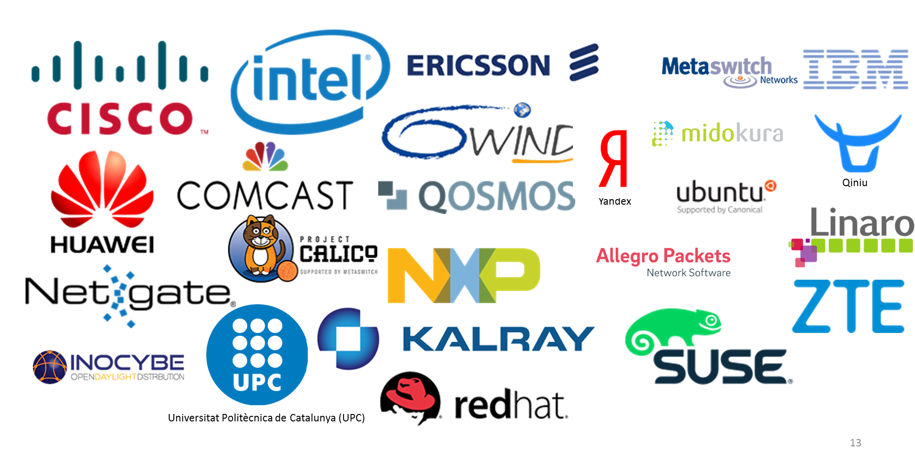
Multiparty: Contributor/Committer Diversity

Slide 12
Multiproject: FD.io Projects
Dataplane Management Agent
Testing/Support
Honeycomb
hc2vpp
CSIT
Packet Processing
govpp
puppet-fdio
NSH_SFC
ONE
TLDK
trex
CICN
odp4vpp
VPP Sandbox
VPP
Network IO
deb_dpdk
rpm_dpdk

Slide 13
Vector Packet Processor - VPP
Bare Metal/VM/Container
Packet Processing Platform:
  High performance
  Linux User space
  Run’s on commodity CPUs: / /
  Shipping at volume in server & embedded products since 2004.
Dataplane Management Agent
Packet Processing
Network IO

Slide 14
VPP Universal Fast Dataplane: Performance at Scale [1/2]
Per CPU core throughput with linear multi-thread(-core) scaling
IPv4 Routing
IPv6 Routing
Topology:
Phy-VS-Phy
Hardware: Cisco UCS C240 M4
Intel® C610 series chipset
2 x Intel® Xeon® Processor E5-2698 v3 (16 cores, 2.3GHz, 40MB Cache)
2133 MHz, 256 GB Total
6 x 2p40GE Intel XL710=12x40GE
Software
Linux: Ubuntu 16.04.1 LTS Kernel: ver. 4.4.0-45-generic
FD.io VPP: VPP v17.01-5~ge234726 (DPDK 16.11)
Resources
1 physical CPU core per 40GE port
Other CPU cores available for other services and other work
20 physical CPU cores available in 12x40GE seupt
Lots of Headroom for much more throughput and features

Slide 15
VPP Universal Fast Dataplane: Performance at Scale [2/2]
Per CPU core throughput with linear multi-thread(-core) scaling
L2 Switching
L2 Switching with VXLAN Tunneling
Topology:
Phy-VS-Phy
Hardware: Cisco UCS C240 M4
Intel® C610 series chipset
2 x Intel® Xeon® Processor E5-2698 v3 (16 cores, 2.3GHz, 40MB Cache)
2133 MHz, 256 GB Total
6 x 2p40GE Intel XL710=12x40GE
Software
Linux: Ubuntu 16.04.1 LTS Kernel: ver. 4.4.0-45-generic
FD.io VPP: VPP v17.01-5~ge234726 (DPDK 16.11)
Resources
1 physical CPU core per 40GE port
Other CPU cores available for other services and other work
20 physical CPU cores available in 12x40GE seupt
Lots of Headroom for much more throughput and features

Slide 16
VPP: How does it work?
1
vhost-user-
input
af-packet-
input
dpdk-input
… graph nodes are optimized
to fit inside the instruction cache …
2
ethernet-
input
Microprocessor
mpls-input
lldp-input
arp-input
cdp-input
l2-input
ip4-input
ip6-input
Packet 0
Packet 1
Packet 2
Packet 3
Packet 4
Packet 5
Packet 6
Packet 7
Packet 8
Packet 9
Packet 10
...-no-
checksum
Instruction Cache
3
ip4-lookup
ip4-lookup-
mulitcast
Data Cache
4
mpls-policy-
encap
ip4-load-
balance
ip4-rewrite-
transit
ip4-
midchain
interface-
output
… packets moved through
graph nodes in vector …
… packets are pre-fetched,
into the data cache …
Packet processing is decomposed into a directed graph node …
* approx. 173 nodes in default deployment

Slide 17
VPP: How does it work?
6
dispatch fn()
… instruction cache is warm with the instructions from a single graph node …
while packets in vector
Get pointer to vector
while 4 or more packets
Microprocessor
PREFETCH #3 and #4
ethernet-input
PROCESS #1 and #2
4
ASSUME next_node same as last packet
5
Update counters, advance buffers
Packet 1
Packet 2
Enqueue the packet to next_node
while any packets
<as above but single packet>
… data cache is warm with a small number of packets ..
… packets are processed in groups of four,
any remaining packets are processed on by one …

Slide 18
VPP: How does it work?
dispatch fn()
while packets in vector
7
Get pointer to vector
while 4 or more packets
Microprocessor
PREFETCH #1 and #2
ethernet-input
PROCESS #1 and #2
ASSUME next_node same as last packet
Update counters, advance buffers
Packet 1
Packet 2
Enqueue the packet to next_node
while any packets
<as above but single packet>
… prefetch packets #1 and #2 …

Slide 19
VPP: How does it work?
dispatch fn()
while packets in vector
8
Get pointer to vector
while 4 or more packets
Microprocessor
PREFETCH #3 and #4
ethernet-input
PROCESS #1 and #2
ASSUME next_node same as last packet
Update counters, advance buffers
Packet 1
Packet 2
Enqueue the packet to next_node
Packet 3
while any packets
Packet 4
<as above but single packet>
… process packet #3 and #4 …
… update counters, enqueue packets to the next node …

Slide 20
VPP Features as of 17.01 Release
Hardware Platforms
Routing
Switching
Network Services
  Pure Userspace - X86,ARM 32/64,Power
  Raspberry Pi
  IPv4/IPv6
  14+ MPPS, single core
  Hierarchical FIBs
  Multimillion FIB entries
  Source RPF
  Thousands of VRFs
  Controlled cross-VRF lookups
  Multipath – ECMP and Unequal Cost
  VLAN Support
  Single/ Double tag
  L2 forwd w/EFP/BridgeDomain concepts
  VTR – push/pop/Translate (1:1,1:2, 2:1,2:2)
  Mac Learning – default limit of 50k addr
  Bridging
  Split-horizon group support/EFP Filtering
  Proxy Arp
  Arp termination
  IRB - BVI Support with RouterMac assigmt
  Flooding
  Input ACLs
  Interface cross-connect
  L2 GRE over IPSec tunnels
  DHCPv4 client/proxy
  DHCPv6 Proxy
  MAP/LW46 – IPv4aas
  MagLev-like Load
  Identifier Locator Addressing
  NSH SFC SFF’s & NSH Proxy
  LLDP
  BFD
  Policer
  Multiple million Classifiers –
  Arbitrary N-tuple
Interfaces
  DPDK/Netmap/AF_Packet/TunTap
  Vhost-user - multi-queue, reconnect,
  Jumbo Frame Support
Language Bindings
Segment Routing
  C/Java/Python/Lua
  SR MPLS/IPv6
  Including Multicast
Inband iOAM
  Telemetry export infra (raw IPFIX)
  iOAM for VXLAN-GPE (NGENA)
  SRv6 and iOAM co-existence
  iOAM proxy mode / caching
  iOAM probe and responder
Tunnels/Encaps
LISP
Security
  GRE/VXLAN/VXLAN-GPE/LISP-GPE/NSH
  IPSEC
  Including HW offload when available
  LISP xTR/RTR
  L2 Overlays over LISP and GRE encaps
  Multitenancy
  Multihome
  Map/Resolver Failover
  Source/Dest control plane support
  Map-Register/Map-Notify/RLOC-probing
  Mandatory Input Checks:
  TTL expiration
  header checksum
  L2 length < IP length
  ARP resolution/snooping
  ARP proxy
  SNAT
  Ingress Port Range Filtering
  Per interface whitelists
  Policy/Security Groups/GBP (Classifier)
Monitoring
MPLS
  Simple Port Analyzer (SPAN)
  IP Flow Export (IPFIX)
  Counters for everything
  Lawful Intercept
  MPLS over Ethernet/GRE
  Deep label stacks supported

Slide 21
Rapid Release Cadence – ~3 months
16-09
Release:
VPP, Honeycomb, NSH_SFC, ONE
17-01
Release:
VPP, Honeycomb, NSH_SFC, ONE
16-02
Fd.io launch
16-06
Release- VPP
16-06 New Features
16-09 New Features
17-01 New Features
  Enhanced Switching & Routing
  IPv6 SR multicast support
  LISP xTR support
  VXLAN over IPv6 underlay
  per interface whitelists
  shared adjacencies in FIB
  Improves interface support
  vhost-user – jumbo frames
  Netmap interface support
  AF_Packet interface support
  Improved programmability
  Python API bindings
  Enhanced JVPP Java API bindings
  Enhanced debugging cli
  Hardware and Software Support
  Support for ARM 32 targets
  Support for Raspberry Pi
  Support for DPDK 16.04
  Enhanced LISP support for
  L2 overlays
  Multitenancy
  Multihoming
  Re-encapsulating Tunnel Routers (RTR) support
  Map-Resolver failover algorithm
  New plugins for
  SNAT
  MagLev-like Load
  Identifier Locator Addressing
  NSH SFC SFF’s & NSH Proxy
  Port range ingress filtering
  Dynamically ordered subgraphs
  Hierarchical FIB
  Performance Improvements
  DPDK input and output nodes
  L2 Path
  IPv4 lookup node
  IPSEC
  Softwand HWCrypto Support
  HQoS support
  Simple Port Analyzer (SPAN)
  BFD
  IPFIX Improvements
  L2 GRE over IPSec tunnels
  LLDP
  LISP Enhancements
  Source/Dest control plane
  L2 over LISP and GRE
  Map-Register/Map-Notify
  RLOC-probing
  ACL
  Flow Per Packet
  SNAT – Multithread, Flow Export
  LUA API Bindings

Slide 22
New in 17.04 Release
VPP Userspace Host Stack
Security Groups
Segment Routing v6
  TCP stack
  DHCPv4 relay multi-destination
  DHCPv4 option 82
  DHCPv6 relay multi-destination
  DHPCv6 relay remote-id
  ND Proxy
  Routed interface support
  L4 filters with IPv6 Extension Headers
  SR policies with weighted SID lists
  Binding SID
  SR steering policies
  SR LocalSIDs
  Framework to expand local SIDs w/plugins
API
  Move to CFFI for Python binding
  Python Packaging improvements
  CLI over API
  Improved C/C++ language binding
iOAM
SNAT
  UDP Pinger w/path fault isolation
  IOAM as type 2 metadata in NSH
  IOAM raw IPFIX collector and analyzer
  Anycast active server selection
  CGN: Configurable port allocation
  CGN: Configurable Address pooling
  CPE: External interface
  DHCP support
  NAT64, LW46
IPFIX
  Collect IPv6 information
  Per flow state

Slide 23
Key Takeaways
Feature Rich
High Performance
  480 Gbps/200mpp at scale (8 million routes)
Many Use Cases:
  Bare Metal/Embedded/Cloud/Containers/NFVi/VNFs

Slide 24
Solutions Stacks:
Fast and extensible networking natively integrated into OpenStack

Slide 25
What is “networking-vpp”
FD.io / VPP is a fast software dataplane that can be used to speed up communications for any kind of VM or VNF.
VPP can speed-up both East-West and North-South communications
Networking-vpp is a project aiming at providing a simple, robust, production grade integration of VPP in OpenStack using ml2 interface
Goal is to make VPP a first class citizen component in OpenStack for NFV and Cloud applications

Slide 26
Networking-vpp: Design Principles
Main design goals are: simplicity, robustness, scalability
Efficient management communications
  All communication is asynchronous
  All communication is REST based
Robustness
  Built for failure – if a cloud runs long enough, everything will happen eventually
  All modules are unit and system tested
Code is small and easy to understand (no spaghetti/legacy code)

Slide 27
Networking-vpp: current feature set
Network types
  VLAN: supported since version 16.09
  VXLAN-GPE: supported since version 17.04
Port types
  VM connectivity done using fast vhostuser interfaces
  TAP interfaces for services such as DHCP
Security
  Security-groups based on VPP stateful ACLs
  Port Security can be disabled for true fastpath
  Role Based Access Control and secure TLS connections for etcd
Layer 3 Networking
  North-South Floating IP
  North-South SNAT
  East-West Internal Gateway
Robustness
  If Neutron commits to it, it will happen
  Component state resync in case of failure: recovers from restart of Neutron, the agent and VPP

Slide 28
Networking-vpp, what is your problem?
You have a controller and you tell it to do something
It talks to a device to get the job done
  Did the message even get sent, or did the controller crash first? Does the controller believe it sent the message when it restarts?
  Did the message get sent and the controller crash before it got a reply?
  Did it get a reply but crash before it processed it?
  If the message was sent and you got a reply, did the device get programmed?
  If the message was sent and you didn’t get a reply, did the device get programmed?

Slide 29
Networking-vpp, what is your problem?
If you give a device a list of jobs to do, it’s really hard to make sure it gets them all and acts on them
If you give a device a description of the state you want it to get to, the task can be made much easier

Slide 30


Networking-vpp: overall architecture
Neutron Server
ML2 VPP
Mechanism Driver
journaling
Compute Node
Compute Node
VM
VM
VM
VM
VM
VM
HTTP/json
vhostuser
vhostuser
VPP
VPP
ML2 Agent
ML2 Agent
dpdk
dpdk
vlan / flat network

Slide 31
Networking-vpp: Resync mechanism
The agent marks everything it puts in VPP
If the agent restarts, it comes up with no knowledge of what’s in VPP, so it reads those marks back
While it’s been gone, things may have happened and etcd will have changed
For each item, it can see if it’s correct or if it’s out of date (for instance, deleted), and it can also spot new ports it’s been asked to make
With that information, it does the minimum necessary to fix VPP’s state
This means that while the agent’s gone, traffic keeps moving
Neutron is abiding by its promises (‘I will do this thing for you at the first possible moment’)
Compute Node
VM
vhostuser
VPP
ML2 Agent
dpdk

Slide 32
Networking-vpp: HA etcd deployment
The service
etcd is a strictly consistent store that can run with multiple processes
They talk to each other as they get the job done
A client can talk to any of them
Various deployment models – the client can use a proxy or talk directly to the etcd processes
Client
The processes

Slide 33
Networking-vpp: Role Based Access Control
Security Hardening
  TLS communication between nodes and ETCD :
    Confidentiality and integrity of the messages in transit and authentication of ETCD server.
  ETCD RBAC :
    Limit the impact of a compromised Compute Node to the node itself
Neutron Server
HTTPS/json
Compute Node 1
Compute Node 2

Slide 34
Networking-vpp: Roadmap
Next version will be networking-vpp 17.07
Security Groups
  support for remote-group-ID
  Support for additional protocol fields
VXLAN-GPE
  support for ARP handling in VPP
  Resync states in case of agent restart
Improved layer 3 support:
  support for HA (VRRP based)
  Resync for layer ports

Slide 35
Solution Stacks for enhanced Network Control:
OpenStack – OpenDaylight – FD.io/VPP

Slide 36
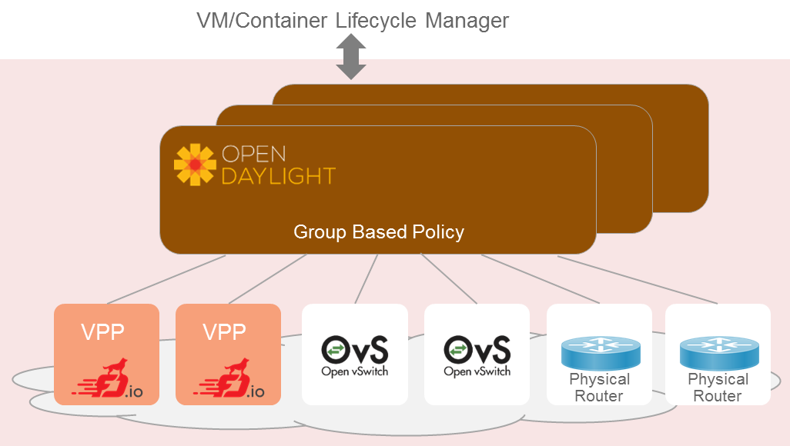
Towards a Stack with enhanced Network Control
FD.io/VPP
  Highly scalable, high
  performance, extensible virtual
  forwarder
OpenDaylight Network Controller
  Extensible controller platform
  Decouple business logic from network constructs: Group Based Policy as mediator between business logic and network constructs
  Support for a diverse set of network devices
  Clustering for HA

Slide 37



Solution Stack Ingredients and their Evolution
OpenDaylight
  Group Based Policy (GBP) Neutron Mapper
  GBP Renderer Manager enhancements
  VPP Renderer
  Virtual Bridge Domain Mgr / Topology Manager
FD.io
  HoneyComb – Enhancements
  VPP – Enhancements
  CSIT – VPP component tests
OPNFV
  Overall System Composition – Integration into CI/CD
  Installer: Integration of VPP into APEX
  System Test: FuncTest and Yardstick system test application to FDS
...
Neutron
REST
Neutron NorthBound
GBP Neutron Mapper
GBP Renderer Manager
VPP renderer
Topology Mgr - VBD
Netconf/YANG
Honeycomb (Dataplane Agent)
VPP
DPDK
System Install
(APEX)
System Test
(FuncTest, Yardstick)
See also:
FDS Architecture: https://wiki.opnfv.org/display/fds/OpenStack-ODL-VPP+integration+design+and+architecture

Slide 38



Example: Creating a Neutron vhostuser port on VPP
POST PORT
(id=<uuid>, host_id=<vpp>, vif_type=vhostuser)
Neutron
Update Port
Neutron NorthBound
Map Port to GBP Endpoint
GBP Neutron Mapper
Update/Create Policy involving GBP Endpoint
Resolve Policy
GBP Renderer Manager
Apply policy, update nodes
VPP Renderer
configure interfaces over Netconf
Bridge domain and tunnel config
Netconf/
YANG
Topology Manager (vBD)
Netconf/
YANG
Configure bridge domain on nodes over NetConf
VM
Honeycomb
Honeycomb
vhostuser
VPP 1
VXLAN Tunnel
VPP 2

Slide 39


FastDataStacks: OS – ODL(L2) – FD.io
Example: 3 node setup: 1 x Controller, 2 x Compute
Internet
Controlnode-0
External network i/f
OVS (br-ex)
OpenStack Services
qrouter (NAT)
Network Control
Computenode-0
Computenode-1
tap
HoneyComb
tap
Bridge
Domain
HoneyComb
DHCP
VPP
HoneyComb
VM 1
VM 2
Bridge
Domain
Tenant network i/f
Bridge
Domain
vhost-
user
VXLAN
VXLAN
Tenant network i/f
vhost-
user
Tenant network i/f
VXLAN
VPP
VPP

Slide 40
FastDataStacks: OS – ODL(L3) – FD.io
Example: 3 node setup: 1 x Controller, 2 x Compute
Internet
Controlnode-0
External network i/f
OpenStack Services
Network Control
Computenode-0
Computenode-1
HoneyComb
tap
Bridge
Domain
HoneyComb
DHCP
VPP
HoneyComb
VM 1
VM 2
Bridge
Domain
Tenant network i/f
Bridge
Domain
vhost-
user
VXLAN
VXLAN
Tenant network i/f
vhost-
user
Tenant network i/f
VXLAN
VPP
VPP

Slide 41
FastDataStacks: Status
Colorado 1.0 (September 2016)
Base O/S-ODL(L2)-VPP stack (Infra: Neutron / GBP Mapper / GBP Renderer / VBD / Honeycomb / VPP)
  Automatic Install
  Basic system-level testing
  L2 networking using ODL (no east-west security groups), L3 networking uses qrouter/OVS
  Overlays: VXLAN, VLAN
Colorado 3.0 (December 2016)
Enhanced O/S-ODL(L2)-VPP stack (Infra complete: Neutron / GBP Mapper / GBP Renderer / VBD / Honeycomb / VPP)
  Enhanced system-level testing
  L2 networking using ODL (incl. east-west security groups), L3 networking uses qrouter/OVS
O/S-VPP (Infra: Neutron ML2-VPP / Networking-vpp-agent / VPP)
  Automatic Install, Overlays: VLAN
Danube 1.0 (March 2017)
Enhanced O/S-ODL(L3)-VPP stack (Infra complete: Neutron / GBP Mapper / GBP Renderer / VBD / Honeycomb / VPP)
  L2 and L3 networking using ODL (incl. east-west security groups)
Danube 2.0 (May 2017)
Enhanced O/S-ODL(L3/L2)-VPP stack: HA for OpenStack and ODL (clustering)

Slide 42
FastDataStacks – Next Steps
Simple and efficient forwarding model
  Clean separation of “forwarding” and “policy”:
    Pure Layer 3 with distributed routing: Every VPP node serves as a router, “no bridging anywhere”
    Contracts/Isolation managed via Group Based Policy
  Flexile Topology Services: LISP integration, complementing VBD
Analytics integration into the solution stacks
  Integration of OPNFV projects:
    Bamboo (PNDA.io for OPNFV)
    Virtual Infrastructure Networking Assurance (VINA)
    NFVbench (Full Stack NFVI one-shot benchmarking)
Container Stack using FD.io/VPP
  Integrating Docker, K8s, Contiv, FD.io/VPP container networking, Spinnaker

Slide 43
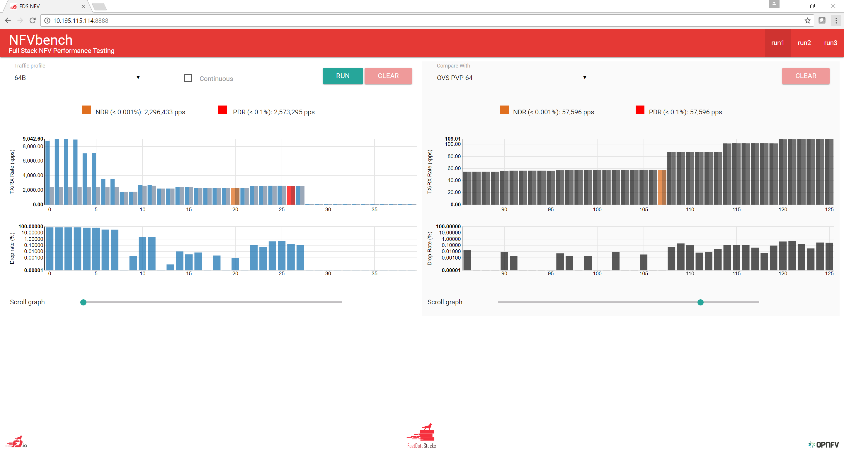
An NFV Solution Stack is only as good as its foundation

Slide 44
Thank you

