Slide 1


Designing Storage Networks
for solid-state storage and next-generation virtualized applications
Paresh Gupta (paregupt@cisco.com)
Technical Marketing Engineer
Cisco Storage Networking
23-May-2017

Slide 2
All Flash Arrays (AFA) are mainstream
Solid State Drives (SSD) has become mainstream storage media replacing Hard Disk Drives (HDD)
Top 4 factors
  Reliability
  Performance
  Scalability
  Performance consistency
Source: IDC: The Evolving All Flash Array (AFA) Market January 2017

Slide 3



SSD vs HDD
Hard Disk Drive
Solid State Drive
Data stored on magnetic media
Moving mechanical parts
  Rotation motor
  Moving head
Data stored on electronic media
No moving mechanical parts
Higher performance
Lower power
Lower cooling requirement
Almost same cost points as of HDDs
How do you define and measure performance today?

Slide 4



What is meant by performance?
  Write CMD
  Exchange Completion time
  Data Access Latency
MDS
MDS
XFER_RDY
Data Access
Latency
  Outstanding IO
Exchange
Completion
Time
  IOPS & other flow level counters
STATUS
  Read CMD
  Per flow timeout drop frames
  Failed exchanges, IO retransmissions
MDS
MDS
  SCSI error conditions (Aborts, Rejects, etc)
Exchange
Completion
Time
Data Access
Latency
  IOPS, IO block size & other detailed flow level stats
STATUS
To be measured at VM-SID-DID-LUN level

Slide 5
Challenges in quantification of performance
Production deployments are getting large and complex
Production networks are much different from lab networks used for pilot testing
Limitation of tools for metric measurement
Different teams managing different components.
Teams working in silos.
Hybrid environments.
Virtualization.
Reference point of measurement matters.

Slide 6















Understanding end-to-end block IO path
Not a SAN issue
Not a storage issue
Not an App/host issue
Application issues
Database
Server
Writes
All Flash Arrays
Web
Server
SAN
Compute & Applications
Reads
HBA (firmware)
Storage
Video
Streaming
Server
FC Driver
Too many components involved
Everybody is limited by their own view
Virtualization adds complexity
Hybrid-shared environments
    Bare-metals & virtualized servers
    Spinning disks & All flash arrays
    Multiple speed (4/8/16/32G FC)
HBA (firmware)
SCSI
FC Driver
Block
Storage Processor
Spinning Disk Arrays
OLTP
Backend connect
File System
Application
Drive enclosure
When application user complains, where do you start?

Slide 7


Complete I/O visibility using Cisco MDS
Monitor the wire to find the problem
Application issues
Database
Server
Writes
All Flash Arrays
Web
Server
SAN
Compute & Applications
Reads
FC
HBA (firmware)
SCSI
Storage
Data
Video
Streaming
Server
FC Driver
HBA (firmware)
SCSI
Deep packet visibility - FC & SCSI headers
Monitor every flow, every packet, at every speed in real time
Predictive & proactive, on-wire, vendor neutral monitoring between I & T
FC Driver
Block
Storage Processor
Spinning Disk Arrays
OLTP
Backend connect
File System
Application
Drive enclosure

Slide 8
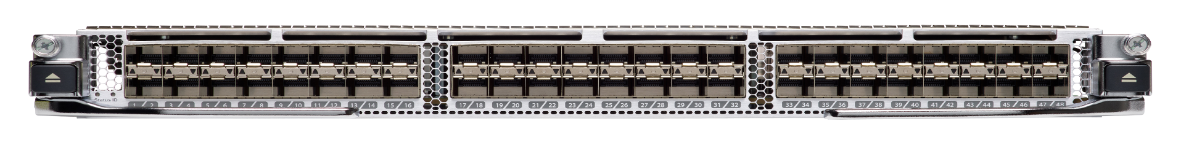
Switch Native Line Rate IO visibility
4/8/16/32 G Fibre Channel module for MDS 9700
Pervasive | No appliance | No probes | Always on
High Performance
Onboard analytics engine for data collection
End to End Visibility for trouble shooting
100% Visibility
Every Packet, Every Flow, Every Speed
Scale with MDS 9700 Director Platform
Hardware is available in April 2017. Analytics functionality will be enabled in 2HCY17 by SW-only upgrade

Slide 9



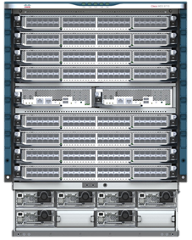

32G FC deployment with MDS 9700 – Option 1
SAN upgrade from MDS 9500 or competition
Full deployment using 32G FC module
Storage connectivity
16 or 32G FC
16G or 32G FC
Host connectivity
4, 8, 16 or 32G FC
ISL connectivity
Up to 16 physical links at 32G FC
in a single port-channel (Up to 512 Gbps)
32G FC
SAN analytics
Everywhere in the fabric. No extra device
4, 8, 16, 32 G FC
SAN Management
Centralized using DCNM
32G FC module
16G FC module

Slide 10
32G FC deployment with MDS 9700 – Option 2
SAN upgrade with 16G FC on MDS 9700 – Seamless adoption of 32G FC
32G FC module for ISL or storage connectivity
Storage connectivity
16 or 32G FC using 32G FC module
16G or 32G FC
Host connectivity
Use existing inventory of 16G FC module for 2/4/8/10/16G FC, 32G FC module for 32G
ISL connectivity
Use existing inventory of 16G FC module or 32G FC module for higher speed
16G or 32G FC
SAN analytics
32G FC module required in data path: Either storage edge, ISLs or everywhere.
2, 4, 8, 16, 32 G FC
SAN Management
Centralized using DCNM
32G FC module
16G FC module

Slide 11



Best Practice for 32G FC module on MDS 9700
SAN upgrade with 16G FC on MDS 9700 – Seamless adoption of 32G FC
Native switch-integrated fabric-wide analytics
Investment protection of 16G FC module on MDS 9700
Seamless & non-disruptive insertion of 32G FC module
High speed ISL ➔ Increase performance with fewer links
1
2
3
Existing
Cisco Recommended
Possible
32G FC module
16G FC module

Slide 12

Lessons learned
for SAN design with All Flash Arrays (AFA)

Slide 13
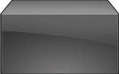
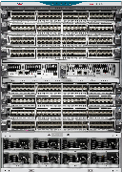
Oversubscription in storage networks
Host-edge switch needs more time to transmit the frames
Response at line rate
64K read request
Time to transmit 32 full size FC frames
16G
AFA- 1
16/32G
4G
8G
8G
Host-1
AFA- 2
16G
16G
64K read request
40µs
80µs
160µs
Increased oversubscription
Response at line rate
All Flash Arrays are extremely fast
Frames are transmitted at line rate (of the directly connected interface)
Backpressure is created if downstream links have less bandwidth
Effect is multiplied if same host makes simultaneous read requests to multiple targets almost at the same time
Calculations are approximated to convey the message using simple numbers

Slide 14
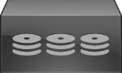
What changed with All Flash Arrays?
Response at line rate
Response may not be at line rate
16G
16G
AFA- 1
16/32G
16/32G
Traditional
spinning-disk arrays
8G
8G
Host-1
AFA- 2
Host-1
16G
16G
All Flash Arrays
Spinning Disk Arrays
Traditional spinning disks:
Most have 8G FC ports
Have large random-read delay (due to mechanical moving parts)
Data transmit is rarely at line rate
Larger inter-frame gap on the wire (at microsecond granularity)
All flash arrays enable high speed random read of data from underlying media

Slide 15
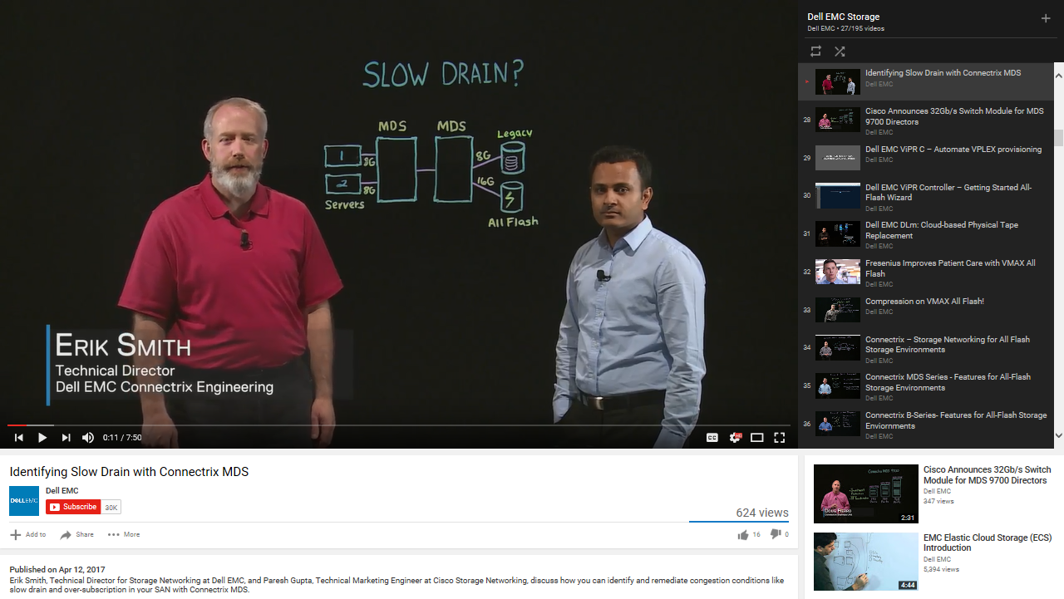
Watch video for more details
https://www.youtube.com/watch?v=tY7gu16ar_Q&feature=youtu.be&list=PL1F6F23C54113557F

Slide 16
Host Oversubscription due to speed mismatch
Mitigation – Host IO limits on Storage Arrays (Dell EMC’s recommendation)
16G
AFA- 1
16/32G
Limit IO per Storage Group or LUN
8G
Host-1
AFA- 2
16G
Limit the BW on the array to match host’s BW
Mitigates the impact in some environments, not all.
To know more if you will be benefited:
  Dell EMC VMAX3 and VMAX All Flash Quality of Service Controls for Multi-Tenant Environments
  Configuring your SAN to support All Flash Arrays – Alan Rajapa and Erik Smith - Dell EMC World 2017

Slide 17
Design recommendation with AFA
All Flash Arrays (AFA) changed everything – responses are extremely fast - FC-NVMe will make it even faster
Best
Better
16G
16G
16G
AFA- 1
32G
AFA- 1
8G
32G
Host-1
AFA- 2
Host-1
AFA- 2
16G
16G
Physical ISLs must be the highest speed links in a fabric
16G
16G
AFA- 1
Host-edge should have same link speed as the storage-edge
16G
Host-1
AFA- 2
16G

Slide 18
SAN Congestion
Oversubscription compared to typical slow drain due to Tx B2B credit starvation
SAN congestion due to host oversubscription
SAN congestion due to Tx B2B credit starvation
Explained in previous slides
Single host does not return R_RDY
Leads to Tx B2B credit starvation on switches
Other end-devices get impacted
Host-edge switch needs more time to transmit the frames
Response at line rate
64K read request
16G
AFA- 1
Host-1
Array-1
16/32G
Impacted
Impacted
8G
vs
Host-1
AFA- 2
16G
64K read request
R_RDY
Increased oversubscription
Host-2
Array-2
Response at line rate
Culprit
Impacted
Important – Understand the difference for effective resolution

Slide 19
Slow Drain due to Tx B2B credit starvation
R_RDY
R_RDY
1
Host-1
1
Array-1
Impacted
Impacted
2
2
R_RDY
Back Pressure
R_RDY
Back Pressure
R_RDY
Host-2
Array-2
Culprit
Slow Drain device
Impacted
Fibre Channel is a loss-less fabric – achieved using B2B credits and R_RDY
A single misbehaving host, not sending back R_RDY fast enough, causes slow drain
Impact is seen on multiple end-devices sharing the same pair of switches and ISLs
Switchport connected to a slow drain device is starved for Tx B2B credits
Resolution depends on the duration of Tx B2B credit unavailability on switchport connected to the slow drain device

Slide 20
SAN Congestion
Oversubscription compared to typical slow drain due to Tx B2B credit starvation
SAN congestion due to host oversubscription
SAN congestion due to Tx B2B credit starvation
ISL utilization is limited by host BW B2B credit starvation | ISL is under-utilized B2B credit starvation
Oversubscribed host link
Response at line rate
16G
Host-1
Array-1
AFA- 1
Impacted
Impacted
vs
8G
16/32G
Host-1
AFA- 2
R_RDY
16G
Host-2
Array-2
Culprit
Impacted
Host link is over-utilized No B2B credit starvation | Host link is under-utilized B2B credit starvation
Use TxWait and tx-datarate counters under port-monitor feature on Cisco MDS to find the difference

Slide 21
Virtual Link (VL) isolation of slow drain device
R_RDY
Back Pressure
Released
Back Pressure
Released
R_RDY
1
Host-1
1
Array-1
R_RDY
Normal Priority VL
Impacted
Impacted
R_RDY
Low Priority VL
2
R_RDY
Back Pressure
Back Pressure
R_RDY
Host-2
Array-2
Culprit
Slow Drain device
Moved to Isolated state
Impacted
Slow Drain device is moved to Isolated state
All traffic destined to isolated port is moved to low priority Virtual Link
All virtual links have dedicated B2B credits
B2B credit starvation in low priority virtual link does not impact B2B credits in normal priority virtual link

Slide 22


Investment Protection for the Next Decade
NVMe-over Fabric: Improved Performance and Faster Response

Slide 23
What is NVMe?
Storage
Non-Volatile Memory based storage (flash or solid state) has been widely adopted
There are no more rotating motors or moving heads in the storage drives
Reads and Writes are extremely fast
Compute
CPU are extremely fast, multi-core, hyper-threaded
Network
Interconnect between CPU and storage is very fast (PCI 3.0 or > 100 Gbps fabrics)
Software
The traditional SW layer (SATA or SAS) unable to take full advantage
Welcome NVMe
  Written from ground-up (Incorporated years of learnings and best practices)
  Up to 64K queues for command submission and completion, each CPU core can have its own queues
  Streamlined and simple command sets and many more…

Slide 24
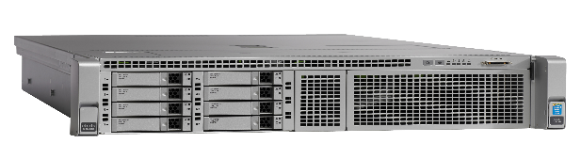
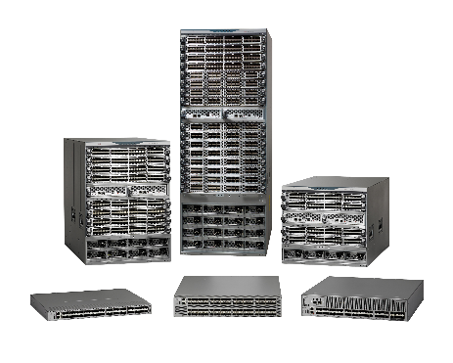


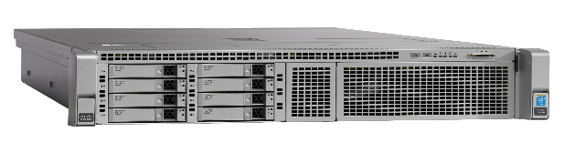
NVMe over FC – Same FC Paradigm
Cisco C-series Rack Servers
HBA
Traditional FC-SCSI capable initiator
FC-NVMe capable target
HBA
FC-NVMe capable initiator
FC or FCoE fabric built using
Cisco MDS 9000 switches
Traditional FC-SCSI capable target
Increased Performance
Seamless
Insertion
Phased
Transition
Multiprotocol Flexibility
Ecosystem
Support
No New Network
Established Solution
Co-exists with current Solutions
Notes:
Increased Performance: Unleash the power of All flash arrays using NVMe over FC or FCoE
Seamless Insertion: Support on all existing 16G FC and new 32G FC MDS switches
Phased Transition: SCSI & NVMe initiators & targets continue to share same SAN
Multiprotocol flexibility: SCSI or NVMe traffic over FC or FCoE transport
Ecosystem support: Fully validated solution on UCS C-series servers, MDS switches, Broadcom & Avago HBAs

Slide 25
Fibre Channel Architecture & NVMe
Application
ULP
Mapping
ESCON
IP
NVMe
FC-4
SCSI
IP
FC-3
Generic Services
FC-2
Framing & Flow Control
FC-1
Encoding
FC-0
Physical Interface (1-32G FC)
FC-NVMe extends benefits of NVMe over Fibre Channel fabric
Utilize FC benefits like plug-n-play, fabric server, name server, zone server, etc.
Deploy in existing infrastructure using current HBAs, switches, and management software
FC-NVMe, SCSI-FCIP and FICON can be transported concurrently in the same fabric

Slide 26
FC-NVMe – Phased & Seamless transition
FC
FC
SCSI
SCSI
HBA
Traditional FC-SCSI capable initiator
Traditional FC-SCSI capable target
Cisco C-series Rack Servers
FC
FC
SCSI
NVMe
SCSI
NVMe
Cisco MDS
HBA
FC-NVMe capable initiator
FC-NVMe capable target
FC-NVMe end-devices are dual-stack – simultaneous support of NVMe and SCSI transport
Cisco MDS enable simultaneous switching of NVMe & SCSI transport encapsulated in Fibre Channel frames
SCSI-only or NVMe capability of end-devices is auto-detected and advertised
Similar to the existing plug-and-play architecture of Fibre Channel
FC-NVMe is independent of FC speed. Possible even at 2G FC. 32G FC recommended.

Slide 27
FC-NVMe – Phased & Seamless transition
FC
FC
SCSI
I am a
SCSI initiator
FCNS database
SCSI
HBA
I am a
SCSI target
Traditional FC-SCSI capable initiator
Traditional FC-SCSI capable target
Cisco C-series Rack Servers
I am a
SCSI & NVMe initiator
I am a
SCSI & NVMe target
FC
FC
SCSI
NVMe
SCSI
NVMe
Cisco MDS
HBA
FC-NVMe capable initiator
FC-NVMe capable target
MDS9700# show fcns database vsan 160
VSAN 160:
--------------------------------------------------------------------------
FCID TYPE PWWN (VENDOR) FC4-TYPE:FEATURE
--------------------------------------------------------------------------
0x590020 N 10:00:00:90:fa:e0:08:5d (Emulex) scsi-fcp:init NVMe:init
0x590140 N 21:00:00:24:ff:7f:06:39 (Qlogic) scsi-fcp:init NVMe:init
(showing entries only for dual-stack NVMe capable initiators. Other devices will look similar)
Fibre Channel Name Server (FCNS) is a distributed database on MDS switches
End-devices register Upper Layer Protocol (ULP) with FCNS database, to be advertised to other end-devices in the same zone

Slide 28

FC-NVMe – Interop certified by Cisco
Cisco C-series Rack Servers
HBA
Broadcom / Emulex
Cavium / Qlogic
HBA
FC-NVMe capable target
Cisco MDS 9000
(All 16G and 32G switches)

Slide 29
Key Takeaways

Slide 30
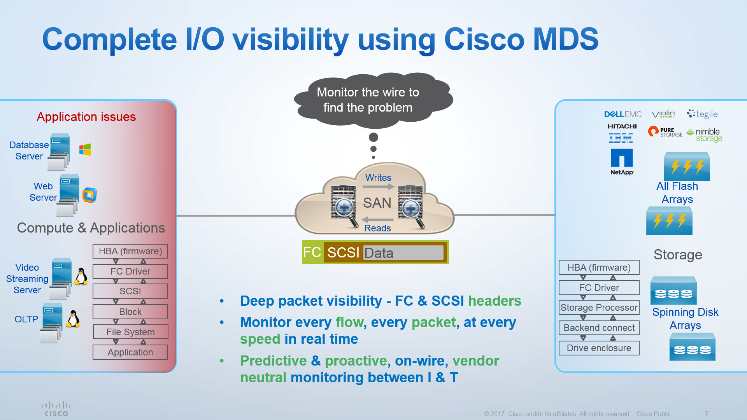
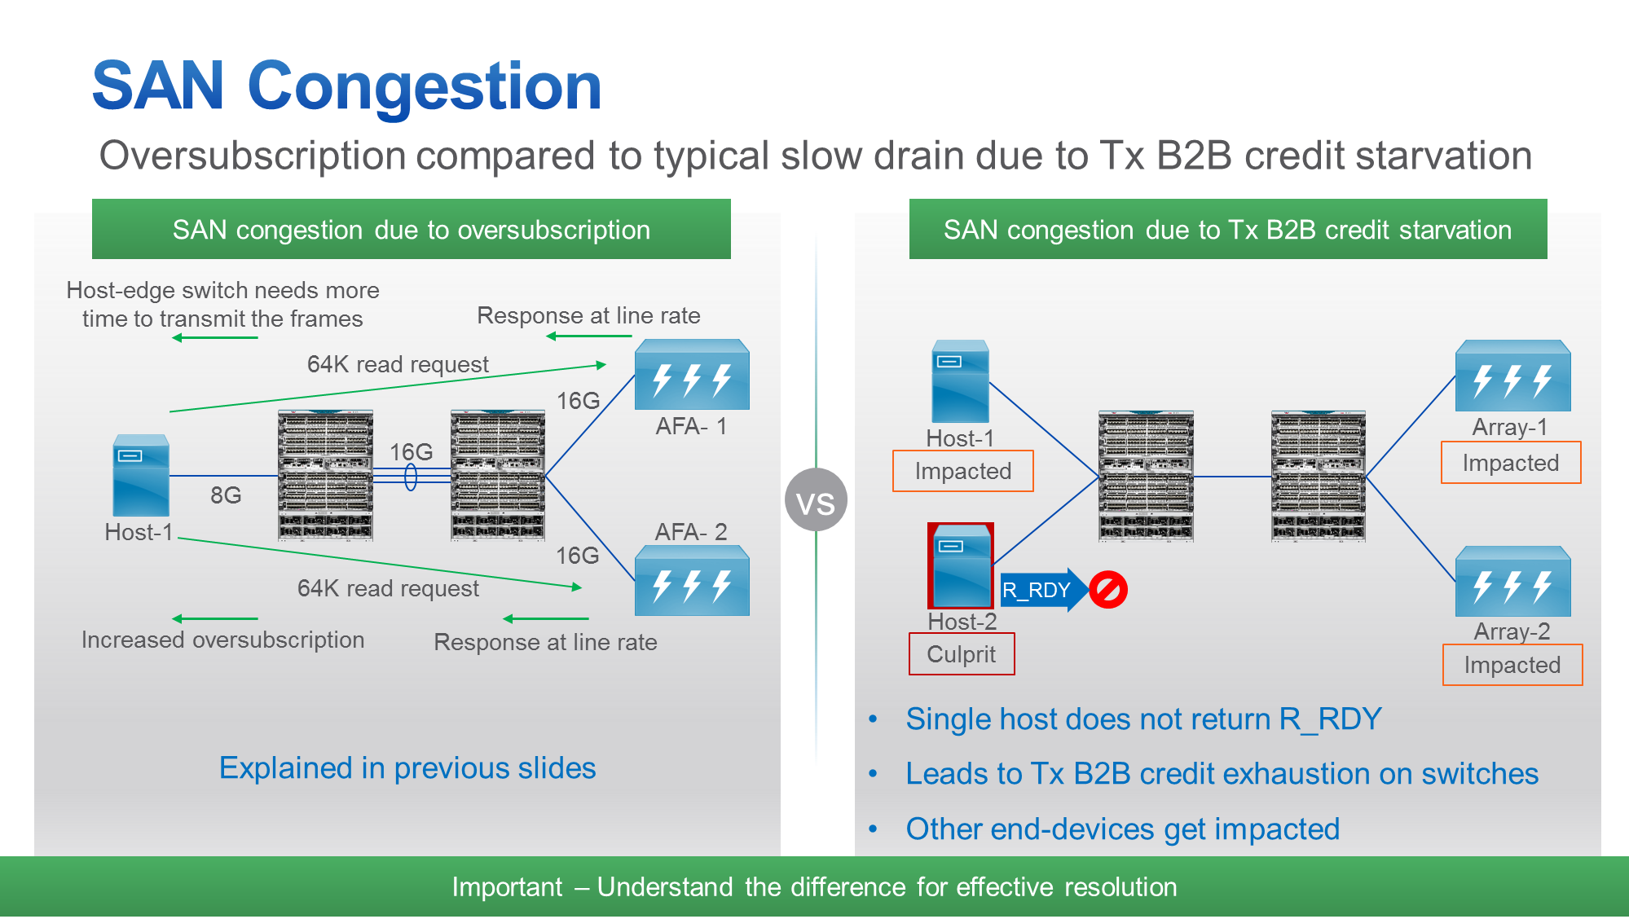
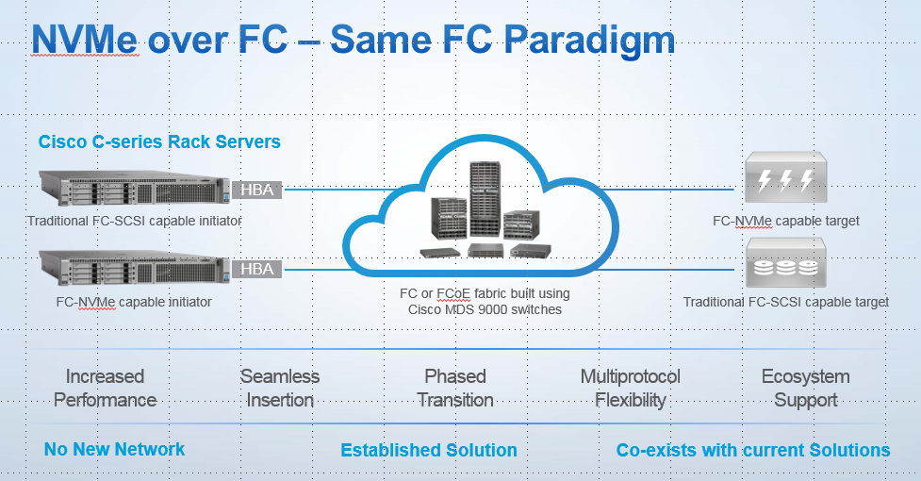
Key Takeaways
Deep Visibility
SAN Design for AFA
Investment Protection
Industry’s first and only
line-rate, integrated SAN analytics solution
Proactive & Predictive problem resolution
High speed connectivity
Physical ISL must be the highest speed links in a fabric
Host-edge should have same link speed as the storage-edge
Use of VSANs or Virtual Links
Enabling technology transition
NVMe over FC : Scale Flash deployments
Seamless transition
Low Cost, Low Risk, Low turnaround

