Slide 2
Cisco 5G Strategy and Innovations CiscoLive@LasVegas
Prakash Suthar, Principal Architect psuthar@cisco.com
BRKSPM-2071

Slide 3
Agenda
Introduction
5G Industry Updates
Evolving to 5G Architecture
Cisco 5G Updates
Architecture, Orchestration
Network slicing
5G Advisory Services
Summary

Slide 4
Introduction Time For The Next Generation Mobile Technology
2020s
5G
2010s
2000s
4G
1980s
1990s
3G
2G
LTE/LTE-A, Broadband data & video
1G
WCDMA, CDMA2000
Voice & data
Analog
AMPS
Voice
Digital
GSM, IS-95, IS-136
Voice capacity
Driven by Data Growth
More Devices (IoT)
More Traffic – Pervasive Video
New 5G Enabled Applications
New Business Models
Asset Provider (XaaS)
Connectivity Provider
New Partnering Arrangements
Technology Landscape
Virtualisation/NFV & SDN
New RAT/New Spectrum
Enabling Enhanced Video
Common IdM and Core platforms
New Internet Technologies (ICN)
4
Notes:
We have come long way since mobile devices use to be big bulky devices and unable to fit hands
LTE Technology
End users – More bandwidth, lower cost, more access to OTT and SP contents
SP – More radio and network capacity, all IP infrastructures
OTT – New business model, access to large subscribers, ability to monetize SP network
5G Technology
No need to wait till 2020. everyone is in rush to make something happen and call it 5G
Major play for unlicensed radio, seamless integration between licensed and unlicensed
5G is not new technology – new radio, new network BUT
New business model (5GPP partnership, sharing and leveraging best of all)
Create model for SPx (Service Provider – anyone, anytime, anywhere)
Agile network, More software play, DevOps model using continuous integration and continuous developments
Cloud-platforms to offer new services
US National Science Foundation research programs to trigger Future Internet Architecture (FIA)
Information Centric Networking
MobilityFirst
NEBULA
eXpressive Internet Architecture
ChoiceNet

Slide 5
5G is Not just Bandwidth - Evolution to the app economy and complex value chains
1G
2G
3G
=
First
5G
4G
History: 1G to 4G was all about the vertical radio ecosystem
IMMERSIVE
Enhanced mobile broadband
INCLUSIVE
Basic Services – Voice, Text, MMS and Packet Data
Massive machine-type communication
=
+
Radio
5G
Services
Network
Future : 5G is about the disaggregated, cloudified virtual network, ubiquitous connectivity and the “app-economy” for People and Things
INTERACTIVE
Ultra-reliable low-latency networks
Business Models now come first
Notes:
And the thing that's different now as we look at it-- those of you who've been in mobility for a while, you know, 1G, 2G, 3G, 4G-- really a lot of the services that the mobile operators were able to deliver were defined by the radio ecosystem and by the handset. That's not the case anymore, right? I mean it's all about the smartphone, it's all about applications, and the radio really does become an access point. We make great access points in the Wi-Fi space. And so there's a huge opportunity for us there. But it really shifts the power around from the [? RAN ?] vendors to someone like us with our platform.

Slide 6
Digitization Leading Cloud, IoT, 5G
$2 Trillion
SP Economic Opportunity
More Cloudification
More IoT
5G Journey Begin
More Video
4X
HALF
4.7X
7X
Cloud Traffic Increase
Connected Devices Are M2M
Traffic of LTE
Mobile Traffic Increase
Notes:
Digitization or the digital business transformation is leading the path for several market dynamics: cloud, IoT, and 5G
First more applications and workloads will move to the cloud due to the scale and economic benefits. This will result in a 4 times increase in global cloud traffic through 2020, Cisco GCI
There will be more IoT. As data, people, processes, and devices become increasingly connected, through 2020 nearly half of total connected devices will be machine-2-machine (M2M). Cisco VNI
Video is already the majority of fixed and mobile traffic. This will continue to drive global mobile traffic to the tune of 8 times over the next four years. And as the transition to 5G occurs, video will be one of the primary beneficiaries with faster speed and improved quality. Cisco Mobile VNI
The blending of these dynamics leads to a $2 trillion economic opportunity for service providers over the next decade through new services and operational savings (Cisco Consulting Services). But there are more transitions at bay…

Slide 7
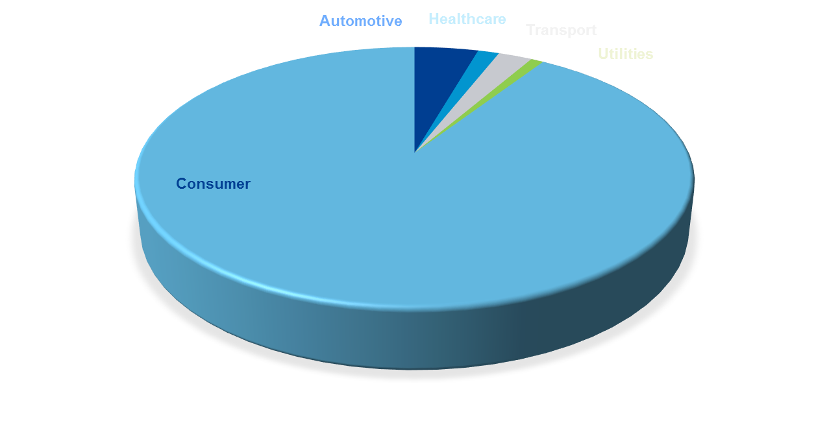
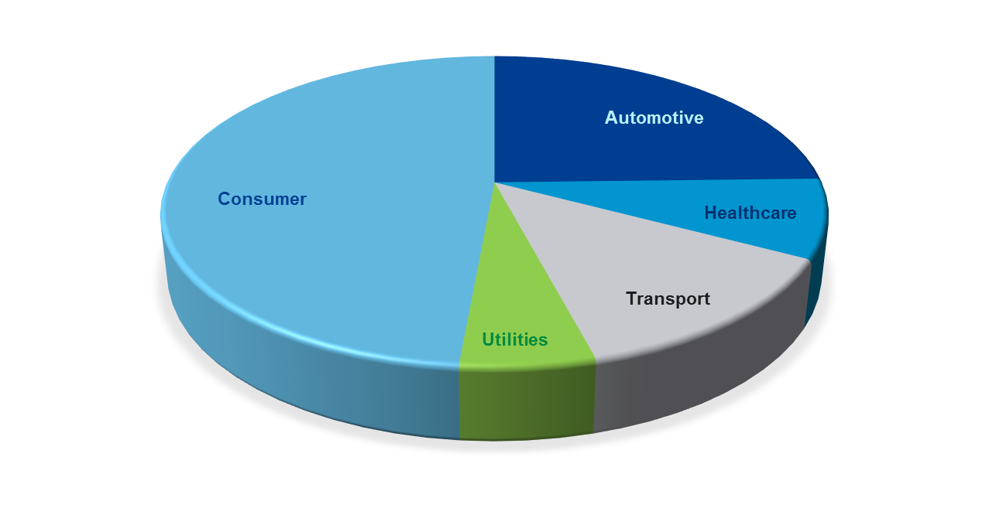
Operator Revenue Growth Opportunities
Automotive
Healthcare
Transport
Utilities
Core
$
Core
$
Illustrative
Today
Operator business mostly focused on the saturated consumer market
2025
Vertically targeted services will accelerate operator business growth
Source: European Commission Report, 2016
Notes:
Today’s market share of Enterprise business is small compared to consumer.
Industry studies and our conversations with several service providers indicate that by year 2020 this the proportion of Enterprise originated business will grow significantly.
And while it will still be far less of a share than consumer, the profit margins are expected to be much better.
Why? Because many Enterprise services will be customized and complex – there are profits in complexity.

Slide 8
Aggregation of Licensed and Unlicensed Spectrum
Notes:
LTE-U FCC announcement for 5GHz (AT&T, Verizon, Qualcomm, LG, Samsung)
Recent FCC announcement to allow LTE-U. LTE-U deployment options, this document focuses on supplemental downlink (SDL)
deployment in unlicensed band, which will be paired with a licensed LTE carrier as carrier aggregation mode in legacy LTE (up to 3GPP Rel 12). This deployment will target the regions without listen-before-talk (LBT) requirements such as US (for example, U-NII radio bands in the US covering 5.15 GHz –5.85 GHz regulated by the FCC)
3GPP Rel-10 onward provides spec for LTE in conjunction with an LTE deployment in licensed bands,
The FCC has given several companies the go-ahead to activate a wireless technology called LTE-U in their base stations; if all goes as planned, devices will be able to communicate cellular data over unlicensed frequencies

Slide 9
5G has Lots… of New THINGS!
LTE in 2010
5G in 2016
5G in 2017+
Existing-Radio
IOT-Radio
Network slicing
5G standardizations
5G Early Adopters - Use Cases Demo/POC
5G Mobile Edge Computing
5G Core – Network Slicing, Control and User Plane Separation
5G Management and Orchestration
Dedicated Core
MANO
Fronthall
Cloud-RAN
OTT
Internet
Operators Services
Mobile Core
Backhaul
Radio
ICN
OPNFV
Realty – virtual, augmented, Mixed
Mobile Edge Computing
Sensor network
Backhaul
Cellular IOT
Cloud
Hybrid, on-prem, public
WiFi-Radio
Self Learning Network
Telco NFV
Machine Learning
Openstack
LoRa
5G-Radio
Virtualisation
Notes:
Drive 5G Standardization
Drive standardization work at ITU IMT-2020, 3GPP, NGMN, IEEE, IETF etc.
Dedicated team to support standardization work
Lead co-development, POC
Co-development/Partnership for Cloud RAN, Mobile Edge Computing (MEG)
Introducing ICN in WiFi AP, Smallcell, VPC, CDN etc.
5G Mobile Edge Computing
Edge processing, caching for internet traffic
5G Core
NFV Virtualization Portfolio
Virtualization & orchestration for services hosted on 5G
Grow ecosystem for ESC, NSO to ETSI MANO
Establish 5G Leadership
Drive industry leadership
Take lead/champion role at ITU IMT-2020, 3GPP, NGMN, IEEE, IETF

Slide 10
Evolving to 5G Architecture

Slide 11
LTE/EPS Reference Architecture (Ref 3GPP TS23.401/402)
3GPP
IP Access
Evolved Packet System
2G/3G
3GPP Access
HSS
SWx (DIAMETER)
S12 (GTP-U)
UTRAN
PCRF
SGSN
S4 (GTP-C, GTP-U)
S6a
(DIAMETER)
GERAN
S3
(GTP-C)
Rx+
LTE
MME
S11
(GTP-C)
Gxc
(Gx+)
S1-MME
(S1-AP)
Gx
(Gx+)
Gxa
(Gx+)
Gxb
(Gx+)
3GPP
AAA
S10
(GTP-C)
S6b
(DIAMETER)
Serving
Gateway
S5 (PMIPv6, GRE)
PDN
Gateway
Operator’s
IP Services
E-UTRAN
eNodeB
S1-U
(GTP-U)
SGi
S5 (GTP-C, GTP-U)
IP Traffic
S2c
Transport (Tunneled Traffic)
SWm
(DIAMETER)
S2a
(PMIPv6, GRE
MIPv4 FACoA)
S2b
(PMIPv6,
GRE)
UE
SWa
(TBD)
ePDG
SWn
(TBD)
Non-3GPP
IP Access
Trusted
Untrusted
Trusted Non-3GPP IP Access
Untrusted Non-3GPP IP Access
S2c (DSMIPv6)
STa (RADIUS, DIAMETER)
UE
SWu (IKEv2,
MOBIKE, IPSec)
S2c
UE
Architecture Challenges covered in next slide
Notes:
3GPP specifications have mandated support for IPv6 for all interfaces. Since some of network might not be ready for IPv6 therefore dual stack IPv4v6 is allowed
MME - The MME provides the overall mobility management and session management functions in an LTE network. At any point in time, an LTE UE can connect only to one MME node. Functionality of an MME for EUTRAN Access is provided. MME functions include:
NAS signalling, NAS signalling security
Inter CN node signalling for mobility between 3GPP access networks (terminating S3)
UE Reachability in ECM-IDLE state (including control and execution of paging retransmission)
Tracking Area list management
PDN GW and Serving GW selection
MME selection for handovers with MME change
SGSN selection for handovers to 2G or 3G 3GPP access networks
Roaming (S6a towards home HSS)
Authentication, Authorization
Bearer management functions including dedicated bearer establishment;
Warning message transfer function (including selection of appropriate eNB)
UE Reachability procedures
SGW - The SGW provides the mobility anchor point for an LTE UE to access Evolved Packet Service (EPS) bearer services. At any point in time, an LTE UE can connect only to one SGW. The functions of the SGW include
local Mobility Anchor point for inter-eNodeB handover;
sending of one or more "end marker" to the source eNodeB, source SGSN or source RNC immediately after switching the path during inter-eNodeB and inter-RAT handover, especially to assist the reordering function in eNodeB
Mobility anchoring for inter-3GPP mobility (terminating S4 and relaying the traffic between 2G/3G system and PDN GW)
ECM-IDLE mode downlink packet buffering and initiation of network triggered service request procedure
Lawful Interception
Packet routing and forwarding
Transport level packet marking in the uplink and the downlink, e.g. setting the DiffServ Code Point, based on the QCI of the associated EPS bearer
Accounting for inter-operator charging. The SGW generates accounting data per UE and bearer
Interfacing OFCS according to charging principles
PGW - The PGW provides the access to one or more packet data networks. It also manages UE IP address assignments either by assigning an IP address from its own pool of addresses or adopting the UE subscribed IP address from the HSS or supporting the assignment method through an external DHCP server. An LTE UE may create one or more PDN connections and connect to one or more PGWs. PGW functions include:
Per-user based packet filtering (e.g. by deep packet inspection)
Lawful Interception
UE IP address allocation
Transport level packet marking in the uplink and downlink, e.g. setting the DiffServ Code Point, based on the QCI of the associated EPS bearer
Accounting for inter-operator charging
Uplink and downlink service level charging (e.g. based on SDFs defined by the PCRF, or based on deep packet inspection defined by local policy)
Interfacing OFCS through according to charging principles
Uplink and downlink service level gating control
Uplink and downlink service level rate enforcement
Uplink and downlink rate enforcement based on APN-AMBR (e.g. by rate policing/shaping per aggregate of traffic of all SDFs of the same APN that are associated with Non-GBR QCIs)
Downlink rate enforcement based on the accumulated MBRs of the aggregate of SDFs with the same GBR QCI (e.g. by rate policing/shaping)
DHCPv4 (server and client) and DHCPv6 (client and server) functions
Packet screening
Accounting per UE and bearer
Policy and Charging Enforcement Function (PCEF) can be part of PGW and it enforces the Layer-4 to Layer-7 Policy and Charging Controls (PCC) provided by the PCRF. This enables service based routing, packet forwarding, traffic shaping and policing.
3GPP Interfaces
S1-MME: Reference point for the control plane protocol between E-UTRAN and MME.
S1-U: Reference point between E-UTRAN and Serving GW for the per bearer user plane tunnelling and inter eNodeB path switching during handover.
S14: This interface is between the UE and the ANDSF that enables UE configuration to be able to select Access networks dynamically.
S5: It provides user plane tunnelling and tunnel management between Serving GW and PDN GW. It is used for Serving GW relocation due to UE mobility and if the Serving GW needs to connect to a non-collocated PDN GW for the required PDN connectivity.
S6a: It enables transfer of subscription and authentication data for authenticating/authorizing user access to the evolved system (AAA interface) between MME and HSS.
Gx: It provides transfer of (QoS) policy and charging rules from PCRF to Policy and Charging Enforcement Function (PCEF) in the PDN GW.
S10: Reference point between MMEs for MME relocation and MME to MME information transfer.
S11: Reference point between MME and Serving GW
SGi: It is the reference point between the PDN GW and the packet data network. Packet data network may be an operator external public or private packet data network or an intra operator packet data network, e.g. for provision of IMS services. This reference point corresponds to Gi for 3GPP accesses.
Gz: This reference point resides between the PCEF and the OFCS.
Sp: This reference point allows the PCRF to request subscription information related to the IP‑CAN transport level policies from the SPR based on a subscriber ID, a PDN identifier and possible further IP‑CAN session attributes.
X2: These procedures are used to hand over a UE from a source eNodeB to a target eNodeB. In these procedures the MME is unchanged. Two procedures are defined depending on whether the Serving GW is unchanged or is relocated.
IMS Interfaces: The Internal IMS interfaces will be discussed when the IMS section is added.
S14 Interface: This reference point is between UE and H‑ANDSF / V‑ANDSF for direct queries via pull. It enables dynamic provision of information to the UE for access NW discovery and selection procedures related to non-3GPP and 3GPP accesses.
S2a Interface: It provides the user plane with related control and mobility support between trusted non 3GPP IP access and the Gateway.
S2b Interface: It provides the user plane with related control and mobility support between ePDG and the Gateway.
S2c Interface: It provides the user plane with related control and mobility support between UE and the Gateway. This reference point is implemented over trusted and/or untrusted non-3GPP Access and/or 3GPP access.
S3 Interface: It is the interface between SGSN and MME and it enables user and bearer information exchange for inter 3GPP access network mobility in idle and/or active state. It is based on Gn reference point as defined between SGSNs
S4 Interface: This interface provides provides related control and mobility support between GPRS Core and the 3GPP Anchor function of Serving GW. In addition, if Direct Tunnel is not established, it provides the user plane tunnelling.
S7 Interface: This interface provides transfer of (QoS) policy and charging rules from Policy and Charging Rules Function (PCRF) to Policy and Charging Enforcement Function (PCEF) in the PDN GW. This interface is based on the Gx interface

Slide 12
Some of 3G/LTE Architecture Challenges
Overall Architecture
Centralised Gateway with limited distribution
Limited Agility and scaling limitations
Designed for consumer cellular mobiles
Added feature for CIoT, MTC, service chaining
Complex QoS enforcement
Mobility Control Management
Heavy signalling
No integrated Signalling Storm Management
Centralised Mobility Management decisions
User Session Management
Resources intensive and sub-optimal in managing resources
Tunneled traffic to Mobile Gateways
Centralised Policy Management
Infrastructure & UE Security concerns
NAS Event Type | MME | HSS | SGW | PGW | PCRF
Attach | 10 | 2 | 3 | 2 | 1
Additional default bearer | 4 | 0 | 3 | 2 | 1
Dedicated bearer | 2 | 0 | 2 | 2 | 1
Idle-to-connect transition | 3 | 0 | 1 | 0 | 0
Connected-to-idle | 3 | 0 | 1 | 0 | 0
X2-based handover | 2 | 0 | 1 | 0 | 0
S1-based handover | 8 | 0 | 3 | 0 | 0
Tracking area update | 2 | 0 | 0 | 0 | 0
Total | 34 | 2 | 14 | 6 | 3
CIoT – Cellular IOT
MTC – Machine Type Communication
GiLAN – IP Services

Slide 13
3GPP - 5G Architecture Framework, 3GPP TR 23.799 v0.5.0 and later
Application Management Function
NG5
Service Management Function
NG2
NG4
NextGen UE
NG1
NextGen RAN
User Plane
Forwarding Function
Data Network
(Contents)
NG3
NG6
Enhanced E-UTRA
LTE | 5G (Interfaces To be Defined) | Description
NAS | NG1 | NG1 to carry Authentication Messages
E-UTRA | Enhanced E-UTRA | New/modified RAT messages from 5G radio
S1-MME | NG2 | Control messages for mobility management
S1-U/S5/S8 | NG3 | User traffic between NextGen RAN and User Plane including Mobile Edge Computing (MEC)
S11 | NG4 | Control message (GTP, SDN based e.g. Open Daylight) to set-up User Plane forwarding end points
Gx/Gx’ | NG5 | Control message for policy, authentication/authorisation, billing, backend systems
SGi | NG6 | User traffic between Forwarding function and Data services (contents)

Slide 14
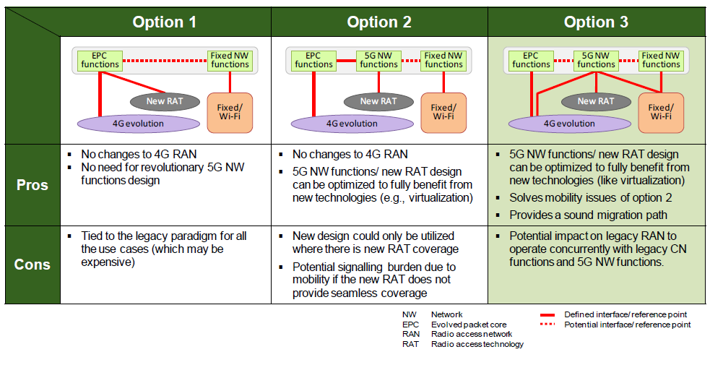
Options for Integrating 5G with Existing 3G/LTE Technologies
Industry converging on Option 3

Slide 15
Cisco 5G Architecture Updates

Slide 16
Cisco Open Network Architecture for 5G Unified Enablement Platform
Service Creation
OSS | BSS
Open APIs
Services
Public • Private Cloud and/or On-Prem
Business • IoT • Video • Mobile • Collaboration
Security
Open APIs
Policy
Analytics
Network Abstraction
Orchestration • Automation • Assurance
Open APIs
Streaming Telemetry
Infrastructure
Physical & Virtual
Notes:
Cisco Open Network Architecture (ONA) is really a framework to help simplify technical discussions.
The Cisco 5G Unified Enablement Platform uses the bottom two layer of the ONA; Infrastructure and Automation

Slide 17
5G Architectural Tenets
Secure Inside-Out
Access Agnostic
Converged Access Gateway
True Heterogeneous Networks
Seamless mobility
Early 5G use cases
Cloud-Scale Network
Virtualized and Programmable
Simplicity
Service velocity
Open and flexible
Automation and Orchestration
Self Optimising Infrastructure
Optimize Operations and Service Creation
API Exposure
Build from strength in mobile core
Extract data from the network
Create Vertical Value
Enable New Business Models
Notes:
Secured from Inside out

Slide 18
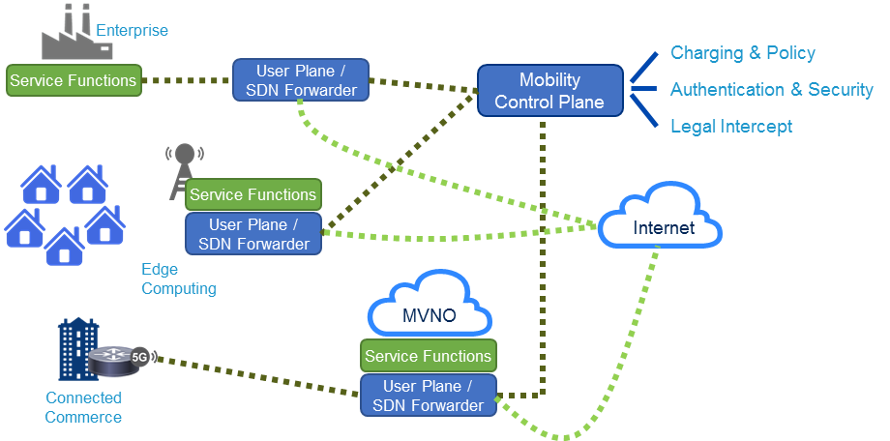
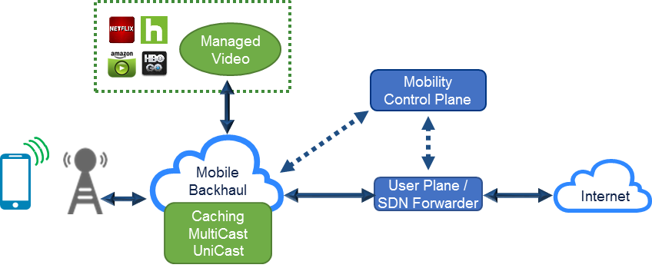
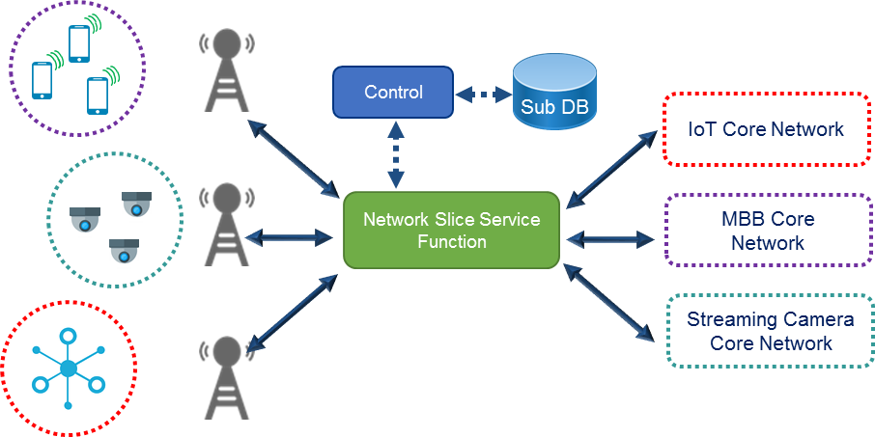
Key Enabling Technologies for 5G
CUPS:
Control/User Plane Separation
Cloud RAN
Mobile network to scale using MEC
Network Slicing

Slide 19
Cisco 5G Network Architecture: A Synthesis View
Service Focused
Programming the network
Micro Services
“Personal” Networks
Intelligent Slicing
Sub-Slicing
Converged Access Gateway

Slide 20
4G Architecture and Evolution Options
Very flat architecture for Internet offload based on 5G Control and User Plane (CUPS)
Internet APN for opted-in subs is deployed via compute at cell site
IMS APN, Internet APN for opted-out users, and special APNs are via centralized user plane: ASR 5500.
Benefits
Offloaded traffic can be directed to regional and metro caches for OTT video
Offloaded traffic does not generate growth on MSOs and is simple to network
Mobility does matter!
Architecture preserves the mobile user experience through anchoring and app-level resiliency
Hybrid CUPS with ASR 5500 UP and Edge Compute UP
23

Slide 21
Cisco Packet Core Enhancements – High Level Mobile Session Establishment Flow
Policy and Charging
AAA
PCRF
OCS
Diameter (Gx, Gy, S6b)
S11
Control Plane
Profile Request
Policy Request
IP Addr Request
Quota Request
Program UPF
Session
Created
MME
GTP
Demux
Session Manager
AAA
Manager
IP Address Manager
S1-C
Session Request
OpenFlow
UE
eNB
✔
SGi
User Plane
Forwarder
S1-U

Slide 22
Cisco NFV Architecture Mapped to ETSI NFV Framework
OSS / BSS
NFV Management & Orchestration
Os-Ma
Modular architecture that maps to ETSI NFV framework
Model driven design for declarative NFV orchestration
Supports Cisco and 3rd party VNF Managers
Supports Cisco and 3rd party SDN Controllers
Supports Cisco and 3rd party VNFs
Service, VNF & Infrastructure Description
Se-Ma
NSO (NFV Orch.)
NFV-O (NFV Orch.)
NSO (NFV Orch.)
EMS 1
EMS 2
EMS 3
Ve-Vnfm
EMS 1
EMS 2
EMS 3
Nfvo-Vnfm
VNF
VNF
VNF
Vn-Nf
VNF-M (VNF Managers)
ESC
(VNFM)
VNF-M (VNF Manager)F Managers)
NFVI
On-Vi
KVM / ESXi
Virtual Storage
Virtual Network
KVM / ESXi
VTS/NFM etc.
(Network Only)
Nf-Vi
Vnfm-Vi
Virtualization Layer
OpenStack / vCenter (VIM)
Virtual Infra Manager
Hardware Resources
Compute
Storage
Network

Slide 23
Cisco 5G Services

Slide 24
Cisco 5G Services Portfolio
Experience
Intellectual Capital
Proven
Methodologies
Best
Practices
Business Goals
Strategic Partnerships
Advise
Implement
Support
Optimize
Manage
Focus on business drivers to help define a technology strategy and achieve business objectives
Focus on implementation of technology strategy
Assessment
Design
Deployment
Validation
Migration
Provides direct, anytime access to Cisco engineers including issue resolution and maintenance
Help optimize and automate IT environment
Help with the management infrastructure, applications, and environment
TRAINING
Improving the engineering and operations staff skills and increase adoption of new technologies
Notes:
Why Cisco Services? We know Cisco products. But more than that, we have the experience it takes to deploy products and solutions effectively and to integrate them into your network. We can help you use those products and solutions to achieve your business outcomes.
Surveys by Heavy Reading in 2014 of over 80 of our service provider customers showed Cisco being the #1 preferred vendor for SDN, NFV, and cloud-based solutions based on key decision criteria. Systems integration was one of the service providers’ top priorities. HP, IBM, and Oracle all scored 20-40 percent lower than Cisco.
We have over 12,000 engineers and technicians, including over 2500 CCIEs. Our intellectual capital goes deep: Our team has been granted over 1100 patents since 1998. We manage over 100,000 devices for customers in 75 countries. We use proven methodologies and best practices derived from our experience with enterprises all over the world. And we’ve been supporting complex networks for 28 years.
That breadth of experience with other enterprises is unique, and we can put it to work for you. You’ll be in safe hands.
Our services are integral to making the best use of these technologies – getting the architecture to work with services to work with devices to work with applications to work with clouds to work with customers.

Slide 25
Cisco 5G Advisory Services
Business Alignment Workshop
(PMO) Present Mode of Ops
Analysis
(FMO) Future Mode of Ops
Readout Report
Current Service
New Services
Growth Challenges
Network Operation challenges
3 – 5 Year Priorities
Domains
Operations
Security
Onboarding
Infrastructure
Cloud Platforms
Metrics
Processes
Scalability and Resiliency
Automation
Architecture
Future Mode
Infrastructure Transformation
Operations Transformation
5G Deployment Strategy
Executive Presentation
Detailed Report
5G Use cases Services
Domains
Operations
Security
Provisioning
Infrastructure
SP-OTT Service Offers
Interim Report
Final Report

Slide 26
Transform to 5G-Ready Network
Build in 5G capabilities into existing IP Transport Network
Densification
Higher Throughout
Virtualization
Cloud-scale simplified
NSO
Analytics/
Telemetry
Ultra-Automate
WAE
Evolve traditional packet core to virtual (or hybrid) solution
CUPS
Distributed Functions
Edge Compute
Control Plane
User Plane/
Service Func.
Packet Core
User Plane
Internet
Automate and Simplify
Service orchestration
Automation
Analytics and Telemetry
Predictive management
Small Cell
SR
SR
SR
LTE
Fronthaul
vRAN
Backhaul
IP Edge and Core
Central Data Center
SP Wi-Fi
Unified Wireless
Seamless HetNet
SON
Inter-domain Cloud management
Cisco Security for Mobile
*SR = Segment Routing

Slide 27
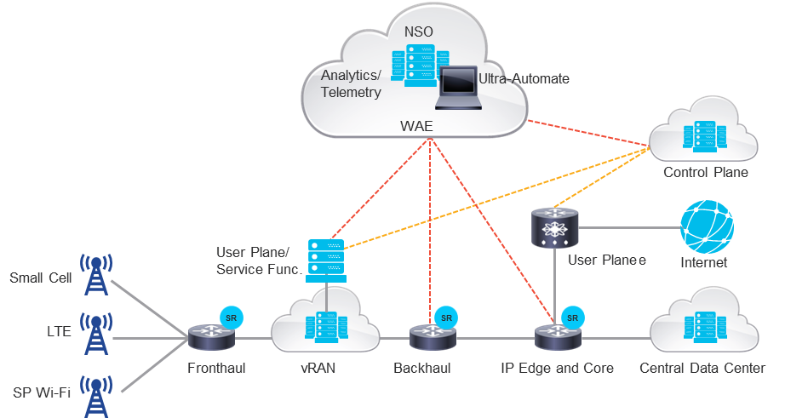
Deploy New “5G” Services
Smart Cities
Next Generation Retail
VR: Remote Expert
VR: Consumer Video
Connected Industry
Cisco Security for Mobile
Notes:
So from there, what we're talking about-- here, we took some of the examples and said, OK. As you get that infrastructure in place, let's make sure we can map that to specific services or industries where you can actually start making money. And also get-- there is a cache aspect. Often, like at Verizon, the money is critical. They want to make money. But they also want the umph. They want the wow. And when you look at Nokia, Samsung, Ericsson-- go to Mobile World Congress, you will see that there is a glitch. There is a wow effect. They try to capture the imagination. Even of CXOs. If you go to an enterprise customer and say 5G, most likely, he's going to say 5 gigahertz. He's not going to say 5G. He's going to say something that relates to Wifi. So there is work that we need to do as an organization to really make sure that they understand or the store understands the value, outside of some of the specific industries, what we do. And then that we can actually bring that back to our service providers to fulfill that to show how we can connect the two. That's really our value.

Slide 28
Summary and Key Takeaways

Slide 29
Summary
5G Standardization and Industry Engagements
Consensus on 5G Architecture (2016-17), Detailed specification work (2018-2019)
Key technologies - Cloud Scale Networking, Network Slicing, Edge Computing, Open Networking, Virtualization and orchestration
Cisco’s 5G Engagements
Industry - ITU (IMT2020), 3GPP, NGMN, ATIS, 5G Americas, IEEE, IETF etc.
Early Customer engagements – 5G Advisory Service, xHaul, Cloud Scale Networking, v-RAN
Prototyping new technologies e.g. ICN, 6CN for 5G use cases
Participate and Learn from 5G Trials/POC
Academia, industry, service providers driving 5G forums and innovations
Many 5G use cases trials
http://www.verizon.com/about/news/verizon-sets-roadmap-5g-technology-us-field-trials-start-2016
http://about.att.com/story/unveils_5g_roadmap_including_trials.html
Notes:
On timing, we believes 5G will emerge when 4G strains to support the applications and the use- cases the market demands at the desired economic cost points (>2020)
5G is about developing technologies that will the network on a new economic cost curve to follow after 4G has been pushed to its limit in supporting the breadth of use cases in mobile broadband, IoE, M2M, etc
5G is about transforming the architecture from a vertically-integrated silo of network assets to a horizontal architecture that loosely-couples the access layer to the mobility core
Can a new core networking framework that incorporates Mobility, Security and Storage as fundamental players in the networking layer be the means to achieve the 5G economic objective? Will Information Centric Networking (ICN) play a key role in enabling 5G to meet this objective?
We must provide an economically sound transition from 4G to 5G that continues to protect the SP’s prior network investment and maintains sound operations.

Slide 30
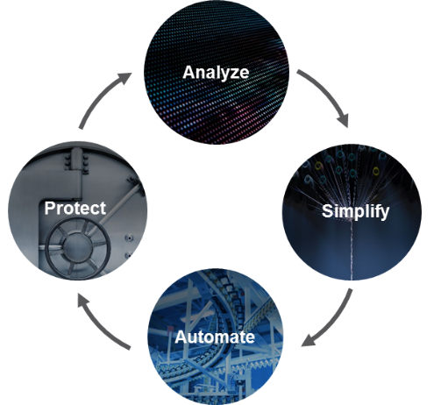
Cisco Trainings & Certifications
Other Rapid Trainings
Next-Generation Networks
Foundation for: Business Critical and Digital Transformation
edX: https://www.edx.org/
Coursera: https://www.coursera.org/ (example six modules cloud computing specialization)
Udacity https://www.udacity.com/
Linux Foundation and Open networking https://www.linuxfoundation.org/
https://www.linuxfoundation.org/projects
Openstack Trainings and Certifications
https://www.openstack.org/coa/
Products NCS, CRS
Cloud based, Open and Programmable, Policy Driven, Secure Networks
CCNA SPNGN1 SPNGN2
CCNP SPROUTE
SPADVROUTE
CCIE
Written Exam Lab Exam
SPCORE
SPEDGE
https://learningnetwork.cisco.com/community/certifications
Notes:
Cisco’s Data Center ASAP Open and Programmable, policy driven, secure data center
Differentiation:
Integration of DC/Cloud products to deliver the ASAP architecture
Consistent policy-defined model across entire hybrid cloud domain
Continuously Maximize Application Performance, economics and security
Certification portfolio is job-role based, the covers extensive skills, DC infrastructure technologies (beyond networking), and industry best practices.
Benefits to certification holder: validated job skills, portable not product based, covers depth and breadth needed in today’s job market.
Benefits to business: faster implementations, higher up time, highly scalable/flexible/secure dc infrastructure to support new business models and re-architected business critical applications.
Totally revised with the latest skills, technologies, and industry best practices covering both breadth and depth required to excel in today’s demanding job roles
CCNA: two exams and two certification courses
CCNP: five exams and five certification courses
CCIE: one written exam and one lab exam
__________________________________________________________________________________________________________
Details
CCIE Data Center v2.0 certifies Expert-level skills focused on in-depth data center solutions and emerging technologies needed to design implement and manage complex, modern data center infrastructure. V2.0 brings emphasis on policy driven infrastructure, automation, and orchestration for data centers. Certification of skills include Layer 2 and Layer 3 technologies, network services, storage networking and compute, implementing and troubleshooting data center automation and orchestration, and fabric infrastructure. CCIE Data Center v2.0 certifies abilities for data center architecture, deployment, implementation, operational models and considerations, where the technologist is uniquely qualified to play a leadership role in harnessing evolving technologies and deep domain expertise to meet business requirements.
Certified IT professionals with this level of certification can play a leadership role in creating, delivering, and managing data center infrastructure that is the foundation for business critical and digital transformational initiatives to run with high: QoS, performance, scalability, reliability, and ROI. Scalability comes into play to support rapidly expanding data growth and mobility requirements.

