Slide 1
Cloud DVR Innovations
Cisco Knowledge Network
Amit Mookerjee, Product Manager, Service Provider Video
Yoav Schreiber, Marketing Manager, Service Provider
January 24, 2018

Slide 2




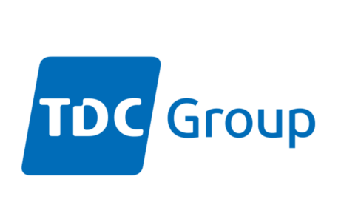
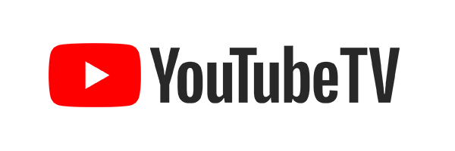



Industry Dynamics
Lots of TV content being watched and recorded across devices
  45 billion hours a month are spent watching TV on all devices in the U.S. (Nielsen May 2017)
  55% of Millennial (18-34) viewing time is spent watching previously recorded TV content (CTA August 2017)
  58.7% of TV Households own at least one Internet-enabled device capable of streaming content to the television set. (Nielsen)
On Demand Consumption:
  Nielsen: DVR and TSTV users watch 2hrs/day
  Netflix subscribers stream 1.3hrs/day
Notes:
In a year-end blog post, the streaming service announced that users watched more than 140 million hours of content per day, or 1 billion hours per week. As of Q3 2017, the company has more than 109 million subscribers, a little less than half of which are in the U.S.
https://www.recode.net/2017/9/9/16266854/millennials-watch-tv-live-video-on-demand
https://www.marketingcharts.com/featured-24817
http://www.businessinsider.com/streaming-services-comparison-hulu-youtube-tv-sling-directv-now-playstation-vue-fubo-2017-8?op=1
https://www.tomsguide.com/us/youtube-tv-vs-cable-tv-replacements,news-24578.html

Slide 3




Cloud-Native Evolution for Cloud DVR
Cloud Deployment Models
Cloud Operating Models
Reduce CPE expense with cheaper IP clients
Agile infrastructure for operational efficiency and elastic scale
Reduce capex with converged infrastructure for live, VOD, time-shift and DVR
Intelligent recording and storage optimization to reduce TCO
Accelerate service time to market
Cloud logic and analytics to upsell users instead of devices
Record and playback from any screen
Auto-scaling and Self Healing
TCO Optimization
Data-driven Optimization
Independent scaling of recording, storage and playback
Microservices
& Containers
Content-aware encode and storage
Analytics Integration
Notes:
At CES we are highlighting the evolution of our Cloud DVR platform.
To date, industry focus has been on cloud deployment models and leveraging the shift from STB-based recording and playback to cloud-based recording and playback.
While important, we see the next wave in Cloud DVR focusing on cloud operating models:
Microservices architecture for auto scaling and self healing across multi-cloud platforms
TCO optimizations with segment based recording and content aware encoding
Data driven optimization to understand users and operations

Slide 4
Cloud Scale and Performance

Slide 5
Advantages of a Micro services and Container Architecture for Cloud DVR
Scale and Performance
Hybrid Cloud Deployment
Operational Benefits
Individual agents deployed as Docker Containers
Kubernetes cluster can be deployed on bare metal or on virtual machine
More effective utilization of compute resources
Configuration and Software upgrades localized to single agent
Issue/defect insulated to single agent
Quick spin up time allows on-the-fly elasticity and less overprovisioning
Self-healing and resilience
Standardized deployment across on-premise and public cloud
Independent auto-scaling

Slide 6
Storage Models Impact on Cloud DVR Deployment
Common Copy
Unique Copy
Private Copy
Sub 1
Sub 2
Sub 1
Sub 2
Sub 2
Sub 1
Big Bang Theory
Big Bang Theory
Big Bang Theory
Big Bang Theory
Big Bang Theory
Big Bang Theory
Separate copy of program stored for each subscriber recording request
Program de-duplication after certain window
Content reconstituted in special storage when user makes playback request
Common copy of the program stored for all subscribers
Separate copy of the program stored for each subscriber recording request
Notes:
Built from the ground up for massive scale
Storage
Scale challenges imposed on cDVR system
How Cisco is making that efficient
Segment-based recording
Flexible system to scale as needed where needed

Slide 7
Segment-Based Recording
  Record only segments wanted by subscribers
  Automated fan-out in active storage
  Separate recording and event definition
  Only 1 copy of each segment stored in archive

Slide 8
Storage TCO – 1 Million Sub Case Study
Up to 40% reduction in
storage spend
Number of
Spindles
Typical
Cisco
Throughput

Slide 9
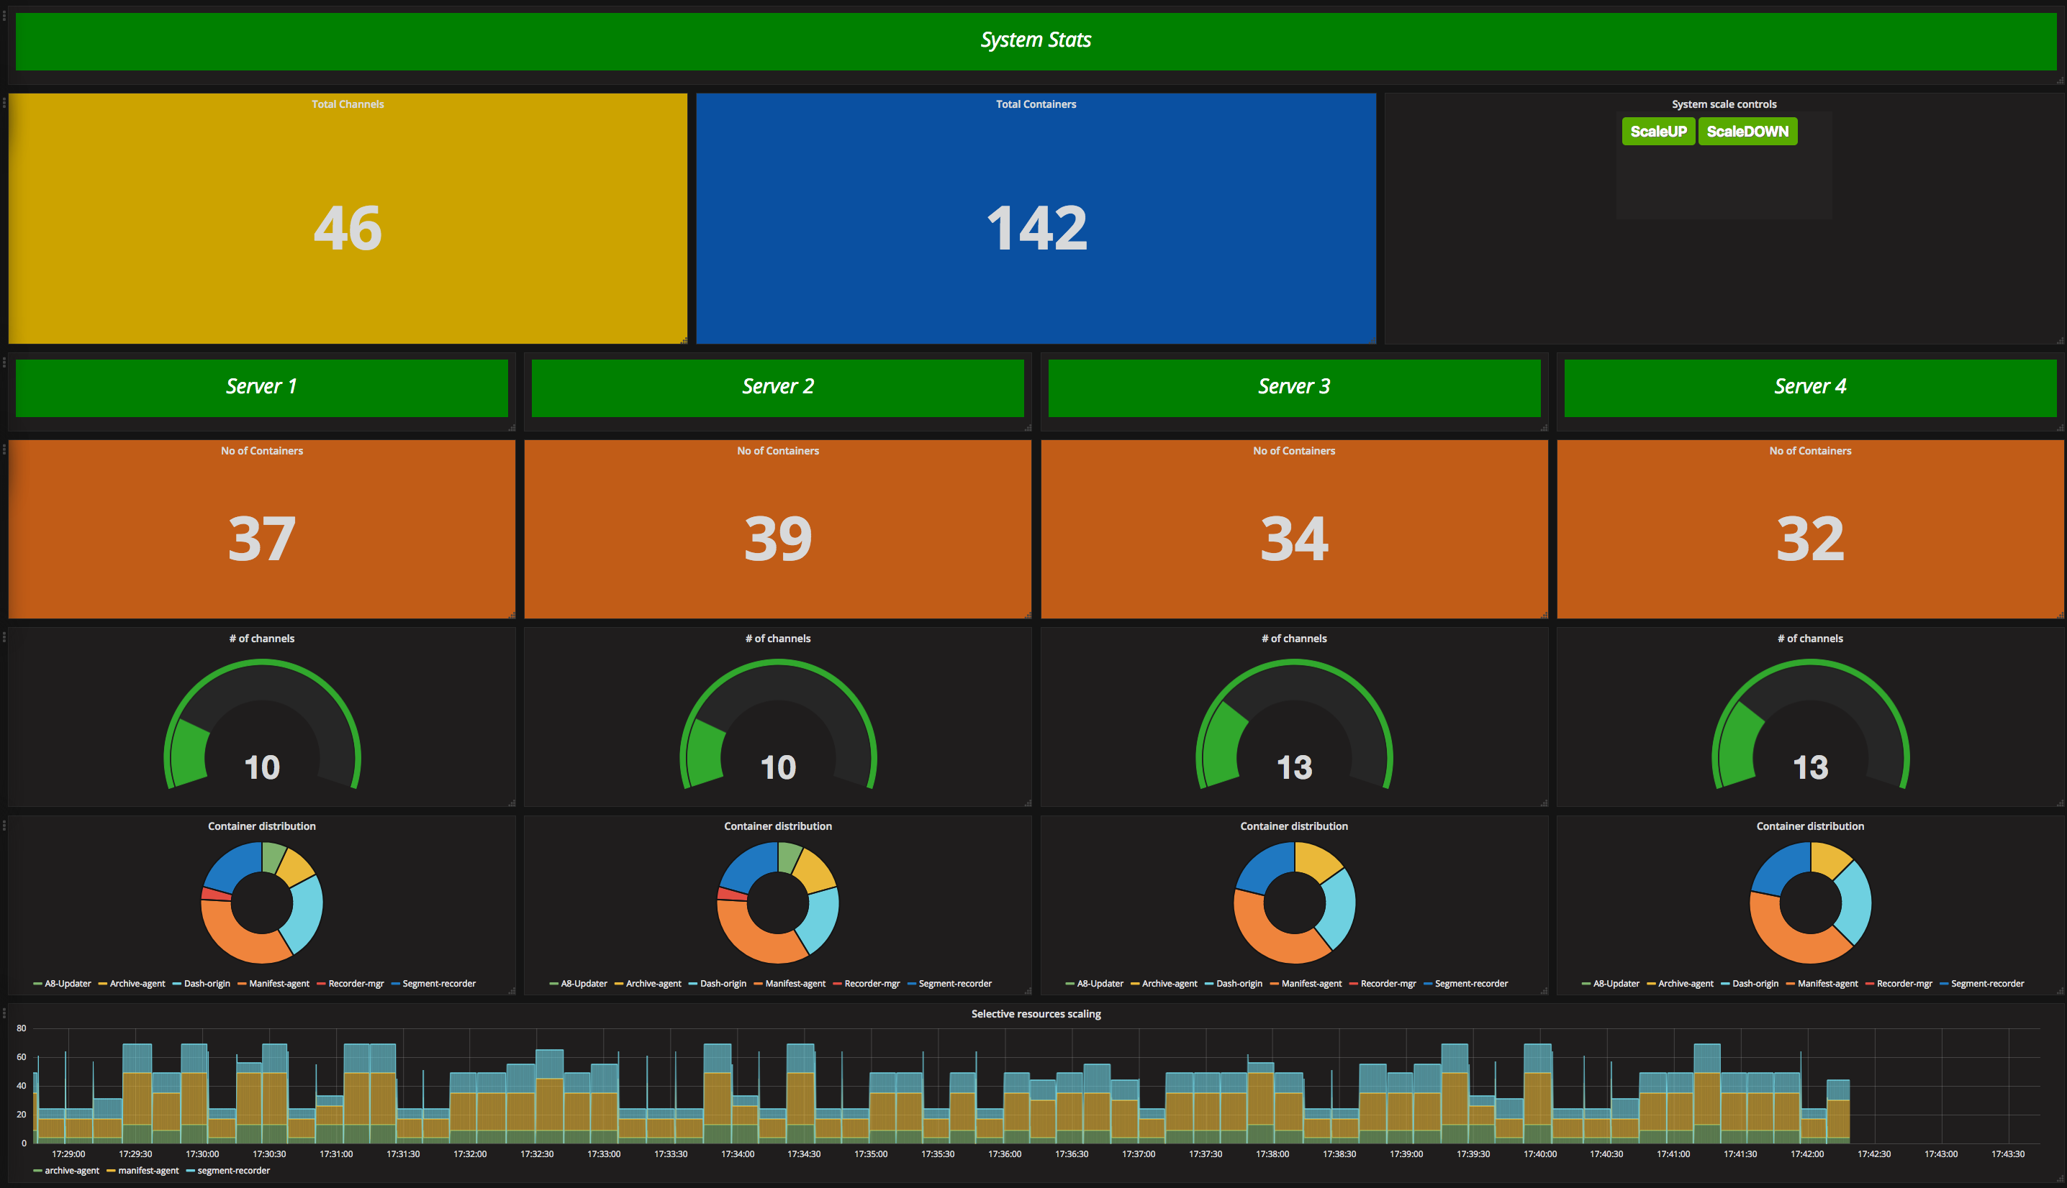
Scalable Containers and Microservices
Notes:
Fine-grained scalability with containers and microservices
Built from the ground up for massive scale
Storage
Scale challenges imposed on cDVR system
How Cisco is making that efficient
Segment-based recording
Flexible system to scale as needed where needed

Slide 10




Video Quality Targeting for ABR Encode
SVQ = 3.33
Bit rate = 2Mbps
SVQ = 5.08
Bit rate = 4Mbps
SVQ = 6.41
Bit rate = 6Mbps
SVQ = 8.54
Bit rate = 8Mbps

Slide 11
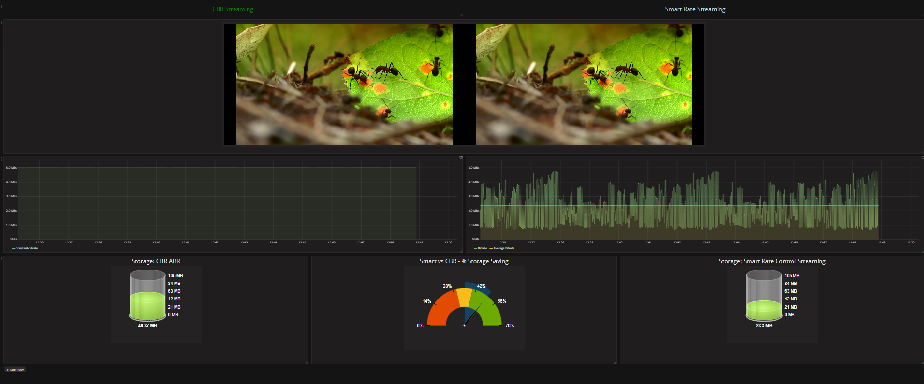
Storage Savings with Smart Rate Control

Slide 12
Smart Operations and Machine Learning
Notes:
Reduced time to pin point problems
Automatically applying fixes
Identifying issues spanning multiple use cases
How issue prediction improves with feedback

Slide 13
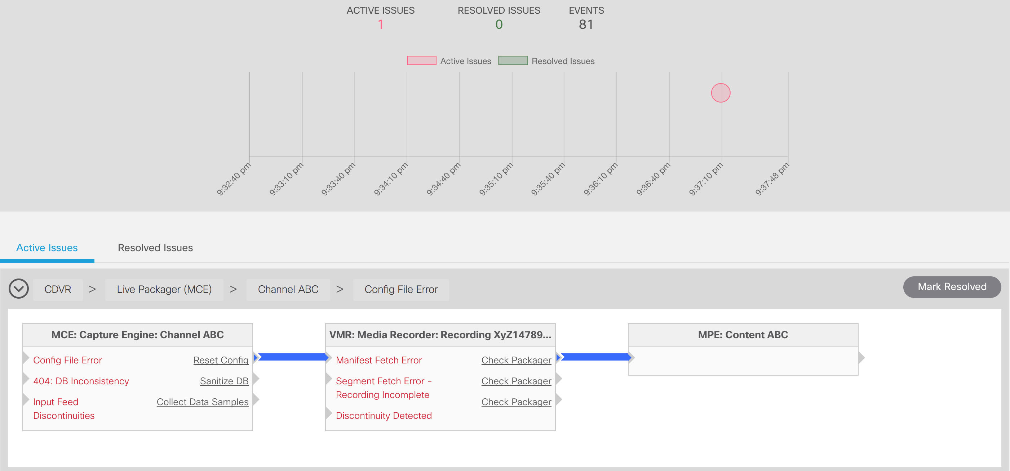
Machine Learning to Auto-triage Problems

Slide 14
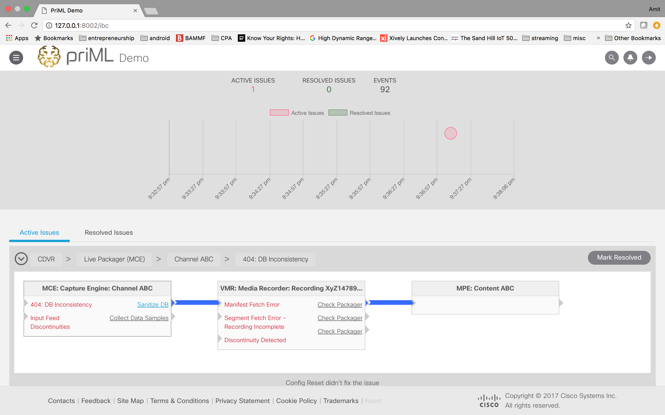
Automatically Apply Fixes to Known Issues

Slide 15
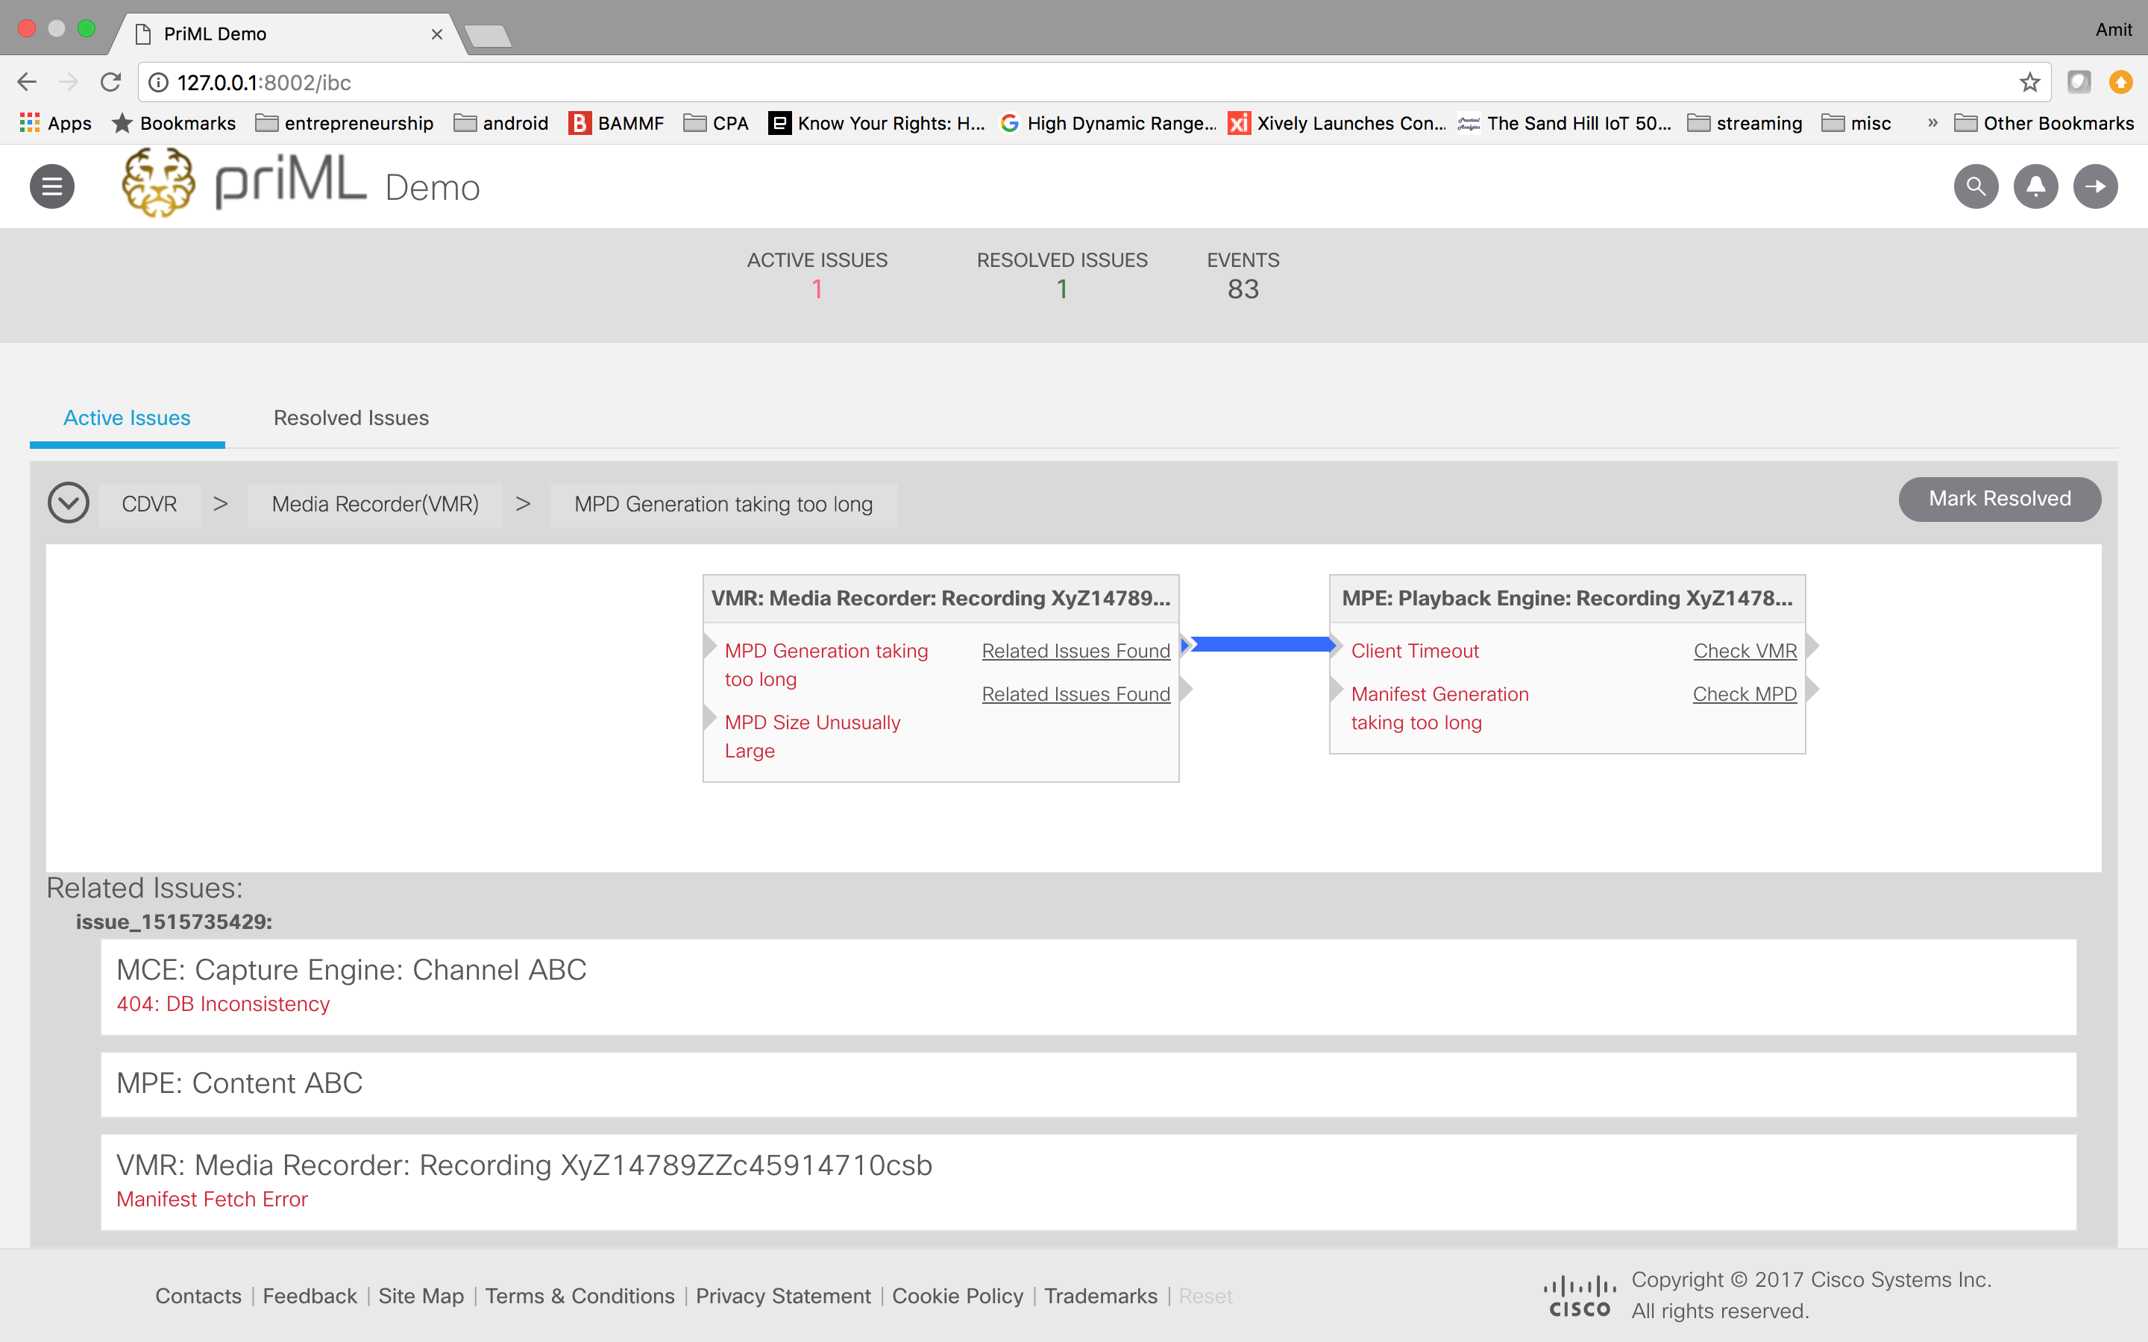
Correlate Issues Across Different Components

Slide 16
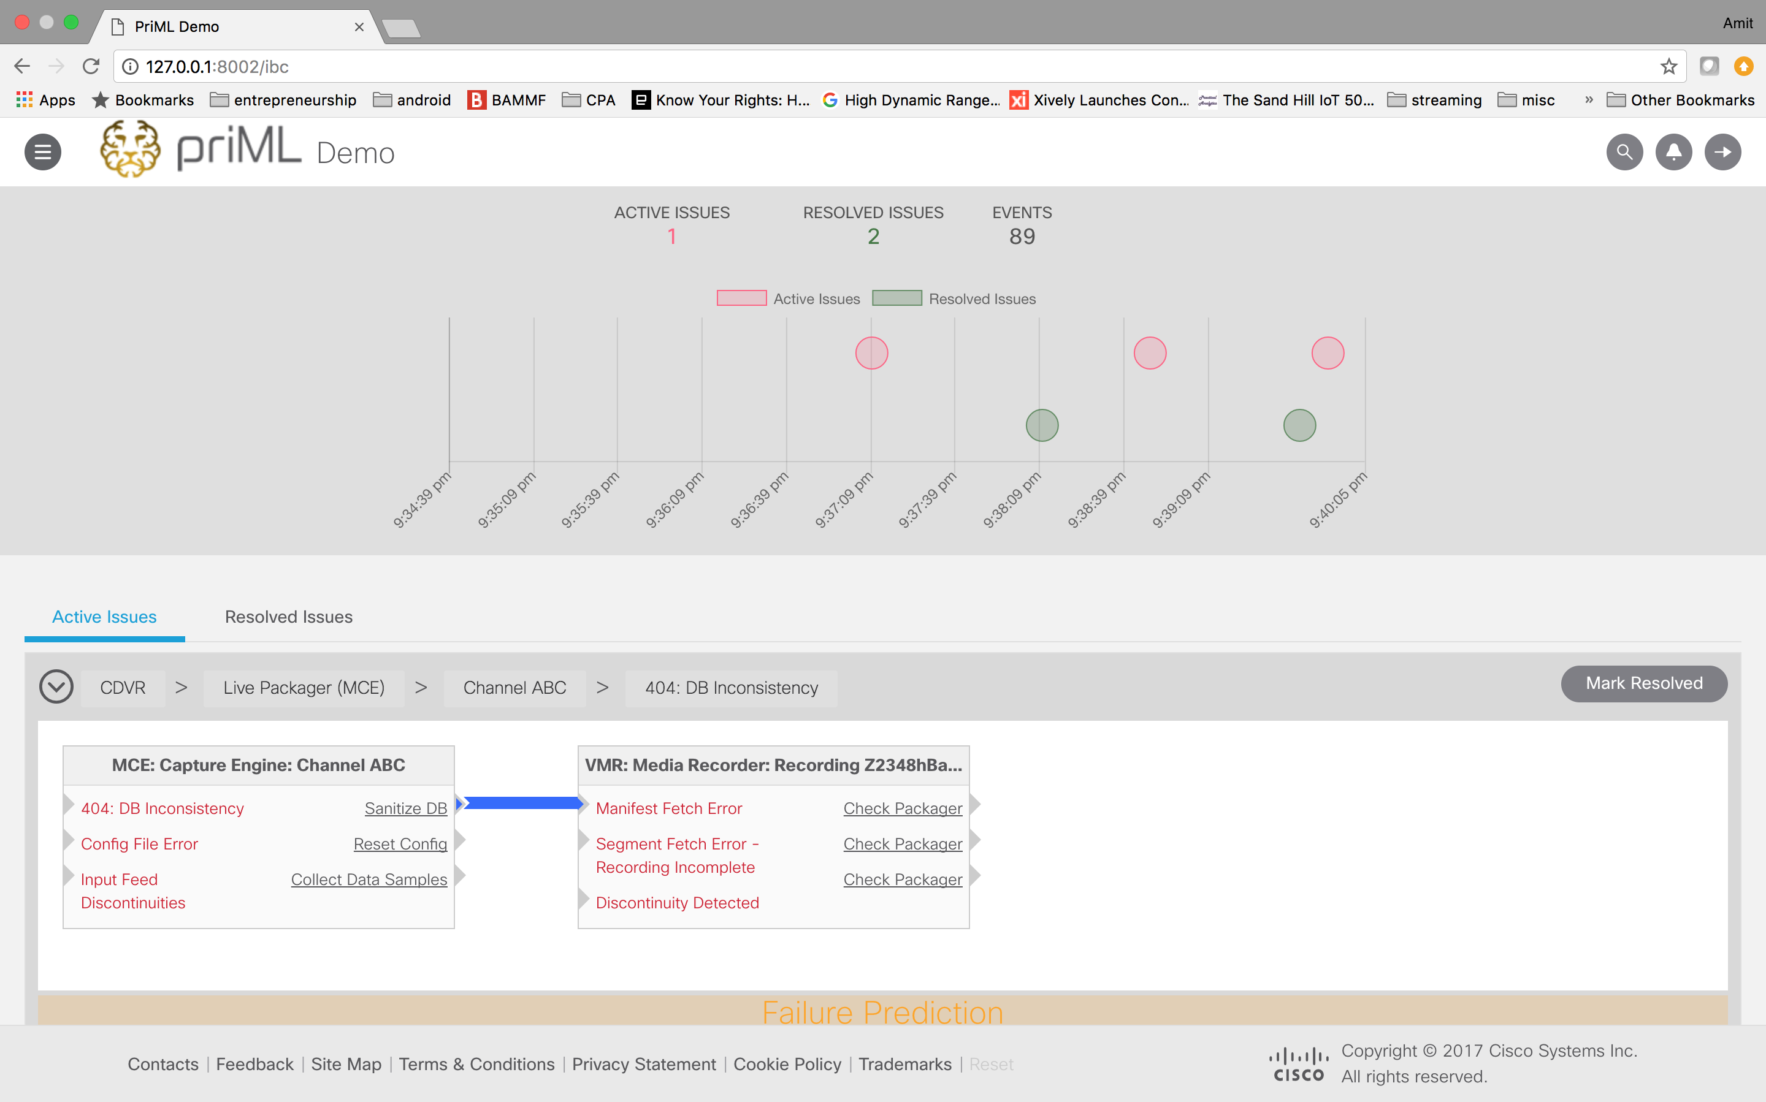
Better Predictions with Feedback

Slide 17
Data-driven Monetization

Slide 18
Monetize Subscriber Engagement Across Screens
Combat competition
  Lower priced offers, OTT, churn...
  Adopt cloud-based revenue models
Take advantage of multiscreen engagement: (Nielsen adults 18+)
  Tablet: 43% Entertainment, 20% search/social
  Smartphone: 26% Entertainment, 29% search/social
Subscriber analytics to drive targeted campaigns
  Subscriber data captured in the cloud
  Integration into mobile messaging platforms and customer billing systems
  Subscriber notifications to increase storage capacity
Operational analytics to assess campaign effectiveness
  Engage subscribers on the right screen at the right time
  Evaluate campaign effectiveness
Notes:
Mobile messaging platforms like: Amazon Pinpoint, Google Firebase
Research shows that users are 23% more likely to use an app with push notifications turned, on than apps without push notifications or disabled push notifications.

Slide 19
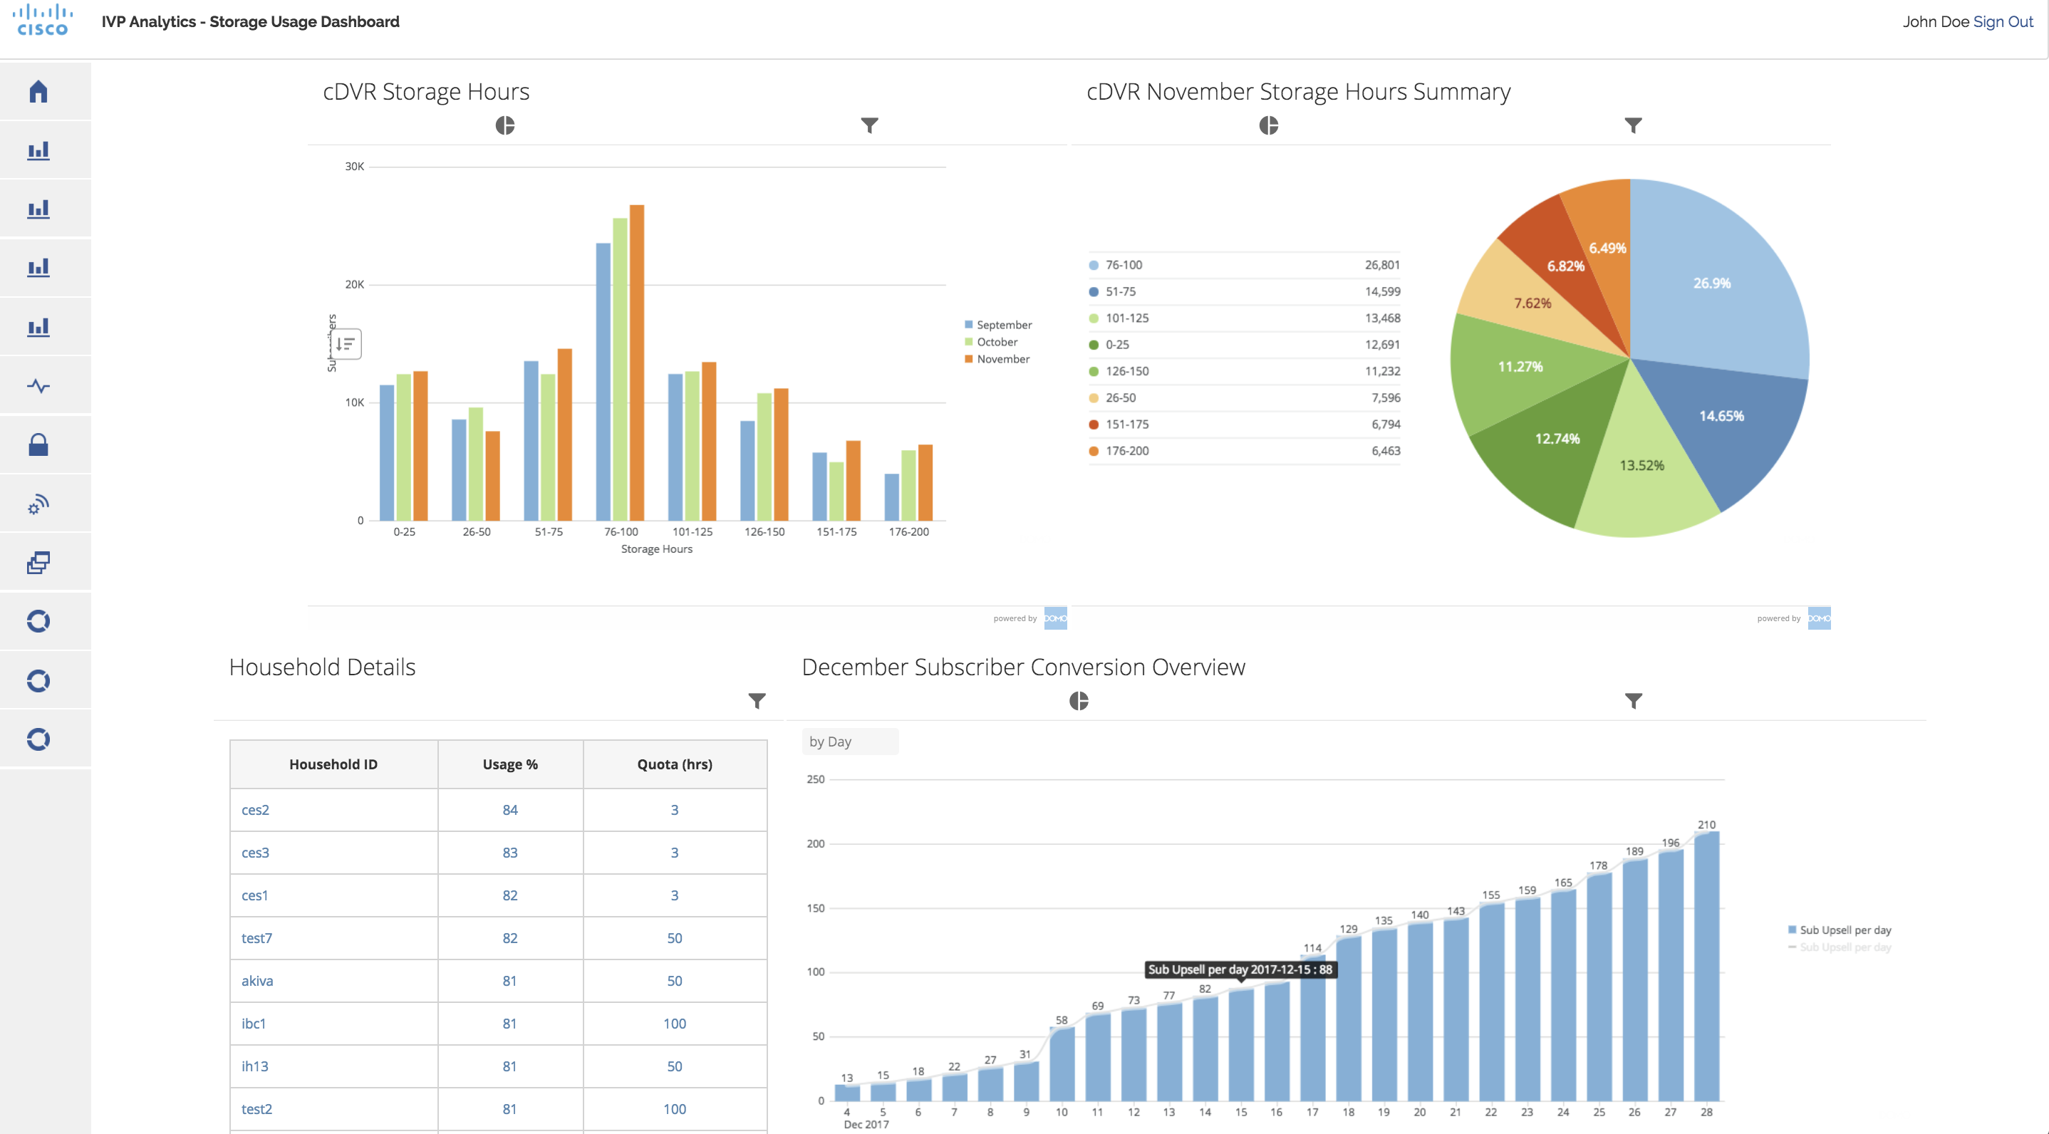
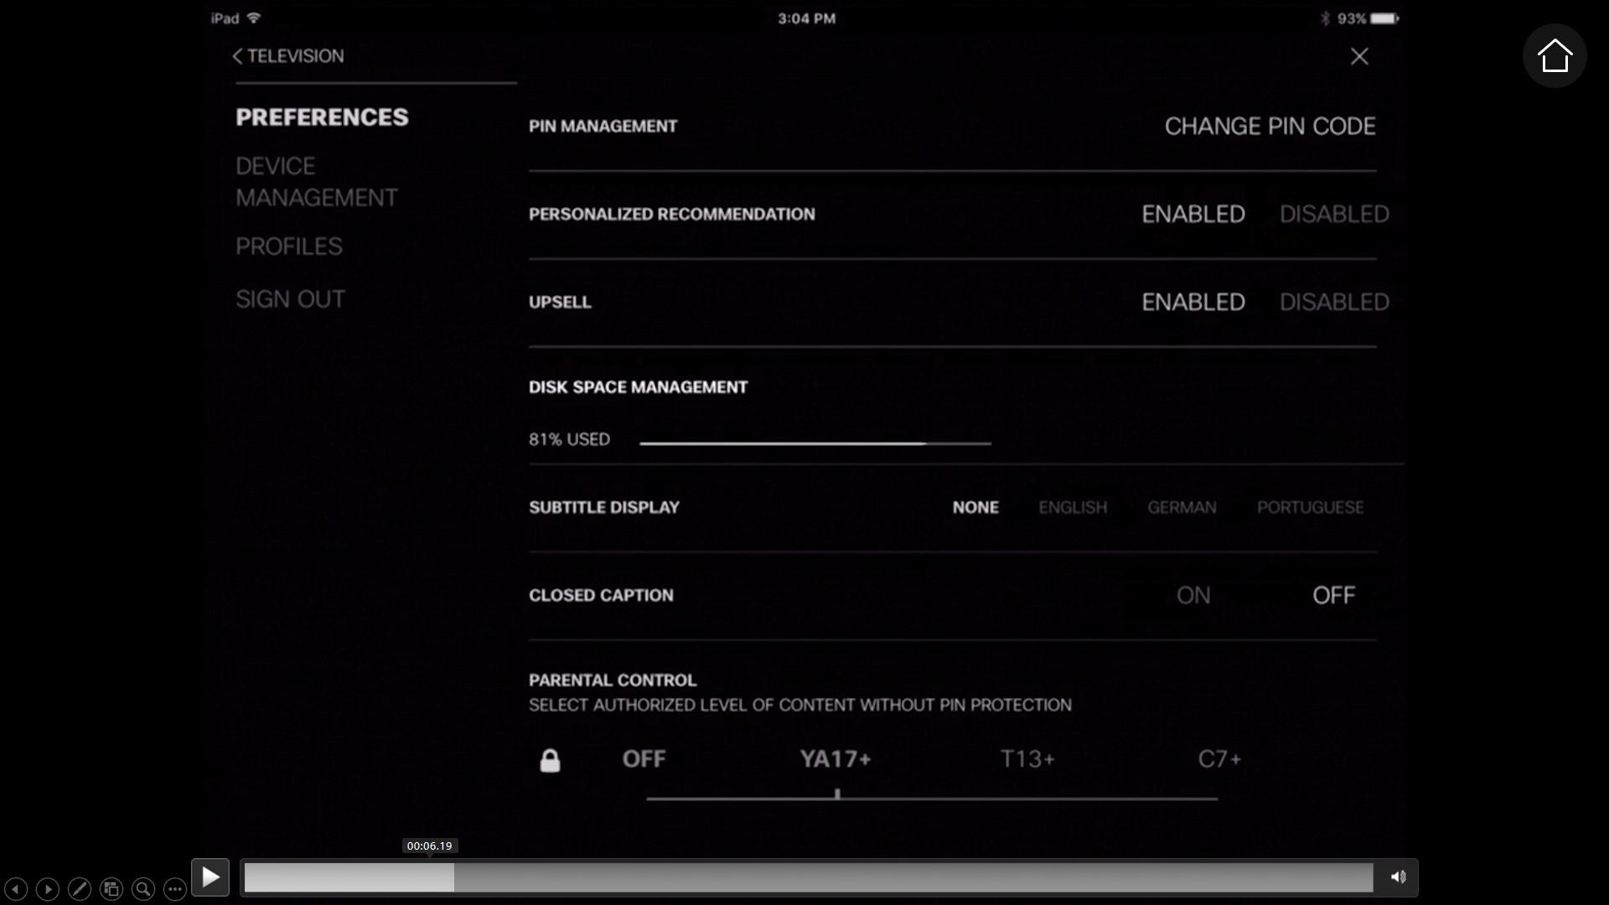
Analytics-Driven Operations
System usage to determine thresholds
Cloud integration of subscriber data

Slide 20
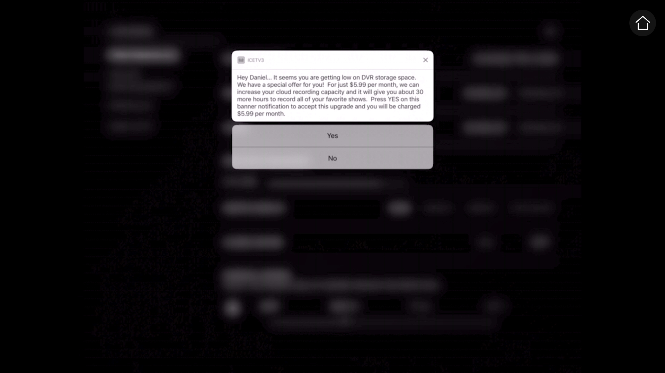

Targeted Mobile Messaging Campaign
Subscribers engagement on relevant screens
Campaign effectiveness tracking

Slide 21
Summary

Slide 22
Cisco Cloud DVR Summary
Best performing and the lowest TCO Cloud DVR solution in the industry
Highly optimized and flexible
Machine learning innovations to auto triage and fix problems in field deployments
Analytics to monetize subscribers across multiple screens

Slide 23


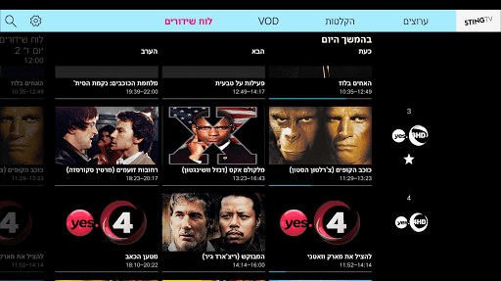
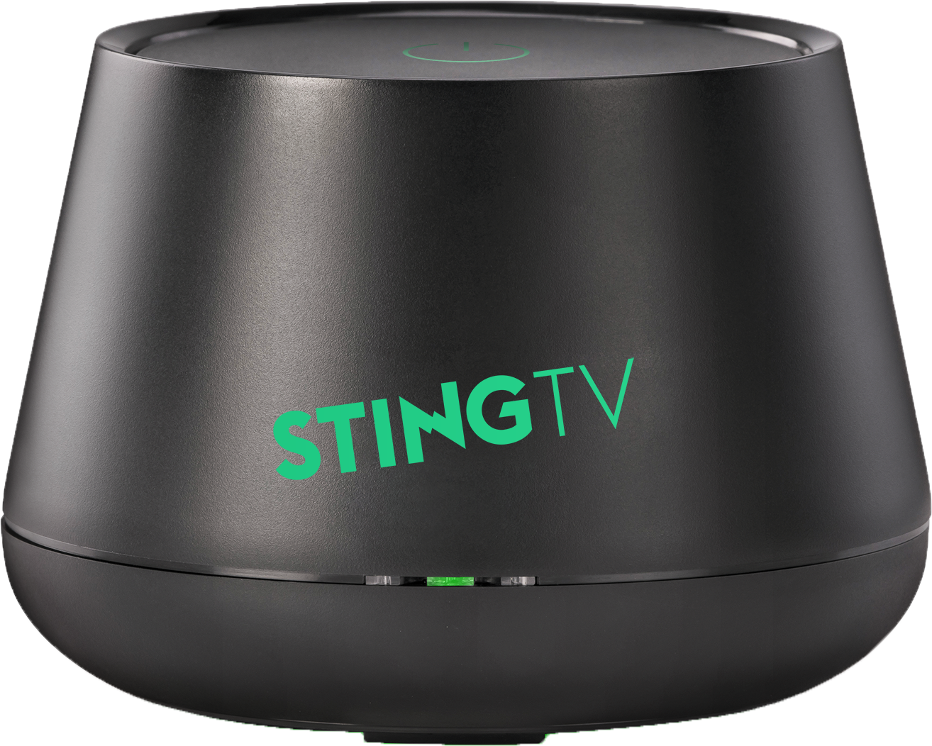
Yes
Sting TV on Android
Enhance customer experience while replacing existing technology
Monetize linear, VOD, catch-up and cloud DVR
Reduce time to market for new services while reducing CapEx
“
One of the benefits of moving to the Infinite Video Platform is the ability to innovate faster at lower cost. Gone are the days of costly professional services engagements to make minor changes with high downtimes. Being able to provide immediate feedback, and adapt the functionality accordingly, is a critical success factor in the new video world.”
Yitschak Elyakim, CTO, YES
Notes:
YES is an Israeli satellite provider and customer of our Infinite Video Platform.
YES developed a thought-provoking strategy to fight back the new OTT competitors: They established an OTT brand of their own, called STING TV, and marketed it mainly to millennials.
YES is fighting back with price, but also with the quality of their content, seeing as how they already have the endless richness of quality content from their mother satellite company. YES is also fighting back with video quality, quick rollouts of innovations and a very flexible offering -- all enabled by the Infinite Video Platform.

Slide 24


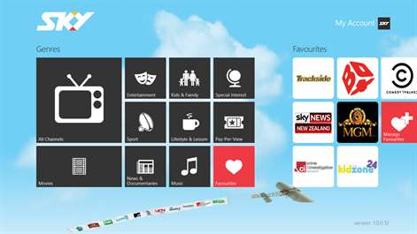
Sky New Zealand
Cloud Transformation for Video
Multiscreen TV experiences via phone, tablets and Internet-connected set-top-boxes
Cloud DVR
“
Sky is uniquely positioned to offer a seamless experience that brings the best of the broadcast & IP world, and takes the TV experience to a whole new level. Cisco’s cloud-based SaaS delivery model combining broadcast and IP offered us the speed we needed to get new services to market.“
Julian Wheeler, chief products & technology officer, Sky New Zealand
Notes:
Sky NZ is transforming from a 1-way satellite to a cloud and 2-way connected device service provider

