Slide 1
VideoGuard Everywhere Anti-Piracy
Video Service Provider Security Product
January 2018

Slide 2
Outline
The State of Piracy
Cisco’s Anti-Piracy Approach
Forensic Watermark
Streaming Piracy Prevention
Credentials Sharing Prevention
Anti-Piracy Analytics Enhancements
Summary
Notes:
I would like to start this session by an overview of the piracy the video service ecosystem is facing
Then I will explain how at Cisco we approach this piracy problem with our offering for: forensic watermark, streaming piracy prevention, and credentials sharing prevention
Then I will share with you some details about analytics enhancements related to anti-piracy that we are working on
And then we will wrap up

Slide 3
The State of Piracy

Slide 4
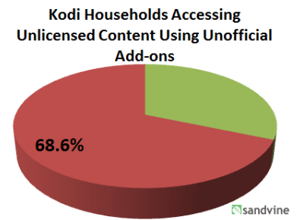
The IP Effect: Online Video Piracy Is Growing
Video transformation to IP network infrastructure and connected devices drives adoption of online video – both legal and illegal
User visits to piracy sites grew 129% between 2015 and 2016
Kodi, which simplifies the illegal streaming experience, grows in popularity
40 million active users
UK: 13% of infringers
N. America: 68.6% of HH
that have a Kodi device
(8.8% of HH population)
access unlicensed content
Source: MUSO global sample piracy reports
Sources: ABI Research, Sandvine, UK Government
Notes:
Online video piracy is growing the same way legitimate online video distribution is growing.
The pirates use the same client capabilities to simplify access to illegal content and the same network infrastructure to reach greater audiences.
We have here examples that show:
how streaming piracy is taking over torrent based on MUSO data
popularity of accessing illegal content among Kodi users, due to Kodi simple user interface

Slide 5
Starting with Millennials, Streaming Piracy Can Become a Social Norm
Streaming piracy is prevalent among younger generations (18-34)
>50%
47%
37%
watch content illegally
subscribe to legal OTT service but also watch illegal
of total pirate video users
Piracy habits are likely to continue as this young generation matures
Even when they earn more, their reference point is free/freemium Internet economy rather than paid media for previous generations
They already have the technical know-how to access illegal services
Sources: The Guardian; LaunchLeap; Anatomy Media; YouGov
Notes:
And this trend is likely to persist because it relies on social attitude towards video piracy.
It is a fact streaming piracy is prevalent among the younger generation – more than 50% watch video illegally!
Problem is that piracy habits are likely to continue as this young generation matures because they don’t perceive this is a crime they should be punished for. They expect everything on the Internet to be free or low cost.
Sometimes piracy viewers who pay subscription to a pirate service are not fully aware that the service they are using is illegal.
This generation is also Technology and Internet savvy, which helps them find pirate content

Slide 6


Video Piracy Is Moving to Online Redistribution
Pirates leverage Internet infrastructure, enjoy global reach, 80% profit margins!
From traditional piracy
Attack: hacking video access controls
Monetization: selling fake smartcards, key sharing
Security measures: CA/DRM
To online piracy
Attack: grabbing & redistributing video output from devices
Monetization: offering pirated content on IP-STB/app/web
Security measures: piracy detection & response
Pirate Re-distribution :
Open Internet
Closed Networks
Credentials Sharing
Video Service Provider
Take 7
www…
Media Company
www…
Notes:
As a result of these technology and social trends, the main form of piracy to be concerned about today is Online Redistribution
In the past the pirates monetized fake clients of the video distribution network. Today they enjoy greater monetization opportunity by having their own distribution network.
From the pirate perspective: why bother hacking the security of CA and DRM when you can simply use the HDMI output to grab the video and re-distribute it to millions of users over the world through web sites opened to everyone on the internet, or through closed networks that require subscription for small fee
For pirates it is low Opex business, and most importantly no content costs. Cisco operational security analysis estimated 80% profit margins for such pirate operations.
Re-distribution can be even easier (though at lower scale) by sharing passwords, which we consider as another form of piracy

Slide 7
Video Streaming Piracy Poses a Tough Competition
Taiwan: piracy site visits > 8 x legal site visits
According to Ministry of Economic Affairs, in May 2017 the top five pirate sites registered more than 64 million visits and 564 million page views while top five legitimate video websites in Taiwan logged more than 8 million visits and 25 million page views.
Source: S&P Global
LATAM: pirate pay-TV can be positioned as the 3rd largest player on the market
With 7% household share behind América Móvil and DirecTV. In Argentina
Source: Dataxis
Mayweather-McGregor fight: pirate views in US > 10 x legal pay-per-view in US
VFT tracked 51.66 million views in USA (out of 123 million globally) on Facebook Live, Periscope, and Youtube Live, dwarfing Showtime’s stated estimate of 4.6 million paid views in USA.
Source: Forbes
Game of Thrones 7th season opener: piracy views > 5 x legal site views
It was pirated 91.74 million times, 85% of which by online streaming, with US, UK and Germany leading piracy viewership. In contrast, legal viewership on HBO amounted to 10.1 million viewers for linear, and another 6 million viewers for same-day DVR playback and streaming via HBO Go and HBO Now.
Source: MUSO monitoring, Hollywood Reporter
Notes:
The bottom line is that video Streaming Piracy Poses a Tough Competition to legal video services.
In some places pirate content is as popular as the legal video services or more (see examples of Taiwan and LATAM).
For premium content assets, the popularity of piracy supersedes that of the legal services (see examples special live sports events and Game of Thrones)

Slide 8
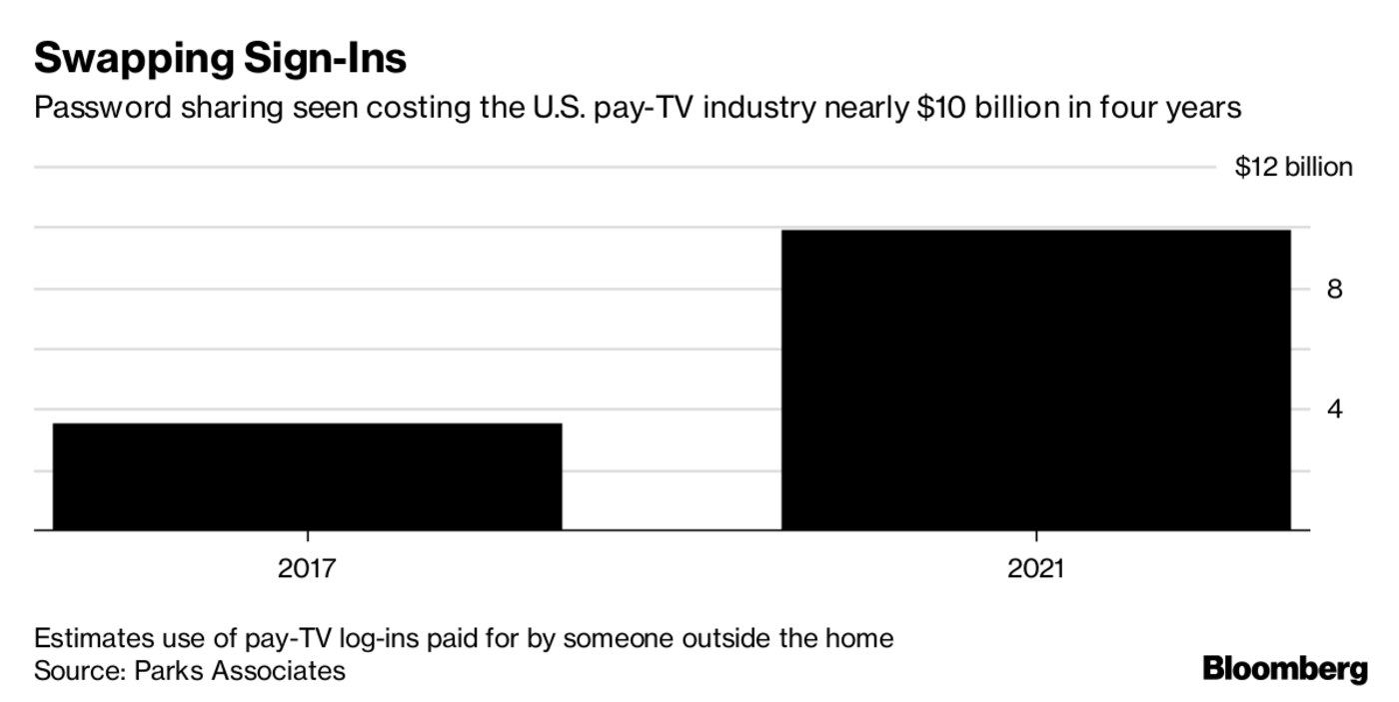


Credentials Sharing Piracy: $10B Problem by ‘21
Video service providers are concerned about credentials sharing
PayTV revenue loss due to password sharing is expected to almost triple in the next 4 years
“There’s lots of extra streams, there’s lots of extra passwords, there’s lots of people who could get free service.”
Tom Rutledge, CEO
“The more the practice is viewed with a shrug, the more it creates a dynamic where people believe it’s acceptable. And it’s not.”
Justin Connolly, EVP
Notes:
There are other forms of video access redistribution that evolve as video services evolve.
In the past media executives insisted that password sharing wasn’t a big problem, and viewed it as a way to market their content to the next generation.
Now as streaming is more widely adopted, it’s become more of an issue - $10B problem by 2021 according to Parks Associates.
And media executives are now becoming concerned about password sharing as evident by these 2 examples.

Slide 9
Piracy Distorts the Pay-TV Marketing Funnel
Marketing Investment
Distortion due to piracy
Awareness
Subscriber Acquisition Cost
Lost leads of younger generation to
pirate video services whose zero/low
price distorts consumer evaluation
Consideration
Conversion
Piracy increases churn, as more
consumers are exposed to easily
accessible, zero/low price pirate services
Subscriber Retention Cost
Loyalty
Advocacy
Notes:
The fierce competition that piracy poses means that marketing dollars invested to acquire new subscribers and retain them are wasted.
When the consumer reference point is zero/low price, then a legal service cannot be on par, and the message to consumer along the marketing funnel is simply not effective. Leading to loss of marketing dollars.
Why would consumers care about content exclusivity promoted by service provider when they can get it for free – there go the marketing dollars of the expensive campaign with the Hollywood star.
would a consumer care about the video provider giving away gift points in loyalty program when they can just drop the subscription for a free service? Probably not
Piracy distorts the marketing funnel so it is worth to consider how anti-piracy can become part of the marketing toolbox to amend this

Slide 10
Anti-Piracy Investment to Protect Video Revenues
Content Revenue to be Secured by Anti-Piracy to Reach $215 Billion in 2022
Live Sports
Rights:
US$55 Bn
in ‘22
Early
Release VOD:
US$12 Bn
in ‘22
UltraHD*
Content:
US$95 Bn
in ‘22
Exclusive
Series:
US$117 Bn
in ‘22
UltraHD overlaps with the other three categories. Total value is ~US$215 billion
Source: ABI Research ‘17
“Converting 10% of pirate users into legitimate users is realistic and feasible”
Namir Kahn, PwC at CSDA Summit 2017
Notes:
Analysts conclude a great need for anti-piracy solutions is ahead of us:
ABI research estimates that the premium content Revenue to be Secured by Anti-Piracy to Reach $215 Billion in 2022
PwC thinks it is possible to convert pirate users to legitimate ones.
And anti-piracy will be needed to do that.

Slide 11
Cisco Anti-Piracy Approach

Slide 12



Cisco’s VideoGuard Everywhere Extends Security from ‘Protect’ to ‘Detect & Respond’
Protect
Conditional access
Multi-DRM
Device and app integrity
Detect unauthorized distribution with real-time monitoring and big data analytics.
Respond to detected piracy in real time.
Detect
Web monitoring
Analytics
Tracking pirate networks
Forensic watermarking
Operational security
Respond
Piracy source device termination
Credential sharing analysis and response
Pirate viewer conversion
Forensic Watermark
Streaming Piracy Prevention
Credentials Sharing Prevention
Pirate User/Entity Behavior Analytics
Notes:
Cisco approach to fighting piracy is that with video distribution more open to consumer platforms, it is critical to focus on ways to detect and respond to any re-distribution piracy in real-time, instead of just guarding the content access.
The tools we currently offer for that are:
Forensic watermark
Streaming piracy prevention
Credentials sharing prevention
In addition we are working on more tools based on big data analytics

Slide 13
Forensic Watermark
Rapid Watermark
Headend-based Watermark
Notes:
Let’s start with forensic watermark. I will cover both:
our existing rapid watermark product
and our new head-end based watermark

Slide 14


Forensic Watermarking for Video
Forensic watermarking = embedding digital information in a video signal to identify its source of origin
Watermark injection (headend / client / 2-step)
Watermark
identification
Notes:
For those who are new to this topic, I would like to explain the principals of Forensic Watermarking for Video
The idea is to embed digital information in a video signal to identify its source of origin
That can happen on different places along the distribution path – headend of the network or on the client side
When the pirate accesses the video via the legitimate network, and re-distributes it, the watermark embedded in the legitimate video is also re-distributed
Then when a video from the pirate service is captured, the watermark embedded in it indicates the source of the piracy from which the video was re-distributed. For example, the client device ID, the subscription ID, the session ID

Slide 15


Cisco Rapid Watermark
Designed for Piracy Prevention for Live Streaming Content
Fast
Very short injection and detection times
Imperceptible
Covert watermark; does not disrupt viewer experience
Robust
Flexible and configurable; multiple techniques available
  Protects both broadcast and OTT services
    Operates on STBs, including legacy HD STBs
    and consumer devices
  Simple yet secure overlay-based technology
    Low processing requirements
    Encoding and content agnostic
  Real-time piracy termination with Streaming Piracy Prevention
Notes:
Cisco offers rapid watermark designed for Piracy Prevention for Live Streaming Content
For proactive anti-Piracy of live video, the more crucial factors are:
quick detection and response
as well as high robustness to prevent pirates from hacking the watermark
Cisco Rapid watermark is Fast – very short injection and detection times
Only a single watermark occurrence is required for identification
Overall process requires 1-4 minutes of video (depends on watermark trigger method)
It does not disrupt the viewer experience
Multiple techniques and configurations are available so that the pirates won’t be able to overcome the watermark
It can be deployed across client devices, including legacy HD set-top-boxes, because pirates will always try to find the weakest link
It enables real-time piracy termination as part of our streaming piracy prevention service, which I will talk about in a minute

Slide 16
Cisco Headend-based Watermark
Designed for OTT content on consumer devices
Released in 2018
Simple Deployment
No integration on client; Technology agnostic
Imperceptible
Designed to meet studio requirements & 4K compliance
Robust
Avoids hacking by design; Patent-pending technology
  Protects OTT services with great device reach
    Any DRM
    Any ABR format
    Any commercial CDN
  Uses A/B variants technology - allows signaling the ID as a sequence of A and B
  Real-time piracy termination with Streaming Piracy Prevention
Notes:
Cisco Headend-based Watermark, which will be released later this year is designed for OTT content on consumer devices
For the growing number of consumer device platforms for video streaming, which video service providers have to support, it offers the advantage of simple deployment
No impact on client, no SDK integration
Technology agnostic: any DRM, any ABR format
Works seamlessly with any commercial CDN leveraging its advantages, such as reduced traffic cost, user low latency, that are important for OTT services
It is designed to meet studio requirements and 4K compliance
It is Robust by design against piracy hacking - Uses A/B variants technology, which allows signaling the ID as a sequence of A and B. Security of this solution is patent pending
Similar to the rapid watermark, it will also support real-time piracy termination with streaming piracy prevention

Slide 17
Streaming Piracy Prevention
Gather Evidence
Automatically Respond to Piracy
Notes:
Streaming piracy prevention extends the anti-piracy capabilities from detection to response
It is used to gather evidence for legal action
And on top of it, it provides automated response to piracy

Slide 18
Streaming Piracy Prevention
Respond to Live Online Piracy in Real Time
Grow subscriber base
Increase subscriber acquisition and retention by eliminating the competition of illegal content redistribution
Improve monetization
Protect the value of your premium content investments
Extend client device lifetime
Secure content distribution to a broad range of existing devices with Cisco’s minimal footprint solution
Locate
Identify
Verify
Respond
Locate illegal streams
automatically and/or
with OpSec
Identify piracy source
with advanced watermarking
techniques
Verify the pirate’s ID
by sending a unique
command to the
suspicious source
Deactivate service on pirate device or send custom message to illegal viewers for monetization
Notes:
Streaming piracy prevention enables to respond to piracy in real time
It uses illegal streams located automatically and/or with our operational security team.
It Identifies piracy source with the advanced watermarking techniques I just told you about
It then verifies the ID of the identified source of the piracy
Finally the response can be
either immediate termination of the verified source of piracy, so it cannot be viewed any longer
or be a marketing message to the viewers of the pirate service that educate them that the service they are watching is illegal, or offer then a promotion for registration to the legal service
In both cases the response is aiming at conversion of piracy viewers to legal subscribers
Streaming piracy prevention addresses the business challenges I reviewed before
It increase subscriber acquisition and retention by eliminating the competition of illegal content redistribution, that distorts the marketing funnel.
It protects the content investment of the video provider
It extends legacy devices lifetime, because it can detect and respond to piracy that originates from these devices, even if they are only capable of fingerprint

Slide 19





Streaming Piracy Prevention (SPP): How It Works
Streaming Piracy Prevention Service
Automatic Web Monitoring
Operational Security
Step 2: Identify
Step 1: Locate
Step 3: Verify (optional)
Step 4: Respond
Pirate Site on Open Internet
Pirate Closed Network
Content Provider
Infrastructure
The content you’ve been
watching is pirated.
Client Devices
VGE
The content you’ve been
watching is pirated.
VideoGuard Everywhere (VGE)
The content you’ve been
watching is pirated.
The content you’ve been
watching is pirated.

Slide 20
Advantages of Managed Service for SPP:
Keep-up with Piracy Shift to Re-distribution Threats
“Content protection must shift to operational models using enforcement” ABI Research
Cisco’s OpSec: Established, experienced, intelligence-gathering operation worldwide
Proactive Preparations for Monitoring Piracy
Only Solution for Closed Pirate Networks
Real-Time and Non-real-time Response
  Research pirate attempts to work around Cisco security products (including the anti-piracy tools)
  Predict what pirates will do next
  Input for configuration of Watermarking and Streaminatgor tools
  Investigate pirate network business model and its primary dealers
  Obtain subscriptions and devices to verify services and perform software and hardware analysis
  Based on customer needs - ongoing and/or event based
  Suggest actions to customers (whether legal or not)
  Use sophisticated electronic counter measures
  Prepare evidence reports
  Establish close ties with law enforcement agencies
Notes:
SPP is currently offered as a managed service, which enables the customer to keep-up with new piracy threats as they arise
The reality is that Anti-piracy technology implementations must be backed up by operational capabilities because:
It involves obtaining subscription and devices
It involves investigations of pirates business
It involves additional investigative activities that are not real-time if you are going after the full piracy supply chain
Cisco’s OpSec (short for operational security) provides this service. It has the required experience and the well established worldwide operations to support the service.

Slide 21


Using SPP to Fight Pirated Content on Kodi
Aggregator Sites
Cisco focuses on closed pirate networks and
Kodi-based piracy is treated as a closed network:
  Requires download and installation of
  software add-ons
  Often requires paid subscription
Cisco fights closed pirate networks with
Streaming Piracy Prevention & Rapid Watermark
Ripple effect of fighting Kodi-based piracy
  Most of the Kodi content is sourced from other open and closed pirate networks
  OpSec researches Kodi add-ons to locate pirate sources, and address them with Streaming Piracy Prevention tools
1. User selects video to watch
2. Add-on calls aggregator sites and receives URLs for video streams
Piracy Add-on
Illegal Content Sites
3. User selects link to stream
4. Kodi App launches video
5. Many Kodi stream are shared with other closed/open pirate networks
Pirate Networks
www…
Notes:
I would like to make a special note about piracy consumption via Kodi because I know it is of great concern to many video service providers.
This figure explains at high level how users access pirate content via Kodi piracy add-ons
User selects the video to watch in the UI of the add-on
Add-on calls aggregator sites and receives URLs for video streams
User selects link to stream
Kodi App launches video
Many Kodi stream are shared with other closed/open pirate networks
Cisco Streaming Piracy Prevention has impacts Kodi-based piracy
Terminating source of piracy that was detected separately form Kodi often terminates the stream also for Kodi-based piracy because most of the Kodi-based pirate content is sourced from other open and closed pirate networks
In addition, OpSec researches Kodi add-ons to locate pirate sources, and address them with Streaming Piracy Prevention tools

Slide 22
Credentials Sharing Prevention

Slide 23








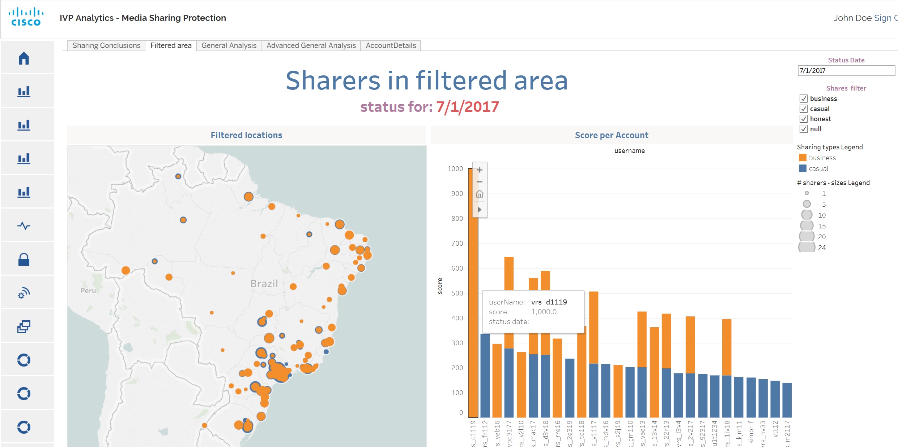
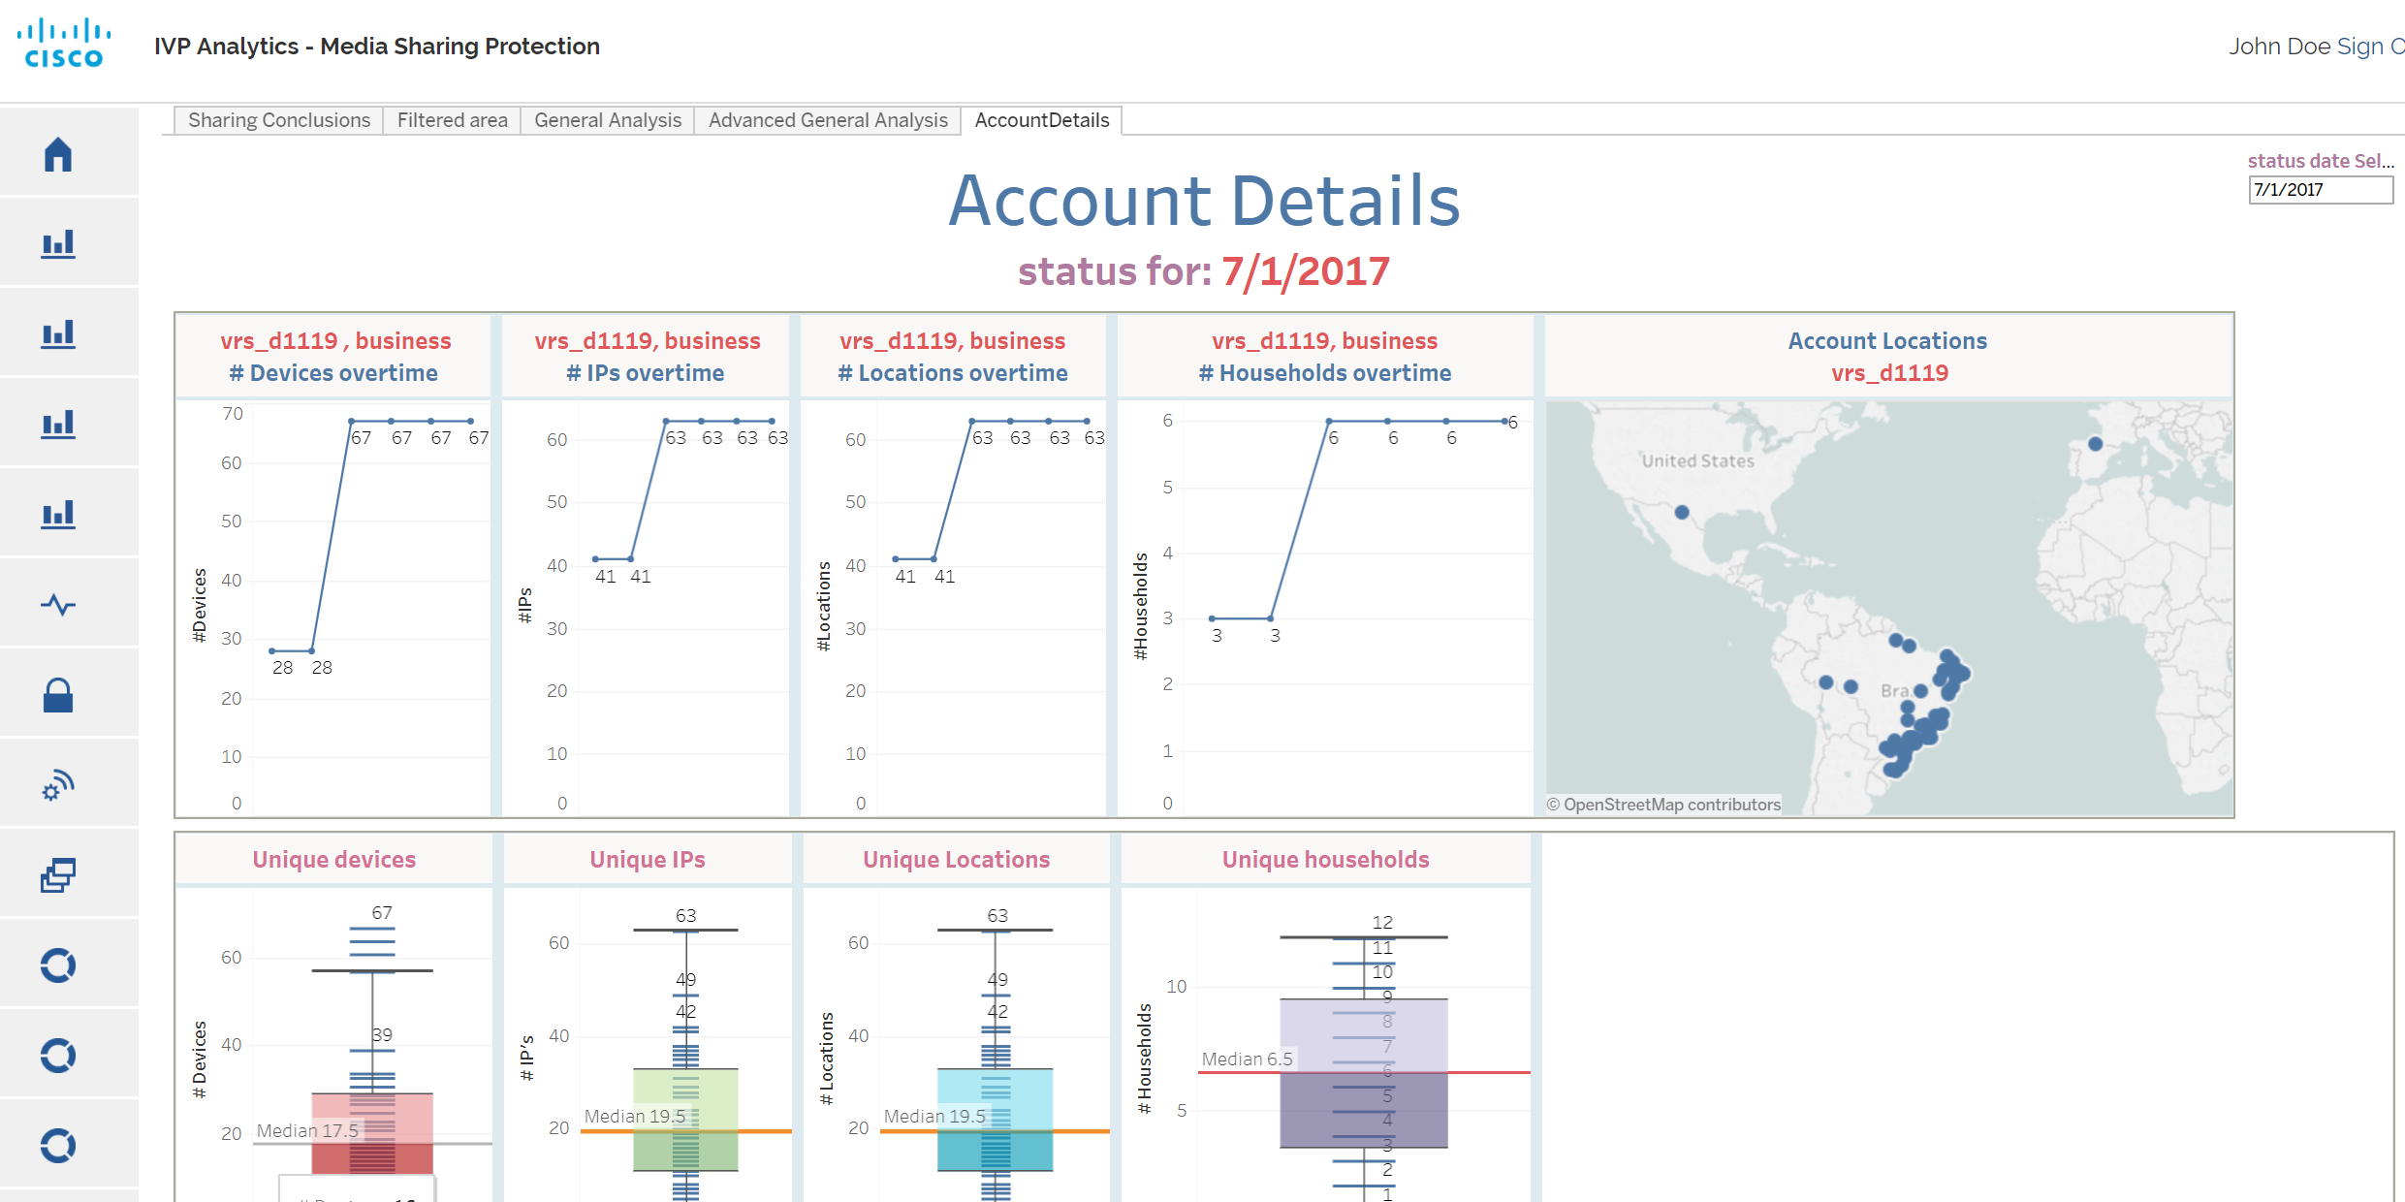


Credentials Sharing Prevention
Data Analytics to Differentiate Credential Sharing Types
>20% of adults use someone else’s subscription*
Video Security Data Analytics
Convert to Paying Subscribers
Extract Features from Logs
Classify Credential Sharing Accounts
Accounts/Devices
Timing
Detect and analyze credential sharing behavior outside household
Casual – friends/family
Business – pool/sublet
Stolen
Trigger Response Based on Sharing Type
Location
Recommendation Integrity
Setup Changes
Messaging and Entitlement Control
Access Failures
UX/Session Navigation
*Source: Parks Associates
Notes:
As I mentioned before for, video providers are now recognizing the problem of credentials sharing.
OTT services are exposed to the problem and at the same time have the characteristics that enable the solution – they have a lot of data on the service usage as part of their normal operation.
We use Data Analytics to Differentiate Credential Sharing Types and to distinguish them from the legal use of the subscription account.
First step is to extract from mountains of data in logs the features that will enable us to conduct this classification
These features capture behavior of an account in terms of time of usage, and taste, spatial aspect of the viewing, etc.
They represent statistical measurements on various log fields.
There are features that reflect the changes of other features over time
The second step is classification
defines the normal behavior
measures distance of each account to normal behavior
Sets a sharing-score threshold from which to take action
Classifies suspicious accounts into sharing types
Casual sharing with family members and close friends
Business sharing – where subscribers re-sell their subscription to multiple users, or users pool together to purchase a subscription
Stolen – more similar to fraud where the subscribers are not aware their password is used elsewhere
The system then triggers the response chosen by the service provider for each sharing type and its sharing-score
Can involve engagement through the customer via Customer Relationship Management system, such as sending challenge questions to the subscriber to validate personal or billing information.

Slide 24
Anti-Piracy Analytics Enhancements

Slide 25


Analytics for More Automated, Scalable Anti-Piracy
Leverage data available in IP video distribution networks
Value
Expand detection and user conversion with analytics
Automatically respond to piracy
Gather evidence for legal action
Identify sources of content leakage
Solution Scope
√
√
√
2018
Notes:
In a world where more and more video is consumed over IP distribution networks there is more data to be analyzed to detect piracy and use the data to trigger the appropriate response.
Now that we have the building blocks for anti-piracy, analytics increases the value of the solution by scaling it
This year Cisco anti-piracy offering will be enhanced with more analytics based capabilities
Similar to credentials sharing prevention, analytics can also be used to detect other cases where subscribers find ways to circumvent video service rules related to concurrency and geographic limitations.
As for streaming piracy analytics is a powerful tool – it enables to identify potential sources of piracy by analyzing their video service and network usage patterns
Measuring piracy viewership among broadband-only subscribers can also be used to upsell video services to them

Slide 26
Summary

Slide 27
Summary
Video piracy is moving to online redistribution
Cisco’s anti-piracy extends security from ‘Protect’ to ‘Detect & Respond’
  Watermark
  Streaming Piracy Prevention
  Credentials Sharing Prevention
This year - greater scale and automation for anti-piracy with analytics

Slide 29
Sources
ABI Research
Sandvine
UK Government
The Guardian
LaunchLeap
Anatomy Media
YouGov
S&P Global
Dataxis
Forbes
MUSO
Hollywood Reporter
Bloomberg
PwC
Parks Associates
Ovum
Icon made by Freepik from www.flaticon.com
Icon made by Smashicons from www.flaticon.com
Icon made by Alessio Atzeni from www.flaticon.com
Icon made by Becris from www.flaticon.com
Icon made by Eucalyp from www.flaticon.com
Icon made by Vectors Market from www.flaticon.com
Icon made by Gregor Cresnar from www.flaticon.com

