Slide 1
Ultra Services Platform and 5G Strategy
Cisco Knowledge Network Webinar
Key Presenters: Krishna Chirala and Biju Kachappilly
Mobile Core Business Unit (MCBU)
Jan 23, 2018

Slide 2
Topics
Business Drivers (5 minutes)
Technology Evolution (5 minutes)
Cisco Ultra Services Platform (30 minutes)
  Ultra Overview (Gateways and Functions (including CPS))
  Network Slicing
  Ultra Automation
  CUPS, Distributed Core, MEC
  Cloud Native Core
  5G Evolution View
MWC and Announcements– Great things to come (3 minutes)

Slide 3
Business Drivers

Slide 4




Average Mobile User and Connection
Cellular Traffic per Month
2016
2021
Average Traffic per User
1,456 MB per month
8,423 MB per month
2016
2021
Average Traffic per Connection
902 B per month
4,226 MB per month
Source: Cisco VNI Global Mobile Data Traffic Forecast, 2016–2021
Notes:
Regional figures for average traffic per user
Regional figures for average traffic per connection
User figure excludes M2M, includes wearables
Device/connection figure includes M2M, including LPWA
Globally, mobile traffic per user will reach 8,423 megabytes per month by 2021, up from 1,456 megabytes per month in 2016, a CAGR of 42%.
Last year: global: 746 MB in 2015 and 5,216 MB in 2021
In North America, mobile traffic per user will reach 17,921 megabytes per month by 2021, up from 4,443 megabytes per month in 2016, a CAGR of 31%.
In Western Europe, mobile traffic per user will reach 9,796 megabytes per month by 2021, up from 1,881 megabytes per month in 2016, a CAGR of 38%.
In Central and Eastern Europe, mobile traffic per user will reach 12,341 megabytes per month by 2021, up from 2,312 megabytes per month in 2016, a CAGR of 40%.
In Asia Pacific, mobile traffic per user will reach 7,413 megabytes per month by 2021, up from 1,201 megabytes per month in 2016, a CAGR of 45%.
In Latin America, mobile traffic per user will reach 5,443 megabytes per month by 2021, up from 931 megabytes per month in 2016, a CAGR of 42%.
In Middle East and Africa, mobile traffic per user will reach 7,649 megabytes per month by 2021, up from 777 megabytes per month in 2016, a CAGR of 57%.
Globally, mobile traffic per mobile connection (including M2M/LPWA) will reach 4,226 megabytes per month by 2021, up from 902 megabytes per month in 2016, a CAGR of 36%.
In North America, mobile traffic per mobile connection (including M2M/LPWA) will reach 5,841 megabytes per month by 2021, up from 2,712 megabytes per month in 2016, a CAGR of 17%.
In Western Europe, mobile traffic per mobile connection (including M2M/LPWA) will reach 3,709 megabytes per month by 2021, up from 1,122 megabytes per month in 2016, a CAGR of 27%.
In Asia Pacific, mobile traffic per mobile connection (including M2M/LPWA) will reach 4,023 megabytes per month by 2021, up from 756 megabytes per month in 2016, a CAGR of 40%.
In Central and Eastern Europe, mobile traffic per mobile connection (including M2M/LPWA) will reach 5,865 megabytes per month by 2021, up from 1,405 megabytes per month in 2016, a CAGR of 33%.
In Latin America, mobile traffic per mobile connection (including M2M/LPWA) will reach 2,987 megabytes per month by 2021, up from 600 megabytes per month in 2016, a CAGR of 38%.
In Middle East and Africa, mobile traffic per mobile connection (including M2M/LPWA) will reach 4,061 megabytes per month by 2021, up from 459 megabytes per month in 2016, a CAGR of 55%.

Slide 5


By 2021, a 5G connection
will generate 30 GB/mo,
nearly 5X higher than
the 6.3 GB/mo for
4G connections.
Source: Cisco VNI Global Mobile Data Traffic Forecast, 2016–2021
© 2016 Cisco and/or its affiliates. All rights reserved. Cisco Confidential
28
Notes:
Globally, the average 5G connection will generate 4.7X more than the average 4G connection by 2021, and 10.7X more than the average 3G connection.

Slide 6
Technology Evolution

Slide 7

The Market’s Evolution Paths
5G
Scale | Distributed Architecture | Slicing
Low Latency | Gig-Speed
4G
Cloud
Native
Automation | Containers | Micro-Services
Transition to Virtual
Performance
2020

Slide 8
Cisco’s Evolution Paths
5G
Ultra Platform with CUPS
MANO
MEC, MAF, NB IoT
4G
1 Gbps at edge
1 ms latency
1 billion connections
Cloud
Native
Dynamic Distributed Slices
Containers
Microservices Architecture
ASR 5500 to Ultra
Performance parity
Migrate functionality
2020

Slide 9
Cisco Ultra Services Platform
The Industry’s Leading NFV Core

Slide 10
1
Business Challenge
Compete with Hyper-cloud and other MNO
Cloud Providers have different business model:
More Agile – Lower costs
You need:
Increase flexibility and agility (services and schedules)
Automate and simplify  Service creation, testing, and activation
Telco-reliability with cloud efficiencies  New architecture that is also 5G ready
…and need to support multiple use cases without overbuilding the network

Slide 11
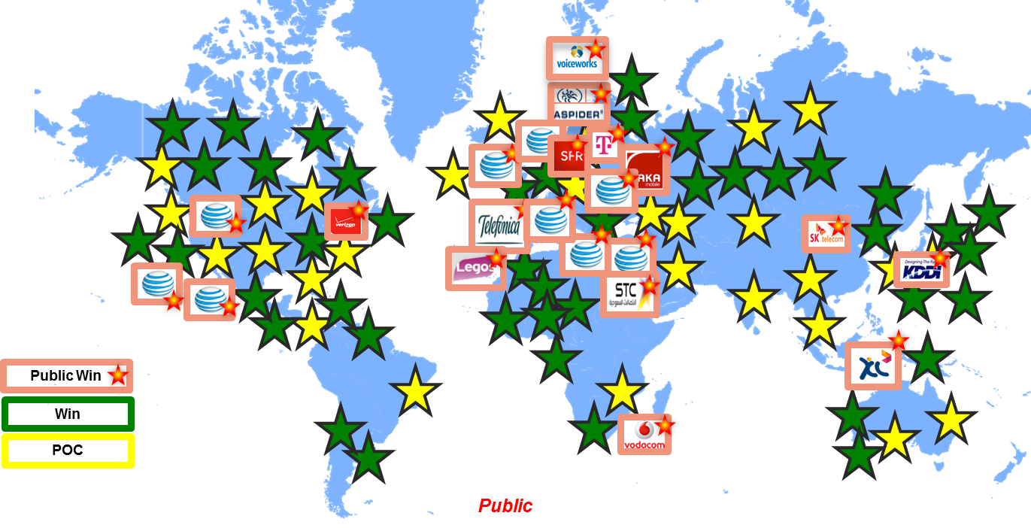
Cisco Ultra Services Platform
Industry Leading Virtualized Mobile Core
35+ Deployed
150M Deployed Subs within 6-12 Months

Slide 12
Cisco Ultra Services Platform
VNF Element Manager, VNFM Proxy, Service Manager, Monitoring
Ultra Policy Platform
Carrier-grade policy, charging, and subscriber data management solution
Rapid service creation environment
Monetization opportunities for 3G, 4G, 5G and IMS service architectures
Ultra Gateway Platform
Ultra Services Function
Pluggable framework for in-line, subscriber-aware, enhanced services
Integrated as separately upgradeable software packages
Native life-cycle management and automated configuration
Cloud ready VNF, fully featured packet core functionality
Multiple EPC/PC elements
CUPS - Separated control and user-planes
Remotely deployable user plane for ultimate elasticity & scalability
Notes:
One integrated Virtual Network Function (VNF)
Three main sub-system components under the Ultra Services Platform
Policy Functions, Gateway Types, In-Line Services (Gi-LAN)

Slide 13
Ultra Services Platform – ETSI NFV Compliance
Composite ETSI MANO Virtual Network Function (VNF) software bundle with multiple mobility use cases:
  Gateway Functions (vEPC)
  Policy Functions (CPS)
  Service Functions (USF)
Common Management and Orchestration Framework
Integrated Configuration Management
VNFM Lifecycle
SDN Integration
NFVI/VIM Support
WebScale-IT Automation

Slide 14



Safe & Simple Stepping Stone to Virtualized Architecture
=ASR5K
Ultra M
Pre-integrated, tested & validated by Cisco
Feature parity with physical packet core
Full stack Mobility Solution
Single support point of contact
Ready to deploy today

Slide 15
What’s Inside the Ultra M Stack
VNF
VPC (MME, SGSN, SGW, PGW)
Elements Manager
VNFM
Cisco ESC
Deploy GUI
VIM
OpenStack
Compute, Network & Storage Hardware
Cisco UCS C

Slide 16










Delivering Instant Mobile Networks
The Outcome
Focus existing core on mass market traffic
Add Virtualized slice(s) for verticals & introduction of new mass market services
Immediate set up — Enterprises on-boarded in minutes
Highly customizable
Self-service reduces OpEx
With Ultra
Each enterprise
or category
gets its own Core
IaaS

Slide 17



Capture Vertical Markets—Quickly Meet Diverse Business Requirements
DATA SOVEREIGNTY
SEPARATION OF OPS
FEATURE CADENCE
DATA SOVEREIGNTY
SEPARATION OF OPS
FEATURE CADENCE
DATA SOVEREIGNTY
SEPARATION OF OPS
FEATURE CADENCE
Geo + DATA SOVEREIGNTY
SEPARATION OF OPS
FEATURE CADENCE
SELECT
Wi-Fi?
DEVICE ENTITLEMENTS
PAYMENT
SELECT
Wi-Fi?
DEVICE ENTITLEMENTS
Invoice
DEVICE ENTITLEMENTS
Invoice
PAYMENT
SELECT
Wi-Fi?
DEVICE ENTITLEMENT & CAPABILITY
PAYMENT
SELECT
Wi-Fi?
Invoice
Invoice
PAYMENT
Enterprise 1
REDUNDANCY MODEL
IoT
SLAs
SECURITY
REDUNDANCY MODEL
MVNO / E
SLAs
SECURITY
REDUNDANCY MODEL
SLAs
SECURITY
REDUNDANCY MODEL
Enterprise 2
SLAs
SECURITY
Notes:
Separation of operational interests. - Frequently different departments (or even companies want secure and separate operational control and management of the platform.
Geographic requirements. Some enterprises / MVNO’s will want to place geographical requirements on the placement of the service. For example a large car manufacturer will sell cars all over the world and so parts of the connected car infrastructure are likely to be regionally deployed.
Geo political requirements around specific political tensions, or data storage and retention policies may lead to specific location asks from operators customers.
Features and release cadence. Some operator vertical enterprise customers or MVNO’s will have specific functional requirements where it is easier to delivery form a separate virtual platform than form the core consumer platform. Often there may be a different release methodology or cadence (volume of releases in a year) required by different vertical customers.
Device control. Some customers may have very specific requirements around the control of their devices meaning they expect their own instantiation of for example ANDSF or entitlement servers. Other services need bespoke N/W like NBIOT due to the nature of the devices
Security – Some large customers may simply demand that their instantiation is physically or virtually separated from other customers.
Scaling. Some customers (or operator themselves may want to deal with volume at a different rate of change for different service sectors)
Charging – Some operators may wish to charge their larger customers based upon the size, tx load, scale of a platform being supplied
Redundancy models – Large operator customers may make specific demands upon the redundancy architecture over and above an availability SLA.
SLA’s – In general .. Not every SLA need will be the same for every vertical sector, virtual instances of platform allows operators to offer more flexibility in SLA’s. E.g. Ambulance service may request 100% uptime and a release cadence of two policy changes a year. A virtual operator might request 99.9% availability but a release cadence of 2 policy changes per week.

Slide 18

Ultra Automation Services
  Ultra Automation Services enables operators to deploy and run Ultra Packet Core Services, Orchestrating hardware, software and Openstack with Day 0 Configuration and Day N Services
  (enables full Life Cycle Management, onboarding of 3rd party VNFs and, IoT use cases)
Ultra Automation Services
End to End deployment option
Automate NFVI & OpenStack installation
Accelerate software qualification & deployment

Slide 19
Day-0/Day-N Provisioning & Deployment
Site & VNF Inventory
NFVI Installation
VNFM & VNF-EM Installation
Full VNF Deployment
Deployment Validation
Cloud Installation
Monitoring
AutoDeploy
AutoSLA
AutoIT-NFVI
AutoIV
AutoVNF
AutoIT-VNF

Slide 20
Day-N Operations
Service Level Monitoring
Software Qualification
Software Validation
Software Upgrade
AutoIV & AutoQA
AutoSLA
AutoIV
AutoIT-VNF & AutoVNF

Slide 21
Ultra Automation Services – Main Functionalities
AutoDeploy
1
VNF & VNFM orchestration
  Bootstrapping
  Software management
  VIM provisioning for VNFs
  AutoVNF HA
  Upgrades (ICSR & Non-ICSR)
  Graceful stop of VNF
Site-level orchestration
NFVI & VIM installation automation
  Bootstrapping
  Configuration management
  Software management
  Hardware and VIM sanity
  L2/L3 hardware elements in Ultra-M
Operational tasks automation (Future)
  AutoQA
  AutoIV
  AutoSLA
2
VIM/NFVI Inventory Management
Align AutoVNF to Managed Inventory
Full Day-N Service Configuration
AutoIT-NFVI
AutoIT-VNF
AutoVNF
3
1
1
2
Automated upgrade & install of NFVI
Installs in customer environment
Integration with underlying hardware
Automated upgrade & install of VNF
Installs in customer environment
Import 3rd Party Functions
Automated Deployed of VNF
Support for Multiple NFV-O/VNFM Stacks
ESC/ECM/HP-NFVD
3
AutoIV
AutoQA
AutoSLA
4
4
4
Automated Instrumentation of key VNF Metrics
Automated In-Service VNF Service Validation
Validate VNF via fully automated QA Cycle
Runs on target whether virtual application or cloud
Automate measurement of key SLA metrics
Correlation with AutoIV triggered KPIs
4

Slide 22




Ultra Packet Core CUPS
Co-Located Network Architecture
Ultra Packet Core CUPS
Remote Network Architecture
Central Data Center
Ultra Services Platform
Management Plane
VM
VM
Control Plane
VM
VM
User Plane
VM
VM
User Plane
User Plane
VM
VM
VM
VM
Service
Component
Service
Component
Service
Component
Service
Component
Service
Component
Service
Component
Service
Component
Service
Component
Service
Component
Remote Data Center
COTS/5500
Remote Data Center
COTS/5500

Slide 23
Ultra Packet Core CUPS Options
Hybrid-CUPS
CUPS
Hybrid CUPS Ultra Packet Core solution.
ASR5500 as U-Plane.
C-Plane on COTS.
3GPP Compliant CUPS architecture.
DPC2 card based solution.
New Ultra Packet Core Architecture to cater to NextGen requirements.
CUPS Ultra Packet Core solution.
C & U-Plane on COTS.
3GPP Compliant CUPS architecture.
New Ultra Packet Core Architecture to cater to NextGen requirements.

Slide 24
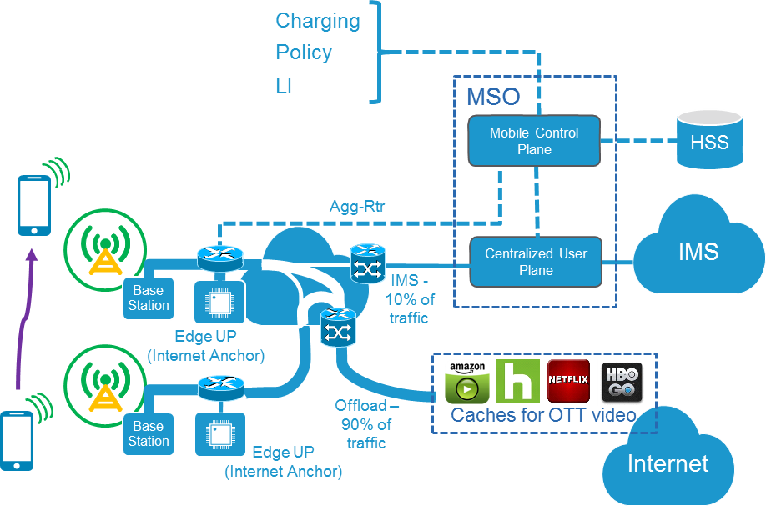
Mobile Edge Computing with CUPS
A very flat mobile core architecture based on CUPS
  Internet access is via “Edge UP”
  IMS and special APNs are accessed via “centralized UP”
  Edge UP+ CP is functionally equivalent to StarOS and includes services (ADC, NAT, etc.)
Benefits
  Offloaded traffic can be directed to regional and metro caches for OTT video
  Offloaded traffic does not impinge on MSOs and is much simpler to network as it can be express directed to an Internet POC

Slide 25

Combine applications from different sources
Cisco’s Cloud-Native
Architecture provides:
Extend SP’s innovation capabilities at scale
API-driven NFV model
Support new functionality
Quickly install patches
Notes:
Cisco’s Cloud Native architecture for mobility provides an API-drive NFV model, enabling the ability to;
combine applications from different sources
support new functionality
and install patches quickly
Greatly expanding the amount of innovation providers and the telecom community at large can achieve

Slide 26
The Road To Cloud Native
Self-Healing Network
20192020
Leverage analytics to combine artificial intelligence & deep learning and dynamic network to create knowledge network
Mobile Core Vertical Solutions
20192020
Build Mobile Core as a Service Solutions for E2E IOT, Enterprise, MVNO, PMB, and Consumer verticals
Cloud Hosted Mobile Control Plane
2019
Ability to deploy an E2E mobile core solution in a public cloud with user plane on premise. Fully automated lifecycle integration of local UP and hosted CP in separate domains.
Cloud Native Platform
2018
Automated instantiation and lifecycle management across a complete mobile core solution. Along with EPC and PCRF, include additional 3GPP functions for an E2E Mobile Core: AUSF/HSS, UDM, etc.
Cloud Native Mobile Gateway
2018
Refactor and rebuild functions of StarOS as containerized microservices extending current UP/CP separation effort. Address next gen forwarder, state and protocol separation.
Fully Automated Mobile Core
2017
Combine Ultra and CPS platform services to support Docker lifecycle automation and common operational functions. Package VNFs as Docker containers for orchestration and automation.
Notes:
Pivoting to SW (vs appliance)

Slide 27
Cisco’s Evolution in Cloud Nativity
VPC instantiation
in cloud
Bring up virtual instance in a cloud environment
PoC on Vmware and public cloud – Nordic Operator
CUPS and separation
of UP in geo locations
Functional demo available with TME support, successfully demoed at MWC earlier this year
PCRF (CPS) + VPC instantiation in cloud
Onboarding of CPS on Ultra Platform → Composite VNF
Dockerised
PCRF + VPC
Targeted for early next year, planning in process to define roadmap requirements
Completed
Completed
On Track
In Planning
February 2017 MWC 2017 2H17 1H18
Remote DC
User Plane
Central DC
Control Plane
EPC VNF
PCRF VNF
Remote DC
User Plane

Slide 28
Mobile Core is the key to driving 5G services through CUPS, Network Slicing, Identity & Policy
Cloud Native enables the transition to automation and simplicity to maximize OPEX savings
Deliver 5G enabled services and new business adjacencies focused on fixed/mobile, Enterprise, IOT, Security & Video
Integrate multi-access solutions across Cisco technologies such as WiFi, Fixed & Cable

Slide 29
What is Driving 5G - Next Generation Application Needs
10 Gbps
Video
360º video
360º VR/AR
VR/AR
360º video (hi-res)
Autonomous Vehicles
1 Gbps
100 Mbps
Video training
10 Mbps
360º video (lo-res)
4K video streaming
Haptic VR
Bandwidth
1 Mbps
People
& Things
Remote control vehicles
System
Control
HD video streaming
100 Kbps
Cloud-assisted driving
Sensors
10 Kbps
Comms & Chatbots
Electric grid control
Sources include:
K. Budka, "5G and the Next Industrial Revolution: The transformative power of low latency services," presented at the The Brooklyn 5G Summit, 2017.
Cisco Analysis
1 Kbps
Home Sensors
Latency
10s
1s
100ms
10ms
1ms
100us
10us
Core Cloud
Edge Cloud

Slide 30
5G Migration Options
Dotted line depicts split bear case

Slide 31
Deploy 5G Radio alongside 4G Core
HSS
AMBR
PCRF
Option 3 - 5G radio is deployed and high BW traffic is passed through optimized user plane
PGW
SGW
SPGW
5G RAT
Limited network changes
Focus on the Radio and Transport changes
New MME, HSS and policy features
High Speed connection use case deployments
MME
Dual Connectivity
E-UTRAN
E-UTRAN/
NR (Opt. 3)

Slide 32
3GPP 5G Standalone Packet Core
(Service Based Architecture)
NSSF
AUSF
UDM
NEF
NRF
Nnssf
Nausf
Nudm
Nnef
Nnrf
APIs (HTTP/JSON)
Namf
Nsmf
Npcf
Naf
AMF
SMF
PCF
AF
N1
N2
N4
UE
(R)AN
UPF
DN
UPF
N3
N6
NG-RAN, Fixed
Control
Data
N9
AUSF Authentication Server Function
AMF Access and Mobility Management Function
AF Application Function
DN Data Networks
SMF Session Management Function
NEF Network Exposure Function
NSSF Network Slice Selection Function
NRF Network Repository Function
PCF Policy Control Function
UPF User Plane Function
(R)AN (Radio) Access Network

Slide 33
Easy Steps to Option 3 and 5G Core
CUPS
StandAlone
Virtualize
Option 3
Distribute
Understand how to deploy VNF on NFVI
Automation and integration tools
Create new slices
Re-architect the GW
High speed UP
Scale the UP and CP independently
New LCM
Augment RAN capacity
Optimize the deployment
Define new services
Introduce SMF, AMF etc nodes
Create slice per service
New 5G core services
Introduce low latency services
Address new verticals
Cloud native implementation

Slide 34



Feature Continuity from PGW to SPGW-C/U to SMF/UPF
DPI, Charging,
IP Pools,
KPIs, Resiliency…
90% of features
Platform evolves to virtual and distributed
SGW and PGW features and operation need to continue with little to no interruption
Per APN UP
Flexible scaling
NSA
SA Arch, SBA
5G Features
MEC
Cloud Native
CI/CD
VPP
SPGW
SPGW-C
SMF
SMF
SPGW-U
UPF
UPF
ASR5500
VNF/Ultra
UPF
UPF
SPGW-U
4G CUPS
5G SMF+UPF
VNF’s
5G SMF+UPF
Cloud Native
Notes:
The ASR5500 based SPGW today is a very feature rich and capable network element. As we move to 5G we want to build on these features and not have to deal with a new set of integration challenges.
CUPS are disruptive but Cisco has take a very operational approach to keep things simple and limit the number of perceived changes to a minimum.
NSA is only a few changes on the EPC and the main requirement is to be able to handle the high throughput which CUPS is very well positioned for.
As mentioned previously, the SMF is all but an SPGW-C and the move to SBI and new procedures does not detract that this is a gateway and most of the features used in 4G will carry over to 5G.
5G featues build on the exiting GW functions but the underlying plarform is being radically changed to meet the deployment requirements and the true cloud native architectures.

Slide 35
Cisco @ MWC-Barcelona
Cisco 5G Now!

Slide 36
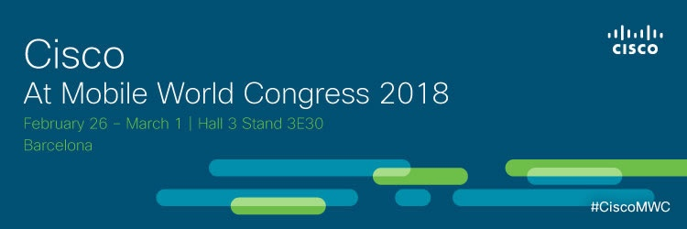
Coming Soon
Mobile World Congress
  Announcements of new products, solutions and capabilities
  Live demonstrations of new solutions
  Come see us in Barcelona:
    Cisco Booth in Hall 3, location #3E30

