Slide 1
Cisco Enterprise Cloud Suite for Service Providers
Cisco Knowledge Network – Data Center
Jan 16, 2018

Slide 2
Agenda
Cisco ONE Software Suite Overview
Cisco Enterprise Agreement for Cisco ONE
Cisco Service Provider License Agreement (SPLA)

Slide 3
Agenda
Cisco ONE Software Suite Overview
Cisco Enterprise Agreement for Cisco ONE
Cisco Service Provider License Agreement (SPLA)

Slide 4
What is Cisco Software?
Cisco software provides customers the latest innovations in networking, infrastructure, collaboration, security, and more. It consists of products (e.g. Cisco ONE), buying programs (e.g. Enterprise Agreement), software management capabilities (e.g. Smart Accounts) and more.

Slide 5
What is Cisco ONE?
Open Network Environment
Network automation and more efficient operations
Hardware, software, services, support
Physical and virtual services
  Hypervisors
  Software Defined Networking
  Network Function Virtualization
New licensing model
  Smart Licensing/Smart Accounts
  Enterprise Agreements
  Service Provider License Agreement (SPLA)

Slide 6
Key Differentiators
Policy Driven – Compute, Networking, Storage
  Governance
  Security
  Standardization
Ease of implementation and management
Global Visibility
Virtual and Physical / Hypervisor Independent
Single Point of Support System, Network, Storage, Virtualization, Automation, Analytics, 3rd Party SW
Open API’s

Slide 7




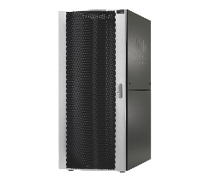
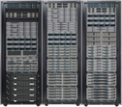






Form Factor Independence
Cisco UCS® Mini
Cisco UCS E-Series Servers
Fourth-Generation Cisco UCS
Cisco UCS Integrated Infrastructure Solutions
Cisco HyperFlex™ Systems
Microsoft Azure Stack
Rack Servers: Cisco UCS C-Series and S-Series
ROBO
Mainstream
Computing
Converged Infrastructure
Hyperconverged
Infrastructure
Hybrid Cloud
Scale Out
Edge
Core Data Center
Cloud
One Infrastructure Management Model

Slide 8
Cisco ONE Software Suites
Data Center
WAN
Access
Advanced Security Software and Appliances
Advanced Security
Advanced Capabilities, Analytics and Applications Software
Advanced Application
Core Networking, Hybrid Cloud, Security and Systems Software
Foundation
Cloud / Compute
Networking
WAN
Switching
Wireless
Infrastructure and Base OS

Slide 9
Available only as subscription
Cisco ONE ECS Software Suites
Data Center Cloud / Compute
Data Center
Threat Defense for Data Center
New!
ECS - Cloud Management
ECS -Infrastructure Automation
ECS – Big Data Automation
ECS - Service Management
ECS – Workload Optimization
Cloud / Compute Infrastructure
UCS, x86, VM

Slide 10
Enterprise Software is Difficult to Manage
25%
Additional Cost of Complexity¹
75%
Out of Compliance²
30%
Plan to Renegotiate Contracts³
20%
Pay +$1M in True-Up Costs²
93%
Waste Money on Shelfware²
Too Many Vendors
UnmanageableSoftware & Licensing Terms
Never-ending Negotiation & Renegotiation
Unpredictable & Spiraling Costs
Inability to Maximize Investment Value
1. IDC Software Licensing and Pricing Predictions 2016: Top 10 Predictions. 2016, IDC.
2. The State of the (Software) Estate: Waste & Risk Running Rampant in Enterprises. A 2016 Key Trends in Software Pricing & Licensing Survey Report. 2016, Flexera.
3. Cisco Enterprise Agreement: Meeting the Challenges of Shifting Business Trends. How Product and Service Purchasing Must Evolve to Meet Modern IT Requirements. 2017, ESG.

Slide 11
What If There Was an Easier Way?
Simplify Environment
Standardize
All Solutions
Lower TCO
Free Built-In Growth
Financial Predictability
4

Slide 12
Structure & Terms
Available Suites | Multiple in Cisco ONE Software, Collaboration, Security
Terms and Conditions | Single Agreement, Co-Terminus with Investment Protection
Minimum Requirements | Varies Depending on Architecture/Suite
Licensing | Per User or Per Device (Network Security)
Licensing Models | Perpetual and/or Subscription
License Fulfillment | EA Workspace
Capacity | 20% Growth Allowance
Agreement Term | 3 to 5 Years
Payment Schedules | Upfront | Periodic terms
True Forward License Reconciliation
An annual review of current deployment to account for utilization beyond the built-in 20% growth. No retroactive billing for license used prior to the annual true-forward assessment
Growth Allowance & Savings
The program includes 20% growth allowance
only reconciling licenses on an annual basis.

Slide 13
END to END Solutions: Hardware, Software, Services
Infrastructure
Cisco ONE Software / DNA
Collaboration
Security
Switching
Cisco ONE Advantage for Switching² | Campus Fabric³ | Foundation for Switching³
Cisco Spark Flex Plan²
Unified Communications³
Email Security²
Security Essentials²
Wireless
Cisco ONE Advantage for Wireless² | Advanced Mobility Services³ | Foundation for Wireless³
Multiparty³
Customer Collaboration³
Cloud and Web Security²
Policy and Visibility²
Compute
Cisco Tetration™ Analytics² | ECS - Workload Optimization² | ECS – Infrastructure Automation²
Prime Collaboration^{1,3}
Prime Collaboration - Contact Center Assurance Option^{1,3}
Networking
Data Center Fabric³ | Foundation for Networking³
Routing
WAN Collaboration^{3,4} | Foundation for WAN³
Cloud
ECS – Cloud Management²
Cisco Enterprise Agreement: One Agreement / One Workspace / One Term
Buy a Single Suite or a Combination of Suites
13
1. End of Sale 8/28/18 | 2. Subscription | 3. Perpetual | 4. Foundation suite optional - See the Cisco ONE Offer Structure for license details

Slide 14
Cisco EA – Minimum Purchase Requirements
Cisco ONE
Software Network,
Storage, Compute
Cloud¹
Compute
Networking
WAN
Wireless
Switching
$500K Net TCV²
$250k Net TCV²
Collaboration
Unified Communications
Prime Collaboration
Multiparty Plus
1000 Knowledge Workers
Customer Collaboration
Prime Collaboration - CCAO
Cisco Spark Flex Plan
250 Contact Center Agents
250 Knowledge Workers
Security
Email Security
Security Essentials
Cloud and Web Security
Policy and Visibility
$250k Net TCV²
1. $500K minimum only applies to ECS – Cloud Management | 2. Net TCV = Net Total Contract Value (Software + SWSS)
14

Slide 15
Agenda
Cisco ONE Software Suite Overview
Cisco Enterprise Agreement for Cisco ONE
Cisco Service Provider License Agreement (SPLA)

Slide 16
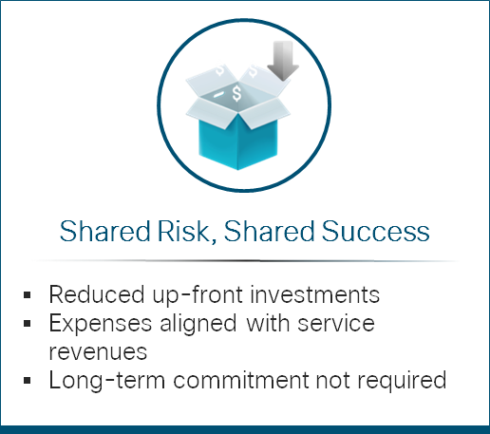
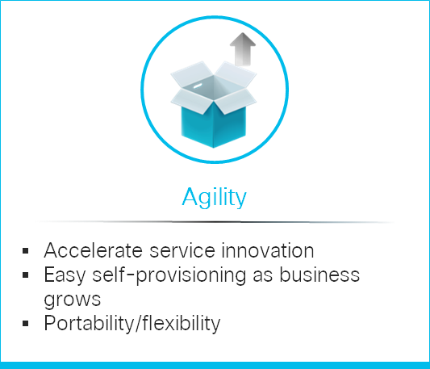
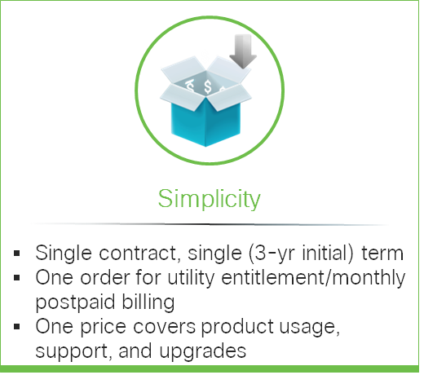
Introducing Cisco Service Provider Licensing Agreement (SPLA) – A New Model for a Digital World

Slide 17

SPLA – Licensing Costs Aligned to Your
Services Lifecycle
No-cost licenses before launch*
Cost
Build
Test
Launch
Market Expansion
Scale
SP GTM Lifecycle
Deploy licenses in real time as you need them
Pay monthly only for the licenses you are using
* some SPLA products may require minimum commitments

Slide 18
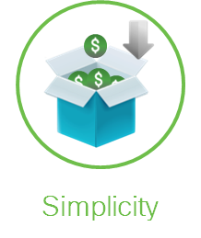
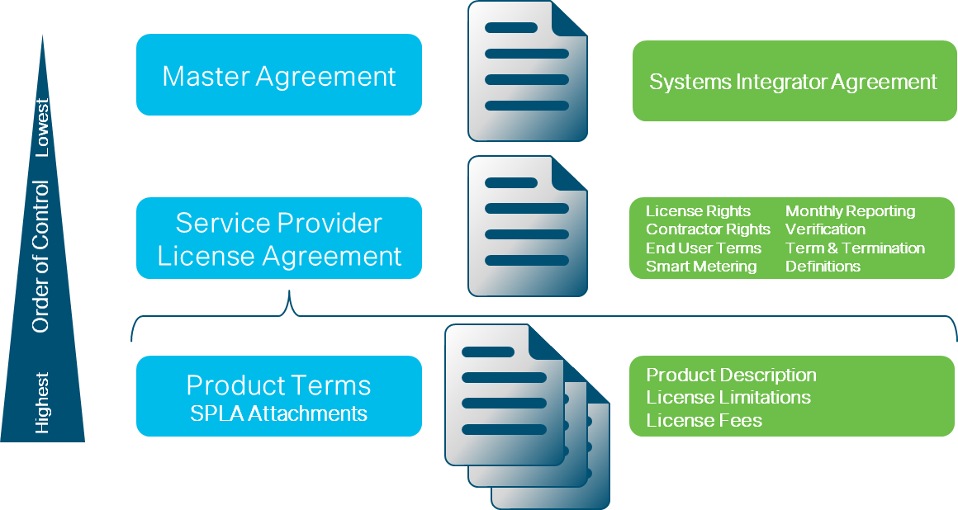
Simple: Post-Paid Utility Agreement
SPLA Contract Structure
Fits under your qualified master agreement
Covers all mechanics for postpaid utility model
Select among available SW offers; easy to add more during term

Slide 19
SPLA Lifecycle: Simple, Standard
At Purchase
In Deployment
Choose products to include in SPLA
Sign 3-year SPLA agreement under system integrator agreement with price guarantee
Set up Smart Account
for SPLA products
Deposit pool of licenses
into Smart Account
SPLA
Lifecycle
At Renewal
In Use
Easily renew SPLA at
end of term
Deploy licenses as
needed based on end
customer demand
Upgrade/downgrade/
reuse as needed
Generate monthly usage report

Slide 20
Ease of Management
Smart
Account
Self-Service
License Fulfillment
Faster rollouts
Real-Time View of Entitlement and Consumption
Reduce guesswork,
delays, audits
Change Management
Easily upgrade or
downgrade software

Slide 21
Cisco Software Support
Software Support
Foundational Support
and Software Upgrades
Maintenance
Minor Updates
Major Upgrades
24x7 Cisco® TAC
Support
Online Support Tools and Community
Protect investment during the term
of the SPLA
Enhance business continuity and
reduce risks
Increase IT productivity and knowledge
Business
Outcomes

Slide 22
What Can You Buy Under SPLA?
Available
In Progress
Under Consideration
Infrastructure
Cloud Services Router 1000 virtual (CSR1000v)
WAN Essentials/ISRv
WAN Foundation/ISRv
Virtual Cisco Unified Border Element (vCUBE)
ISR 4000
ISR 1100
Virtual Wide Area Application Services (vWAAS)
Security
Adaptive Security Appliance virtual (ASAv) firewall
Advanced Malware Protection (AMP) for Endpoints
Next Gen Firewall virtual (NGFWv)
Email Security (ESAv), Web Security (WSAv)
Cloud Email Security (CES)
Stealthwatch Cloud, Umbrella
NGFW for Firepower appliance
Cloud
Cloud Center
Orchestration & Services
Network Services Orchestrator (NSO)
Virtual Managed Services – Intelligent WAN (VMS-iWAN)
This roadmap is subject to change at the sole discretion of Cisco, and Cisco will have no liability for delay in the delivery or failure to deliver any of the products or features set forth in this document.

Slide 23
References
Cisco ONE Landing page:
http://www.cisco.com/go/one
Cisco ONE for Data Center Networking Data Sheet: https://www.cisco.com/c/en/us/products/collateral/software/one-data-center/datasheet-c78-733010.html
Cisco Enterprise Cloud Suite:
https://www.cisco.com/c/en/us/solutions/data-center-virtualization/one-enterprise-suite/index.htmlGlobal
Cisco Enterprise Agreement:
https://www.cisco.com/c/en/us/products/software/enterprise-agreement.html

Slide 24
Wrap Up
Cisco ONE Software Suite Overview
Cisco Enterprise Agreement for Cisco ONE
Cisco Service Provider License Agreement (SPLA)

