Slide 1

Internet of Everything in the Public Sector
Generating Value in an Era of Change
Joseph Bradley, Lauren Buckalew, Jeff Loucks, James Macaulay
May 2014

Slide 2
IoE in the Public Sector: Study Highlights
Augmenting its groundbreaking research, Cisco, with Cicero Group, studied 40 public sector organizations globally
1
Top 10 insights show how public sector organizations are capturing IoE value today
2
Cisco identifies five steps public sector organizations can take now to generate IoE value
3

Slide 3

Governments Are Struggling to Do More with Less
Financial Resources at Breaking Point
Current Environment
Citizen Demands
Continued macro-economic weakness
Lower tax receipts
Fiscal austerity
Improved transportation, education, healthcare, etc.
$

Slide 4
To Thrive Today, Governments Must Be Hyper-Aware, Predictive, and Agile…
Hyper-Aware
Predictive
Agile
Sense the location, status, and context of public sector assets and environment
Collect citizen ideas and inputs for innovation
Optimize performance of assets, operations
Foresee and proactively address emerging threats to safety and security
Build platforms for new types of citizen experiences
Transform service delivery and operating models at speed
Fast Innovation

Slide 5

…by Connecting People, Process, Data, and Things
People
Process
Connecting people
in more relevant,
valuable ways
Delivering the right information to the right person (or machine)
at the right time
IoE
Data
Things
Leveraging data
into more useful information for decision-making
Physical devices and objects connected to the Internet and each other for intelligent decision-making; often called Internet of Things (IoT)
Notes:
5

Slide 6
Cisco’s Earlier Research Showed IoE Represents
$19 Trillion in Value for Companies and Governments
IoE Value at Stake
$19.0*
Trillion
$14.4T
Private Sector
$4.6T
Public Sector
Includes both industry-specific and horizontal use cases
Includes cities, agencies, and verticals such as healthcare, education, defense
Customer Experience: $3.7T
Innovation: $3.0T
Employee Productivity: $2.5T
Supply Chain: $2.7T
Asset Utilization: $2.5T
Increased Revenue: $125B
Reduced Cost: $740B
Employee Productivity: $1.8T
Connected Defense: $1.5T
Citizen Experience: $412B

Slide 7



Building on this Research, Cisco Studied 40 Public Sector Organizations Currently Benefiting from IoE
Global study of IoE capabilities across 40 leading public sector organizations
In-depth interviews with government leaders, department heads, technical experts
Goal: Discover how leaders are generating value from IoE, and inspire others to take their own IoE journey

Slide 8
Top 10 Public Sector IoE Insights
1
Public sector organizations are among world’s leading IoE innovators
2
Cities are using comprehensive strategies to generate IoE value
3
Powerful network foundation expands the art of the possible
4
Scalable pilot projects build support, momentum, and expertise
5
Data analytics magnify impact of IoE
6
It’s an app, app, app, app world
7
IoE solutions must address people / process, not just data / things
8
Transparency and open data drive stakeholder engagement
9
IoE is a catalyst for breaking down organizational silos
10
Senior leadership / tangible public benefits are essential for success

Slide 9
Public Sector Organizations Are Among World’s
Leading IoE Innovators
Insight
1
Public sector is an excellent proving ground for IoE: big institutions,
serve large and diverse population, must solve tough problems
IoE leaders in public sector excel in 3 areas:
  Vision: Embrace the possibilities of IoE to transform how, where, and to whom they deliver services
  Scope: Use size and authority to launch IoE initiatives with impressive scale and transformative potential
  Execution: Navigate political and technological complexity to produce measurable public benefits

Slide 10

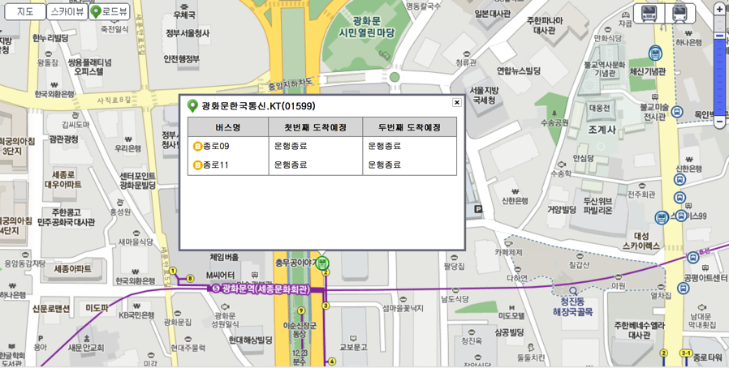
IoE Innovator:
Seoul City’s Transport Operation and Information Center (TOPIS)
Objective
Increase rider satisfaction with better, more efficient public transportation
Strategy
Multiple initiatives to transform transit system through Internet and technological data-gathering devices
Solution
Collect and analyze data from road and video sensors, GPS, taxi credit-card readers, Wi-Fi networks, CCTV
Provide real-time route guidance and bus info on mobile apps
Impact
TOPIS an IoE execution leader for the effectiveness of its complex initiatives, including real-time subway and bus data (above)
Satisfaction rate for public transportation has grown from less than 50 percent to 85–90 percent
Reduced traffic congestion

Slide 11
“There’s a creative way to leverage technology no matter how difficult the problem. Don’t restrict your thinking just because it either hasn’t been done before or that someone’s told you people have [already] tried over and over.”
Hugh Miller
Chief Technology Officer, City of San Antonio, TX

Slide 12
Cities Are Using Comprehensive Strategies to Generate IoE value
Insight
2
Cities are in the vanguard of leveraging IoE capabilities for transformation
Many key IoE use cases (e.g., parking, public transit, waste management) fall under the purview of cities (representing fully 60 percent of civilian Value at Stake)
Most successful cities take a comprehensive approach to conceiving and implementing IoE capabilities with a codified strategy spanning multiple projects
“Platform approach” to foster innovation is a critical success factor for many municipalities

Slide 13

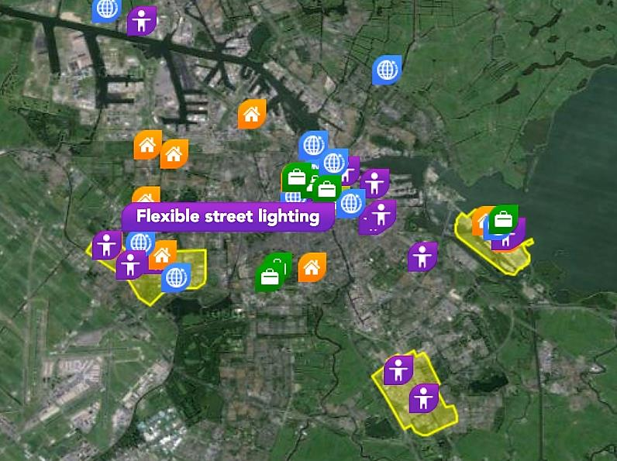
IoE Strategist:
Amsterdam
Objective
Improve the lives – and livelihoods – of citizens
Strategy
Launched “Smart City” IoE strategy, with 47 IoE projects to date
Work with local telecommunications, electricity companies to create IT infrastructure that could support citywide IoE initiatives
Solution
IoE projects include smart energy grid systems, streetlighting, parking applications, building management, and public Wi-Fi
Amsterdam’s citywide IoE strategy and strong IT infrastructure are enabling 47 concurrent IoE initiatives
Strategy accelerates IoE value creation,
enables experimentation
Impact
9 to 14 percent savings on energy bills due to apps that provide greater insight into individual energy usage
Sensors on electric grid have improved network’s reliability

Slide 14
Powerful Network Foundation Expands the
Art of the Possible
Insight
3
Jurisdictions cite the role of a robust, flexible network consistently as a key pillar of IoE strategy
Leaders see the value in converging multiple networks—whether core data network, surveillance video, building/HVAC data—on a single platform to drive efficiencies and integration
Strong network foundation lays the groundwork for future innovation and future proofs investments, capitalizing on demand or when political support / funding becomes available

Slide 15




IoE Network Infrastructure Leader:
San Antonio
Objective
Use technology to deliver city services more efficiently
Strategy
Leverage city’s fiber-optic and wireless mesh network to develop
a broad range of IoE solutions as opportunities arise
Solution
Transportation projects such as networked traffic light control, smart parking, and streetlighting
Remote, video-based (telepresence) municipal court program
In-car video, transaction technologies for police officers
San Antonio installed miles of fiber-optic
cabling and wireless mesh network
City using network to create geographic
information system (GIS) IoE services
Impact
Prior to traffic light synchronization, $2 billion was lost due to longer commutes, higher fuel expenses, safety issues, and other factors

Slide 16
Scalable Pilot Projects Build Support, Momentum,
and Expertise
Insight
4
Savvy jurisdictions see the value of pilots in rallying support for initiatives
Seize the opportunity to share vision of program potential with many different stakeholders, and gather input
Two best practices for establishing pilots:
  Focus on scalable technologies and delivery approach—enables lessons learned from design, testing, and troubleshooting phases to be applied widely after full implementation
  Focus on clear performance metrics and measurement of impacts to round out business case for potential larger deployment

Slide 17



Accelerating IoE Innovation Through Pilots:
Nice
Objective
Develop innovative city services without increasing costs
Strategy
Launch “Connected Boulevard” as test-bed for IoE initiatives
Solution
Ultra-high-broadband network, sensor network, and data
warehouse to aggregate data and conduct analyses
Sensors are placed on waste receptacles, streetlights, and on curbs next to parking spaces
Streetlight sensors monitor light, air quality, noise, traffic flow
Nice’s Connected Boulevard is a multi-initiative IoE pilot to
test projects, determine which ones will be fully rolled out
Allows Nice to innovate quickly, accelerate full
implementation of beneficial programs
Impact
Smart-parking and smart streetlighting initiatives have shown
the most initial promise

Slide 18
“One of the most important lessons learned is that the technology we used was well-tested. We knew it was going to work, and it worked very well from day one … A lot of the reason for that has been very close cooperation between public authorities and the commercial partners who are involved. I can’t really stress that enough.”
Daniel Firth,
Chief Strategy Officer, City of Stockholm Traffic Administration

Slide 19
Data Analytics Magnify Impact of IoE
Insight
5
Analytics serve as the next frontier for many leading jurisdictions in their IoE efforts
Integration of sensor data with predictive analytical applications is giving rise to the opportunity to be more proactive in optimizing operations and responding in real time
Garnering intelligence across data sources—mobile devices, payment systems, machine sensors—creates new potential for resource optimization and operational efficiencies

Slide 20




Seeing Deeply with Analytics:
Hagihon
Objective
Reduce water loss while preserving the company’s bottom line
Strategy
Replace traditional, labor-intensive work model with one that takes advantage of IoE
Partner with data analytics provider
Solution
Smart water management and conservation solution that integrates sensor technology and advanced analytics
Includes SCADA and GIS systems, water-usage analytics,
leak-detecting acoustic sensors, ERP system, and mobile app
Analytics system uses algorithms to identify
irregularities that indicate a leak
Hagihon can fix leak before service is interrupted —
and much water is lost
Impact
Significant decrease in water loss, and increased profitability
Sensors replace manual data collection, boosting efficiency

Slide 21
It’s an App, App, App, App World
Insight
6
Public sector organizations recognize that constituents, increasingly conditioned by online experiences elsewhere, want and expect to replicate these experiences in their interactions with governments
Mobile apps accordingly are emerging as a centerpiece of public sector IoE citizen engagement and service delivery strategies

Slide 22
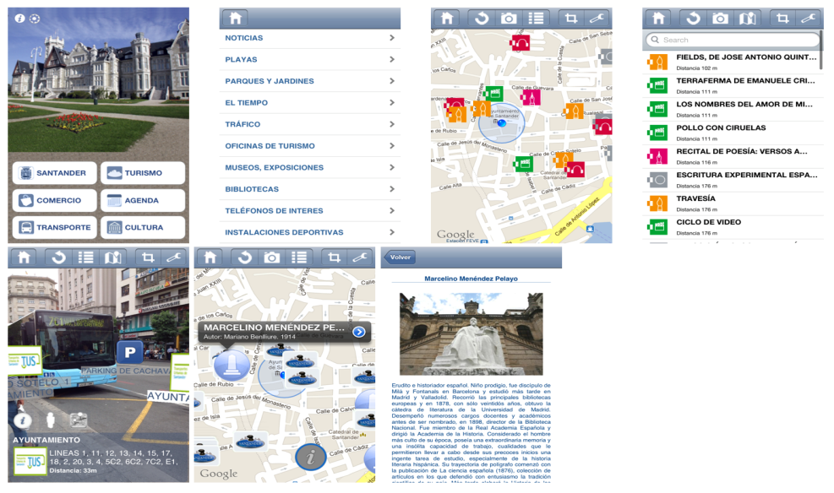

Government Services in Your Hand:
Santander, Spain
Objective
Improve city operations and quality of life for citizens
Strategy
Secure top-down leadership and support from mayor, and partner with local universities to expand technical expertise
Solution
Citywide initiative includes network of 25,000-plus sensors that monitor traffic levels, public transportation options, noise and particulate levels, lighting levels, water quality, parking availability
Develop mobile apps to make data and services accessible
Impact
Santander’s mobile apps having positive impacts,
including reducing traffic congestion and helping
citizens connect with government to solve problems
Smart parking app has cut downtown traffic by 80 percent
15 percent of citizens have downloaded SmartSantander RA app,
which provides info on traffic, transit, and cultural events

Slide 23
IoE Solutions Must Address People / Process,
Not Just Data / Things
Insight
7
Leading public sector organizations recognize the role of people and process change in driving return on investment from IoE projects
Incorporating citizen input throughout project lifecycles is key in terms of service design and new sources of ideation, but also user buy-in
New data flows also demand changes to business processes to
enable greater workflow automation and improved decision-making,
but also necessitate strong focus on change management
for public sector employees

Slide 24



People and Process Innovation:
Hamburg Port Authority (HPA)
Objective
Develop strategy to maintain, modernize, and constantly
improve HPA’s infrastructure
Strategy
Develop more intelligent harbor operation through implementation of Internet of Everything model
Solution
Sensor system for waterway, train, and road traffic management
People/process changes ensure sensor data used effectively
Impact
HPA made people and process changes to ensure
effective use of data from IT systems could
When a ship comes into the harbor, systems detect it, and
ship pilots and cargo handlers are given relevant
information automatically
HPA can make smarter decisions: people get data at the right
time so they can invoke the proper processes when needed
Integrated traffic management system (waterways, roads, rail)
allows port to reduce road congestion when ships are unloaded

Slide 25
“The Internet of Everything incorporates the technology, tries to build a control process, and includes people in this process in order to build more intelligent systems...If you try to approach this type of model and you leave out processes and people, you are going to be left with half-truths, or an incomplete solution.”
Dr. Sebastian Saxe
Chief Information Officer, Hamburg Port Authority

Slide 26
Transparency and Open Data Drive Stakeholder Engagement
Insight
8
Public sector organizations can leverage IoE capabilities for more direct citizen engagement and feedback, and to make high-impact changes to how services are delivered
By opening up data to the public, organizations can create an “ecosystem” dynamic in which private citizens and businesses build new applications that increase data value and offer new services for citizens—with little or no cost to the public sector
Project transparency can also help showcase capabilities for partnership, integration with related information sources, and stakeholder education / best-practice sharing

Slide 27
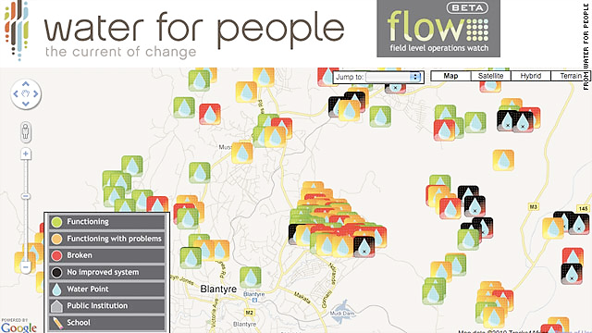
Engagement Through Open Data:
Water for People
Objective
Provide water and sanitation services at scale in developing countries throughout the world
Strategy
Develop mobile-based program called FLOW to collect and transmit program monitoring data
Solution
FLOW-enabled mobile phones remotely collect data, including location data and photos, and upload them to data servers
Data is analyzed and shared so successes can be duplicated
Impact
By sharing data and expertise, Water for People has engaged stakeholders, proven its commitment to long-term success, and helped similar organizations do the same
FLOW helps monitor projects over long term, and share project status and success with investors, donors, other stakeholders
FLOW now used by 300+ organizations for field monitoring

Slide 28
IoE Is Catalyst for Breaking Down Organizational Silos
Insight
9
To get maximum value from IoE—and most technology-driven innovations—organizations must bridge agency stovepipes
But IoE also plays a role in breaking down silos and fostering data sharing / collaboration
IoE capabilities—cloud, mobility, analytics—present the possibility of increased coordination across jurisdictions, especially to address problems that are inherently multi-jurisdictional in nature (e.g., disaster response, safety and security, transportation)

Slide 29


Cross-agency Coordination:
Rio de Janeiro
Objective
Improve safety and incident response
Coordinate/integrate operations of multiple agencies
Strategy
Collect and analyze information from sensors and other sources to make informed operational decisions in city management
Alert citizens of disasters or other problems
Solution
Integrates information from multiple government agencies and private sources to improve city safety and incident response
Communication with public through news, social media, sirens
More than 50 city agencies have been connected, and pertinent data from the agencies integrated
Stronger connections among citizens, government, and media
Impact
More than 50 city agencies connected, with integration of agencies’ pertinent data
Better coordination among agencies during disasters, big events

Slide 30
Senior Leadership / Tangible Public Benefits Are Essential
for Success
Insight
10
Public sector officials interviewed were virtually unanimous in citing the role of strong leadership in driving IoE success
Although individual projects and smaller-scale point solutions can be successful, the largest and most ambitious projects demand senior sponsorship
Tangible public benefits are instrumental in garnering the consistent funding, backing, and coordination needed to see projects through technical and other challenges

Slide 31

IoE Leadership:
Smart City Barcelona, Spain
Objective
Improve citizens’ quality of life and stimulate the economy
Strategy
Use ICT to create more efficient services across multiple levels of of government
Solution
Citywide sensors monitor water, lighting, energy consumption
Data are shared internally and with the general public
Impact
Barcelona’s mayor spearheaded the program by removing barriers to agency collaboration and establishing a Smart City Strategy Team that structures and fosters ICT initiatives
City has streamlined citizens services and revenue collection, reduced resource waste, and connected the public and private sectors in mutually beneficial ways
$58 million annual savings in water management and $50 million annual increase in parking-fee revenues
47,000 new jobs created

Slide 32
Implementing Your Own IoE Program: Next Steps
Develop an action plan to accomplish your objectives.
Establish a process for prioritizing potential IoE initiatives based on the problems that need to be addressed, and your starting point.
1
Select technology partners who have IoE vision and expertise.
Technology partners with IoE expertise can provide skills, analytics capabilities, and perspectives that can make your project more successful.
2
Build the network foundation you need for multiple projects.
For IoE initiatives to succeed in the long term, public sector organizations need a strong network foundation.
3
Launch pilot projects.
Use pilot projects to share your IoE vision, get buy-in, and develop expertise. Pilots should be scalable, and have clear metrics of success.
4
Be open to the possibilities.
Try new things, and do not be daunted by challenges. Once the building blocks of a solution are in place, benefits can come from unexpected places.
5

