Slide 1
Singapore . 16 April 2019
#CiscoConnectSG

Slide 2
Security and Visibility for the
Modern Networks
Ross Traynor, Cybersecurity Specialist, Cisco
Eric Rennie, Systems Engineer, Cybersecurity, Cisco

Slide 3


Digitization complicates visibility
Market demands have taken the network beyond your perimeter
More IoT devices connect everyday
Threats are more numerous and complex
Over 20B connected “things" will be in use by 2020
Companies experienced a 27.4% average increase in security breaches in 2019
Users work anywhere across many devices
Threats are using encryption to evade detection
By 2020, 2/3^{rds} of all IP traffic will come from wireless and mobile devices
3X increase in encrypted communication from malware in a 12-month period
Notes:
Today, market demands have caused the network to expand far outside of the perimeter.
Every day, more IoT devices are connected–a trend that promises to accelerate in the coming years. It is estimated that 1 million new devices will go online every hour in 2020.
The ability to work remotely and from mobile devices is no longer a perk, its an expectation. Users now work everywhere across multiple devices, and by 2020, it is projected that 2/3 of all IP traffic will come form wireless or mobile devices.
As the network expands beyond the perimeter, companies are faced with threats that are growing in number, and increasing in complexity – a trend which recently culminated in a 27.4% average increase in security breaches in 2019.
Finally, more threats are using encryption to mask their communications. Cisco analyzed 400,000 malware samples and found a threefold increase in encrypted network communication used by inspected malware samples over a 12 month period (Nov. 2019 – Oct. 2019).
[TRANSITION] While this new era of digitization has generated new opportunities for businesses, it’s certainly come with a cost.
[CLICK]

Slide 4
The vendor buffet is not a strategy
Adding point solutions adds complexity & can make you less secure
55% Of customers rely on more than 5 vendors to secure their network¹
Complexity
Security Gap
54% Of legitimate security alerts are not remediated due to lack of integrated defense systems²
Complexity
100 days Industry average to detect a common threats³
Capabilities
¹ Cisco 2019 Annual Cybersecurity Report
² Cisco 2019 Annual Cybersecurity Report
³ Cisco 2019 Mid-Year Cybersecurity Report
Notes:
To create an advanced defense against security threats, often times new point solutions will be added to the network. In fact, the average customer relies on more than 5 vendors to secure their network.
These solutions may work for a while but adding solutions that don’t seamlessly integrate with your existing setup can add unnecessary complexity to your environment and actually make you less secure.
The more point solutions, the more difficult it is to correlate information between them to gain a clear picture of what is going on in your business. Every new solution comes with another management interface, and each one demands human resources and management hours to set up, set policy, and respond to alerts. You’ve now added complexity without much overall incremental effectiveness since your security solutions don’t work together or share information with each other.
This complexity can also hinder your threat defense. A lack of integrated defense systems can lead to up to 54% of legitimate security threats not being remediated. These threats continue to sit in your environment for far longer than they should, pushing the industry’s average of time to detect threats up to 100 days.
T: Often times, implementing these point security solutions means sacrificing the efficiency and effectiveness of the network. It’s time for a different approach.
<Click>

Slide 5
The Solution: Network + Security
Activate your network for more holistic security
Understand behavior
Identify host role and monitor behavior without endpoint agents
Contain and isolate threats
Dynamically enforce software-defined segmentation based on business roles
See everything
Transform the network into a powerful security sensor for complete visibility
Detect encrypted threats
Use advanced analytics to automatically detect encrypted threats without decryption
Notes:
Instead, what’s needed is a holistic approach to enterprise security.
A network might have 100 network devices for every firewall. Imagine if you could recruit all of those devices to secure your network without impacting its performance?
[CLICK]
By using the right technology, you can transform your network into an always-on security sensor, capable of seeing everything and understanding normal behavior.
By taking these steps, you can empower your network to dynamically adapt and defend itself – identifying threats, even in encrypted traffic and isolating effected machines.
[TRANSITION] This is the Cisco Network Security Analytics
[CLICK]

Slide 6

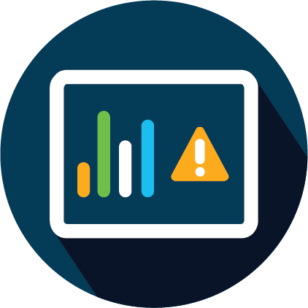





Cisco Stealthwatch
Gain confidence in your security effectiveness
Contextual
network-wide visibility
Predictive
threat analytics
Automated
detection and response
Behavioral modeling
Unknown threats
Machine learning
Insider threat
Global threat intelligence
Encrypted malware
Using existing network infrastructure
Policy violations
Notes:
Stealthwatch Cloud provides
1. Contextual network-wide visibility – Stealthwatch is able to ingest and analyze telemetry from multiple network devices such as routers, switches and firewalls. It can also natively collect telemetry from the public cloud infrastructure. Stealthwatch uses entity modeling to classify all the devices or entities connected to the network such as servers, printers, etc. to efficiently determine normal behavior of these entities so it can alarm on any anomalies. Another unique capability of Stealthwatch is to eliminate duplicate network flows as well as stitch them together to make sense of the communications. This means that Stealthwatch can not only detect a threat, but provide additional contextual information about the source of the threat, like where else it might have propagated, which user has been compromised, and other info such as location, device type, time-stamp, etc. Stealthwatch can also store telemetry for a certain period of time to forensically investigate past or long-running events. In addition, Stealthwatch integrates with other security solutions to infuse user and application data, web information, etc. for faster threat investigation and response.
2. Predictive threat analytics – Attackers use multiple methods to compromise your security so why should you employ just one defense technique? Stealthwatch uses a three-pronged approach to detect advanced threats before they turn into a breach. The first is behavioral modeling. Stealthwatch constantly observes network activities to create a baseline of normal behavior, and alarms on any anomalies using close to 100 different heuristics. It also has knowledge of known bad behavior that it alarms on. So if attackers are using lost or stolen credentials to gain access, or if you are dealing with a malicious employee involved in hoarding or exfiltrating sensitive data, Stealwatch can alarm on it right away. Secondly, Stealthwatch applies a funnel of machine learning techniques to reduce large amount of telemetry to anomalies, to eventually high-fidelity threat detections. So your security team can now focus on investigating critical threats. This cloud-based machine learning engine can also determine malicious servers across the world and flags any communication to these, in order to detect unknown or targeted attacks. And lastly, Stealthwatch uses global threat intelligence powered by the industry-leading Talos platform to correlate local threats globally, and thwart attackers’ rinse-and-repeat tactics of infecting multiple victims with the same malware. All these analytical techniques work together to identify early indicators of compromise like constant pinging/beacoming, port scanning, communications to malicious domains, etc. in order to detect threats before they turn into an attack.
3. Automated detection and response – The combination of this context-driven enterprise-wide visibility and the application of advanced analytical techniques leads to high-fidelity and advanced threat detection. Security teams see alarms that are prioritized by threat severity, and have additional information to take actions easily. No need to analyze large amounts of data in order to detect and investigate incidents.
An alarm can have an associated response:
Notify in the alarm table
Generate an email
Generate a syslog message to a SIEM
And you can quarantine identified threats using the network (Rapid Threat Containment using the ISE integration)

Slide 7

Stealthwatch Use Cases
Context-Aware Visibility
Threat
Detection
Incident Response
Network Planning & Diagnostics
User
Monitoring
  Network, application, and user activity
  Monitor lateral movement using
  the network as
  a sensor
  Advanced persistent threats
  Insider threat
  DDoS
  Data exfiltration
  In-depth, flow-based forensic analysis of suspicious incidents
  Scalable repository of security information
  Network segmentation
  to profile application /
  device traffic
  Capacity planning
  Performance monitoring
  Application awareness
  Cisco ISE
  Monitor privileged access
  Policy enforcement
Customer Use Cases:
https://www.techvalidate.com/product-research/cisco-stealth-watch/facts

Slide 8
Key features
Visibility everywhere
Encrypted
Traffic Analytics
Rapid Threat Containment
Analyses enterprise telemetry from any source (NetFlow, IPFIX, sFlow, other Layer 7 protocols) across the extended network
Only product that can analyze encrypted traffic to detect malware and ensure policy compliance without decryption
Quarantine infected hosts easily using the Identity Services Engine (ISE) integration, collect and store network audit trails for deeper forensic investigations
Unique threat detection
Smart segmentation
Combination of multi-layer machine learning and behavioral modeling provides the ability to detect inside as well as outside threats
Create logical user groups that make sense for your business, monitor the effectiveness of segmentation policies through contextual alarms

Slide 9
Collecting and optimizing telemetry

Slide 10
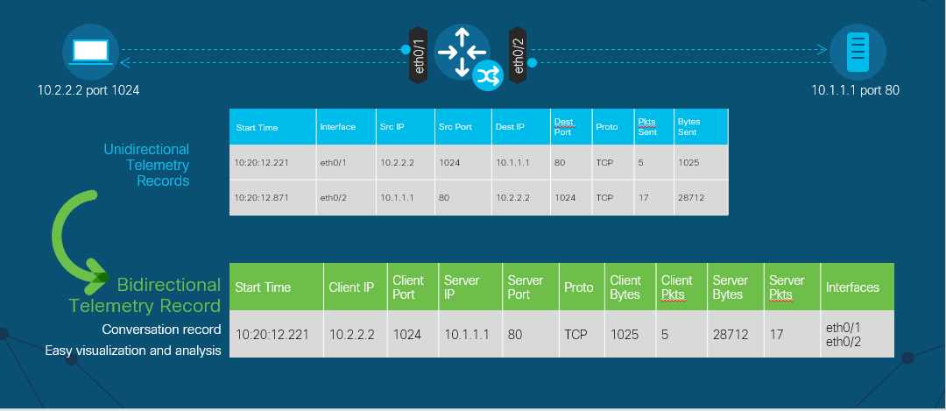
Scaling and Optimization: stitching
Notes:
How we optimize the collected telemetry so that the solution scales easily is very important and unique to Stealthwatch. It involved deduplication and stitching as shown here.

Slide 11
Scaling and Optimization: deduplication
Router A: 10.1.1.1:80 → 10.2.2.2:1024
10.1.1.1 port 80
Router B: 10.2.2.2:1024 → 10.1.1.1:80
Duplicates
Router B
Router C: 10.2.2.2:1024 → 10.1.1.1:80
Router C: 10.2.2.2:1024 → 10.1.1.1:80
Router A
Deduplication
Avoid false positives and misreported traffic volume
Enable efficient storage of telemetry data
Necessary for accurate host-level reporting
No data is discarded
Router C
10.2.2.2 port 240
Notes:
How we optimize the collected telemetry so that the solution scales easily is very important and unique to Stealthwatch. It involved deduplication and stitching as shown here.

Slide 12
Industry-leading
Security Analytics

Slide 13
Anomaly detection using behavioral modeling
Collect and
analyze telemetry
Create a baseline
of normal behavior
Alarm on anomalies
and behavioral changes
Comprehensive data set optimized to remove redundancies
Security events to detect anomalies and known bad behavior
Alarm categories for high-risk,
low-noise alerts for faster response
Threat
Analysis of multiple threat behaviors
Threshold
Anomaly
Number of concurrent flows
New flows
created
Number of
SYNs received
Packet
per second
Number of
SYNs sent
Rate of
connection resets
Bits per second
Time of day
Duration
of the flow
Flows
Exchange Servers
Notes:
Why not enlist your existing investment, the network, to secure your organization? The network telemetry is a rich data source that can provide useful insights about who is connecting to the organization and what they are up to. Everything touches the network, so this visibility extends from the HQ to the branch, data center, roaming users, and smart devices. And also from the private to the public cloud. Analyzing this data can help detect threats that may have found a way to bypass your existing controls, before they are able to have a major impact.
Stealthwatch provides enterprise-wide visibility, from the private network to the public cloud, and applies advanced security analytics to detect and respond to threats in real-time. With a single, agentless solution, you get comprehensive threat monitoring, even in encrypted traffic.
Stealthwatch has a very extensive network behavior and anomaly detection engine. It also has understanding of known bad behavior, and the ability to distinguish malicious behavior from an anomaly.
Complete and efficient data set - Netflow, IPFIX, sFlow as well as other layer 7 protocols
Telemetry from routers, switches, firewalls, data center, cloud
Optimized enterprise telemetry with deduplication and restitching
Security Events or heuristics based on anomalous behavior - Addr_Scan, Beaconing Host, Brute Force Login, Max Flows Initiated, Suspect Data Hoarding, Suspect Data Loss
Over 100 algorithms applied
Deep understanding of known bad behavior
Ability to detect change in “normal” behavior
High level alarm categories - Concern, Recon, C&C, Exploitation, DDoS, Data Hoarding, Exfiltration, Policy Violation
Alarms tied to specific hosts and telemetry for easy investigation
Logical alarms based on advanced attacks
Alarms organized by time, users, user groups, applications, etc. to prioritize risks
<Click>

Slide 14
Behavioral & Anomaly Detection Model
Behavioral Algorithms are Applied to Build “Security Events”
Collect and
Analyze Flows
Security Events
Alarm Category
Response
Addr_Scan
..
Bad_Flag_ACK**
Beaconing Host
Bot Infected Host - Successful
Brute Force Login
Fake Application
Flow_Denied
..
ICMP Flood
..
Max Flows Initiated
Max Flows Served
..
Suspect Data Hoarding
Suspect Data Loss
Suspect Long Flow
..
UDP Received
Concern
Alarm table
Recon
Host snapshot
C&C
Exploitation
Email
Flows
Data hoarding
Syslog / SIEM
Exfiltration
Mitigation
DDoS target
Notes:
Stealthwatch has a very extensive Network Behavior and Anomaly detection engine.
Behaviour Detection – requires understanding of known bad behavior.
Anomaly detection – identify a change from “normal”
Stealthwatch security model:
Security Events – composed of algorithms that analyze flows and activity looking for certain patterns. Over 94 algorithms.
Events feed into high level alarm categories; which can generate an alarm. Some security events can alarm on their own.
An alarm can have an associated response such as notify in the alarm table or generate a syslog message to a SIEM.

Slide 15
Logical alarms based on suspicious events
Source or target of malicious behavior
Reconnaissance
Command
and Control
DDoS
Activity
Insider
threats
Scanning, excessive network activity such as file copying or transfer, policy violation, etc.
Port scanning for vulnerabilities or running services
Communication back to an external remote controlling server through malware
Sending or receiving SYN flood and other types of data floods
Data hoarding and data exfiltration
Notes:
A few examples of the high level alarm categories the Stealthwatch Security Events feed into. There are 11 high level alarm categories; mapping to the kill chain or the attack lifecycle.

Slide 16
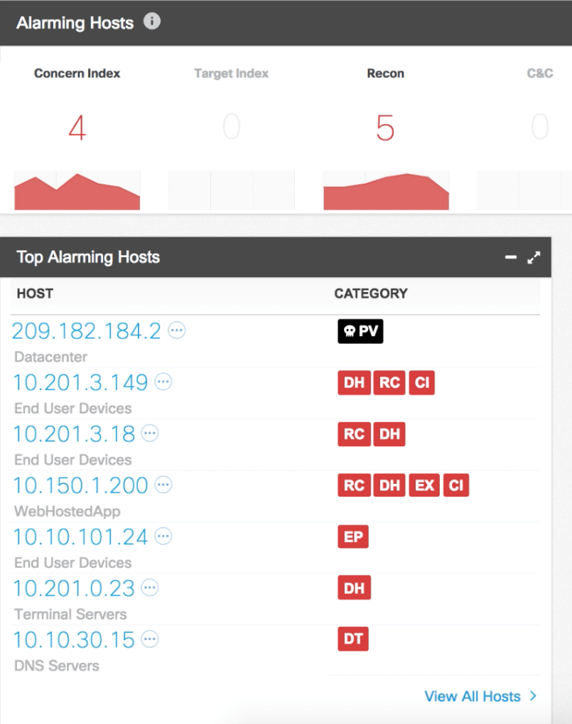

Alarms tied to specific entities
Quick snapshot of malicious activity
Suspicious behavior
linked to logical alarms
Risks prioritized to take immediate action
Notes:
Top alarming categories and hosts are prominently displayed for quick drill down and investigation.
The algorithms base line activity using a point system; points are averaged over a day, week, month period. Algorithms can be applied to both a host and a host group. All algorithms have thresholds to alarm on hosts that exceed what is expected behavior. This is to help prevent learning bad behavior, as well as to tune the algorithms to be very precise in well understood or critical environments such as data centers.

Slide 17
Investigating a host
Host Summary
Traffic by
Peer Host Group
Flows
History
User Name:
Device Name:
Device Type:
Host Group:
Location:
Last Active Status:
Session Information:
Policies:
10.201.3.149
Within
organization
Outside
organization
Quarantine
Unquarantine
Summary of aggregated
host information
Observed communication patterns
Historical alarming behavior
Notes:
User information about who is logged into a suspect host can be obtained via Identity Services Engine (ISE), and attributed to observed activity
You can also look at traffic from a specific host group inside or outside the organization
There’s also a timeline of alarms triggered by a specific hosts provided for quick assessment of the behavior of the host

Slide 18
Encrypted Traffic Analytics

Slide 19
Encrypted Traffic Analytics (ETA)
Visibility and malware detection with decryption
Malware in Encrypted Traffic
Cryptographic compliance
Is the payload within the TLS
session malicious?
End to end confidentiality
Channel integrity during inspection
Adapts with encryption standards
How much of my digital business uses strong encryption?
Audit for TLS policy violations
Passive detection of
Ciphersuite vulnerabilities
Continuous monitoring of network opacity
Notes:
Cisco is innovating by enhancing Netflow with new telemetry for encrypted traffic analytics. This telemetry does not require decryption or deep packet inspection of payload.

Slide 20
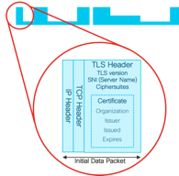


Detect malware in encrypted traffic
Initial data packet
Sequence of packet lengths and times
Global Risk Map
C2 Message
Data Exfiltration
Self-Signed Certificate
Make the most of the
unencrypted fields
Identify the content type through the size and timing of packets
Know who’s who of the
Internet’s dark side
Notes:
<T> So how do we inspect encrypted traffic?
There are three key actors that allow for analysis and discrimination of legitimate vs. malicious traffic.
The first one is the Initial Data Packet or IDP
The initial packets of any connection contain valuable information about the content. IDP allows the analytics engine to access the SSL headers of the HTTPS flows and application headers of related connections. That helps us make the most of the unencrypted fields
Next, the Sequence of Packet Lengths and Times (SPLT) and Byte Counts
The SPLT field gives us visibility beyond the first packet of the encrypted flows. We measure the size of packets and the timing differences to see what kind of content (video, web, voice, or downloads) is being delivered within the connection.
And finally, Stealthwatch Enterprise applies security analytics in the form of multi layer machine learning to these data elements. It employs a Global Risk Map, that maintains very broad behavioral statistics about the servers on the Internet. We pick servers that are related to attacks, may be exploited, or may be used as a part of an attack in the future. This is not a blacklist, but a holistic picture of the server in question from a security perspective. </T>

Slide 21
Identifying malicious encrypted traffic
Google Search Page Download
src
dst
Model
Initiate Command and Control
Sent
Packets
Client
Server
src
dst
Received
Packets
Packet lengths, arrival times and durations tend to be inherently different for malware than benign traffic
Exfiltration and Keylogging
src
dst

Slide 22
Accelerated Threat Response

Slide 23

Cisco Identity Services Engine (ISE)
Stealthwatch Security
Analytics
Network and User Context
Who
What
Where
When
How
Identity Services Engine
Send contextual data collected from users, devices, and network
to Stealthwatch Enterprise for advanced insight
Notes:
Cisco Identity Services Engine (ISE) provides powerful user and device contextual information. This information includes what kind of device an endpoint is, what user is associated with it, where it connected to the network, when it connected, and how. ISE sends this information to Stealthwatch, which helps accelerate incident response investigations by readily providing crucial identity information.
In addition, ISE facilitates rapid threat containment. In response to alerts within Stealthwatch, ISE can quickly quarantine a host from the rest of the network, preventing a threat from spreading or communicating over the Internet.

Slide 24
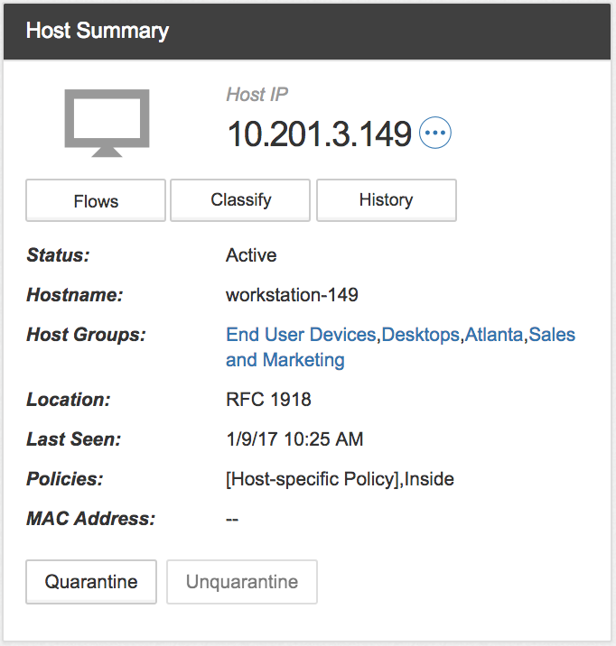


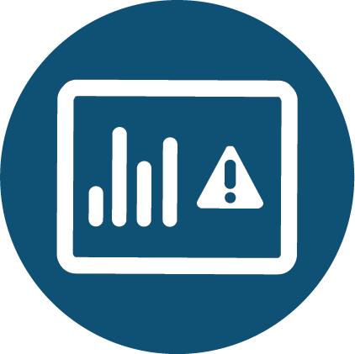
Rapid Threat Containment
Without any business disruption
PX Grid
Mitigation
Information shared with other network and security products
Context
Quarantine or Unquarantine infected host
Cisco®
Identity Services Engine
Stealthwatch
Management Console
Notes:
The Cisco® pxGrid (Platform Exchange Grid) is an open, scalable and IETF standards-driven data-sharing and threat control platform. It allows multiple security products to work together using one API for open, automated data sharing and control between more than 50 security products. Stealthwatch leverages this to communicate with ISE, pulling user, session and device information from it and accessing ISE’s mitigation capabilities.

Slide 25
Stealthwatch Enterprise
Architecture and integrations

Slide 26

Required core
components
Stealthwatch Management Console (SMC)
A physical or virtual appliance that aggregates, organizes, and presents analysis from Flow Collectors, Identity Services Engine (ISE), and other sources
User interface to Stealthwatch
Maximum 2 per deployment
Flow Collector (FC)
A physical or virtual appliance that aggregates and normalizes NetFlow and application data collected from exporters such as routers, switches, and firewalls
High performance NetFlow / SFlow / IPFIX Collector
Maximum 25 per deployment
Flow Rate License
Collection, management, and analysis of telemetry by Stealthwatch Enterprise
The Flow Rate License is simply determined by the number/type of switches, routers, firewalls and probes present on the network
Management Console
Flow Rate
License
Flow Collector
Notes:
The two primary components to this system required for operation are the Flow Collector and Management Console appliances. The can be deployed as physical appliances and as virtual machines.
The flow collector aggregates all of the network telemetry data Stealthwatch uses to conduct its analysis. It performs stitching and deduping operations on the incoming data to create the “general ledger” of every observed network transaction across your network. It builds databases of these events encompassing months of activity, and conducts most of the analytic heavy lifting for the Stealthwatch system.
The Management Console is your micro and macro lens into this sea of information, providing an interface that surfaces observed anomalous activities, as well as providing a means to query into the datastore present on the Flow Collector.
Stealthwatch licensing is based on the Flow Rate Lecense, which depends on the number/types of routers, switches, firewalls and probes present in the network.

Slide 27
Stealthwatch Enterprise architecture
Management Console
Comprehensive
visibility and
security analytics
ISE
Threat Intelligence
License
Cognitive Intelligence
Other Traffic Analysis Software
Flow Collector
Stealthwatch Cloud
UDP Director
Flow Sensor
Hypervisor with Flow Sensor VE
Telemetry for Encrypted Traffic Analytics
VM
VM
NetFlow
10101 10
NetFlow enabled routers, switches, firewalls
Endpoint License
Proxy Data
Non-NetFlow enabled equipment
Notes:
The Stealthwatch system is comprised of a number of components to provide a robust and comprehensive view of activity occurring the enterprise network.
The Flow Collector and the Management Console are the core appliances for the solution… every Stealthwatch deployment will have both of these. The Flow Collector is the work horse of the system, collecting, aggregating and storing all incoming telemetry, building the database and performing much of the analytics against the data.
The SMC is the window into this vast amount of data... Alerting you to detected threats and giving the means to dig into the data. Both of these appliances are available as physical and virtual appliances.
The Flow Rate license helps collect network telemetry from the routers, switches and firewall, including telemetry for ETA.
<click>
The Flow Sensor is an optional component of Stealthwatch Enterprise and produces telemetry for segments of the switching and routing infrastructure that can’t generate NetFlow natively. It also provides visibility into the application layer data. In addition to all the telemetry collected by Stealthwatch, the Flow Sensor provides additional security context to enhance the Stealthwatch security analytics. Advanced behavioral modeling and cloud-based multilayered machine learning is applied to this dataset to detect advanced threats and perform faster investigations.
<click>
The Endpoint License allows Stealthwatch to work with endpoints running AnyConnect 4.4+ with the Network Visibility Module (NVM) to pull in process and MD5 hash information on applications running on the endpoint and correlate it to observed network activity.
<click>
Stealthwatch is also capable of ingesting proxy data from the Cisco WSA and other vendors. Stealthwatch can associate that with observed flows and give you visibility into otherwise “dark” areas of those communications.
<click>
Our integration with the Cisco Security Packet Analyzer turns Stealthwatch into a kind of scalpel for performing traffic forensics. You can view suspect traffic and alerts within Stealthwatch, zero in on the suspicious communications and then pivot from SW into the packet analyzer appliance and have it reach into it’s rolling buffer and pull back the contents of the communication and perform analytics on it using the Packet Analyzer’s built in tools.
<<click>>
Finally, with Stealthwatch Cloud we now have a SaaS based offering to gain visibility into your public and private cloud installations. Additionally, Stealthwatch Cloud can also support SMB-sized customers (<1-2k users), opening up this market for visibility.
<<< This is a build slide, meant to be used as a quick overview of the entirety of the Stealthwatch System.
Ideally, you should be able to summarize the functionality of each component in a sentence or two when using this slide. From there, you would cover individual components more in depth, depending on the interests of your audience/customer. >>>

Slide 28
Solution lifecycle for Cisco Stealthwatch Enterprise and Stealthwatch Customer Experience
Visibility across your entire network
Error free deployment
Highest performance flow collection
Train your staff
24x7 Customer Support
Stealthwatch
Services
Detection based on your business needs
Adopt and improve threats detection fidelity
Reduce time to detection and response of threats
Tactical workshops for use cases
Professional
Learning
Integrate with your incident response plan
Integrate with your telemetry stack
Virtual labs and e-learning courses
24x7 Customer Support
Support
Utilization with Cisco and 3rd party solutions
Notes:
<For when starting presentation with maturity model only>
The industry isn’t just changing, it has already changed. Data itself is at the very least, a critical component of today’s business environment, and in some cases the actual product.
With this shift, it is no wonder that threats to your system continue to evolve and become more sophisticated. On top of this threat landscape, networks themselves become more complex due to the increasing:
Number of end-points
Integration requirements
Volume of data being transmitted
It isn’t realistic to manage these threats with a traditional security solution. They can’t provide the scale or insight to be successful, nor can they flex and adjust for the threats that will come tomorrow.
<For when starting presentation with maturity model only>
Stealthwatch Services combined with Cisco Stealthwatch Enterprise is fundamentally different. Our solution lifecycle is based around 3 key phases:
Drive visibility across your entire network
Detect threats based on your specific network environment
Integrate with other Cisco and 3rd party solutions
Over the course of these 3 phases, you get a maturing solution that will continue to make your life easier as you truly to protect an increasingly complex network from increasingly complex threats.
First is Visibility across your entire network and end-points. This phase focuses on the initial installation, starting here you are able to get a newfound visibility into aspects of the activity on your network you have never had before.
Once it’s up and operational, the second phase is mainly around threat Detection and making sure the system tuned in a way specific for your business and so you have actionable alarms.
The third phase is about Integration, where we’re focusing on integrating Stealthwatch Enterprise with all the other systems in the customer’s environment whether they are part of Cisco’s portfolio or 3rd party solutions.
Once you have gone through the integration phase you enter into a virtuous cycle where that integration creates additional visibility and new process to further enhance your detection and tuning.
Throughout this process, Stealthwatch Customer Experience team provides targeted services offerings to help you get the most at each stage of the Stealthwatch Enterprise lifecycle, whether it is:
Professional Services
Learning Services
Support Services
All together, Cisco Stealthwatch Enterprise provides continuous visibility and it makes it easier for you to detect anomalous behavior on your network. With its constant monitoring and real-time insight, you can continuously improve your enterprise security posture to prevent future incidents in your network. And it integrates with many Cisco and other Security solutions. Stealthwatch Enterprise helps you continuously monitor your network to ensure that you are obtaining value to improve your enterprise security posture.
The Customer Experience team delivers a critical and unique lifecycle experience that provides high touch engagement for all customers of the Stealthwatch Enterprise solution
T: Looking a little closer at “visibility” <click>

Slide 29
How Stealthwatch
CX has helped
Provide network visibility across IT network
Challenges
SIEM integration with Stealthwatch Enterprise is extremely difficult to do on your own
Many SOC teams place strong emphasis on working out of a SIEM
SIEM is viewed as the “single pane of glass” for their
security workflow
Results
Through an extended set of REST API capabilities that are installed for the customer, Professional Services works directly with the customer to understand their investigation workflow
Integrate these API capabilities into their SIEM through either apps, add-ons, or right-click pivot capabilities
Reduce the mean time to resolution for customers by enriching the data they use for investigation with Cisco Stealthwatch data
Provide a clearer picture as to the nature and behaviour of the suspicious host in question, giving them a higher degree of accuracy in securing their networks faster.
X
SIEM dashboard
Stealthwatch Enterprise
Go to Stealthwatch
Get top peer report
Notes:
The Cisco Stealthwatch SIEM Integration service improves the security investigation and incident response process for customers and reduces their mean time to resolution and increasing accuracy, thus ensuring their networks stay as secure as possible. We integrate your Stealthwatch solution with Splunk, ArcSight, Qradar, and other 3rd party vendors to make sure you get a comprehensive view of what is going on.
What was the customer challenge:
In today’s security world, many SOC teams place strong emphasis on working out of a SIEM, some even going as far as to treat it as a “single pane of glass” in their security workflow, but they’re not getting all the data they need from just their SIEM console. They are in need of an easier way to work out of their SIEM, but across other threat monitoring and analytics consoles.
How did Stealthwatch Enterprise and the Stealthwatch Customer Experience Team deliver results:
Through an extended set of REST API capabilities that are installed for the customer (valuable API capabilities beyond what the product currently provides), Cisco Professional Services works directly with the customer to understand their investigation workflow and integrate these API capabilities into their SIEM through either apps, add-ons, or right-click pivot capabilities. These integrated capabilities reduce the mean time to resolution for customers by enriching the data they use for investigation with Cisco Stealthwatch data.
Individual use case conclusion: By being able to quickly and efficiently view such things as the top peers, the top ports used, or even raw NetFlow helps provide a clearer picture as to the nature and behavior of the suspicious host in question, giving them a higher degree of accuracy in securing their networks faster.

Slide 30
Demo

Slide 31
Singapore . 16 April 2019
#CiscoConnectSG

