Slide 1
We Keep Your Network Safe

Slide 2
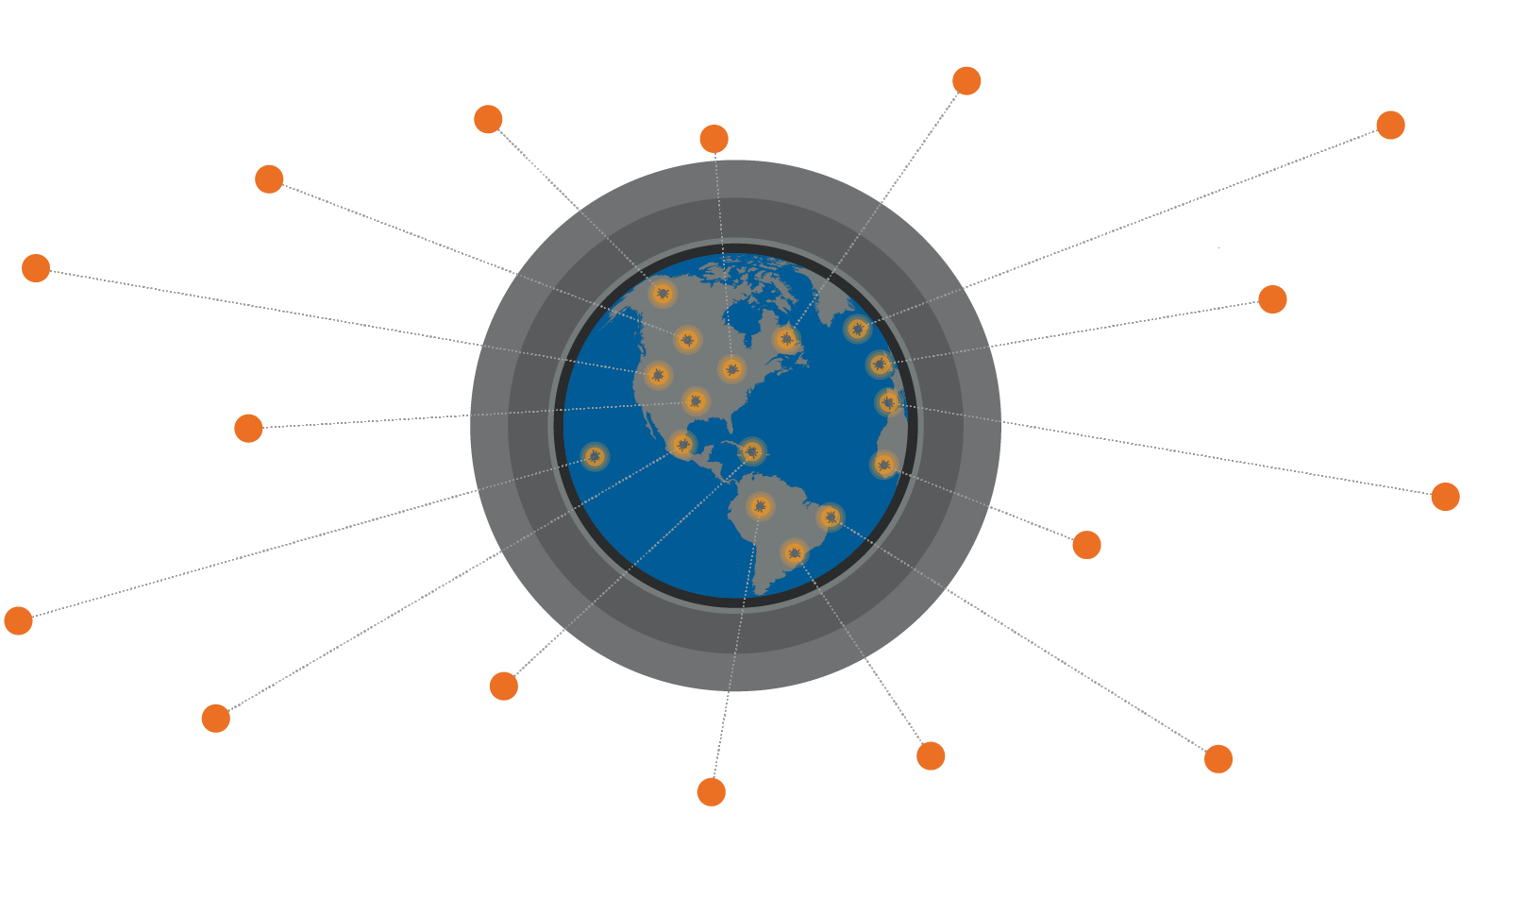
Protecting Customers
Phishing
Unpatched
software
Supply
chain attacks
Ransomware
Wiper
attacks
Advanced
persistent
threats
Data/IP theft
Spyware/
Malware
Malvertising
Drive by
downloads
Man in
the middle
Credential
compromise
DDoS
Botnets
Rogue
software
Cryptomining
Notes:
The mission of Talos is protecting our customers. What I would like you to take away today is how we do that. The digital world is expanding at an unprecedented rate, and attack opportunities are expanding just as quickly. Attacks continuously become more sophisticated and we’ll always see continued innovation from attackers. IP theft, monetary gain, and destructive cyber weapons are all on the rise.
[Note to presenters: Between slides 2 and 3 is a good time to tell a story about a recent Talos "Win" that provides an example of our ongoing efforts to protect our customers and the world as a whole.

Slide 3
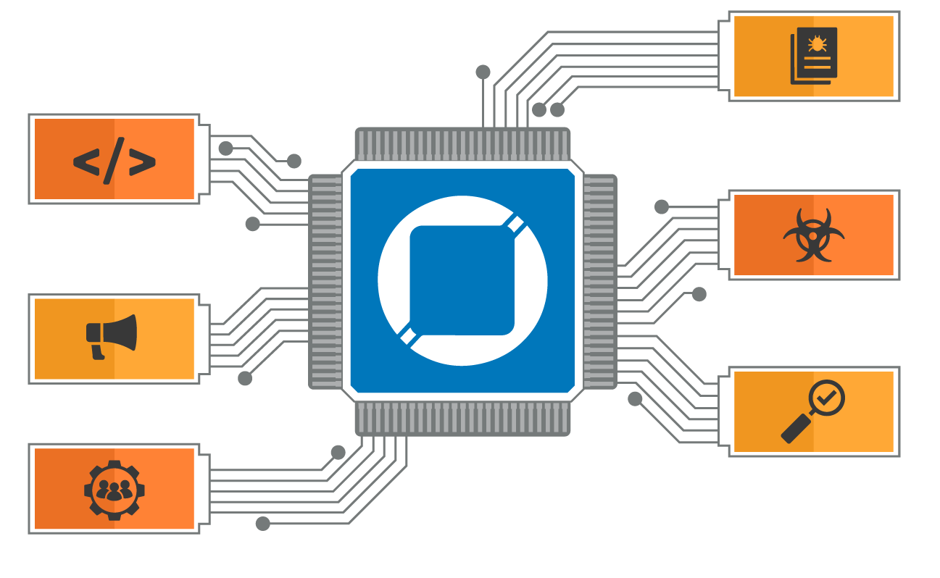
Our job is protecting your network
Talos is the threat intelligence group at Cisco. We are here to fight the good fight —
we work to keep our customers, and users at large, safe from malicious actors.
Vulnerability
Research & Discovery
Engineering
& Development
Detection Research
Outreach
Threat Intelligence
& Interdiction
Community
Notes:
Providing this protection requires a broad talent set. To achieve this, we leverage a wide range of skills, from threat researchers, vulnerability analysts, developers, and even a few rocket scientists. We then build this organization into six key areas:
1. Threat Intelligence & Interdiction: Is focused on "getting in the way" of active threat, by surveilling active threat campaigns for intelligence and working with incident response groups.
2. Detection Research focuses on constantly improving the methods for identifying new threat detection methods.
3. Engineering and Development is about creating more powerful tools that find their way back into Cisco Security Solution or the Open Source Community.
4. Vulnerability Research & Discovery is on the lookout for weaknesses in the software, hardware, and systems that drive our world.
5. The best security research is not done in a vacuum. Our community efforts help us build partnerships with other threat researchers, our customers, and security organizations that are working to protect us all.
and finally, 6. Global Outreach team. We understand that effective security requires education and awareness. This team makes sure that our Cisco Professionals, our customers, and the world at large have the knowledge they need to be successful.

Slide 4
Threat Intelligence
Industry Sharing Partnerships (ISACs)
Internet-Wide Scanning
Daily Malware Samples
Product Telemetry
Daily Web Requests
3rd Party Programs (MAPP)
Service Provider Coordination Program
Open Source Intel Sharing
Daily Email Messages
Vulnerability Discovery
Honeypots
Customer Data Sharing Programs
1
Talos pulls threat data from Cisco’s telemetry, customer feedback, industry partnerships, and many other sources.
Threat Data Cycle

Slide 5

Threat Intelligence
The Backbone of Cisco Security
Snort subscription rule set
AMP for Endpoints
Cloud Email Security
NGFW
AMP for Networks
AMP for Gateways
Cisco Umbrella
Cloud Web Security
NGIPS
FirePower / ASA
Web Security Appliance
Meraki
Network
Endpoint
Email Security Appliance
Cloud
Talos creates the threat detection content in all Cisco Security products, providing customers with comprehensive solutions from cloud to core.

Slide 6

Why trust Talos?
Actionable Intelligence
Unmatched Visibility
Collective Response
Notes:
A fundamental part of your response mechanism is having confidence in the data your are given to protect you against threats. Talos is one of the most trusted providers of cutting edge security research globally. We provide the data Cisco Security products and services use to take action.
The key differentiator of Talos is our process - HOW we SEE what is happening broadly across the threat landscape, ACT on that data rapidly and meaningfully, and DRIVE protection. This process is enabled by our Unmatched Visibility, Actionable Intelligence and Collective Response.
The Cisco Security ecosystem covers email, networks, cloud, web, endpoints, and everything in between. Cisco Talos has more visibility than any other security vendor in the world, with the sheer size and breadth of Cisco Security’s portfolio and the incoming telemetry from Cisco’s customers and products.
This unique visibility delivers greater context from many data points during an occurring incident or campaign. This, along with other resources like open-source communities and internal vulnerability discovery, creates a massive amount of threat data.
Unique capabilities and scale in intelligence enable Talos to move faster and create more comprehensive assessments of ongoing threats.
A key differentiator of Talos is our ability to respond. With a broad portfolio of protection, responding to threats inside your network is simplified with automatic product updates from Talos. Beyond the perimeter, Talos has the ability to take action that few others can to drive collective response on an internet-wide basis, and we will talk more about that in minute.
The core mission at Talos is to provide verifiable and customizable defensive technologies and techniques that help customers quickly protect their assets. Our job is protecting your network.

Slide 7

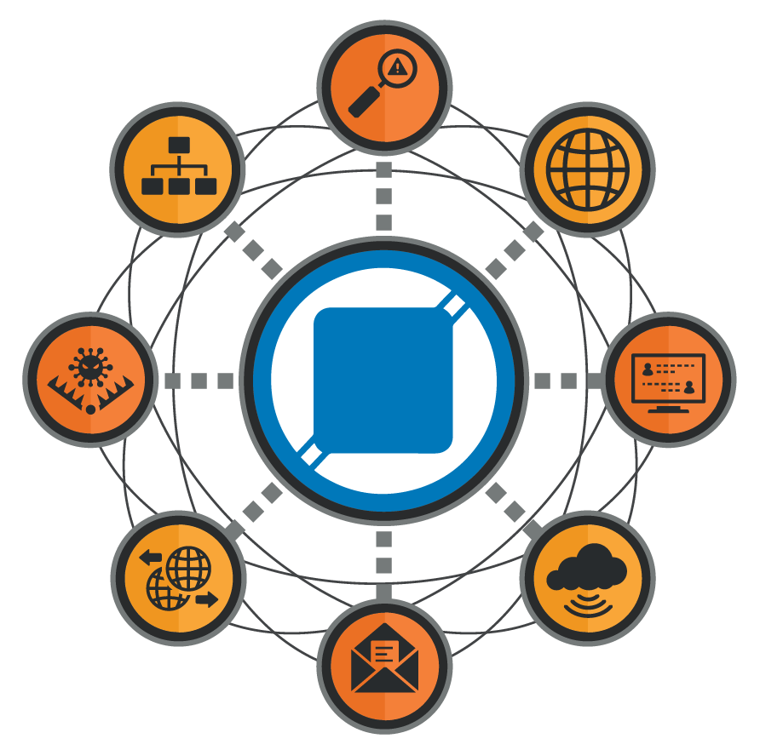
Unmatched
Visibility
Vulnerability Discovery
Network
Web
To stop more, you have to see more.
The most diverse data set
Community partnerships
Proactively finding problems
Unmatched visibility is built on relationships
Threat Traps
Endpoint
Data Sharing
Cloud
Email
Notes:
If you want to stop more, you have to see more. The modern landscape is made up of all kinds of threats coming at defenders from all possible vectors — email, network, endpoint, cloud and more. Talos leverages that immense visibility, ingesting telemetry combined with industry partnerships, customer feedback, hunting intel, actor tracking, and even forward-looking vulnerability discovery.
The most diverse data set: the Cisco Security portfolio is unique as a broad market leader across NGFW, IPS, Email, DNS, and more. Having market-leadership across solution categories generates a massive amount of threat data and begins adding additional context
Fighting the good fight with the community: Talos maintains hundreds of intel partnerships – Industry groups like CyberThreat Alliance, MSSP, ISAC, and customer data sharing programs allow critical intelligence to shared and disseminated collectively among key defenders or specifically within targeted environments
Proactively finding problems: Talos is constantly disclosing vulnerabilities before they can be exploited by bad actors. Vulnerability Discovery is an important aspect of visibility that is not easily replicated by others - actively finding, reporting, and removing vulnerabilities in software and hardware that customers use daily. Incidentally, in 2018, Talos eliminated over 360 new vulnerabilities from the market BEFORE a 0-day threat could ever be weaponized. This goes past “chasing the attack” – Talos is being proactive in finding vulnerabilities increasing our visibility, understanding and maintaining many of the same skills sets attackers are trying to use against customers.
What Talos does as a whole is greater than the sum of our parts. We have a diversity of data, breadth of partnerships and proactive capabilities that feed each other, acting as an on-going multiplier of effectiveness

Slide 8


Actionable
Intelligence
Research
Security controls are best served by data that lets tools respond to immediate threats.
Rapid coverage
Distillation and analysis
Threat Context
It’s not detect and forget, it’s detect and analyze.
Actionable
Intelligence
Telemetry
Industry Partners
Open-Source Intelligence
Notes:
Unmatched visibility yields a mountain of threat data, the majority being related to known existing threats. The challenge is finding the small percentage of malware that is new to the landscape — evolving ransomware, cryptocurrency miners, politically motivated actors, destructive malware and highly targeted espionage activity. Rapidly distilling actionable intelligence from immense datasets involves a high degree of interaction, both human- and machine-driven. Analysts and data scientists, use powerful AI and machine learning to create stronger detection outputs for faster and better results. Those outputs are used by Talos engineers to create protection pushed globally as quickly as technologically possible. The diversity of Talos data creates intelligence with context. Talos provides actionable intelligence that is fast, effective, and deeply contextual. The end result is peerless time-to-detection.
Talos analyzes unmatched visibility every day and pushes immediately actionable intelligence to products. This coverage allows Cisco Security solutions to provide coverage at the earliest signs of a threat.
Talos is capable of distillation and analysis at scale with elite specialized professionals (for example: researchers, analysts, engineers, data scientists, linguists, developers, and even rocket scientists). This process extends us the ability to regularly provide coverage for net new or undisclosed threats.
The diversity of talent and data at Talos means your threat intelligence is more than just simple detection. Threat context puts the “why” behind the “what” – why you should care and where you have gaps in your defenses.
The actionable intelligence generated by the most effective research team in the industry sets Talos up for Collective Response that is unrivaled.
--------
Supporting quote:
From the Dec 11-12th, 2018 Summit of the Cyber Threat Alliance:
“Never try to compete with Cisco on Threat Defense or Threat Intelligence’. You will come up short every time. No one on earth covers threats to the worlds population more holistically than Cisco Talos.”

Slide 9
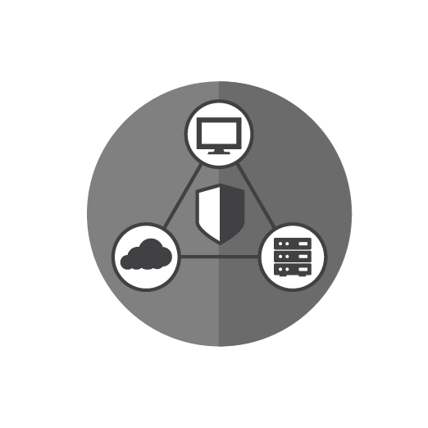
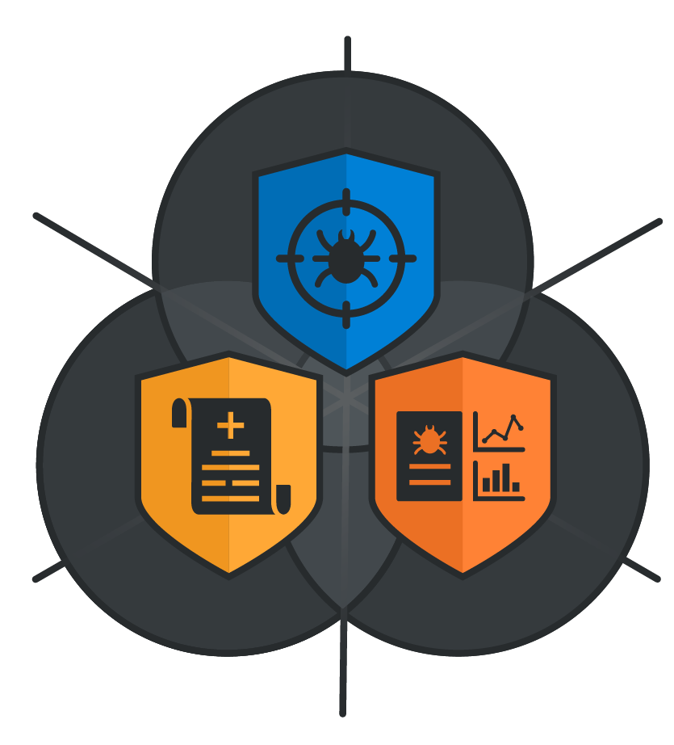
Collective
Response
Incident
Response
The ability to bring rapid protection to close off multiple attack vectors instantaneously is crucial
Breadth: See once, protect everywhere
Depth: Response and interdiction drives continuous research
Scale: Delivering portfolio-wide protection, in real-time
Policy
& Protection
Informed
Analysis
Notes:
Threats move quickly, so providing on-the-fly coverage to customers is crucial. The principal outputs of Talos Intelligence are direct, real-time protections against threats around the globe on a constant basis. There is no Talos threat feed. Talos intelligence is tailored for all Cisco Security solutions. As an example, a phishing email sent to a machine in Tokyo can trigger coverage to protect a user in Topeka from that same domain just minutes later.
Like its namesake of Cretian lore, Talos has the ability to take action that few others can when a major threat arises. Our job is to keep the shores clear of invaders and discourage them from returning.
The impact of collective response is amplified with every solution and device capable of responding with Talos supplied threat intelligence. Talos provides intelligence as product updates to a massive security portfolio and several open-source solutions.
Talos has generated thousands of headlines in the news, and is often cited by government agencies and advocacy groups as leading the charge in response to major threats.
Breadth means EVERYWHERE, not just all global customers sites, but all across the portfolio. One threat example often generates multiple observables that are related to different solution capabilities: IP, domain, SHA, malware characteristics, and other customized protections
Interdiction means “getting in the way” – Talos actively surveils threat campaigns. We partner with Cisco incident response teams, Customer Experience, and the engineers building technologies under threat. This depth of engagement feeds our visibility and intelligence creating the previously discussed multiplier of effectiveness.
As we dig deep into threats, we find new information that matures the capability of our entire security portfolio. When combatting an active threat, we create resources to educate and empower Cisco professionals, our customers, and the world to help fight the good fight. This often includes open-source tools and information released on the Talos blog.
When we put these three elements together, Unmatched Visibility, Actionable Intelligence, and Collective Response – we see how Talos moves customers from threats toward protection. Before we look at that from a high-level, lets take a look at an example of this process in action.

Slide 10


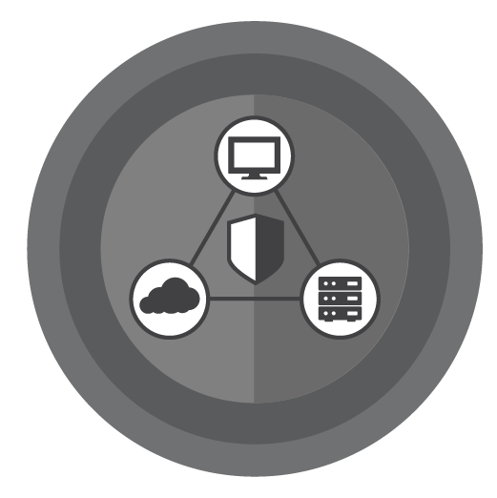












NotPetya: The Costliest Cyber Attack in History
Unmatched
Visibility
Actionable
Intelligence
Collective
Response
AMP
Gathering IOCs
Field engagement
Ukraine Cyber Police
Highly destructive
supply chain attack
Shipped protection
Snort rules
Cyber weapon targeting
the general public
Snort rules
One of the costliest
cyber attacks in history
Blogs
Consumable IOCs
Product maturation
Notes:
Let’s look at the NotPetya/Nyetya supply chain attack – incidentally, this is also a great illustration of why being CORRECT matters much more than being FIRST, enhancing the TRUST and providing better protection. Does anyone remember the early calls of an email vector that never existed? If you aren’t intimately familiar with NotPetya/Nyetya, the broad overview is:
Advanced Actor associated with a Nation State – Global cybercrime law enforcement officials attributed NotPetya/Nyetya to Russian nation-state actors, describing the attack as:
Destructive Attack Masquerading as Ransomware – NotPetya/Nyetya wiped out systems around the globe with blazing speed and devastating effects.
Most Expensive Incident in History – damage assessments top $10Billion USD.
Designed to inflict damage as quickly and effectively as possible.
Appears to be Ransomware, but is purely destructive
Talos intelligence partners in Ukraine initially sounded the alarm about a ransomware attack that was underway. While a majority of the early events were in Ukraine, the malware was infecting organizations that didn’t immediately have any known connection to the country. Because of the scale of the event, Talos initiated an internal response management system called TaCERS (Talos Critical Event Response System) and began the research and response process. TaCERS divides up activities into intelligence, telemetry analysis, reverse engineering, communications and detection research. Talos researchers and engineers from around the world came together to address this threat, including Cisco IR deploying resources on the ground in Ukraine. Our initial visibility (remember “Unmatched Visibility”?) on the attack noted the toolkit in play:
Wormable Wiper
Designed to Spread Internally Not Externally
Leveraged Admin Tools like WMI and PSExec with Mimikatz stolen credentials
Used Eternal Blue / Eternal Romance as a tertiary fallback, but not used much at all
Quickly Talos visibility into the threat (via AMP) uncovered the MeDoc connection, MeDoc was quick to accept the offer of assistance from Talos and Cisco IR. This gave defenders a trove of data to work with in understanding what had occurred in the short attack window and gave defenders the initial data to start protecting themselves (“Actionable Intelligence, any one?”). It quickly became clear that this was a cyber weapon had been unleashed on the general population. Yes, cyberweapon.
Some of the key intelligence taken from the boots on the ground engagement with Cisco IR:
Supply chain attack that backdoored signed updates for accounting software used exclusively by companies doing business in and with Ukraine and victim to victim pivoting within organizations (the clear intent of the attack was to punish large companies doing business in Ukraine, aiding their economy
Rapid Infection Spread – infection propagated at blazing speed, the damage was done in a three-hour window.
Destroyed Countless Systems / Networks
Proved definitively that there was no email angle to the exploitation vector, which was the initial rumor spreading widely over Twitter. This rumor caused multiple Fortune 500 businesses to stop sending/receiving email, which cost companies millions of dollars of lost revenue due to the inability to invoice customers. Talos’ disproving this rumor allowed these businesses to rapidly begin recovering their lost revenue.
You may have noticed that “Snort rules” are listed in a couple spots on this slide. Talos writes NGFW coverage to the vulnerability, not the exploit. This ensures no matter how a vuln is exploited, users are protected. NGFW had protection ahead of the threat for the “Eternal Blue” vulnerability (MS17-010) as weaponized by Nyetya, over 3 months ahead of this threat. This illustrates the cycle e have been talking about in the previous slides.
Other protections generated as part of our Collective Response included:
NGIPS/Snort (detection - 4 rules)
42944 - OS-WINDOWS Microsoft Windows SMB remote code execution attempt
42340 - OS-WINDOWS Microsoft Windows SMB anonymous session IPC share access attempt
41984 - OS-WINDOWS Microsoft Windows SMBv1 identical MID and FID type confusion attempt
43459 - MALWARE-CNC Win.Trojan.Doublepulsar variant successful ping response
NGIPS/Snort (indicators – 5 rules)
5718 - OS-WINDOWS Microsoft Windows SMB-DS Trans unicode Max Param/Count OS-WINDOWS attempt
1917 - INDICATOR-SCAN UPnP service discover attempt
5730 - OS-WINDOWS Microsoft Windows SMB-DS Trans Max Param OS-WINDOWS attempt
26385 - FILE-EXECUTABLE Microsoft Windows executable file save onto SMB share attempt
43370 - NETBIOS DCERPC possible wmi remote process launch
ClamAV (4 sigs)
Win.Ransomware.Nyetya-6331388-0
Win.Ransomware.Nyetya-6331306-0
Win.Ransomware.Nyetya-6331649-2
Win.Ransomware.Nyetya-6331387-0
AMP Coverage
W32.Ransomware.Nyetya.Talos
W32.F9D6FE8BD8.Backdoor.Ransomware.Nyetya.Talos
W32.D462966166.Backdoor.Ransomware.Nyetya.Talos
W32.2FD2863D71.Backdoor.Ransomware.Nyetya.Talos
W32.02EF73BD24-95.SBX.TG
W32.GenericKD:Petya.20h1.1201
Nyetya SHAs
027cc450ef5f8c5f653329641ec1fed91f694e0d229928963b30f6b0d7d3a745
02ef73bd2458627ed7b397ec26ee2de2e92c71a0e7588f78734761d8edbdcd9f
eae9771e2eeb7ea3c6059485da39e77b8c0c369232f01334954fbac1c186c998 (password stealer)
M.E. Docs files with Backdoor SHAs
f9d6fe8bd8aca6528dec7eaa9f1aafbecde15fd61668182f2ba8a7fc2b9a6740
d462966166450416d6addd3bfdf48590f8440dd80fc571a389023b7c860ca3ac
2fd2863d711a1f18eeee5c7c82f2349c5d4e00465de9789da837fcdca4d00277

Slide 11
DNSpionage

Slide 12
What is so Unique?
DNSpionage malware contains DNS tunneling capabilities.
This generally will ensure the malware is able to communicate with its C2 depending on how much inspection you do on your DNS traffic – Hint… Do more.

Slide 13
Overview
Event #1:
  Office MalDoc/spear-phishing.
  Typo-squatted domains.
  RAT with HTTP/DNS support
Event #2:
  DNS redirection campaign focused on the Middle East, targeting the private and public sectors.
  Abusing LetsEncrypt for certificate creation.

Slide 14
DNSpionage
Event #1

Slide 15
Infection Vectors
Spear-phishing emails
Social media contacts such as LinkedIn and other job-focused sites
Links Talos identified as being used were HR related:
    hr-wipro[.]com (with a redirection to wipro.com)
    hr-suncor[.]com (with a redirection to suncor.com)

Slide 16
Infection Vectors
Source: https://blog-cert.opmd.fr/dnspionage-focus-on-internal-actions/

Slide 17
MalDoc
An example of malicious doc hosting:
  hxxp://hr-suncor[.]com/Suncor_employment_form[.]doc
Attempting to appear to be a legitimate Suncor HR document, hosted on a seemingly related domain.

Slide 18
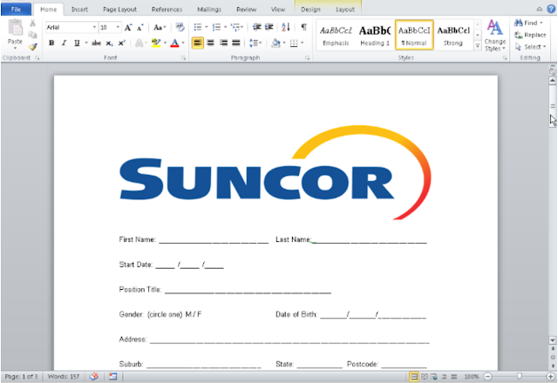
MalDoc – Macro Abuse!
Two macros embedded within the maldoc.
One macro executes on Opening of the doc.
The other executes when the doc is closed.

Slide 19
Maldoc Opening & Closing
When opened, a base64 decoding function decodes a PE to:
    %UserProfile%\.oracleServices\svshost_serv.doc
When the lure document is closed, "svshost_serv.doc” is renamed to "svshost_serv.exe."
A scheduled task is created:
    "chromium updater v 37.5.0” to execute the binary

Slide 20
End users still click on Warnings. Why?!
Having macro-based documents requires human interaction.
A human must close the doc before the macro finishes.
Anti-sandbox technique.
Final payload is DNSpionage

Slide 21
DNSpionage characteristics
First, DNSpionage will create its own working directory — it’s a fancy malware that really wants you to think it’s Oracle.
  %UserProfile%\.oracleServices/
    %UserProfile%\.oracleServices/Apps/
    %UserProfile%\.oracleServices/Configure.txt
    %UserProfile%\.oracleServices/Downloads/
    %UserProfile%\.oracleServices/log.txt
    %UserProfile%\.oracleServices/svshost_serv.exe
    %UserProfile%\.oracleServices/Uploads/

Slide 22
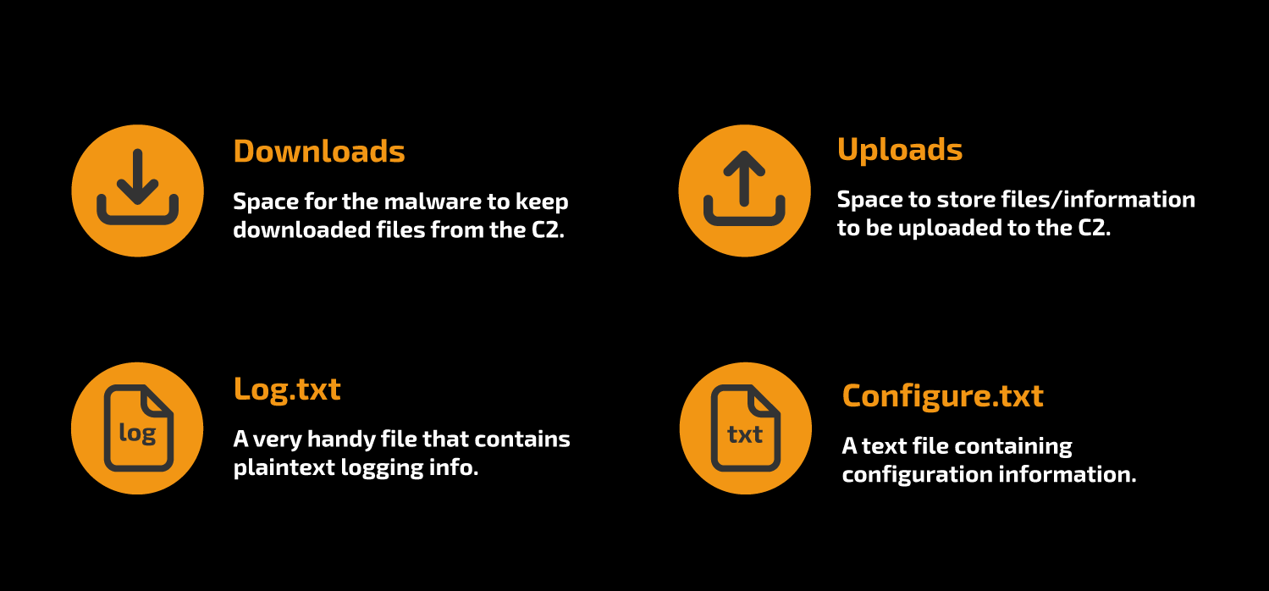
DNSpionage on the system
The directories are used by DNSpionage to perform different functions:

Slide 23
DNSpionage
Communications
DNSpionage had two distinct communication techniques:
  HTTP Mode
  DNS Mode
These two different modes of communication were used by the attacker to send additional commands, etc. to the victim.

Slide 24
DNSpionage
HTTP Mode
yyqagfzvwmd4j5ddiscdgjbe6uccgjaq[.]0ffice36o[.]com
A DNS request is sent to 0ffice36o.com
Random data (using ()rand) and base64 encoding
This is the malware checking in to the C2.
At the time of infection this was - 185.20.184.138

Slide 25
DNSpionage
HTTP Mode
A request is sent to 0ffice36o.com using random data (()rand) and base32 encoding
  yyqagfzvwmd4j5ddiscdgjbe6uccgjaq[.]0ffice36o[.]com
This is the malware checking in to the C2, at the time of infection this was - 185.20.184.138
Of course, our attacker can also reply – that’s important!
  oGjBGFDHSMRQGQ4HY000[.]0ffice36o[.]com

Slide 26
DNSpionage
HTTP Mode
Config file is then obtained via HTTP
  hxxp://IP/Client/Login?id=Fy -- target ID
This request will be used to create the configuration file, particularly to set the custom base64 dictionary.
The second HTTP request is
  hxxp://IP/index.html?id=XX
  (where "XX" is the ID for the infected system)

Slide 27
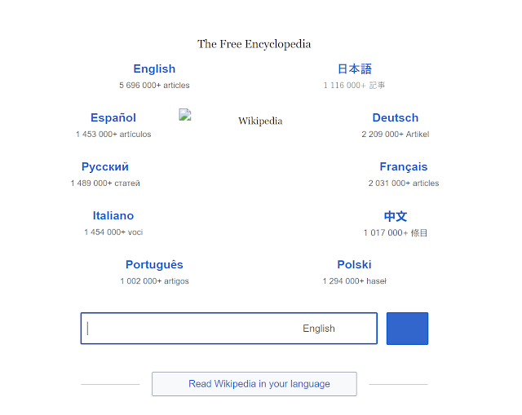
DNSpionage
HTTP Mode
The ultimate destination for the malware is a fake Wikipedia page.
Here, the commands for the host are obtained.
Not obfuscated at all, they are only encoded.

Slide 28
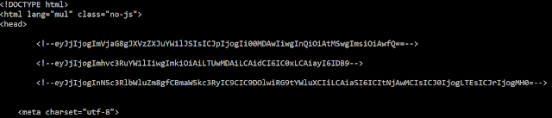
DNSpionage
HTTP Mode
Encoded commands available to see in plaintext on the website. No custom dictionary was available, commands are in simple base64.

Slide 29
DNSpionage
HTTP Mode
When decoded, the commands look like this:
  {"c": "echo %username%", "i": "-4000", "t": -1, "k": 0}
  {"c": "hostname", "i": "-5000", "t": -1, "k": 0}
  {"c": "systeminfo | findstr /B /C:\"Domain\"", "i": "-6000", "t": -1, "k": 0}

Slide 30
DNSpionage
HTTP Mode
This is part of the recon phase of DNSpionage.
All of this information is now stored in the /Uploads/ directory waiting to be sent to the C2.
Finished with the createprocess() API used to execute the commands and then createpipe() API to re-direct information to a pipe.

Slide 31
DNSpionage
DNS Mode
DNS mode can be used if configured within the configure.txt file by the attacker.
Most likely used to help avoid detection by any web filtering, proxies etc.

Slide 32
DNSpionage
DNS Mode
A DNS request is sent to 0ffice36o.com using random data (()rand) and base32 encoding
  RoyNGBDVIAA0[.]0ffice36o[.]com
The C2 server replies with an IP address, not always valid. DNS allows for this, and has no checking in place, so it can be 0.1.0.3
GBDVIAA0. The decoded value (base32) is "0GT\x00". GT is the target ID and \x00 the request number.

Slide 33
DNSpionage
DNS Mode
The second DNS query
  t0qIGBDVIAI0[.]0ffice36o[.]com
The C2 server will return a new IP: 100.105.114.0.
If we convert the value in ASCII we have "dir\x00,” the command will be execute.

Slide 34
DNSpionage
DNS Mode
And finally, the commands come in via multiple DNS queries:
gLtAGJDVIAJAKZXWY000.0ffice36o[.]com ->
GJDVIAJAKZXWY000 -> "2GT\x01 Vol”
TwGHGJDVIATVNVSSA000.0ffice36o[.]com ->
GJDVIATVNVSSA000 -> "2GT\x02ume”
1QMUGJDVIA3JNYQGI000.0ffice36o[.]com ->
  GJDVIA3JNYQGI000 -> "2GT\x03in d”
iucCGJDVIBDSNF3GK000.0ffice36o[.]com ->
GJDVIBDSNF3GK000 -> "2GT\x04rive”
viLxGJDVIBJAIMQGQ000.0ffice36o[.]com ->
GJDVIBJAIMQGQ000 -> "2GT\x05 C h”
[etc]

Slide 35
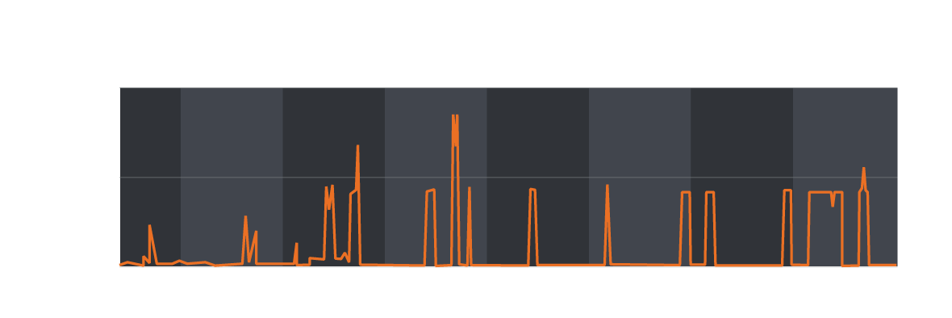
DNSpionage
Observed Victimology
We can observe the DNS queries with our DNS exfiltration and Umbrella monitoring.

Slide 36
DNSpionage
Event #2

Slide 37
DNS Redirection
Within the DNSpionage attack lies DNS redirection:
  185.20.184.138
  185.161.211.72
  185.20.187.8
All three hosts were located in DeltaHost in Holland.
These IPs were used for the creation of LetsEncrypt certificates – this was most likely used for trying to perform MiTM attacks.
** We are currently unable to confirm if these were successful **

Slide 38
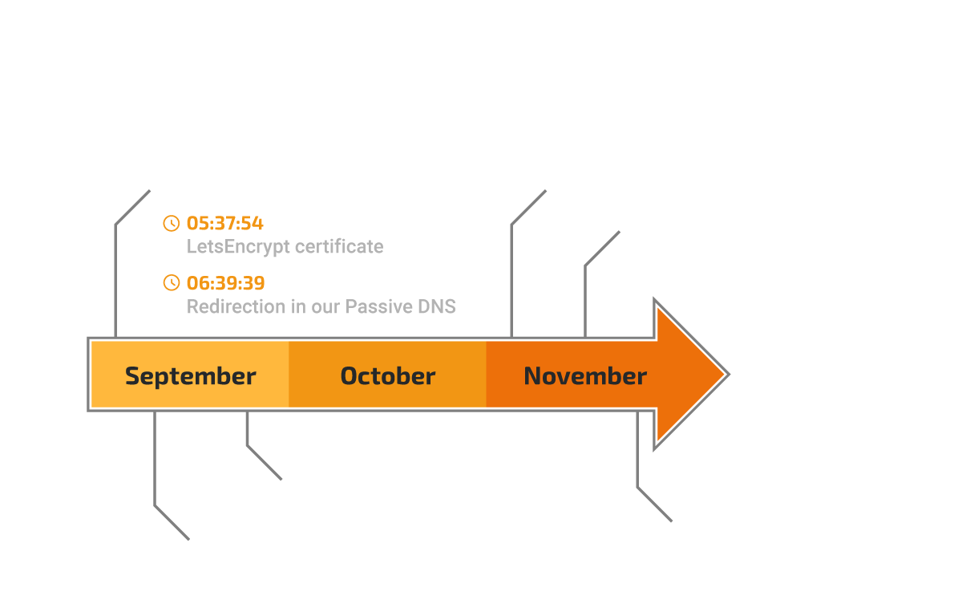
DNS Redirection
185.161.211.72

Slide 39
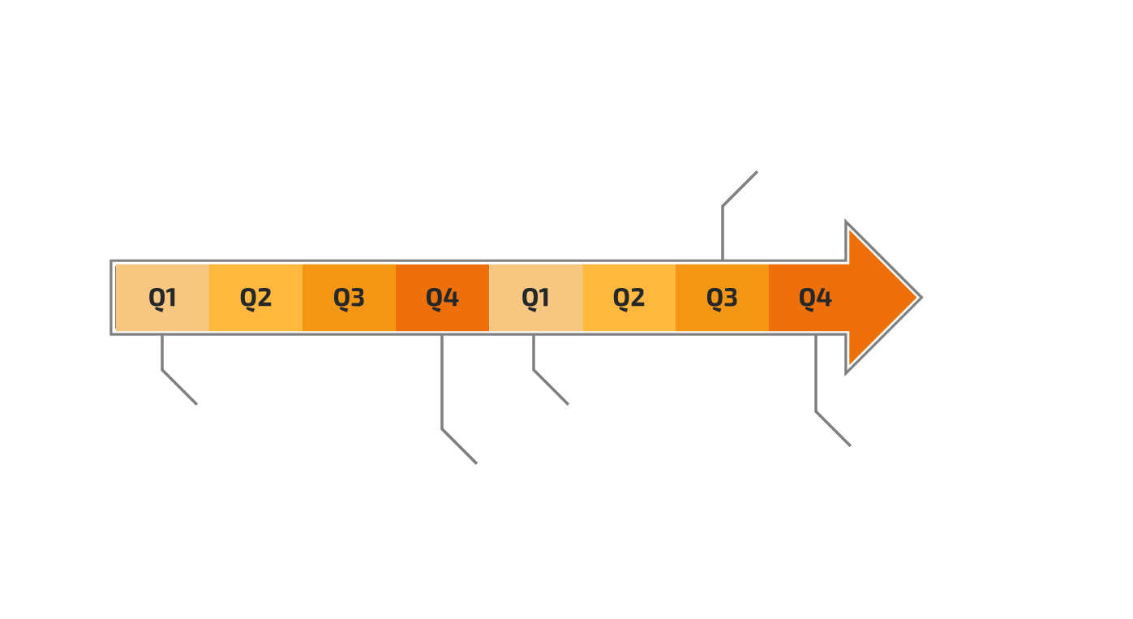
DNS Redirection
2 years of activities

Slide 40
DNS Redirection
Few statistics
  More than 25 identified redirections
  2 years of activities
  A pick during 2018 Q4
  More than 10 countries
  Public & private sectors
  Mainly in Middle-East … few in EU/USA

Slide 41
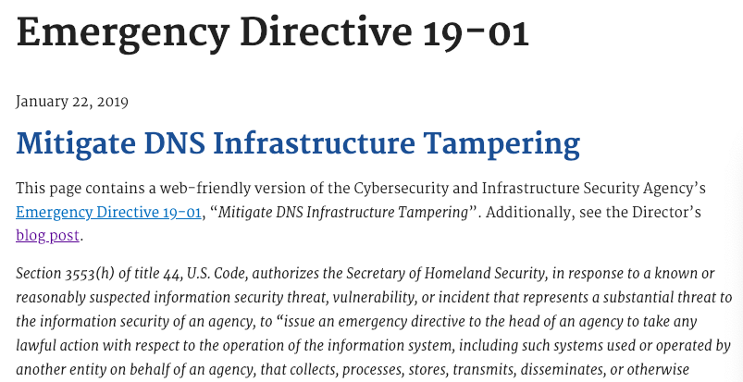
DNS Redirection
DHS Emergency Directive 19-01

Slide 42
DNS Redirection
DHS Emergency Directive 19-01
  Action One: Audit DNS Records
  Action Two: Change DNS Account Passwords
  Action Three: Add Multi-Factor Authentication to DNS Accounts
  Action Four: Monitor Certificate Transparency Logs

Slide 43
Our job is protecting your network
Talos is the threat intelligence group at Cisco. We are here to fight the good fight —
we work to keep our customers, and users at large, safe from malicious actors.
Vulnerability
Research & Discovery
Engineering
& Development
Detection Research
Outreach
Threat Intelligence
& Interdiction
Community
Notes:
Providing this protection requires a broad talent set. To achieve this, we leverage a wide range of skills, from threat researchers, vulnerability analysts, developers, and even a few rocket scientists. We then build this organization into six key areas:
1. Threat Intelligence & Interdiction: Is focused on "getting in the way" of active threat, by surveilling active threat campaigns for intelligence and working with incident response groups.
2. Detection Research focuses on constantly improving the methods for identifying new threat detection methods.
3. Engineering and Development is about creating more powerful tools that find their way back into Cisco Security Solution or the Open Source Community.
4. Vulnerability Research & Discovery is on the lookout for weaknesses in the software, hardware, and systems that drive our world.
5. The best security research is not done in a vacuum. Our community efforts help us build partnerships with other threat researchers, our customers, and security organizations that are working to protect us all.
and finally, 6. Global Outreach team. We understand that effective security requires education and awareness. This team makes sure that our Cisco Professionals, our customers, and the world at large have the knowledge they need to be successful.

Slide 44
Forcing the Bad Guys to Innovate
Fostering an Informed Open Source Community
Talos contributes heavily to the open source body of security knowledge, better equipping the community defenders.

Slide 45
Forcing the Bad Guys to Innovate
Immunet
Synful Knock Scanner
MBR Filter
PyREBox
MoFlow
FreeSentry
Talos
Reputation Center
Teslacrypt Decryption Tool
File2Pcap
Empowering End Users with Open Source Tools
PE Sig
Talos provides a number of free tools and resources to the public in order to help users better protect themselves from security threats. We are constantly adding new tools to our library to keep abreast of new threats.
Spamcop
Snort
Daemonlogger
Ropmemu
ClamAV
Flokibot Tools
Cisco Smart Install Scanner
FIRST

Slide 46
Forcing the Bad Guys to Innovate
Spreading security news, updates, and other information to the public.
White papers, articles, & other information
talosintelligence.com
ThreatSource Newsletter
cs.co/TalosUpdate
Talos Blog
blog.talosintelligence.com
Social Media Posts
Facebook: TalosGroupatCisco
Twitter: @talossecurity
Instructional Videos
cs.co/talostube
Beers with Talos Podcast
talosintelligence.com/podcasts
Talos publically shares security information through numerous channels to help make the internet safer for everyone.

