Slide 1
Singapore. 16 April 2019
#CiscoConnectSG

Slide 2
Delivering Digital Experiences
Vish Iyer
Vice President, Architectures,
Cisco Asia Pacific, Japan and Greater China

Slide 3




YOU are expanding to the Cloud
This expansion is driving fundamental change across every IT infrastructure domain

Slide 4

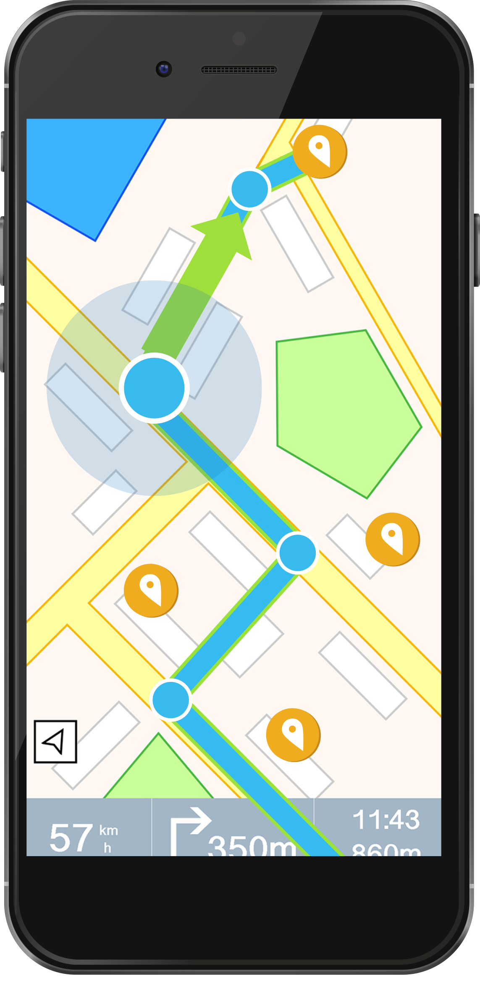
YOU are building
the next generation
of digital experiences
Applications anywhere, any
time with secure access to
any information

Slide 5
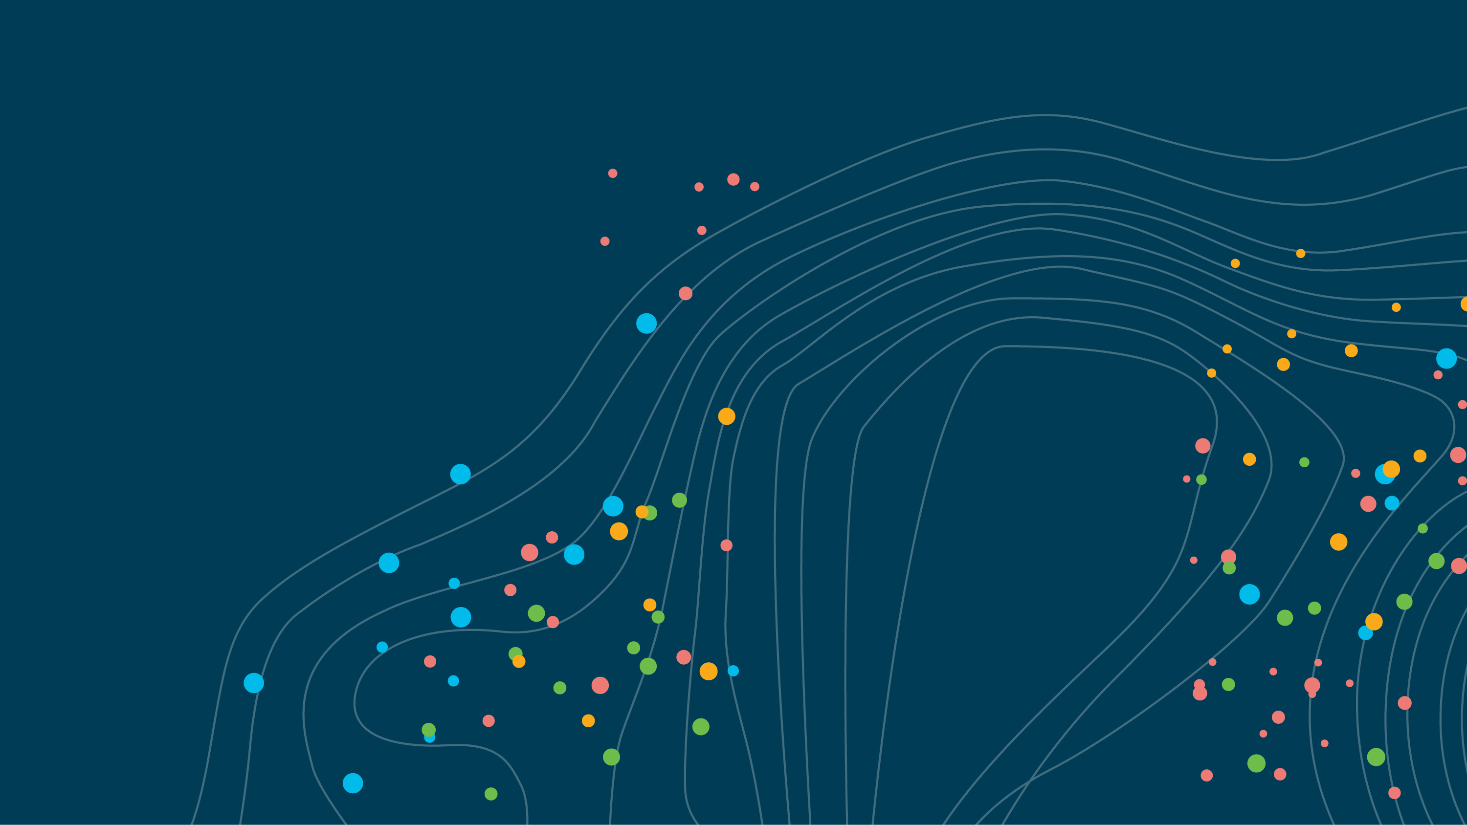
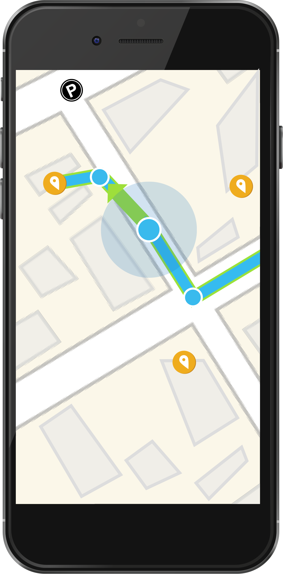
This environment is creating
a new set of challenges
YOU are required to manage
a set of variables that are changing constantly
APPLICATIONS
USERS
DATA
DEVICES

Slide 6


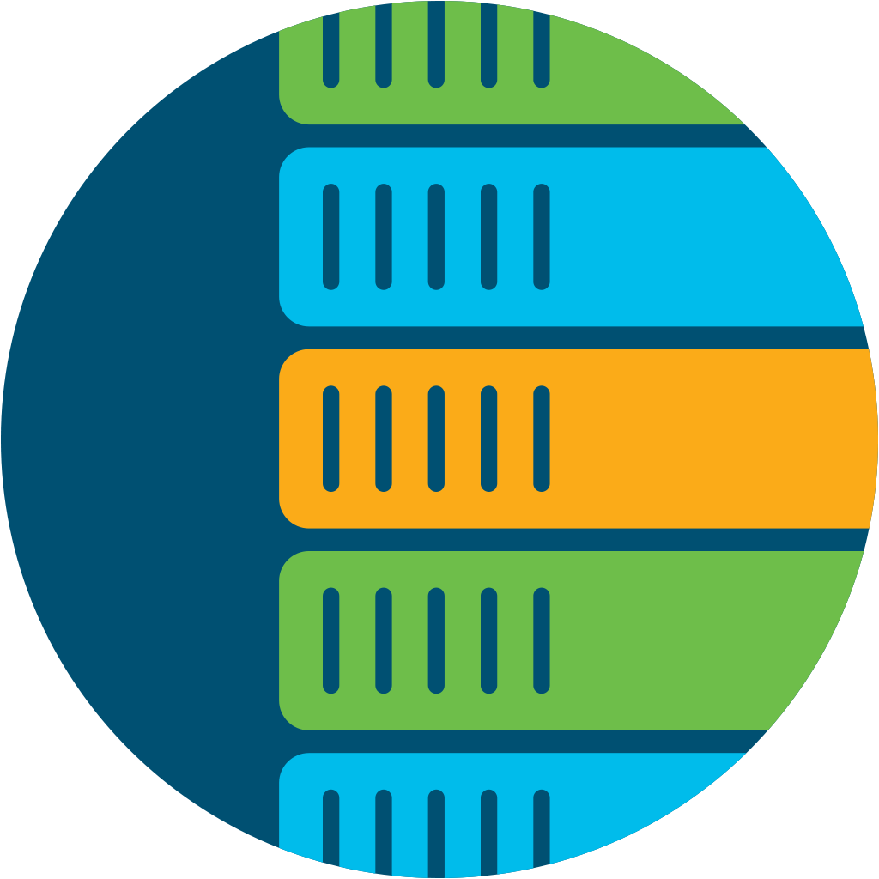
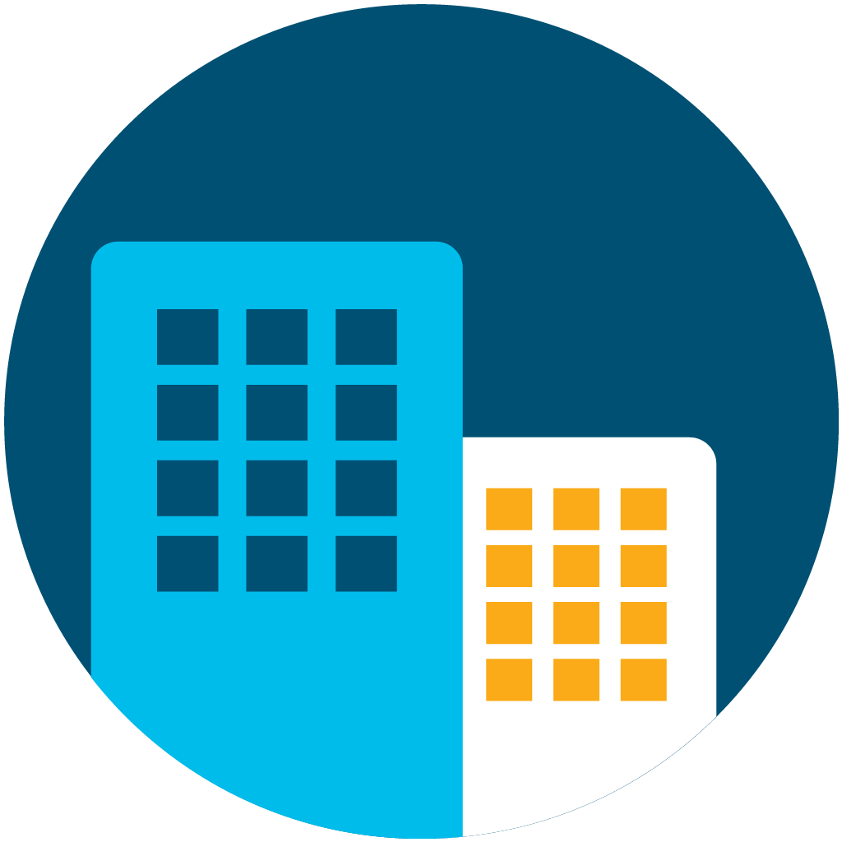
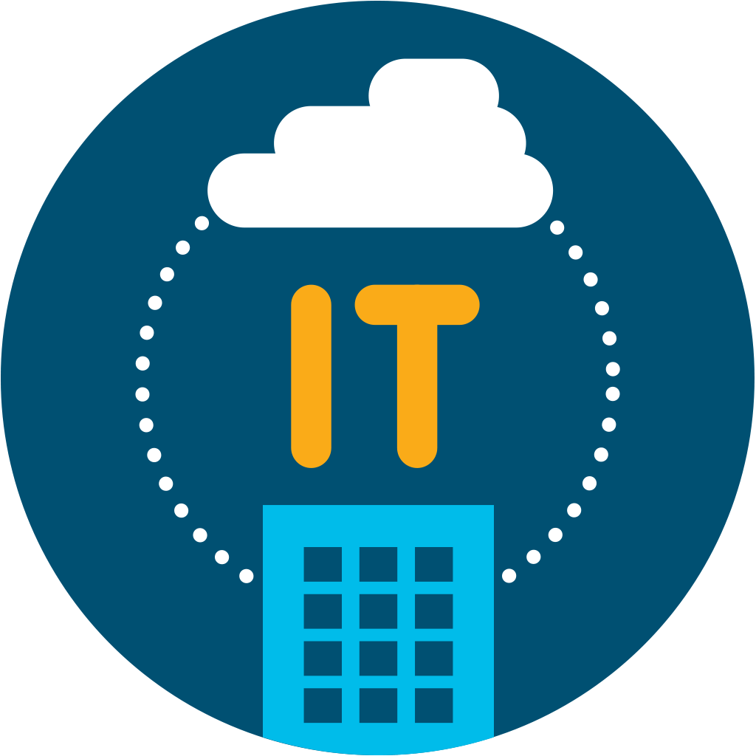
Security
IT architectures must be reinvented for the realities of this next-gen
digital world
It must span across the new
and emerging network
domains, integrating
them in new ways
Service Providers
Cloud Providers
Data Center
Branch
Campus (IT and OT)
© 2019 Cisco and/or its affiliates. All rights reserved

Slide 7
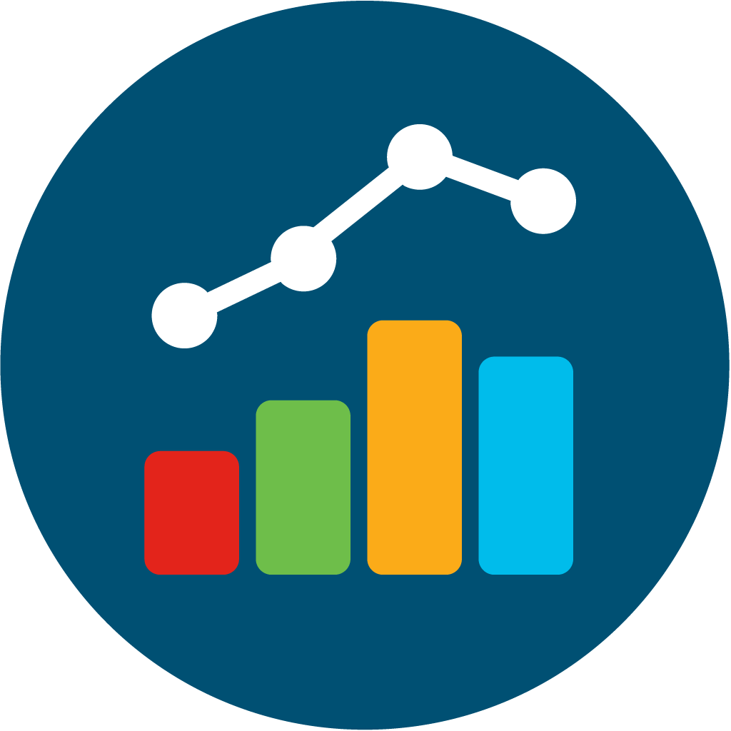

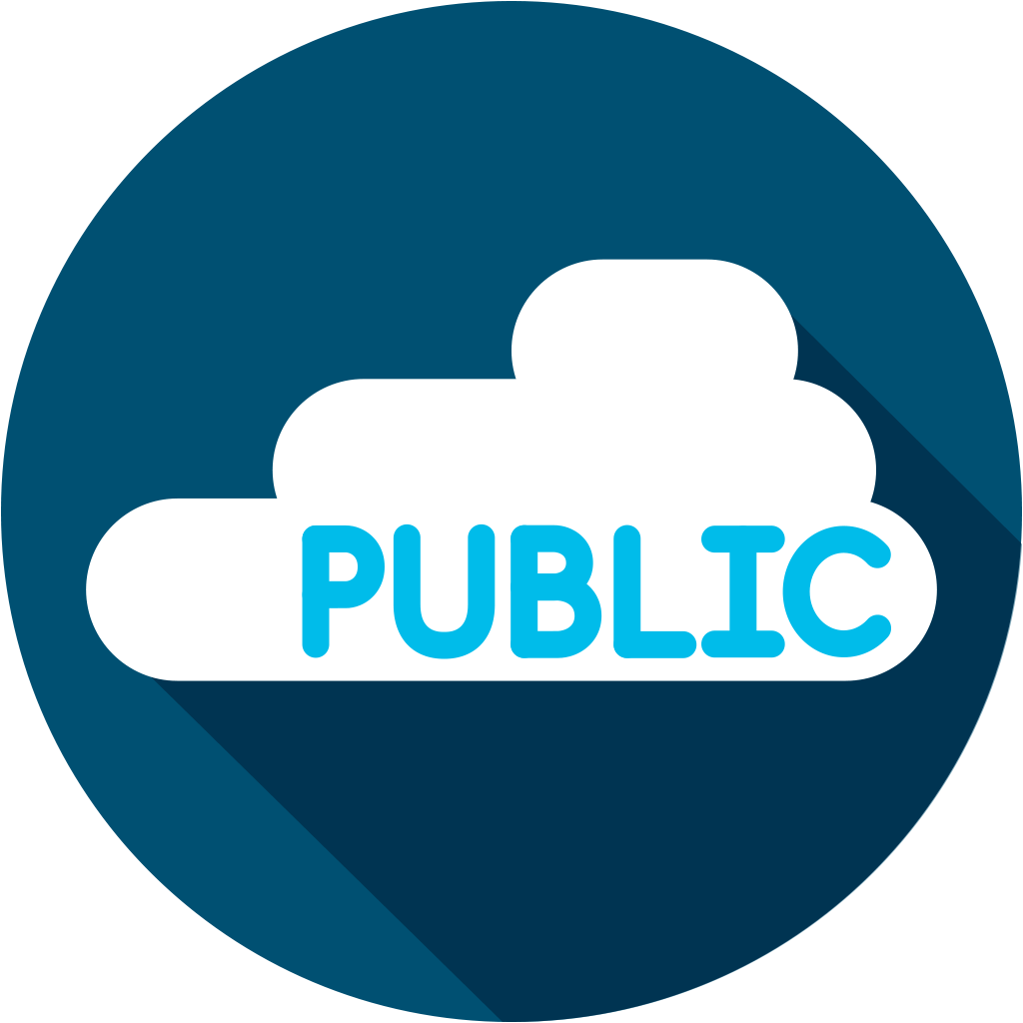
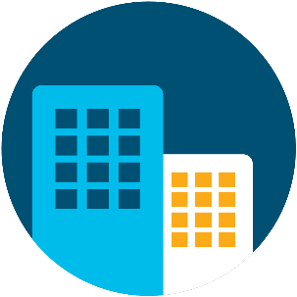
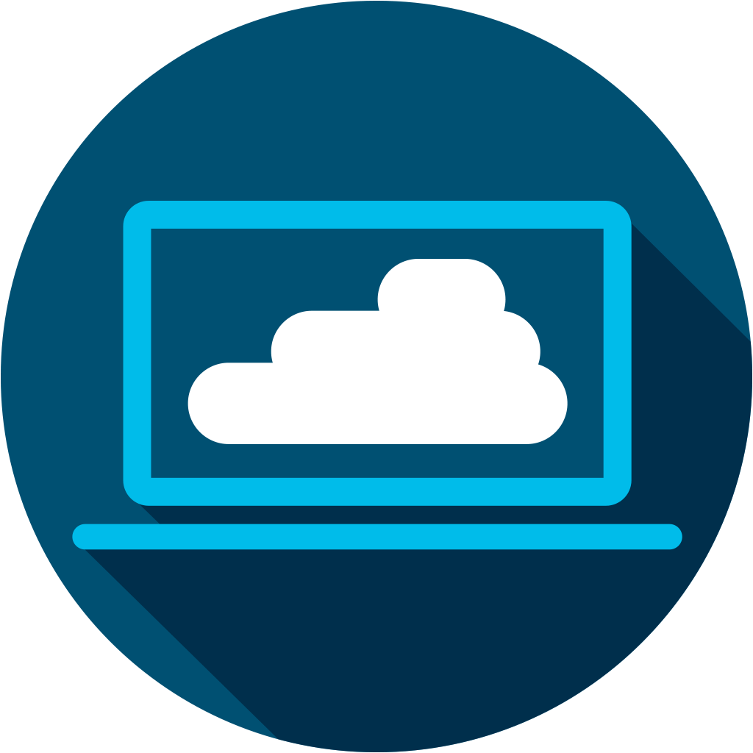
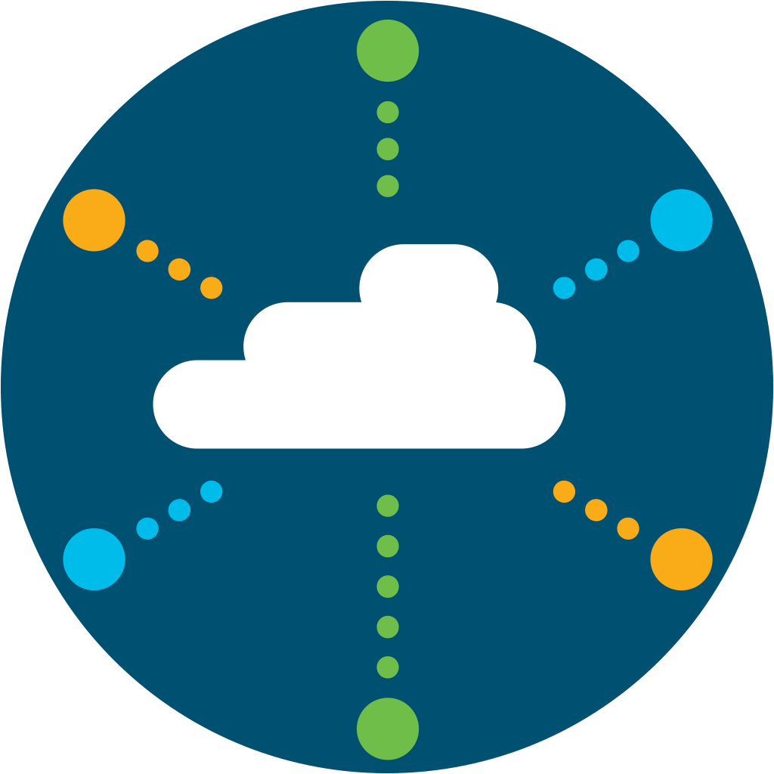


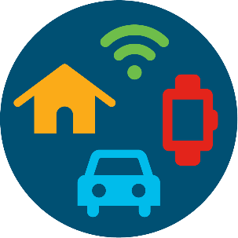

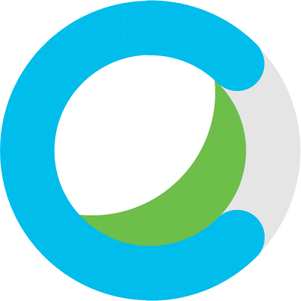
IT Architectures must be reinvented for the realities of this next-gen digital world
Visibility, Assurance, Automation and Analytics
Data Center
(ACI)
Public
Cloud
Users
SaaS
Software
Defined Access
Software
Defined
WAN
Cloud
Edge
Services
Internet
Devices
Pervasive Security – Identity, Mobility, Policy and Compliance
Notes:
Make this a used case slide
Lets looks at the holistic problems we are solve in different industries
Say Pharma – US FDA defines the compliance requirements and audits on regular basis. So how can we help automate those compliance activities so you bring drugs to market faster
Say in Banking – RBI is tweaking various regulations so you as custodian of customer data have to comply to different sets of requirements with uniform policy across multiple domains from data center to branches to Internet banking
Lets take a used case in manufacturing – what is the cost of downtime on account of a hack like in the Honda factory in Japan for a day. Would they have not ben being having uniform policy proactively as opposed to reactively after the attack. Do you know that one day down cost them 19M of USD of productivity versus the investment in a solution. In manufacturing you are all focused on cost optimization but really you think need cross-domain as you automate users/things
Net-Net, this demonstrates we have a cross domain architecture which solves your business challenges – my ask to you is to proactively reach out and co-create solutions that leverage the power of multi-domain, multi-architecture solution to deliver business outcomes like increase productivity, lower cost and increase revenue

Slide 8
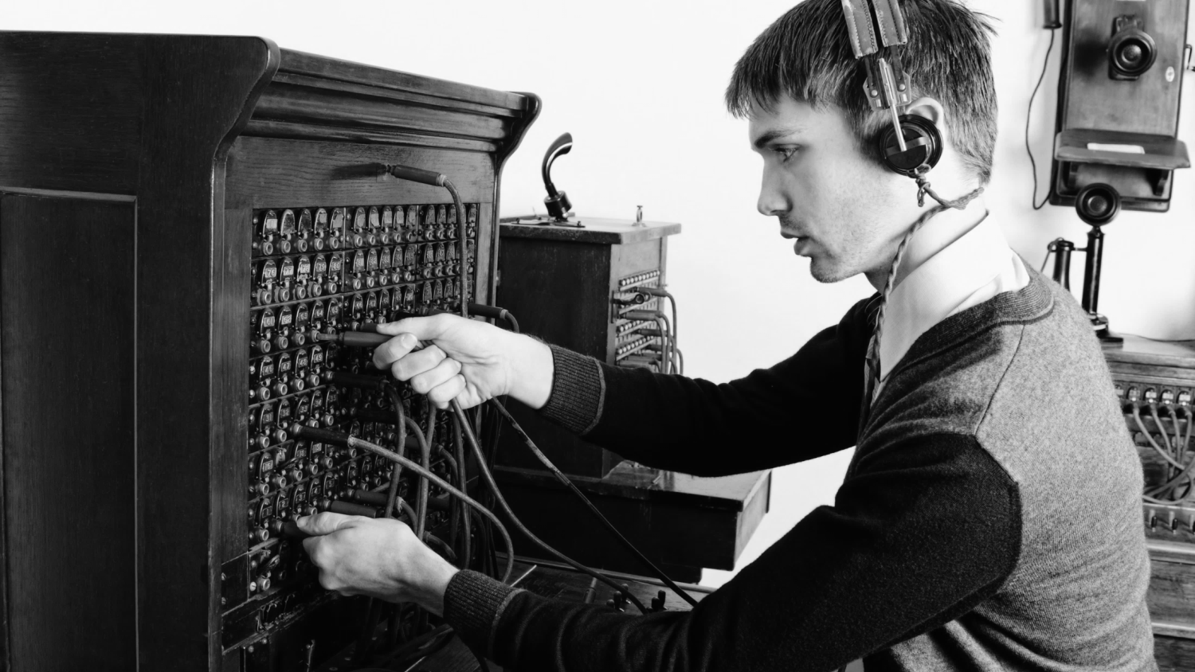
Reinventing the Network
Notes:
There comes a time when doing things the old way will not longer work, no matter how you try to optimize the technology. And it requires a new way of thinking. A great example is the manual switchboard operators who connected every call, but that was no going to scale with telecommunications demands … we had to automate it. That tiem has come in networking and we need to re-write the networking playbook we have been running or over 30 years ... and more to a new paradyme: Intent-based netowrking.
Gartner quote in Network World: http://www.networkworld.com/article/3202699/lan-wan/what-is-intent-based-networking.html
Gartner:
In essence, IBNS provides networking middleware to replace intelligence that was previously only available from networking engineers/architects. Intent-based networking systems are driven by sophisticated algorithms that translate business intent into network configurations. Algorithms are key to this process because they "effectively capture knowledge and work at a speed and scale that cannot be easily matched simply by scaling the human workforce
Gartner sees the biggest benefits from IBNS are improving network agility and availability, and supporting unified intent and policy across multiple infrastructures
Gartner believes a full IBNS implementation can reduce network infrastructure delivery times to the business leaders by 50% to 90%, while simultaneously reducing the number and duration of outages by at least 50%

Slide 9
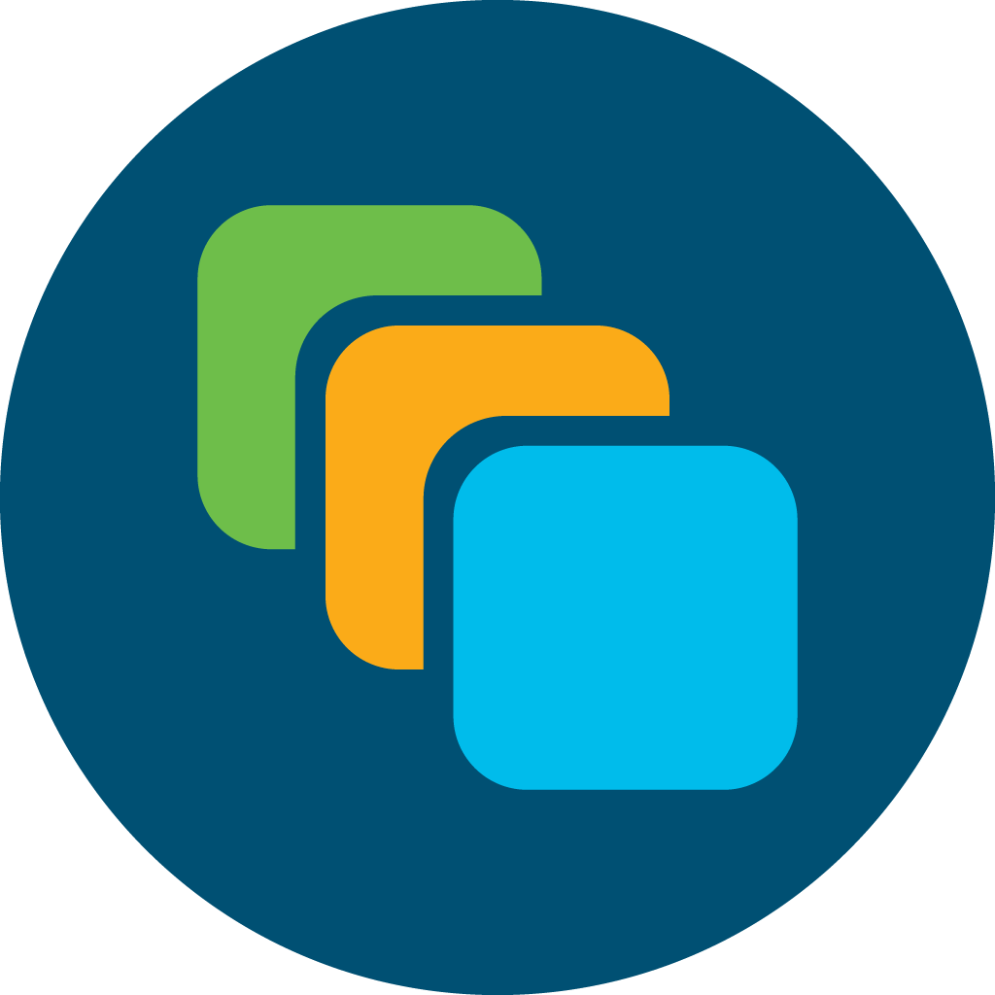
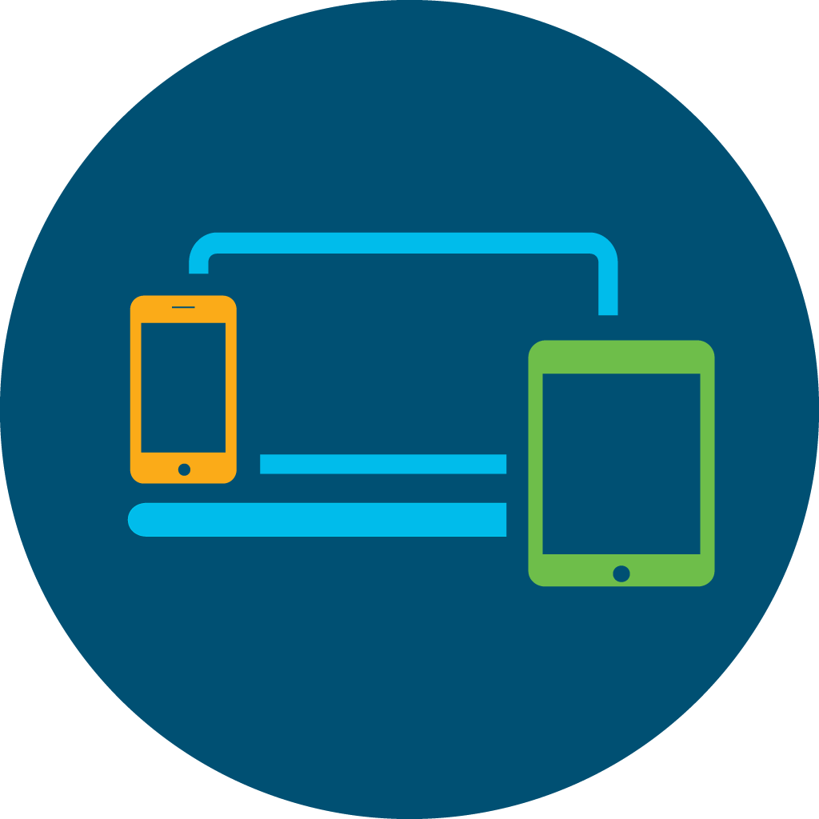
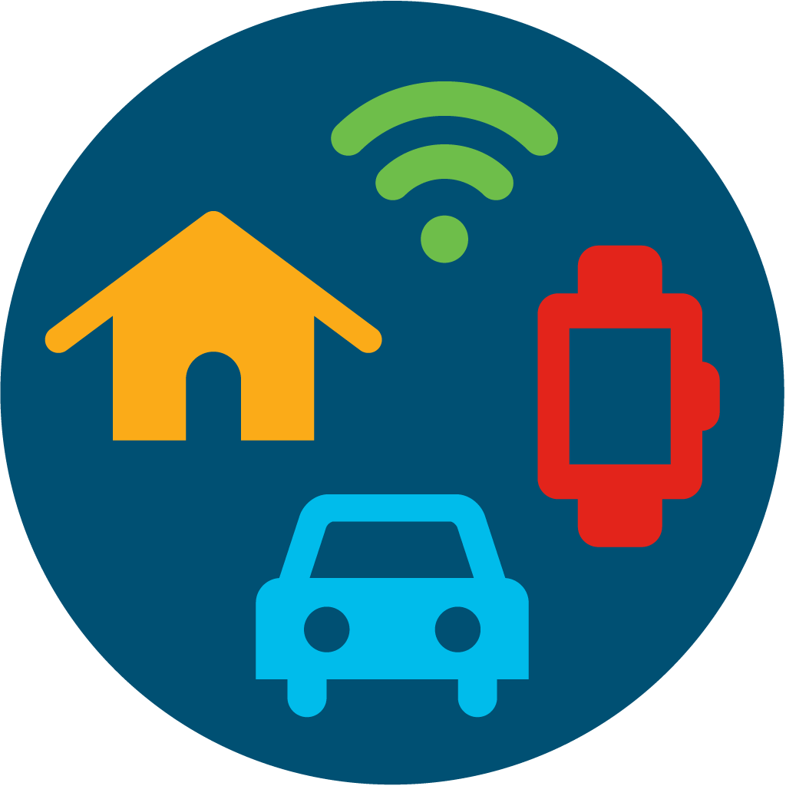
Only Cisco is building Multi-Domain Architecture
that securely connects any user or any thing
on any device, on any network to any application
Applications
Devices
Data
Users
Things
Notes:
Net-Net, this demonstrates we have a cross domain architecture which solves your business challenges – my ask to you is to proactively reach out and co-create solutions that leverage the power of multi-domain, multi-architecture solution to deliver business outcomes like increase productivity, lower cost and increase revenue

Slide 10

Global Financial Player - Business Challenge
$80M Impact of Cyber Security Hack - Direct and Indirect cost
One Day of service downtime Ransomware hack exploiting a website
Siloed operation Physical Separation, manual
Configuration, static rules for mobile devices/IT/DC
Predictable time for financial transactions
Competitive Differentiation
Notes:
In line with this new Network Topology we are also on a journey to deliver a new set of Networking Services that are focused on changing the operating model for the network by driving IN significant levels of agility + visibility, while also taking OUT operating Costs.
Intent Based Networking is a set of capabilities where the Network can operate as a self-managing system. The amount to which the Network becomes self-managing is determined by the Customer.
The best way to understand what we mean by an Intent Based System is to do a walk through of how it operates.
The systems Ingests the Customer’s Business Policies / Rules of Operation or Intent, and converts these to Network Device configurations which can then be implemented or ‘written to’ the Network Devices via Automation
Streaming Telemetry / Analytics provide full visibility of all traffic flows and also allows for the continuous learning and understanding of Enterprise traffic flows across the Network. This enables the Intent Based System to understand ‘normal’ behaviour.
Central systems then continually monitor Network traffic to ensure that the Intent that was defined by the operator is being delivered, PLUS are able to generate alerts in the event of any anomalies or issues
At this point, depending on Customer preference - Network configurations can either be A) scheduled / updated manually or they can be B) sent out automatically to ensure that the Business Intent is delivered regardless of changing Network conditions
Cisco is already delivering Intent Based Networking solutions in a number of key Network Domains today e.g.
DC via ACI – which manages application policies,
WAN Core via WAN Automation Engine (WAE) - which manages Traffic flows in Backbone networks, AND
Self Defending Security via Stealthwatch + Enhanced Threat Analytics in Security which are constantly monitoring live traffic streams for anomalies, sending alerts to the operator when it detects potential threats
We have also recently launched Intent Based Networking services for the Access + Cloud Edge Network Domains and will deliver these during FY18.
The plan is to continually simplify and extend Intent Based Networking operations across the entire Enterprise over time.

Slide 11
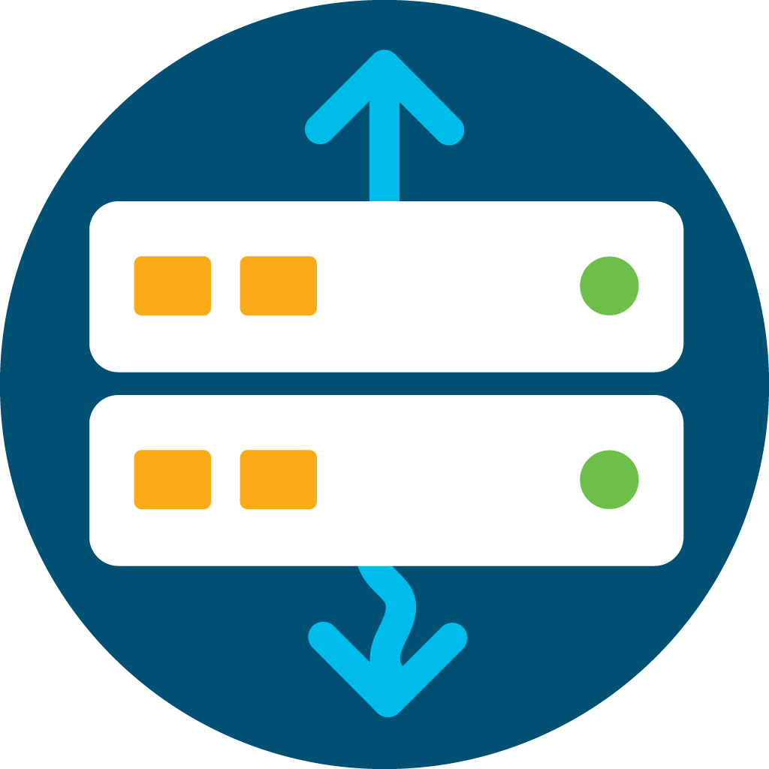
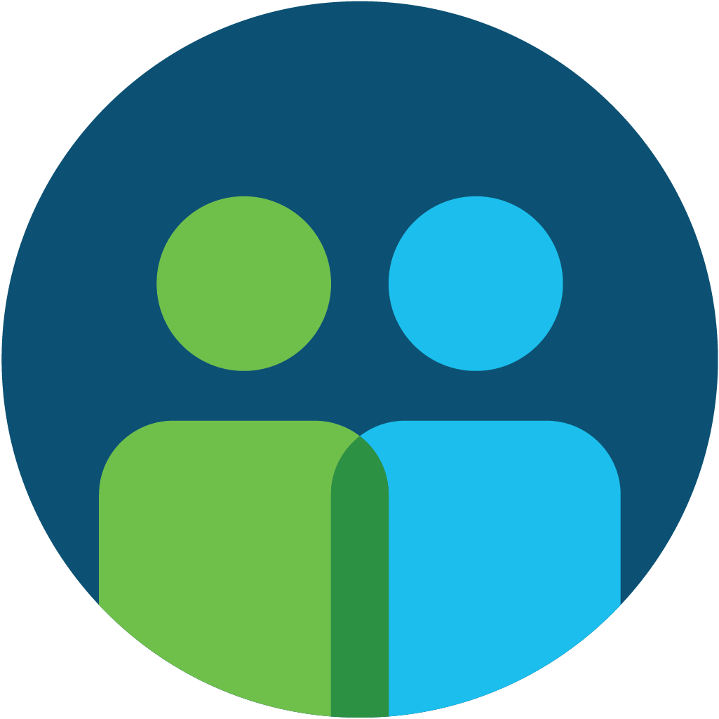
Multi-domain Customer Journey Approach
Mainframe/
Server
Consumers
Providers
Public
hot spots
WAN
Data
center
Cloud
Apps
Customers
ATMs/
Devices
Notes:
Historically the Network and Security implementations were separate.
This diagram highlights the End to End focus of the architecture from Consumer / Access to Cloud Edge and Provider places in the Network.
Security is now fully integrated at each place in the Network to ensure delivery of a Secure Intent Based Enterprise Network.
We will now take a quick walk through the key Cisco Building blocks and highlight the unique benefits that are delivered in each area to deliver an End to End network platform

Slide 12
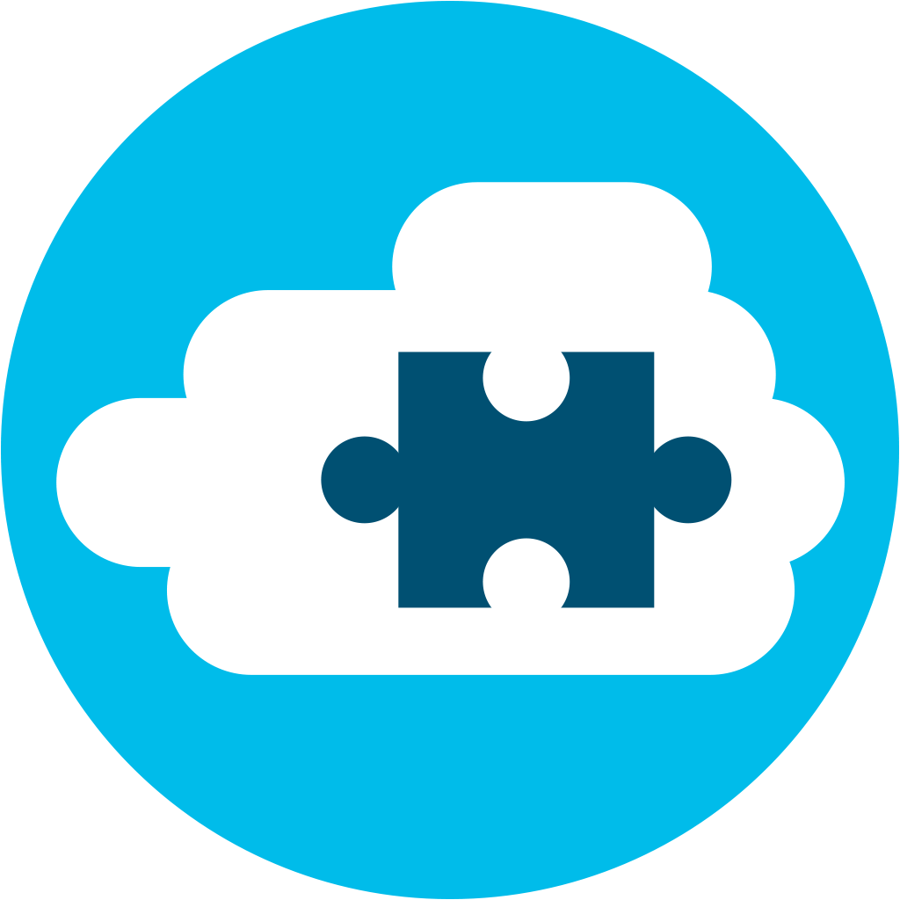

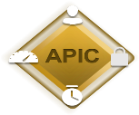

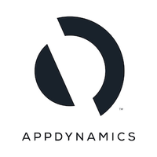
Customer Success Journey – Making it real!
Traditional Approach
Physical Separation, Manual Configuration, Static Rules
Multiple silos with different administrative domains – IT/OT/DC/SecOps
New Approach: Software Defined
Intuitive Segmentation – User/Things/Apps
AppDynamics – application performance management
Dynamic Policies with Complete Visibility
Digital Experience - Uncompromised Security (Multi-domain)
Faster time to market
ISE
ACI
End-to-end Segmentation & Policy
B
B
Cisco SD-Access Domain
EXT-EPG1
EXT-EPG3
Users/Things – Wired/Wireless
Data Center – Servers & Apps
Notes:
Make this a used case slide
Lets looks at the holistic problems we are solve in different industries
Say Pharma – US FDA defines the compliance requirements and audits on regular basis. So how can we help automate those compliance activities so you bring drugs to market faster
Say in Banking – RBI is tweaking various regulations so you as custodian of customer data have to comply to different sets of requirements with uniform policy across multiple domains from data center to branches to Internet banking
Lets take a used case in manufacturing – what is the cost of downtime on account of a hack like in the Honda factory in Japan for a day. Would they have not ben being having uniform policy proactively as opposed to reactively after the attack. Do you know that one day down cost them 19M of USD of productivity versus the investment in a solution. In manufacturing you are all focused on cost optimization but really you think need cross-domain as you automate users/things
Net-Net, this demonstrates we have a cross domain architecture which solves your business challenges – my ask to you is to proactively reach out and co-create solutions that leverage the power of multi-domain, multi-architecture solution to deliver business outcomes like increase productivity, lower cost and increase revenue

Slide 13
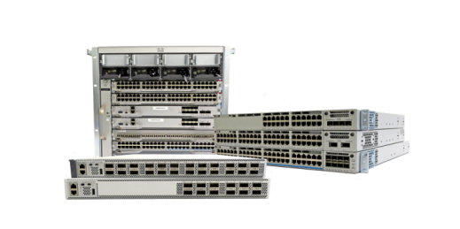
Digital Experience Customer Journey
Platform Value Proposition
360 Visibility
Automation
and Security
Leverage API
Multi-domain architecture
End-to-end view of the Customer Experience with full context
Policy Based Automation with Embedded security
Partner professional Services and Dev-Ops
Delivering Digital Business Outcomes
Notes:
To summarise – Lead with best in class product with assurance & DNAC, upsell automation capabilities (improve RO/Software penetration). Overall profitability improves with higher back end rebate and opens up opportunity to insert professional services to consult and deploy some of the great innovation that solution has to offer. More importantly partners can now leverage open API capabilities to deliver devops/custom services.

Slide 14
Unleashing the human dimension – Time to value
Delivering
Business Outcomes
Breaking the Silos
New skills
Programmability
Cloud
Security
APIs

Slide 15
Key Takeaways for You!
Focus on Your Business Outcomes
Think Multi-domain
Customer Experience
Leverage Cisco Platforms
Let’s co-create
together!

Slide 16
Singapore. 16 April 2019
#CiscoConnectSG

