Slide 1

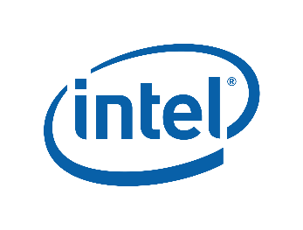

Data Center Innovation Day

Slide 2
Transform DC with Flexible Infrastructure Platform
Prasad Radhakrishnan
Data Centre Solutions Lead, Cisco Systems
Oct 2018

Slide 3
Performance , Control & Safety !

Slide 4
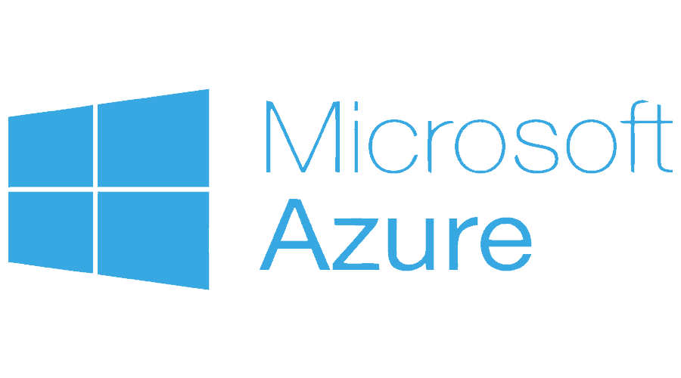
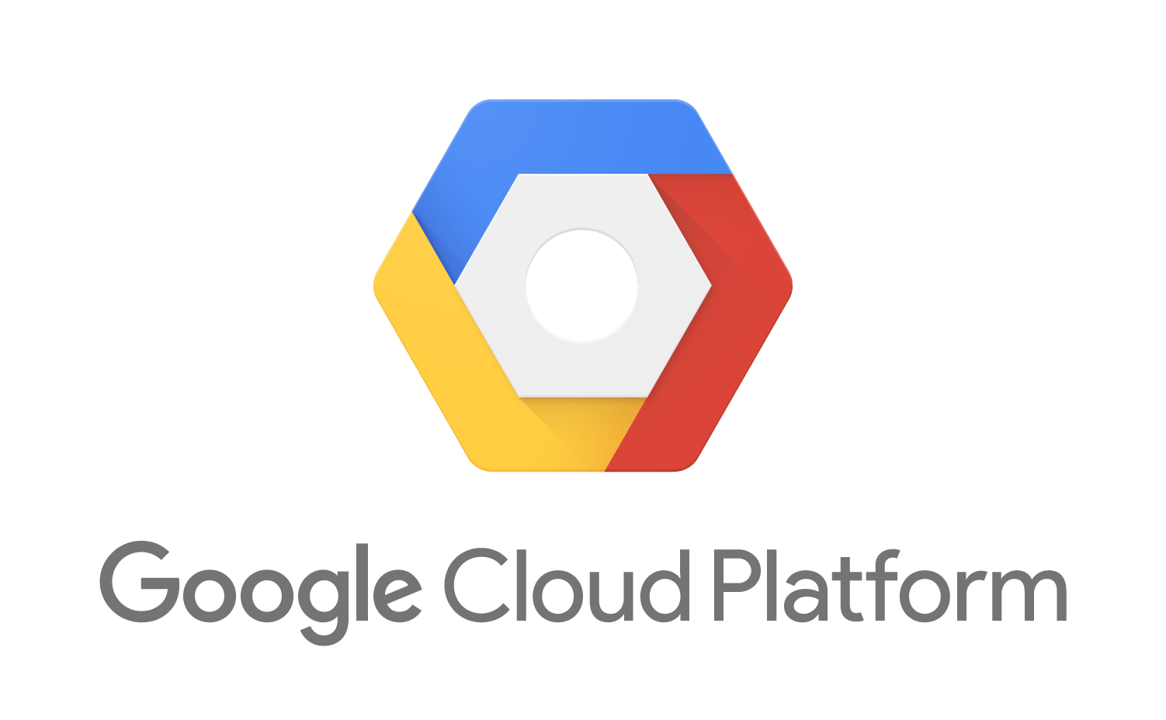
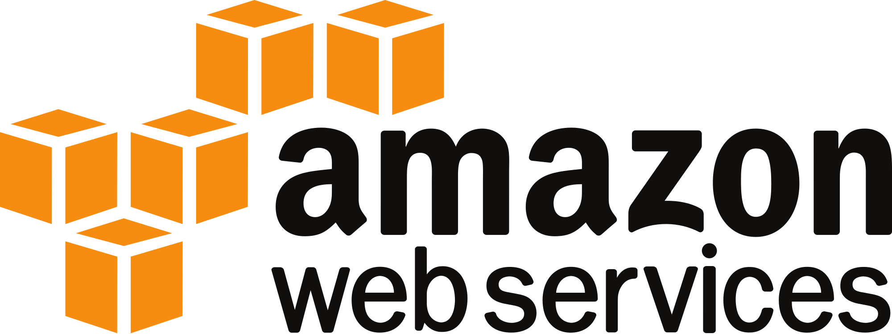
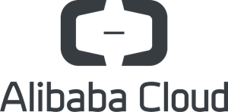
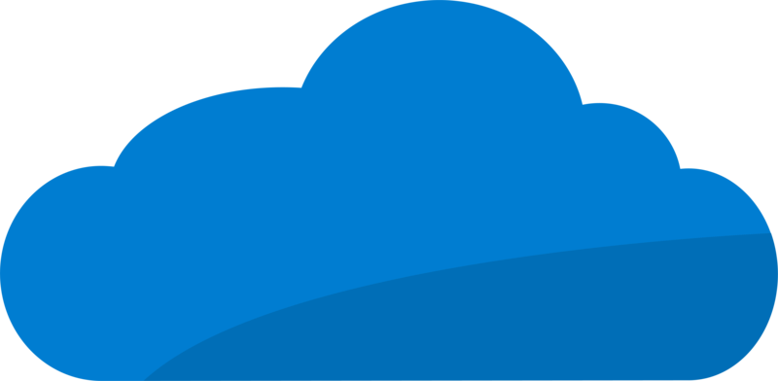
“Flexible IT”
Public Cloud
Application &
Infrastructure
Automation
Others
Security
Server Storage Network
On Premise Datacenter

Slide 5
We Want to Simplify More
Speed and Simplicity
Cloud-Like On-Premises
Power More Workloads
Common Management Policy Across Data Centers
Pay-as-you-grow Economics with Resource Scaling On-Demand
Expand this Simplified Approach
to More Use Cases

Slide 6
Hyperconverged Infrastructure
Cloud like resource model
Speed and Simplicity
Common platform across data center
Predictable, reliable performance
Pay as you grow
Pay-as-you-grow Economics with Resource Scaling On-Demand
Streamlined Operations
Cloud like simplified management and orchestration
© 2017 Cisco and/or its affiliates. All rights reserved. Cisco Partner Confidential

Slide 7
Requirements for Next Generation Hyperconvergence
Complete
Next-Gen Data Platform
Convergence on a
Common Platform
Unified Network and Management
Advanced File System
Integrating into Existing and
Future Infrastructures

Slide 8
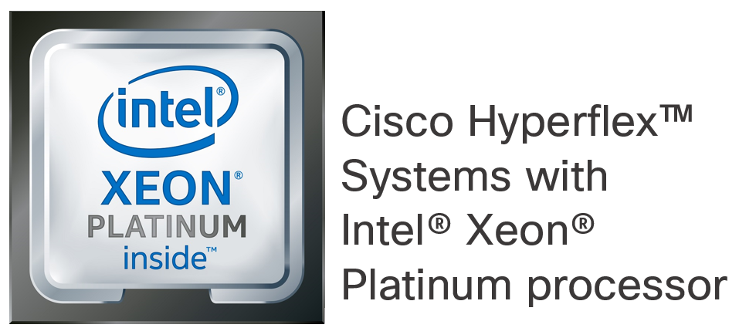
Cisco HyperFlex : HCI Engineered on UCS
Part of a Complete Data Center Strategy
Elastic and Secure at Enterprise Scale
CloudCenter
AppDynamics
CWOM
Tetration
ACI
UCS
Intersight
Security
Next Gen
Data Platform
Designed for
Distributed Storage
Cisco HX Data Platform
Data Services and Storage Optimization
UCS – Completely integrated compute + network
Complete Hyperconvergence
Unified Compute and Network Infrastructure
Cisco HyperFlex

Slide 9

Hyperconverged Scale Out and
Distributed File System
Hypervisor
Controller
Hypervisor
Controller
Hypervisor
Controller
Hypervisor
Controller
Hypervisor
Controller
HYPERCONVERGED DATA PLATFORM
Start with as Few as Three Nodes
Hyperconverged Data Platform Installs in Minutes
Network Fabric Policy Configures QoS Settings
Add Servers, One or More at a Time
Distribute and Rebalance Data Across Servers Automatically
Retire Older Servers
Balanced Space Utilization
No Data Migration on VM Migration
Less Stress on Network

Slide 10
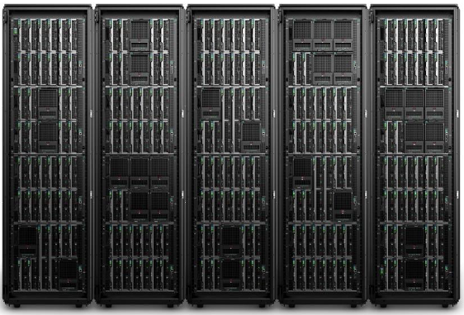

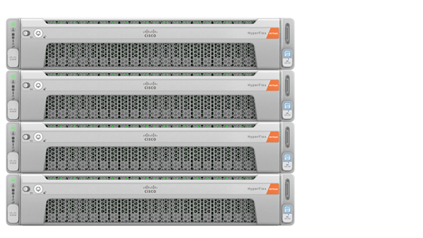
HyperFlex – Simplify Infrastructure & Operations
Infrastructure
Management
Remove infrastructure silo
Simplified management
Single support model
Modular and Scalable
Business Continuity
Improve TCO
Cloud Economics – Pay as you grow

Slide 11



Simplified Operations Across DC & Branch Operations
Automation
Analytics
Proactive TAC
Recommendation Engine
Branch 1
Branch 2
Datacenter
Branch 4
Branch 5
Simplified Compute and Storage Management Across Sites
Notes:
Here’s what’s coming up next… we are shortly going to introduce the ability to manage HyperFlex from the cloud
Customers are looking for speed, simplicity and scale in the management of their infrastructure whether in the datacenters or remote and branch office locations
Our management solution, many of you have probably heard the codename Starship will give you the ability to Deploy, Monitor, and Upgrade your hyperconverged infrastructure from a single cloud based management tool that will be offered as a SaaS platform.
We recently announced HyperFlex Edge – a variant of HyperFlex that’s optimized for remote office and branch office deployments
A typical use case for HyperFlex Edge is a retail chain or bank that would deploy small HyperFlex clusters in 10s or even hundreds of their branch locations

Slide 12
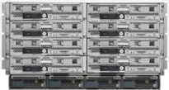
Cisco HyperFlex Architectural Differentiators
Hardware and Software Engineered Together
Complete Hyperconvergence with Integrated Network Fabric
Independent Scaling
Unified Network Infrastructure
Guaranteed QoS with low latency
Use diskless UCS rack/blade servers
No additional HyperFlex licenses
Unified Architecture
Enterprise Storage Features
Connect to existing storage
Ideal for tiered storage architecture , migration , backup etc
Snapshots , Dedupe , Compression
No performance impact , no licenses
Cisco HyperFlex System
Notes:
Cisco HyperFlex has been built from the ground up to offer a complete solution for hyperconvergence. It’s based on the industry changing and very successful Cisco UCS platform, and has tight integration with the functionality that UCS provides. The HyperFlex Data Platform was designed for distributed storage that provides higher performance, better consistency, and higher availability that solutions that rely on legacy file systems and data locality. And HyperFlex is an integral part of Cisco’s overall vision for the Data Center, which includes application advanced workload placement, hybrid cloud management, application visibility, micro-segmentation, and an overarching commitment to pervasive security.

Slide 13
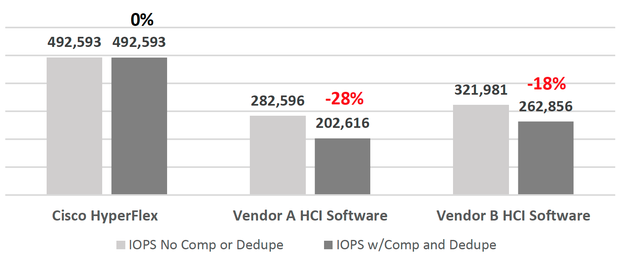

Unmatched Performance
HyperFlex
Vendor A
Vendor B
SQL as a workload
https://research.esg-global.com/downloadfile/ciscoucs?shortCode=ESG-Technical-Valida

Slide 14




HyperFlex - Continuous Innovation
Workloads
Platform
AI/ML
Workloads
Enterprise
Workloads
IaaS & Cloud Mobility
All Flash
SED
M5 Skylake
40G NW
Kubernetes Containers
EasyVDI
For Citrix
SAP Modernization
Hyper-V
Edge
All NVMe
Stretch Clusters
Native DR Enhancements
Cloud Storage Analytics
Profiler &
Sizer
Application Performance
Monitoring
Native
Replication/DR
Greater Scale with Resiliency
Connect UI
Ease of Use
Business Criticality
Scale
Notes:
HyperFlex Team has built tremendous momentum in the market in large part due to the pace of innovation that we have been able to achieve. Everything on the slide has been released in the last 18 months, roughly a release every quarter. Innovations include new SW features and HW configurations. It is a proof of the strength of hyperflex architecture that it has seamless and rapidly been able to support several hardware changes – starting with hybrid to all flash to NVMe and now to all NVMe! Added support for a wide variety of applications and a ton of new features.

Slide 15
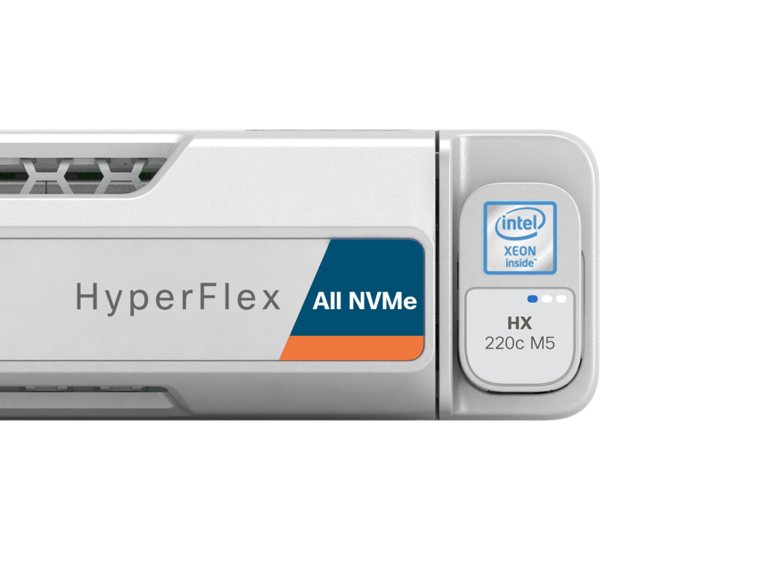


Introducing All NVMe HyperFlex
All NVMe with 40 GbE Integrated Fabric Networking
RAS with Intel VMD for Hot-Plug, Surprise Removal etc.
NVMe Optane Cache, NVMe Capacity (up to 32TB/Node )
15

Slide 16

A Chain Is Only As Strong As Its Weakest Link

Slide 17

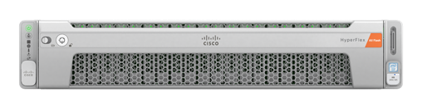

HyperFlex Native Data Security
Data-at-Rest Protection
Secure Platform
Regulatory Compliance
  Data-At-Rest Encryption thru Self-Encrypting Drives
  Enterprise Key Management Support
  Vulnerability Assessments and Hardening
  Role-Based Access Control and Auditing
  Certifications Starting with FIPS, Common Criteria*
  Compliance for Data Privacy (HIPAA, PCI-DSS etc.)
Notes:
Key Points/Differentiators:
Built as a foundation to support multiple hypervisors – Hypervisor agnostic UI (Supports ESX, will support Hyper-V, KVM etc.)
Designed for mobile monitoring and management – UX design fit for tablet users
Localized in multiple languages – Simplified Chinese, Japanese, Korean (in addition to english)
No need for additional plugins* (note: few operations may still require plugin, though the goal is to get rid of plugin needs by 3.0)

Slide 18
HyperFlex End-to-End Platform Security
Policy
Network
Data and Storage
Application
Cloud and Edge
Micro-segmentation and Policy
ACI and Tetration
HyperFlex Data at Rest Drive Encryption
Advance Malware Protection (AMP)
Threat Detection (Stealthwatch)
Next-gen Firewalls (NGFWs)
Intrusion Protection (NGIPs)
Adaptive Security Virtual Appliance (ASAv)
Next-Gen Virtual Firewalls
(NGFWv)

Slide 19
Primary Workloads
ROBO &
Edge
Server Virtualization
Test and
Development
Virtual Desktop Infrastructure
Databases
& ERP
Containers
  Simple deployment
  Centralized management
  No
  “fly-and-fix” missions
  Reduce operational complexity
  Adaptive
  scaling
  Always-on resiliency
  Agile provisioning
  Frequent iterations
  Instant
  cloning and snapshots
  Low
  upfront
  costs
  Consistent performance
  Predictable scaling
  Consistent,
  low-latency
  High IOPS
  All-flash
  nodes
Simple & seamless customer experience
Enterprise grade container storage
Cloud native development on prem

Slide 20
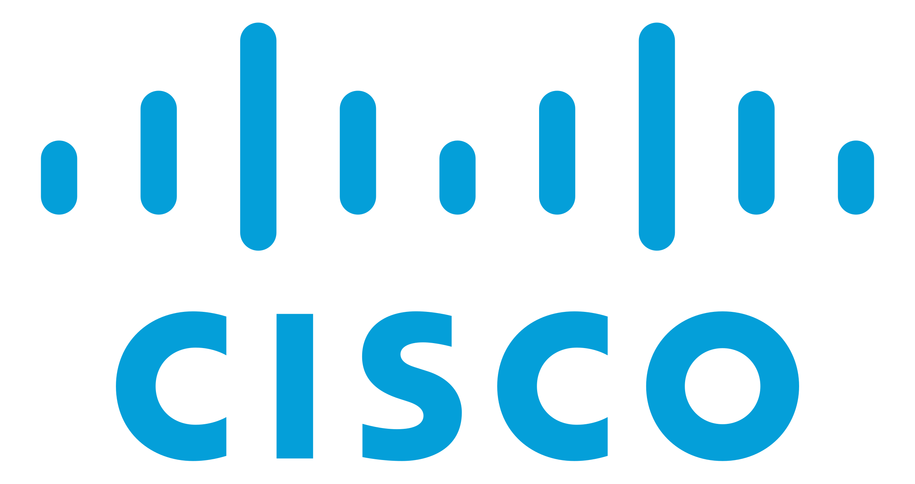
Bring together the technologies to simplify the Multicloud experience with
Unmatched performance with a best in class Azurestack platform
Complete hyperconvergence with unmatched performance for highest workload density & improved TCO
End to end security & broad solution ecosystem

