Slide 1



Data Center Innovation Day

Slide 2
Real-time application visibility and policy management for compliance
Joseph Yap
ASEAN DC Switching Sales Lead, Cisco Systems
Oct 2018

Slide 3
Intent-Based Networking is the future
Translation
Capture intent, translate to policy, and check integrity
Cisco Data Center
Intent-Based
Networking
Application-Centric Infrastructure
Activation
Orchestrate policies and configure systems
Cisco Tetration
Assurance
Continuous verification, insights and visibility, and corrective actions
Network Assurance Engine
Notes:
Some of you may have heard of Intend Based Networking. This is the evolution of automation moving beyond initial provisioning. So what does that mean…real-time analytics enable you to capture business intent and then translate into IT policies, automation activates those policies across the entire data center and continuously validates the original intent stays in it’s desired state.
When we started on this journey of ACI about 4 years ago, we focused on delivering application agility in the data center. We built a policy driven automation framework, our flagship software-defined storage solution, Application-Centric Infrastructure, when combined with our new Network Assurance Engine, turns on the power of intent-based networking. Any changes can be simulated and when pushed out, and immediately validated whether the change was successful and functioning as intended.

Slide 4
The Autonomous Vehicle
Network
Analyze
APP
Assurance
Automation
Notes:
Constantly Learning: Every packet, Every flow Every app ; Machine learning to optimize; Benchmark each
Constantly Adapting: Run-time provisioning; On-demand capacity; Multicloud App mobility
Constantly Protecting: Micro-segmentation based isolation; Securing data in transit; Zero-trust model

Slide 5

Intent-Based Networking for the Data Center
Automation
Intent
Application Centric Infrastructure (ACI)
Policy & Automation
Network Assurance Engine
Tetration Analytics
Assurance
Guarantees
Compliance
Consistency
ADM
Monitoring
Forensics
Analytics
Configuration Analysis
Traffic Analysis
“Lots of Data”

Slide 6
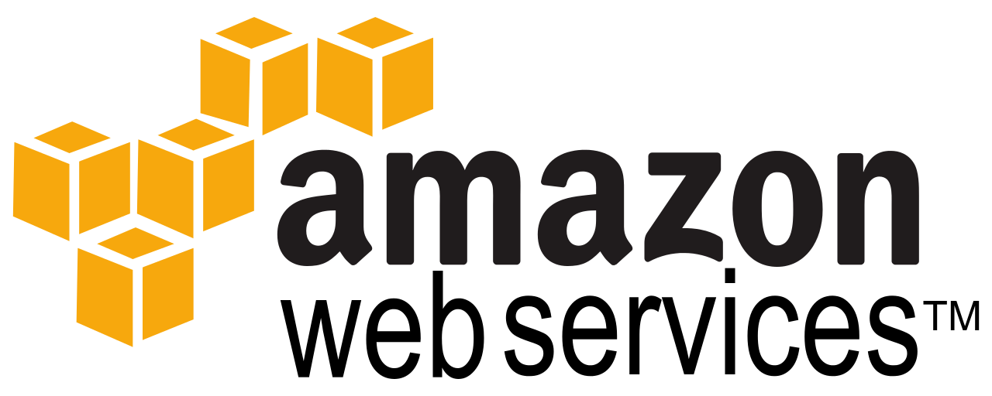





ACI with ACI Anywhere
Any Workload, Any Location, Any Cloud
ACI Anywhere
Remote PoD
Multi-Pod / Multi-Site
Hybrid Cloud Extension
IP WAN
IP WAN
Remote Location
On Premise
Public Cloud
Security Everywhere
Analytics Everywhere
Policy Everywhere

Slide 7
Cisco Network Assurance Engine
Notes:
NAE is addressing the fundamental question we’ve had in networking for decades: Is your network doing exactly what you intended it to do? We’ve never been able to answer this, instead treated the network as a black box, measured telemetry of some packets to infer its health. At NAE, we are taking a completely different approach – one of mathematically Verifying and Validating the behavior of the Network, and doing so continuously. So you have the Confidence that the network IS indeed operating correctly,
This is what we call Always-On Intent Assurance

Slide 8
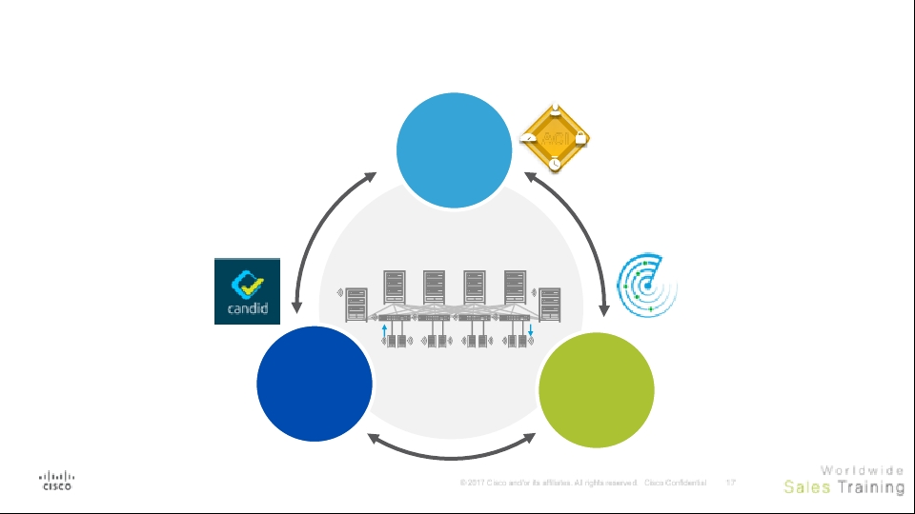

Intent-Based Network for Data Center
Intent
“Should”
Policy &
Automation
ACI
Tetration
Analytics
Cisco Network Assurance Engine (CNAE)
Continuous
Verification &
Validation
Assurance
“Can”
Configuration Analysis
“Very Large State-Space”
Guarantees
Compliance
Consistency
ADM
Policy
Forensics
Analytics
“Has”

Slide 9

Assurance in Other Industries
Chip Design
Functional and Physical Design Verification, Lint, Timing Analysis
Software Verification
Semantic Checks, Dynamic Testing, Memory Profiling
Mars Rover
Mars Rover (B) Still Operational After 14 yrs with Formal Verification
Formal Methods Assure Intent
Notes:
Fortunately these ideas are NOT new, and the concept has been there from Academia. Researchers at Stanford, UIUC re-kindled an idea that was initially talked about almost a decade ago…
They have been used extensively in other domains like chip design for instance.
1) These chips with billions of transistors they’re actually more complex than the networks we actually built. But amazingly, when you send a chip out for fabrication, it comes back and actually works most of the time it is because they have these set of tools built around formal methods. When the designer builds an adder or multiplier or a data pipeline in the high level language like verilog, he can look at his adder and check that given any 64 bit inputs this adder will always do A + B correctly without having to put every possible input stream into a simulation and checking it, that is computationally prohibitive. You can check that this adder, this finite state machine under any input, will not go into some funky state and that it will always complete its operation within 1 clock cycle and when the system translates that adder into the physical design - the gates and metal lines - it can check that they are both exactly the same giving you confidence that the chip will actually come back and work correctly.
2) The same in the software world, the developers have a whole set of tools around dynamic testing, checking memory profiling, checking pointers, checking variables etc.. And as a result, they’re able to catch 99% of the issues before the code is put into production and then putting monitoring tools like app dynamics to catch production traffic related issues. We don’t have that luxury in networks unfortunately we’ve been asked to always make changes in production with no tools, and ensure that there is zero down time. Kind of impossible, but that’s what formal methods help you assure and what Candid is bringing to this market …
With formal methods you can assure intent

Slide 10
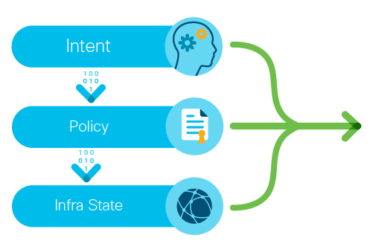
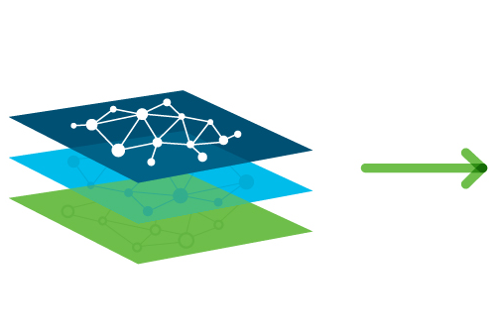
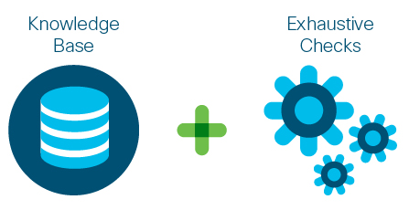
Cisco Network Assurance Engine
Data Collection
Comprehensive Network Modeling
Intelligent Analysis
Captures all non-packet data: intent, policy, state across data center network
Mathematically accurate models spanning underlay, overlay and virtualization layers
5000+ domain knowledge-based error scenarios built-in, codified remediation steps
Notes:
Let’s double-click to see how it works.
1. Starting from the left – what data do we collect. Candid goes to every leaf, every spine in the network and collects all the configurations and control-place state, data-plane state, even hardware state like TCAM tables, VLAN tables etc. From the controller we pick up the entire policy and configs and a representation of the intent. In addition, we have the implicit intent based on the expected network behavior.
2. With all this we now build the comprehensive network model – underlay, overlay, and tenancy layers.
3. Against this model – we run checks based on 30+ years of Cisco operational domain experience. These checks are based on 3 things: i) our expertise on how networks and our hardware should correctly operate, - there should be no routing loops, or no overlapping subnets in a VRFs of duplicate Ips and so on. ii) best design practices that we learn from our AS teams. If you want a subnet to talk externally what are all the BD and L3out configs required, or all the access policies required to correctly deploy an EPG iii) finally, from our TAC cases. The 10% of of failure scenarios that cause 90% of failures in the field. Bringing this collective knowledge for all our customers.
Every 15 mins orso, the engine builds the most real-time model of the network, and runs these checks against that model – like an intelligent robot watching your back, always checking the network for correctness.

Slide 11
What Makes Cisco Network Assurance Engine Unique
Codified Cisco
Domain Knowledge
Deep Policy
Controller Integration
Most Comprehensive Analysis
5000+ built-in failure scenarios
Assures controller policy and configurations
Capture and analyze switch configs + hardware
Notes:
Overlay/underlay/tenant

Slide 12

Cisco Network Assurance Engine
Predict the impact of changes
Proactively verify network-wide behavior
What are the Benefits?
Assure network security policy and compliance
Notes:
Drive increased change agility
Reduce risk of network failures caused by human errors
Ensure connectivity
Eliminate potential network outages
Be proactive before business impact occurs
Reduce security risk
Achieve provable continuous compliance by policy and state

Slide 13
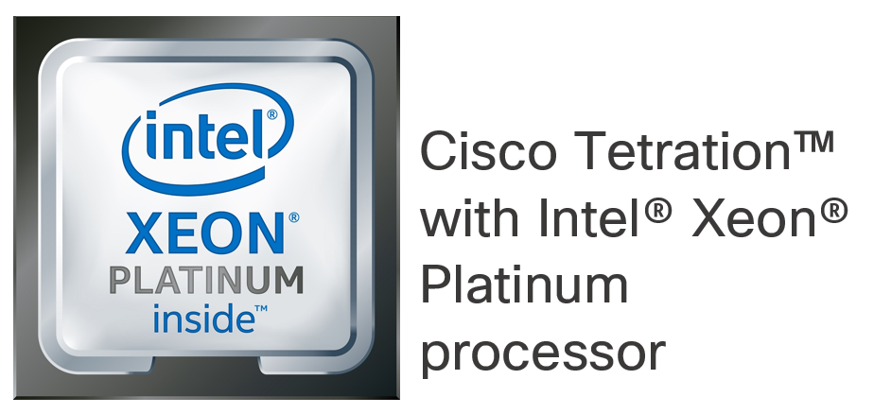
Intent-Based Network for Data Center
Intent
“Should”
Policy &
Automation
ACI
Tetration
Analytics
Cisco Network Assurance Engine (CNAE)
Assurance
“Can”
Guarantees
Compliance
Consistency
ADM
Policy
Forensics
Analytics
“Has”
Traffic Analysis
“Lots of Data”

Slide 14
Tetration Analytics Platform

Slide 15
Cisco Tetration
Understand what’s running in your datacenter
Visibility and forensics
What is running in your datacenter
Process inventory
Application insight
Cisco Tetration
Network performance insights
Main features
Software sensors that support bare-metal, virtual machines and containers
Other telemetry collection option includes Nexus 9000 series hardware, ERSPAN and Netflow sensors
Visibility into every packet, every flow within the datacenter
Information about users accessing application, user groups and location
Long term retention for telemetry and forensics

Slide 16
Cisco Tetration platform
Architecture overview
Web GUI
REST API
Event notification
Cisco
Tetration apps
Data collection layer
Cisco Tetration
Software sensor and enforcement
(Virtual/Bare metal/Containers)
Third-party sources
(configuration data)
Embedded network sensors*
(telemetry only)
ERSPAN sensors*
(telemetry only)
Analytics engine
Netflow sensors*
(Augmentation for telemetry)
*Note: Telemetry only; no workload protection functionalities
Notes:
At the heart of Cisco Tetration is a big data platform, designed to deal with large volumes of streaming rich telemetry, map thousands of applications spanning across tens of thousands of workloads, enforce tens of millions of policy rules for applications. Using Unsupervised Machine Learning, algorithmic approaches and automated enforcement, customers get a turn-key solution with this platform. In addition, platform is designed for long term data retention (months) enabling deep forensics.
Data is collected and fed into Tetration a few different ways
By using a Software sensor on a host. Software sensor also becomes the enforcement point for the policy. Software sensors can be in monitoring mode or monitoring+enforcement mode. Enforcement runs as a separate process for compliance reasons.
When applications are running as containerized workloads, using container host sensors allows the Tetration platform to generate and enforce segmentation policy consistently.
By using hardware sensors located in our 9K switching platform ASIC, where Tetration telemetry is collected in the ASIC and exported from ASIC directly without any impact to switch CPU.
By using ERSPAN sensors, where copy of the network traffic is sent to a dedicated VMs running sensors using ERSPAN. These VMs have Tetration sensors which remove the ERSPAN headers and generate the Tetration telemetry.
All of his enables us to work in both Cisco and Non Cisco environments as well as Private and Public Cloud environments. These options enables complete coverage from operations and security perspective.
As part of the telemetry collection, there are four types of information that is collected. Standard flow details, inter-packet variations, context details and inventory of software packages installed on the servers. Context details for example is the process information that is running on the server and that is tied to actual traffic flow.
Each sensor captures only metadata from the packet header. Sensors do not collect any information from payload. Payload can be encrypted and does not impact any analysis that’s done on the platform.
In addition to the collection sensors we can add 3rd party configuration data. Like SLB configs., ACE, F5 information, HA-Proxy, Route-Tags, etc.. to increase it’s full understanding of your environment.
Tetration provides multiple different access mechanism for the data and information. Robust Web based user interface that allows you to visualize information using intuitive charts and advanced indexing algorithms enables users to search and replay information from data lake in couple of seconds. Tetration Platform is designed to be open. Its Open Access method provide REST API for users to query the information from a northbound system, Publish notifications to northbound systems using Kafka message bus, for example trigger a notification when an application communication deviates from the policy. Custom Apps enables developers to write their own application on the platform using python or Scala. It provides access to the deep store within the platform and developers

Slide 17
Cisco Tetration data sources
Software sensors
Network sensors
Other sensors
Virtual, Bare metal and Containers
Next-generation Cisco Nexus® Series Switches
Other types of sensors
Linux servers
(virtual machine and bare metal)
Cisco Nexus 9300 EX
ERSPAN sensor
Windows servers
(virtual machines and bare metal)
Cisco Nexus 9300 FX
Netflow sensor*
Windows desktop VM
(virtual desktop infrastructure only)
Container host
(Linux container host OS)
*Telemetry augmentation only
Main features
Low CPU overhead (SLA enforced)
Low network overhead
Enforcement point (software agents)
Highly secure (code signed and authenticated)
Every flow (no sampling) and no payload
Server process and software package information
Notes:
Software sensors:
Current Release supports Linux and windows server based workloads. These can be bare metal server or VMs. Software sensors collect the meta data information from packet header’s that leaves or enters the hosts. In addition to the packet meta data it also collects the process information, user id associated with the process and other OS characteristics. Sensors in general does not collect any information from the payload, which is important when you take into consideration PII and other legal/security concerns.
Software sensors also can act as enforcement points for application segmentation. Policy for the segmentation is provided by the Tetration platform and software sensor orchestrates it using OS capabilities. Tying the packets to the process provides a powerful security use case and can enable you to implement enforcement.
The Software sensors also guarantees SLA. It uses less than <3% CPU of CPU. On average we have been seeing 0.5% CPU utilization on our current installs. This threshold limit is configurable. So you can set a limit to the CPU Utilization is can use. (please note this can cause packets to be dropped)
In this release, we have introduced what are called as “Universal Sensors”. These are primarily used for application dependency use cases, where certain applications components may be using other legacy operating systems (example: AIX, Solaris). In this case universal sensors provides basic information about the connectivity and conversation view that enables Tetration platform to perform ADM. Information collected by Universal sensors is limited in nature, does not include per packet information and it does not support enforcement.
Sensor security, authentication, cannot be copied, code signed by Cisco and customer’s PKI infrastructure. Managing of the software sensors can be done through cluster itself.
Network sensors – embedded into our next generation hardware. Hardware sensor monitor and build flow information for every packet coming into the switch. This is all done at line rate speed. (it is our patented ASIC that provides this capability. No one else in the market can do this today).
Flow information is directly exported from the hardware to the Tetration cluster. This does not impact CPU utilization on the switch. This is highly scalable model where each switch can export up to 32K flows every 100ms.
3rd party data sources – The Tetration Platform allows you to add 3rd party data sources like F5, IP address management database, DNS Configurations and others to increase Tetration’s full understanding of your environment. In addition, customers can also import information about the workloads and traffic types using asset tagging. This enables granular identification of resources and types of resources. (See next slide for details)

Slide 18
Performance monitoring
With deep-visibility software sensors only
Application
Process or server cannot drain traffic fast enough
Identify whether limitation is on provider or
consumer slide
Network
Network congestion is causing TCP congestion
and window collapse
Enhanced TCP metrics
SRTT latency
Application-perceived latency
TCP retransmissions
TCP congestion window reduced
TCP MSS changed
TCP zero window
Long TCP handshakes
With deep-visibility software sensors
installed on servers
Cisco Tetration™
Notes:
When using deep visibility software sensors on Linux and Windows servers, Tetration platform can provide key insights regarding TCP flows within the network. Using machine learning, Tetration platform identifies if the performance issue is because of a network bottleneck or because of server and process on the host. If the bottleneck is on the server side, it can also identify if the issue is on the provider end or consumer end. In addition, Tetration provides information regarding
-- Application perceived latency → how long a process took to respond to a request
-- Network round trip latency
-- Indicators on reducing TCP window sizes or zero window
-- Tracking how long it takes to establish TCP sessions → long TCP handshake
-- Where TCP re-transmissions are happening
All this information is available in time-series view which allows you to go back in time and take a look at the information for diagnostics and troubleshooting purposes.
This is possible because of the per packet telemetry data collected from the servers and applying the analytics using supervised and unsupervised machine learning. For example, by correlating TCP congestion, retransmissions and TCP window collapse, Tetration can identify that the issue is on the network end.

Slide 19

Performance monitoring
With Cisco ACI and Cisco Nexus 9300 FX switches
Track topology and topology changes using time series
Covers fabric and external devices such as servers
(LLDP required)
Flow-context-specific topology views
View traffic flow information in time series
Mapping of individual flows to fabric topology and queues
Per-flow hop-by-hop path view
Per-hop latency and fabric latency
Fabric drop indicators
Burst detection and packet drops due to traffic burst
View link and queue information in a fabric in time series
Flows through a particular link
Throughput information
Average and maximum latency
Drop indicators
Burst indicators
Additional flow search capabilities
Search for specific flows within a link and queue
Search based on fabric links
Search based on class of service
Cisco ACI™ infrastructure using Cisco Nexus® 9300 FX leaf switches and Cisco Nexus 9300 FX line cards in spine
Cisco Tetration™
*PTP required in production fabric
Notes:
When using Nexus 9300-FX leaf switchs and 9300-FX line cards in a Cisco ACI fabric, Tetration can provide insights into what happening in the network infrastructure. Operations team can quickly identify
where is the congestion in the network
what applications are impacted due to link congestion
which applications use which links
what is the latency within the fabric, on each hop
what flows are experiencing packet drops
what does the hop by hop path look like for each application flow
what is the flow end to end latency
what is the Class of Service per flow
All this information including the topology data is available in time-series view which allows you to go back in time and take a look at the information for diagnostics and troubleshooting purposes.

Slide 20
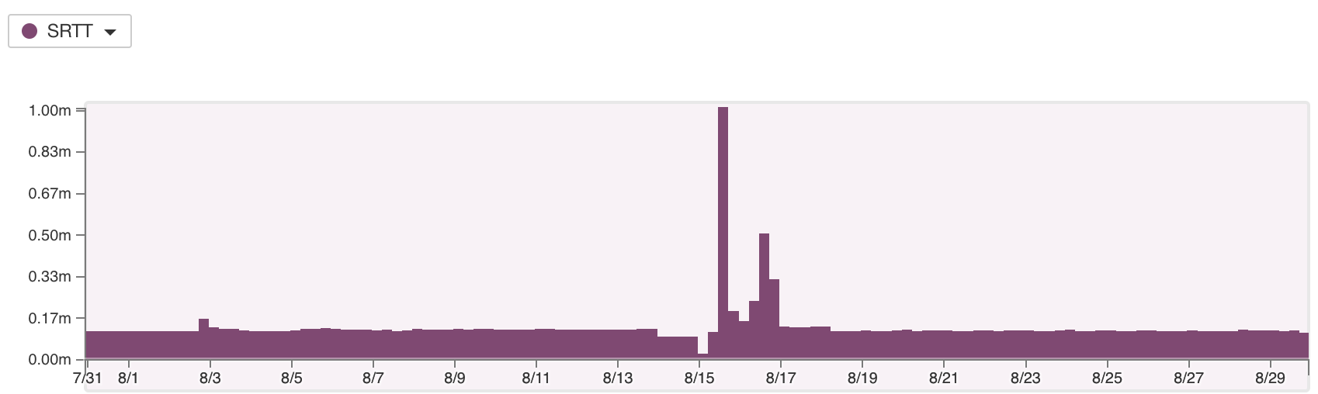
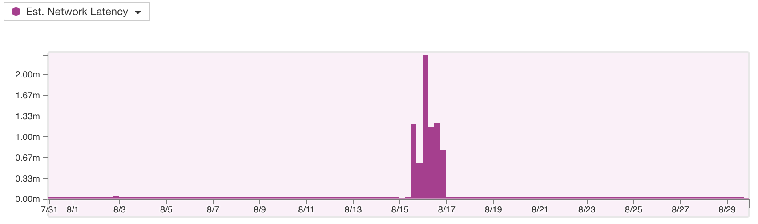
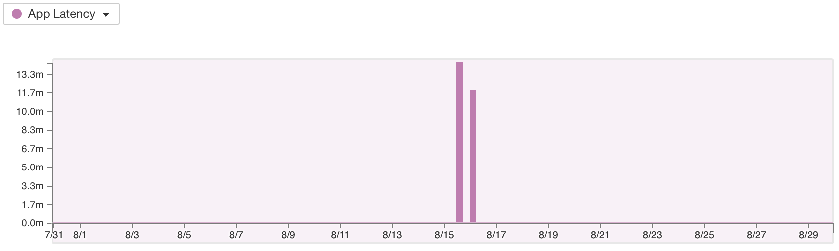
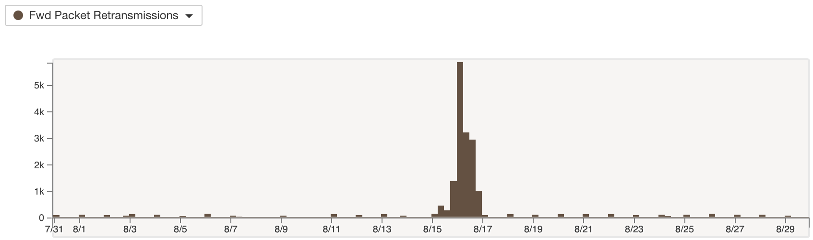
Visibility into network performance trends
Visualize network trends for application or subnet or datacenter
Get answer to key performance questions
What is the round trip trend look like for
this application?
How many retransmissions are seen for this application over the selected time range?
What is the application response trend
looks like?
Is the traffic throughput inline with baseline or are there significant deviations?

Slide 21
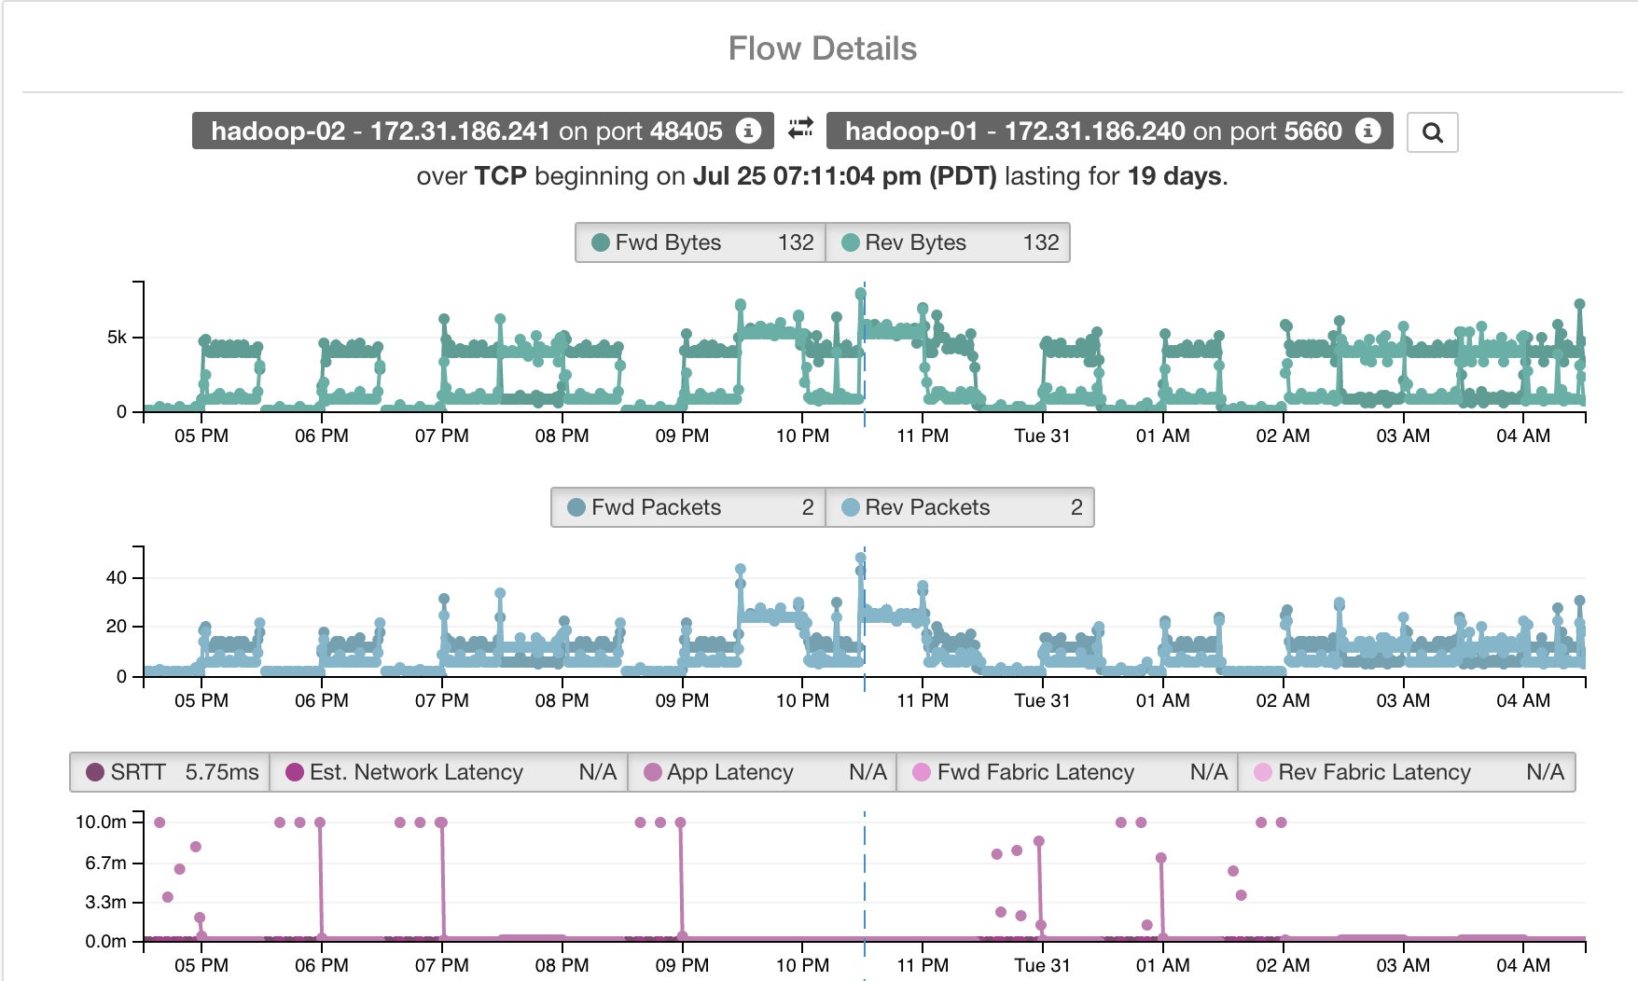
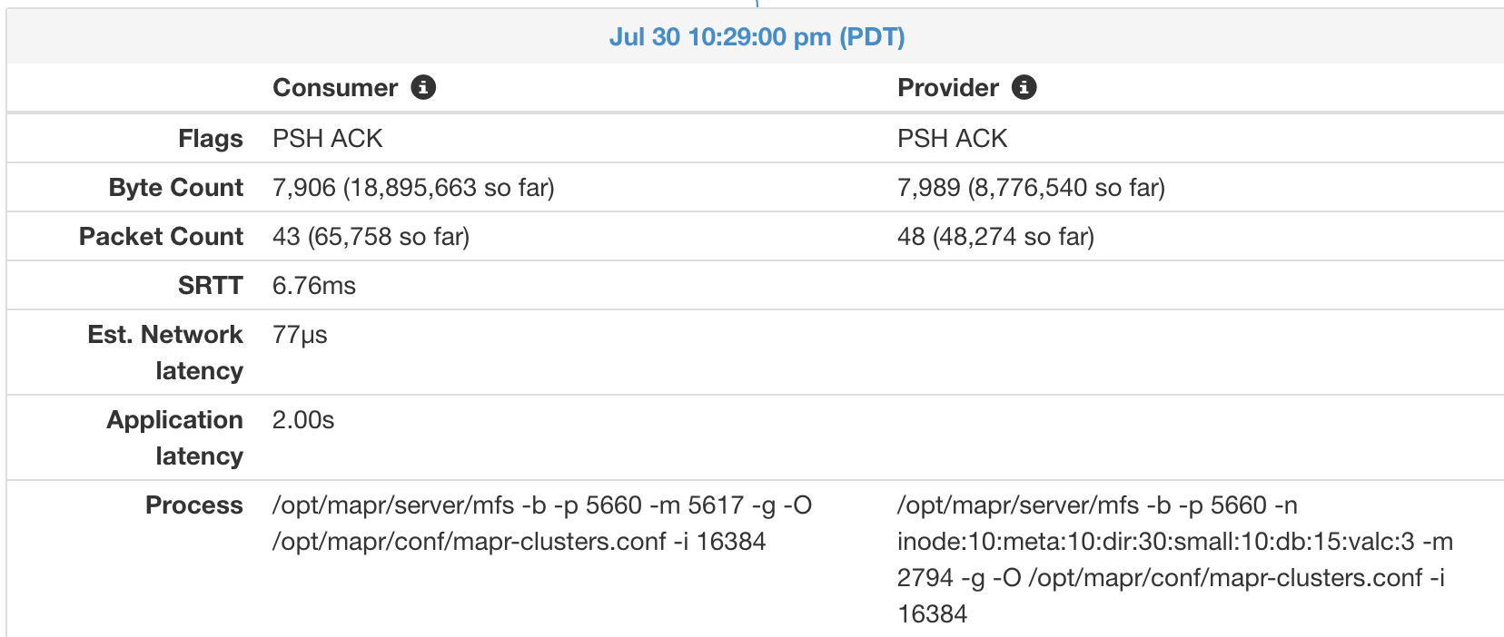
Drill down into granular flow details
Visualize granular flow details between server – server or server - client
Drill down up to process information
Quickly identify key performance metrics for that specific flow
SRTT
Estimated network latency
Application response latency
Fabric and hop-by-hop level performance data (if hardware sensors are available)
Navigate across the timescale to the metrics at a specific time

Slide 22

Cisco Tetration Platform
Security use cases
Advanced security
Process security
Software
inventory baseline
Segmentation
Whitelist policy
Application segmentation
Policy
compliance
Cisco Tetration
Insights
Visibility and
forensics
Process inventory
Application insight
Notes:
Cisco Tetration is an analytics platform that provides a turn key solution for the data center security use cases. This removes any requirement for in-house data scientists or other programming expertise to deploy, operate and realize the benefits from the platform. These features are supported independent of the infrastructure that you have and where the applications are running.
In the Cisco Tetration platform we start with collecting rich telemetry from both servers as well as network, use unsupervised machine learning and other algorithmic approaches to baseline the behavior of the workloads and apply statistical models on top. Telemetry it collects includes meta data from every packet header (monitor every packet, every flow) within the datacenter, process related details on the servers such process name, user, process execution details and process binary hash. The platform correlates the network traffic to the process on a server.
Application insight use case is designed to provide clear and accurate view of application communications and its dependencies. It also provides information about which communication is going through L4-7 serverices such as load balancers, other infrastructure services that these applications are dependent on and external entities accessing the application.
Building on the insights foundation, Cisco Tetration extends the capability on the security by providing the ability to auto generate a consistent white list policy based on application behavior and near real-time approach to keep the policy up to date as the application behavior changes. Perform policy simulation and impact analysis using historical data or real-time data to determine what traffic will be allowed what will be dropped if that policy is enforced.
Application Segmentation: With Tetration analytics we are extending the platform to take action based on the white list generated as part of application Insight. This policy can then be enforced consistently to realize a consistent segmentation. Implementation of granular policies using operating system capabilities such as Iptable or windows firewall on the servers provides massive scale, consistent implementation whether it is a virtualized, bare-metal or container workloads. This model also ensures that the policy stays intact even when the workload moves. Once the policy is enforced, platform continuously monitors for compliance. If there is any policy deviation then notification is sent to northbound systems, enabling proactive security operations.
Process behavior deviation: Next step is to baseline the behavior of the processes running on the servers. Then apply models to identify any behavior deviations and compare them with known “bad” patterns exhibited by these processes. When these indicators of compromise are detected early on you can minimize the impact by faster remediation.
Software vulnerability detection: last but not least, keeping an accurate inventory of the software packages and versions installed on the servers and then identifying common vulnerabilities and exposures associated with them is also key. This enables you to significantly reduce risk and threat exposure from known vulnerabilities.

Slide 23
Cisco Tetration application segmentation
Policy recommendation
Application workspaces
Public
cloud
Private
cloud
Application
segmentation
policy
Cisco Tetration™
On-premise
Notes:
In order to implement effective and efficient Application segmentation is critical to understand how application components are communicating with each other, what infrastructure services they are dependent on and how the component clusters are grouped together. Tetration uses rich telemetry and un-supervised machine learning to achieve this. This application insight and dependency forms the basis for the segmentation policy. To get started, customer needs to deploy Tetration Analytics platform and deploy the agents. If customer has the Nexus 9300-EX switches they can turn on hardware sensors, in addition to the software sensors.
Application administrators can perform ADM runs and create application workspaces. Application workspace allows users and administrators to:
Group endpoint hosts and application clusters together to create application views
Accurately understand the relationship of consumers and providers based on communication patterns
Understand the service dependencies for each component
Associate labels and tags with endpoints for easy understanding
[Mention this only when Audience is more technical and can understand hierarchy]
An application can be have multiple workspaces in a hierarchy. For example at the lower level may be the application team such as HRMS. HRMS may be using a database and that database could be part of 5 other applications. Even higher would be security ops or network ops teams defining their policy. When Tetration platform generates the policy it automatically merges the higher level policy with the application specific policies. For example, these could be production workload should not talk to non-production workload, database servers cannot connect to internet.
Application administrators will be able to view the higher level predefined policies but will not be able to modify it.
White-list policy for segmentation is available from the application workspace.

Slide 24
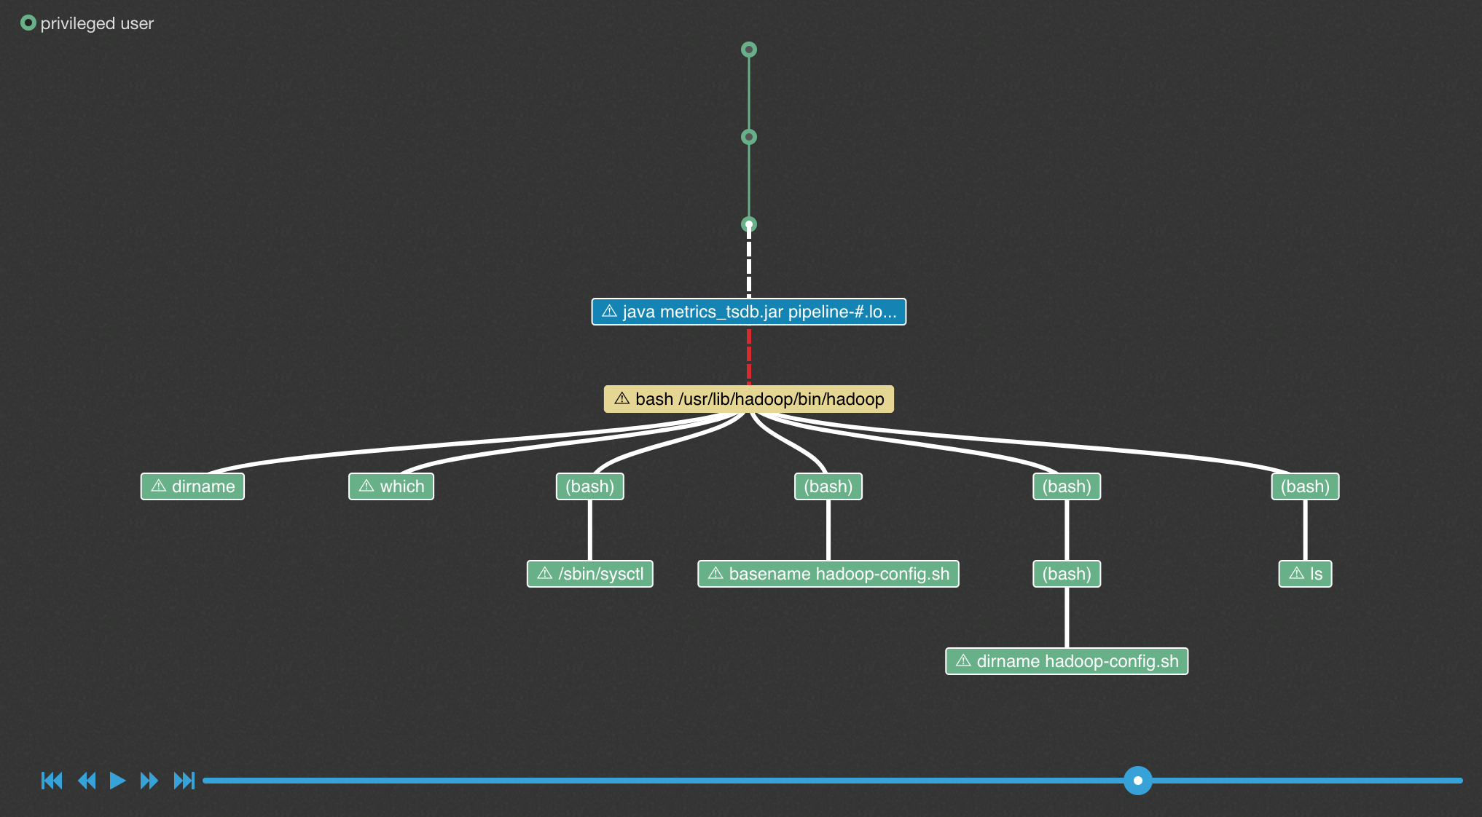
Identifying process behavior deviation
Cisco Tetration Analytics™
Match the process behavior deviations with malware behavior patterns to suspicious activities
Search for specific process events and find out the details, for example:
  Privilege escalation
  Shell-code execution
  Side channel attack
Privilege escalation
Notes:
In Cisco Tetration, we have reverse engineered and modelled malware and its behavior patterns, to identify process behavior deviations, For example a privilege escalation by a process followed by a shell code execution is a definite indication of compromise. It is also designed to identify side channel attacks, raw socket creation, track user login activities on the servers, etc., This model allows the platform to detect critical security events such as Spectre and Meltdown.

Slide 25
Deployment options

Slide 26
Cisco Tetration: On-premises deployment options
  On-premises appliance options
  Virtual appliance options
  Cisco Tetration™ Platform
  (large form factor)
  Suitable for deployments of more than 5000 workloads
  Built-in redundancy
  Scales to up to 25,000 workloads
  Includes:
  36 Cisco UCS® C220 servers
  3 Cisco Nexus® 9300
  platform switches
  Cisco Tetration-M
  (small form factor)
  Suitable for
  deployments of less
  than 5000 workloads
  Includes:
  6 Cisco UCS C220 servers
  2 Cisco Nexus 9300
  platform switches
  Cisco Tetration Virtual
  Suitable for deployments of up to 1000 workloads
  Supported in VMware ESXi-based environment
  Customers provide their own hardware and storage to run Tetration-V
  Simplified deployment process
  Faster realization of Tetration benefits
Software subscription license based on number of workloads; available in 1-, 3-, and 5-year terms

Slide 27
Cisco Tetration software-as-a-service option
  Cisco Tetration™ SaaS
  Software-as-a-service model:
  No need to purchase, install and manage hardware or software
  Fully managed and operated
  by Cisco
  Suitable for commercial
  customers and SaaS-first/SaaS-only customers
  Flexible pricing model; lower barrier to entry
  Quick turn up
  Scales to up to 25,000 workloads
Public
cloud
Real-time Data Sync
Private
cloud
Legacy
Software subscription license based on number of workloads; available in 1-, 3- and 5-year terms

Slide 28
In summary: Platform built for scale and flexibility
  Real time and scalable
  Holistic workload protection
  Easy to use
  Open
Every packet, every flow
Application segmentation for 1000s of applications
Extends visibility to process and software packages
Long term
data retention
Consistent application segmentation
Any workload, anywhere
Process behavior deviations
Software package vulnerability
One touch deployment
Self monitoring
Self diagnostics
Standard web UI
REST API (pull)
Event notification (push)
Tetration applications

Slide 29
What are we
Delivering?

Slide 30
The Autonomous Vehicle
Notes:
Constantly Learning: Every packet, Every flow Every app ; Machine learning to optimize; Benchmark each
Constantly Adapting: Run-time provisioning; On-demand capacity; Multicloud App mobility
Constantly Protecting: Micro-segmentation based isolation; Securing data in transit; Zero-trust model

Slide 31
Intent-Based Networking for the Data Center
Automation
Intent
Application Centric Infrastructure (ACI)
Policy & Automation
Network Assurance Engine
Tetration Analytics
Assurance
Guarantees
Compliance
Consistency
ADM
Monitoring
Forensics
Analytics
Configuration Analysis
Traffic Analysis
“Lots of Data”

