Slide 1



FLASHSTACK
FAST & SIMPLE
Chin Yi Shuen
SE Director ASEAN/Greater China

Slide 2
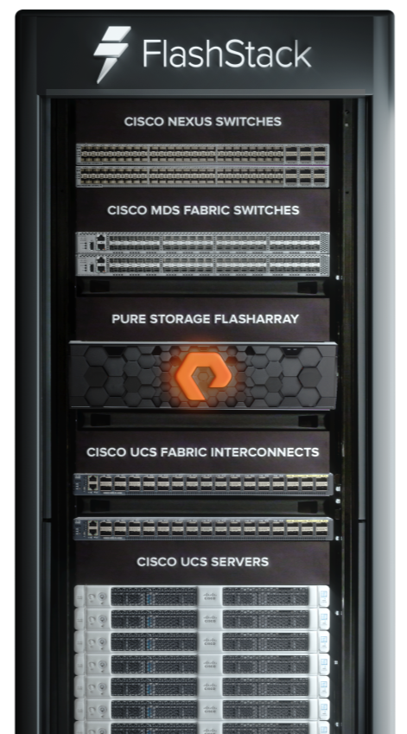
Cisco UCS: Server platform built for the cloud
Cisco Fabric: data center fabric switching
FlashStack Data Centric Architecture
Data-centric
architecture
Pure Storage: Evergreen storage
Stateless compute
  Highly dense, modular, policy-driven compute platform
  Backwards and future compatible; in-chassis upgrades
Fast networks
  Fibre Channel or Ethernet/iSCSI storage interconnect
  Nexus 5K, 7K, 9K. MDS. Customer-defined choice for configurations
  All-flash storage systems built for the cloud era
  Fibre Channel, iSCSI, NFS, or S3 Storage
  Backward and future compatible; in-chassis upgrades
Fast, reliable
shared storage
CONSOLIDATION
SIMPLIFY OPERATIONS
SCALE WITH AGILITY
Notes:
First this lets look at the NVMe protocol.
The NVMe protocol is a parral that in time will enable direct communication between applications and flash storage, performance will significantly change. Today ata storage level wwe are see significant improvesmnet in latency
Eliminates off host latency, improves CPU prosession overheads

Slide 3
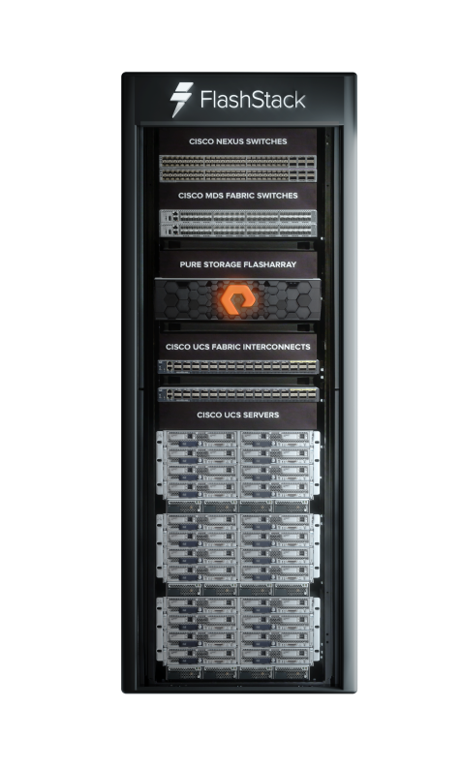
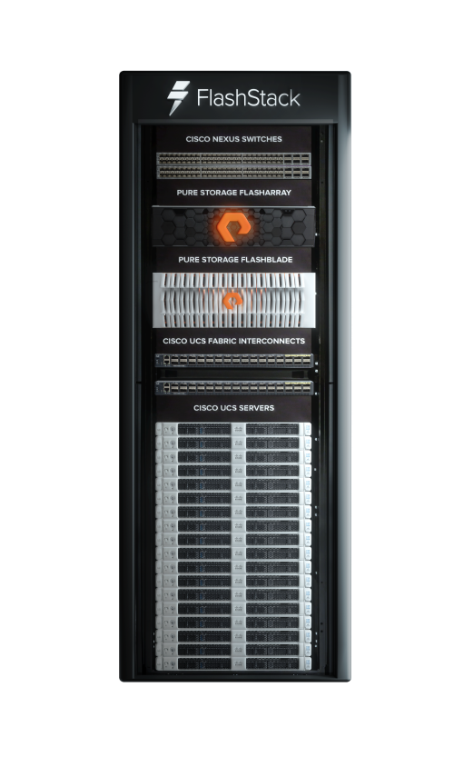
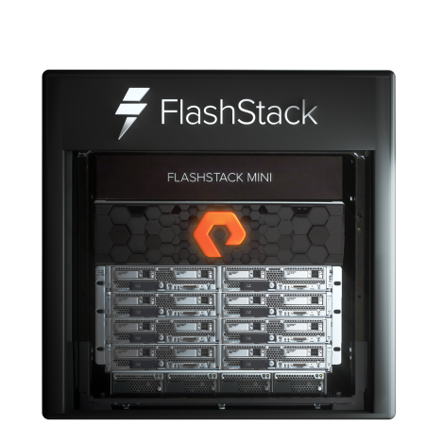
Flexible deployments for your business
FlashStack with FlashArray
FlashStack with FlashBlade
FlashStack Mini
Data center consolidation or hybrid cloud
Cisco UCS® B-Series or C-Series Servers
All-flash block storage
Fibre Channel or iSCSI
Data warehouse, analytics, or
artificial intelligence
Cisco UCS B-Series or C-Series Servers
All-flash file and object storage
Small deployments or
specialized applications
Up to 16 Cisco UCS B-Series Blade Servers
Starting at 5TB all-flash block storage
Fibre Channel or iSCSI

Slide 4
Cisco and Pure Storage: A growing alliance
2015
Pure Storage IPO with ALL-FLASH storage
FlashStack Love Your Partner (LYP) Channel Incentive
Hundreds of FlashStack customers globally
Thousands of FlashStack customers globally
ActiveCluster, OpenPay,
MDS Resell
#1
8
14
8
>100
>1K
Cisco and Pure Storage announce FlashStack
1st CVD
5000 seat VDI Citrix XDT
8th CVD – data protection with Commvault and Cisco® S3260
Cisco ACI™, Cisco UCSD 6.5,
//X NVMe storage,
Cisco UCS® M5 processors, FlashBlade,
14th CVD FlashStack with FlashBlade for Oracle
2016
2017
2018
Notes:
Partnered with Cisco to redefine Converged Infrastructure by bringing to the market the first All Flash Converged Solution!
3 main investment strategies: -
Continue to innovate and make robust the core key features of FlashStack (call out all the key new features and functionality from Cisco and Pure e.g. ActiveCluster,…, TechData Integration Services, M5 processors, UCSD, Cloud Center, Cisco Workload Optimizer)
Exapnd addressable market for today’s traditional (Oracle, SAP, MS, …) AND nex gen workloads (big data analytics, containers, AI, etc…) in major verticals – Financials, Mfg, Healthcare, etc…
Cloud-connect i.e. build out a FlashStack Private Cloud with connectivity to AWS, etc…
This leads into what’s next – e.g. additional automation, FlashStack with FlashBlade opening up AI, Accelerated Analytics, etc…
JUST GETTING STARTED!

Slide 5
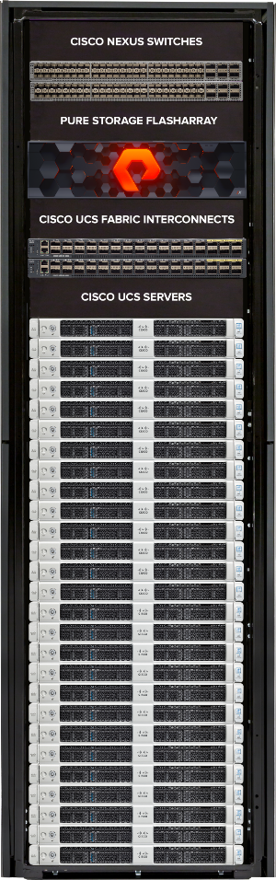
MODERNIZING PRIVATE CLOUD WITH FLASHSTACK
WORKLOAD CONSIDERATIONS
MOST ENTERPRISES
HAVE NON-UNIFORM
WORKLOADS
BEST SERVED
BY A DISAGGREGATED
ARCHITECTURE
SCALE INFRASTRUCTURE
COMPONENTS
INDEPENDENTLY TO
MEET WORKLOAD REQUIREMENTS
CPU
CPU
CPU
CPU
CPU
CPU
CPU
CPU
DISK
DISK
DISK
DISK
DISK
DISK
CPU
CPU
CPU
CPU
CPU
DISK
DISK
DISK
DISK
DISK
CPU
CPU
CPU
CPU
DISK
CPU
DISK
DISK
DISK
DISK
DISK
CPU
CPU
CPU
CPU
DISK
CPU
DISK
DISK
DISK
DISK
DISK
CPU
CPU
CPU
CPU
CPU
CPU
CPU
DISK
DISK
DISK
DISK
DISK
DISK
CPU
CPU
CPU
DISK
CPU
CPU
DISK
DISK
DISK
DISK
DISK
VDI, TIER-2 VSI,
TIER-1 VSI, & BUSINESS CRITICAL APPS

Slide 6


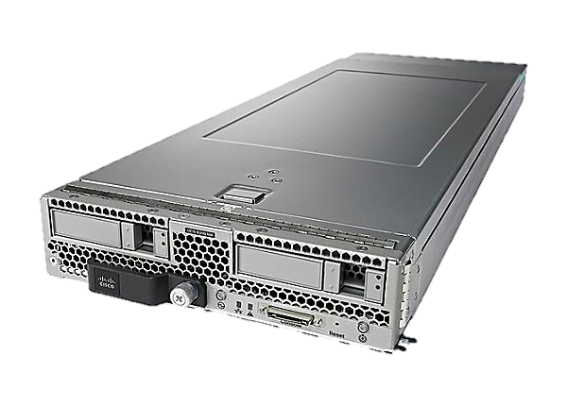
ELASTIC SCALE SOLVES THE PROBLEM
DISAGGREGATING COMPUTE & STORAGE OFFERS FLEXIBILITY TO MEET ANY NEED
ADD BLADES 1 AT A TIME TO LINEARLY SCALE STORAGE PERFORMANCE & CAPACITY
ADD NODES 1 AT A TIME TO SCALE COMPUTE PERFORMANCE
Notes:
It looks something like this. If you go from middle to the right, this is your file system. When you add more compute nodes as your compute needs increase, you slightly add your preferred compute nodes as your build up your rack. If you storage needs increasing, just add more blades. You don’t have to be stuck in 2014 tech. The elasticity can adjust based on your business changes and needs. You don’t have to overpay for any of the systems. Let’s walk through an example. (click next slide)

Slide 7
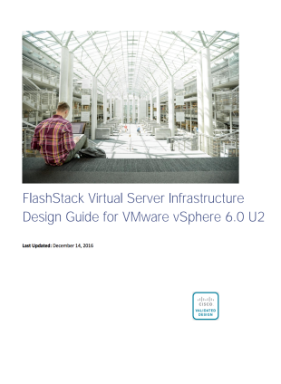
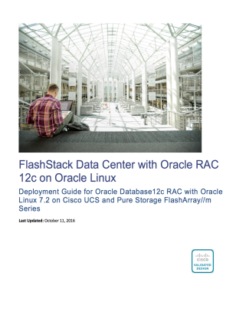
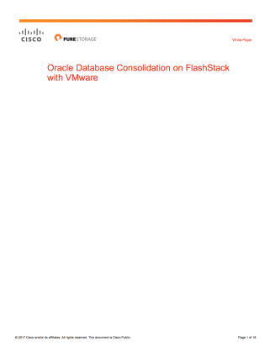
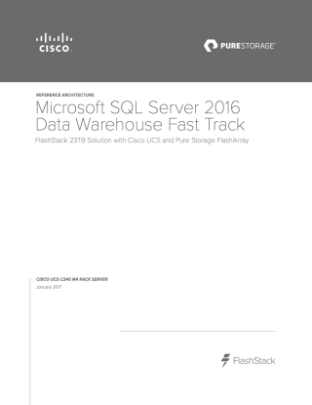


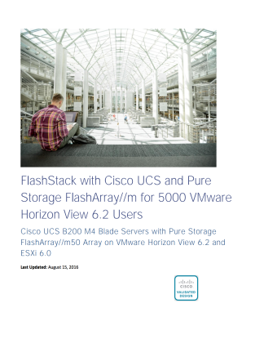
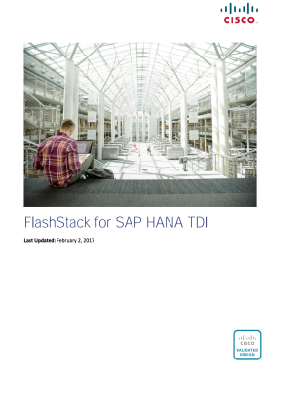
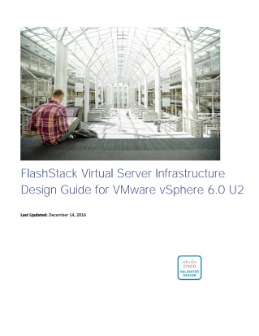
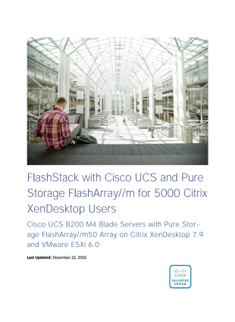
CISCO VALIDATED DESIGNS
. . . and joint collateral
Cisco Validated Designs (CVD)
Joint white papers
Recently released
FlashStackMINI
Citrix XenDesktop with
Microsoft Hyper-V
Reference Architecture
vSphere
vSphere 6.5 Update 1
EPIC EMR
Reference Architecture
FlashStack
vSphere 6.5/Horizon View
Reference Architecture
Commvault Data Protection
for Oracle Databases
Reference Architecture
Commvault Data Protection
for
Virtual Server Infrastructure
CVD
FlashStack
Virtual Server Infrastructure with Cisco ACI and Pure Storage FlashArray
vSphere 6.5 Update 1
Notes:
16 CVDs jointly covering solutions including Databases, Desktop/Server Virtualisation, Data Protection

Slide 8

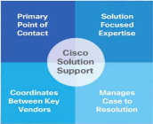

FULLY, EXPERTLY SUPPORTED
Enhanced
cooperative support
Cisco solution support for critical infrastructure
Flashstack-authorized
support partners
        Support provided directly, individually by Cisco or Pure Storage
        Cisco and Pure Storage collaborate
        on expediting tickets via the TSAnet mechanism
        Cross-trained teams make support quick and efficient
        Single-call experience delivered
        by Cisco
        Part of a Cisco SMARTnet™ contract
        Cisco staff trained on Pure Storage and FlashStack
        Single-number experience delivered
        by selected partners
        Part of partner services offerings
        Meet stringent training and quality requirements

Slide 9



























FlashStack customers
Notes:
Approved for public use by Customer References team

Slide 10

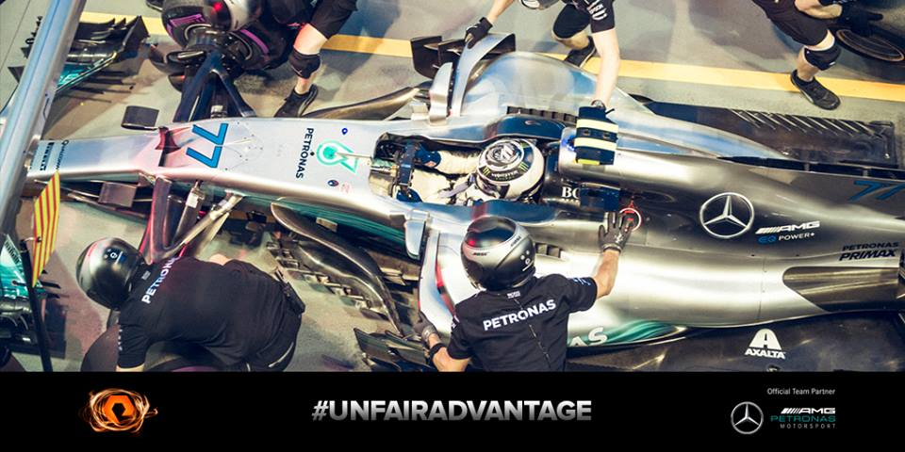
Data-set, Ready, Go!
Burning Rubber and Churning Data!

Slide 11
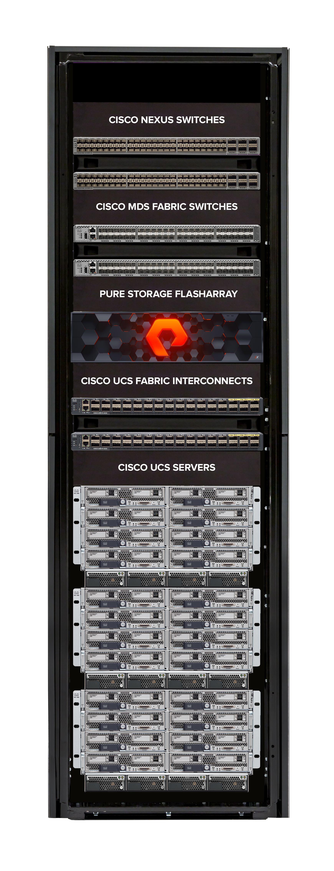
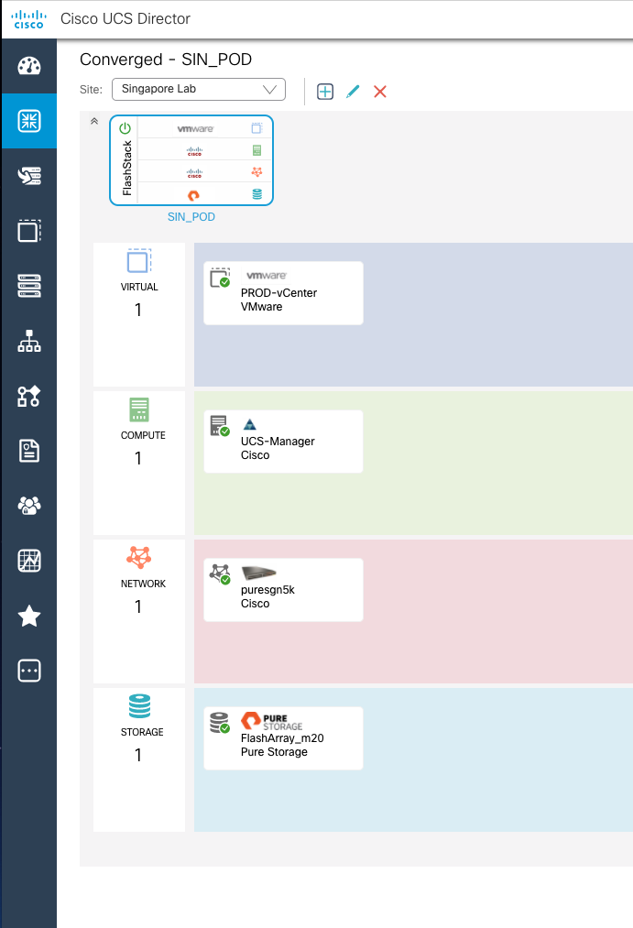
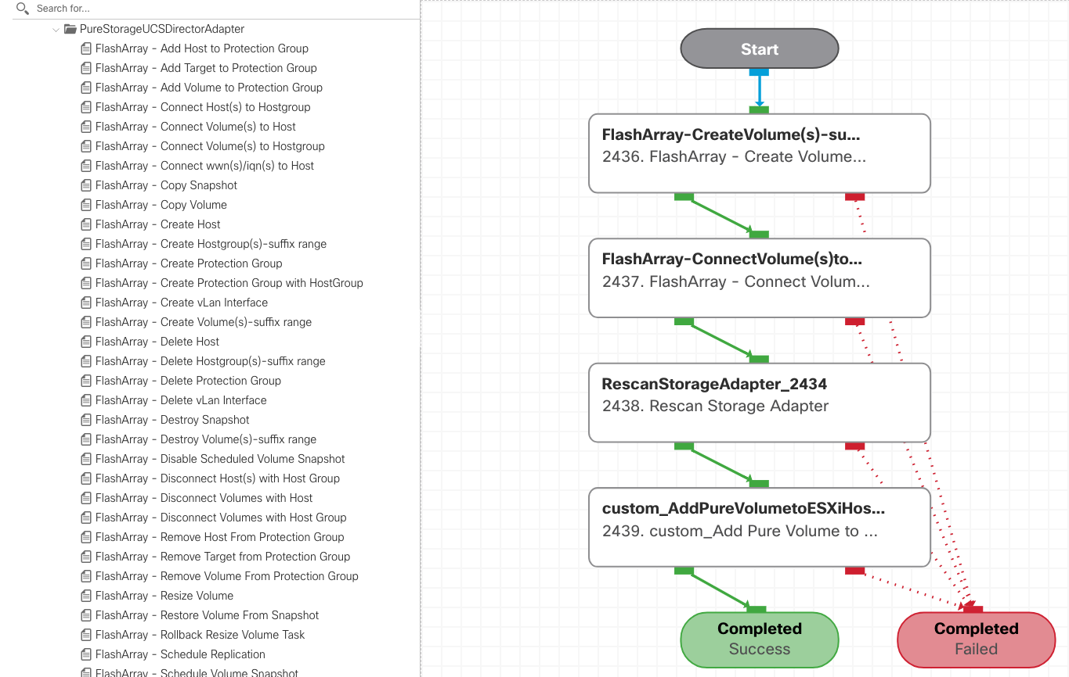
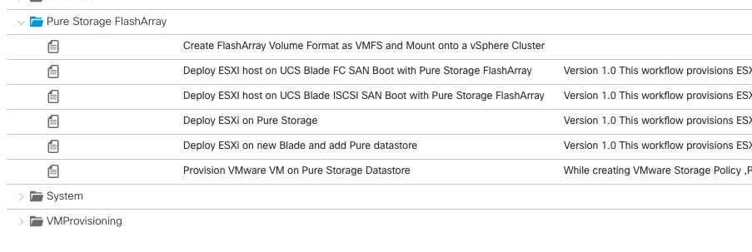
FLASHSTACK FOR PRIVATE CLOUD
UCS DIRECTOR FOR END-TO-END ORCHESTRATION
    OVERVIEW
    Developed jointly by Cisco’s select contractor OneCloud and Pure Storage
    Cisco TAC leverages OneCloud for UCS Director support and training
    Cisco field and partners use OneCloud globally for service engagements
    FEATURES
Capacity and Inventory views and reports
ESXi end to end deployment workflow automation for iSCSI and FC
UCS Bare metal agent (PXE boot) image bootstrapping
VM provisioning on FlashArray Datastore
Provisioning tasks with rollback: -
  Volume (Create/Destroy/Resize/Clone/Restore)
  Host and Host Group (Create/Delete/Connect/Disconnect)
  Protection Group (Create/Delete/Add/Remove)
  Snapshots (Clone/Schedule/Delete)
  VLAN (Create/Delete)
AVAILABLE ON GITHUB: - www.github.com/purestorage/ucs-director-plugin
Notes:
v2.2 released in Dec 17, supported since UCSD 5.4 > 6.5

Slide 12
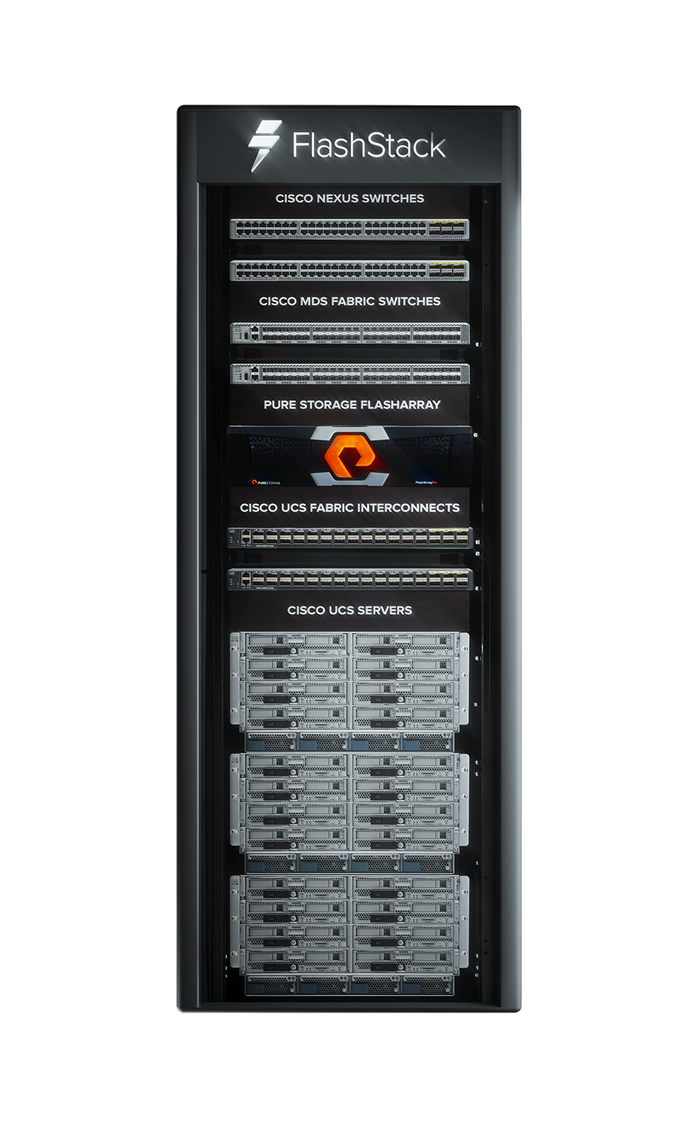
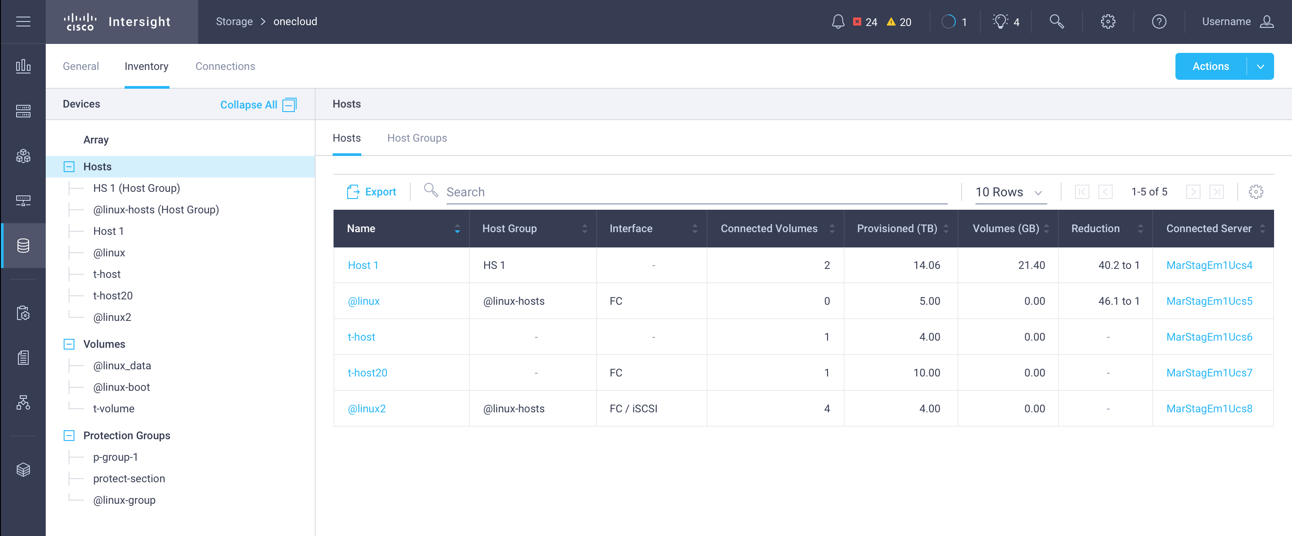
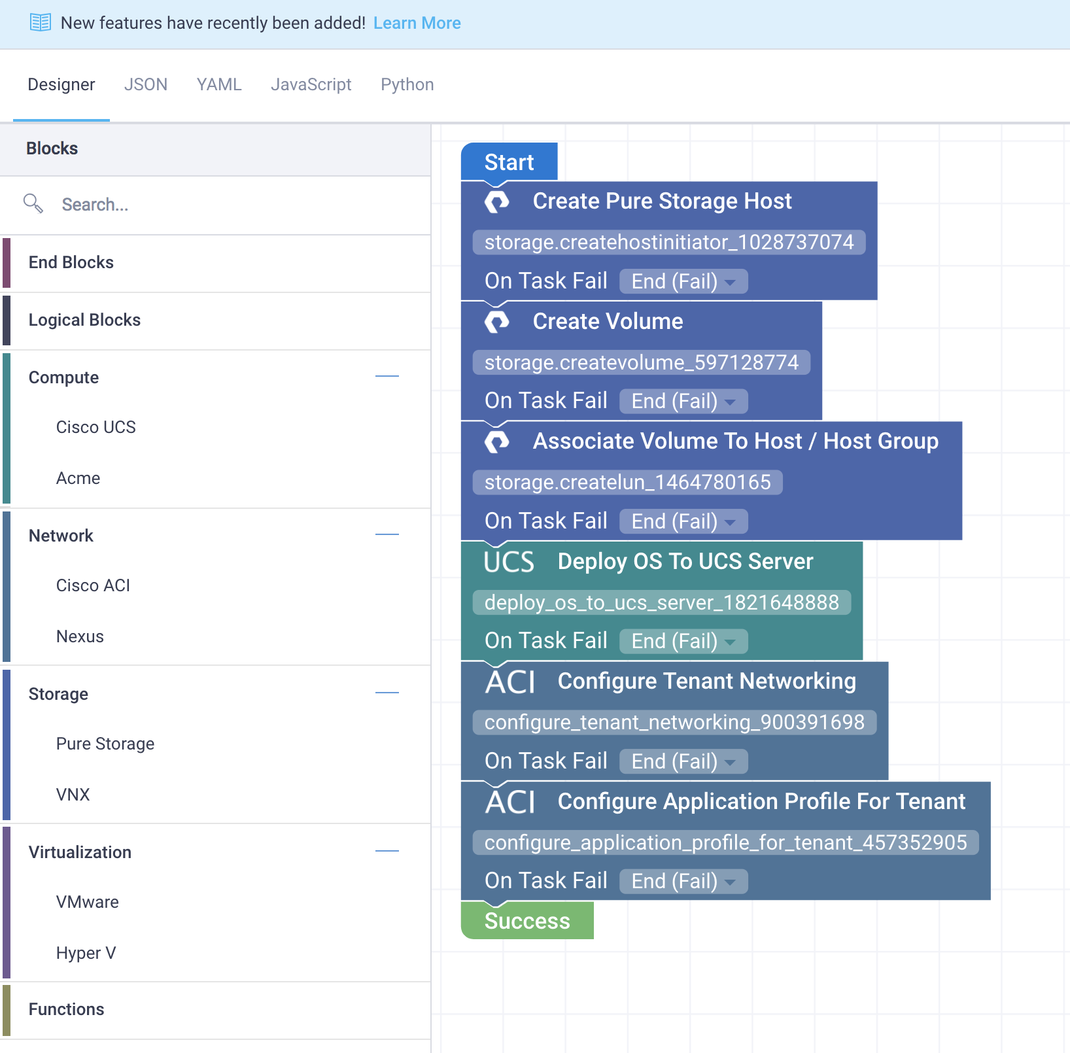
CISCO INTERSIGHT
POC
FLASHSTACK INVENTORY, ORCHESTRATION AND AUTOMATION
    OVERVIEW
    Announced at Cisco Live Orlando 2018
    Developed jointly with Cisco and Pure Storage
    Leverages Cisco Intersight Device Connector for Pure Storage FlashArray
    FEATURES
Capacity and Inventory views and reports
Provisioning tasks with rollback: -
  Volume (Create/Destroy/Resize/Clone/Restore)
  Host and Host Group (Create/Delete/Connect/Disconnect)
  Protection Group (Create/Delete/Add/Remove)
  Snapshots (Clone/Schedule/Delete)

Slide 13
IT’S TIME
TO UNIFY ALL YOUR DATA WITH A
NEW APPROACH TO DATA WAREHOUSE
Notes:
It is time to move away from a data silo approach and look at different architecture that unifies and modernize data warehouse

Slide 14
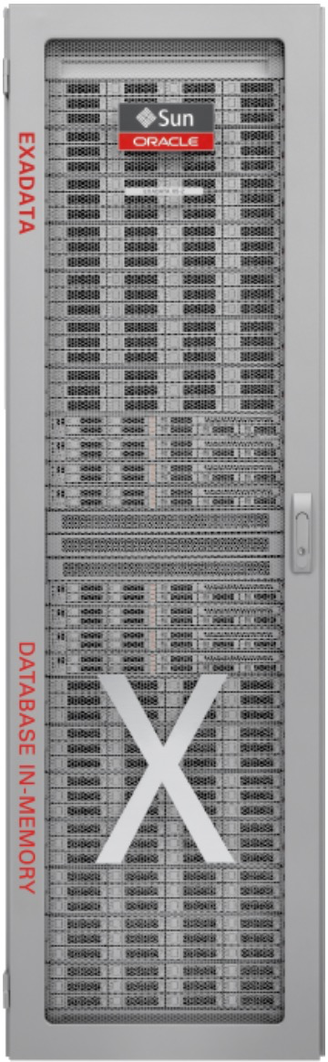


EXADATA TAKEOUT
WHY NOW?
Many X2/X3 refresh opportunities
FlashArray excels in transactional workloads
but less ideal for analytics workloads
  FlashBlade changes this!!
Pricing – Let’s undercut someone else for a change.
Notes:
Designed 2008
Takeup 2012/012 X3/4
Oracle Sales Rep – no exa sale no accelerators
Huge sales push at this time
Marketing message – converged stack that he DBA can own – pluag and play - will solve all your infra problems
- UBS 20+ exa purchase, Deutche Bank even more
Reality 3-4 years on – Stability not improved, support stinks, current pressure to forklift refresh with X6/X7
The first generation exadata was designed in 2008 but it was until 3rd and 4th generartion exadatas of 2012/2013 that there was a big uptake.
At this time Oracle reps were being told that if you don’t sell at least one exadata then any multipliers on your commissions are being cancelled. So there was a huge sales push around this time.
These app teams were sold on the dream of this engineered systems that you could just just plug in and play and the marketing said everything would work perfectly and all your infrastructure problems would disappear.
now here we are in 2017 and a lot of these customers are now coming up for tech refresh and have found out the marketing was just marketing with no substance… they’ve paid for an extremely expensive converged infra, the stability has not been improved.. the support experience stinks and they’re now being pressured by oracle reps to tech refresh to the latest generation ex data the x6-2….
Previously locked out of deals for true warehouse and anaystics workloads as this is what exadata was designed for and they would trounce us on performance
- Flashblade opens this door so we’ve now got the complete portfolio of storage solution to truly compete on those warehouse performance plays.
2 Types of workload OLTP or WareHouse
Exa designed for Warehouse and performs very well as all the aggregations of data are offloaded to storage cells as such For performance plays we would get trounced and have to walk away
FlashBlade has now fully opened the door for exadata takedowns as we can compete performance wise in the warehouse space.

Slide 15






THREE FUNDAMENTAL FLAWS OF APPLIANCE
DUE TO LEGACY, APPLIANCE ARCHITECTURE
DEGRADING PERFORMANCE
OVER-PAYING FOR WHAT YOU DON’T NEED
LOCKS DATA FOR ONLY ORACLE
Fixed Appliance Design
Pay for Compute when Need Storage
Pay for Storage when Need Compute
$10K’s per Core & HDD
Workload Performance
data
Fixed Compute & Storage
Time
Notes:
Let’s look at three examples of Exadata because this is where you have your data warehouse today. The appliance has three fundamental flaws that are holding customer back. First, Exadata degrades and under performs over time. This may be surprising to hear but what happens when the customer buys the next Exadata? The customer tends to over pay for what they don’t need and this is fundamentally wrong about the appliance which we’ll get into more detail later on. The third is the data sits in storage is only for Oracle Data Warehouse workloads. So other applications like Hadoop, Kafla, Spark and AI cannot read the data natively without going through Oracle, making it hard to build modern analytics in a fast, data demanding world today. Well, let’s dig a little deeper into the performance.
The three challenges of Exadata
Fixed Compute to Storage Design
Same Technologies for Years
Built for Single Task Only

Slide 16
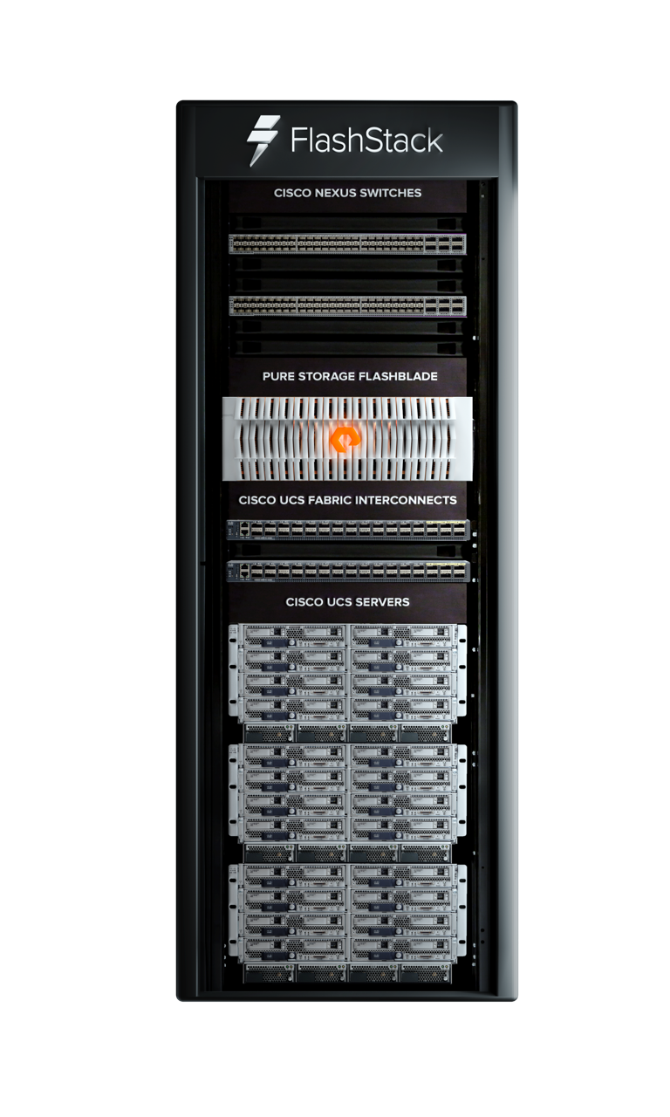
FLASHSTACK™ WITH FLASHBLADE™
ARCHITECT IT ONCE AND ADOPT NEW TECHNOLOGY WITHOUT DISRUPTION
STORAGE
Scale-out file flash storage designed to accelerate analytics workloads
Elastic performances that grows as data increases
Simple blade insertion to increase capacity
Multi-dimensional performance
NETWORK
Ethernet - Nexus 9K
MANAGEMENT
Manages the entire infrastructure
COMPUTE
Integrated Fabric (Multi-Protocol)
Stateless UCS Servers
Notes:
FlashStack's fully modular and non-disruptive architecture allows customers to seamlessly deploy new technology without having to re-architect their data center solutions. Flashblade’s elasticity allows the ease of scale out any file size to accelerate any types of analytics workloads, whether it is for ETL processing ,to running machine learning for AI. Adding capacity is just a simple blade insertion and our software automatly ,fine tune FlashBlade to ensure no impact to multi-dimensional performance. The integration of Cisco’s Nexus network and Stateless UCS Servers give the administrator the flexibility to add network or compute independently from storage without the heavy lifting of managing an appliance.

Slide 17
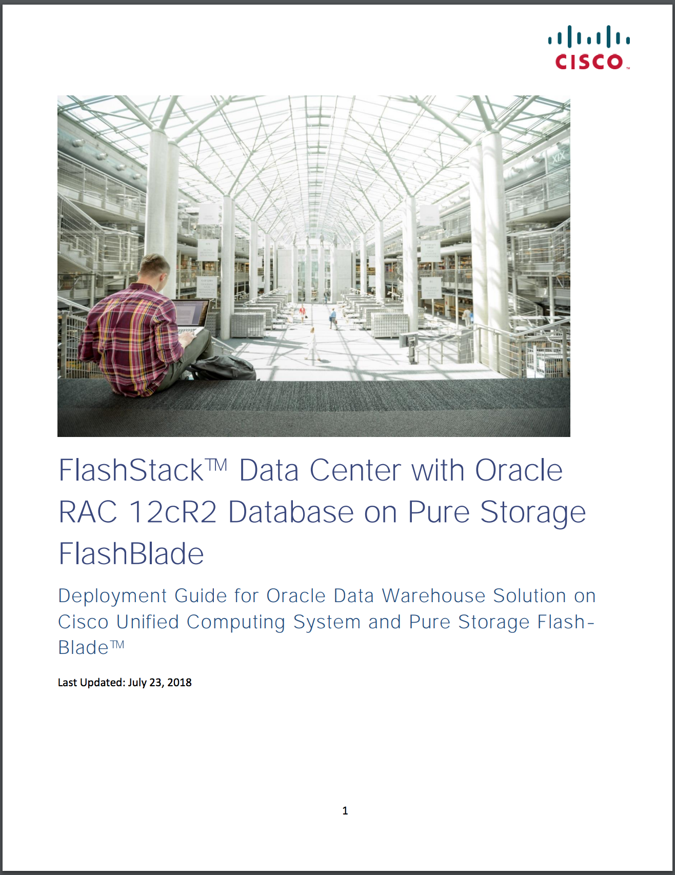
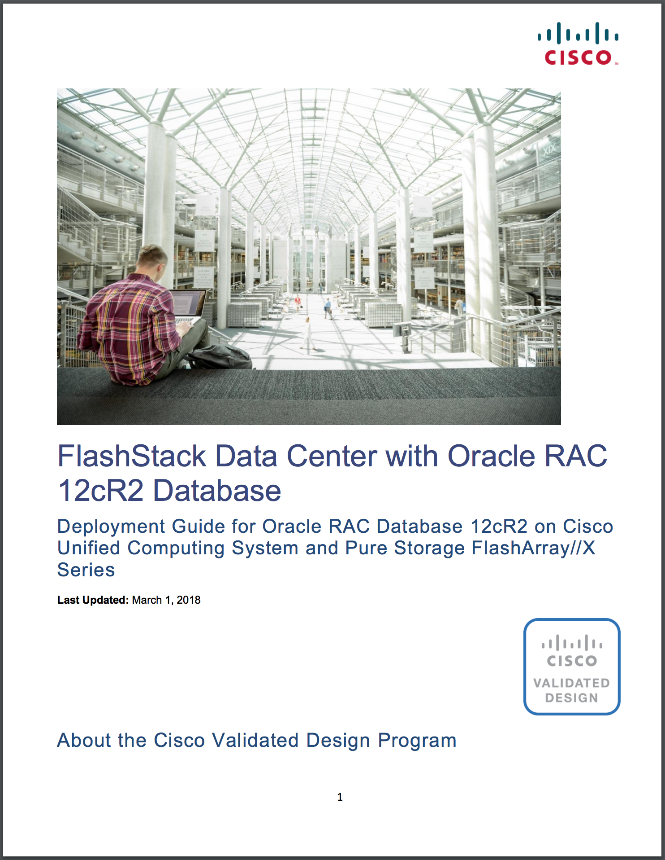
RESOURCES
The Cisco Validated Design (CVD) is designed, tested, and documented to facilitate faster, more reliable, and more predictable converged infrastructure deployments for Oracle RAC
Notes:
Dean Bolton VLSS

Slide 18
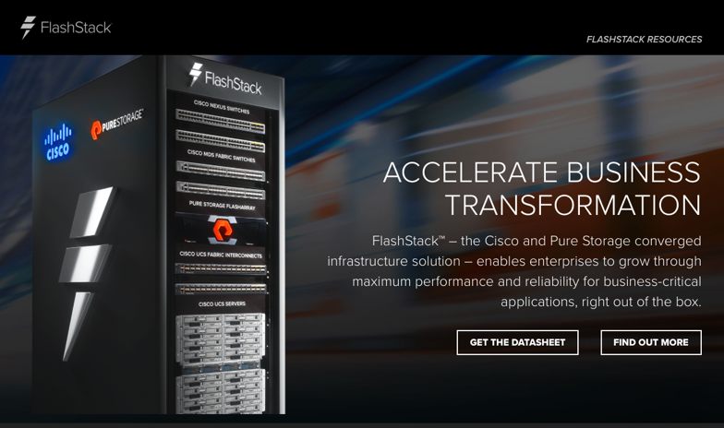

New Web Presences
FLASHSTACK.COM
Streamlined site
Product Specific
Lead Capture
PURESTORAGE.COM
New CI page
Broader context
Tie in to Pure message

Slide 19
Q&A

