Slide 1
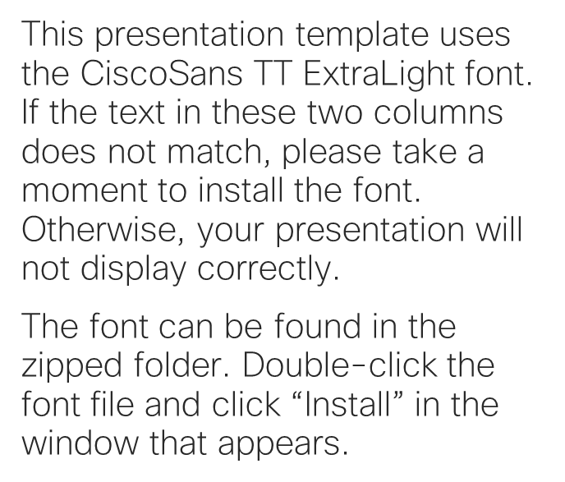
Please read
This presentation template uses the CiscoSans TT ExtraLight font. If the text in these two columns does not match, please take a moment to install the font. Otherwise, your presentation will not display correctly.
The font can be found in the zipped folder. Double-click the font file and click “Install” in the window that appears.

Slide 2

Future IT and Strategies for Talent Growth
Colin Seward
CIO EMEAR, Cisco
April 4th, 2019

Slide 3

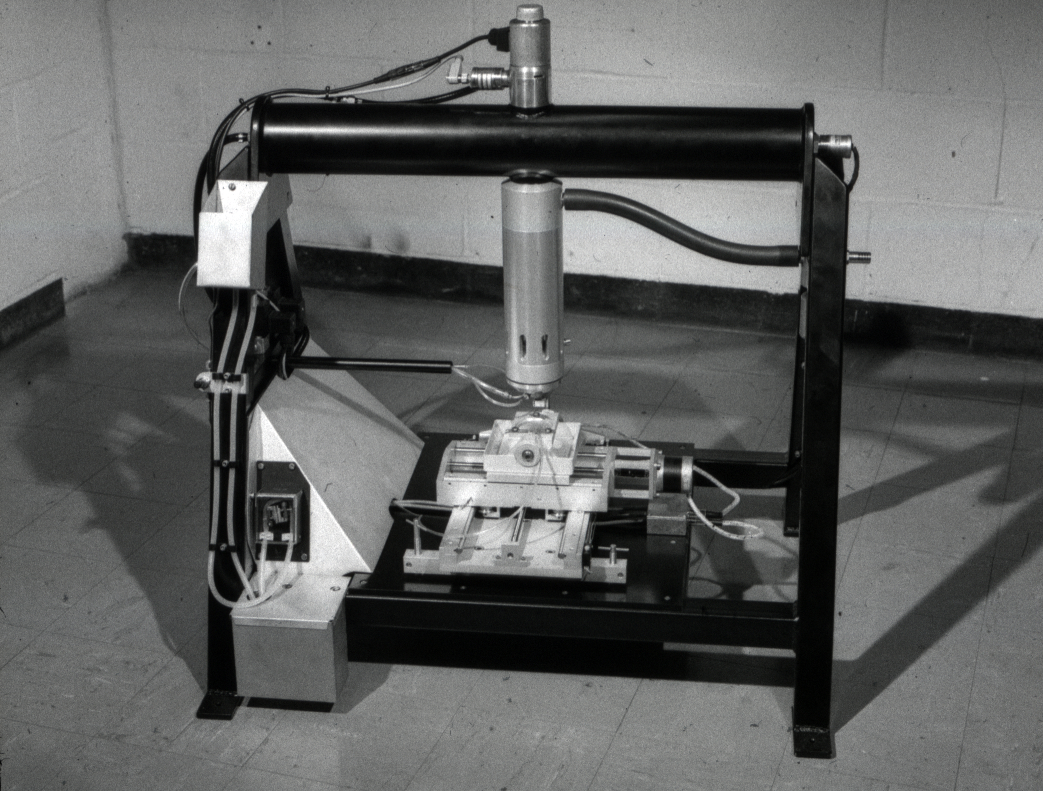

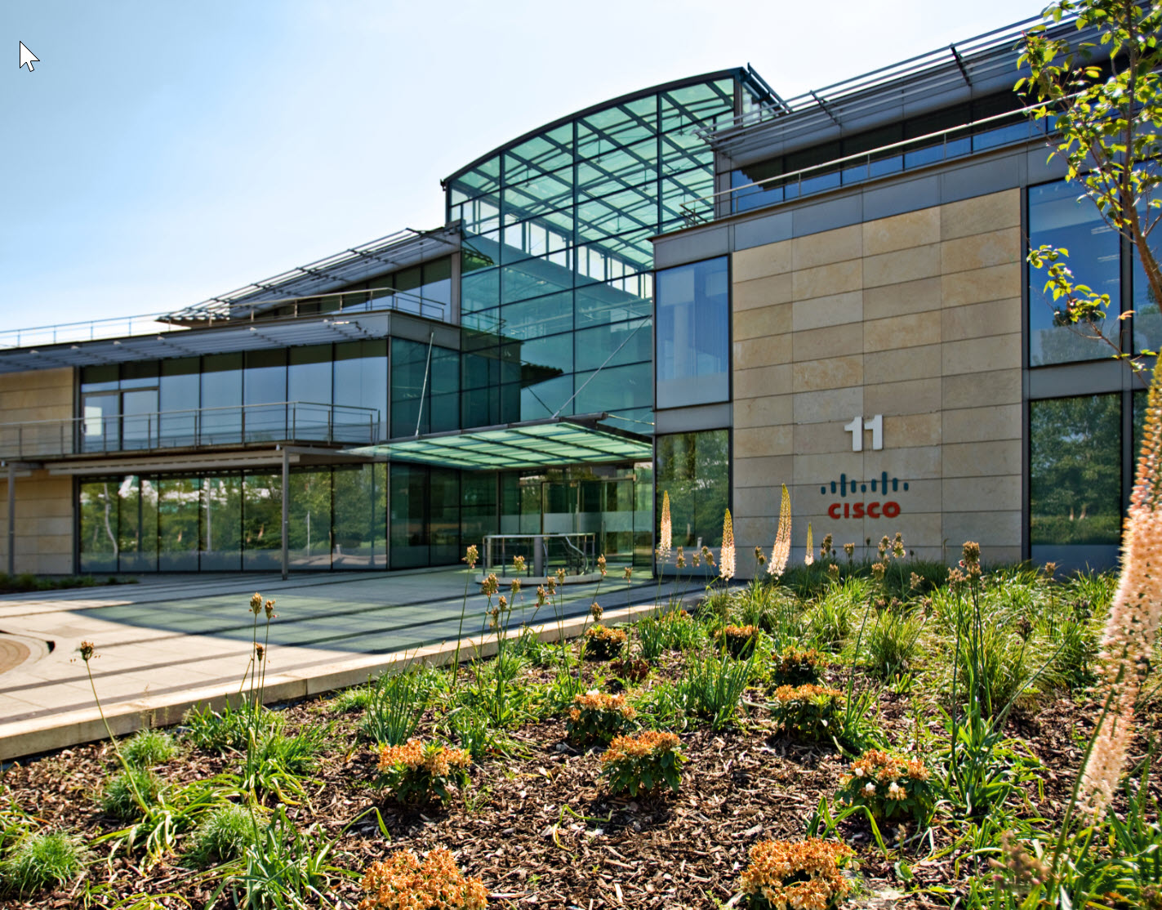
Quick bit about me…
2000–Now
Cisco IT
1985–1992
Degree & PhD in Physics
Cambridge University
1994–2000
Management Consultant
End user computing
Application development
Communication & collaboration
Networking
EMEAR CIO
1990–1994
Co-founder start-up

Slide 4








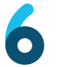

Cisco at a Glance
Customer Experience
73,222
136,244
Sales & Marketing
Connected Stakeholders
Employees
Countries
Offices
Other
93
47,526
167,464
6.4M
Operations
Internet Threats Blocked Per Day
(WSA w/AMP)
Engineering
Services
Virtual Machines
Connected User Devices
Core Cisco Functions
7,607
8,495
12,042
MW
PB
Routers
LAN Switches
UCS Servers
Billion DNS requests per day
Data Center Capacity
Overall Usable Storage

Slide 5



Future IT
Business
Strategy
Accelerate innovation
Customer and partner value
E2E digital company
Why
IT Service Management
Agile / Continuous Delivery
DevSecOps
How
Modernize IT
Strategic Investments
Data, Analytics & AI
Secure Digital Platform
Self-Driving Operations
What
Best People & Teams
Future Skills
Open Culture
Best Place to Work
Who

Slide 6
Future IT
Business
Strategy
Accelerate innovation
Customer and partner value
E2E digital company
Why
How
Modernize IT
IT Service Management
Agile / Continuous Delivery
DevSecOps
Strategic Investments
Data, Analytics & AI
Secure Digital Platform
Self-Driving Operations
What
Best People & Teams
Future Skills
Open Culture
Best Place to Work
Who

Slide 7
Digital transformation models
Enable
Differentiate
Define
IT agility and
increased productivity
Reduced tech costs
(Opex and Capex)
Faster response times
to customer needs
New user experiences, products, services
Accelerated product, services, and business process innovation
Distributed connectivity
and intelligence
Business model innovation, industry transformation
Machine 2 machine, augmented decisions,
self-learning analytics
New growth and
constant innovation

Slide 8

The state of digital disruption:
2017
13. Healthcare &
pharmaceuticals
14. Energy &
utilities
11. Transportation
& logistics
12. Real estate
9. Hospitality
& tourism
10. Manufacturing
7. Education
8. Professional
services
5. Telecoms
6. Consumer
package goods
3. Retail
4. Financials services
1. Media &
entertainment
2. Tech products
& services

Slide 9

Company Strategy
“ When I became CEO in 2015, I identified three main priorities for Cisco:
To accelerate the pace of our innovation …
Increase the value of the network, and…
Deliver the right consumption
models for our customers
New Leadership
Chuck Robbins, CEO Cisco Systems

Slide 10

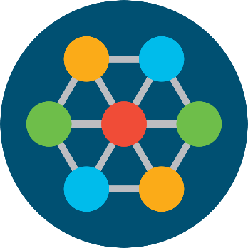



Secure, intelligent platform for digital business
Create meaningful experiences
Power a
multicloud world
Reinvent the
network
Unlock the
power of data
Security is
Foundational
Increased pace of innovation

Slide 11
Transformation:
MAKING IT REAL
Business Strategy
Innovation
Customer
engagement
Customer care
Commercial
processes
Accelerate and expand the
value of the offers we develop
(HW + SW + Service)
Drive growth through
Customer Success culture
Shrink time to value
Use digital strategies to
ensure and accelerate the success of our customers
Scale our capabilities to cope with new consumption models and buying centers
Ecosystem Readiness and Development
Secure Digital Platform
Business Architecture
Systems Architecture
Data Architecture

Slide 12
Feedback loop
Ideas
Scientific Method
Question
Research
Hypothesis
Experiment
Analyse
Interpret
Share
Learn
Build
Data
Code
Measure
“Lean Startup”: Eric Ries

Slide 13
Mind the gap
Wanted: business
savvy tech teams
Where are IT’s biggest gaps?
93%
Knowledge (Business acumen)
43%
Professional skills
34%
Behavioral skills (Soft skills)
Have an IT talent gap in supporting transformation
33%
Technical expertise
29%
Source: “How CIOs Can Close the Skills Gap and Drive True Business Transformation” 2019 Base Size = 600.

Slide 14
Future IT
Business
Strategy
Accelerate innovation
Customer and partner value
E2E digital company
Why
IT Service Management
Agile / Continuous Delivery
DevSecOps
How
Modernize IT
Strategic Investments
Data, Analytics & AI
Secure Digital Platform
Self-Driving Operations
What
Best People & Teams
Future Skills
Open Culture
Best Place to Work
Who

Slide 15
Cisco IT Operating Model
(2006-2013)
Workforce Agility
Vision
Architecture
Planning
Release
Management
IT Services
Business
Architecture
Portfolio Program/
Project Definition
Build
Business
Capabilities
Strategy
Technical
Architecture
Demand
Clearing
Deliver
IT Infrastructure
Business Model Assessment
Integrated Roadmaps
Committed Plans
Execute
Operational Requirements ← Information
IT Operations / IT Support

Slide 16
Cisco IT Operating Model
(2018)
Value Streams
Architect
Strategy
Portfolio
Demand
Selection
Build
Design
Develop
Test
Deploy
Deliver
Publish
Subscribe
Fulfill
Usage
Operate
Detect
Diagnose
Change
Resolve
Improve
Measure
Learn
Persevere
Pivot
Innovation
e.g. Design Thinking, Lean Startup, CD/CI, DevSecOps
Outcomes
Vision
IT Priorities
Strategy
Fast
e.g. Scaled Agile Framework (SAFe), CD/CI, DevSecOps
Traditional
e.g. Waterfall, ITIL
Levers
Analytics
Automation
Cloud
Experience
API’s
Foundation
Security
Culture
IT Service Management
People
Operational Excellence

Slide 17
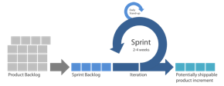
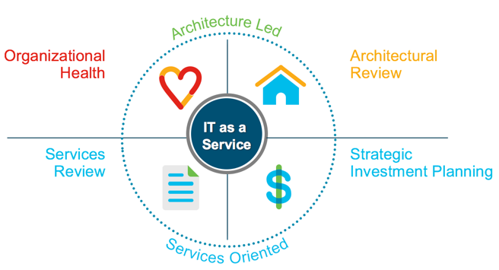
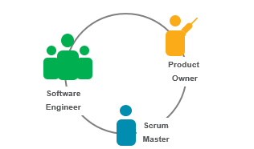
Our transformation journey
Foundation
Architecture Led; Services Oriented
DevSecOps
Secure Digital Business
2007
2014
2018
Accelerate
Pervasive Agile Mindset

Slide 18
Architecture led; service oriented
Foundation
Architecture Led; Services Oriented
2007
People
Culture: GM Mindset
Service Roles
Outcome Focused
SERVICES
FOUNDATION
Process
Portfolio Management
Architecture Lead
Checkpoint Reviews
Technology
ITSM Platform
Metrics Dashboards
Self Service Store

Slide 19


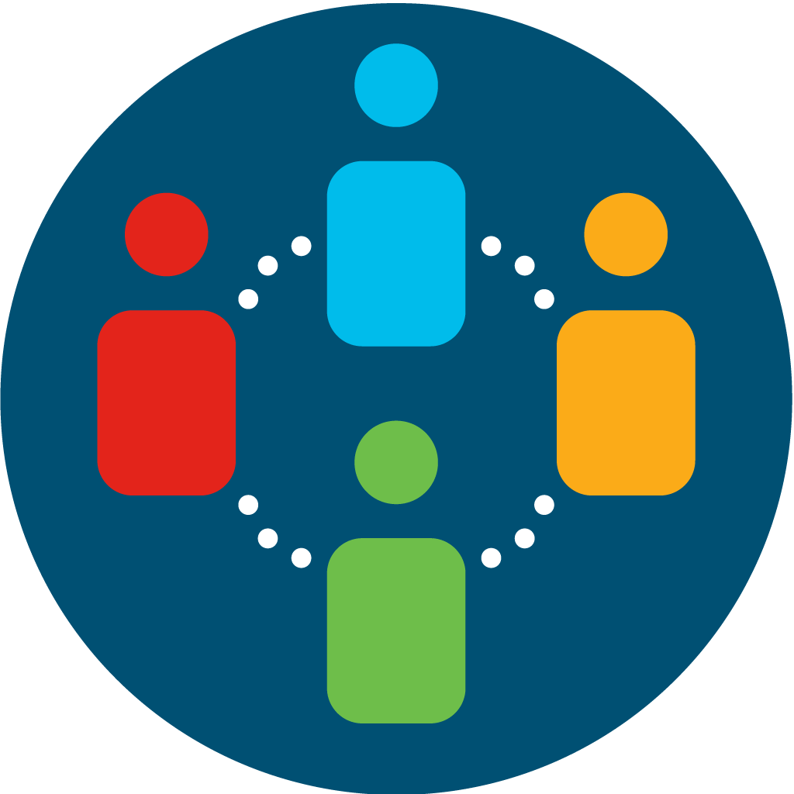
Driving the “General Manager” mindset
Business within
a business
Service to customers
Cost
Transparency & Investment Value
Competition
Quality & user experience
IT as a Service

Slide 20
Culture: Empowered accountability
Architecture Led
Services Oriented
Services review
Continuous improvement
and innovation
Strategic Investment Planning
Continuous portfolio planning
IT as a
Service
Architectural review
Architecture dependencies
roadmap review
Organizational health
Workforce planning
digital skills

Slide 21



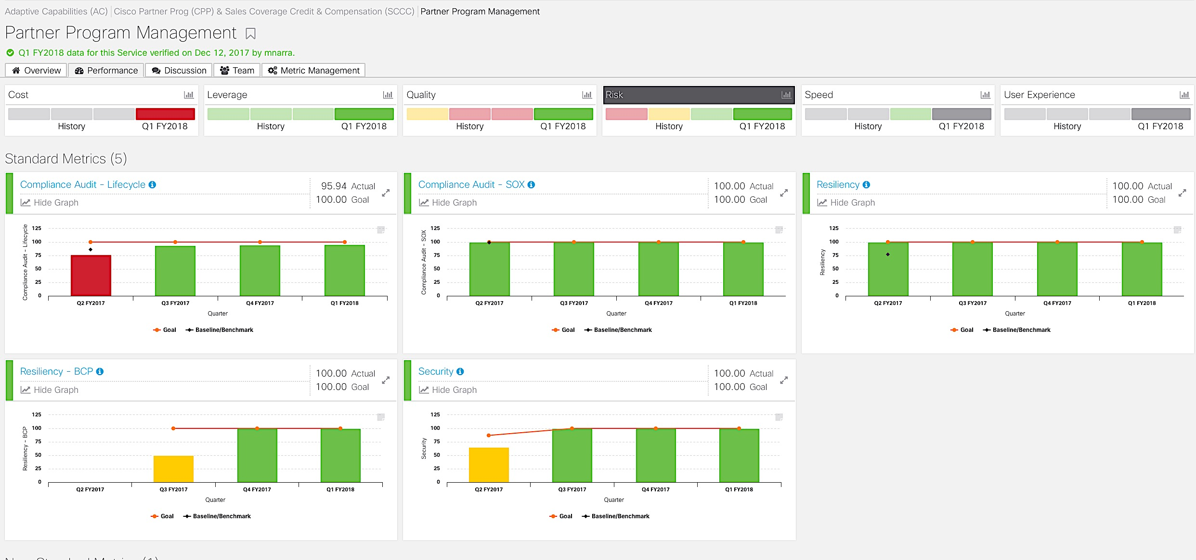
Continuous Improvements through Data Insights
User
Experience
Cost
Leverage
Quality
Risk
Speed
Service Performance Central (SPC)
Service Accountability through Quarterly Integrated Checkpoint

Slide 22
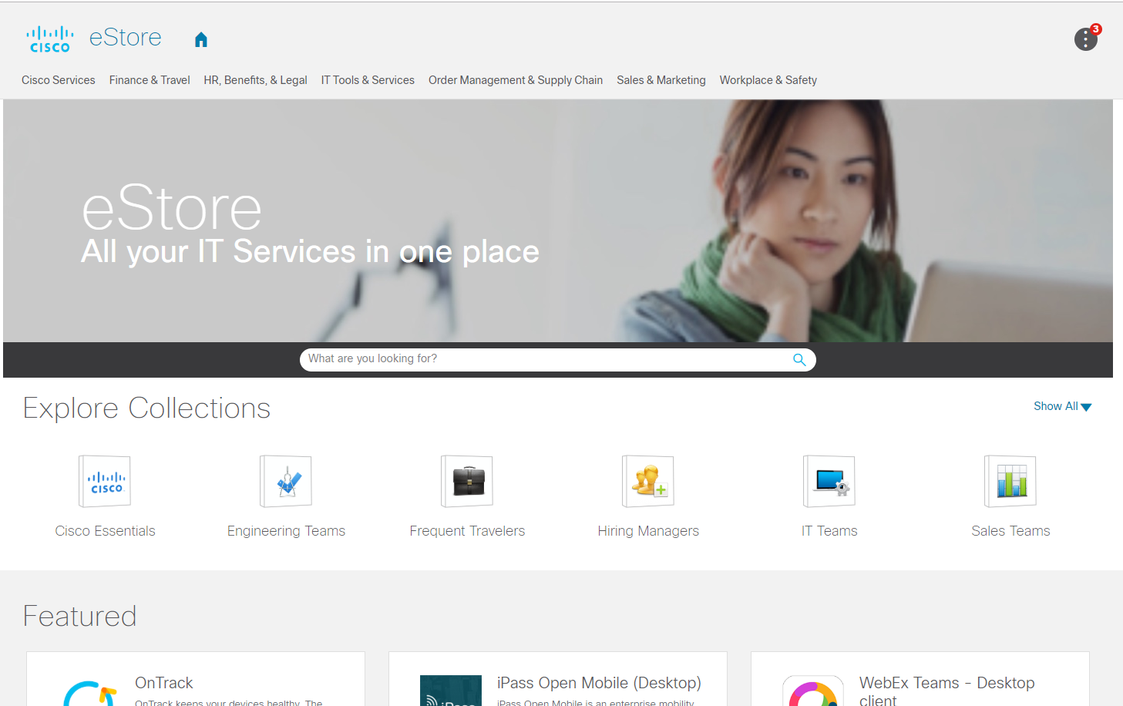
Self-service store for IT services
Experience
Find
Applications
Orchestration
Storage
Choose
Policy
Compute
Network
Use

Slide 23
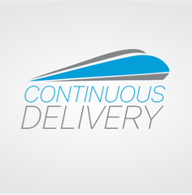
Pervasive agile mindset
Accelerate
Pervasive Agile Mindset
2014
People
Culture: Value Focus
Agile Roles & Skills
Dynamic Teams
Process
Agile Maturity
Minimum Viable Product
Continuous Innovation
Technology
Development Tool Chain
Developers’ Analytics
Workgroup Tools

Slide 24
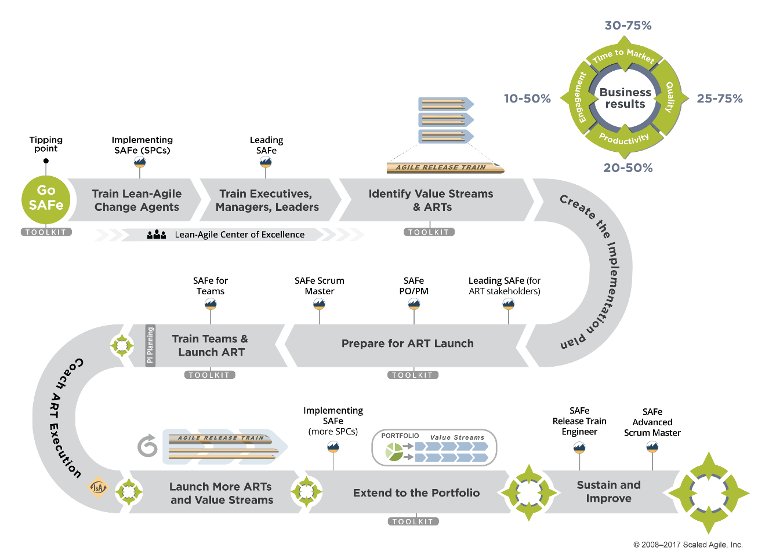











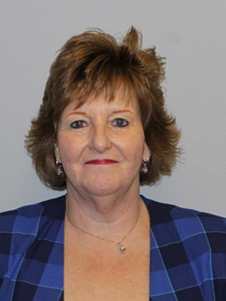








Global training methodology
Global Support
Standard Methodology
Global “Champions”

Slide 25






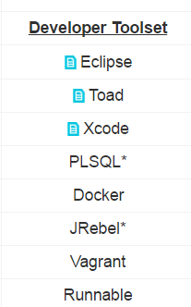
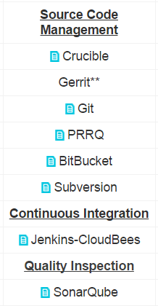
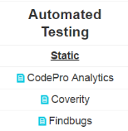
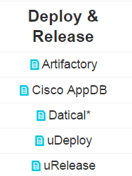
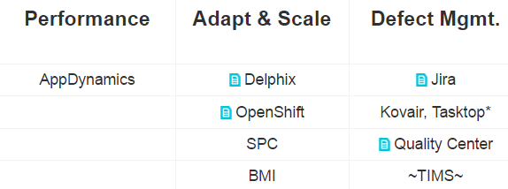

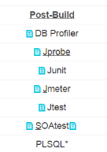

CD end-to-end platform
Iterate
Iterate
Iterate
Strategize
Plan
Execute
Operate
Formulate
Strategies
Define
Outcomes
Assess
Opportunities
Plan
Capabilities
Prioritize
Investments
Explore
Solutions
Deliver
Capabilities
Adopt
Capabilities
Realize
Outcomes
Plan
Develop
and Build
Automated
Testing
Deploy
and Release
Performance
Adapt
and scale
Defect
Management

Slide 26
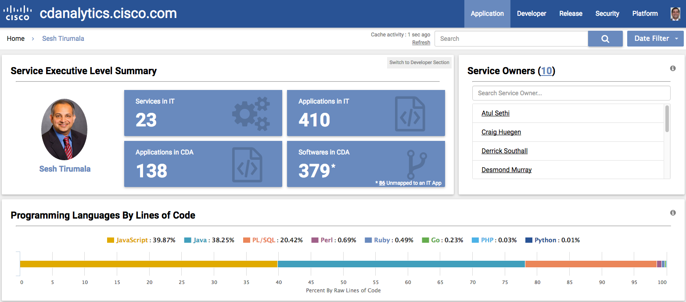
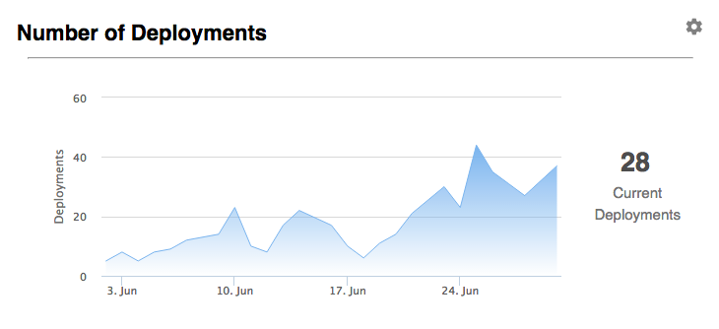
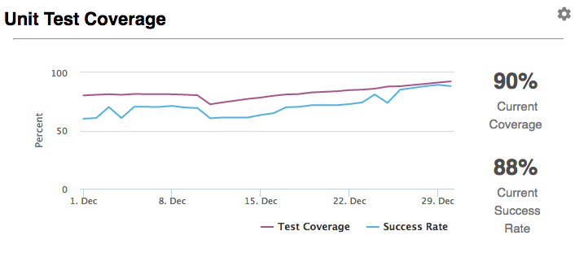
Continuous Improvements through Data Insights
Continuous Delivery Analytics (CDA)
Empowering developers with real-time insights
Speed
Quality
Risk

Slide 27
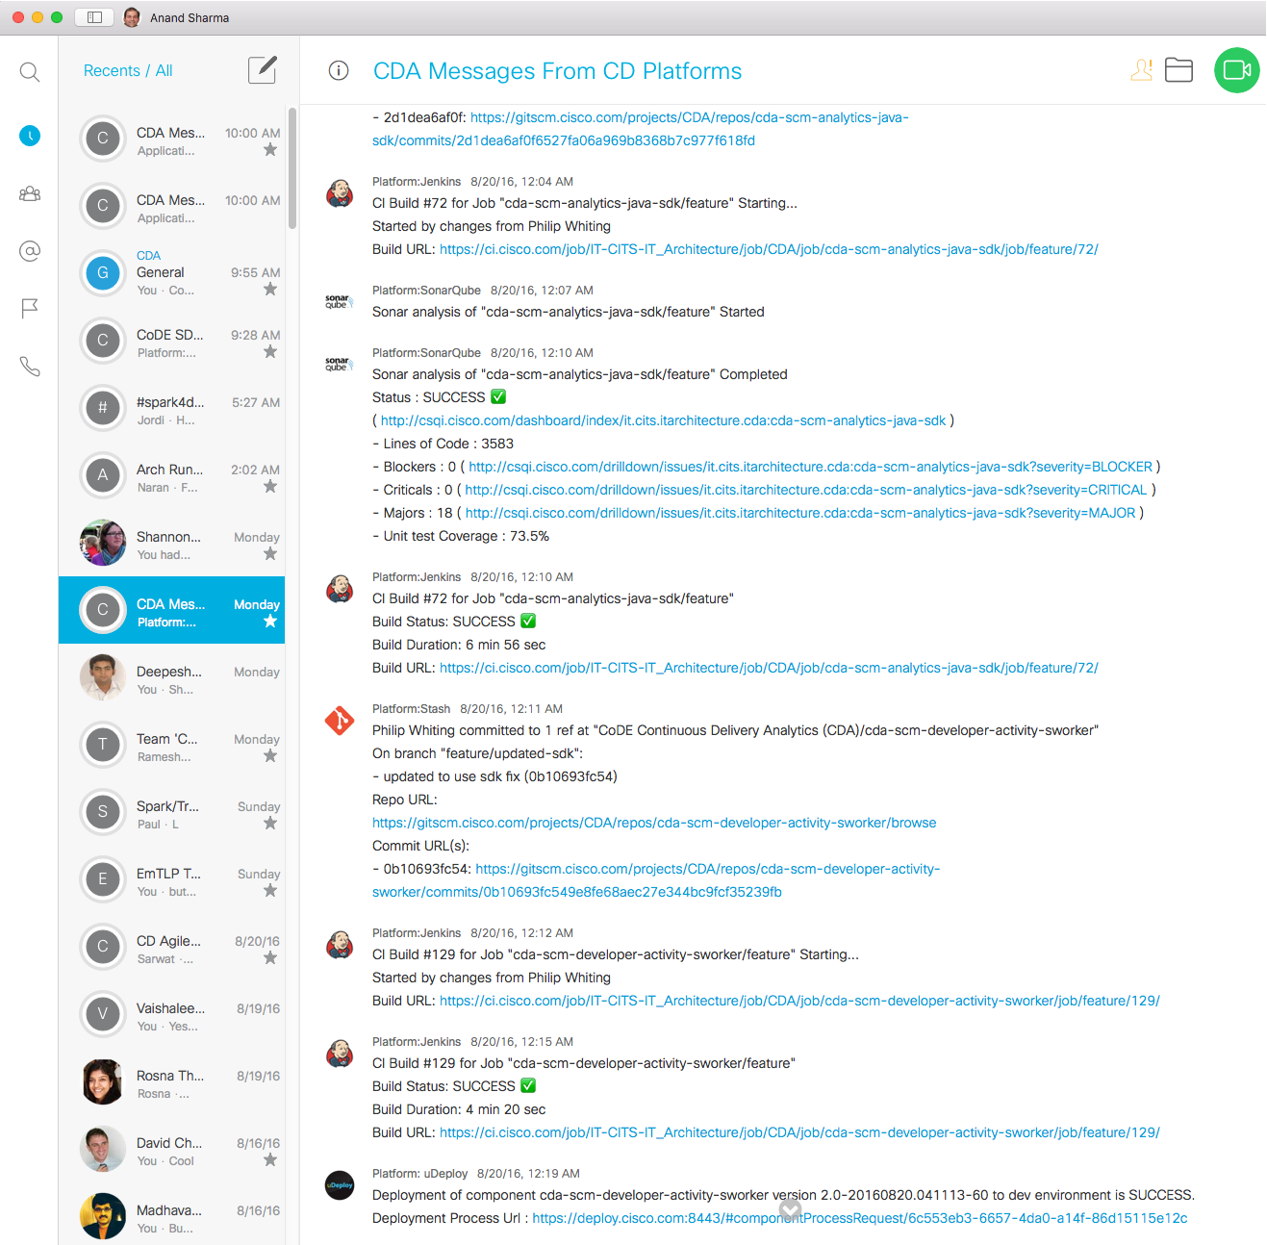
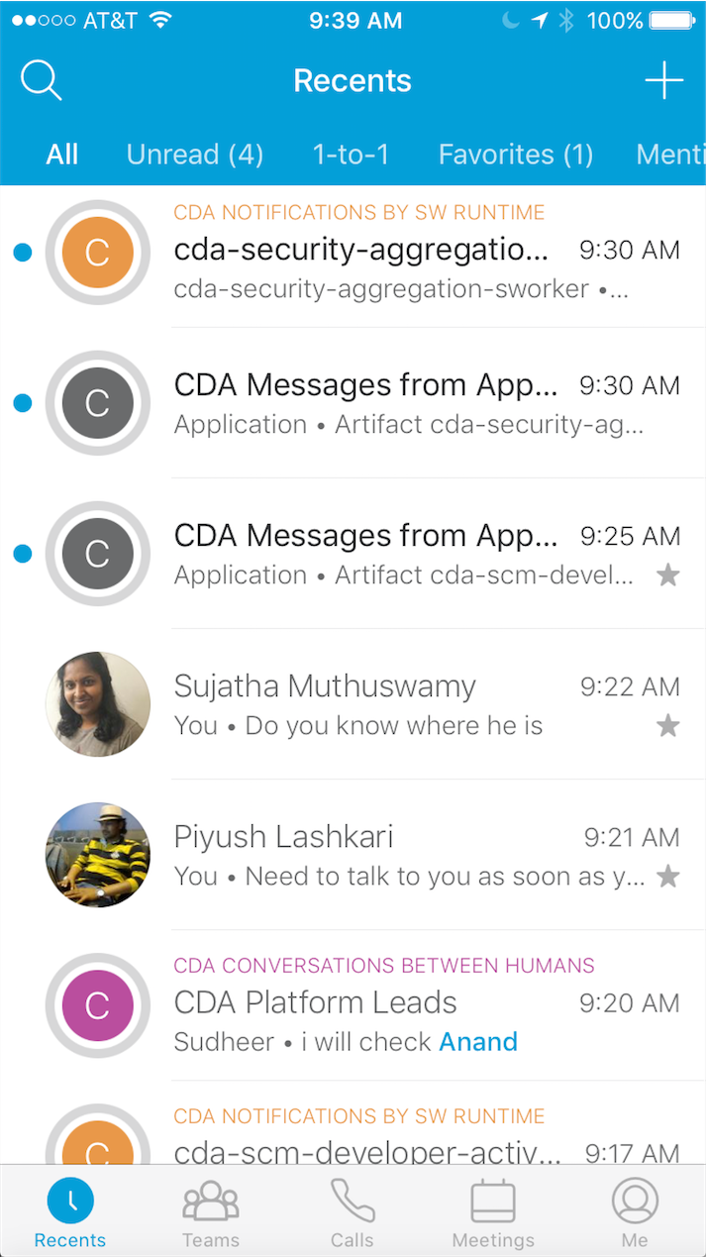

Share learning in Webex Teams

Slide 28

Transformation outcomes
Business Outcomes
- 20% Y:Y
90% On-time Closure
-5% Y:Y
+30% Y:Y
Velocity
to Value
Production
Incidents
Security
Vulnerabilities
Optimization
Transformational Capabilities
Defect
Management
Engaged Workforce
Dynamic
Team
Continuous Planning

Slide 29
Our transformation journey
Foundation
Architecture Led; Services Oriented
DevSecOps
Secure Digital Business
2007
2014
2018
Accelerate
Pervasive Agile Mindset

Slide 30

Secure Digital Business
DevSecOps
Secure Digital Business
2018
People
Culture: One Team
Organization Strategy
Roles & Responsibilities
Process
Agile Maturity
Feedback Loops
Security Focus
Technology
DevSecOps Tools
Automation Everywhere
On-Demand Infra

Slide 31




DevSecOps Lifecycle
Maximum speed with Maximum reliability
Code
Quality
Release &
Deploy
Change
Operation
& Support
Event
Management
Secure Coding
Vulnerability
Management
Disciplines
Develop | Secure | Operate
Standards
Policy
Training
Mindset/ Maturity
Certificate
Solution
Delivery Mechanism
DSO Webinar
Best Practice Session
DSO Engineering Day
Assessment
Certification Training
Delivery
Mechanism

Slide 32
Future IT
Business
Strategy
Accelerate innovation
Customer and partner value
E2E digital company
Why
IT Service Management
Agile / Continuous Delivery
DevSecOps
How
Modernize IT
Strategic Investments
Data, Analytics & AI
Secure Digital Platform
Self-Driving Operations
What
Best People & Teams
Future Skills
Open Culture
Best Place to Work
Who

Slide 33






Advanced security
Internet
of Things
APIs everywhere
Cloud
native
Self-driving operations
Future IT
Intelligence
and Data
Blockchain
Seamless collaboration
AI and machine learning

Slide 34
Reskilling is critical
Most important technology skills:
Cloud
Architecture
Big Data
DevOps
Security
IoT
Development
Cloud Native
Automation
54%
46%
56%
43%
42%
41%
41%
Need emerging skills for their transformation
37%
35%
30%
Source: “How CIOs Can Close the Skills Gap and Drive True Business Transformation” 2019 Base Size = 600.

Slide 35

Data insights enable digital transformation
Connecting and
converting the right data into actionable insights that are embedded within the transactional workflow to drive faster business outcomes

Slide 36
Connected Quality
TRANSFORMING WITH DATA
Actions based on connected data and advanced analytical models
Connected Insights
Customer quality analytics - customer heat map, propensity of escalation
NPS correlation
Quality insights for functions to drive growth, profitability and customer experience
Cost of quality
Engineering
Supply Chain
Services
Workflow with embedded insights
HW failures
Analytics to support…
In-process insights
Dynamic component hotspots
Digitized quality phase gates
Field quality
RMA avoidance
Improved validations
Defects management
Gate reviews and adoption
Intelligent routing
Regressions
Rebuilds
Digitized process
Optimization
Curated and enriched data, governance and policy enforcement
Enterprise
Data Foundation
Business rules, KPIS
Install base
Contracts
Service requests
RMA
Escalations
FA
GLMS
CSAT/NPS
CDETS (bugs)
CARETS
FTS (features)
S/W downloads
Auto-test

Slide 37
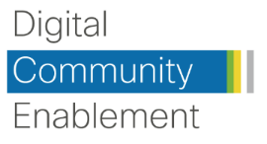



Enterprise Data Science Office
Supporting digital transformation through:
Digital Solutions
Digital Standards
Digital Skills
Outcome-driven, adaptive digital processes for faster, more accurate decision making
Enterprise standards and platforms, improving productivity through leverage and reuse
New digital learning to unleash the collective power of innovation from our community
Accelerate
Cross-functional, collaborative data science project pods
Dynamic sourcing from the community
Scale
Reusable code and model repository
Model lifecycle management platform
Data preparation as a service
Methodologies and best practices
Recommended tools
Amplify
Data Science Certifications: Practitioners, Engineers, Project Managers and Leaders
Career paths and titles
Mentoring and coaching
Community events and competitions

Slide 38
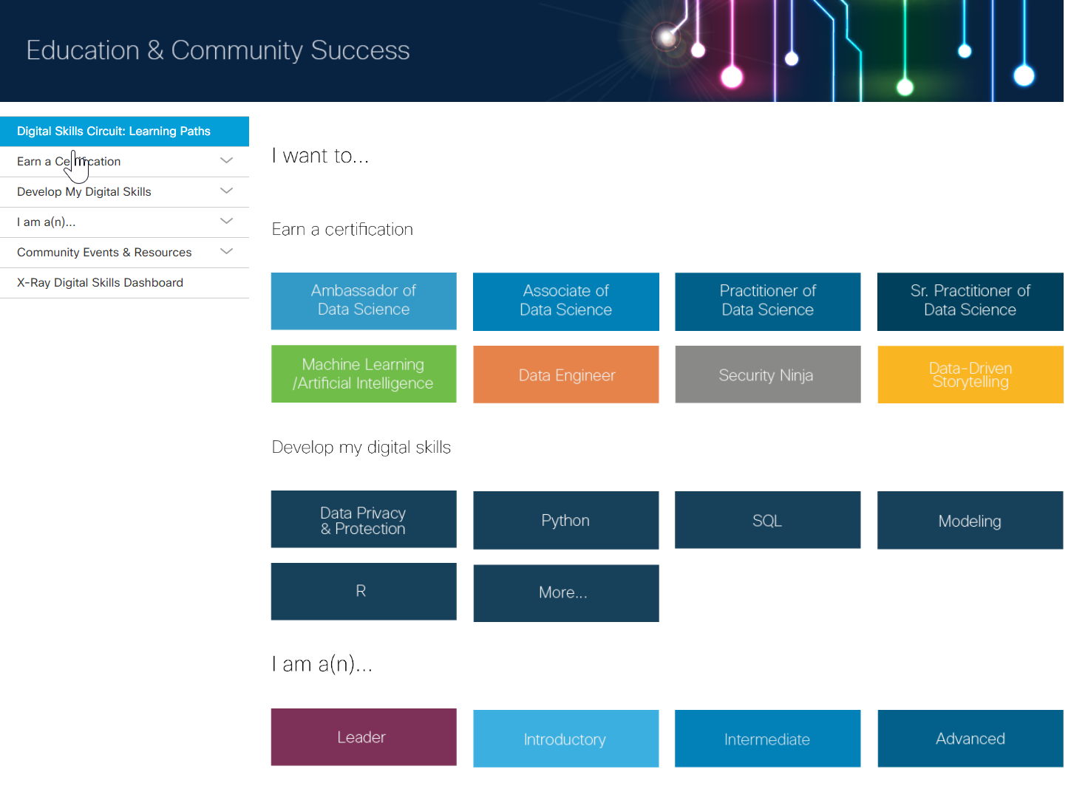
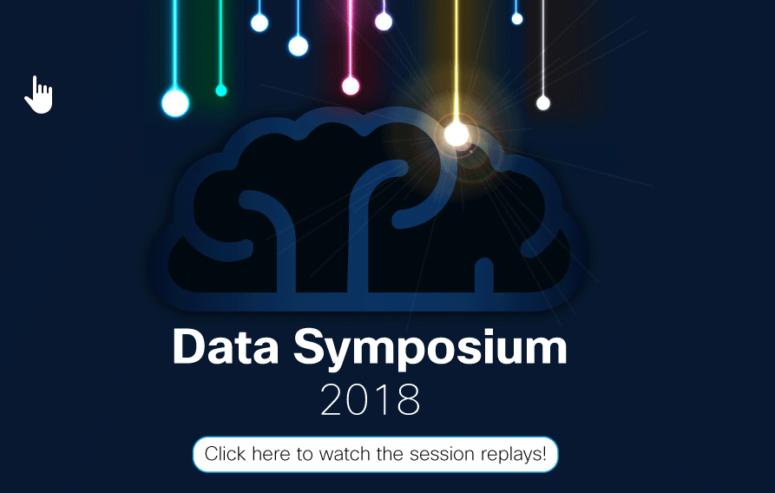
Data skills

Slide 39
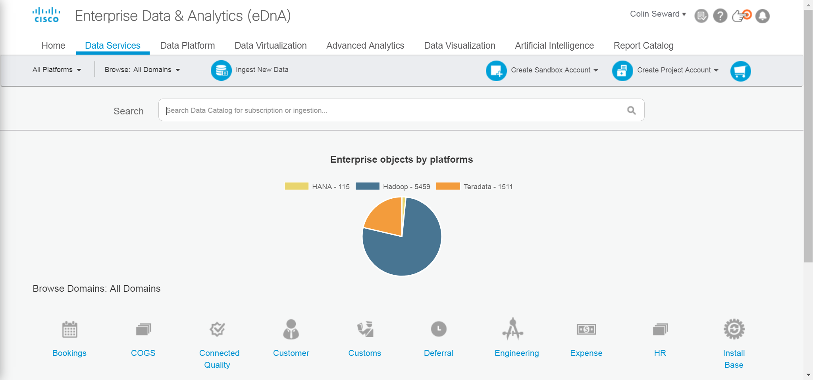
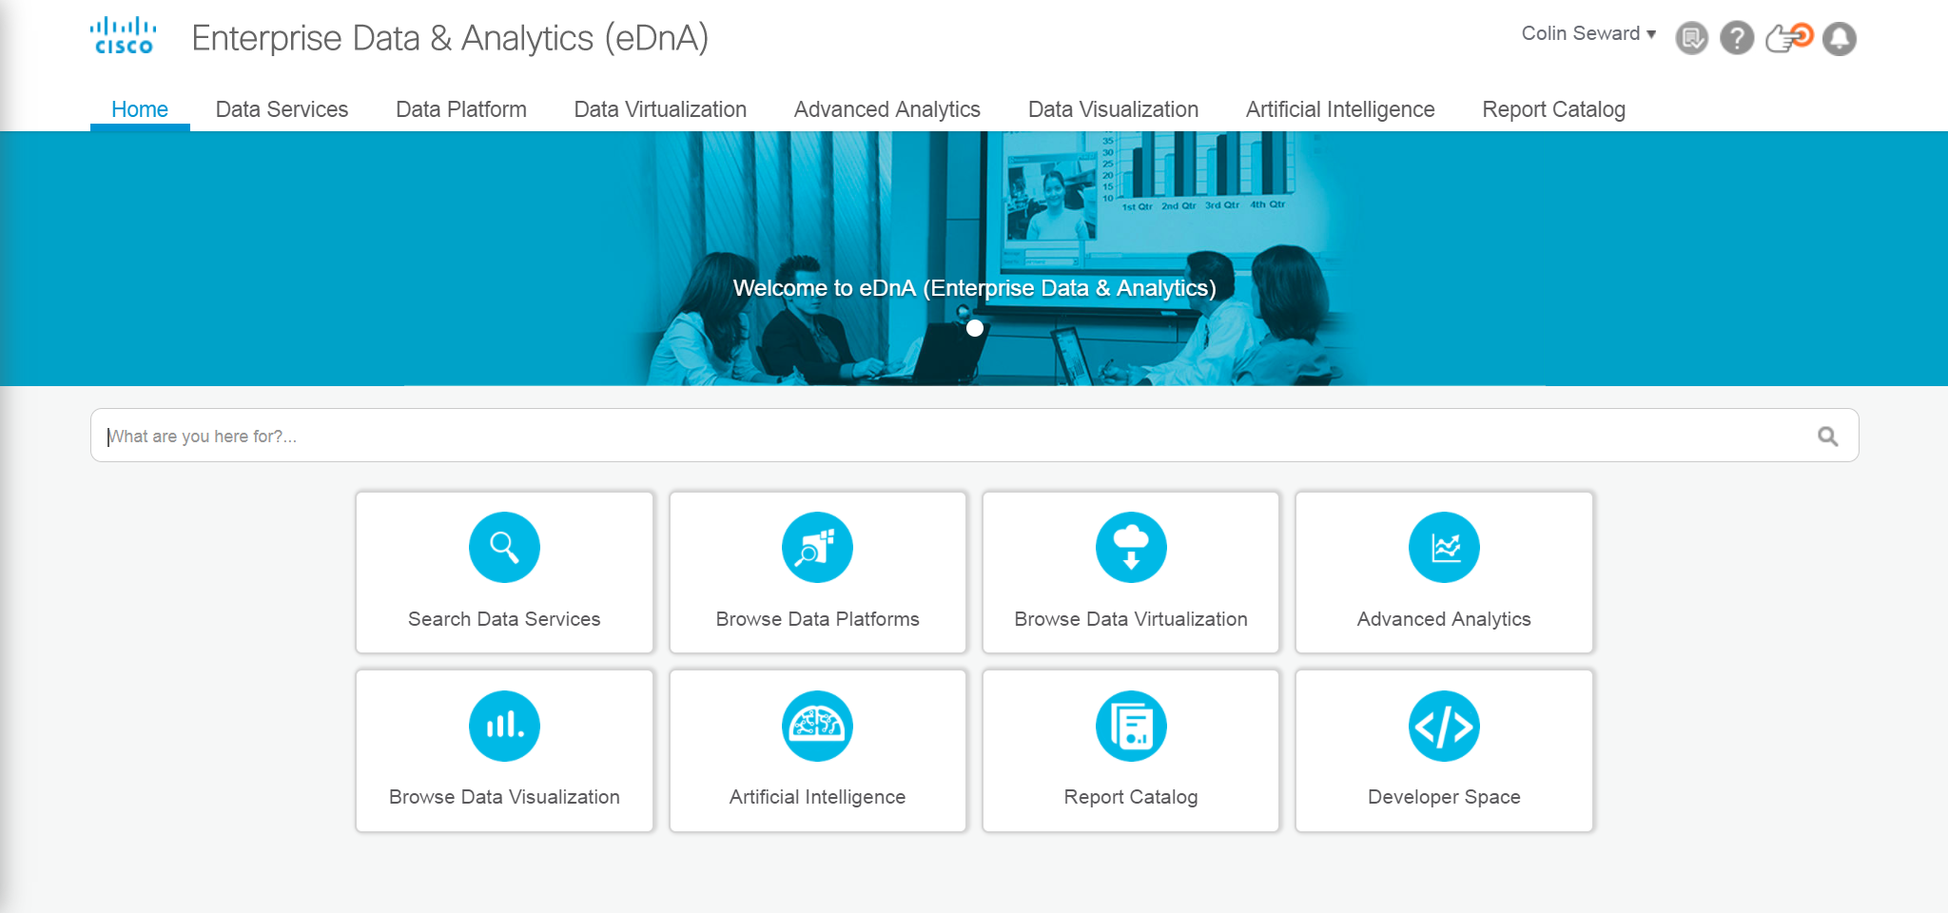
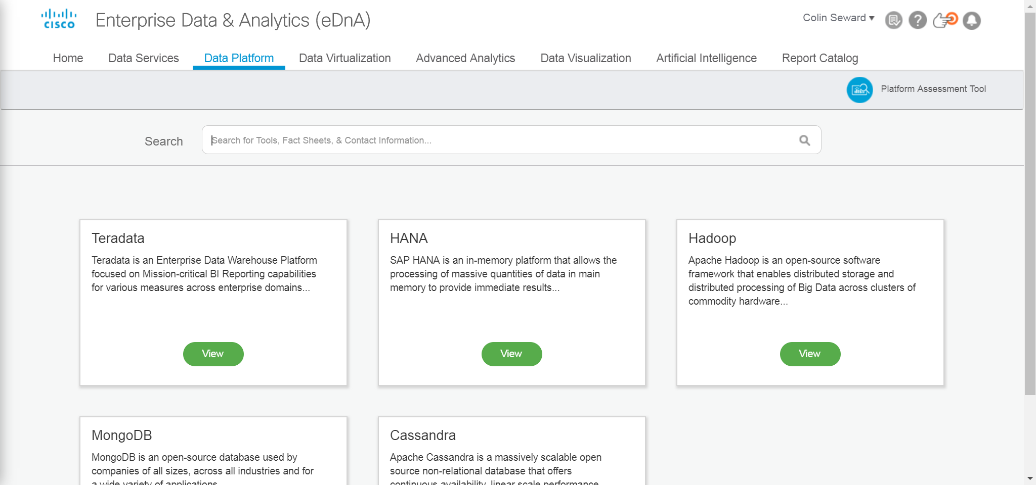
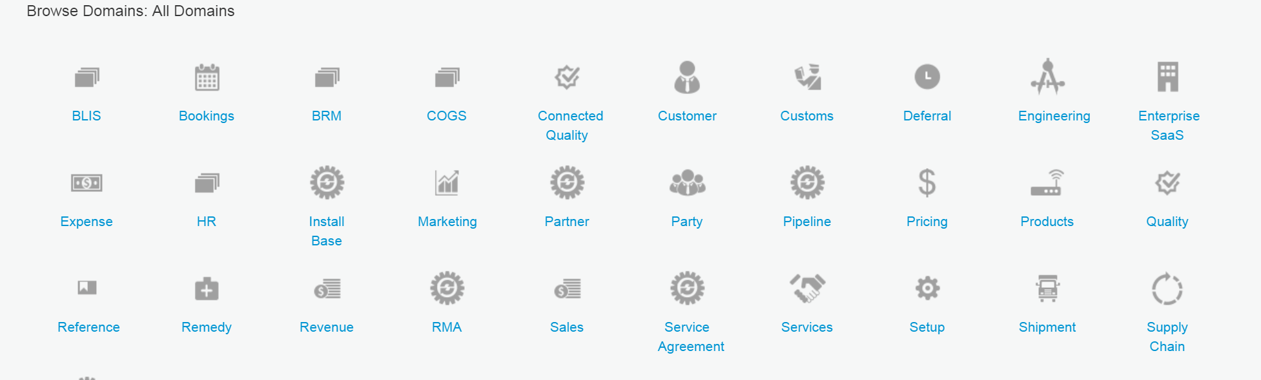
Data as a Service

Slide 40


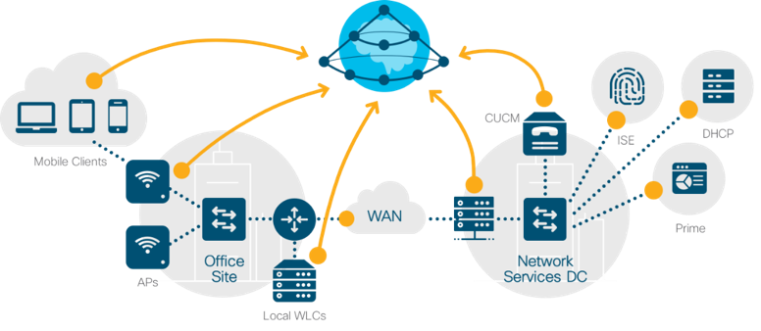



Software Defined Everything (SDx)
Self-driving operations
End to end visibility
“A vision where all infrastructure service offerings are orchestrated in software at scale to meet service-level agreements and the demands of a dynamic business”
SaaS
Intuitive network
PaaS

Slide 41

Software Defined Everything (SDx)
2017
People
Mindset: Infra as Code
Roles & Responsibilities
Skills Transformation
SDx
Process
Agile (SAFe)
DevSecOps
Technology
Controllers & API’s
CI/CD Toolchain
On-Demand Infra

Slide 42
Infrastructure Services, Cisco IT
…in the past
…today
Architecture/ Design
Implementation/ Operations
Data Center
Collab
Network
Collab
Architecture
DC
Software
Security
Operations
Network
Security
Governance
= small, agile teams

Slide 43
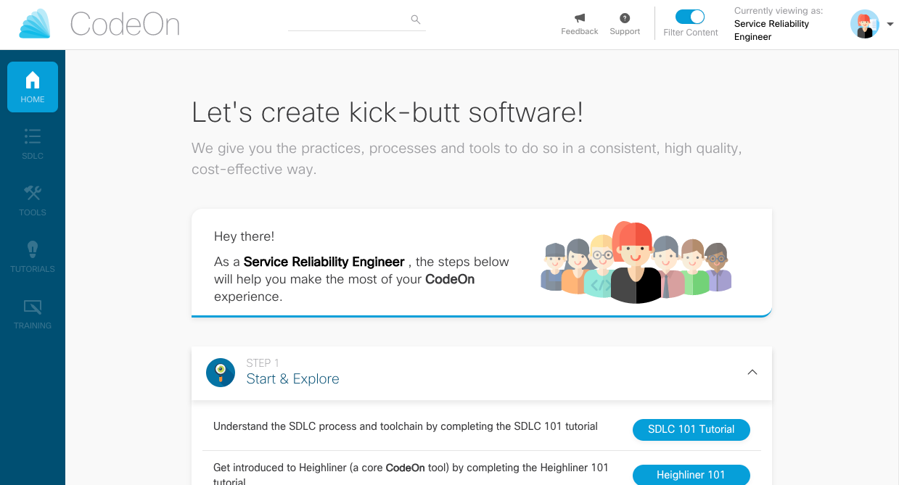
CodeOn
A ONE-STOP PORTAL

Slide 44


Cisco DNA Center used to mitigate network vulnerability event
1
Infosec alerts network operations to
out of compliance network devices
Information Security Team
1
2
Cisco DNA Center upgrade request is initiated to affected devices
3
2
Cisco DNA Center opens Webex Team room with IT, Security and Network Operations
3
Webex Teams
4
ITSM
4
Cisco DNA Center
Cisco DNA Center opens change request window with service management system
6
5
Cisco DNA Center performs change on
affected devices
Physical and Virtual Infrastructure
5
6
Cisco DNA Center closes out CR with
progress update in Webex Teams
Cisco & 3rd Party

Slide 45
Future IT
Business
Strategy
Accelerate innovation
Customer and partner value
E2E digital company
Why
IT Service Management
Agile / Continuous Delivery
DevSecOps
How
Modernize IT
Strategic Investments
Data, Analytics & AI
Secure Digital Platform
Self-Driving Operations
What
Best People & Teams
Future Skills
Open Culture
Best Place to Work
Who

Slide 46

What skills will we need in the future?
How do we close the skills gap?
“You’re either a learning organization or you’re losing to someone who is”
How do we attract and retain top talent?
Do current processes hold us back?
Are we focused on diversity?
Do we have a high trust (blameless) culture?
- Andrew Shafer, Pivotal Software
How do we outlearn our competition?
Are our leaders evolving as fast as their teams?
What we continuously ask ourselves

Slide 47

Workforce strategy
Attract
Retain
Transform
Proactive, competitive, innovative
Culture, branding, development
Engaged, fulfilled, inclusive
Transform myself
& my team
Cycle of Talent
© 2018 Cisco and/or its affiliates. All rights reserved.

Slide 48
Continuous learning comes in many forms and from many directions
Learn by doing
On the Job – stretch plus
Talent Marketplace
Job rotations
Feedback Loops
Incidents
Labs
Learning from Others
Cohorts
Mentor Connect
Shadowing
Employee Resource Orgs
IT Advisor
Formal Learning
Network Academies
Web-based training
Leaders Day
Experience
Exposure
Education

Slide 49
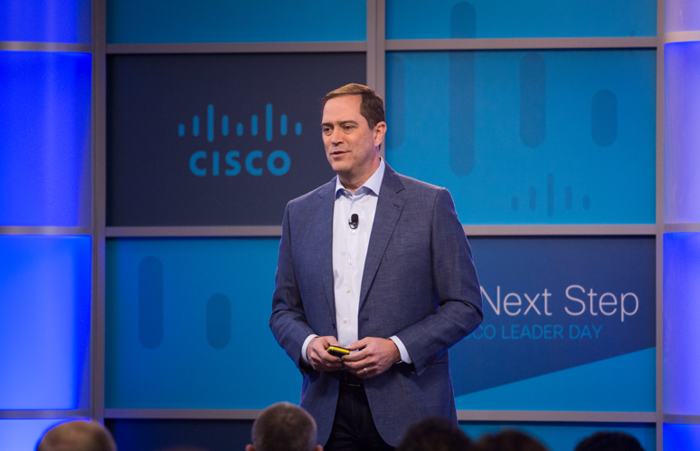
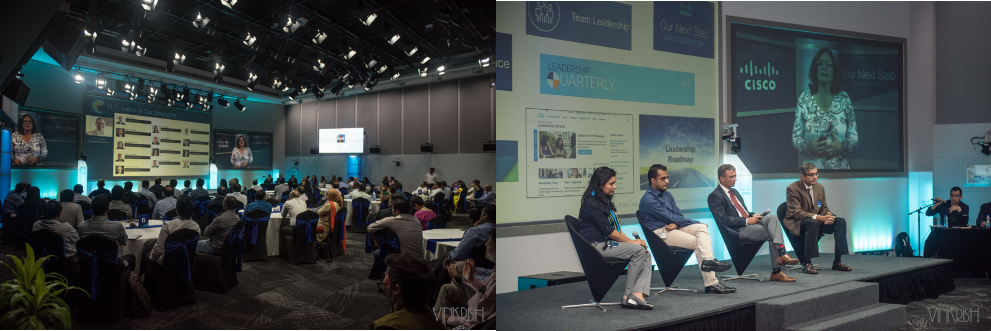
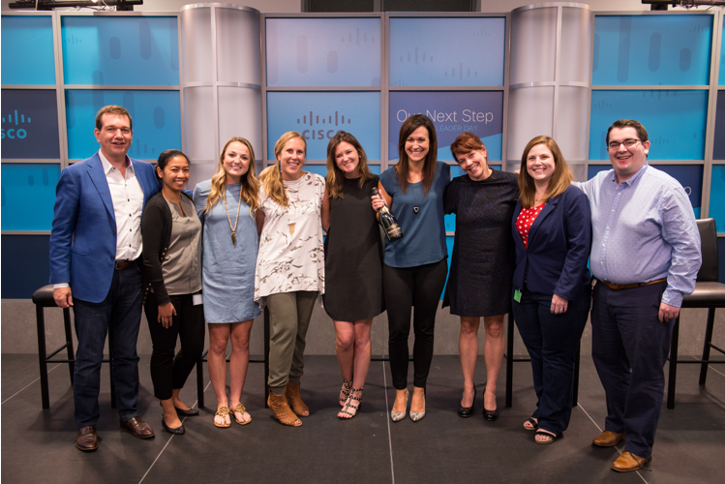
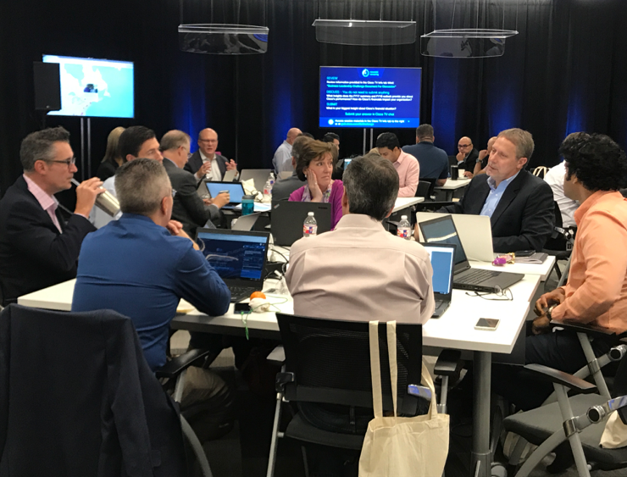
Leaders Day
© 2018 Cisco and/or its affiliates. All rights reserved.

Slide 50
Future IT
Business
Strategy
Accelerate innovation
Customer and partner value
E2E digital company
Why
IT Service Management
Agile / Continuous Delivery
DevSecOps
How
Modernize IT
Strategic Investments
Data, Analytics & AI
Secure Digital Platform
Self-Driving Operations
What
Best People & Teams
Future Skills
Open Culture
Best Place to Work
Who

