Slide 1

Duo Identity
TechClub, 17.2.2026
Milan Habrcetl, Cisco AE Security
mhabrcet@cisco.com
Duo: Identity Simplified. Security Amplified.

Slide 2
Identity Security is Security: By the Numbers

Slide 3
80%
of breaches leveraged identity as a key component
Cisco Talos Incident Response Data 2023-2024
Notes:
- 100% of breaches include an identity component https://blog.talosintelligence.com/incident-response-trends-q3-2024/
So let's start with the state of identity security. This is a statistic from Cisco Talos, our own threat intelligence and threat research organization. And in the last year, so 2023 to 2024, their incident response team found that 80 % of breaches leverage identity as a key component.
This is a startling statistic, but I don't think it'll be unfamiliar to people who see this. In fact, you know, I bet if you put this slide up, most people will nod their head and say this is something I understand. I know that identity is a key aspect of breaches. The next step though is why is this happening? Why do these breaches happen year in, year out? Why do we continue to see identity as a core vector for breaches?

Slide 4
66%
of initial access cases involved Valid Accounts
Cisco Talos Incident Response Trends Data Q3 2024
Notes:
https://blog.talosintelligence.com/incident-response-trends-q3-2024/

Slide 5
40%
of compromises included misconfigured MFA, no MFA, or MFA bypass
Cisco Talos Incident Response Trends Data Q3 2024
Notes:
https://blog.talosintelligence.com/incident-response-trends-q3-2024/

Slide 6

Why Duo for Identity?
Consolidate IAM and Identity Security
Reduce friction, risk, and spend with:
AI identity analytics
Identity and access automation
Unified management
Seamless, interoperable experience

Slide 7
Enter: Duo Passport

Slide 8





Login Once, Access Everything Securely
2nd Browser
MFA ACCESS
MFA ACCESS
1st BROWSER
OS LOGIN
SSO Auth
SSO ACCESS
Common Security Policy
 | Interactive authentication - end user friction
 | Authentication brokered through device, Duo, and Duo Desktop
Notes:
UX – Trusted first & second factor session
UX - Trusted second factor session
No browser config
No MDM requirement With Duo Passport, user and device trust is verified once, at OS login – and delivers a seamless access experience to all apps and resources without interrupting the user again. At the same time, Duo continues to assess device posture and risk signals for each access attempt in the background and will adjust security requirements based on risk and changes in user context. Security teams maintain visibility and control over who and what is accessing what application – and a continuous measure of their associated risk.
Passport really belongs in both the User experience AND Admin experience side
Enabling Passport in a Duo environment is essentially a few clicks. Duo Desktop takes care of the rest on the endpoint
Other similar SSO solutions require MUCH more admin configuration in a dashboard as well as on the endpoint and have limitations on browser / external browser support. Some have dependencies on MDM managed devices

Slide 9
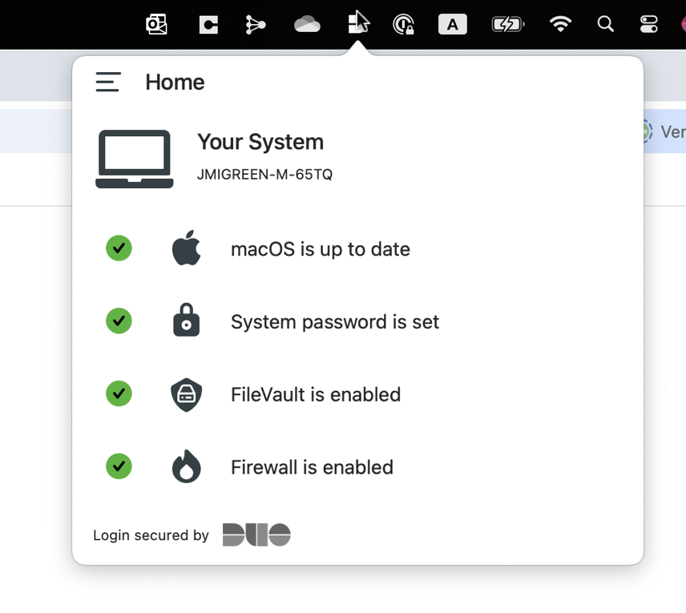
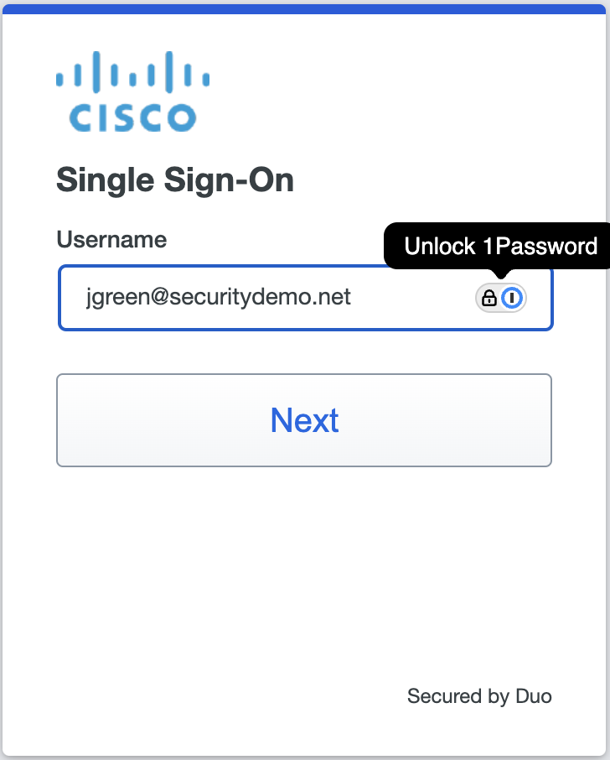
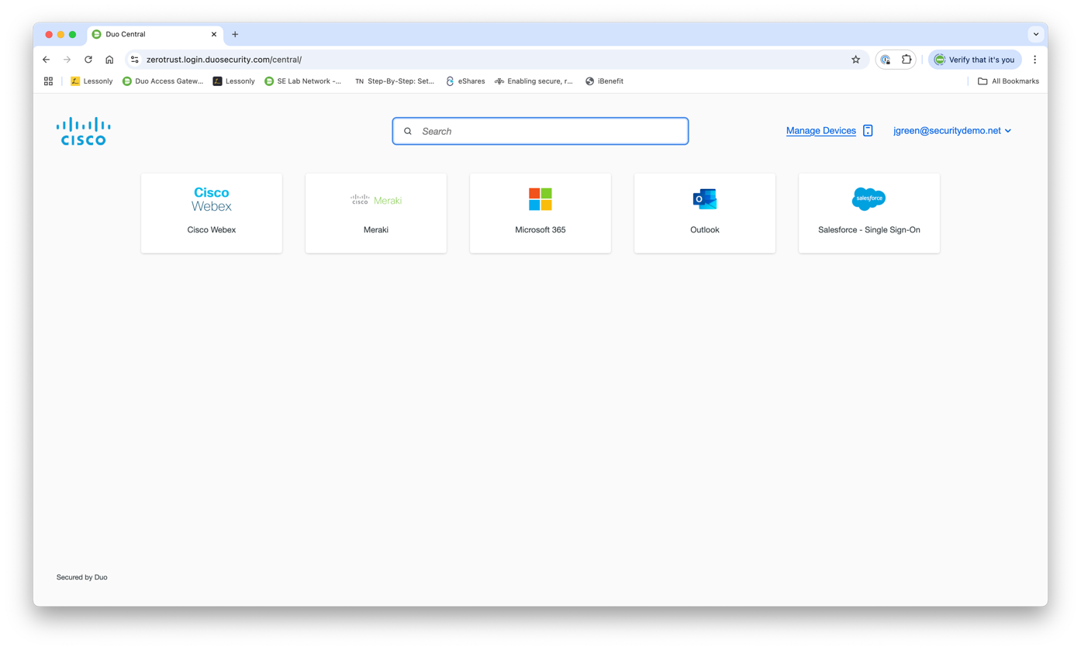


Duo Passport – True SSO
Endpoint
Duo Desktop sends signed user and device profile to Duo Cloud
User accesses a Duo-protected application via any browser
Duo Desktop sends an updated profile to the cloud
User is logged in to the application
Timeline
Duo Cloud records this profile.
Duo requests a fresh user & device profile from the device
Does the new profile match the original profile?
Duo issues a new session for the application
Duo Cloud
Notes:
Duo Passport takes the SSO experience, which for all of history was relegated to only a single browser, and extends it to ANY browser; including EMBEDDED browsers.
This means that for the first time, a user can move between browsers and client applications without having to sign in again.
This is accomplished with the assistance of the Duo Desktop application. It’s OS-level connection with Duo Cloud means that sessions can be initiated in any browser, and thus there is no need to be moving 3rd party cookies between browsers nor any issue with ephemeral, embedded browser sessions.

Slide 10


Duo Passport – True SSO
Endpoint
User accesses a Duo-protected application via a 2nd browser
Duo Desktop sends profile to the cloud
User is logged in to the application
Timeline
Duo requests user & device profile from the device
Does the new profile match the original profile?
Duo issues a new session cookie for the application
Duo Cloud
Notes:
Duo Passport takes the SSO experience, which for all of history was relegated to only a single browser, and extends it to ANY browser; including EMBEDDED browsers.
This means that for the first time, a user can move between browsers and client applications without having to sign in again.
This is accomplished with the assistance of the Duo Desktop application. It’s OS-level connection with Duo Cloud means that sessions can be initiated in any browser, and thus there is no need to be moving 3rd party cookies between browsers nor any issue with ephemeral, embedded browser sessions.

Slide 11

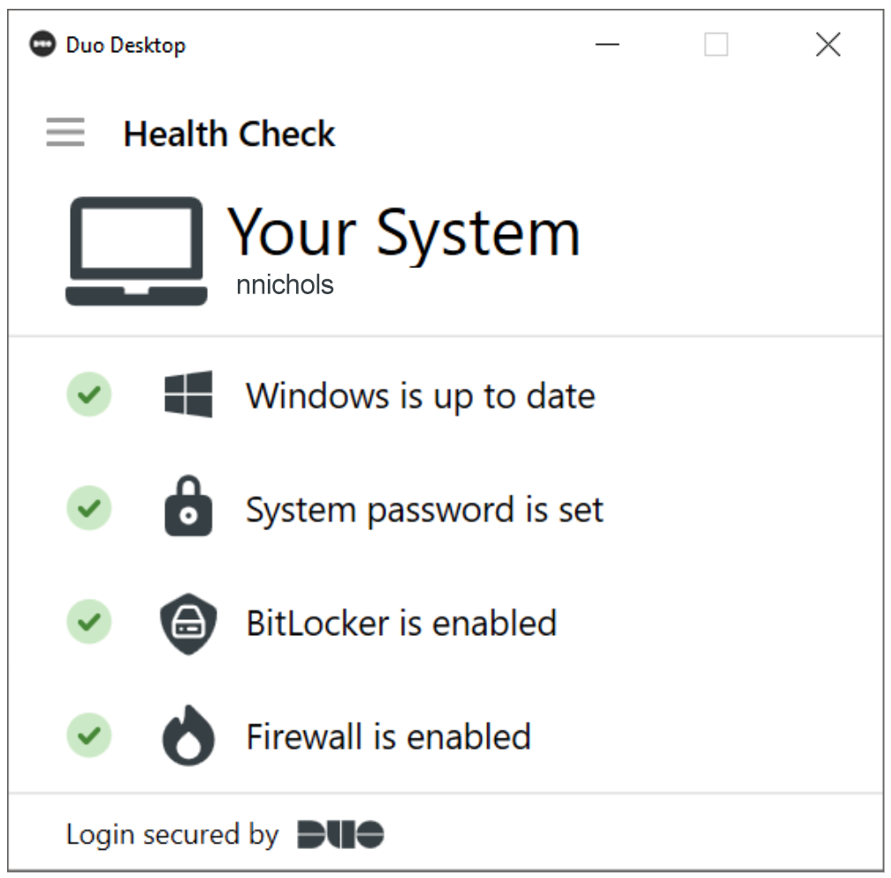
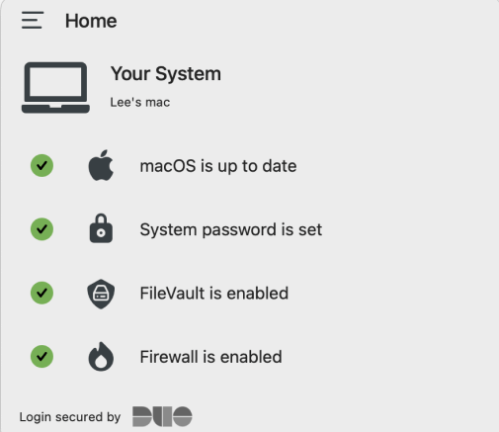
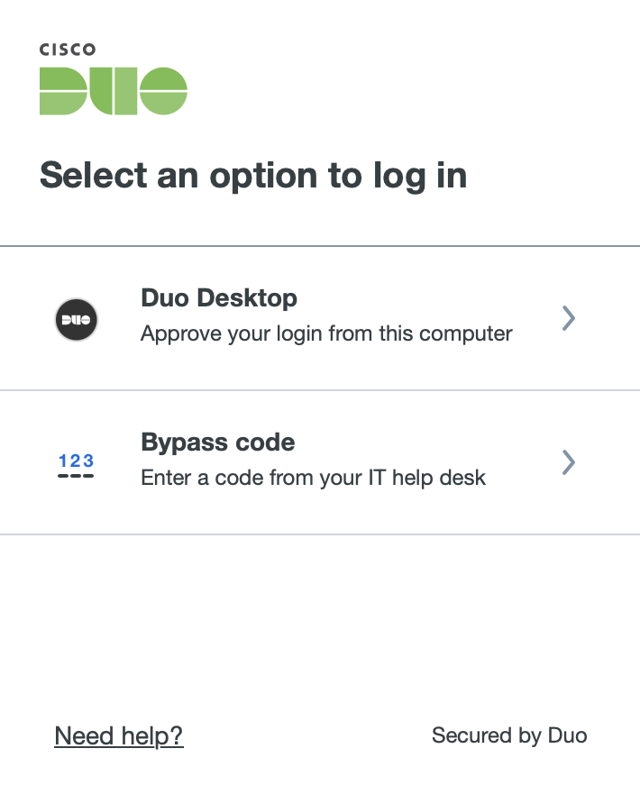
Duo Desktop
A muti-faceted component
Authentication
Device Health
Device Trust
Cryptographic Device Binding
Wi-Fi Fingerprint

Slide 12
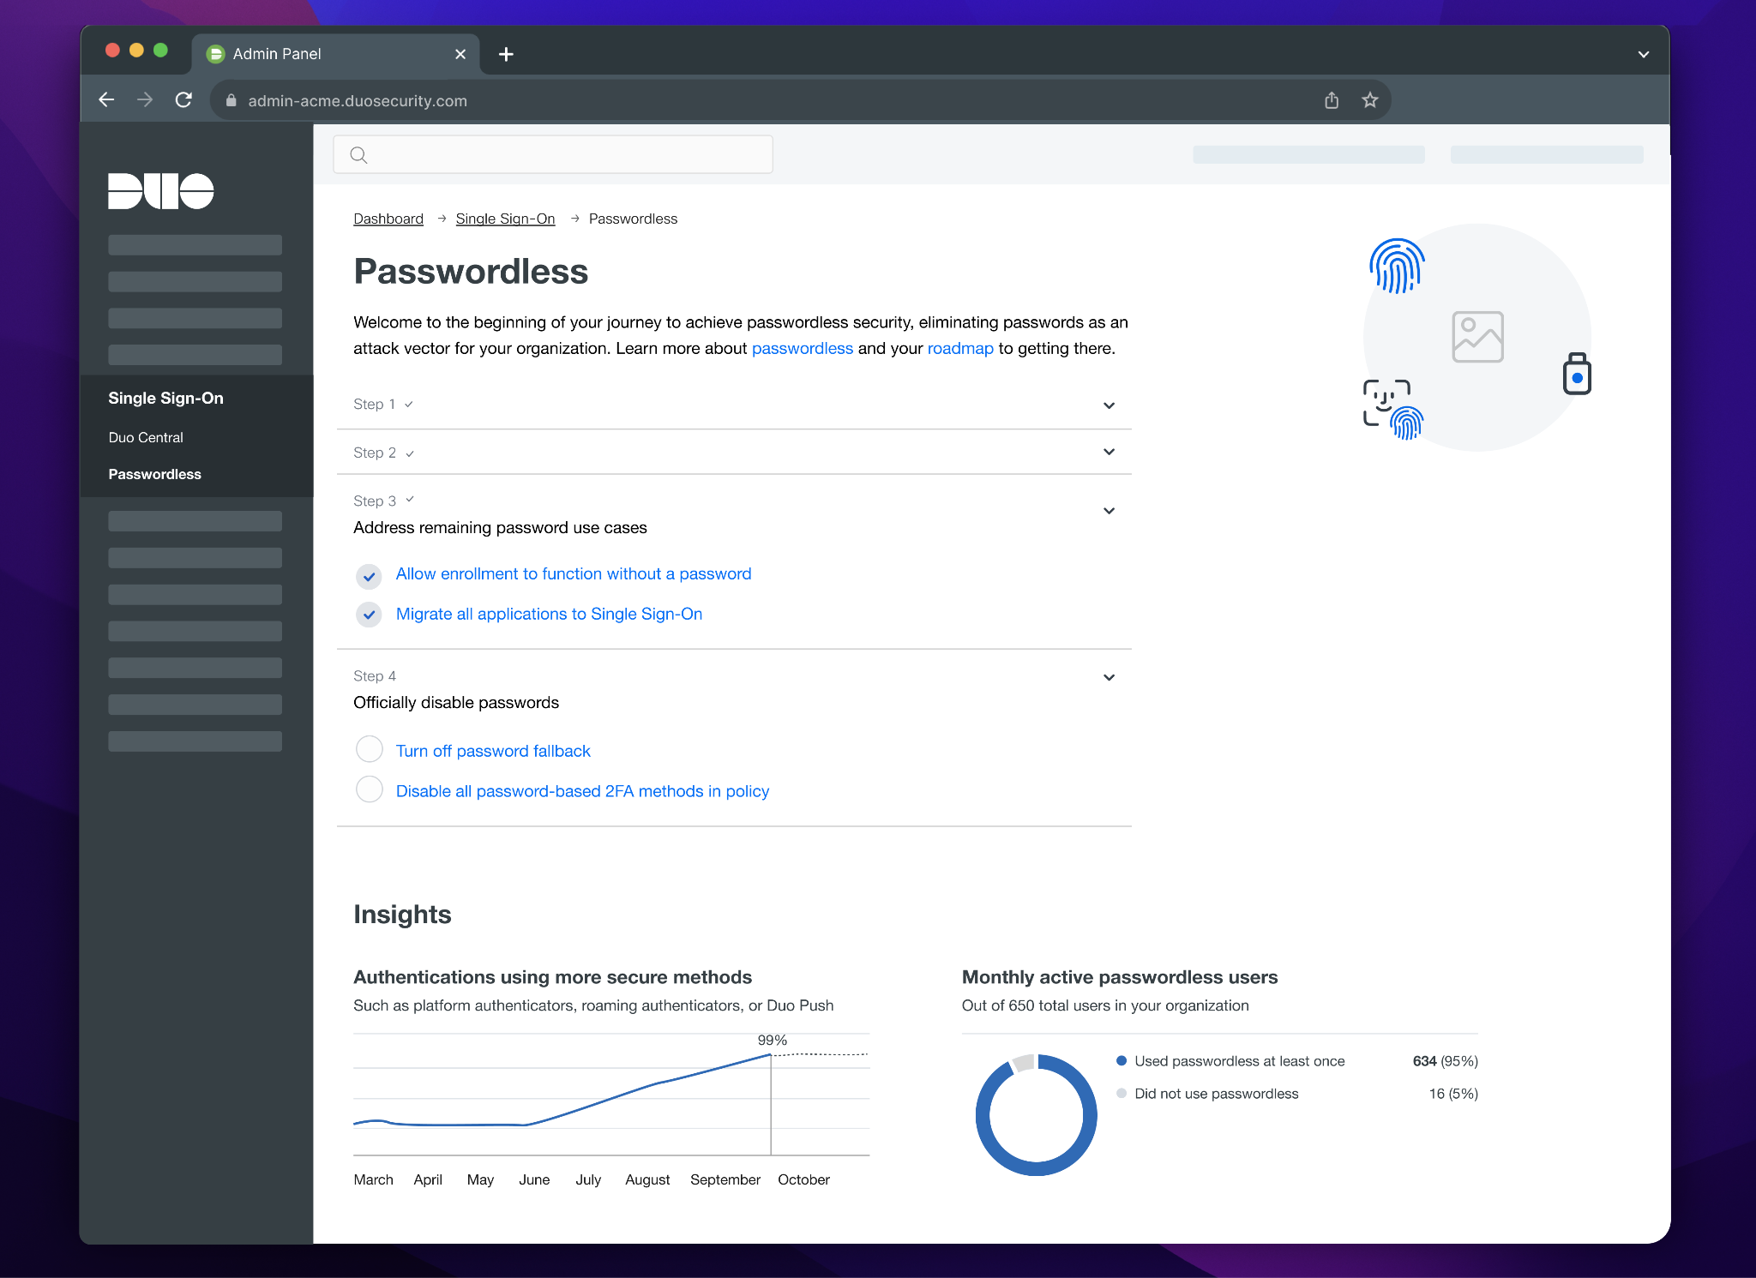
Duo Supports True Passwordless
Most passwordless solutions are still rooted in passwords
For fallback & bootstrapping
Duo Passwordless can be configured for 100% passwordless
From initial enrollment through the entire identity lifecycle
Notes:
Use Case:
Today’s passwordless solution allows fallback to password & 2FA and relies on password to bootstrap trust for new user enrollment. The objective is to enable a completely passwordless experience and achieve the full promise of passwordless.
Solution:
Duo is working on a series of new features to enable new user enrollment without relying on a password, secure ways for account recovery, disable fallback to passwords, controls to allow administrator to test and rollout gradually, additional functions to reduce the administrative burden managing the transition period.
YOU CAN configure fallback to a password, but you don’t have to.
We’re also working to add 3rd party identity verification as a recovery option to further ensure a secure, seamless, passwordless recovery flow.

Slide 13
True Passwordless Enrollment Demo

Slide 14
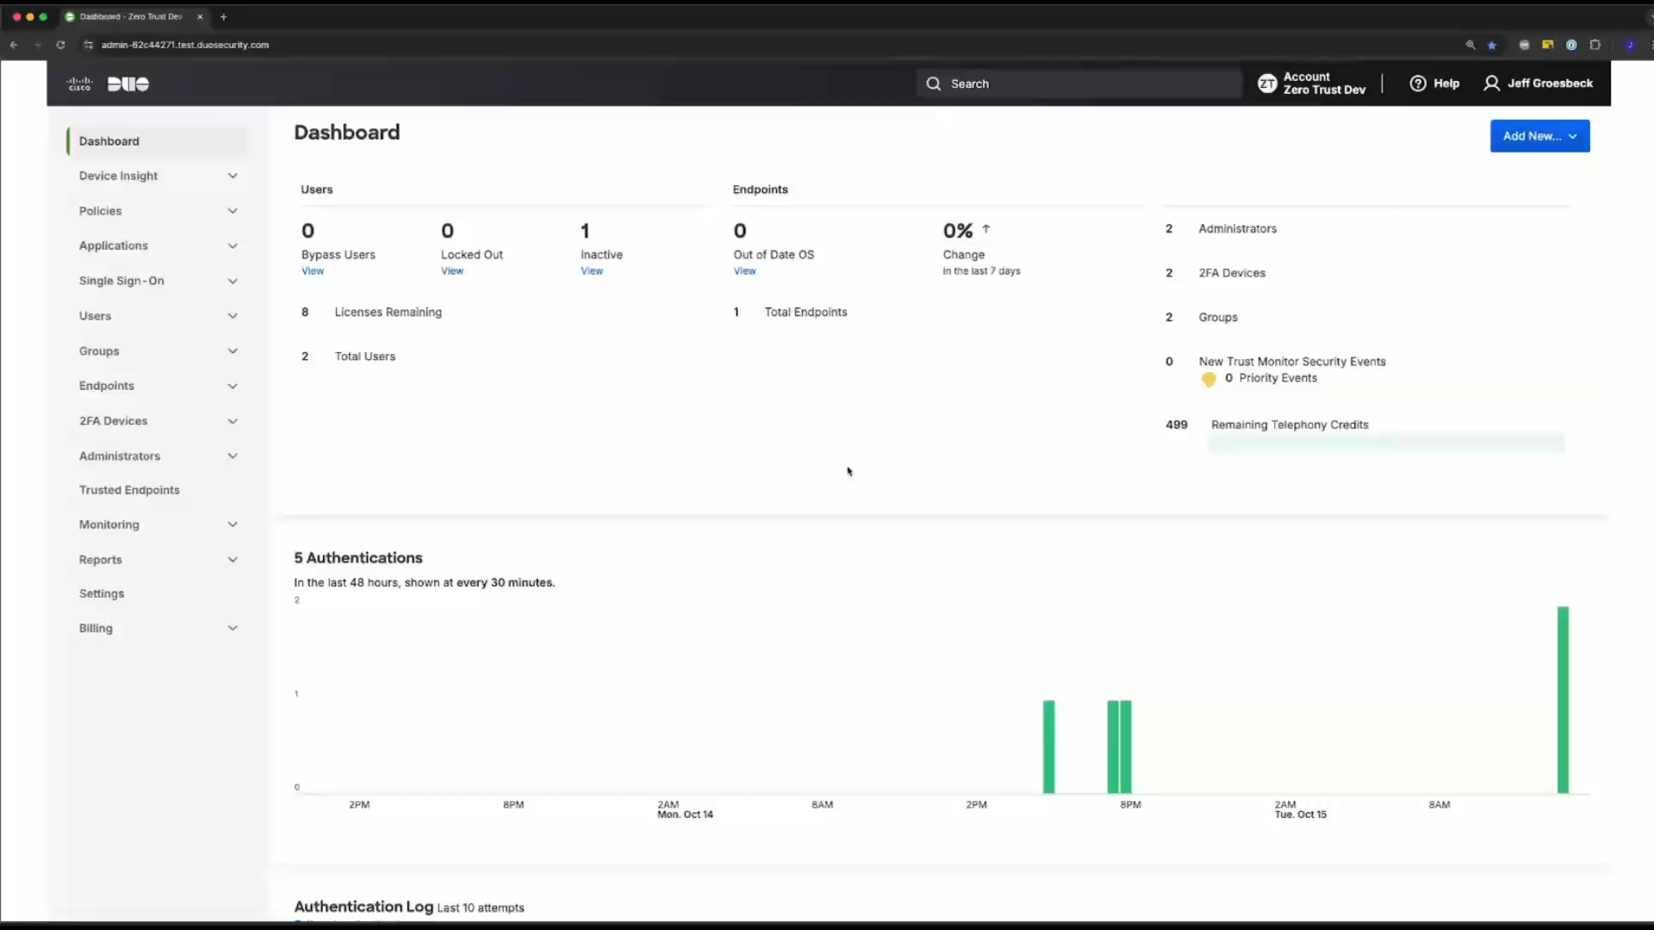

Slide 15
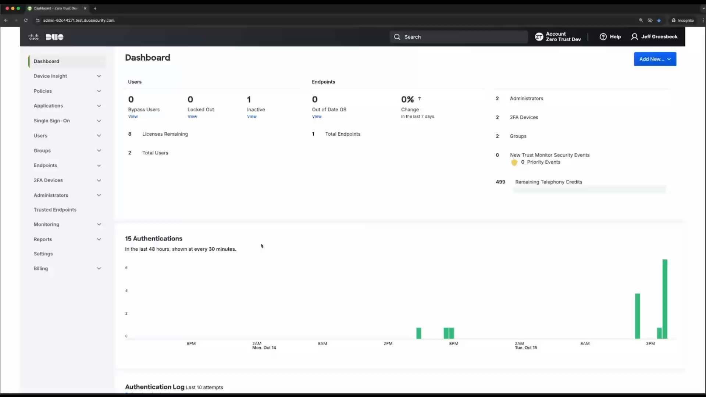

Slide 16
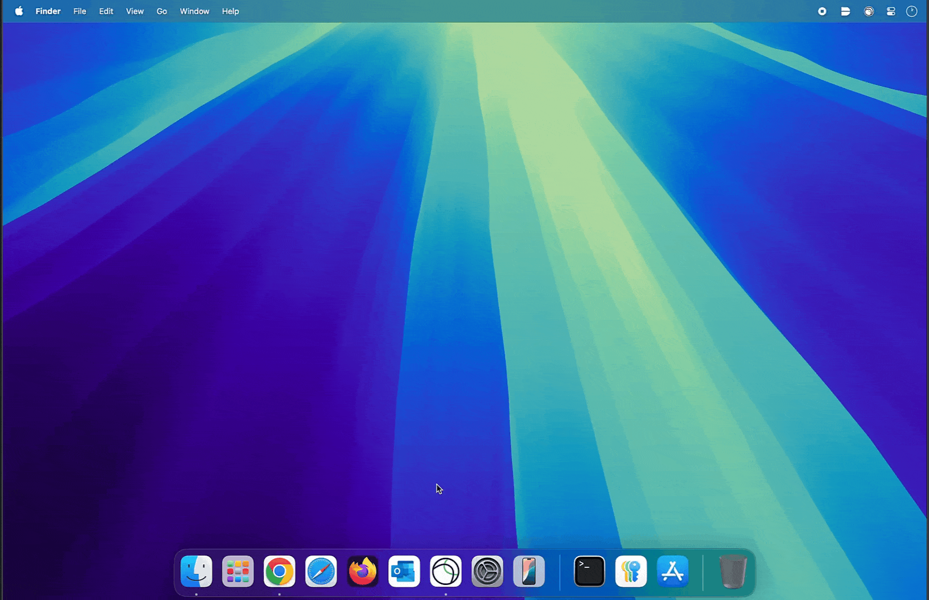
Passwordless: Embedded Browsers
WebAuthN support is required for passwordless
Embedded browsers often don’t support WebAuthN
Duo leverages Duo Desktop to bridge that gap
Provides passwordless support to those embedded browsers
Notes:
Use Case: A challenge with passwordless adoption today is that some applications do not support WebAuthn in their embedded browsers or thick clients, such as VPN software or Microsoft Office Suites. While some applications provides a configuration path to leverage the default system browsers, the option is not available to all applications and sometimes not feasible in customer’s particular environment.
Solution: Duo is able to solve this challenge with Duo Desktop, which is used to bridge the cases where WebAuthn support isn’t available in the embedded browsers.

Slide 17
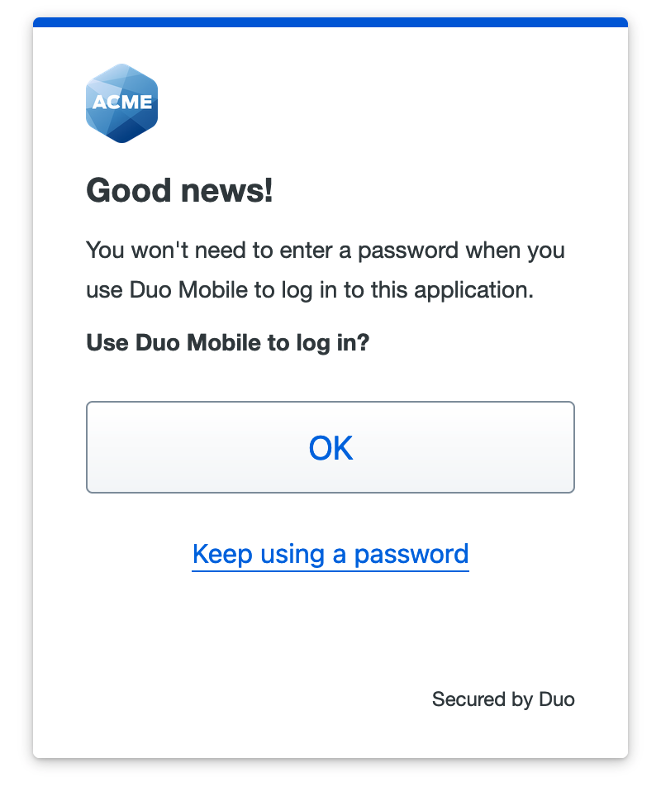
Passwordless with 3rd Party IDPs
Duo provides Passwordless for 3rd party IDPs
Can leverage:
LDAP (like Active Directory)
Entra ID
OpenID Connect
SAML 2.0
Notes:
Use Case: Today’s requirements of on-premise Active Directory and Auth Proxy have prevented some customers who don’t have AD or want to migrate off AD to use Duo Passwordless.
Solution:
This new feature will enable customers to use Duo Passwordless with cloud authentication sources like Entra ID. Behind the scenes, Duo’s attribute stores are enhanced with custom attributes and will be able to provide user information without the need for Duo to reach outwards to other user information stores.

Slide 18
Passwordless OS Login

Slide 19
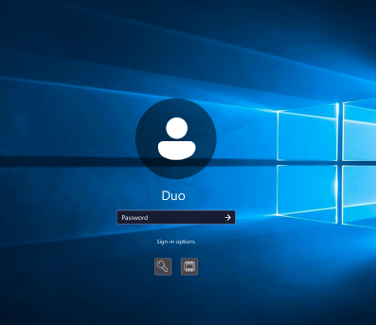
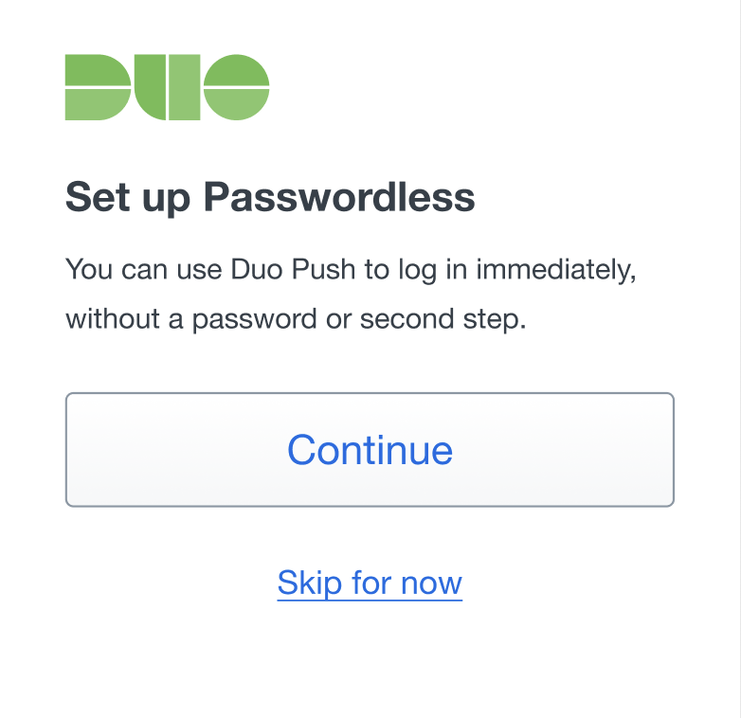
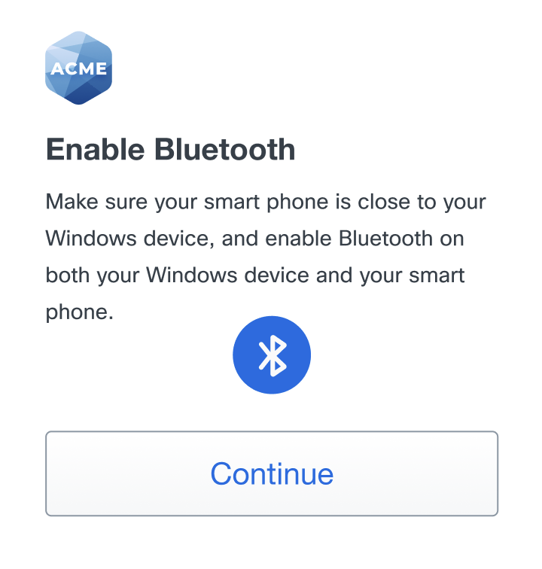
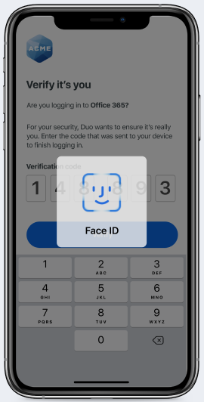
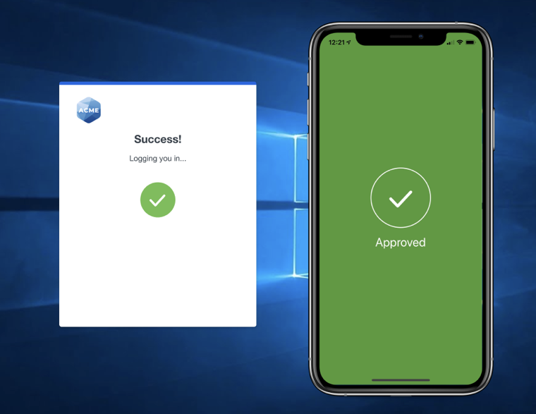


Passwordless OS Login – First Login
Endpoint
Lee enters username/PW and is prompted to register by Duo
Endpoint Bluetooth Low Energy (BLE) advertisement starts
Lee is registered and gets access
Timeline
Key Pair created/stored in TPM, PW is encrypted
Lee is prompted for BLE permissions in Duo Mobile
BLE advertisement is read by Duo Mobile
Lee completes a biometric push
Encrypted PW is sent through Duo Cloud to Duo Mobile
Mobile

Slide 20
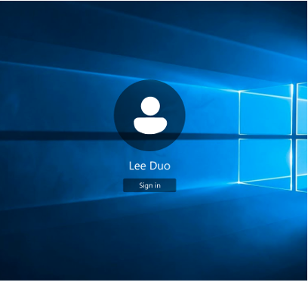
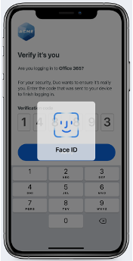
Passwordless OS Login – Login 2+
Endpoint
Lee clicks ‘Sign in’ and is not prompted for a password
Duo Cred Provider starts BLE advertisement
Duo CredProvider decrypts PW and Auto-Logs in Lee
Lee logs in, OS session is established
Encrypted PW is sent from Duo Mobile, through Duo Cloud to OS
Timeline
BLE advertisement is read by Duo Mobile
Lee completes a biometric push
Mobile

Slide 21

Offline Authentication for Windows and macOS
Why it’s needed
Users need to authenticate into their machines with MFA before they can access internet / secure portal
Who it’s for
Remote users who need to perform 2FA while they are temporarily disconnected from the internet
Supported Auth Methods for Windows and macOS Offline:
Offline auth via OTP with Duo mobile
Use the smartphone you own
Enter one-time passcode
Or auth with a security key (Windows Only)
Grab a YubiKey or other security key
Just tap the key!
#####
Notes:
Windows login and RDP are one of our most popular and highly demanded integrations. In concert with Duo Passport, this yields a very flexible and user-friendly experience that even Microsoft struggles to deliver.

Slide 22


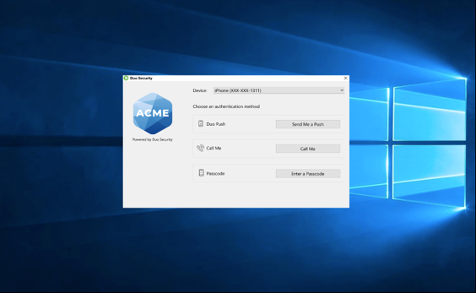



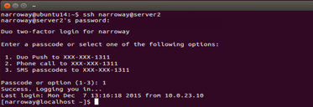
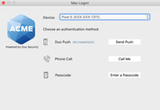
WinLogon, MacLogon, & Linux PAM
Local Logins
√
√
√
Online/Offline
√
√
Online
Protocols
RDP (incoming)
SSH
Other Features
User Account Control (UAC)
Passwordless login

Slide 23
Passport & Passwordless OS Login Demo

Slide 24
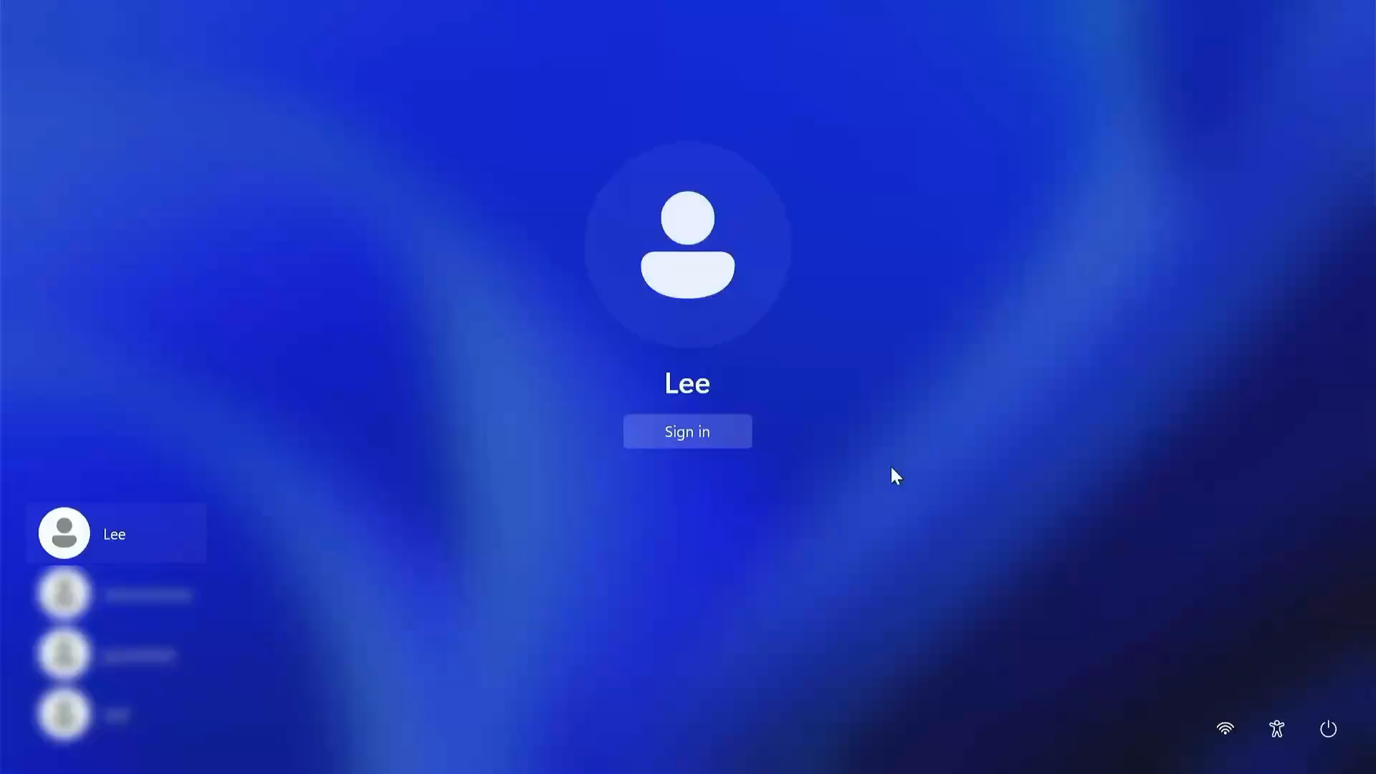

Slide 25
Ok, this all looks great, BUT How do we put this all together?

Slide 26








Identity Simplified. Security Amplified.
Active Directory
SAML 2.0 Identity Provider
Duo as an identity store + external IdP sync
Automate user access & least-privilege
AI-powered zero trust identity security
Enable passwordless across IdPs
Multi-domain routing + segmentation

Slide 27















Duo as an Identity Store + External ID sync
Use Duo as an identity provider or sync in your external IdPs
Provision user access and enable passwordless
Protect apps with zero trust identity security
Duo as an Identity Store
Duo now supports full-first factor with passwords + MFA or passwordless with MFA
Automate provisioning
Dynamically provision user app access with segmentation and zero trust policies
Enable zero trust identity security
Protect apps with segmentation and continuous identity security
Multi-domain support
Give admins tools to support mergers and acquisitions or segment contractor or partners with stronger access control

Slide 28








Third-Party SSO/IAM Support
Integrate Duo natively across multiple Identity/SSO platforms
Provide consistent end user experience and security controls across all applications
Easily gain device visibility and trust across all applications

Slide 29








Duo as the Identity Store or Duo as the SSO Provider
Acme User
user@acme.com
Duo Single Sign-On (SSO) IdP
Duo Identity Store
Acme User 2
user2@acme.com
Third-Party Identity Provider (IdP)

Slide 30

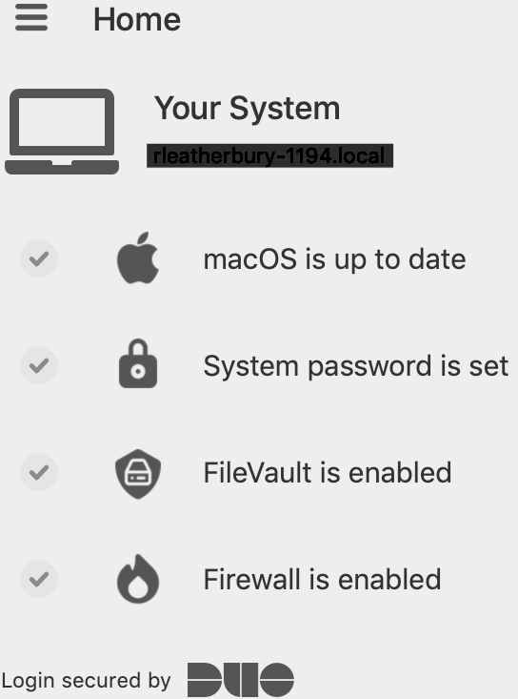






Verify user devices are trusted
Establish device trust before granting access​
Verify Endpoint Trust
Block access from unmanaged and unknown devices
Guide Self-Remediation
Eliminate vulnerabilities and lower IT costs by empowering users to remediate their device
Check
Device
Health
Assess Security Posture
Deny access to compromised or out of compliance devices
Trusted Browser
Trusted Device

Slide 31



Trusted Endpoints
Block attackers by only allowing registered and managed devices to gain access to corporate resources
Block Attackers
Only allow registered or managed devices to gain access to corporate apps and resources
Cover BYOD
Safely allow BYOD and 3rd party devices without requiring Mobile Device Management software
Control Device Access
Give organizations control over which devices can access corporate apps and resources
Mitigate Risk
When limited authenticator options are available
Corporate Managed Device
Registered Device
Unknown
Device
!
We’re sorry. Access is not allowed.
LEVEL OF TRUST

Slide 32
Device Verification: Device Health
Device Posture Checks Explained
Conditions
Result
Disk Encryption status
Host firewall status
Device password status
OS Type and Version
3rd Party Security Agent Status
Browser Type and Version
Flash & Java plugin versions
User Identity
+
Device Posture
√ - Access Granted
Disk Encryption status
Host firewall status
Device password status
OS Type and Version
3rd Party Security Agent Status
Browser Type and Version
Flash & Java plugin versions
User Identity
+
Device Posture
X – Access Denied
Begin self-guided remediation flow

Slide 33
Device Verification: Trusted Endpoints
Device Trust Explained
Conditions
Result
User Identity
+
Device Identity
Device Identifiers match Duo Device Inventory
√ - Access Granted
User Identity
+
Device Identity
No Device Identifier match in Duo Device Inventory
X – Access Denied

Slide 34
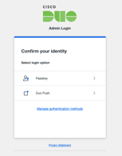



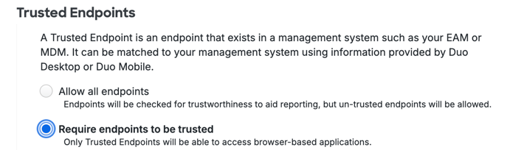

How Trusted Device Verification Works With Duo Desktop (Win/macOS/Linux)
Device Identifiers
Device Identity
Sync
2
4
Duo Desktop
5
Duo Device Cache
Your Device Manager MDM/EMM
1
AuthN from Win, macOS, or Linux device
Identifiers from Windows:
Hostname
Machine_GUID
Computer_SID
Domain_SID
Identifiers for macOS
Hostname
UUID
Match Duo Device Inventory
or
Match AD Domain_SID
(domain joined only)
3
Duo Policy - Trusted Endpoint
- Device Posture
Trusted Endpoint management integrations that use Duo Desktop for verification match the information reported by Duo Desktop to information reported by the endpoint management system to determine the computer's management status.
For example, this could be matching unique IDs from the device with those same IDs stored within an AD domain. Or this could be the device UUID as presented by the device and as stored in a management tool like JAMF.
Notes:
Trusted Endpoint management integrations that use Duo Desktop for verification match the information reported by Duo Desktop to information reported by the endpoint management system to determine the computer's management status.
Note: For AD domain joined devices, Domain SID is used to verify trust of the device. Administrators will have to provide the SID as part of the initial API integration. Duo Desktop collects the domain name from the access device and uses Windows APIs to query the SID based on the domain name.
For generic or manual integrations, you can use Device API to upload device Identifiers to Duo Device Cache.

Slide 35


What Posture Information Does Duo Gather?
Mobile Devices
Laptops / Desktops
Corp managed asset status
Biometrics (Touch/Face) status
Screen lock status
OS condition (tampered) status
Encryption status
Platform type
Device OS type
Device OS version
Device owner
Duo Mobile version
Disk encryption status
Host firewall status
Device password status
OS type and versions
OS patch level
Third-party security agent status
Corporate managed vs. unmanaged status
Device IDs
Browser type & versions
Flash & Java plugin versions

Slide 36
But I “get MFA for Free”

Slide 37

Strong Multi-Factor Authentication (MFA) Options
Duo has flexibility with MFA for every use case
Authentication Methods
Biometrics
Security Keys
Configure authentication options for each application or group of users
Require phishing-resistant MFA (FIDO2) for critical applications and privileged users
Enable multiple option for users for ease of use and flexibility
Verified Push
Wearables
Level of Assurance
Push
#####
Soft Token + Duo Desktop Authenticator
SMS
Phone Call
Notes:
Duo offers a broad range of authentication options for MFA. From Duo Push, our most commonly-used second-factor authentication method, to more traditional methods that use a secure passcode generated by a physical token, configuring any authentication method is easy with Duo. You can configure authentication methods on a per-application or per user group basis, and for ease of use and flexibility, you can enable multiple methods.
While some methods are clearly more secure than others, users and companies in some locales can only do SMS based auth. It is still better than no 2FA at all, and this is why we give administrators the final say about which methods and authenticators they wish to enable.

Slide 38
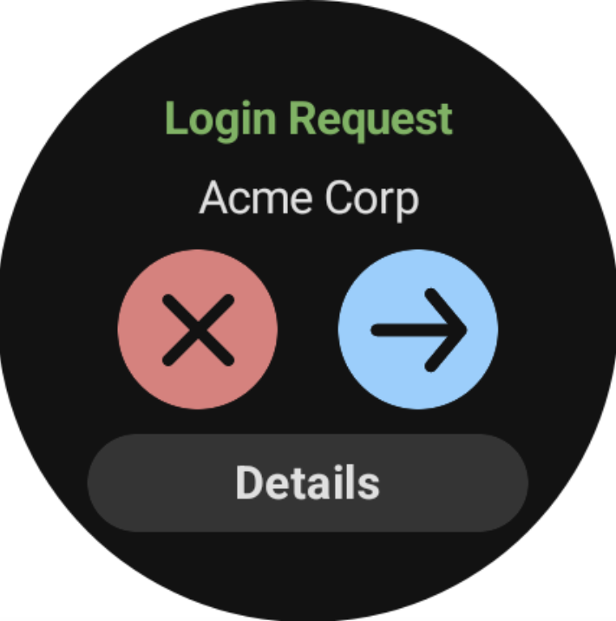
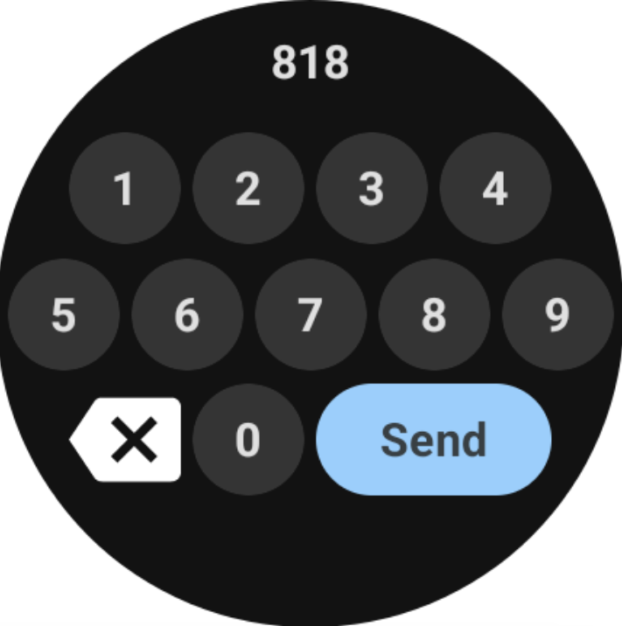
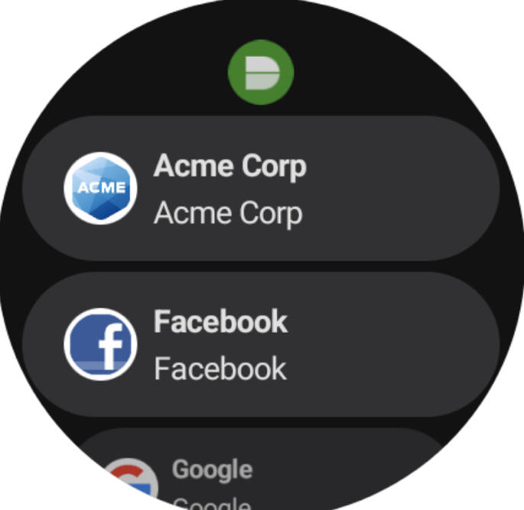
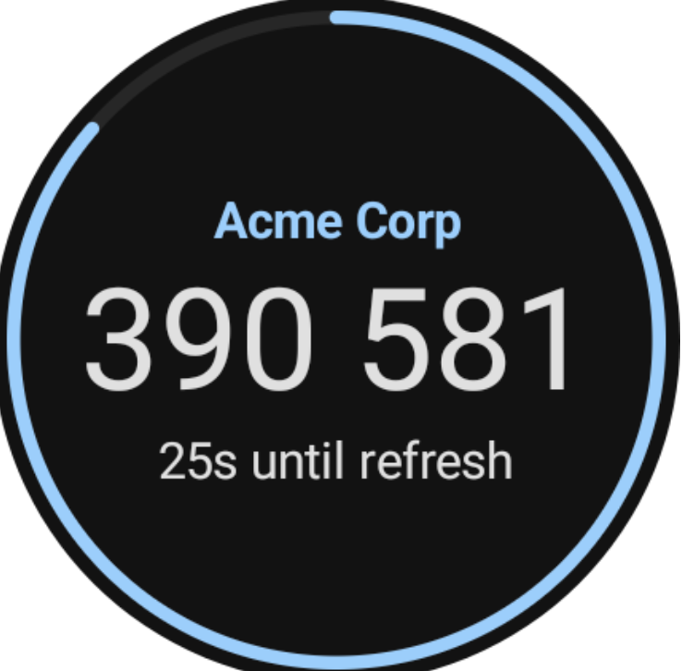
Duo Wear – Android
Duo Wear
Companion smart watch app for Duo Mobile
Capabilities:
Generate OTP
Respond to Duo Pushes
Verified Pushes, too!
Notes:
USE CASE:
Give Android users an easy way to authenticate directly from their wrists!
Solution:
Duo Wear is a companion smart watch app for Duo Mobile. It allows users to generate OTPs and answer Duo Pushes and Verified Duo Pushes.

Slide 39
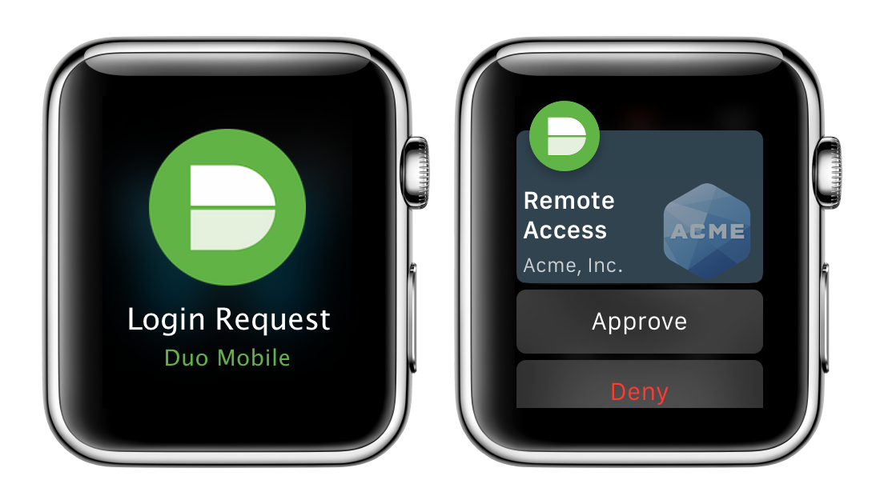
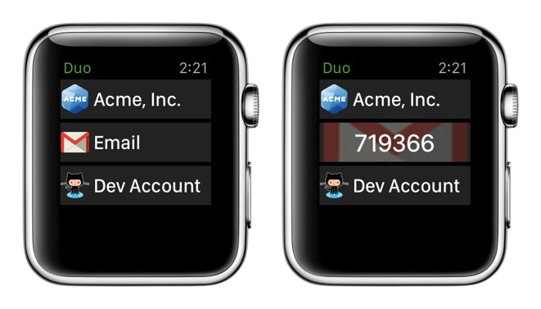
Duo Push and Apple Watch
Duo Push w/ Apple Watch
Companion app for Duo Mobile
Notified when phone is locked
Capabilities:
Generate OTP
Respond to Duo Pushes
Verified Pushes, too!
By drawing or narrate the code
Not compatible with passwordless
Notes:
When you receive a two-factor push notification, you'll also see the notification on your paired Apple Watch if your phone is locked. Apple Watch’s Taptic Engine is a linear actuator inside the device that produces haptic feedback, meaning it literally taps you on the wrist whenever you receive an alert or notification. That means you’ll also feel a tap whenever a login request is sent via Duo Mobile, letting you quickly log in or deny the request.
You can approve the two-factor authentication login request or deny the login request without ever touching your phone.
If your organization requires Duo Push verification with a numeric code you can draw or narrate the code to approve the login request from your Watch.
You'll only see the Duo request on your watch when your phone is locked. Notifications won't go to your Apple Watch when your phone is unlocked.
Duo Passwordless push login requests can't be approved from an Apple Watch because passwordless push authentication requires that you complete an additional verification step — either biometric verification with Touch ID or Face ID or entering your device's screen lock PIN. The same additional verification step may be necessary for two-factor Duo Push authentication if your organization's Duo policy enforces it. In these situations, the Duo notification received on your Apple Watch instructs you to open Duo Mobile on your phone to view the request.
Passcodes
You can also generate passcodes from the Duo Apple Watch app. Simply launch the app from the watch and tap an account to generate a passcode for that account.

Slide 40
Supported Authenticators & Policies
Authenticators
Policies
Touch ID
Face ID
Windows Hello
FIDO2 security keys
Duo Mobile
HOTP or TOTP passcodes
Duo Push & Verified Duo Push
User groups
Policy for OS, browser & location
Per-App Remember Me
Device Trust policies
VPN-less remote access policies

Slide 41
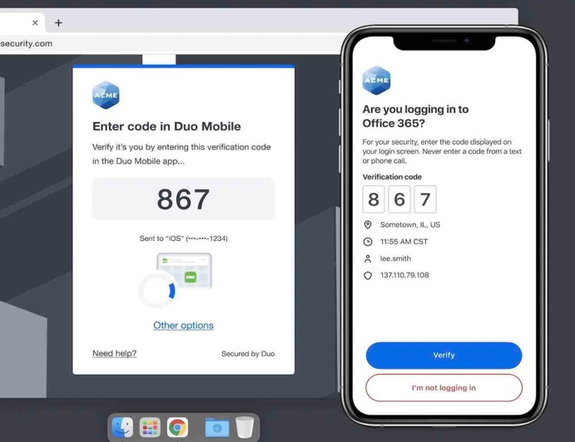
Prevent Push Phishing Attacks
Duo Verified Push
Increases security of push-based MFA while preserving ease of use
Customizable code length
3-6 digits
Can be triggered only when risk level increases to preserve user productivity
Covered more in the Risk-Based Auth Section
Notes:
Verified Duo Push, commonly known as push with number matching, is a more secure form of push-based authentication. This mitigates attacks that bypass MFA by tricking users into accepting a fraudulent push.
WHY IS IT IMPORTANT?
MFA Fatigue
Getting used to accepting MFA challenges without thinking…..

Slide 42
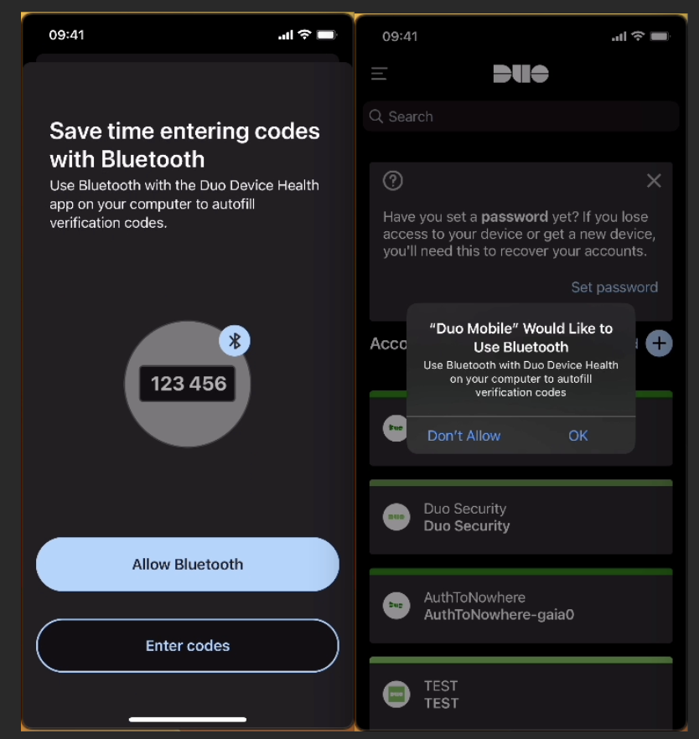
Proximity Verification
You can’t push phish, if you can’t push at all
Increase security assurance by requiring the access & authentication devices are nearby.
Prevents bad actors from accessing apps from a different location.
Duo Desktop is required (available for all editions)
Uses Bluetooth Low Energy (BLE)
Two Modes:
AutoFill the Verified Code - Reduces Verified Duo Push friction
Proximity required to accept & respond to the push (most secure)
Notes:
Use Case:
Reduce Verified Duo Push friction by using Bluetooth to autofill verification codes
Increase phishing-resistance of Verified/Duo Push by checking proximity between auth and access devices
Solution:
Using Bluetooth LE to broadcast and autofill verified code to reduce user friction, meanwhile guaranteeing mobile phones (auth device) and computers (access device) are in proximity to prevent bad actors from accessing from a different location. Duo Desktop is required (available for all editions)
*Evaluating against NIST 800-63 AAL2/3. In progress.

Slide 43
Pricing and Packaging
Duo Essentials
Implement simple and effective tools to secure the workforce identity perimeter.
$3 | User | Month
Duo Directory
Complete Passwordless
Proximity Verification
Multi-Factor authentication
Single Sign-On
Trusted Endpoints
Unlimited applications
Duo Advantage
Upgrade to Continuous Identity Security that works before, during, and after login.
$6 | User | Month
Duo Passport
Session Protection
Cisco Identity Intelligence
Adaptive authentication
Risk-based authentication
Duo Premier
Expand protection and effortless access to cloud, on-premises and private apps and resources.
$9 | User | Month
Cisco Talos Threat Hunting
Secure VPN-less remote access
3rd party EDR agent check
Seamless Identity Verification: Partnership with Persona

