Slide 1
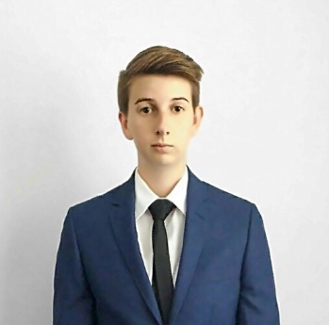
MEET THE WOMEN
RISE OF WOMEN TECHNOPRENEURS: USING DRONES AND AI FOR COMMON GOOD.
THURSDAY
DURATION
7 NOV 19
1HR
12 NOON (SGT), 3:00 PM (AEDT), 9:30 AM (IST), 9 PM (PST )
SPEAK NAME
ATTEND THE
LIVE SESSION
TITLE COMPANY
Her unwavering passion for marine conservation got Hover UAV involved with the NSW state government for trial that alerted swimmers & surfers to the presence of sharks.
• Learn the benefits of a
technology career.
• Be connected to successful female role models.
• Learn how job seekers
looking to switch careers
can tap into a tech career.
• Bring it all together with
self-study courses offered
free if you attend this live
interactive session.
NOTE: To change picture, right click on image and click ‘Change Picture’. Scale and resize as necessary.
SPEAKER NAME HERE
TITLE
COMPANY
Banoo utilizes a microbubble generator, an IoT sensor, solar technology, cloud computing & a mobile app to improve the efficiency of fish production where land and water availability are scarce.

