Slide 1
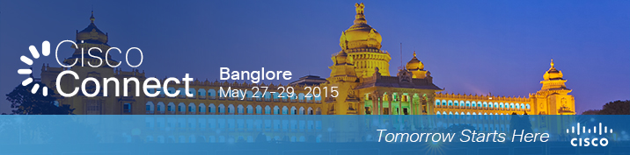

Virtualized Telco Cloud
Chia Tan, chiatan@cisco.com
Director of Engineering, Service Provider, Asia Pacific Japan
Date: 28/05/2015

Slide 2


Agenda
Market Update
Overview of Telco Cloud (NFV-I)
Cisco’s Telco Cloud Solution
Telco Cloud Deployment Strategy
Case Studies
Summary

Slide 3






Network Function Virtualization in SP Segment
Today
Desired End State
PE / Service Edge
Service 1
CE Router /
Broadband
CE Router /
Broadband
On-Net /
Off-Net
Transition
Service 2
Video
Headend
On-Net /
Off-Net
SP’s
Cloud
Partner
Cloud
STB & TV
STB & TV
Content 1
On-Net /
Off-Net
Mobile Gateways
Content 2
Mobile & Tablet
Mobile & Tablet
Today’s Service Delivery In
“Connected” Model
Any Device, Any Service, Any Content, Any Where, Any Time
Target is to Achieve Optimized TCO, Agility, Cloud Consumption & economics. SP’s now “can afford to go wrong”
NFV = Networking + Cloud → A Key Enabler of this Evolution
Top of the Mind for All SP’s

Slide 4
Cisco Visual Networking Index for M2M
M2M Traffic
In India, M2M traffic will grow 42-fold from 2014 to 2019, a compound annual growth rate of 112%.
In India, M2M traffic will reach 11.4 Petabytes per month by 2019.
In India, M2M will account for 1% of total mobile data traffic by 2019, compared to % at the end of 2014.
In India, M2M modules were 0.75% of device connections in 2014, and 0.31% of total traffic.
In India, M2M modules will be 3.9% of device connections by 2019, and 1.0% of total traffic.
M2M Connections
In India, the number of mobile-connected M2M modules grew 1.5-fold or 48% in 2014, reaching 7 million in number.
In India, the number of mobile-connected M2M modules will grow 6.9-fold between 2014 and 2019, reaching 47 million in number.

Slide 5
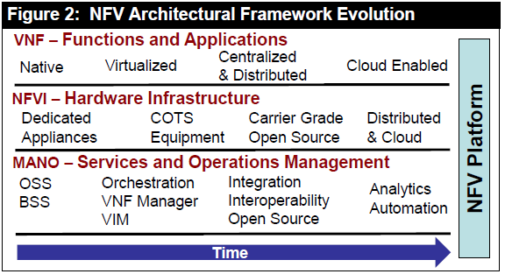
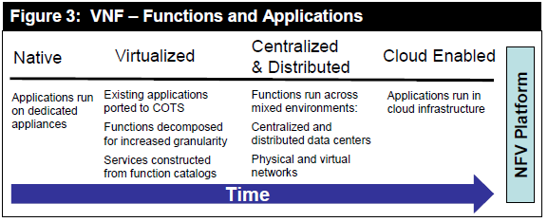
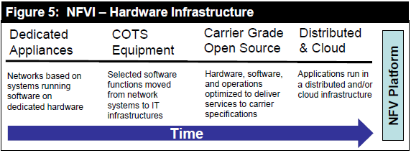
Evolving Network Function Trend
1
2
3
Source Dell Oro 2015

Slide 6
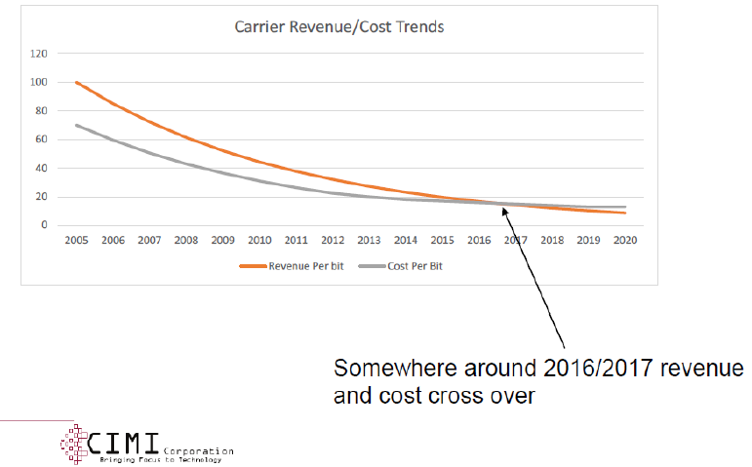
Drivers for Network Function Virtualization Infrastructure
Converged network function virtualization infrastructure (NFVi): Virtualization is rapidly moving from the compute (Infrastructure) into networking to deliver “carrier grade” software solutions
  Virtualization of core networks and network functions – Driven by rapidly expanding capacity needs on telco networks; automate to control costs
Virtualization is rapidly moving from the compute (Infrastructure) into networking
to deliver “carrier grade” software solutions

Slide 7
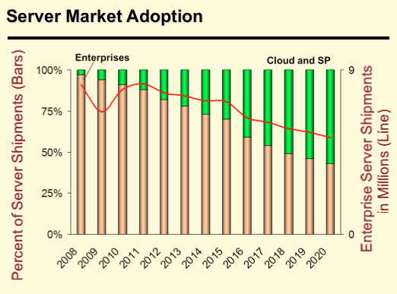
Cloud & NFV Changes the Server Market Adoption
Workloads & Network Functions are getting Cloudified
Outcome → 50% of Server TAM is forecasted to be in Cloud & SP by 2018
Source: Dell’Oro

Slide 8
Overview of Telco Cloud (NFV-I)

Slide 9



High Level E2E Framework for Service Orchestration and NFV
Applications
Business
Mobility
Video
Consumer
Cloud
Evolved Services Platform
Service Broker
Catalog of Virtual/
Physical Functions
Orchestration Engine
Service Profiles
vBranch
(NFVI)
Cloud POP
(NFVI)
Regional DC
(NFVI)
Central DC
(NFVI)
Evolved Programmable Network

Slide 10
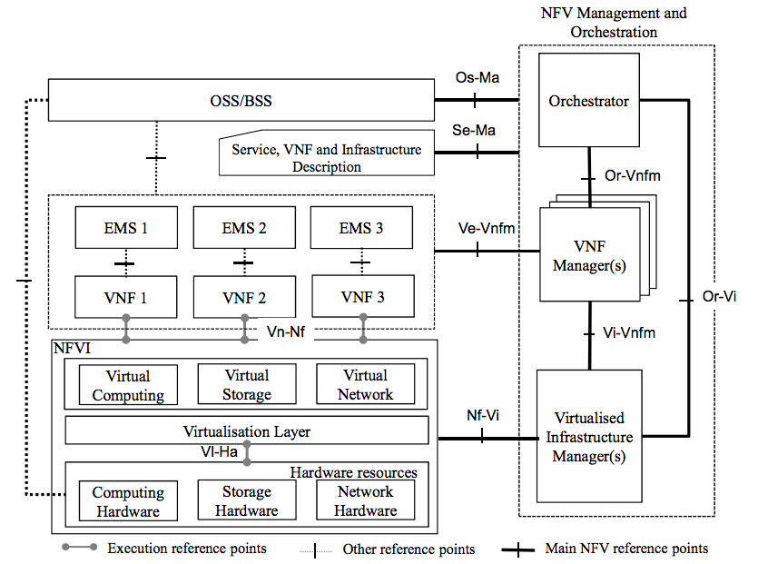

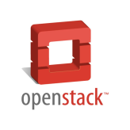

ETSI NFV Reference Architecture
OPNFV

Slide 11
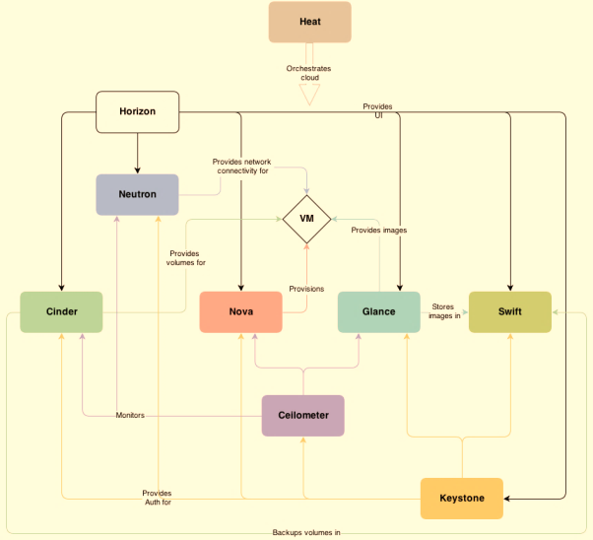
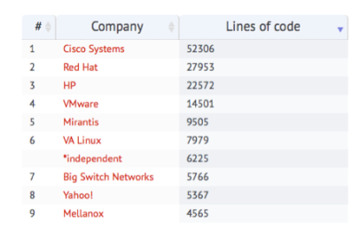

OpenStack
Juno: Neutron LOCS
OpenStack is an Infrastructure As A Service (IaaS) cloud computing project
= Cloud Operating System
“…provides a means to control (administer) compute, storage, network and virtualization technologies…”
Heat – Orchestration
Horizon – Dashboard
Neutron – Networking
Cinder – Volume Storage
Nova – Compute Service
Glance – Image Service
Swift – Object Storage
Ceilometer – Telemetry
Keystone – Identity Service

Slide 12
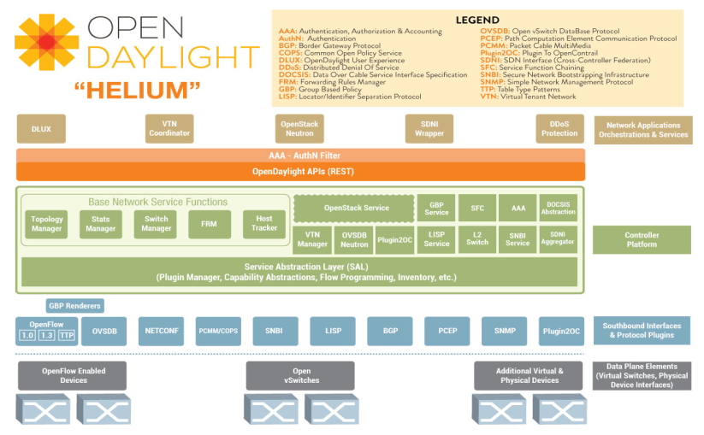
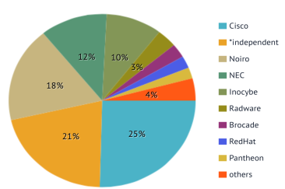
OpenDaylight Controller
Open platform for network programmability
Enables SDN for networks at any size and scale
New “Helium” release delivers new user interface and a much simpler and customisable installation process

Slide 13
Cisco’s Telco Cloud Solution

Slide 14
(1) Overlay Stack Solution Option
Compute
Storage
Switching
Northbound API’s
KVM, ESXi, Hyper-V
Software Defined – Ceph
OpenStack – Swift / Cinder
Nexus1000v,
AVS
dVS, OVS, Linux Bridge
UCSD / Single Pane of Glass
OpenStack
APIC
Service Assurance & Netflow Analytics
Hardware Software
Preferred - UCS-B + FI + VIC
UCS-C Series
UCS-M (Bare Metal)
CSX – Branch / Cell Site NFVI
UCS-C240 – Compute/IO Intensive
UCS C31XX – Storage Intensive
Whiptail
NetApp/EMC
Switching Underlay – ACI
DCI – ASR9K or N7K
Soft-DCI – Sunstone vPE

Slide 15
(2) Integrated Stack Solution Option
Compute
Storage
Switching
Northbound API’s
KVM, ESXi, Hyper-V
Software Defined – Ceph
OpenStack – Swift / Cinder
Nexus1000v,
VPP (VTF)
dVS, OVS, Linux Bridge
UCSD / Single Pane of Glass
OpenStack
VTS (with ODL)
Service Assurance & Netflow Analytics
Hardware Software
Preferred - UCS-B + FI + VIC
UCS-C Series
UCS-M (Bare Metal)
CSX – Branch / Cell Site NFVI
UCS-C240 – Compute/IO Intensive
UCS C31XX – Storage Intensive
Whiptail
NetApp/EMC
Underlay– N9K/7K/5K/3K/2K
DCI – ASR9K or N7K
Soft-DCI – Sunstone vPE

Slide 16
NFVI – High Level Requirements
1
Predictable Performance
E2E Service Assurance
4
Performance at Scale
Elastic Infrastructure
Resiliency & Availability
Tight SLA
End-to-end visibility
OAM Toolkits
2
Flexible and Agile
Single Pane of Glass
5
Any workload (VM, BM, Container)
Any hypervisor (KVM, ESXi, H-V)
Unified platform for NFV
Simplified Management
Provisioning of the NFVI
Management and Operations
3
Distributed, Policy-based
Open Architecture
6
Multi-DC Architecture
Consistent e2e policy
Platform & Service security
ETSI Compliant
Open Protocol, API
Modular Platform

Slide 17
(1) Predictable Performance
Virtual Topology Forwarder (VTF)
VTF
Light weight, multi-tenanted x86 software forwarder
Industry’s only “User Space” forwarder (as VM)
Highest Performance in Industry – 10Gbps / Core
Integrated with Intel’s DPDK drivers
Multi-Hypervisor capable, highly portable VM model
Full networking stack – L3 (IPv4, IPv6, PBR), L2
Overlay – MPLSoGRE, L2TPv3, VXLAN, MPLSoUDP
Programmed using YANG over RESTConf
VTF
VTF

Slide 18
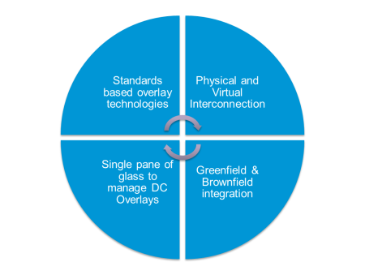

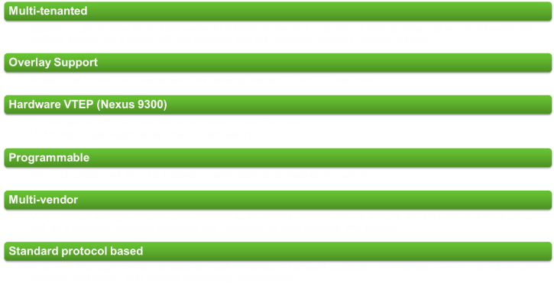
(2) Flexible and Agile
Virtual Topology System (VTS)
VM
VM
Physical
OS
OS
Virtual
Hosts
L4-L7 Services

Slide 19


(2) Flexible and Agile
VTS Architecture
Management &
Orchestration Plane
3rd Party VM
Manager
Cisco NSO
OpenStack
VCenter
VTS GUI
REST API
Control Plane
Virtual Topology System
(VTS)
MP-BGP
MP-BGP
RR
BGP-EVPN
BGP-EVPN
RR
IP / MPLS
WAN
WAN / Internet
3rd Party Cloud
ToR
RESTCONF/Yang
ToR
DCI
DCI
OVS
VTF
VTF
dVS
VM or
VNF
VM or
VNF
Data Plane
VM or
VNF
VM or
VNF
VM or
VNF
VM or
VNF
VM or
VNF
VM or
VNF
VM or
VNF
VM or
VNF
VM or
VNF
VM or
VNF
Bare Metal
Workload
Virtualized
Workloads with OVS
Virtualized Workloads with Feature Rich &
High Performance Cisco VTF Solution
Virtualized
Workloads with dVS
Virtualized
Workloads with SR-IOV

Slide 20
(3) Distributed Policy Based
Policy Cisco Data Center Strategy & Vision
Defined by Applications. Driven by Policy. Delivered as a Service / Solution
BUSINESS
REQUIREMENTS
APPLICATIONS
Policy
Policy
Network
Cloud
Policy
Compute
SECURITY AND L4-7 SERVICES
MANAGEMENT AND ORCHESTRATION
FLEXIBLE SOFTWARE MODEL (DevOps / PaaS)
BUSINESS OUTCOMES
Business Agility
New Business Models
Lower TCO

Slide 21
(3) Distributed Policy Based
Linking the Application Language to Infrastructure
Common Policy
Application
Language
App Network Profile
UCS Service Profile
Network Language
Multi-Tier / DevOps
Security & Compliance
SLA
Performance
Compliance
High-Availability
  Decouple
  Application AND Policy
  from underlying infrastructure
Compute Language
Infrastructure
Security Language

Slide 22


(4) E2E Service Assurance
Service Assurance Solution: Key Tenets
Assure the delivery of services offering a consistent and reliable user experience
Fault Management
Performance Monitoring
Capacity Planning & Forecasting
Optimization/Placement
Predictive Analysis
Root Cause Analysis
Cross-Domain and Multi-Vendor: End-to-end visibility across multiple domains and vendors (i.e. EPC to WAN to VPC and Cloud)
Multi-layer: Correlated view across application, service, physical and virtual infrastructure layers
Automation: Policy-based automation tying visibility and analytics to control and optimization
Orchestration Integration: Loosely coupled and tight integration with Service Orchestration
Pre-integrated with Cisco ESP Solution: Out-of-box content supporting use-cases for Cisco ESP Solution offering (e.g. CloudVPN, VPC).
Cloud based: Flexible packaging

Slide 23
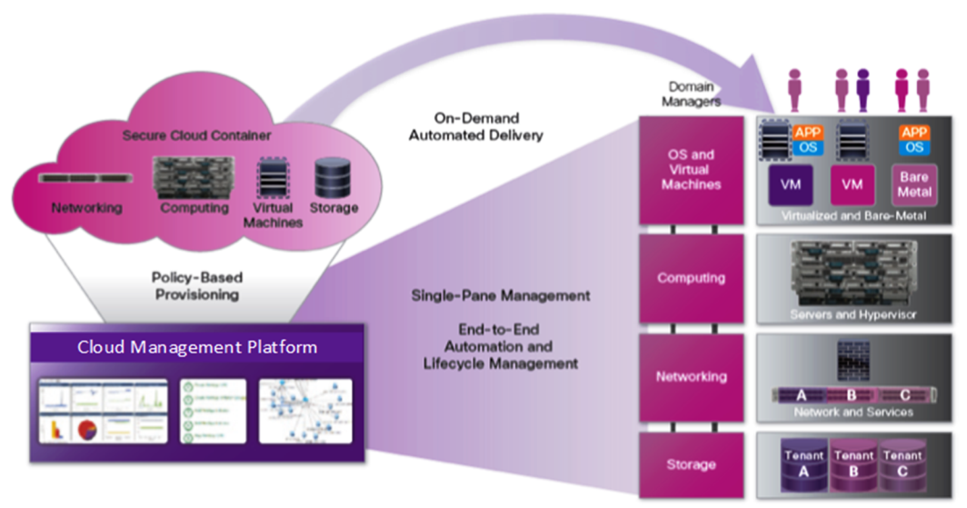
(5) Single Pane of Glass

Slide 24




(6) Open Architecture
Interface Options
Application Frameworks, Management Systems, Controllers, ...
C/Java
Python
NETCONF
REST
OpenFlow
ACI Fabric
OpenStack
Puppet
Protocols
…
RESTful
Management
Puppet
…
Orchestration
Neutron
Network Services
“Protocols”
BGP, PCEP,...
Control
OpFlex
Forwarding
OpenFlow
YANG
JSON
API and Data Models
Operating Systems – IOS / NX-OS / IOS-XR

Slide 25
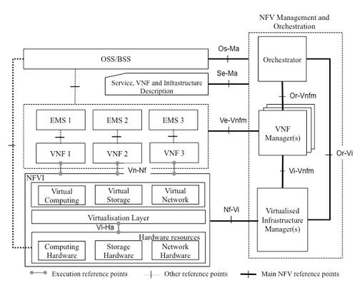
(6) Open Architecture
Alignment with ETSI Framework
SP’s Portal / Prime Service Catalog
Service Assurance
NSO
(Powered by tail-f NCS)
SP’s OSS/BSS or Prime Order Fulfillment
NSO
NSO
NSO
ESC /
CTCM
VNF 1
(Cisco or 3rd Party)
VNF 2
(Cisco or 3rd Party)
VNF 3
(Cisco or 3rd Party)
KVM
(or ESXi)
Ceph
(or Cinder/Swift)
VTF / OVS
OpenStack
(or vCenter)
ETSI
defined NFVI
APIC /
VTS or ODL
Cisco UCS
UCS (iSCSI/Flash)
Or SAN
Cisco Network

Slide 26
Telco Cloud Deployment Strategy

Slide 27
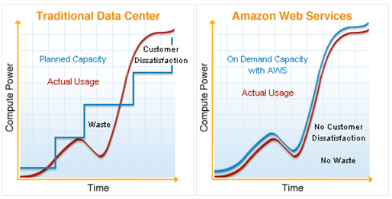
Characteristics of Telco Data Center
Open, standards based stack
System Automation
Multi-tenant
High resiliency
SLAs
Latency And Jitter Sensitive
Highly secure
Elastic to provide ON DEMAND
OAM and Service Assurance
On-Demand

Slide 28
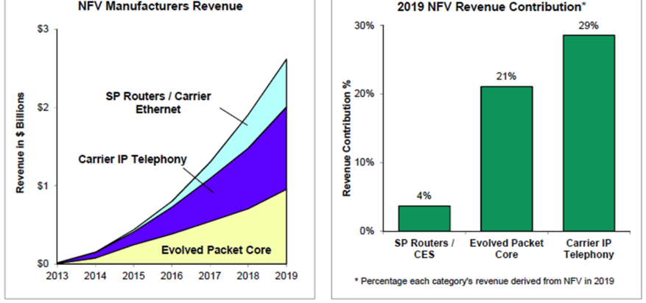
Telco NFV Spend
 | Worldwide Spend (US$ M) |  |  | 2013–2018
 | 2013 | 2014 (E) | 2018(E) | CAGR
PCRF and DPI Functions | $306 | $570 | $2,805 | 56%
Mobile Core and EPC Functions | $32 | $71 | $1,548 | 117%
IMS Component Functions | $57 | $80 | $1,029 | 78%
Security Functions | $6.1 | $36 | $307 | 119%
vRouters | $0.3 | $2.5 | $113 | 230%
Other | $0.1 | $1.4 | $452 | 404%
Total VNF Revenue | $401 | $761 | $6,253 | 73%
Infonetics 2014
Spend
Spend
Spend

Slide 29





Increased Network Events (Global)
Smart Offices
Smart Industry
Smart Homes
Established
3.6T → 9.8T
4.5T → 12.7T
1.5T → 47.8T
Smart Agriculture
Smart Car
Smart Health
Emerging
1.3B → 24.1B
102.9B → 7.2T
12.5B → 971.8B

Slide 30
Network Functions – Resource Requirements
CPU
Variable CPU / FPGA / NPU
Distributed: Lots of CPUs
High
OSS/BSS, subsystem
and N/W control
Wireless
GWs
Service
Appliances
(L4-L7)
Distributed: CPUs
CPU
Reqs
Wireline GWs
Core Backbone Routing,
CE Access-Aggregation and DC switching
Centralized: CPU or SoC
Business CPE
Home CPE
Low
0
10Mbps
100Mbps
1Gbps
10Gbps
100Gbps
1Tbps
10Tbps
100Tbps
1Pbps

Slide 31
NFV Approach Taken by Operators
SP Considerations for NFV Journey:
Organization readiness
Software & Operational skillsets
Time to market
Open Environment
Capital Efficiencies with separation of Hardware & Software
Rapid Service Innovation via Software Development
Operational Efficiencies Through Adoption of Cloud Procedures
Integration with existing OSS/BSS
Service
Providers
Service Based POD Approach
VNF Based Approach
NFVi Stack
Approach

Slide 32
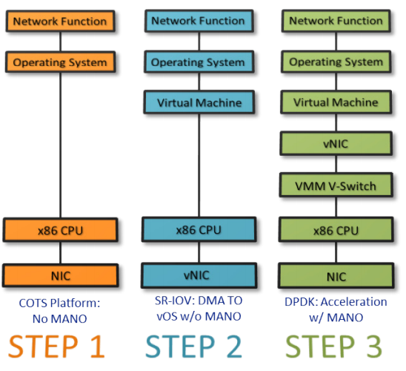
NFV Deployment Stages

Slide 33
How Operators are Approaching NFV
Use Case /
Service POD Led
Orchestration
Platform Led
Top down approach
Business outcome driven
Mostly Business Unit / Product management led
Common MANO solution for multiple use cases is the key driver
Mostly led by SP’s NMS/OSS team
VNF Led
Infrastructure Led
Targeting the virtualization of very specific functions to address business needs
Engineering / planning led
Not very common
Bottoms up approach
Infrastructure convergence is key theme
Mostly engineering led, with CxO/Sr. Mgmt support

Slide 34

NFVI Led Approach
Tenants
Tenants
Tenants
vMS
(As a tenant for NFVI)
VPC
(As a tenant for NFVI)
IaaS
(As a tenant for NFVI)
The respective MANO stack need to integrate with a single VIM (eqv. of a brownfield VIM integration)
Requires a consistent
VIM strategy between Enterprise, Mobile, Cloud
Architecturally may become an anchor point
Unified NFV Infrastructure
(Telco Grade DC)
Virtualized
Infrastructure
Manager
Converge Infrastructure, Get it right once, achieve higher agility

Slide 35
Case Studies

Slide 36

Example: XL Axiata
Virtualized Packet Core
Solution Overview
Deployment of 3rd Mobile Core location in Virtualized form in Pekanbaru to provide efficient local offload.
World’s 1st commercial Virtual Mobile Core that is carrying consumer Smartphone and Dongle traffic.
Solution installed includes Virtual Packet Core Software, Cisco UCS, Management and Cisco Services

Slide 37

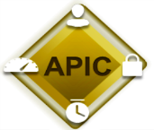
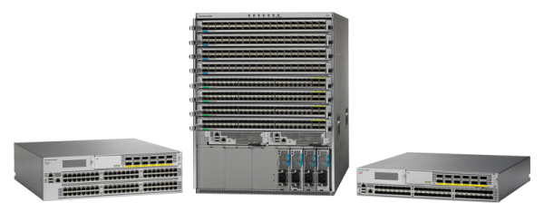
Example: NTT Docomo
NFV-I Fabric
Solution Overview
NFV Infrastructure for NTT’s Orchestration and vEPC
Insertion with ACI (APIC, Nexus 9K) with Openstack integration into Orchestration
Underlay for Telco Virtualization

Slide 38















Service Providers Who are Taking NFVI Led Approach
Significant Momentum Is Being Seen
* Partial List

Slide 39
Summary

Slide 40
Cisco’s NFV-I Benefits
Superior SLA management via
  Telemetry, Visibility of health per NFV
Smart Fabric for Congestion Avoidance
  Worlds most advance Latency Management solution embedded in network fabric
Multi Tenant and Secure
  End to End multi tenancy in Compute and Network fabric for NFV segregation.
Policy Centric Stack
  Stateless Computing and Network for consistent policy and scale out architectures – simple operations
Multi Geo Deployment
  Zero touch deployment of consistent policy for NFV’s across geo’s.

