Slide 1
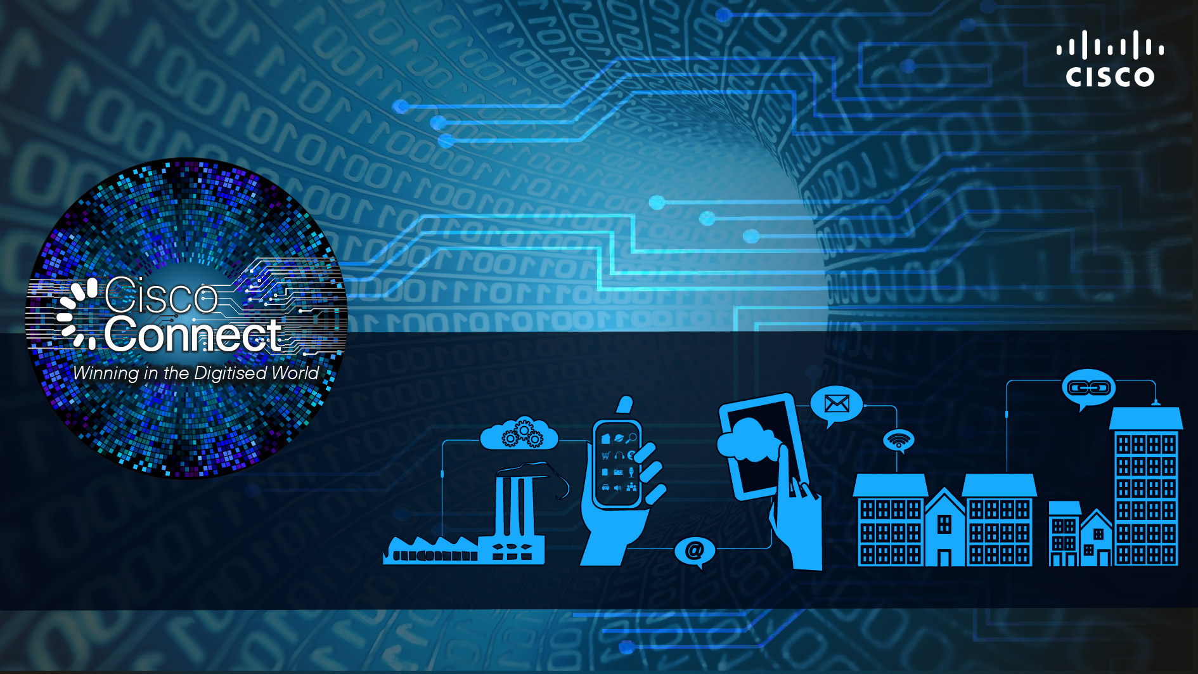
Partnering for Digital India
Marketing Presentation
Marketing Presentation
Speaker Name
Speaker Name
Designation
Designation
Date: 00/00/0000
Date: 00/00/0000
AMIT PHADNIS
President Engineering and India Site Leader, Cisco
Date: 29/05/2015
#CiscoConnectIN
@amitphadnis
Notes:
Make text more prominent

Slide 2
India Is Ready To Be Digitized
Digital Disruptors
By 2018, Video will be 62% of India's mobile data traffic
108 Mn
33 Mn
Broadband in Every Home
70 Mn
20 Mn
Rapid Adoption of Mobility
Citizen Services
By 2018, the equivalent of all movies ever made will cross India's IP networks every 2 hours
81% of India’s population use mobile phone. 10% have smartphones
Young Workforce
The App Economy
Social Media
By 2018, there will be 526 Mn Internet users in India
By 2018, there will be 1.5 Bn networked devices in India
Entertainment
Learning and Education
Source: Cisco VNI Global IP Traffic Forecast 2013-2018; Nielsen 2013; ComScore 2013; IAMAI; Mint
Notes:
Talk about opportunity in India

Slide 3
What a Digital India will mean for Citizens & Businesses
75 Mn children with online access to education
$70 Bn eCommerce industry
250 Mn online shoppers
100 Mn women online shoppers
$550 Bn - $1 Tn in annual economic impact.
Help improve the lives of 500 Mn citizens.
Additional 400 Mn with access to Healthcare
200 Mn people in villages will be online
Additional 300 Mn financially included
20 Mn SMEs could gain access to digital tools in the Cloud
Source: India’s Technology Opportunity: Transforming work, empowering India, McKinsey, 2015; Retail 2020: Retrospect, Reinvent, Rewrite. BCG and Retailers Association of India, 2015; Adding to Cart: Digital’s Impact on FMCG, Google and Bain & Co., 2015

Slide 4
Digital India Today: Smart Cities
DELHI MUMBAI INDUSTRIAL CORRIDOR
BENGALURU
MUMBAI
JAIPUR
LUCKNOW
ICT Master Planning Services for the first four cities
Design the converged digital infrastructure
TelePresence-driven remote FIR solution for Bengaluru Police
Helping citizens file an FIR from any location 24/7
Smart & city-wide safety alert system for Navi Mumbai
Pervasive video infrastructure
Smart analytics engine & control room
Safety & security
Public transportation & traffic mgmt for Jaipur Dev. Authority
Citizen & tourist services
Smart city-wide integrated CCTV network for Lucknow Police
Transforming Indian cities into Smart+Connected Cities

Slide 5
End-to-End Digitisation – What’s Needed
PEOPLE
PROCESS
IoE
DATA
THINGS
Mobility
Sensor Network/
Network as a Sensor
Data In
Motion
Network
as Fog
Connected Cloud
Distributed policy
Notes:
The Internet of Everything is Happening Now and technologies that are needed for IoE
There is a sea change occurring in the IT industry.
Digital disruptions are creating rapid changes in the way we work, live, play and learn.
At Cisco, we call this the Internet of Everything.
The Internet of Everything is the networked connection of people, process, data and things.
The best way to understand the value of the Internet of Everything (IoE) is to think of it in terms of connections.

Slide 6
Journey of India Engineering
Exponential growth in India presence & skill sets...
900+ patents filed
5+ marquee products conceptualized in India
~11000
IP created
~4000
NASSCOM innovation award for ASR 901
Aegis Graham Bell award for MDS 9250i
IT Innovation award by Express group
ET innovation award - developing OEM Product
~1700
~10
~600
Awards for India team
1995
2000
2007
2010
2014
Technical skills
Upgraded skills
around routing, switching, s/w etc
Advanced technical skills
around data center, collaboration etc
Complete ecosystem
product marketing, manufacturing etc
Product concepts, innovation & design
6500 R&D engineers
24 PE/DE
Largest global development center outside US
Talent
Notes:
How we have always kept the pace with market and trends?
How are we getting stronger on innovations with increasing patent count and PE/DE count

Slide 7
Innovations with Business Impact
Hackathons
Mentorship by Technical Talent
Innovation Portal
Notes:
On going innovation initiatives on campus.
Innovation is our culture and we will always encourage and facilitate our people to innovate

Slide 8
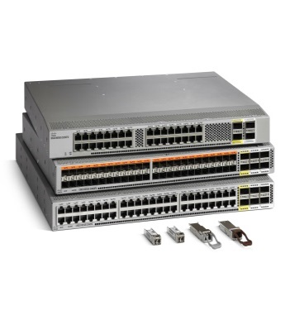
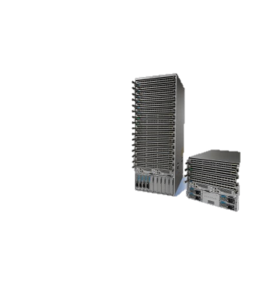
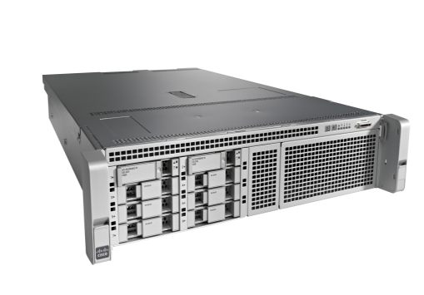
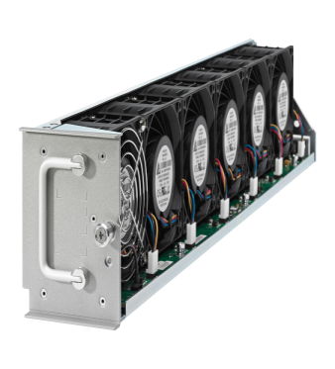
India Product Portfolio
Security
Email Security Appliance, Cisco Security Manager, 50% of Unified Security Manager
CSPG
C220, C240 , C22, C24
SPVSS
CRS
Catalyst 2K, 3K, 6K
MITG Engineering
SPAG Portfolio :
ASR 901, 903, 920, ME Series of Products
Optical
Portfolio
Nexus 2K,3k,4K,5K,6K
WLAN Controller
Notes:
The contribution of cisco india to Cisco’s overall portfolio is getting stronger day by day. We are driving more and more products out of India

Slide 9
Interlock to Deliver Complete IoE Solutions
Goal
Develop an ecosystem of startup companies, ISV Partners and solutions from Cisco to deliver complete IoE solutions in verticals such as Manufacturing, Smart Cities and Communities, Healthcare, Education etc.
Execution
GSF-Cisco Accelerator
Covacsis stack with routing equipment and IOx created solutions + bundle from go-to-market perspective.
Working closely with Wipro’s automotive and manufacturing team to create vertical automotive and manufacturing solution on IOx
Notes:
IoE is huge opportunity.
Tremendous amount of money is being pumped into start up communities in India. Among countries, India received the third highest VC funding and Bangalore came in fifth in a list of cities globally that received the most venture capital in 2014. This indicates growing significance of startup ecosystem in India. Most of our engineering partners are large ISVs themselves. An ecosystem comprising of startups, ISVs and Cisco Technology will be highly effective in delivering end to end IoE solutions and establish Cisco as a thought and market leader in the IoE space.

Slide 10
Digital India Today: Manufacturing
A collaborative strategy that addresses security, the management of remote assets and production, related impacts on the supply chain and workforce productivity.
Deployed ICT support network at their Chakan plant to bridge the gap between resource planning and shop floor operations with efficient manufacturing systems and surveillance.
Realizing the value of ‘The Connected Enterprise’

Slide 12
Thank you

Slide 13
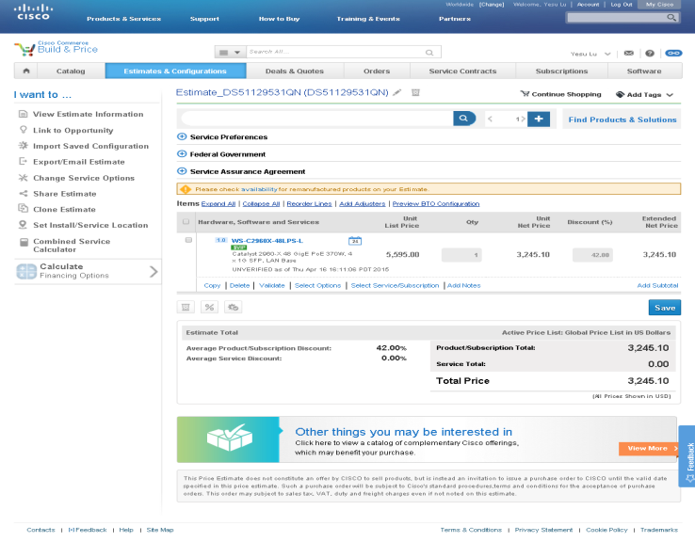
Build & Price BOM Optimizer & Configuration Advisor
Configuring BOMs: Maximize profitability & compress the first stages of the sales cycle
Good – Better – Best: BOMs are generated based on performance and margin profitability while applying bundles discounts
BOM Optimization: Upload any BOM. It will be optimized by applying all Bundles and Discounts
Downstream: Selected BOMs will be processed in CCW while applying other incentives by GDR
Power over Ethernet
Good
Better
Best
Gigabit Ethernet
Catalyst 2960XR Switch PID: WS-C2960XR-48LPS-I
Catalyst 3650 Switch PID: WS-C3650-48PS-S
Catalyst 3850 Switch PID: WS-C3850-48P-S
Application Visibility Control
Total List: $8,695
Total List: $9,400 (+$705)
GPL Subtotal: $13,000 (+$4,305)
Security

Slide 14
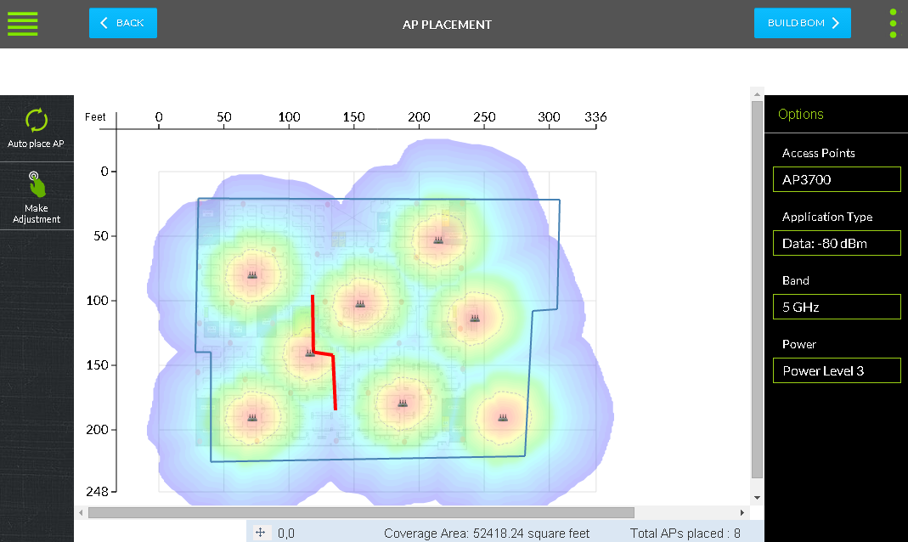
Cloud Based RF Predictive Tool
Aironet, Meraki Access Point Support
Cisco Commerce Workspace Integration
Easy RF Proposal Integration
Google Earth Integration

