Slide 1

Cisco Medical-Grade Network 2.0 Security Architecture and Solutions
TDM Presentation
Healthcare Industry Solutions Engineering (ISE)
EDCS-1225848

Slide 2

Agenda
Security Trends in Healthcare
Cisco MGN 2.0—Security Architecture
Deployment Models
Regulatory and Compliance Overview
Clinical Devices and Systems
Communication Devices
General Purpose Devices
Summary
Notes:
2

Slide 3
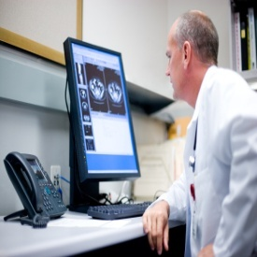
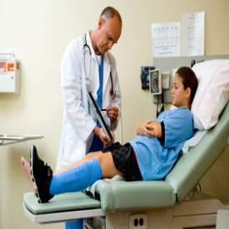
State of Healthcare
Healthcare Reform
Low IT Investment
Stimulus Package
Capturing HIT Stimulus
Aging Population
Joint Commission Mandates
Transforming the Patient Experience
New Models of Patient Care
Organizational Silos
Medicare/Medicaid Reimbursement
Provider
Clinical Process Improvement
Patient Satisfaction/Safety
Alternate Care Options
Operating Margin Pressures
Patient
Notes:
Summary of FY09 highlights, insights, trends, etc. Our focus this year is on addressing the pain points we reviewed earlier. Today, our focus is on the provider and treating the sick. Our goal is to help focus more on the patient and the continuum of care with better enablement for well care. To do this, we are focusing on four business imperatives with our solution development. We will deliver solutions that allow you to:
Capture economic stimulus funding
Transform the patient experience so they will want to come back to your services
Support clinical process efficiency and improvement, and
Create new models of patient care.

Slide 4

MGN Guiding Principles
Protected
Data at rest or in motion
Wired or wireless
Responsive
Adapt to the changing communications needs
Interactive
Access any time, any device
Resilient
Non-stop computing

Slide 5
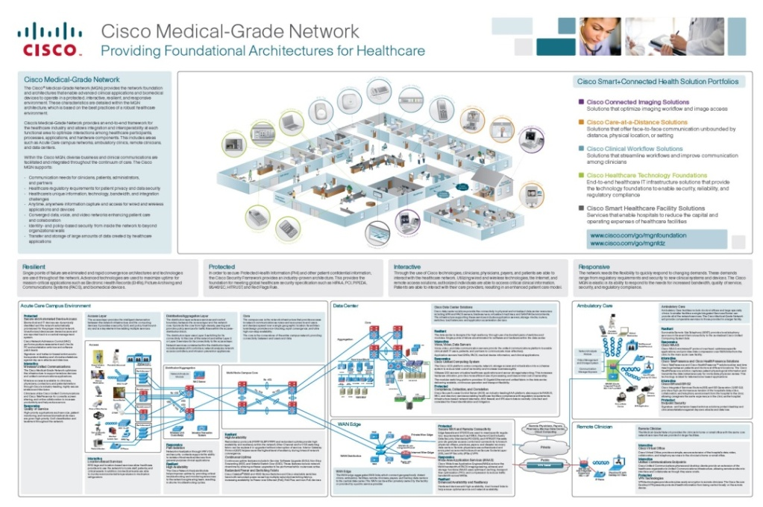
What Is the Cisco Medical-Grade Network?
The Cisco Medical-Grade Network is an optimized architecture for the healthcare industry based on Cisco’s best practices for security, campus, data center, remote office, and wireless networks.
The Cisco MGN 2.0—wireless architecture:
Industry-specific framework following a set of proven best practices
Provides a mapping of clinical and business needs to technology solutions
Optimizes interactions between processes, applications, and technical architecture components
Facilitates business and clinical communications throughout the continuum of care
Enhances collaboration across the technology partner ecosystem
Notes:
5

Slide 6
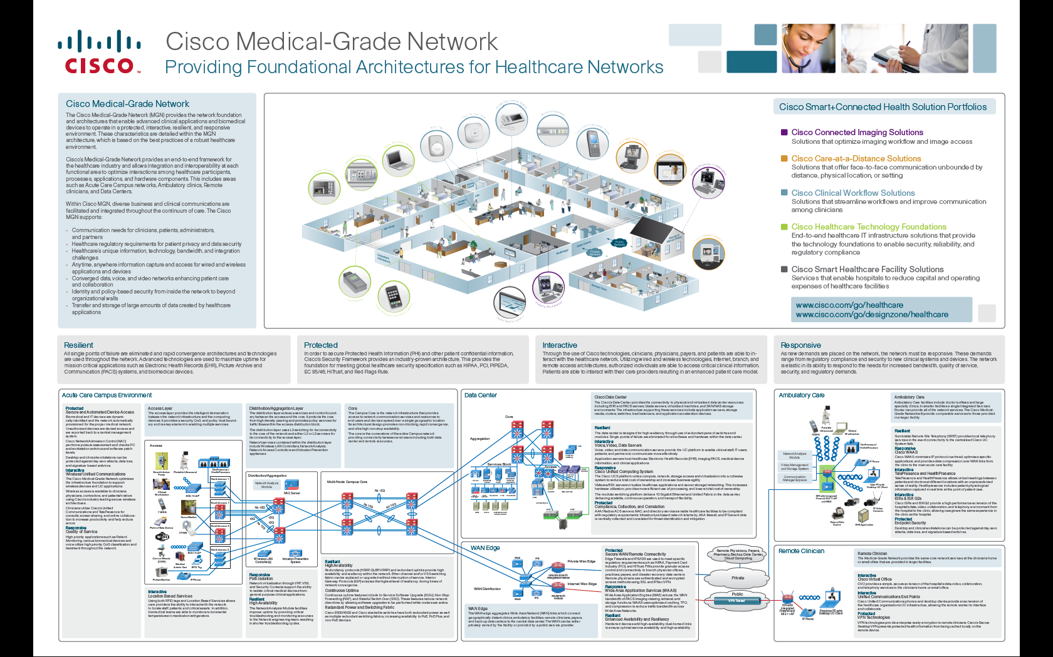
MGN—Architecture Overview Poster
Notes:
6

Slide 7



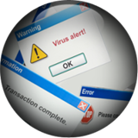
The Growing Need for Security Solutions
Regulatory Compliance
Data Loss
Threat Management
A Systems Approach to Streamline IT Risk Management for Security and Compliance
Notes:
This environment has driven the need for true security solutions. For some time, “products” have been called solutions, often misrepresenting the term as products alone are not solutions. If a worm was the threat you were concerned about, you might deploy an intrusion prevention system to stop the propagation of the worm, the single product (or solution as it may have been called) may successfully address this problem.
The security challenges faced today require a solution not just a product. For instance to meet compliance requirements, or in this case PCI, there are 12 specific requirements that must be addressed, requiring a system or solution and not a single product. For the increasing problem of data loss, information may leave the enterprise through many different points (user PC storage media, email, backup media, malware).
A system or solution is needed to address data leakage and the many aspects of how and where leakage may occur. The same holds true for managing threats. For instance, malware is often shared or propagated through a multi-step process, email used to deliver an initial attempt to begin malware installation, followed by links it efforts to drive traffic to a malware hosting site, and subsequent activities across the network or on an endpoint that may carry out the attack, such as connecting systems to a botnet, loading trojans on endpoints for key logging or data capture, or sending intellectual property or critical information outside the organization.
This all highlights the need for a systems approach that can streamline IT Risk Management for security and compliance.

Slide 8
Cisco MGN 2.0—Security Architectures
Business Challenges
Cisco MGN 2.0
Regulatory
Provides architecture to help meet various regulatory
requirements
HIPAA and PCI Compliance
Integrate Security into Network to Meet Audits
Securing ePHI
Cisco MGN 2.0
Provides Security of PHI and PCI Data
Secure Today and Tomorrow
Data Loss Prevention
Leverage SAFE Architecture to Prevent
Data Loss
Securing Clinical and Biomedical Devices and Systems
Provides Highly Secure Access to Clinical Network Resources
Securing Voice, IT Devices and Systems
Utilize Best Practices in Securing IT and Voice Systems
Cisco MGN 2.0—Security Architectures Meet Security Needs for Regulatory and Compliance, Data Loss Prevention and Threat Mitigation, Giving Healthcare Providers a Highly Secure Network Ready for Today’s Modern Healthcare Environment

Slide 9
Agenda
Security Trends in Healthcare
Cisco MGN 2.0—Security Architecture
Deployment Models
Regulatory and Compliance Overview
Clinical Devices and Systems
Communication Devices
General Purpose Devices
Summary
Notes:
9

Slide 10
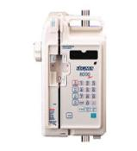


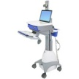




MGN 2.0 Security Architecture
Cisco Security Intelligence Operations
Hospital
Wireless LAN Controller
WAN Edge
Remote Clinician
Web Security Appliance
Host Intrusion
Prevention
6500 with WISM
ISR G2w/FW
ISR w/FW
Wireless
Devices
3750G
MGN 2.0
Campus
Internet
Physician PC with Desktop UC Client
ISR G2 w/FW
Remote Clinic
Wired
Devices
3560
WAN
Email Security Appliance
ASA/IPS
ISR w/FW
Host Intrusion Prevention
Cisco AnyConnect Client
Identity Service Engine
Data Center
Identity Service Engine
Partner
PACS
Cisco
Prime Infrastructure
ISR G2 w/FW
Cisco AnyConnect Client
Host Intrusion
Prevention
Clinical
App/EMR
MGN 2.0
Data Center
Cisco
ACS
Partner/Payer
DNS
Cisco Security
Manager
Mobile Clinician
Email and Web Servers
WiFi/#G/$g
ACE/XML GW
Web App FW
Notes:
10

Slide 11
Agenda
Security Trends in Healthcare
Cisco MGN 2.0—Security Architecture
Deployment Models
Regulatory and Compliance Overview
Clinical Devices and Systems
Communication Devices
General Purpose Devices
Summary
Notes:
11

Slide 12



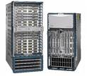


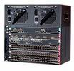



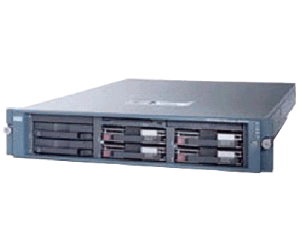




Compute and Network Services for Primary and Secondary Care Segments
Network Services
Computer Services
1–6
Physicians
6–12
Physicians
Multi-Physician
Clinic
< 200 Beds
200‒600
Beds
> 600 Beds
Multi-Hospital System
Primary Care/Ambulatory
Secondary Care/Acute
Notes:
Public/private split = ~25% of all hospitals are government-owned (state, county, local)

Slide 13
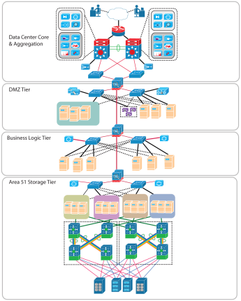
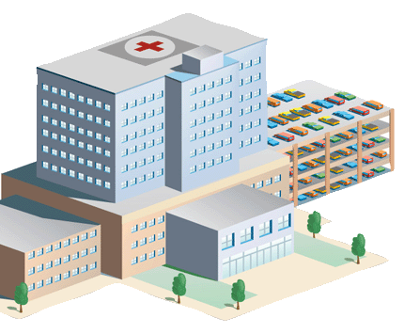
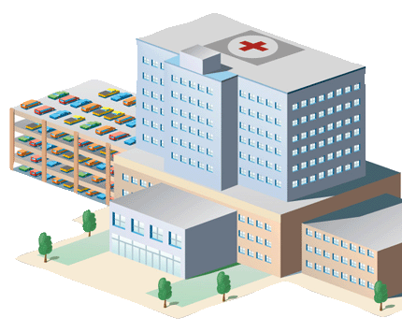
Secondary Care/Acute Care Centralized and Shared Datacenter Architectures
Centralized Datacenter
Shared Datacenter Architecture
Internet
WAN

Slide 14

PACS and EHR Storage Architectures
Isolated Storage Architecture
Common Storage Subsystem
Compute Services
Compute Services
EHR System
PACS
EHR & PACS
EHR & PACS
Storage Services
Storage Services
EHR Storage Island
PACS Storage Island
EHR & PACS Storage
EHR & PACS Storage
Separate Security Policies
Common Security Policy

Slide 15
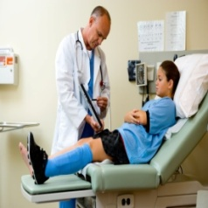
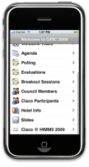


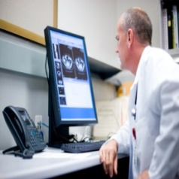

Primary Care/Ambulatory Architecture
IP Video Surveillance
AnyConnect
Voice Mail Access, Single Number Reach
Hospital
Guest/Patient
Cisco Unified Communications 500
PSTN Cellular
EHR/
PACS
Secure and Encrypted Wireless Data and Voice
MGN
Secured Host (Host Intrusion Prevention)
Internet or Private WAN
IOS FW
Practice Management System/EMR
Host Intrusion Protection
Host Intrusion Protection
+
AnyConnect VPN Client
Internet
Host Intrusion Protection
Secure VPN Access

Slide 16
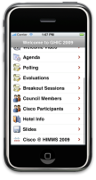
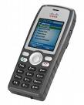
Guest Internet and Voice Service Architecture
Smart Phone Guest Services
Hospital
Secure VPN Access,
Voice Mail Access, Single Number Reach
Guest/Patient
Cisco Unified Communications 500
PSTN Cellular
Cisco Unified Communication Manager Cluster
Extended Voice Services Including Paging
Secure and Encrypted Wireless Data and Voice
Integrated IVR and Visual/Voicemail
Services
MGN
Internet or Private WAN
Wireless LAN
Controllers
Locally Terminated Guest Access Model
Wireless Anchor
Controllers (Guest Access)
iPhone Dual-Mode
7925G VoIP Wireless Phone
Centrally Managed Guest Services
Secured Host (Host Intrusion Prevention)
Internet

Slide 17

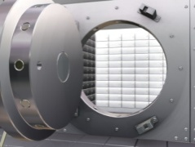
Remote Clinical Access Architecture
Identity Services Engine
CT/MRI
IDS/IPS
ISR Router or ASA
Other Clinical Applications
ASA 5500
Medical Device Vendor
Internet
ASA 5500
Remote Clinician with VPN Client and Host Intrusion Prevention
ISR Router or ASA
IDS/IPS
PACS
EHR
Mobile Clinician
Remote Clinician

Slide 18


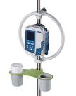
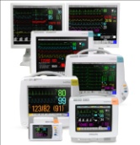
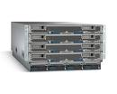
Remote Vendor Access Architecture
Virtualized Security Contexts
Radiology Vendor Zone
Medical-Grade Network
Cisco NAC
RIS/PACS
Internet or Private WAN Access
SmartPump Vendor Zone
AAA Authentication Server
Medical-Grade Network
Vendor VPN Access Headend
Smart Pump Monitoring/Admin
Identity Services Engine
Trusted Inside Interface(s)
IDS/IPS
Patient Monitor Vendor Zone
ASA 5500 with SSM
Medical-Grade Network
Central Station DB Server
Identity Services Engine
VDI Server(s)
EHR Vendor Zone
On-call Support Staff (Biomed) SSL/AES VPN
Vendor Support Call Center Dedicated or Client based VPN Access
Medical-Grade Network
Cisco UCS
Protocol break between vendor and clinical network
Session Logging & Recording
Identity Services Engine

Slide 19
Primary Care/Ambulatory EHR and Practice Management Considerations
Encrypted NAS
Cisco Unified Communications 500
Secure and Encrypted Wireless Data and Voice
PSTN Cellular
Internet or Private WAN
Encrypted Backup Snapshots of PM/EHR
Secured Host (Host Intrusion Prevention)
Practice Management System/EHR
Host Intrusion Protection
Host Intrusion Protection
Host Intrusion Protection
+
AnyConnect VPN Client
Secure VPN Access

Slide 20
Agenda
Security Trends in Healthcare
Cisco MGN 2.0—Security Architecture
Deployment Models
Regulatory and Compliance Overview
Clinical Devices and Systems
Communication Devices
General Purpose Devices
Summary
Notes:
20

Slide 21
Healthcare Compliance Regulations
Protecting Sensitive Business and Customer Data is the Key Focus of Regulatory Compliance Requirements
HIPAA
Maintain administrative, technical, and physical safeguards to ensure the integrity and confidentiality of patient information, protect against threats or hazards; unauthorized uses or disclosures of patient information
Red Flags Rule
US Federal Trade Commission rule requiring doctors’ offices, hospitals, and providers to develop a written program to spot warning signs of identity theft
PCI
Payment Card Industry (PCI) impacting organizations that process, stores, or transmits credit card information; must secure customer card information and comply with PCI requirements
EC 95/46
Data Protection Directive on protection of individuals for processing and free movement of data in European Union
Notes:
21

Slide 22

The PCI Data Security Standard
Published January 2005, version 1.1 released September 7, 2006
Impacts all who
Process
Transmit
Store: cardholder data
PCI Security Standards Council maintains the standard and certifications
http://www.pcisecuritystandards.org
Payment Card Industry Data Security Standard
January 2005
Notes:
In essence, PCI is different than legal regulatory compliance because it was created by the card brands, not legislature. This makes the standard much easier to read and understand (it’s 12 pages in total), and is more detailed than the government standards.
Important is that it applies to more than just processing credit cards (like at Walmart). It also applies to 3rd party hosting companies, information storage companies, etc.
PCI is NOT specific to retail only – it’s applicable to ANY industry that touches credit cards – i.e.. Most of them!
This is not US specific, it is global. However, the fines and enforcement have not reached outside the US – yet.
Each card brand – VISA, MC, Discover, etc. have their own security programs. This includes the PCI standard, but has the process of reporting security breach, assessment questions, programmatic information, etc. They all are built upon the PCI standard though.
To date: less than 25% Level 1 merchants are compliant. The other 75% have submitted their initial Report on Compliance.

Slide 23
Building Blocks of the Payment Card Industry Data Security Standard (DSS)
 | PCI Data Security Standard Requirements
Build and Maintain a Secure Network | 1. Install and maintain a firewall configuration to protect data 2. Do not use vendor-supplied defaults for system passwords and other security parameters
Protect Cardholder Data | 3. Protect stored data 4. Encrypt transmission of cardholder data and sensitive information across public networks
Maintain a Vulnerability Management Program | 5. Use and regularly update anti-virus software 6. Develop and maintain secure systems and applications
Implement Strong Access Control Measures | 7. Restrict access to data by business need-to-know 8. Assign a unique ID to each person with computer access 9. Restrict physical access to cardholder data
Regularly Monitor and Test Networks | 10. Track and monitor all access to network resources and cardholder data 11. Regularly test security systems and processes
Maintain an Information Security Policy | Maintain a policy that addresses information security
Notes:
The network plays a critical role to achieving PCI Compliance

Slide 24
HIPAA: Security Rule
HIPAA
Health Insurance Portability and Accountability Act of 1996
Title I
Title II
Title III
Title IV
Title V
Health Care Access, Portability, and Renewability
Preventing Health Care Fraud and Abuse
Medical Liability Reform
Administrative Simplification
Tax-Related Health Provision
Group Health Plan Requirements
Revenue Offsets
Electronic Data Interchange
Privacy
Security
Security standards: general rules
Administrative safeguards
Technical safeguards
Physical safeguards
Organizational requirements
Policies and procedures and documentation requirements
Transactions
Identifiers
Code Sets
Notes:
24

Slide 25
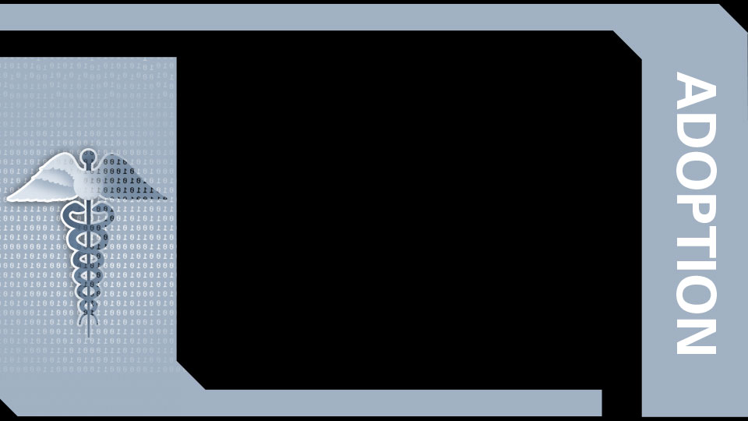
EHR Meaningful Use in the Stimulus Legislation
HITECH passed one year ago within ARRA
Rules and timelines underway
$40B+ through U.S. Department of Health and Human Services (HHS)
EHR incentives
Grants for various programs
Funding to public sector health entities
Emphasis on secure, electronic exchange of health information
Meaningful use - physicians and providers must use certified EHR in a meaningful way to get reimbursed
Ensure adequate privacy and security protections for personal health information
ADOPTION
Source: Cisco IBSG Healthcare Practice, 2009
Notes:
Run down the bullets—emphasize the final one and relevance for today’s audience and the panel

Slide 26
Privacy/Security Objectives and Criteria
Proposed Stage 1 Objective | Eligible Professionals (Selected Highlights) | Eligible Hospital (Selected Highlights)
Protect electronic health information created or maintained by the certified EHR technology through the implementation of appropriate technical capabilities | Unique name/number of identifying and tracking identity. and access controls Emergency access for authorized users Terminate electronic session after predetermine time of inactivity Encrypt and decrypt electronic health information Encrypt and decrypt electronic health information when exchanged | Record actions (audit log), provide alerts based on user defined events, electronically display, and print upon request… Verify that electronic information has not been altered in transit and detect alteration and deletions… Verify that a person or entity seeking access… Is the one claimed and is authorized Verify that a person or entity seeking access… Across a network is the one claimed and is authorized… Record disclosures…

Slide 27
Technology Categories for Healthcare Compliance
Category 1 | User authentication, access rights, termination
Category 2 | Transmission and encryption
Category 3 | Network security
Category 4 | Logging, tracking, monitoring
Category 5 | Remote access
Category 6 | Wireless security
Category 7 | Anti-virus and patch management
Category 8 | Database security
Notes:
27
There are common security technology requirements in both HIPAA and PCI. Working to be compliant to one also makes progress to become compliant with others.
HIPAA and PCI both focus on the above list for security requirements.

Slide 28
Security Compliance Mapping Table
Security Coverage Areas | MGN Products | HIPAA ReQ | HIPAA Audit | PCI DSS | Meaningful Use EHR Req
1. User Authentication, Access Rights, Termination | ACS, NAC, Host Intrusion Prevention, Cisco Trust Sec, Cisco ISE | * WP | 1, 3, 14, 29, 34, 42 | 7
2. Transmission and Encryption | VPN, Email (Encryption), CSM, Cisco MDC / 3rd Party Disc Encryption | * WP | 7, 14, 19, 20, 28, 31 | 4 | 2, 3
3. Network Security | ASA Firewall, IPS, Email Appliance, Web Security Appliance, Cisco SIEM Partners, Cisco Security Manager | * WP | 4, 8, 13, 17 | 1, 10 | 5, 7
4. Logging, Tracking and Monitoring | Cisco Security Manager, Cisco / EMC Network Configuration, Cisco ISE, Cisco Prime Infrastructure | * WP | 9, 10, 11, 25 | 10
5. Remote Access | Cisco ASA VPN, FW, IPS, CSM, Cisco AnyConnect VPN | * WP | 14, 23 | 1 | 9, 10
6. Wireless Security | WCS, WLC, Host Intrusion Prevention, ISR, ISR G2, TrustSec - ACS | * WP | 16 | 6, 10
7. Antivirus and Patch Management | Host Intrusion Prevention, ASA-CSC, NCM, AV Software | * WP | 22, 24, 36, 38 | 5, 6
8. Database Security | Firewall, Host Intrusion Prevention | * WP | 4, 13, 21, |25, 40 | 3
* WP—Refer to MGN 2.0 Security Whitepaper Table X
Notes:
28

Slide 29
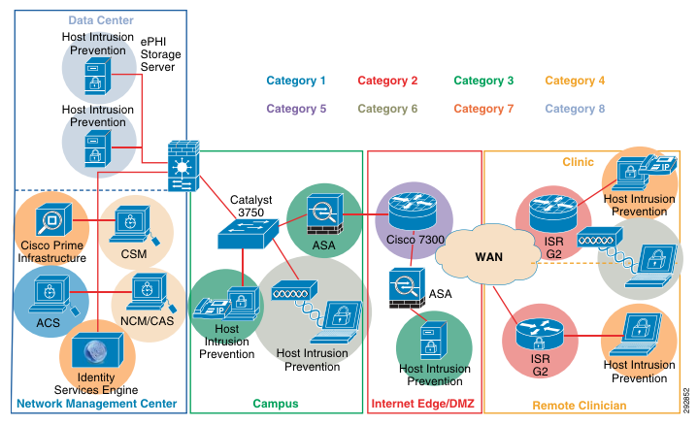
MGN Security Requirements and PIN

Slide 30
Agenda
Security Trends in Healthcare
Cisco MGN 2.0—Security Architecture
Deployment Models
Regulatory and Compliance Overview
Clinical Devices and Systems
Communication Devices
General Purpose Devices
Summary
Notes:
30

Slide 31
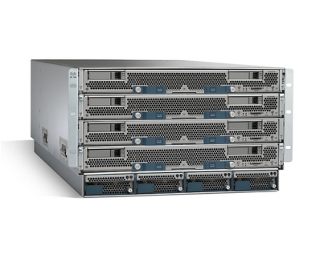
Common Three-Tier EHR Architecture
IDS/IPS
IDS/IPS
Application Control Engine (ACE)
Presentation
Layer
Application
Layer
Data Layer
Clinical User Community
Adaptive Security Appliance (ASA)
Adaptive Security Appliance (ASA)
Out-of-Band Management
Host Intrusion Prevention
Host Intrusion Prevention
Host Intrusion Prevention
Access Layer—Web, Visual Basic, Thick Client Backend, Thin Client, VDI, etc.
Compute Services EHR Clinical Workflow Engines
Virtualized Computer Services—Cisco UCS
Database Server(s)

Slide 32
Common Two-Tier EHR Architecture
Presentation and
Business Logic Layer
IDS/IPS
Application Control Engine (ACE)
Database
Layer
Clinical User Community
Adaptive Security Appliance (ASA)
Out-of-Band Management
Host Intrusion Prevention
Host Intrusion Prevention
Presentation and Business Logic Layer—Web, Visual Basic, Thick Client Backend, Thin Client, VDI and Clinical Workflow Logic
Database Servers
Virtualized Computer Services—Cisco UCS

Slide 33
High Availability EHR Architecture
Dynamic load sharing and security provided by ACE. Implements access policy and load sharing, security and reporting. SSL encryption services provide for end-to-end encryption of ePHI data
Adaptive Security Appliance (ASA) provides high availability stateful access control and deep packet inspection (IDS/IPS) with the Security Services Module (SSM)
Security reporting and trend analysis provided by IDS/IPS
Application Control Engine (ACE)
5
3
IDS/IPS
1
Clinical User Community
Netflow and Policy Feature Card (PFC) provide trending and alerting to CSMARS
6
Adaptive Security Appliance (ASA)
Adaptive Security Appliance (ASA)
Out-of-Band Management
Host Intrusion Prevention
Host Intrusion Prevention
Host Intrusion Prevention
Highly available virtualized hosts with the ability to dynamically move workload, create additional host machines for increased demand. Security patching of OS and clinical systems improves security and availability
Access Layer—Web, Visual Basic, Thick Client Backend, Thin Client, VDI, etc.
Compute Services EHR Clinical Workflow Engines
7
2
Virtualized Computer Services—Cisco UCS
4
Highly available SAN with media encryption services provide by mds-9000—Storage Media Encryption (SME) provides security for ePHI at rest
Host protection and continuous posture assessment provided by Host Intrusion Prevention and Cisco NAC Services

Slide 34
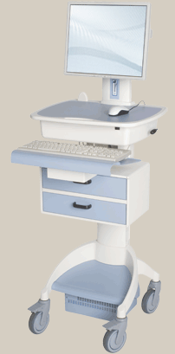
Clinical Workstation Security
3
Cisco Access Control Server (ACS) provides authentication, authorization, and accounting services
1
Cisco Security Manager—Provides policy-based security management
4
Network Access Control (NAC) Services provides access to network resources. Posture assessment (Service Packs, AV Signature updates) are monitored
5
WIPS (Wireless Intrusion Prevention Services)
Internet
Single sign-on providing mobile clinical desktop using Virtual Desktop Infrastructure services
2
7
DLP (Data Loss Prevention) services provided by IronPort. Web access policy enforcement provided by Cisco ASA Firewall
6
Wireless security provided by 802.1x EAP and AES192 or AES256 bit encryption
8
Biomedical and/or PKI-based Authentication
9
Host protection and posture assessment provided by Host Intrusion Prevention and NAC
Clinical Systems
10
Clinical System access controlled by ACE. End-to-end encryption provided by SSL termination service on ACE

Slide 35
Pharmacy and Lab—Vendor and Remote Access Architecture
Identity Service Engine
Virtualized Security Contexts
Internet or Private WAN Access
Pharmacy Security Zone
AAA Authentication Server
Medical-Grade Network
Vendor VPN Access Headend
Smart Pump Monitoring/Admin
Pharmacy System
Trusted Inside Interface(s)
IDS/IPS
LAB Security Zone
ASA 5500 with SSM
Medical-Grade Network
EHR/Lab System
Cisco UCS
Identity Service Engine
VDI Server(s)
On-call Support Staff (Biomed) SSL/AES VPN
Vendor Support Call Center Dedicated or Client based VPN Access
Protocol break between vendor and clinical network
Session Logging & Recording

Slide 36

Patient Floor—Clinical System Architecture Overview
Hospital
Virtualized Security Contexts
SmartPump Security Zone
Medical-Grade Network
EHR & Clinical System(s)
Smart Pump Monitoring/Admin
Pharmacy System
Cisco NAC
Trusted Inside Interface(s)
Medical-Grade Network
Clinical UserSecurity Zone
DOB Management
Medical-Grade Network
Cisco UCS
Identity Service Engine

Slide 37

Data Loss Prevention Using SSL for End-to-End Encryption
Possible Outsourced Campus Infrastructure
Wireless LAN
Controller
SSL encrypted traffic enables data loss prevention of ePHI
SSL termination— end-to-end encryption
4
Presentation
Layer
3
Application Control Engine (ACE)
WAN
2
SSL encrypted traffic
1
Host Intrusion Protection
Secure and encrypted wireless data using WPA2 with AES 192 or AES 256 bit keys protects ePHI confidentiality for many years
Notes:
1 – Man in the Middle attack, DLP is achieved with other the air encryption.
2 – outsourced infrastructure, or those unauthorized to view ePHI are prevented via SSL encryption services provided by ACE
3 – DLP from Service Providers providing private leased WAN connectivity is assured via SSL encryption.
4 – Overhead from SSL encryption is not placed on hosting presentation layer servers, performed on ACE module.

Slide 38
Secure Remote Vendor Access
Only supported VDI hosts permitted
Cisco NAC
Policy only allows access to authorized hosts and protocols. Deep packet inspection using SSM module in ASA
Virtualized Security Contexts
Internet or Private WAN Access
Radiology Vendor Zone
AAA Authentication Server
Medical-Grade Network
Vendor VPN Access Headend
RIS/PACS
Pharmacy System
IDS/IPS
LAB Security Zone
Only IPSec and/or SSL allowed to inside VPN termination device
Trusted Inside Interface(s)
ASA 5500 with SSM
Medical-Grade Network
Cisco UCS EHR/Lab System
Only supported VDI protocols and access methods. Deep packet inspection if not encrypted
Identity Service Engine
VDI Server(s)
Vendor Support Call Center Dedicated or Client based VPN Access
Access to unauthorized hosts is prevented
Protocol break between vendor and clinical network
Session Logging & Recording

Slide 39
Virtual Desktop Infrastructure (VDI) Security Summary
Only supported VDI hosts permitted
Cisco NAC
Policy only allows access to authorized hosts and protocols. Deep packet inspection using SSM module in ASA
Virtualized Security Contexts
Internet or Private WAN Access
Radiology Vendor Zone
AAA Authentication Server
Medical-Grade Network
Vendor VPN Access Headend
RIS/PACS
Only IPSec and/or SSL allowed to inside VPN termination device
Pharmacy System
IDS/IPS
LAB Security Zone
ASA 5500 with SSM
Trusted Inside Interface(s)
Medical-Grade Network
Cisco UCS EHR/Lab System
Identity Service Engine
VDI Server(s)
Secure Remote Access via SSL/AES VPN
Vendor Support Call Center Dedicated or Client based VPN Access
Access to unauthorized hosts is prevented
Protocol break between vendor and clinical network
Session Logging & Recording
Only supported VDI protocols and access methods. Deep packet inspection if not encrypted

Slide 40
Agenda
Security Trends in Healthcare
Cisco MGN 2.0—Security Architecture
Deployment Models
Regulatory and Compliance Overview
Clinical Devices and Systems
Communication Devices
General Purpose Devices
Summary
Notes:
40

Slide 41
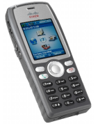

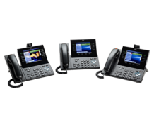
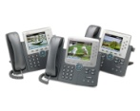
Communication Device Security
Security Challenges
Applications share Protected Healthcare Information (PHI) on a variety of endpoints
PHI must be protected in motion and at rest
Personal devices
Clinicians expect to use their personal devices to access clinical systems
Easily stolen/lost
Small computers that contain software so vulnerable to compromise—some easily breached
Wireless IP Phones
Wireless IP Phones
802.11a/b/g/n phones for mobile communications and integrated applications
Multimode Phones
Dual Mode Phones
Cellular phones with 802.11a/b/g/n capabilities. Typically smartphones that are capable of data applications
Wired IP Phones
IP hard phones with various size LCD/LED displays allowing integrated data applications

Slide 42


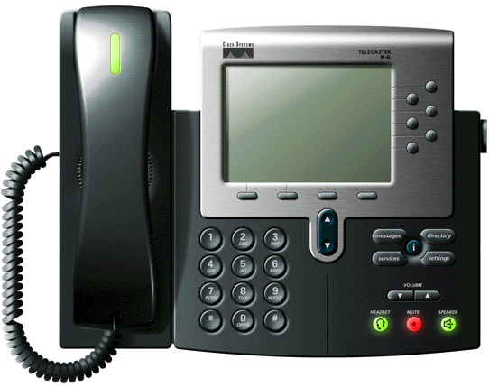
Unified Communications Infrastructure Security
Infrastructure
VLAN segmentation
Layer 2 protection
Firewall
Intrusion detection
QoS and thresholds
Secure VPN
Wireless security
Applications
Multilevel administration
Toll fraud protection
Secure management
Hardened platforms
Internet
Intranet
Endpoints
Digital certificates
Authenticated phones
GARP protection
TLS protected signaling
SRTP media encryption
Centralized management
Call Management
Hardened Windows OS
Digital certificates
Signed software images
Integrated Host intrusion prevention
H323 MGCP SCCP SIP

Slide 43
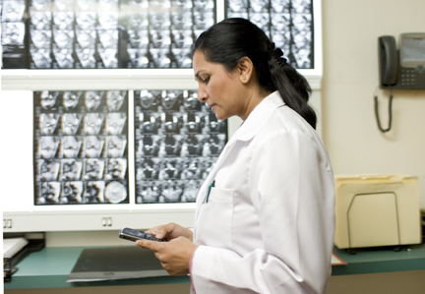

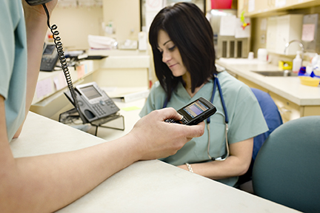
Smartphones
Recommendations
Do not store ePHI on the device
If possible use VDI to centralize clinical applications using the endpoint as a display and input device only
If that is not possible, ensure the clinical application provider provides encryption of ePHI stored on the device independent of the platform’s encryption
Use 2 (or 3) factor authentication
For applications utilizing ePHI
Critical if the application stores ePHI on the device
Lost/stolen device management
If possible centralized management should be set up to enforce policy and wipe data from stolen devices

Slide 44
Agenda
Security Trends in Healthcare
Cisco MGN 2.0—Security Architecture
Deployment Models
Regulatory and Compliance Overview
Clinical Devices and Systems
Communication Devices
General Purpose Devices
Summary
Notes:
44

Slide 45


General Purpose IT Services and Devices
Healthcare Organizations Must Provide the Same IT Services and Devices as Any Other Business, but They Are Dealing with Highly Regulated, Confidential Information Requiring Tight Security
The MGN 2.0 Security White Paper discusses:
Email
Instant messaging
Internet access
Guest services
Workstations
Storage services
Identity services
Notes:
45

Slide 46
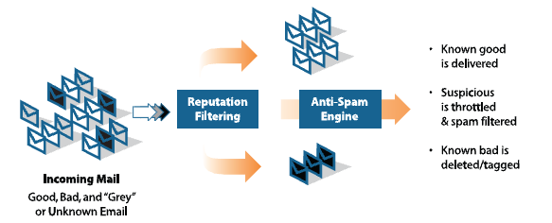
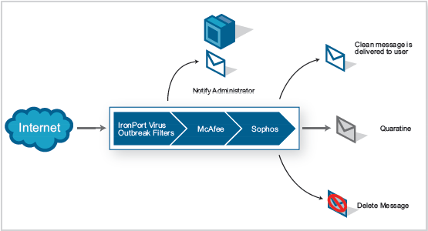
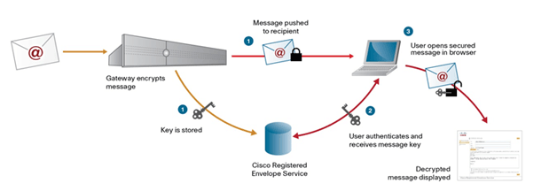
Email
Email is the Dominant Means of Business Communications
ePHI included in email must be recognized and protected
Email is a common vector for virus/worms so they must be identified and eliminated
SenderBase Gathers reputation information from around 100,000 networks around the world
Ironport appliance identifies mail from malicious sites
Policy based actions are performed on that email
IronPort Virus outbreak filters identify and quarantine viruses based on known patterns
The messages are deleted or archived until new identity files can be updated
Fully integrated with antivirus engines from both McAfee and Sophos,
Can automatically rescan messages automatically when new signature updates are available
IronPort will encrypt outgoing email based on policy using a per message key
Messages can be received and opened with no client software or certificate on the recipient machine
Recipient is prompted to authenticate with a key service using a password
Key is released and message decrypted
Key service can be on the IronPort Appliance or hosted by IronPort
Notes:
46

Slide 47
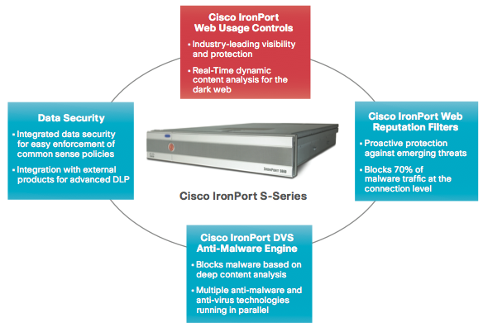
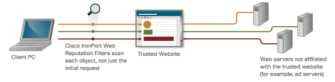
Internet Access
Internet access provides instant access to information that can be used to improve patient care—and many malicious sites
Malware must be recognized and blocked at the edge
Acceptable use policies must be implemented and enforced to prevent these being used as attack vectors
IronPort S-Series Appliances provide these services
URL filtering based on the Cisco Security Intelligence Operation (SIO) which uses global internet traffic visibility and analysis to target categorization efforts
URL filtering is combined with real time on box dynamic page analysis for unclassified web content
DVS anti-malware engine blocks malware before it enters the network utilizing scanning engines from Sophos, WebRoot and McAfee
Reputation filtering uses data gathered by the SIO to block malware at the connection level
Notes:
47

Slide 48
Agenda
Security Trends in Healthcare
Cisco MGN 2.0—Security Architecture
Deployment Models
Regulatory and Compliance Overview
Clinical Devices and Systems
Communication Devices
General Purpose Devices
Summary
Notes:
48

Slide 49
Summary
Increasing usage of clinical and non-clinical wireless applications throughout the continuum of care
Security applications:
Improve communication efficiency
Streamline clinical workflows
Enhance patient experience
Cisco Medical-Grade Network 2.0—security architectures outline best practices for the effective use and deployment of variety of wireless applications

