Slide 1
Social Media Marketing: Cisco Partner Guide
Notes:
This guide was developed based on questions from Cisco partners on how to incorporate social media into marketing plans.
The guide is divided into three major sections. Within each section, we discuss the following:
Why it is critical to use social media
What are the media or outlets that you can tap into
How to incorporate social media into your marketing mix
Some valuable resources that you can use

Slide 2

Reasons to Use Social Media
Targets Your Audience
Serves as a Cost-Effective
Complement
Builds Relationships Differently
Adds the Human Element
Creates a Two-Way Dialogue
Notes:
Why use social media?
Targets your audience
66.2% of Facebook users are between the ages 25 to 54, typically the age group of your business decision makers and buyers. So, if you want your company to be where your customers are, then it is time to look at social media.
Serves as a cost-effective complement
Social media offers a cost-effective opportunity for amplifying your messages and communicating with your stakeholders. Social media are simple and easy to use once you know how. Most of the outlets and media are free and give you an effective way to reach out to a broader audience.
Builds relationships differently
Social media let you engage customers directly, but informally, while online—and clearly send a signal that your company is open to new ways of doing things and can adapt to our changing culture.
Adds the human element
Puts a face behind the company by offering a more personal approach, giving the human element to your business and product.
Creates a two-way dialogue
Clients can interact directly by asking questions or by reading your updates.

Slide 3

Social Media: Complement, Not Substitute
Social media marries traditional marketing efforts with today’s web 2.0 technologies
Traditional marketing is about getting attention
Web marketing is about giving attention
Notes:
Social media does not replace traditional marketing efforts but becomes one of the key elements within your broader marketing plan.
While social media provide new ways to engage customers, you still need your traditional marketing mix for effective overall marketing.
While traditional marketing is all about getting attention, such as a magazine ad, social media marketing is about giving attention. Your customers already know about you and your services. It is up to you to keep them engaged. Social media may help to provide a more informal way for potential customers to ask questions and learn more about your company as well as to develop a “personality” for the company.
It is key to understand that the web supports more informed customers, helping them to verify, compare, and check information. Online media is much more task-oriented. Thus, web marketing is all about the tasks: helping customers complete the tasks they have set out to do.

Slide 4

Key Outlets
Social Media Sites
Video
Company Webpage
Notes:
4
We will be discussing three key outlets: the company webpage, video, and social media sites. To be most effective, these outlets need to be integrated. For instance, you can embed videos into the company webpage and into social media sites as well as integrate social media into the company webpage.
Because all of the outlets tie together, your marketing strategy determines which ones you focus on and how you want to combine the three outlets to develop a strong web 2.0 strategy.

Slide 5


Company Website
Notes:
The first outlet is the company webpage. This is arguably the most important because the company webpage is the first go-to location for any customer or potential customer. Your company website should act as a hub for all your social media activities.

Slide 6


What to Do
What NOT to Do
Prioritize your customer’s time
Consider investing in search engine optimization
Simplify
Develop Flash, Java, or JavaScript introductions
Use advertising language
Have external links open in the same window
Notes:
When developing the company website, the goal is to empower an impatient customer. Almost all customers are on your website to get something specific. Instead of attempting to manipulate emotions or sell your customer on something they haven't thought about, your website’s role is to assist your customers in getting what they want.
DO
Prioritize your customer’s time
Think about how much time your website wastes telling your customers what they already know and pushing new products. Your customers’ time on your website is valuable; don’t waste it.
Gerry McGovern tells us that the customer is on your website because they are interested in your product; keep that in mind when developing the page. As an example, most airline travel websites work because the website does not start off with an elaborate page that promotes the airline. Instead, it takes you directly to the task for which most of us visit the website: to reserve a ticket, do a price comparison, check flight status, etc.
Invest in search engine optimization
Customers want to be able to find what they want quickly. Search is 90% effort and 10% technology; simply including a search engine on the website is not enough to meet the needs of your customers. How you optimize your search engine is extremely important. When searching, on average, 42% of people click on the first result and 90% of people click on a result that is on the first page. More people have probably been on the top of Mount Everest than have been to the tenth page in search results.
To optimize your search, you have to know the words that your customers are using and you have to use these words in your content. Your customers set the language.
Simplify
Simplicity is easy to say but hard to achieve. Consider Google: Google has decided to prioritize searching as a simple task, which is why the search bar is the largest thing you see on the homepage. If you want to go to Google news, email, or shopping, you must click on additional links. It starts with understanding the customers' priorities.
Keep your navigation simple and easy to follow. Take your homepage seriously and try to include the most important tasks on that page. For example, when you go to a hotel website, the homepage typically provides information on how to book the hotel.
Keep contact information accessible. Ensure sound functionality at any download speed or with any browser. And periodically check to make sure all of your links are working.
Tip: Customer attention goes to the top right corner of the webpage; put your key information there.
DON’T
Develop Flash, Java, and JavaScript introductions
Not everyone has them installed, and in general, customers do not like introductions and do not like websites that start with sound. Consider Toyota’s experience: after investing a large amount of money in designing a Flash introduction for the website, they found that 45% of site visitors who went to the introduction left before getting to the home page. Great web brands are built by being useful, not by being flashy.
Use advertising language
Your website is a source of information. You win over the customer with honesty and facts, not by manipulating emotions as you may try to do with print advertisements. Customers are more likely to trust a website that is honest and authentic. Customers come to the website because they are driven by a task. Instead of trying to change your customer's mind, the best thing you can do is provide the customer with what he or she wants.
Have external links open in the same window
Let your visitors close your site down when they are finished with it; don’t preempt them. Your goal is to keep your customer on your website as long as possible.
It is better to have fewer web pages and more information. For instance, Microsoft cut down on a large portion of their web pages by deleting and hiding web pages in the search. Through its efforts, Microsoft saw a drop in website dissatisfaction from 10% to 3%.

Slide 7
Cisco Resources
Effective strategies from Dr. Flint McGlaughlin on optimizing your search
Build your customer-centric website with Gerry McGovern
Bust the status quo with web tools and social networking tips from Scott Klososky
Partner log-in required
Notes:
These resources are found on the Cisco Velocity Partner website (http://www.cisco-partner-velocity.com/) and are from expert presentations all over the world.
Dr. McGlaughlin shows you, for example, how to optimize your search engine.
Gerry McGovern gives you in-depth tips on how to create a customer-centric website.
And Scott Klososky’s presentation teaches you about web tools.
All of them are recorded video sessions with PowerPoint presentations.
Transition: Moving on to our next social media category - Video

Slide 8

The Power of Video
Notes:
The second primary outlet for engaging the customer is through multimedia, specifically videos. Videos are beneficial because they can hold an audience, can help to build brand, and are immediate and interactive.

Slide 9

What to Do
Be creative
Embed multimedia into your website
Consider your customer’s attention span
What NOT to Do
Skip steps in the development process
Use as a substitute for text
Include more than 1-3 main points
Notes:
DO
Be creative
Multimedia is an innovative option for engaging your customers. In the typical video format, you can do a customer testimonial, how-to, primer, executive interview, and so on.
Another format you can explore is live streaming. The advantages: you have a captive audience, you can brand building by adding the human element, and the option is both immediate and interactive.
Video Internet streaming is found all around us: HBO, sports programming, and Netflix. Our research indicates that live streaming has jumped by 600% in the past year. Some great sites to consider are ustream, justin.tv, and Cisco's own Show and Share. Live streaming gives you the opportunity to invite your customers to ask questions, provide a technology demonstration, bring in experts, have executive chats, and more.
Companies all around us are integrating video into their marketing platforms. For example, FrontPoint Security, a company that makes home security systems, has video tutorials on their website and on YouTube. With the launch of the videos, the number of sales from the website increased 250%. Another company, Smule, maker of iPhone apps, produces in-house videos to launch each of its products.
Embed multimedia into your website
You want to make sure that any multimedia you create can be embedded into your website. YouTube is a fantastic channel because it provides you with the link to embed the video directly into your website. You don't want customers to leave your website and go to an external site to view your multimedia.
Consider your customer's attention span
Try to keep your video to under 60 seconds.
DON'T
Skip steps in the development process
There are really five steps to creating a video:
Scripting. You don’t need the script to be written out word-for-word. You want your actors to be natural while talking.
The set. You need to make sure the lighting is correct and that the background doesn't distract from the speaker.
Filming. When filming, try multiple camera angles and then integrate in editing. Be sure to film extra footage, as it’s often needed during the editing process.
Editing. During the editing process, cut irrelevant parts as well as add transitions and sound. For sound, try to avoid having sound while someone is talking.
Marketing. Embed your video into your website and release it through your social media outlets. Refer customers to the video when they have questions on the topic.
Use as a substitute for text
You need captions for your videos for the page to be captured by the search engine. Use video to complement text.
Include more than 1-3 main points
This goes back to your customer's attention span. Instead of cramming many points into one video, consider splitting up the information into several short videos.

Slide 10
Cisco Resources
Learn the process of bringing your marketing to life through video with Alex Krasne
Leverage the power of video through live internet streaming with Alex Krasne
Lights, Camera, Action: learn the video basics to do it yourself
Partner log-in required
Notes:
Here are some Cisco resources that already exist on the Partner Channel and on Cisco Partner Velocity (http://www.cisco-partner-velocity.com/) to assist you with incorporating video into your web 2.0 marketing strategy.

Slide 11

Social Media Sites
Notes:
Social media platforms can help you to engage customers and others in meaningful ways: to tell your story, build your brand, and open up new opportunities.

Slide 12




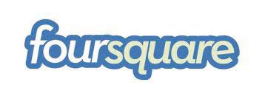




Social Media Outlets
Network
Share
Promote
Notes:
Social media outlets can be used for a combination of networking, promoting, and sharing. Your company can network with other partners, vendors, customers, and potential customers; promote products and events; and share information about what the company has been working on. Depending on the social media outlet, it can be used for one or more of the three functions.
Your company’s social media strategy will depend on the following:
Goals. Consider if you are using social media for brand building, PR, selling products, driving traffic, and/or communications.
Audience. Consider who your audience is and where you can find them online, to determine what social media outlet you want to use.
Resources. Consider how many people you can have to update the pages regularly. If it’s just you, you might want to start small, but if there is a larger internal team, you may be able to use more than one outlet.
We will be focusing on Facebook and Twitter, because these are the most popular options. The ideas presented here, however, can be applied across the board. Take some time to research some of the other social media outlets to see if they fit in with your company’s goals, audience, and resources.
Social media outlets can be used for a combination of networking, promoting, and sharing. Your company can network with other partners, vendors, customers, and potential customers; promote products and events; and share information about what the company has been working on. Depending on the social media outlet, it can be used for one or more of the three functions.
Your company’s social media strategy will depend on your goals, audience, and resources. For goals, you should consider if you are using social media for brand building, PR, selling products, driving traffic, and/or communication. You should consider who your audience is, who they are and where you can find them online, to determine what social media outlet you want to use. And finally, consider your own resources and how many people you can have to update the pages regularly. If it’s just you, you might want to start small, but if there is a larger internal team, you may be able to use more than one outlet.
For the presentation, we will be focusing on Facebook and Twitter, because these are the most popular options. However, these ideas can be applied across the board. Take some time to research some of the other social media outlets to see if they fit in with your company’s goals, audience, and resources.

Slide 13

Description
Getting Started
Giant user base (>600 million users)
Friends connect with friends and follow news streams
Good for networking, relationship building
Includes a range of possibilities for marketers: communities, games/applications, advertising
More fans does not necessarily mean better
Create an official business fan page
Set up a business account
Secure a URL for your fan page
Post links, videos, photos, and business updates through your newsfeed
Ask for feedback through “discussions”
Other: groups, events, applications
Notes:
Facebook is not just for keeping tabs on friends. It can also be used as a highly effective business tool. It’s great for marketing your products, promoting events, and connecting with your customers.
Facebook’s platform is unique in size and functions. If Facebook were a country, its population of more than 500 million users would rank third in the world. This instantly provides you with a giant user base. Facebook’s primary function is its networking, and its advantage is the personal relationship you have with your Facebook contacts.
The first consideration when using Facebook is the distinction between a group and a fan page. Although much comes down to personal preference, business fan pages, one of Facebook’s newest functions, have many advantages that make it arguably more useful:
Fan pages get internal promotion on Facebook.com. A Facebook fan page will show up on your fans’ (customers’) pages when they click "Like" it. Facebook groups don't get this treatment.
Fan pages have more options for customization. Groups are basically chat rooms; there is no real "look and feel" to them. Their primary focus is live discussions that can be continued at any time. Fan pages, however, act more like a blog with actual content pieces and the ability to add new tabs, static information, and the like.
Search engine visibility. Fan pages can be seen by non-Facebook users and can be crawled by search engines like any other static page. Facebook groups cannot. Facebook pages can also have a "vanity URL" (Facebook.com/MyPage); groups do not have this feature.
Anonymity. The creator of a group is identified with a linked Facebook avatar stating the group's admin. There is no way to remove this, which is bad news for those who wish to remain anonymous. Fages, on the other hand, are completely anonymous; nobody will know that you own it, unless you make a public statement.
Tips for setting up a fan page:
You can set up a business fan page without using your personal Facebook account by setting up a business account.
Once you reach 25 fans, you can secure a URL for your fan page, which makes accessing your profile a lot easier.
After your page is set up, the goal is to get as much user participation as possible. Post links, videos, photos, and business updates through your newsfeed. Encourage interaction through questions and ask for feedback through discussions, which serve as a forum.
Also consider exploring groups, events, and applications. With a group, it’s easy to create an event through the group and automatically invite all of the group’s friends.

Slide 14
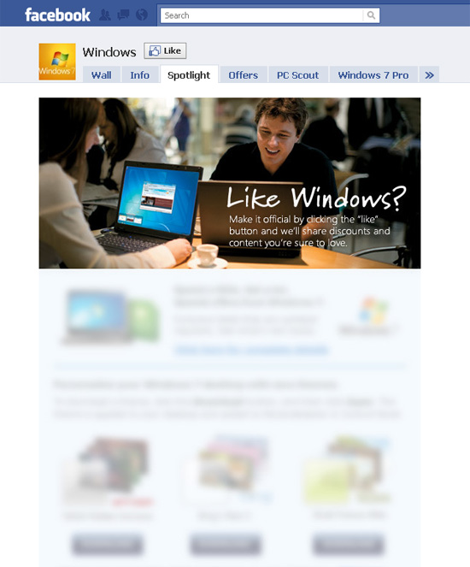

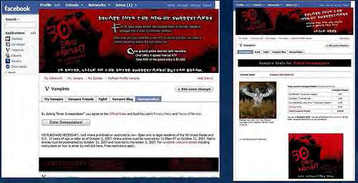
Creative Uses of Facebook
Contests
  Sony’s Vampire widget
Promotions and Discounts
  Windows (Microsoft),
  Avon
Customer Feedback
  Pringles
Notes:
Facebook has some conventional uses: updating fans on business products and sharing links for company-related articles and videos. While these are very important, you may also want to explore creative uses of Facebook to augment your marketing programs.
Companies are using three primary creative strategies for engaging its fans: contests, promotions and discounts, and customer feedback.
Contests
Contests serve as a great interactive option to market your company while engaging your fans and even boosting your fan base.
For example, Sony's Facebook campaign was designed to promote its 30 Day Night vampire horror movie. They wanted to hire a third-party developer to rebrand a popular game/widget. Facebook marketing efforts to drive it became viral. The contest drew 11.6 million hits on the front page and more than 59,000 sweepstake entries.
Promotions and discounts
Microsoft, through its “Windows” page, offers promotional deals for its operating system. Avon does something similar with its products. A good strategy for promotions and discounts is to have the discounts last for a short period of time and to offer them on an irregular schedule. This encourages fans to continuously check back for updates so they don’t miss out on a great deal.
Customer feedback
Pringles allows customers to post reviews about its products. Because Pringles does not censor its reviews, demonstrating honesty and facts are important to the company. This adds a human element as well as shows that the company values the opinion of its consumers.

Slide 15

Description
Getting Started
Smaller, up and coming platform
Fast moving, fwith rapid-fire stream of comments
Less personal than Facebook; you can “follow” or be followed by thousands
More followers does not necessarily mean better
Set up your profile
Connect with friends, colleagues, contacts
When tweeting, blend a combination of daily activities and adventures with interesting links to articles and videos
Be conversational, interesting, engaging in your tweets
Provide value to your followers
Notes:
Twitter may not be as large as Facebook, but it is gaining momentum quickly. About 95 million tweets are sent every day, and your company can be included in that number. Twitter may not be as large as Facebook, but there are unique advantages. For one, Twitter is less personal than Facebook, which allows people to follow or be followed by thousands. For example, Padmasree Warrior, Cisco’s CTO, is followed by more than a million people.
More followers, however, does not necessarily mean better. A smaller platform just means you can better engage your loyal followers.
To start off, set up a profile for your company. Immediately connect with existing friends, colleagues, and contacts as well as other business contacts.
When tweeting, blend a combination of daily activities and adventures with interesting links to articles and videos. You want to try to maintain 50% business and 50% personal. People who are following you or your business want to hear some of the random entertaining day-to-day stories but at the same time want valuable information about your product. Remember to focus on providing value and be authentic.

Slide 16
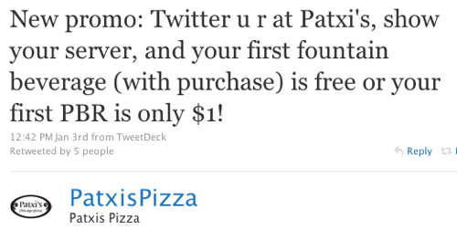
Creative Uses of Twitter
Twitter Quizzes
  Be fun and interactive
Promotions
and Discounts
  Instant word of mouth
Customer Service
  Give customers a voice
  Answer customer questions
Notes:
Twitter is for tweeting, but there a lot of creative uses as well.
One example is twitter quizzes. For instance, Mid-Columbia Insurance, a small, independent insurance company, quizzes its followers on the rules of the road in Washington state. You can use a similar format to ask questions and start a discussion.
Another option, similar to Facebook, is promotions and discounts. Twitter promotions and discounts are a bit more effective than those on Facebook because they combine instant word of mouth with the deal. For instance, Patxis Pizza asks followers to tweet about Patxi’s, show their servers the tweets, and receive a free fountain beverage. This encourages retention on Twitter because customers will be looking for future discounts.
Customer service is one of the most important aspects of Twitter. For instance, Dell provides basic IT support through Twitter, helping customers by answering questions about products.

Slide 17

What to Do
Online Communities
Identify monetization goals and strategy: brand-building vs. monetization
Promote community content
Observe, understand, and implement
What NOT to Do
Overly censor customer comments and posts
Leave up outdated content
Notes:
Online communities ensure a two-way conversation with the customer. Communities emphasize collaboration and are a great way to build loyalty, receive valuable feedback, increase sales, and reduce costs. A McKinsey and Jupiter Media Metrix study showed that chat rooms, bulletin boards, product review pages, and similar community features create substantial value for both retail and content sites. For example: Users of community features at the web sites studied generate two-thirds of their sales despite accounting for only one-third of their visitors. Users who contribute product reviews or post messages visit these sites nine times as often as nonusers do, remain twice as loyal, and buy almost twice as often. Even users who read but don’t contribute to community exchanges are more frequent visitors and buyers. (See the McKinsey Quarterly for more information.)
DO
Identify monetization goals and strategy: brand-building vs. monetization
To monetize or not goes back to your goals for building a community in the first place. If your goal is to use the community to enhance your brand or gain feedback from your customers, monetization may not be part of your strategy. Rather, the goal of your community can simply be to listen to the voice of your customer and make sure that your company is developing strong relationships and innovating based on customer preferences.
If monetization is an important objective, however, there are various monetization models you can use. Here are some examples:
Advertising. Opportunities include pre- or post-roll video ads (the commercials you see before and after a video plays), ad overlays (ads that take up the bottom third of the video), and affiliate partnerships (through which you can buy products that are featured in videos.
E-commerce. This is a hot monetization topic as brands determine how to better integrate the buying process and turn valuable customer buzz into immediate sales.
Pay-to-participate. This is a unique model that online communities are experimenting with. Users pay a membership fee to receive members-only content (similar to online magazine subscriptions) or a nominal entry fee to participate in a contest or tournament.
Don’t feel obligated to monetize your site. You can obtain value from your community in several ways that don't always equate directly to revenue. Sometimes a brand needs an online community to stay current, competitive, and in touch with its customers.
Promote community content
Instead of simply having a discussion section on the community, put exclusive content on the community that isn’t found in other places, and then promote it through newsletters, webcasts, and conversations. For example, Sony Electronics rolled out a series of online, community-focused features in 2008, including electronics-related courses and tutorials, forums and discussion boards, contests, and more—all aimed at providing value for, and making a connection with, personal electronics users of all brands. The endeavor has been paying off with high usage rates, increased insight into consumer preferences, consumer loyalty and advocacy for Sony products, and month-after-month growth in product sales.
Observe, understand, and implement
Online communities are the best way to pick up on the voice of the customer. Rather than having an unstructured discussion, you can explore other activities such as online journaling and online panels that can supplement or even replace other time-consuming and costly offline focus groups and ethnographic studies. Additionally, consider creating a section or a contest for customers to submit ideas for new products or product improvements.
Be sure to follow through with the information you gather from your online community, tracking the influence on fiscal year planning, product enhancements, marketing strategies, and so on.
DON’T
Overly censor customer comments and posts
Embrace the good and bad comments. Controlling what customers say in your communities only results in mistrust. Accept criticism. Apologize. Let people vent. Tell them you promise to improve. If you have an irrational customer in your community, use the Socratic approach to deal with him or her: Ask the group if it's their experience as well. A vigilante will be neutralized if you have strong supporters. This is much better than simply ignoring the customer or, worse, deleting the comment.
Leave up outdated content
The worst thing you can do is leave up outdated content. This will turn off customers and make them assume that there will not be anything worthwhile on the community and that your company does not take the community seriously. Be sure to spend time cleaning up the community as well as actively posting new content and responding to posts. The faster you respond to your customers, the more valued they will feel.

Slide 18
Cisco Resources
Check out Cisco Quad to learn about the Cisco collaboration platform for communities
Learn how to tap into the power of your customers with Charlene Li
Read about preparing your enterprise for social success

Slide 19
Managing Your Social Media Outlets
How Often Should You Update?
Twitter
  At least 4-5 times a day
  Use HootSuite to automatically spread out tweets
Facebook
  Aim for once a day
Putting It All Together
Use TweetDeck or Tweetie to update all social media outlets in one location
Use SocialMiner (Cisco product) to provide proactive social media customer care
Notes:
How often should you update social media outlets? It varies from outlet to outlet. For Twitter, it is recommended to tweet at least 4-5 times a day, if possible, sometimes even more. While it might seem difficult to interrupt your work to consistently update Twitter, you can utilize HootSuite, a free resource that allows you to schedule the time at which a tweet will go out.
With Facebook, it’s not as important that you update very frequently, but about once a day is recommended. For instance, Cisco updates about 2 times a day: one Cisco update, and one update about other news in the world.
TweetDeck or Tweetie allows you to manage all of your social media outlets in one location. You can log in and at once update everything, from Facebook to Twitter to blog.
Cisco SocialMiner is a social media customer care solution that can help you proactively respond to customers and prospects communicating through public social media networks like Twitter, Facebook, or other public forums or blogging sites. By providing social media monitoring, queuing, and workflow to organize customer posts on social media networks and deliver them to your social media customer care team, your company can respond to customers in real-time using the same social network they are using.

Slide 20
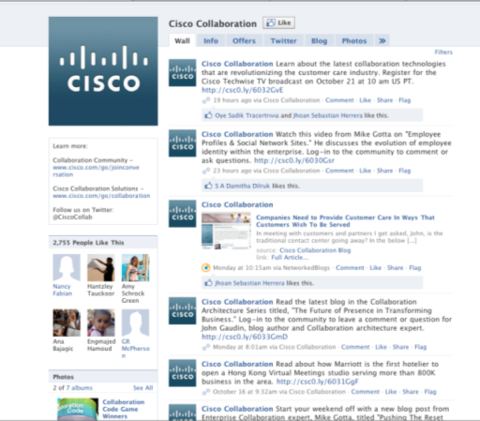
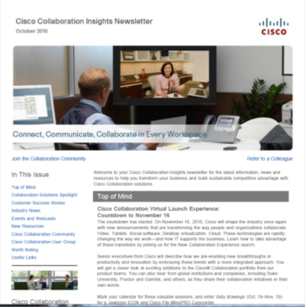
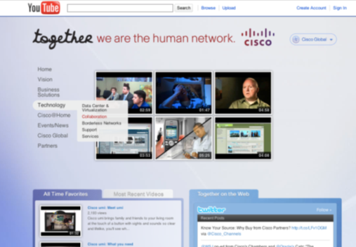


What to Do
Be authentic
Incorporate multimedia
Set privacy settings
What NOT to Do
Perceive social media as simply an outlet for broadcasting messages
Allow social media to substitute for traditional marketing methods
Set it and forget it
Notes:
DO
Be authentic
While you want to remain professional because you are representing your company’s brand, you should allow your company to have a personality. One of the main benefits from having social media is the human element—don’t lose it!
Incorporate multimedia
People are more likely to click on photos and videos than they are to read a business update. Be sure to incorporate a large amount of multimedia into your social media sites. Studies show that multimedia is clicked on far more often than photos.
Set privacy settings
You do not necessarily want people to be able to see or do everything; think about how much power you want your customers to have.
DON’T
Perceive social media as simply an outlet for broadcasting messages
Remember that social media is a two-way stream; it is not all about your company.
Allow social media to substitute traditional for marketing methods
Social media is a complement to, not a substitute for, your marketing plan. Social media is about giving attention. Users are already familiar with your brand; now they are acting in a task-oriented manner to learn more about something that they are specifically interested in.
Set it and forget it
It’s not enough to create a Facebook page or to set up a Twitter account. Update frequently with relevant information so customers keep coming back. Add potential customers to your page after meeting with them. Incorporate social media into your regular client interactions.

Slide 21
Cisco Resources
Have Charlene Li help you tap into the power of your customers
Learn the 8 social media commandments with Will McInnes
Learn about the power of Web 2.0
Partner log-in required
Notes:
Here are some Cisco resources that are available through Cisco Partner Velocity (http://www.cisco-partner-velocity.com/) to help you get started with your social media plan.

Slide 22
External Resources
Social networking in plain English
Marketing Profs: great best practices to use to market your products
Search Engine and Social Media Marketing
Notes:
While these resources are not provided by Cisco, they are great external resources you can use to learn more about social media and web 2.0 marketing.

Slide 23
Measuring Success
Return on Investment (ROI)
Qualitative
Quantitative
Polls, questions, customer feedback
Corporate reputation
Conversations
Customer relationships
Online traffic
New leads generated
Lead closure rates
Correlations (sales and engagement)
Net new customers
Promotional code redemptions
Proactive issue resolution
TOOLS
Google Analytics Feedburner Xinu SocialMiner
Notes:
When setting up your social media sites, measure success: you want to make sure that your social media sites are adding value to your marketing mix and company. For this, the three main focus areas are traffic, customer interaction, and retention. You need to set a benchmark and then have a method of measurement to determine your success.
Qualitative
For a qualitative approach, start by setting up a benchmark. Consider how your company is part of the conversation regarding the product or industry and how the company is talked about in comparison to competitors. Then, for measurement, consider the impact of building better relationships with the key audiences, participating in conversations where you previously did not have a voice, and having meaningful dialogues with customers.
Quantitative
There are many ways to quantitatively analyze your success:
For Facebook, consider total fans, monthly active users, engagement by category, fan demographics, unique page views.
For Twitter, consider total followers, number of times listed, @reply ratio, number of clicks per tweet, total retweets.
For website/blog, consider traffic, unique visitors, total page views, subscribers, blog comments.
Check out the tools listed on the slide:
Google Analytics and Feedburner are free tools to help analyze your company’s block traffic, subscriber count, keyword optimization, and additional trends.
Xinu is also a free resource. You can type in a URL and receive a lot of useful statistics such as search engine optimization, social bookmarking, and more.
Cisco’s Social Miner offers an excellent way to listen to your customers voice.
Return on Investment
The most important part is the return on investment. You can determine if there is a correlation between sales and engagement. Additionally, you can determine the number of net new customers thanks to social media marketing. By providing unique promotional code redemptions only on the web, you can see how many people buy with these codes to determine the number of people utilizing your social media sites. Finally, check proactive issue resolution, or the number of issues that were able to be resolved through social media rather than by phone or an in-person meeting.

Slide 24
5-Week Social Media Marketing Plan
Week | Deliverable/Activity
1-2 | Strategy. Define your audience, research social media platforms, and develop your strategy. Plan. Think through your plan carefully.
2-4 | Staffing. Choose the right people. Guidelines. Develop a social media policy and a common set of matching orders. Measurement. Decide what you want to measure and how you'll measure your ROI.
5 | Ongoing support. Help your staff do their jobs. Training. Set up training sessions for your staff to review engagement policies, best practices and overall strategy and expectations
Developing a Social Media Marketing Program
Notes:
Here is an overview of a 5-week social media marketing plan. You can click the link on the bottom for more information on developing a social media marketing program.
During the first 2 weeks, you want to think about your goals, audience, and resources. After that, it’s important to research different social media platforms to find the one or ones that best serve your needs. Then develop your strategy.
During weeks two to four, it’s time for you to find the right people who will be dedicated to your social media strategy. Additionally, there should be some basic guidelines that are agreed on as well as a strategy for measuring ROI. We provided some ways to measure ROI on the previous slide. It’s impossible to track everything, so prioritize.
During the fifth week, you want to ensure that your social media strategy is sustainable. Create some best practices and determine how you can support staff in the long run with the program. Be sure to keep updating and measuring your success.

Slide 25













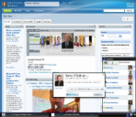













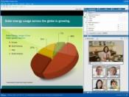

Cisco’s Social Media Outlets
Partners
Cisco Channels Twitter feed:
  @Cisco_Channels
Cisco Channels on Facebook
Cisco Channels Blog
Cisco Partner Communities
Customers
Cisco on Twitter (various topics, people)
Cisco on Facebook (various topics)
Cisco Blogs (various topics, people)
Cisco Communities (various topics)
Cisco on YouTube (various topics)
Notes:
We are using social media tools such as blogs, Twitter, Facebook, YouTube, and communities to collaborate with our partners and customers. We encourage you to join the conversation with us.

Slide 26
Notes:
Thank you!

