Slide 1

Cisco
HyperFlex
Systems
BDM Presentation
Notes:
Cisco_HyperFlex_BDM_1.8_Oct11

Slide 2

Analyze.
Simplify.
Automate.
Protect.
Digital transformation starts with an ASAP Data Center.
Notes:
Analytics. Simplicity. Automation. Protection.
Bring them together and transformation happens, ASAP. Apps launch, ASAP. A thousand users become millions, ASAP. New business models are provisioned, ASAP. And it’s no longer a question of how to transform, but when?
With a next-gen data center from Cisco, the answer is simple: ASAP

Slide 3
Analyze.
Automate.
Protect.
Simplify with HyperFlex
Notes:
Analytics. Simplicity. Automation. Protection.
Bring them together and transformation happens, ASAP. Apps launch, ASAP. A thousand users become millions, ASAP. New business models are provisioned, ASAP. And it’s no longer a question of how to transform, but when?
With a next-gen data center from Cisco, the answer is simple: ASAP

Slide 4

New IT Operating Models Require
New Consumption Models
Moving at the Speed of Business
Operationalizing Speed and Simplicity
CFOs Expect a
Cloud Economics
On-Premise
APPS
Consumption of infrastructure adds time, cost and inefficiency
Proliferation of solutions
creating silos that complicates operations
Expectation of pay-as-you-go economics with scaling on-demand

Slide 5
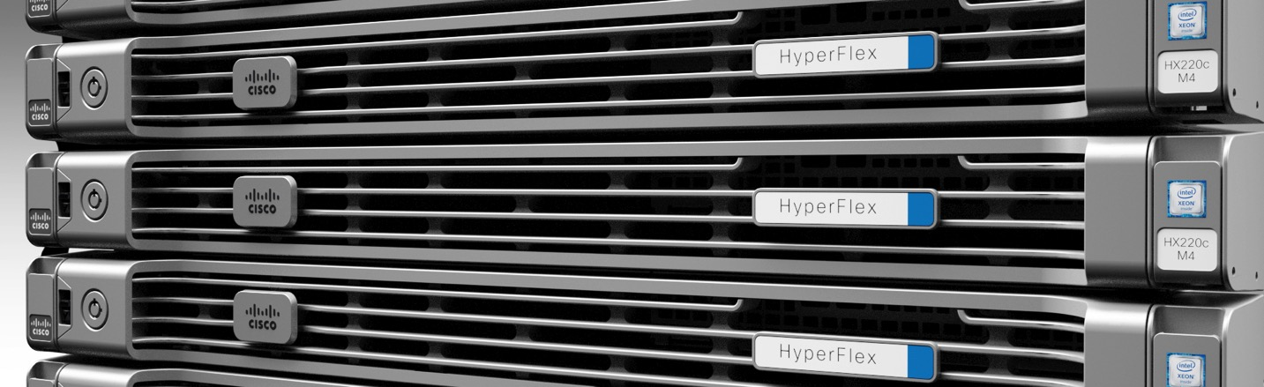
Requirements for Next Generation Hyperconvergence
Complete
Unified Network
and Management
Next-Gen
Data Platform
Advanced File
System
Convergence on a Common Platform
Integrating into existing and
future infrastructures

Slide 6
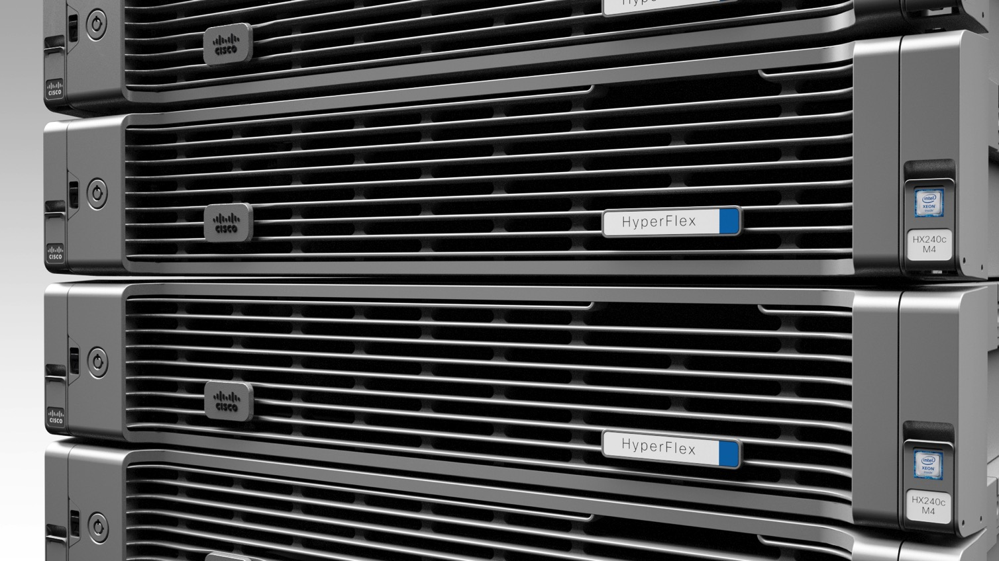
Cisco
HyperFlex
Systems
Simplify

Slide 7

Cisco HyperFlex Systems
Engineered on Cisco UCS
The Ideal System for Hyperconvergence
Integrated, High Performance Network Fabric
Programmable Automation of all Hardware
1
Complete Hyperconvergence
Unified Compute and Network Infrastructure
Wide Array of Rack and Blade Form Factors

Slide 8

Cisco HyperFlex Systems
2
Next Gen
Data Platform
Designed for
Distributed Storage
Cisco HX Data Platform
Data Services and Storage Optimization
1
Complete Hyperconvergence
Unified Compute and Network Infrastructure
Cisco HyperFlex

Slide 9
Cisco HyperFlex Systems
3
Part of a Complete Data Center Strategy
Elastic and Secure at Enterprise Scale
Tetration
HyperFlex
UCS
UCS Director
ACI/ CloudCenter
Security
2
Next Gen
Data Platform
Designed for
Distributed Storage
Cisco HX Data Platform
Data Services and Storage Optimization
1
Complete Hyperconvergence
Unified Compute and Network Infrastructure
Cisco HyperFlex

Slide 10

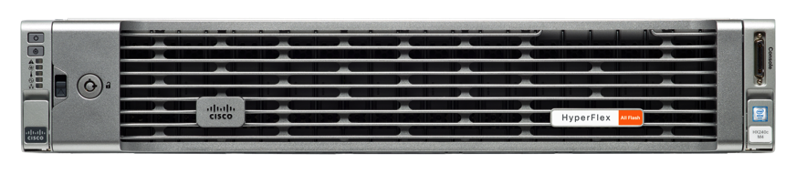
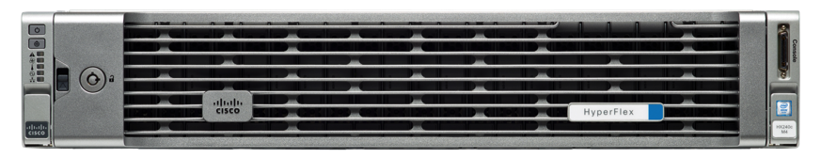
Hyperconvergence Meets
Unified Computing
Flexible Choices
HyperFlex HX-Series Nodes
HX220c
HX240c
Turnkey Appliance w/
vSphere
All Flash
Nodes
Performance
Hybrid
Nodes
Annual
Subscription
Software
Model
HX220c
HX240c
Capacity
Notes:
Graphic about choice

Slide 11

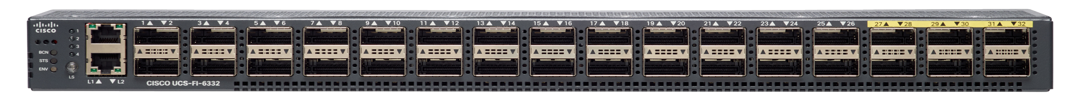
Maximizing Performance and I/O
HCI with All Flash and 40Gbps Fabric Network
Industry’s Highest Flash Density
Paired with Cisco UCS
40Gbps Fabric Technology
Cluster-wide:
High Performance,
High IOPS, Low Latency
Built for Data Intensive Workloads

Slide 12

HCI with Converged Fabric Networking
Network Integrated HCI
All Flash
Cluster
+
Policy Based Mgmt
HX220c
High Performance in Small Footprint
(Databases, VDI, VSI)
HX240c
High Density with Performance
(Database, VDI, VSI, Test/Dev)
40 Gbps / 10 Gbps
UCS Fabric Networking
90+ Nodes, Single Fabric, Single Management Domain
End-to-end HCI Automation
Hybrid
Cluster
+
HX220c
Smallest Footprint
(VDI, VSI, ROBO)
HX240c
Capacity-Heavy
(VDI, VSI, Test/Dev)

Slide 13
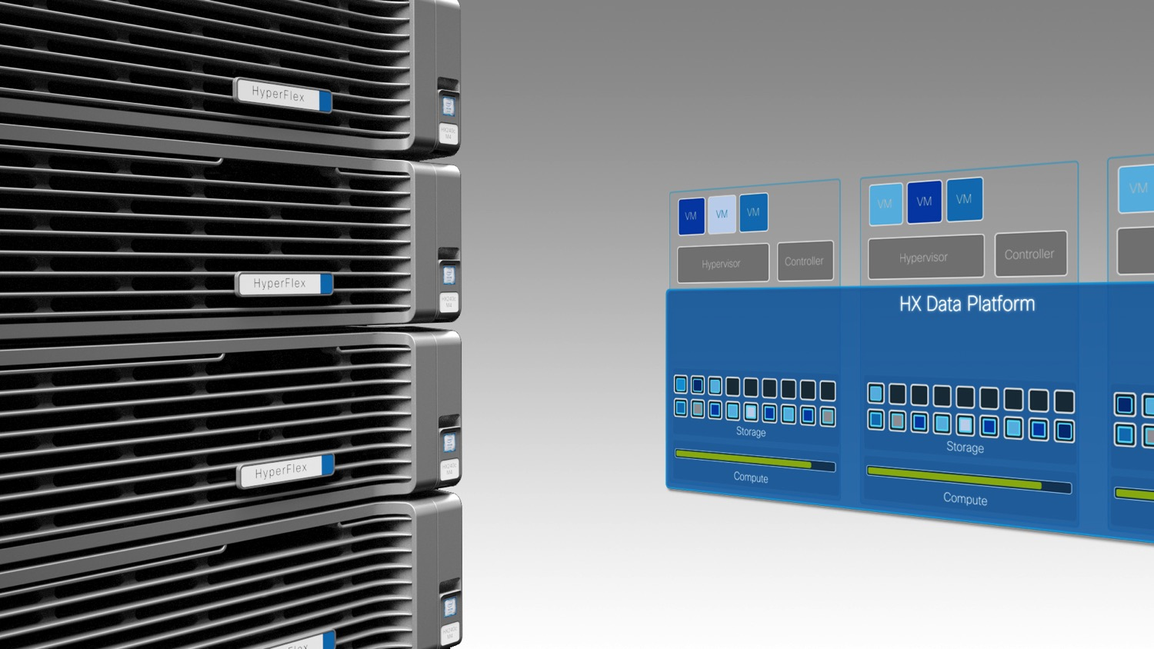
Cisco HyperFlex
Systems
HX Data Platform

Slide 14


The Cisco HX Data Platform
HX Log Structured File System Designed Specifically for Hyperconvergence
Distributed
object-based file system architected for scale-out, distributed storage
Advanced Data Services
Built into file system architecture
Future Ready
Designed for Containers and Next Gen Applications

Slide 15

HX File System
Built for Flash
Engineered for Flash
Sequential SSD writing for increased component longevity
Blazing Fast
Cluster-wide SSD pooling maximizing IOPS and throughput
Low Latency
Consistent low latency for data intensive applications and databases

Slide 16

Next Generation Data Platform Benefits
Independent Scaling and
Scale Out Architecture
Enterprise Storage Features
Pointer-Based Snapshot
Near Instant Clones
Inline dedupe and compression
Predictable, Pay-as-You-Grow Efficiency
Highly Available/Self-Healing
Single Button Non-Disruptive Rolling Upgrades
Call Home and Onsite 24x7 Support Available
Integrated into vCenter
Robust Reporting and Analytics
UCS Director Orchestration/Automation
Enterprise Data Protection
Integrated Management

Slide 17
Inside HX Data Platform Node
VM
VM
VM
VM
VM
HYPERVISOR
HX CONTROLLER
VM
IOVisor
VAAI
DATASTORE/VOLUME
HX Controller VM assumes direct access of local storage
IOVisor Module presents pooled storage to HyperVisor and stripes IO
Data Services Are Offloaded
to HX Data Platform

Slide 18

Hyperconverged Scale Out and
Distributed File System
VM
VM
VM
VM
VM
VM
VM
VM
VM
VM
VM
VM
VM
VM
VM
HYPERVISOR
CONTROLLER
VM
HYPERVISOR
CONTROLLER
VM
HYPERVISOR
CONTROLLER
VM
HYPERVISOR
CONTROLLER
VM
HYPERVISOR
CONTROLLER
VM
HYPERCONVERGED DATA PLATFORM
HYPERCONVERGED DATA PLATFORM
HYPERCONVERGED DATA PLATFORM
HYPERCONVERGED DATA PLATFORM
Start with
As Few As Three Nodes
Hyperconverged Data Platform Installs in Minutes
Network Fabric Policy Configures QoS Settings
Add Servers, One or More at a Time
Distribute and Rebalance Data Across Servers Automatically
Retire Older Servers

Slide 19
Dynamic Data Distribution
Systems built on conventional file systems write locally, then replicate, creating performance hotspots
HX Data Platform stripes data across all nodes simultaneously, leveraging cache across all SSDs for fast writes
Balanced space utilization: no data migration required following a VM migration
VM
VM
VM
VM
VM
VM
VM
VM
VM
VM
VM
VM
CONTROLLER
HYPERVISOR
CONTROLLER
HYPERVISOR
CONTROLLER
HYPERVISOR
CONTROLLER
HYPERVISOR
CONTROLLER
HX Data Platform

Slide 20

Simplified Scaling
Creating Virtual Pools of Shared Resources
Application
View
CPU
Memory
Write Cache
SSDs
Virtual Controller
Cache
Capacity
VM
VM
VM
VM
VM
VM
VM
VM
VM
VM
VM
VM
Physical
View
HYPERVISOR
CONTROLLER
HYPERVISOR
CONTROLLER
HYPERVISOR
CONTROLLER
HYPERVISOR
CONTROLLER
HX Data Platform
Cisco HyperFlex

Slide 21
Independent Scaling of
Compute and Capacity
Scale
Compute-Only Racks
VM
VM
VM
VM
IOVisor
IOVisor
VM
VM
VM
VM
Scale
Compute-Only Blades
IOVisor
IOVisor
IOVisor
IOVisor
IOVisor
IOVisor
IOVisor
IOVisor
VM
VM
VM
VM
VM
VM
VM
VM
VM
VM
VM
VM
HYPERVISOR
CONTROLLER
HYPERVISOR
CONTROLLER
HYPERVISOR
CONTROLLER
HYPERVISOR
CONTROLLER
Non-HyperFlex Hosts Can Connect to Storage with IOVisor
HX Data Platform
HX Data Platform
Scale Cache or Capacity Within Nodes
Add Nodes
Notes:
Converged nodes are where the Storage IO exists
With SSDs, you can more only with more IOPS available

Slide 22
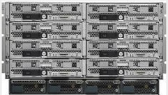


Independent Scaling with Cisco UCS
Maximize TCO Cluster Scaling
UCS Compute-Only Nodes
B200 / C220 / C240
All Flash
Nodes and Clusters
+
Maximize All Flash IOPS
HX220c All Flash
Cluster
HX240c All Flash
Cluster
Minimize Cost per
VDI Seat
Hybrid
Nodes and Clusters
+
HX220c Cluster
HX240c Cluster

Slide 23
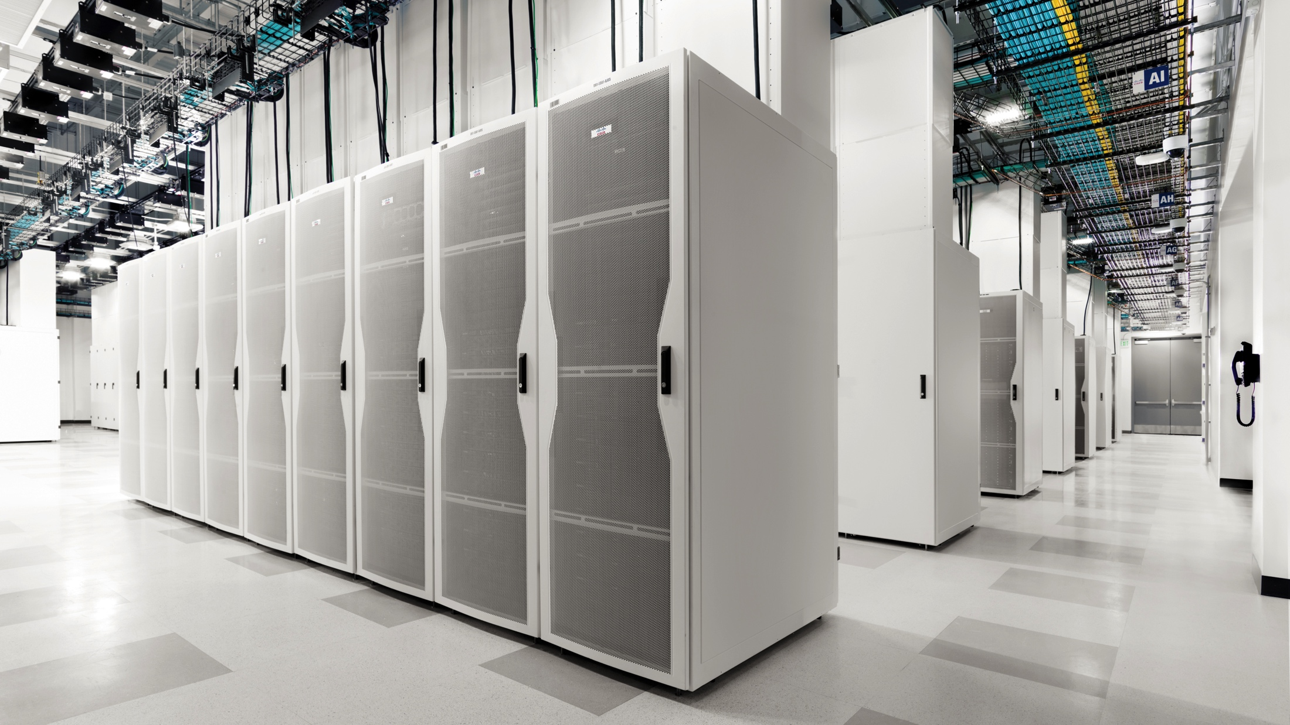
Introducing Adaptive Infrastructure
Simplified Operations
Dynamic Resource Allocation

Slide 24
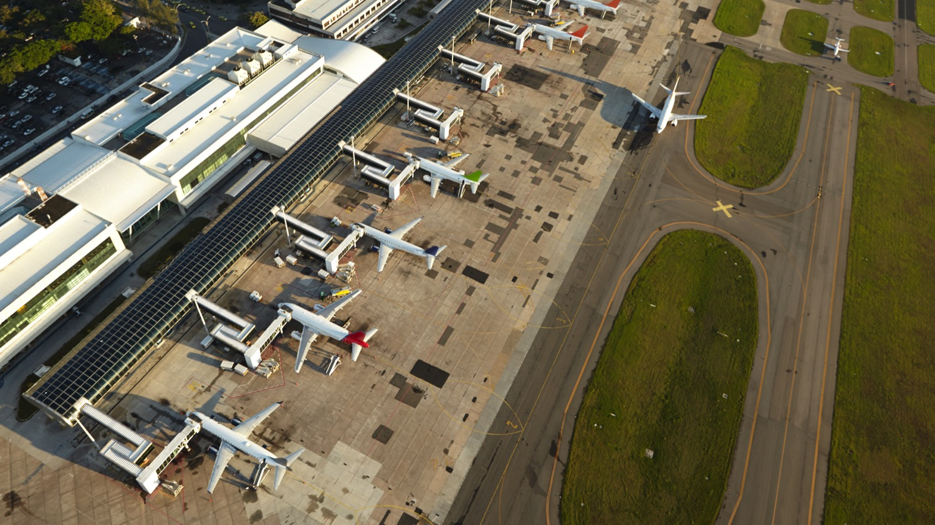
Adaptive Infrastructure for Simplified Operations
Intelligent Automation
flexible deployment tailored to your specific needs
Independent Scaling
of nodes, compute or capacity
Flexible Infrastructure shift resources for operational demands

Slide 25
Integrate Into Your Existing Infrastructure
Common Management Policy
Hyperconverged
Standard Compute-Only Nodes
Traditional Storage
Scale
Compute-Only Racks
VM
VM
VM
VM
VM
VM
VM
VM
HX Data
Platform
HX Cluster
Nodes
Storage Arrays
SAN/NAS
VM
VM
VM
VM
Scale
Compute-Only Blades
Common Network Fabric

Slide 26
Simplified Operations with HCI and CI Working Together
Flexible Infrastructure
Unified Management for all applications with HyperFlex and Existing Environments
Compute-Only Nodes can be Shared Across HCI and CI Applications
UCS Director and Cloud Center for Migration and Orchestration
Common Network Fabric
Network Attached Storage
VM
VM
VM
VM
VM
VM
VM
VM
VM
HX Data Platform
Hyperconverged
Infrastructure
Converged and Traditional Infrastructure

Slide 27
End-to-End HX Deployment Automation
Intelligent Automation
Networking
HX Optimized Service Profiles
For rapid cluster deployment and expansion
Intelligent
Configuration
Intuitive User Interface
Simple wizard installer for the entire process
Compute
Storage
Start
UCSM
Validation
UCSM
Configuration
Hypervisor
Configuration
Deploy
Validation
Deploy
Create
Validation
Cluster
Creation

Slide 28

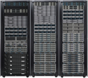







One Architecture for Operational Simplicity
Unified Management Model
UCS Management
Cloud Center
ACI
UCS Mini
Fourth Generation UCS
HyperFlex Systems
UCS
C240
UCS C3000
Mainstream Computing
Converged Infrastructure
Hyperconverged
Infrastructure
Software-Defined Storage
Scale Out
Edge
Core Data Center
Cloud

Slide 29
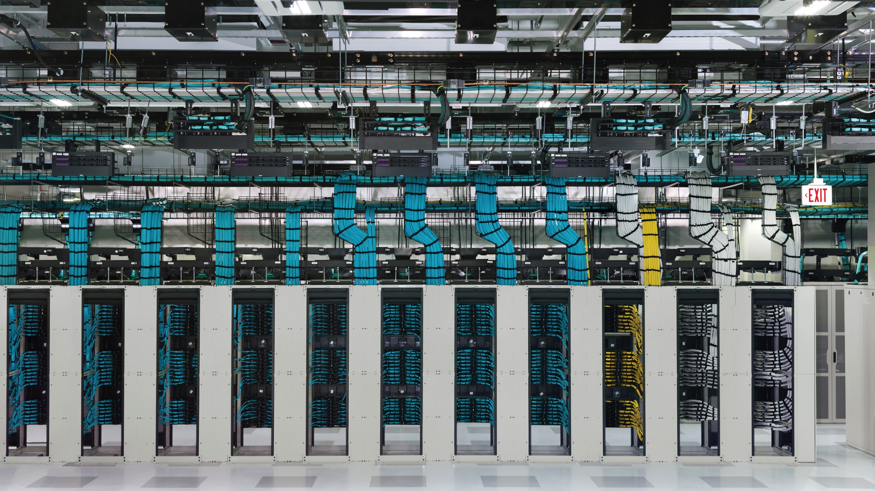
Part of Complete Data Center Strategy

Slide 30












Cisco CloudCenter (ECS) with HyperFlex
Application lifecycle management & mobility across clouds
Datacenters
Deploy
Model
Private Clouds
Manage
Public Clouds
Single Integrated Management Platform
Full Application Lifecycle Management
Enterprise-Ready
Scalable
Secure

Slide 31


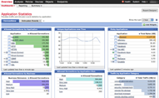
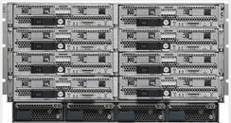


Cisco UCS Director (ECS) with HyperFlex
Infrastructure automation and Private Cloud IaaS
HyperFlex Stack with UCS Director
A
B
C
Infrastructure Automation of
UCS, Storage, Virtualization
Networking and Application Centric
UCSM Security Model
Management and
Operational Visibility
Private Cloud IaaS Automation
Policy Based Data Center
IaaS Service Catalog
Workload provisioning
Metering and Chargeback

Slide 32









HyperFlex Data Protection w/ UCS C3260 + Veeam
Replication
vSphere
Backup
vSphere
HX Cluster
UCS C3260 with Veeam
HX Cluster

Slide 33
Proven Success Around the World
Customers Across Verticals
Financial Services
Government
Education
IT Software and Services
Industries
Entertainment
Pharmaceutical
Health Care
High Tech/ Industrial Mfg.
Online Services/ Social Media
Travel and Hotel Services
Retail
Use Cases
Virtual Desktop Infrastructure
Server Virtualization
Test and
Development
Large Remote
Branch Office
Databases

Slide 34

HyperFlex Upgrade Overview
HyperFlex Data Platform (software)
Upgradeable Components
Connect non-HX hosts and/or storage
Upgrade Guide Forthcoming: PLEASE WAIT
Upgrade Guidance
Check http://www.cisco.com/c/en/us/support/hyperconverged-systems/hyperflex-hx-data-platform-software/products-installation-guides-list.html
Release Notes: http://www.cisco.com/c/en/us/support/hyperconverged-systems/hyperflex-hx-data-platform-software/products-release-notes-list.html
Software
(Forthcoming)
Download: https://software.cisco.com/download/release.html?mdfid=286305544&softwareid=286305994&release=1.8(1e)&relind=AVAILABLE&rellifecycle=&reltype=latest

Slide 35

Summary: Cisco HyperFlex Systems
Next Generation Hyperconvergence
Independent Scaling, Highest Performance & VM Density – Highest TCO
Complete Hyperconvergence
Integrated networking, compute, and storage – Engineered on UCS
Adaptive Infrastructure
Infrastructure flexibility for operational simplicity – Eliminating Silos
Notes:
Add substantiation for claims in slide notes and footnote

Slide 36
Summary: Cisco HyperFlex Systems
Next Generation Hyperconvergence
Independent Scaling, Highest Performance & VM Density – Highest TCO
Complete Hyperconvergence
Integrated networking, compute, and storage – Engineered on UCS
Adaptive Infrastructure
Infrastructure flexibility for operational simplicity – Eliminating Silos
Notes:
Add substantiation for claims in slide notes and footnote

