Slide 1
SAMT Training:
How to Onboard Additional Administrators
Services Entitlement
October, 2017

Slide 2
How to Onboard Additional Admins
This training module will walk you through how a SAMT Partner Bill-To ID (BID) Administrator onboards additional administrators from their Partner company or from a Service Provider to whom they sold certain technical services. The deck will demonstrate how to onboard an administrator, how to enable SP SAMT Admin to administer entitlement for contracts, and how to manage the Partner’s assigned versus unassigned contracts.
Instructions for Navigating in the Training Module
The training module is animated and best viewed in Slide Show mode. Click on the PowerPoint slide show icon at the bottom of the screen.
To proceed to the next slide, click the mouse, or use the “PgDn” or Down Arrow key on your keyboard. Then click one more time on the blank slide to watch a visual demo.
To return to the previous step, right click and select “Previous” from the menu, or use the “PgUp” or Up Arrow key on your keyboard.
To end the presentation, right click and select “End Show” from the menu, or use the “Esc” key on your keyboard.

Slide 3
Onboard Additional SAMT Administrators
As a SAMT Administrator, you can onboard additional SAMT Administrators. You may do this in any of the following scenarios:
To set up an additional/backup administrator (within your same company)
To decentralize the access management function in your organization, delegating responsibility for managing access to specific types of contracts
To delegate the access management function to someone in another organization (For example, a Partner Administrator delegating access management for a Cisco-branded contract, to an individual from the End Customer (or Service Provider)
Having more than one administrator for a BID/contract is a best practice, to prevent a lapse in administration in the event an administrator goes on vacation or leaves the company.

Slide 4
Demonstration

Slide 5
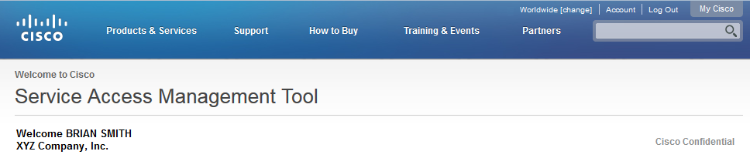
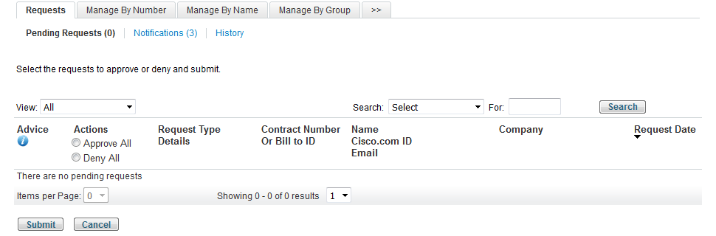

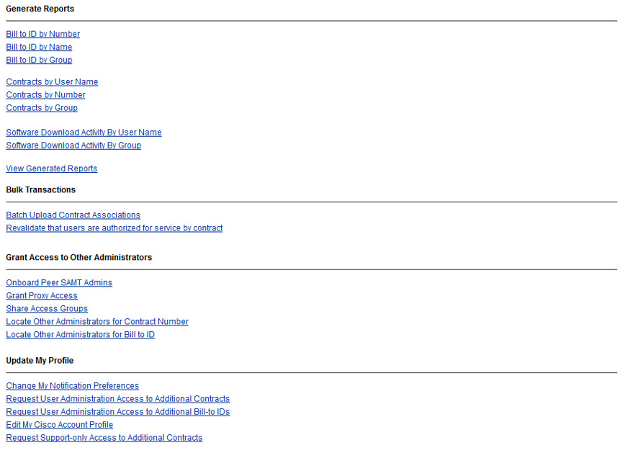
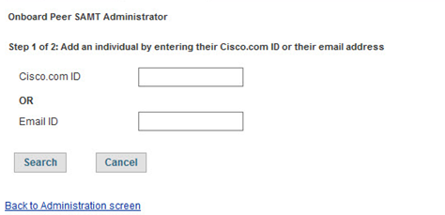
From the default Requests screen, click the “>>” tab to navigate to the Administration screen
On the Administration screen, select
“Onboard Peer SAMT Admins”
In this demonstration, we will show how a Partner BID Administrator can onboard one of their Customer (or Service Provider) users as a Contract Administrator
Click to Continue

Slide 6
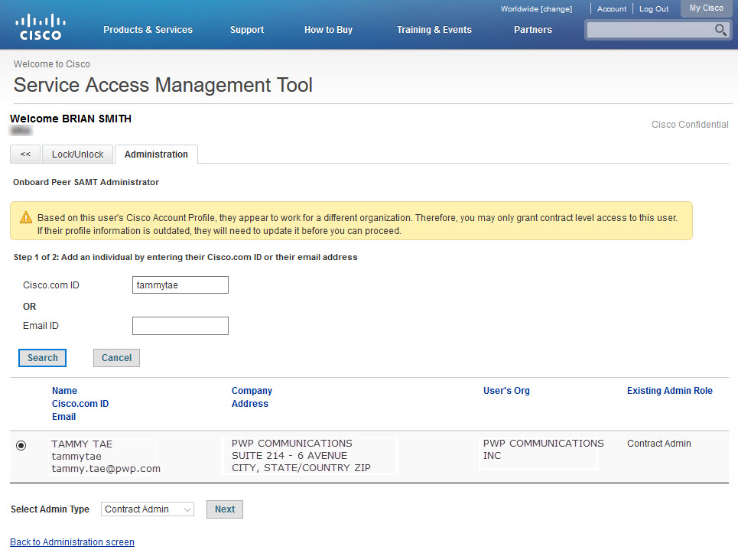
Step 1: Enter the Cisco.com ID or Email ID of the person you want to onboard, and click “Search.”
The email address on their profile must be a business address. Public domain email addresses (such as gmail or yahoo) are not allowed for SAMT administrators.
tammytae
Because the user in this scenario is from a different company
(a customer or Service Provider),
you can only onboard them as a Contract Administrator.
Verify the information, and click “Next.”
Click to Continue

Slide 7
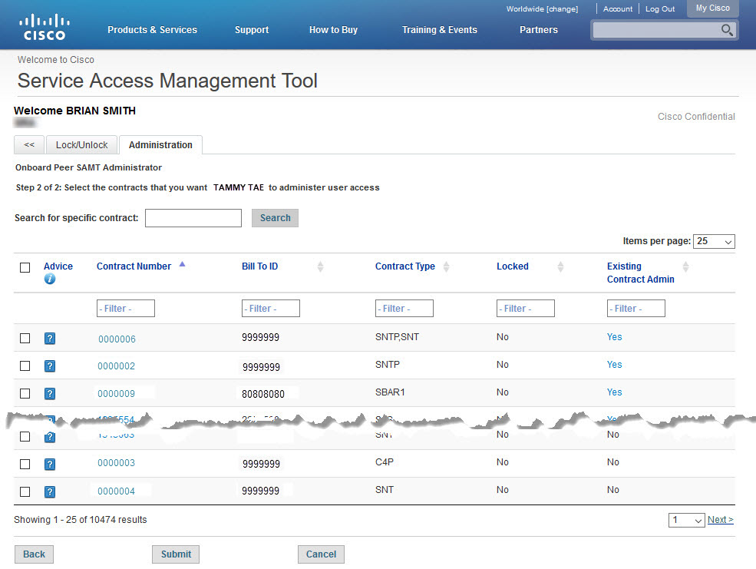
Step 2: Select one or more contracts that the individual will manage.
If you want to grant administrator access to one contract and know the number, enter it here and click “Search.”
The first 25 contracts that you manage are displayed. If the contract you want to assign is not shown, there are two ways to find it: Search, or Filter.
To find one or more contracts from a large list of contracts you manage, first display more contracts (up to 1000 per page).
Then, enter full or partial text string values into one or more filter boxes. For example, to find your Service Provider contracts that have not yet been assigned to a dedicated administrator, enter “SP” into the “Contract Type” filter and “No” into the “Existing Contract Admin” filter.
Click to Continue

Slide 8
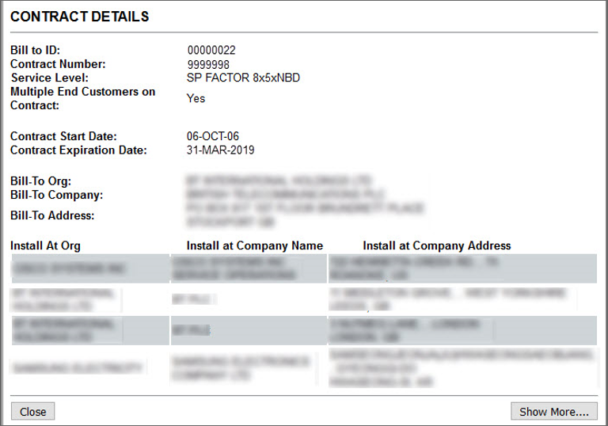
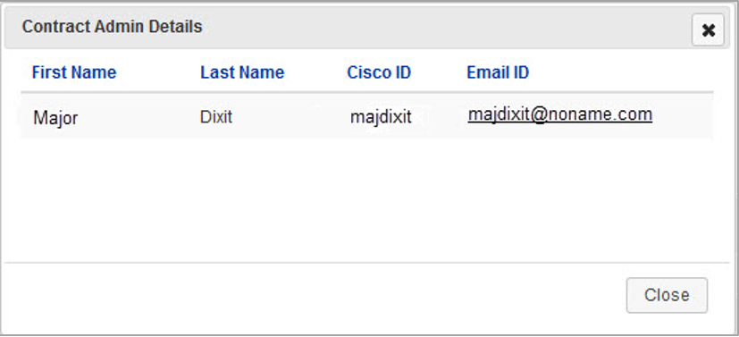
A partner who onboards a customer (or Service Provider) as a Contract Admin must be certain that there are NOT Multiple end customers on the contract.
Step 2: Select one or more contracts that the individual will manage.
For contracts with multiple end customers, Partners can request a service contract be broken into multiple contracts by opening a case with Customer Service Central.
If a contract has an Existing Contract Admin, click on “Yes” to display their information.
To display contract details, click on the contract number.
Click to Continue

Slide 9
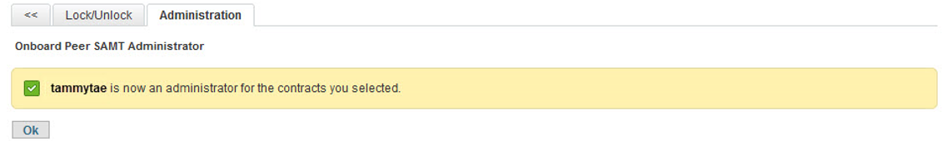
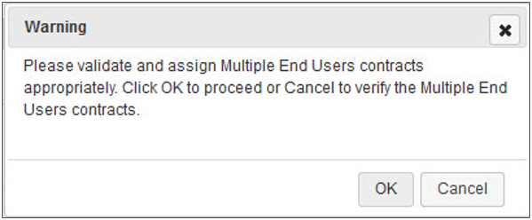
Step 2: Select one or more contracts that the individual will manage.
Check the box next to the contract(s), and click “Submit.”
Confirm that you are NOT making one customer administrator of a contract that has other customers on it.
Doing so would expose one customer’s data to another!
End Demonstration

