Slide 1
How to Automate and Manage Business Services with Cisco VMS
David Roberts
Wayne Ogozaly
December 14, 2017

Slide 2

Cisco VMS
The service creation and delivery platform for service providers
VMS is a service creation and delivery platform that helps managed service providers to rapidly and profitably deliver service offerings to market.

Slide 3

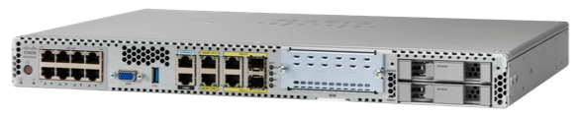
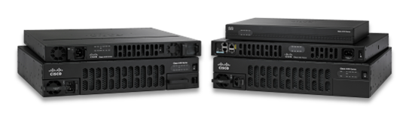
Happy managed services customers
User Portal
Operator Portal
OSS/BSS
SPs already have OSS/BSS
Logging and Alarms
Identity Management
API
Somehow, we need to get all these other things before we can sell the new service
End-to-end Service Offering
Service Monitoring
Service Templates
Workflow
Device Orchestration
Zero-touch Provisioning
Service Chaining
Hardware

Slide 4

Build it?
Buy it?

Slide 5
User Portal
Operator Portal
OSS/BSS
Logging and Alarms
Identity Management
API
End-to-end Service Offering
Most of this is common across services (~80%)
Service Monitoring
Service Templates
Workflow
Device Orchestration
Zero-touch Provisioning
Service Chaining

Slide 6
VMS UI
OSS/BSS
VMS Platform
End-to-end Service Offering
Most of this is common across services (~80%)

Slide 7
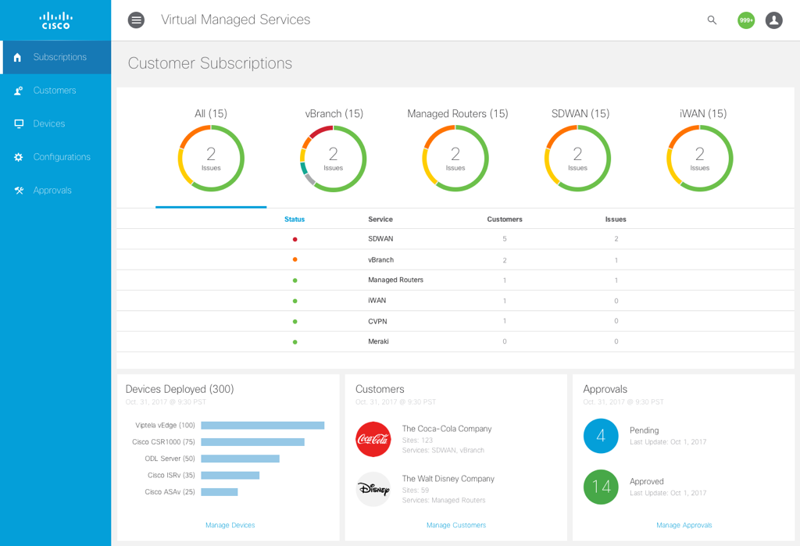
Deploy Multiple Services for Multiple Tenants
Summary status by service type
View devices deployed, customers, and approvals

Slide 8
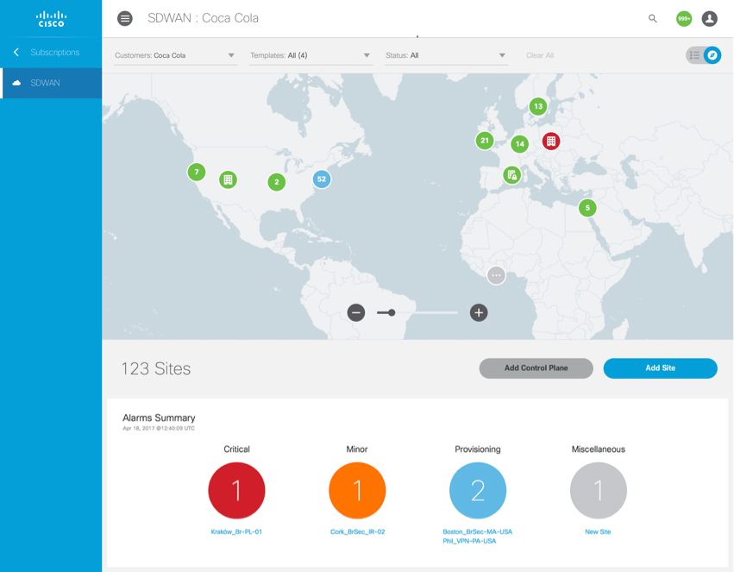
Drill Down To View Tenant Status
Map view
Alarm summary

Slide 9
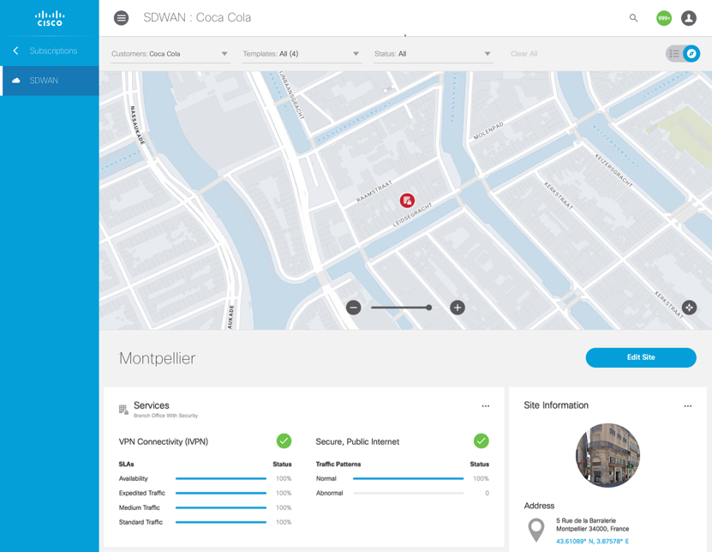
Drill Down to Site/Device Status
Map view
Alarm summary

Slide 10
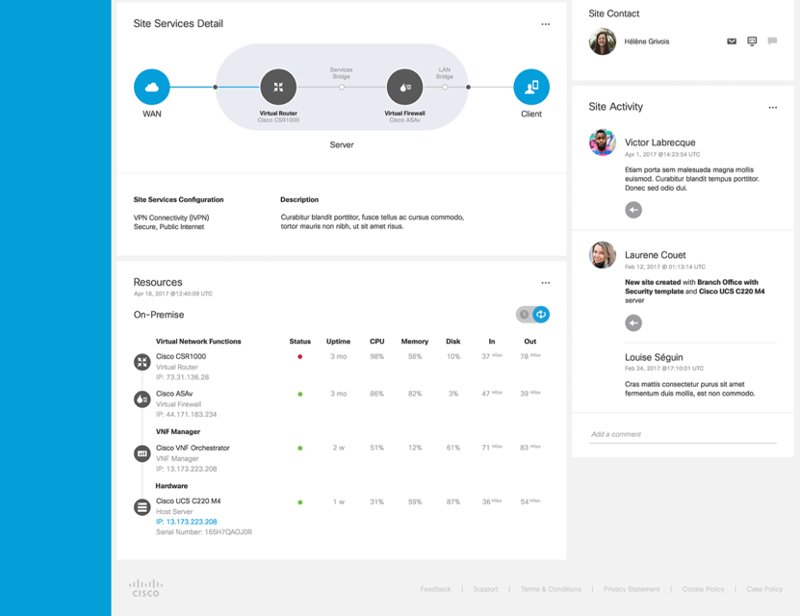
Drill Down to Site/Device Status (cont.)
VNF Topology View
VNF Resource Consumption

Slide 11
Custom UI
OSS/BSS
VMS UI is optional
VMS Platform
End-to-end Service Offering
VMS Platform can be driven through open APIs from any other system

Slide 12

VMS is Multi-Tenant and Multi-Service
Tenant X
Viptela Service Pack
Meraki Service Pack
iWAN Service Pack
Future Cisco Pre-Built Service Packs
Cloud VPN Service Pack
Managed Device Service Pack
Custom Service Pack
vBranch Service Pack
…
Tenant Y
Tenant Z
VMS Service Creation and Delivery Platform

Slide 13
Pre-Built Service Packs – Ready to Sell
vBranch
Allows VNFs to be deployed on "universal CPE" running Cisco NFVIS
Rich templating capabilities provide reusable service chains and device configurations
Cisco SD-WAN
Speeds deployment of multi-tenant SD-WAN environments based on Cisco Viptela technology
Coordinates with vBranch service pack to deploy virtual vEdge on ENCS
Cloud VPN
Cloud-based VPN and firewall security for medium-sized businesses
IWAN
Deploys VNFs to SP data-center clouds, avoiding CPE upgrades
Deprecated. Not recommended for new deployments
Previous generation SD-WAN solution

Slide 14
Pre-Built Service Packs – More Coming Soon
Managed Device
Quickly on-board new devices with Cisco Plug-and-Play and assign them a templatized configuration
Meraki
Integrate with Cisco Meraki for SMB or mixed-enterprise deployments
Cloud UTM
Extend Cloud VPN capabilities to small businesses with enhanced routing, firewalling, and advanced threat protection

Slide 15
VMS UI
OSS/BSS
New service packs just “snap in” to the VMS platform and inherit all platform services such as portals, monitoring, OSS/BSS integrations, etc.
End-to-end Service Offering
Cloud VPN
vBranch
Cisco
SD-WAN
IWAN
Managed CPE
Future pre-built service pack
Meraki
Your Custom Service Pack
Whatever the future might hold…
VMS Platform

Slide 16
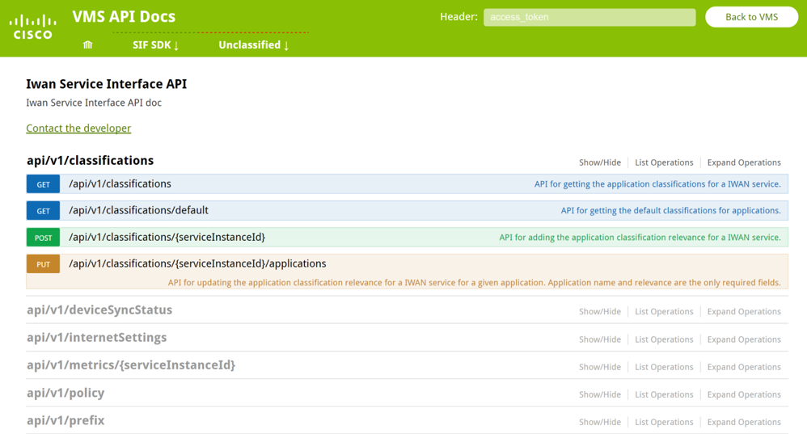
REST APIs and Software Development Kits
Simple to use, simple to create new SP Services
All VMS Services are configurable via REST APIs
New Services can be created through the Software Development Kit (SDK)

Slide 17
Service Design Capabilities
Least flexible and complex
Service Extensions
Extend existing services
Template Development Environment
Create templatized service chains
Most flexible and complex
Custom Service Packs
The sky is the limit

Slide 18
VMS Delivers Future-Proof Flexibility
Virtual Network Functions
Physical Network Functions
Cisco
3rd-Party

Slide 19
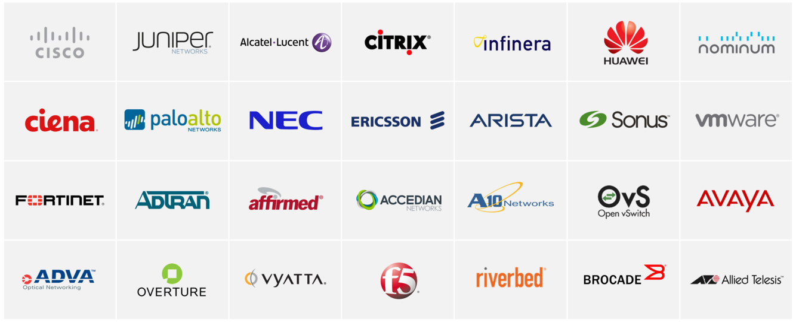
3rd-Party Integrations…managed simply by VMS
Open Platform with the Broadest Multi-vendor support, and Vendor Qualification
Network Services Orchestrator (NSO) - Over 100 Vendors Supported
Cisco Vendor Qualification Program

Slide 20
Custom Branding Support
Fully customizable visual design. Integrate your own colors, icons, fonts, etc.

Slide 21
Cloud Native Architecture and VIM Independence
VMS Platform
Public Clouds
Private Data Center
Private Cloud
Cisco NFVI
3rd-Party NFVI

Slide 22

VMSaaS also delivers Cisco VMS as a cloud-hosted service where Cisco manages the software, infrastructure, and operations.
VMS
VMSaaS helps you deliver services quickly, without the hassle of building it yourself.

Slide 23
VMSaaS Standard Services
VMSaaS – Delivers VMS in a SaaS model
  Platform installation and hosting
  24/7 Monitoring and assurance
  Service reports dashboard
  Backup and restore
  Software updates
  Capacity planning
  Security and vulnerability management
Identity
Federation
OSS/BSS
Integration
VMSaaS
CPE Device
Management
Others…

Slide 24
VMSaaS Optional Services
Optional Services – Mix and match customized services as required
  Application of customer-specific branding (UI “skinning”)
  Identity federation
  Service template design
  OSS and BSS integration
  Service desk integration
  Designated Program Manager (PM) or Service Delivery Manager (SDM)
  Customized reporting
  Physical CPE device or VNF management
  Service Provisioning
  Others…
Identity
Federation
OSS/BSS
Integration
VMSaaS
CPE Device
Management
Others…

Slide 25
VMSaaS Supports Hosting in Any AWS Region Worldwide

Slide 26
VMSaaS Architecture
AWS Regional Data Center
VMS
Operator interface
Service Provider
Monitoring, upgrades, backups
OSS / BSS integration (opt)
Provisioning, management
Configuration, monitoring
Operators
Service Call
Service
Desk
CPE
Enterprise Customer Premises

Slide 27
Cisco VMS
The service creation and delivery platform for service providers
VMS is a service creation and delivery platform that helps managed service providers to rapidly and profitably deliver service offerings to market.

Slide 28

VMS Simplifies Service Delivery
Fast Time to Market
Multiple Deployment Options
Reduces Development Cost
Differentiated Services
Automates services delivery across any infrastructure
Pre-built service packs: vBranch, SD-WAN (Viptela), Managed Device Onboarding, Cloud VPN
Automated provisioning of services
Cisco Advanced Services can assist with installation, operations, and service creation
Cloud-native, multi-tenant architecture
VIM independence: Cisco VIM 2.0, OpenStack, Metacloud, AWS, Google Compute Engine
Deploy in SP data center or public cloud
Also available as a SaaS: VMSaaS
Pre-built platform reduces or eliminates need for internal IT development
76%* reduced OPEX through automation and zero touch provisioning
On-board new customers in minutes
Customer self service portal for planning, installation and management
Open, multi vendor, services catalog
Supports physical devices and virtual functions
Supports Cisco and 3rd party devices and VNFs
Bring your own service or adapt existing services
Can be integrated with existing OSS and BSS systems

Slide 29
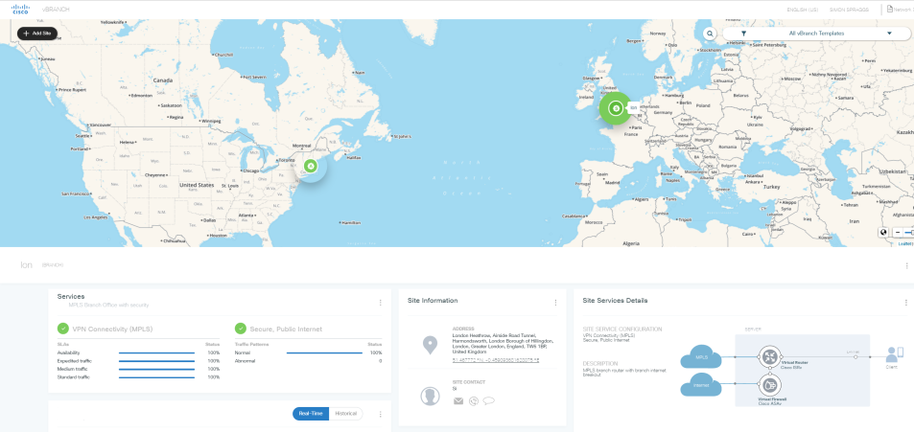
Demo
Virtual Managed Services running on a Virtual Branch x86 device

Slide 30
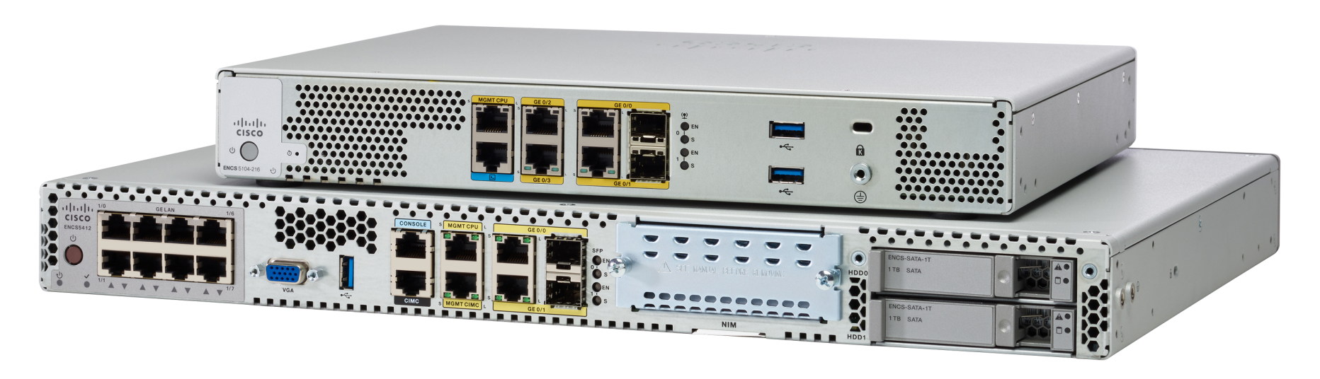
Cisco Virtual Branch x86 NFV Platform
ENCS 5000 Series managed simply from VMS
Best of Routing
& Compute
Complete
Virtualized Services
Open for Third Party
Services and Apps
Enterprise Network Compute System
ENCS 5100 Series
ENCS 5400 Series

Slide 31
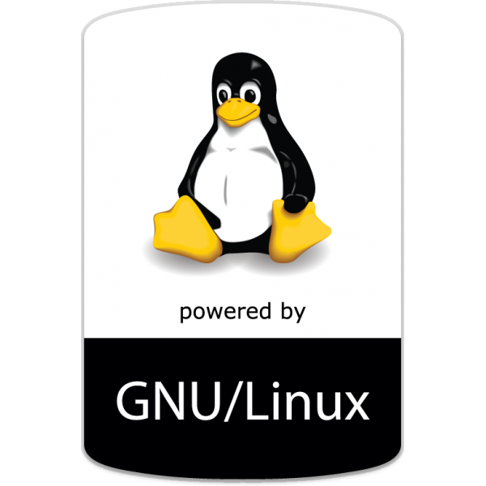


Network Functions simply managed from VMS
Cisco and 3rd Party Virtual Network Functions (VNFs)
Viptela vEdge
Windows Server
Linux
3rd Party
SD-WAN
High Performance
Rich Features
Active Directory,
File Share,
Server Applications
Custom Applications
DNS/DHCP
Network Services
Management & Monitoring
Notes:
In the first phase of Enterprise NFV, there will be several key services supported including the best L3 route platform and intelligent WAN with the ISRv, comprehensive security offering with ASAv and soon to follow FirePower threat defense, the leading WAN optimization solution WAAS along with the integrated Akamai connect, and the industries premier wireless LAN controller. We also will support standard server operating systems for deployment of other software package and custom applications.

Slide 32

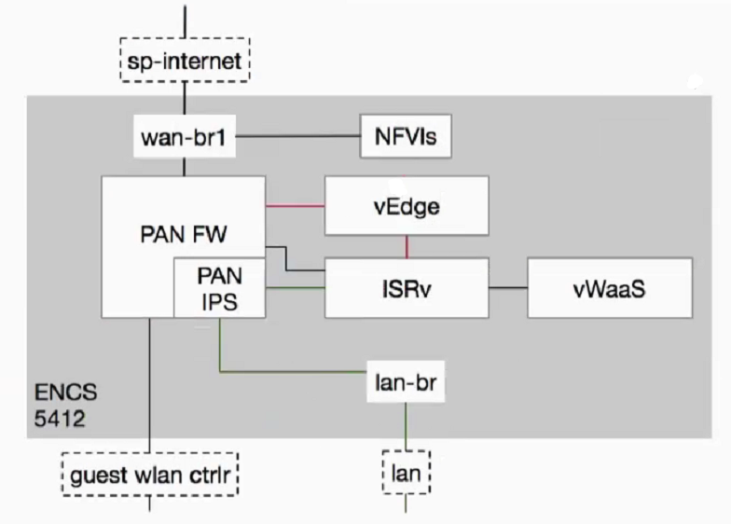



The Power of VMS vBranch…
Many vendors, Many services…One Branch
VMS Dashboard
Internet
VMS vBranch
GE0-0
wan-br1
NFVIS
SD-WAN
VMS Services
Firewall & IPS
Viptela vEdge SD-WAN Service
Cisco vWAAS WAN acceleration
Cisco ISRv IOS-XE routing and mgt
Palo Alto FW WAN firewall + Intrusion Protection Service (IPS)
Cisco NFVIS vBranch service chaining and VNF Lifecycle mgt
ISRv
vWAAS
lan-br1
lan-br2
GE1-2
GE1-0
Branch Clients
32

Slide 33
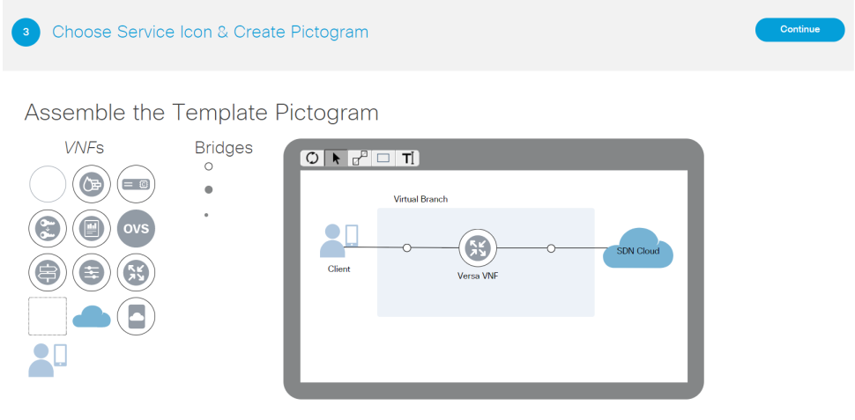
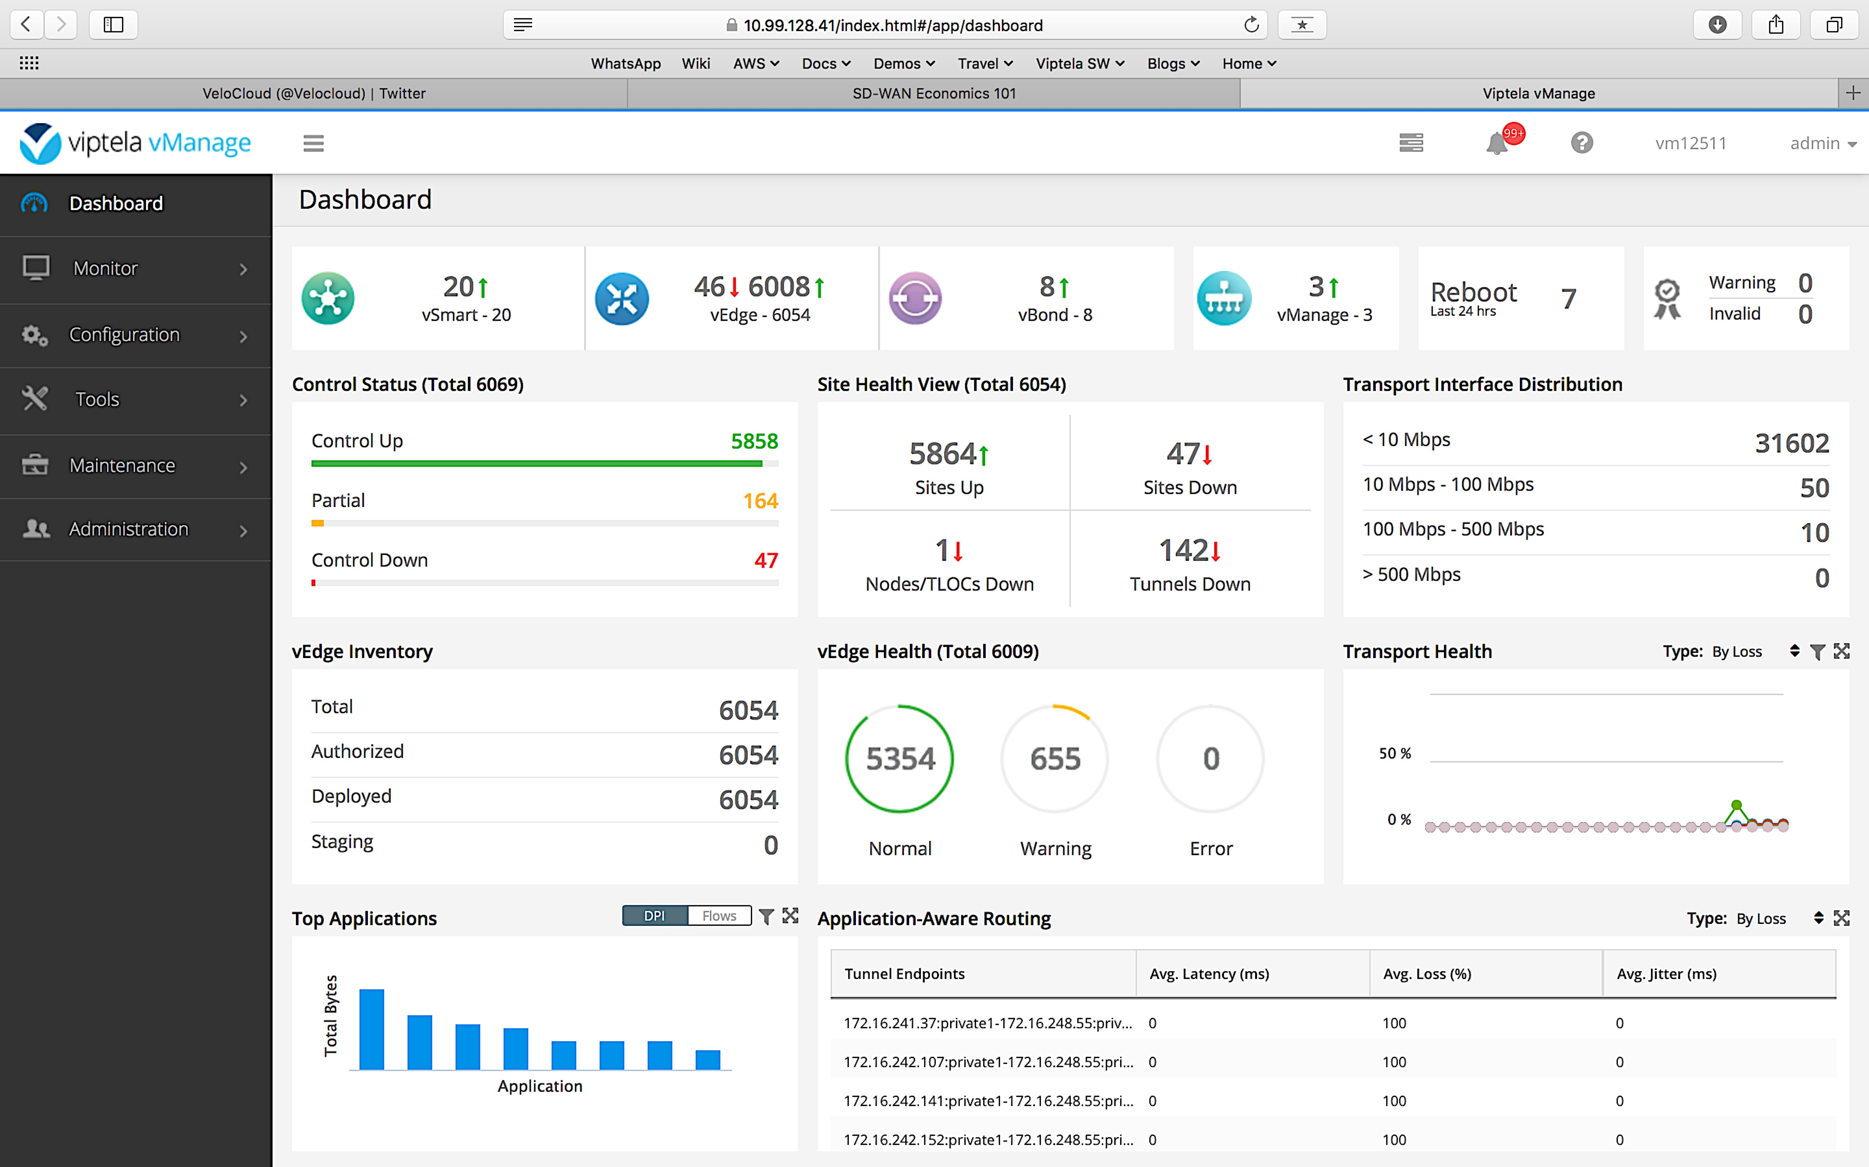
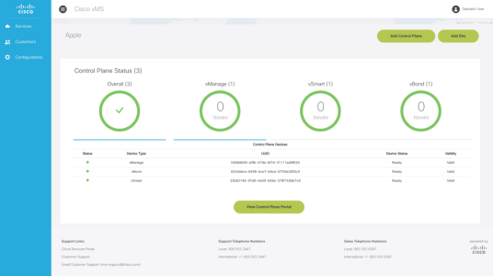

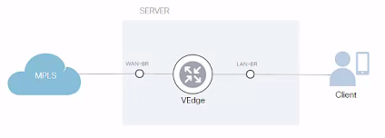
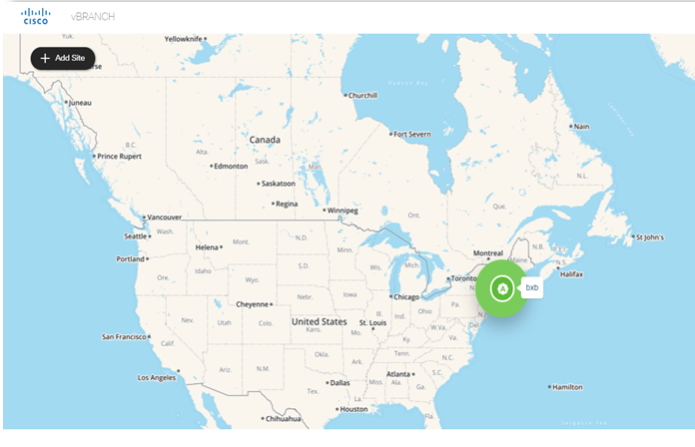
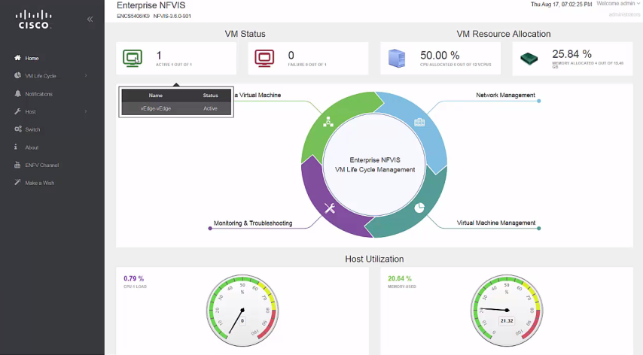
Viptela vEdge Running from on VMS vBranch
1
Viptela Management Dashboard
Cisco VMS – Create Viptela Service Template
4
VMS
VMS
3
Viptela VNF Running on the VMS vBranch
2
Simply on-board a VMS vBranch with the Viptela Template and Zero Touch Provisioning
VMS
VMS vBranch

Slide 34
Simple Implementation of SDN/NFV using VMS
From Network Complexity to Simplicity and Automation
Manual
Plan It
Design It
Where Can
We Put It?
Procure It
Install It
Configure It
Secure It
Is It Ready?
From Months to Minutes
Automated Self- Service On-Demand
Plan It
Design It
Is It Ready?
Service Oriented
Self-Service
Automated Provisioning
Scalability

