Slide 1
Security as a Foundation for SP
Digital Transformation
December 2017

Slide 2

Our Presenters
Amy Henderson is the Security Services portfolio manager for Advanced Services at Cisco. She has over 5 years of experience as a product manager developing IT-based services to help clients simplify their lives, and meet their business objectives.
Taslimm Quraishi has several years of experience developing, managing, and delivering security and risk-based services to Fortune 500 companies, with vertical expertise in communications/service provider.
Amy Henderson
Taslimm Quraishi
Security Services Portfolio Manager
Service Provider Security Principle & Director
Brad Garnett is a Team Leader of Incident Response at Cisco Security Services with over ten years of experience in the information security field focusing efforts on: Digital Forensics, Incident Response, Cyber Security Attacks, Malware, Threat Intelligence, Cybercrime, and hacktivism.
Steve Nowell is a Solutions Architect with twenty years of experience, ten of which are at Cisco, in both security and route / switch technologies. Most of his background has been focused solely with Service Providers.
Steve Nowell
Brad Garnett
Service Provider Solutions Architect
Team Leader, Incident Response
© 2017 Cisco and/or its affiliates. All rights reserved. Cisco Confidential
Notes:
https://blogs.cisco.com/author/amyhenderson

Slide 3
Agenda
1
Market Opportunities and Challenges
2
Your Digital Transformation Journey
a
Evaluating if you are ready
b
Building & Assessing your secure foundation
c
Maintaining your digital solution
3
Questions

Slide 4
Digitization is creating opportunities
Telco, cable, and web: Digitization leading to cloud, 5G, IoT
More cloudification
4x cloud traffic increase
More IoT
Half connected devices Are M2M
$ Sizable $
More video
8x mobile traffic increase
Service Provider
economic opportunity
5G rollouts begin
4.7x traffic of LTE
Notes:
In the 3 markets that GSP is covering (Telco, Cable and Web), Digitization or the digital business transformation is leading the path for several market dynamics: cloud, IoT, and 5G
First more applications and workloads will move to the cloud due to the scale and economic benefits. This will result in a 4 times increase in global cloud traffic through 2020, (Source = Cisco GCI)
There will be more IoT. As data, people, processes, and devices become increasingly connected, through 2020 nearly half of total connected devices will be machine-2-machine (M2M). ( Source = Cisco VNI)
Video is already the majority of fixed and mobile traffic. This will continue to drive global mobile traffic to the tune of 8 times over the next four years. And as the transition to 5G occurs, video will be one of the primary beneficiaries with faster speed and improved quality. (Source = Cisco Mobile VNI)
The blending of these dynamics leads to a $2 trillion economic opportunity for service providers over the next decade through new services and operational savings (Cisco Consulting Services). But there are more transitions at bay…
…And the pace of growth is relentless

Slide 5
Key Security Challenges for Service Providers
34%
of service providers said they lost revenue due to attacks in 2016*
Changing Dynamics
Reducing Complexity
Speeding Innovation
Talent Shortage
*Cisco 2017 Midyear Cybersecurity Report
Notes:
Key Challenges for Service Providers:
Changing Market Dynamics for SPS: They are facing a saturated market, everyone has Cable, Phone, and Internet. They need to come up with new revenue streams. SPs are also in a constant state of defense, DDoS attacks are becoming a way of life.
Reducing Complexity: With massive networks, little visibility, and noise from the endpoint customers, reducing complexity is a necessity for SPs.
Speeding Innovating: New technology has different security implications that SPs need to take into account, including 5G, SDN/NFV, and Cloud and IoT
Finally, there is a workforce shortage of cybersecurity talent that is only increasing as time continues.
59% of CIOs report an inability to change business processes as needed due to IT complexity

Slide 6
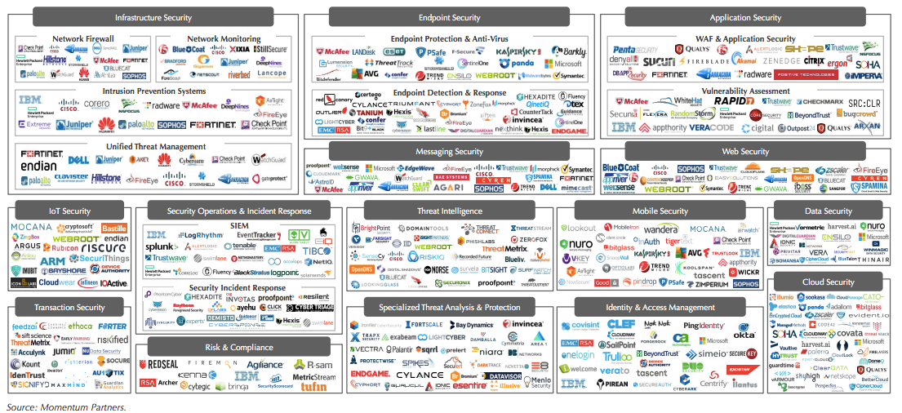
Fragmented Ecosystem for SPs to turn to…

Slide 7
Your network is your business
BRAND
EMPLOYEE DATA
Telco
Gaming
WAN
CONTENT
SERVICE AVAILABILITY
PRODUCTION
NETWORK
SERVICE AVAILABILITY
GAMING
ECONOMY
CONTENT
Cable & Media
Web
Take 7
www…
WAN
www…
SERVICE AVAILABILITY
IP
CONTENT
CUSTOMER DATA
PRODUCTION
NETWORK
SOURCE CODE

Slide 8


Where are you in your Digital Transformation journey?
Maintaining your digital solution?
Building & Assessing
your secure foundation?
Evaluating if you are ready?
Notes:
How des this fit in with the need offered framework? Let’s take a look-
Is your customer determining if their environment is ready for next generation firewalls? (Advisory Services)
CMPA- See the CMPA offer (will not be covered in this PPT)
Does the customer plan on managing the new hardware in-house? (Managed Services)
ATA- Just know we can help with this service but it will not be covered here.
Has the customer budgeted for the installation of the new hardware + configuration? (Implementation Services)
Deployment Services
Migration Services

Slide 9
How do you know when you’re ready?
Mergers and acquisitions
CISO transition
Preparing for a compliance audit
Adoption of new technology

Slide 10
Cisco Security Service’s approach
People
Process
Technology
Executive Management
Security Intelligence
Risk Management
Security Assurance
Secure
Systems
Secure Network
Secure Applications
Current State
Risk Management
Target State
Gaps
Maturity Level Key
Security Resilience Risk Management Program
Security Responsibility, Charter&Governance
1
Security Resilience Risk Management Program
3
M
Secure Network Design and Architecture
Level 0
Absent
0
Privileged Identity and Access Management
Security Incident Response and DDOS
Regulatory & Internal Compliance
Management
Secure Access Provisioning Capability
Data Privacy and Protection
Security Metrics & Reporting
1
Security Incident Response and DDOS
4
H
Security Enclave Management
1
Level 1
Initial
Level 2
Repeatable
2
Architecture Strategy
& Management
Activity and Infrastructure Log Management
Business Continuity & Disaster Recovery
Vendor, Partner, & Virtual Operator Management
Customer/Subscriber Access Management
Virtualized Network & Cloud Environments
OSS and BSS Security
1
Business Continuity & Disaster Recovery
3
M
Level 3
Defined
3
Security Education/ /
Awareness Training
Threat / and Fraud Activity Analytics
Asset Classification and Management
Penetration Testing and Red Teaming
Backup and
Recovery
Network Intrusion Defenses & Clean Pipe
Customer Software and App Security
0
Asset Classification and Management
3
H
Level 4
Managed
4
Physical Infrastructure Security
Configuration, Change & Patch Management
Encryption /
Data
Masking
Level 5
Optimal
5
Vulnerability Management
Configuration, Change & Patch Management
Customer Trust Management
Secure Orchestration & Automation
Data Exfiltration Defense
1
3
M
Crisis Management Support
Application Development / Management
2
Application Development / Management
3
L
Notes:
Solution:
Conducted Cisco Cybersecurity Maturity Program Assessment to evaluate improvement opportunities
Defined key focus areas of security concerns
Increased security posture awareness

Slide 11
Example CMPA Findings
People
  Assign ownership & create IR plan
  Additional Threat Analysts/analytics would be a crucial addition to SOC
  Emphasize a continuing training culture within the organization
  Is there an owner ready to lead an Incident Response scenario?
  Are skill sets positioned optimally?
  Are SOC resources appropriately skilled?
Process
  Manage passwords via best practice
  Identify vulnerabilities and improve speed to remediation via patching
  Further utilize objective, third-party assistance in the assessment of your network
  Are passwords being managed appropriately?
  Is network vulnerability discovered and tracked?
  Are third-parties leveraged to assess the network?
Technology
  Appropriate segmentation needed
  Utilize secure protocols wherever possible to obfuscate sensitive communications
  Implement encryption and authentication on sensitive ones + CASB
  Is the network (micro) segmented appropriately?
  Is internal communication appropriately secured?
  Is sensitive data stored with appropriate controls?
Notes:
Customer gained a nuanced view of strength and weakness as it related to securing their enterprise
Gave them an objective third-party view that contrasted their existing people, process and technology vs. best practice
Allowed them to begin immediate remediation efforts by following a ranked list of priority items

Slide 12
Where are you in your Digital Transformation journey?
Maintaining your digital solution?
Building & Assessing
your secure foundation?
Evaluating if you are ready?
Notes:
How des this fit in with the need offered framework? Let’s take a look-
Is your customer determining if their environment is ready for next generation firewalls? (Advisory Services)
CMPA- See the CMPA offer (will not be covered in this PPT)
Does the customer plan on managing the new hardware in-house? (Managed Services)
ATA- Just know we can help with this service but it will not be covered here.
Has the customer budgeted for the installation of the new hardware + configuration? (Implementation Services)
Deployment Services
Migration Services

Slide 13
Example Penetration Test Progression
  Exploited a known backdoor
Sensitive data was discovered through a known exploit, which could have been patched.
Information obtained through this exploit was utilized for further movement and access through domain.
Lack of segmentation allowed for movement from system to system. Additional access was gained through this lateral movement.
Actionable intelligence gained for attacking the SP and its customers.
Sensitive information obtained through the exploited backdoor allowed for full control of systems at the OS level within the test scope.
Previously compromised data was utilized to access and manipulate multiple crucial access systems.
  Obtained access to sensitive systems through unfettered lateral movement
  Compromised a wealth of operational data
  Obtained admin control of servers
  Compromised several access systems

Slide 14
Build a secure foundation
Infrastructure ACL (iACL)
Steady-State – Traffic destined to subscriber:
Allowed
Internet
Customers
SP Infrastructure
PE
Int.
Peer
Int.
Peer
R1
iACL Applied
Notes:
Do not solely rely on in house talent – validation can be objectively achieved through third party review

Slide 15
Build a secure foundation
Infrastructure ACL (iACL)
Steady-State – Traffic destined to infrastructure:
Blocked!
Internet
SP Infrastructure
PE
Int.
Peer
Int. Peer
R1
iACL Applied
Blocking Traffic

Slide 16
Where are you in your Digital Transformation journey?
Maintaining your digital solution?
Building & Assessing your secure foundation?
Evaluating if you are ready?
Notes:
How des this fit in with the need offered framework? Let’s take a look-
Is your customer determining if their environment is ready for next generation firewalls? (Advisory Services)
CMPA- See the CMPA offer (will not be covered in this PPT)
Does the customer plan on managing the new hardware in-house? (Managed Services)
ATA- Just know we can help with this service but it will not be covered here.
Has the customer budgeted for the installation of the new hardware + configuration? (Implementation Services)
Deployment Services
Migration Services

Slide 17
Making sure you’re prepared – maintain security
Targeted attack by a nation state actor
Organization’s testing/development network environment targeted, which lacked security controls and monitoring
Attackers maintained persistence in the environment for 5+ months
C2 malware zero A/V detection rate, which was utilized for persistence into environment

Slide 18
Command and Control (C2) via C2malware.exe
Attack and investigative timeline
Dwell Time (July – December)
Cisco IR: Forensic Investigation
StealthWatch Deployment
Customer Internal Investigation
Cisco IR: On-Site
C2 traffic observed by law enforcement
Law Enforcement Notification
Cisco IR Engaged
C2Malware.exe identified
1st – 4th
30th
10th
15th
12th
11th
14th
July
January
February
Notes:
Senior leadership visibility and involvement in all research and develop projects
Leadership was not aware of the project requirements
R&D silo’d and lacked leadership oversight
Top-bottom review of pilot program
No firewall | No password | No endpoint security solution
Review of approved executables and dependencies
Application security/ penetration testing
Review of global researchers involved across several countries
Full security architecture review
Network segmentation
Network Visibility (StealthWatch)
Promptly activate Incident Response Plan
Volatile data collection
Monitor and logging of administrator accounts

Slide 19
Our approach
Visibility Tools
Testing Results
Forensics
Communication
Deployed Visibility Tools
Deployed StealthWatch into existing infrastructure to identify other potentially malicious traffic
Deployed AMP for Endpoints to facilitate endpoint, network analysis, and remediation
Forensics
Malware reverse engineering, memory forensics, and disk forensics performed on affected hosts
Testing Results
App Pen Testing group conducted application hardening post-incident response
Communication
Prescribed mechanism, rhythm, and audience for each level of incident severity
Notes:
https://blogs.cisco.com/security/incident-response-fundamentals-communication

Slide 20
Could this have been prevented or minimized?
Incident Response Plan
Communication and Collaboration
Test the IR Plan

Slide 21
Where are you in your Digital Transformation journey?
Descriptive IR Plan
Communication
Periodic Table Top Exercises
Remember…
Maintaining your digital solution?
Segmentation
Manage Passwords and Patching
Visibility
Building & Assessing your secure foundation?
People
Process
Technology
Evaluating if you are ready?
Notes:
Evaluating if you’re ready
Building and Assessing your secure foundation
Visibility to and acknowledgement of your own issues and address them
Third party assessments
Maintaining your digital solution

Slide 22

Cisco Approach:
Best of Breed Integrated Architecture
SP Security Services
Network
Analytics
UTM
Secure Internet Gateway
Email
Advanced
Malware
Policy and Access
NGFW/
NGIPS
WWW
Web

Slide 23
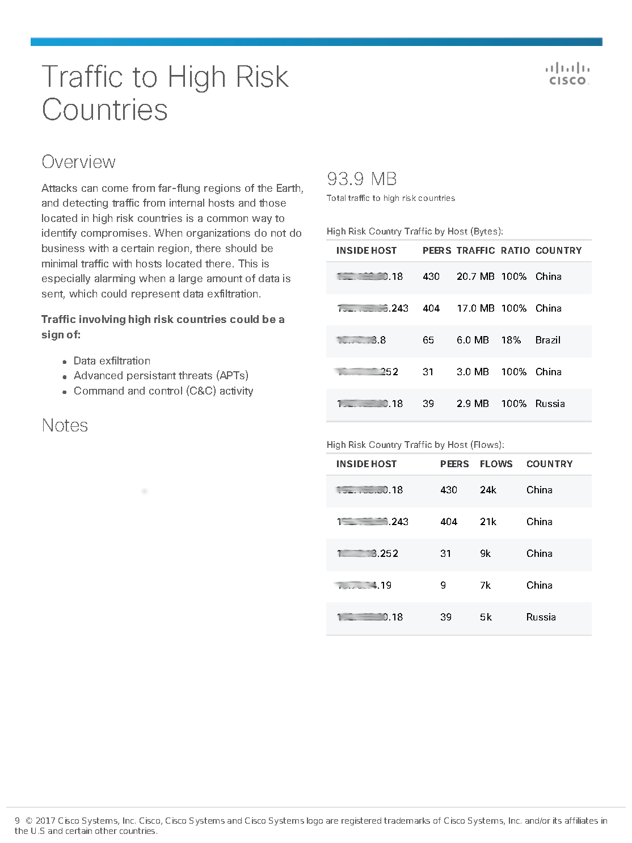
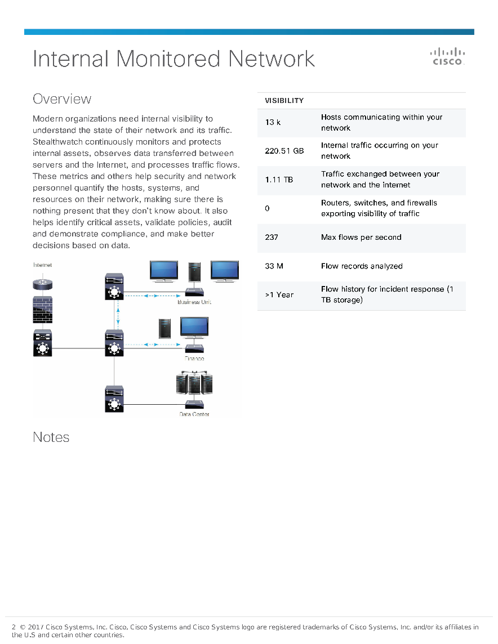
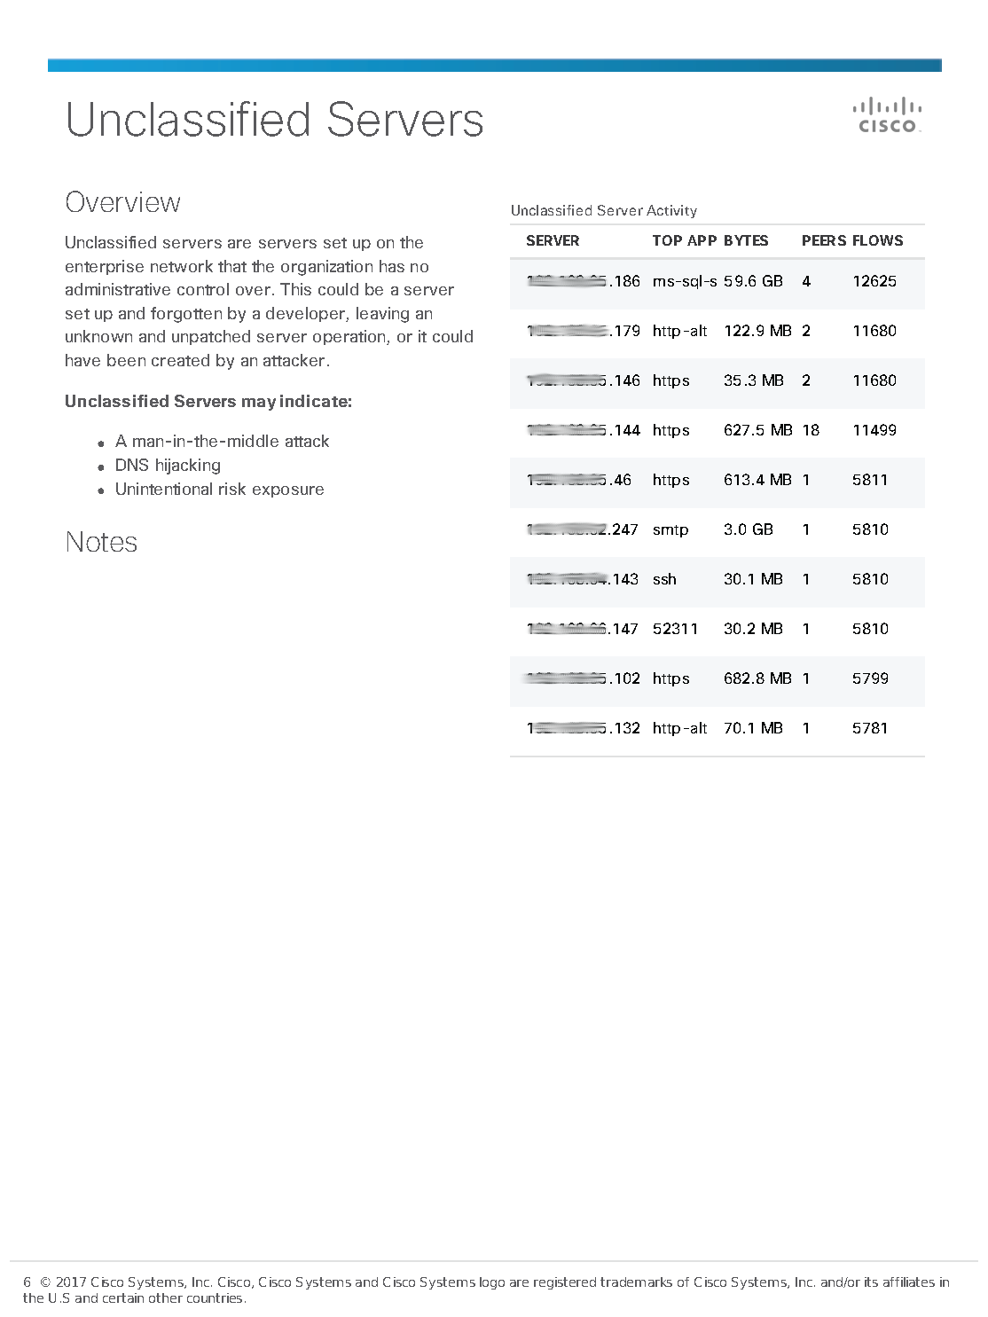
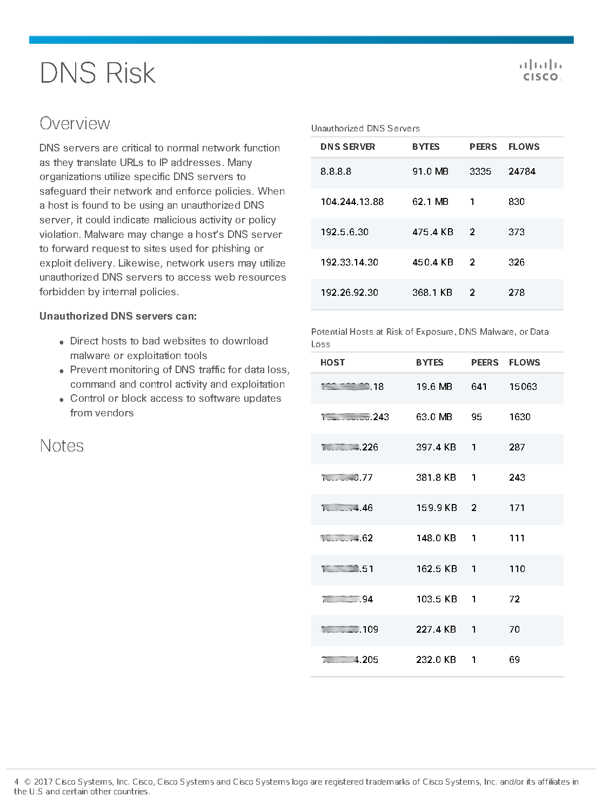
https://salesconnect.cisco.com/c/r/salesconnect/index.html#/program/PAGE-10733
What first step can I take to gain visibility into my SP networks?
Security Online Visibility Assessment (SOVA)
What is a SOVA?
SOVA is a “free” 14-day non-intrusive cloud based network and security visibility offer for all our customers. It works by deploying a lightweight virtual SOVA Collector in the network that forwards network telemetry in passive mode to the SOVA cloud for analysis. After (14) of collecting real time data (internal & external), the cloud generates a confidential standard report for the customer free of charge consisting criteria such as Internal Monitored Networks, SMB & Telnet Risks, Remote Access Breach, etc.
Pick a network segment and get started today
Sign up for your “Free” SOVA today!
Notes:
SOVA is an easy way to get started gaining network and security visibility into any segment of your SP Networks at no cost. This is a “free” service offered by Cisco to all the attendees of today’s webinar. All registrants will be emailed a link to sign up for the SOVA along with details on the process.

Slide 24

For more information on Cisco Security Services, please visit http://cisco.com/go/securityservices

