Slide 1
Build Your Service Provider Data Center Right with Security & Analytics
Sam Rastogi - SP & DC Security Product Marketing
Taslimm Quraishi – GSP Director, Security Services
Ron Hinderer – GSSO GSP Security Sales
Jeff Glass – Director, GSP Sales
November 15, 2017

Slide 2
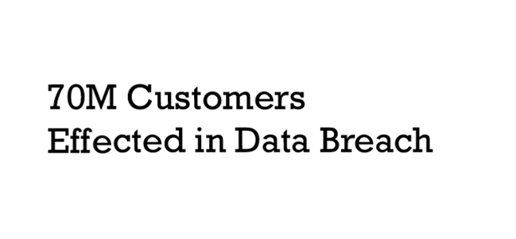



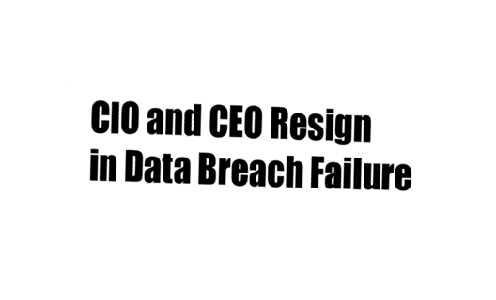
Breaches are the New Normal
14 million vehicles
recalled after hack
FDA Wards of Security Flaw
in Infusion Pump
Notes:
Recent headlines to add:
8/12: Hackers Stole secrets for up to $100 million http://www.reuters.com/article/2015/08/12/us-cybercybersecurity-hacking-stocks-arr-idUSKCN0QG1EY20150812
7/31: FDA warns of security flaw in Hospira infusion pumps
http://www.reuters.com/article/2015/07/31/us-hospira-fda-cybersecurity-idUSKCN0Q52GJ20150731
7/25: Chrysler Recalls 14 million vehicles after Jeep hack
http://www.computerworld.com/article/2952186/mobile-security/chrysler-recalls-14m-vehicles-after-jeep-hack.html
http://www.wired.com/2015/07/hackers-remotely-kill-jeep-highway/
You are not alone. Everyday another headline highlights another breach. Data loss and loss to business are becoming a weekly, if not daily occurrence. Security is top of mind for all organizations, rising up to top executives.
What is behind this dramatic shift in our IT landscape?

Slide 3


Cyber Security is a Boardroom Discussion
Security Breaches are Costly
Security is the #1 Issue for Your Customers
Protect Now the Value You Intend to Create Tomorrow
3

Slide 4


Security Is a Boardroom Concern
Cyber attacks and online piracy raise costs, hurt brand, reduce revenue
Disney, Netflix
Pre-release content stolen from
post-production
Dyn
Mirai botnet DDoS attack on Dyn DNS servers brings down sites
Charter
UI hacked, showed racist messages
Verizon
Customer records exposed on unsecured cloud storage
Notes:
As recent publicized breaches have shown us, the repercussions of attacks are heavy and security is getting executive level attention.
Sources:
Sony Data Breach: http://www.darkreading.com/attacks-and-breaches/sony-data-breach-cleanup-to-cost-$171-million/d/d-id/1097898?
TV5Monde: http://www.scmagazineuk.com/tv5monde-in-chaos-as-data-breach-costs-roll-into-the-millions/article/428605/
World Cup Streaming: http://www.tvtechnology.com/business/0011/viaccessorca-20-million-watched-world-cup-on-illegal-streams/271508

Slide 5

Leaving You Vulnerable to Security Breaches
$87k
$1.45M
60%
54%
Loss for every 1k
data files breached¹
Average lost business cost per attack²
Of security breaches compromise data in hours³
Of security breaches are not detected until months later⁴
Loss of customer trust
¹Verizon – 2015 Data Breach Investigations Report
² Ponemon Institute - 2015 Cost of Data Breach Study: Global Analysis
³Verizon – 2014 Data Breach Investigations Report
⁴Verizon – 2014 Data Breach Investigations Report
Notes:
According to the 2015 Verizon Data Breach Investigations Report, $87,000 are lost for every 1,000 files breached. That’s $87 for every single file. The 2014 Verizon data breach study identified the speed in which these attacks occur, and it’s truly frightening: 60% of all breaches compromise the targeted data within minutes with 54% of all breaches not being detected until months later. A Ponemon Institute’s report on the Cost of Data Breach’s stated that the lost business for every attack equaled, on average, $1.45M. With all that being said, the end result may be the worst of all, and that’s lost of customer trust.
T: Security has reached paramount importance in service provider networks around the world…
<click>

Slide 6

The Modern Data Center is incredibly complex
Big and Fast Data
  Virtualization
  Expanded attack surface
  Increase in east-west traffic
Hybrid Cloud
  Multi cloud orchestration
  Workload portability
  Zero trust model
Application Architecture
  Continuous development | Micro Services | APIs
Notes:
1. Server guys should understand that Security is important… Quickly familiar what Server guys think everyday
2. Network guys should know that Security is more than a Firewall
3. They should be able to get into Depth into Cisco Security (Security they would deploy for the rest of the company)
Application Architectures

Slide 7
Outage/degraded service
Insufficient visibility into the
network, workload, application
Rising security breaches and destruction of service (DeOS) attacks
Increasing regulatory compliance requirements and audits
Rising ACL/FW rule complexity and administration burden
Network
Challenges
© 2017 Cisco and/or its affiliates. All rights reserved. Cisco Confidential

Slide 8
Not enough threat visibility in the network, workloads, applications
Inconsistent policies across workloads
Too many point security vendors
Hackers are more sophisticated
Attack surface is too broad
Security
Challenges

Slide 9

Cisco Data Center Security
Visibility
“See Everything”
Complete visibility of users, devices, networks, applications, workloads and processes
Segmentation
“Reduce the Attack Surface”
Prevent attackers from moving laterally east-west with application whitelisting and micro-segmentation
Threat protection
“Stop the Breach”
Quickly detect, block, and respond to attacks before hackers can steal data
or disrupt operations

Slide 10

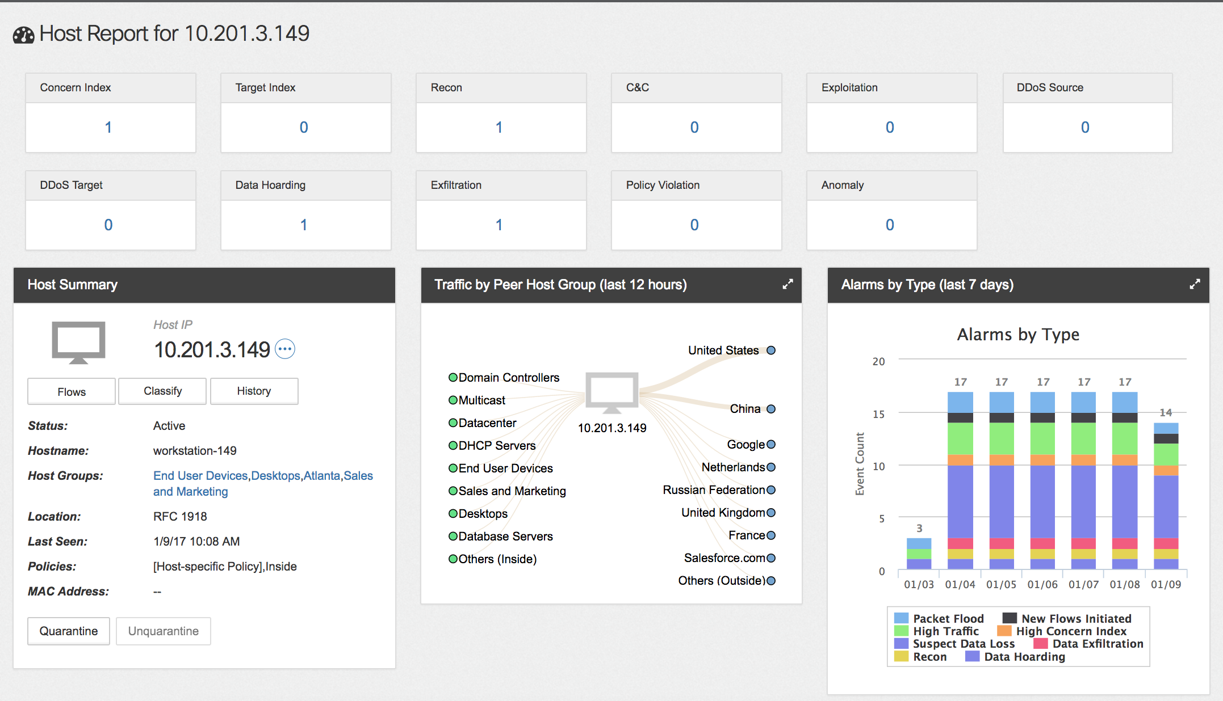
01
02
03
Visibility:
See across the enterprise network
Branch
Data Center
Production & IT Network
Campus
Cloud
Cisco Stealthwatch
Enterprise-wide network visibility across users, hosts, networks, and infrastructure (switches, routers, firewalls, servers)
Collects network flow and other data to provide network visibility for understanding network wide traffic and discover threats
Real-time situational awareness of users, devices, and applications
Holistic network audit trails

Slide 11


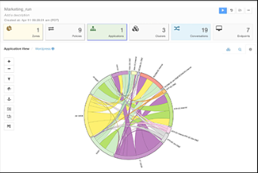

01
02
03
Visibility:
See application components & their behavior
Cisco Tetration
Full visibility into application components including workloads, processes and application behavior in the data center
Application dependency mapping
Application segmentation policies (whitelist/blacklist)
Forensic search and application anomaly detection
Notes:
Value Proposition
Complete visibility and contextual awareness of users, networks, applications, workloads, process based
Network and application behavior
Application dependency mappings
Network Behavioral Analysis
(Netflow / Traffic Analysis)

Slide 12



01
02
03
Segmentation: Reduce the Attack Surface
East-West
Process to Process
Cisco NGFW
Cisco ACI
North-South Perimeter
Cisco Tetration

Slide 13
01
02
03
Segmentation: Reduce the Attack Surface
East-West
East-West
Process to Process
Process to Process
Cisco NGFW
Cisco ACI
North-South Perimeter
North-South
Perimeter
Segmentation across
multiple clouds
Cisco Tetration

Slide 14





01
02
03
Multi-Layered Threat Sensors
Quickly detect, block, and respond dynamically when threats arise to prevent breaches from impacting the business
Threat
Protection:
Stop the Breach
By strategically deploying threat sensors north-south, east-west
ACI
Tetration
Next-Gen IPS
with AMP
Next-Gen Firewall with Radware DDoS
Next-gen Firewall
Next-Gen Firewall with AMP
Stealthwatch
Cisco ACI
Cisco Tetration

Slide 15



01
02
03
Protect the Workload
Everywhere

Slide 16
Security Services
Taslimm Quraishi – GSP Director, Security Services

Slide 17






Security Services:
Securing the New Digital Economy
Advisory
Implementation
Optimization
Managed
Technical
Training
Business Critical Services for Security
Security
Certifications and Learning Programs
Security
Advisory Services
Security Implementation Services
Security Managed Services
Security
Technical Services
Expert security guidance to drive business outcomes
Maximize solution value
Maximize operational excellence and performance
Experts and advanced analytics to lower OpEx
Minimize business disruption
Attract, build and retain skills
Independent assessments: Strategy, Segmentation, Secure Arch, SOC Assessment & Optimization, Compliance
Provide a better ROI
Visibility & Threat Protection
Improve efficiency of your infra and people, imparting new skills and training for the future
Notes:
Cisco Security Services helps you better anticipate and respond to new threats, reduce complexity and fragmentation, and adapt with agility to changing business models. Security is the foundation for agility, innovation, and growth. Today,
Our security blocks an average of 19.6B threats every day
We offer unmatched expertise in security, collaboration, mobility, data center.
Our staff includes former CISOs, consultants, developers, forensics experts, and architects.
In 2016, Cisco was proud to be named “Best Security Company” (by SC Magazine). Let us help you secure your digital business.

Slide 18
Security Services:
Securing the New Digital Economy
Advisory
Implementation
Optimization
Managed
Technical
Training
Business Critical Services for Security
Security
Certifications and Learning Programs
Security
Advisory Services
Security Implementation Services
Security Managed Services
Security
Technical Services
Expert security guidance to drive business outcomes
Maximize solution value
Maximize operational excellence and performance
Experts and advanced analytics to lower OpEx
Minimize business disruption
Attract, build and retain skills
#1
In Cybersecurity
$3.5B
Security
investment
20B
Threats blocked
per day
18.5B
Malware
queries daily
60B
DNS queries
daily
Notes:
Cisco Security Services helps you better anticipate and respond to new threats, reduce complexity and fragmentation, and adapt with agility to changing business models. Security is the foundation for agility, innovation, and growth. Today,
Our security blocks an average of 19.6B threats every day
We offer unmatched expertise in security, collaboration, mobility, data center.
Our staff includes former CISOs, consultants, developers, forensics experts, and architects.
In 2016, Cisco was proud to be named “Best Security Company” (by SC Magazine). Let us help you secure your digital business.

Slide 19
Demo
Ron Hinderer – GSSO GSP Security Sales

Slide 20








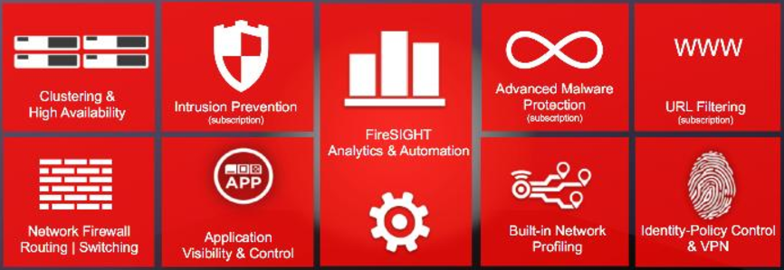






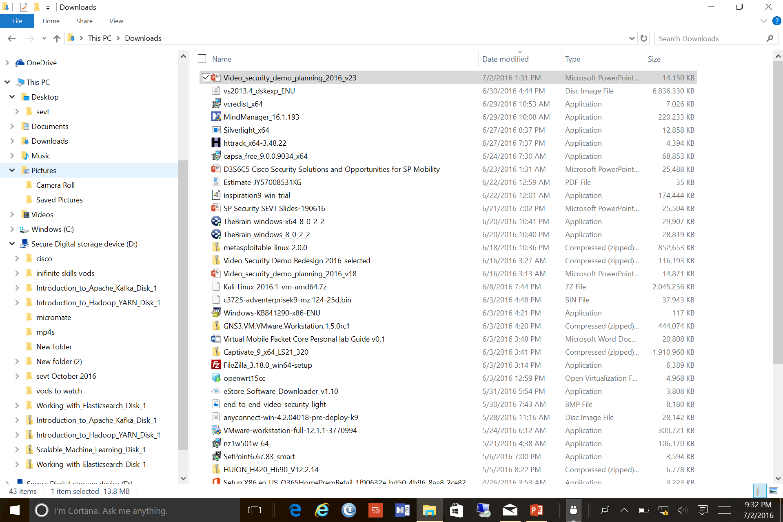





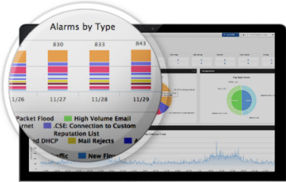
Only Cisco Delivers Comprehensive, Synergistic End-to-End Security
AWS/Azure
V-Firepower
Cisco
Cloudlock
SAAS
The
Internet
Untrusted Nets
Cisco
Umbrella
WEB
DNS
Umbrella
Umbrella
AMP
DNS
Web
File
Cisco DDOS Protection
Allow or..
pxGrid
Nexus/Catalyst
Off Corp.
Corp.
WLAN
Corp.
Wired
Corp. VPN
pxGrid
Force
Web
App
DB
Web
App
DB
Cisco WSA
Cisco ESA
Any
Method
Multi-
Factor
Always
On
Cisco Firepower NGFW
Web
DB
Cisco
Anyconnect
Corp.
Access
Control
App
Web
Web
Web
Web
Web
SSH
SMB
Web
Web
Web
Web
Web
Web
Web
Web
Web
Web
Web
Web
Web
Web
Web
Network Devices
Cisco Firepower
DB
Tablet
Phone
R
A
D
I
U
S
App
ISE
Apply
Policy
Adapt
Policy
pxGrid
Assess
Policy
Web
BYOD
Web
App
DB
Web
App
DB
DB
Data Center Switching Fabric
RADIUS ACCEPT/REJECT/POLICY
App
Endpoint Identity, Context and Policy
Web
MDM
DB
Cisco Software Defined Segmentation
App
Web
GUEST
AAA
Rapid Threat Containment
Network
Behavior
Analysis
 | Sends Telemetry to Stealthwatch
 | Supports pxGrid & Receives Identity Context from ISE
 | AMP Enabled
 | Receives Talos Real Time Threat Updates
Who
What
Where
When
How
pxGrid
Endpoint
Identity &
Context
pxGrid
pxGrid
Cisco Stealthwatch

