Slide 1
Assuring and Troubleshooting Business VPNs with Cisco Orchestrated Assurance powered by Netrounds
John Malzahn – Host, Senior Manager, Cloud and Virtualization Solutions Marketing, Cisco Systems
Song Toh, Senior Product Manager, Cloud and Platform Solutions, Cisco Systems
Mats Nordlund, CEO, Co-founder, Netrounds
Dr. Stefan Vallin, Director of Product Strategy, Netrounds
November 1, 2017

Slide 2




Today’s Presenters
John Malzahn
Senior Manager, Cloud and Virtualization Solutions Marketing,
Cisco Systems
Song Toh
Senior Product Manager, Cloud and Platform Solutions, Cisco Systems
Mats Nordlund
CEO, Co-founder Netrounds
Dr. Stefan Vallin
Director of Product Strategy
Netrounds
Red Hat

Slide 3
Agenda
1
Architecture for Lifecycle Service Automation
2
Cisco’s NSO Solution and Value Proposition
3
Automated Verification of Service Quality with Netrounds
4
Key Concepts, Real World Use Cases, and Demo
5
Summary

Slide 4
Cisco NSO – Our Industry Leading Automation & Orchestration Platform

Slide 5




Key Market Trend Observations
Changing customer behavior and new expectations
Execution at the speed of software
Rapidly changing business models
Agility, DevOps, NFV, SDN, new services platforms
Everything on demand
New services with a press
of a button
Cloud services, virtualization, programmable networks
New ecosystems and
value chains
OTT Co-opetition
All of this requires successful, flexible automation.
But complexity has destroyed many automation initiatives.
Notes:
Let’s set the stage by talking about the business challenges that operators tell us they’re facing today.
First, we’re seeing changing customer behavior and expectations.
More than ever, customers expect speed. They want to be able to capitalize on new opportunities and enter new markets much faster, responding to changes and competition in real time. All of that comes down to agility, and they’re counting on service providers to help give it to them.
When a customer has a need, they can’t wait weeks or months anymore for an operator to design and deploy a new service for them. They need everything on demand, and the ability to implement new network services with the press of a button.
Along these lines, operators are dealing with rapidly changing business models.
New technology innovations like virtualization, programmable networks, and cloud services are changing the way customers do business, as well as their expectations about how they interact with the companies providing services.
New ecosystems and value chains have evolved in the last few years, and if operators are going to support their customers, they need to be able to participate in them.
In this dynamic environment, you may be competing against some of these “over-the-top” (OTT) service and content providers one day while partnering with them the next.
So on the one hand, you need to develop some of the same kinds of capabilities that OTT providers can deliver. On the other hand, you need an infrastructure that’s open and flexible enough to integrate these capabilities into your customers’ evolving business models.
All of this supports a central requirement: the ability to execute at the speed of software.
A good example is the emerging DevOps model that many businesses are adopting, where developers and network operations teams work closely together across the service lifecycle to take ideas from conception to activation in a few weeks --- or even a few days.
That’s the kind of agility customers want, and they’re looking to a range of new technology innovations—network programmability, NFV, SDN, and others—to achieve it.
But as you know, programmability and NFV—not to mention new DevOps models—are very different from the way network service delivery has happened in the past.
It all comes down to automation.
Ideally, you should be able to use programmable networks and virtualized resources to deliver much faster, on-demand services.
But to do that, everything has to be automated—you can’t rely on lengthy, error-prone manual processes and custom OSS coding efforts to set up, change, and tear down network services.
Automation is not a new goal. But the incredible complexity of today’s environments presents a major roadblock to achieving it.
If you look through the stories of operators and enterprises that have tried to automate and not gotten the results they were hoping for, complexity is the biggest reason.

Slide 6
The Four Pillars of Orchestration
1
2
Orchestration Across Multiple Domains
State
Convergence
3
4
Data Models and Data Model Mapping
Orchestrated Assurance
Foundation for Full Lifecycle Service Automation
Notes:
Cisco’s vision for automation and orchestration in programmable networks is captured in this framework which we refer to as four pillars of orchestration.”
This framework details the specific attributes of orchestration required in today’s highly dynamic operator environments. The extends from:
Orchestration Across Multiple Domains,
Stateful Convergence – covering how we need to move from complex service interdependencies and hard-coding to declarative and automated, repeatable, reliable orchestration
Orchestrated assurance, and
Data Models and Data Model Mapping
These are all detailed in a whitepaper “Architecture for Lifecycle Service Automation:” which can be downloaded from our website on cisco.com
We’re talking about how the rapidly evolving role of service orchestration drives fundamental change in assurance. This is a seismic shift, and we argue that the current technologies and best practices around assurance will need to be rethought ground-up.
Today we will taking a deeper dive on a the third pillar Orchestration, Model-driven Automated Assurance.

Slide 7
NSO System Overview
Model-driven end-to-end service lifecycle and customer experience in focus
Seamless integration with existing and future OSS/BSS environment
Loosely-coupled and modular architecture leveraging open APIs and standard protocols
Orchestration across multi-domain and multi-layer for centralized policy and services across entire network
Operations
OSS/BSS
Developers
NSO
Service Manager
Package
Manager
CDB
Device Manager
Device Abstraction
ESC (VNFM)
NED
NED
NED
VNF Lifecycle Manager
VNF Service Monitoring
Multi-domain Networks

Slide 8
Automating Service Delivery
Complexity
Simplicity
Before:
Time-consuming, manual
provisioning processes
Days and weeks to implement
new services
Poor visibility across network
during service activations
Multi-vendor
Network
Orchestration
Comprehensive lifecycle service automation for hybrid networks
After:
70% operational
efficiency increase*
60% reduced time to revenue*
Optimized service and network quality through better visibility
Cisco Network Services Orchestrator (NSO) enabled by Tail-f
Notes:
What’s makes NSO standout is its ability to help you extract simplicity for your network complexity by automating the service delivery function.
Cisco has recently completed a research study about the operational processes of major service provider customers that have automated their environment and shared real-world ROI results. These results are compelling and show how you can address one of your biggest challenges: reducing high operational costs. These operational costs span both legacy and virtual services and infrastructure.
The overall savings in time and motions ranged from 60 to 70 percent, with the related OpEx avoidance from 50 to 70 percent. Over five years, that translated to an ROI of 383 percent and savings of $3 to $16.7 million for Tier 3 to 5 providers. The data for Tier 1 and 2 operators shows an estimated savings over five years that exceed $70 million. These are significant results indeed.
We have white paper detailing the results of this study available on our NSO website if you interested in learning more here.
NSO is also unique in that it works in multi-vendor environments and technology stacks delivering consistent, seamless performance across a broad scope of environments. We have the broadest multivendor support in the industry and constantly adding new vendor drivers to the platform.

Slide 9
Poll 1

Slide 10
Assuring and Troubleshooting Business VPNs with Cisco Orchestrated Assurance powered by Netrounds

Slide 11
How Operators Should Meet Expectations
1
Deliver services right the first time
2
Detect problems from end user point of view
Netrounds Active Testing

Slide 12
Poll 2

Slide 13
Why Active Test and Assurance?
Perform activation tests
Test changes
Monitor from customers’ point of view in real-time
Troubleshoot using automated test sequences
Key requirements
  Multi-layer and multi-domain
  Programmable
  Software-based
Active Test
&
Assurance
1
2
3
Automation &
Orchestration
FM
PM
For efficient network operations, all of the above must be combined

Slide 14
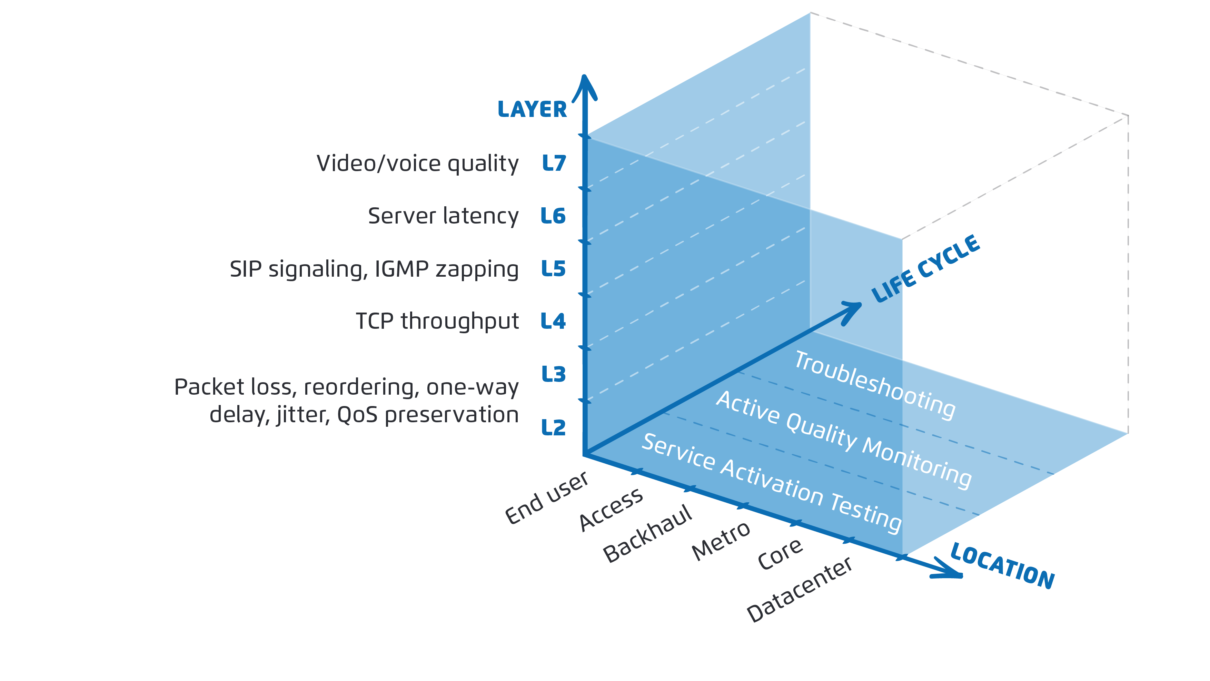
Active Test and Assurance Dimensions

Slide 15
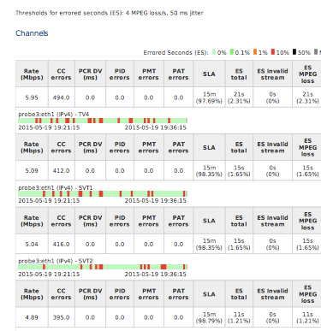
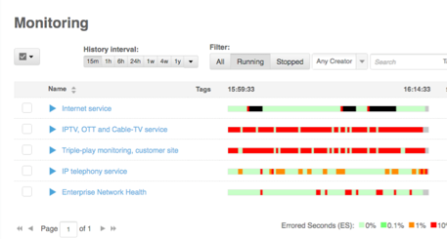
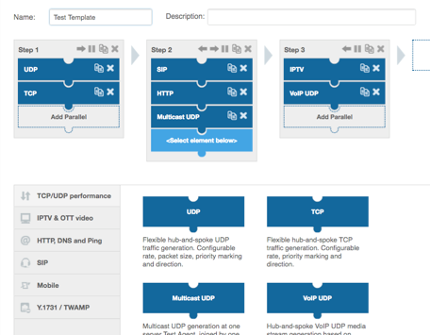
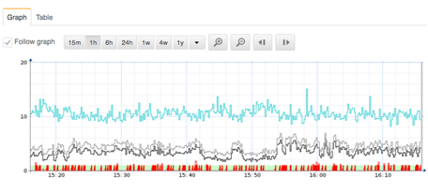

What Do You Get With Netrounds?
Test Delivered Services
Discover Issues Earlier
Resolve Problems Faster
Service activation tests with birth certificate reports
Real-time SLA dashboard with service KPI drill-down
Interactive test sequence builder with remote execution

Slide 16
Problems Identified by Netrounds – Examples
IP Core and Mobile Backhaul Performance
Dynamic and Managed VPN Services
Digital TV and Voice Transport
  Detect underperforming links
  Detect link latency issues
  Segment problem links
  Automate service activation testing
  Validate VNF service chains
  Find poor off-net connections
  Spot problems along delivery chain
  Isolate problems in end-users’ premises
Netrounds works across network domains and network layers
Notes:
Mention that many of the examples are applicable in multiple solution areas

Slide 17


Use Case – Global Business VPN Throughput
Problem
Outcomes Achieved with Netrounds
Before
CIR
Stable TCP throughput for all customers
Low TCP throughput
After
Network counters and indicators look good, no signs of QoS degradation
CIR
Customer experience built
into the delivery process
Upon optimizing queue management at PE, TCP performs steadily at CIR (50Mbps)
Customer dissatisfaction with basic network services
Customer experience increased, decreased OPEX, new revenue opportunities
Notes:
Good slide to distribute in the PDF version, but normally don’t speak to it.
Major World-Wide Operator
VPN for a large customer spanning multiple of continents
Major problems with TCP throughput between sites

Slide 18
Use Case – Off-net Enterprise VPN QoS
Problem
Outcomes Achieved with Netrounds
Severe customer complaints regarding Quality of Service
Problems with DSCP mappings and QoS between operators solved
Unknown quality of new branch site VPN deliveries
Thorough verification with activation test reports
Endless escalation meetings with high
churn risks
Fewer customer complaints and trouble tickets
Notes:
Good slide to distribute in the PDF version, but normally don’t speak to it.
Major European Operator
Large customer with VPN crossing multiple of operators.
Major problems with Quality of Service in the VPN.
Solution:
Process changed to include SAT testing from Netrounds.
Faults captured already during installation.

Slide 19
Netrounds System Overview
Multi-layer
1
Netrounds Control Center
2
Programmable
L7
Video/Voice Quality
L6
Server Latency
Cisco NSO
L5
TCP Throughput
NETCONF/YANG
REST
L4
Web GUI
L3
Loss, Delay, Jitter
L2
QoS Preservation
Smart SFP
Management
Video
HTTP
DNS
SIP
Router/Switch
TWAMP / Y. 1731
Active Traffic
Service Requests
eNodeB
Software
3
Reflectors
Netrounds Active Test Agents
Server content
Notes:
Don’t forget to talk about todays deployments. There is a risk we are considered NFV only. Shared test agents, preinstalled, TWAMP.
Talk about bare metal install on Cisco UCS.
Talk about shared central agents.
Don’t scare the audience of virtual agents all over…

Slide 20

Fulfillment and Assurance Challenges
Disconnect between
Fulfillment and Assurance
Sub-optimal activation testing
DO NOTHING
SIMPLE PING
FIELD EFFORTS
$$$
Limited insight of true end user experience
THE IMPOSSIBLE MAPPING MACHINE
Fear the Mapping Machine!
END USER EXPERIENCE

Slide 21
The Two Disconnected Lists
Alarms
Customer Care
Prio | Alarm
1 | Antenna light malfunctioning
2 | Router STH-ES4 down
3 | Link failure, GE7.1.1
4 | Node GBG-18 not responding
5 | Bad link detected
6 | Encoding error on receiver
<void>
Prio | Customer
1 | The Big Bank
2 | Best Motor Ltd
3 | Alpine Fruit
4 | Night Microsystems
5 | Wizard Solutions
6 | Lagoon Electronics
7 | Diamond Burgers
8 | Thunderking
9 | Jetshow
…
…
7228 | Log file rotation error
7229 | Unknown format detected
<void>
Notes:
Top arrow: Too many alarms without any related customer problems
Lower arrow: Lack of relevant alarms pinpointing a specific customer’s problem

Slide 22
Orchestrated Fulfillment and Assurance
Fulfillment
Assurance
Service Activation
Service Operation
Service Activation Test
Enable Active SLA Monitoring
Notes:
BLUE = MANUAL EFFORT

Slide 23
A Process View Example
Fulfillment
Assurance
Service Activation
Service Operation
Active SLA Monitoring
Service Activation Test
Service Restoration
Test Service
Configuration issue
Service Restoration
Test Service
Trouble-shoot
Analyze
Issue
Fix
Test Service
Connectivity issue
*Blue sections = Manual efforts
Notes:
BLUE = MANUAL EFFORT

Slide 24
Demo Time!

Slide 25
Demo Step 1: Activation and Enable Monitoring
Design-time
Run-time
Activation traditionally considered completed here
Service Design
Service Activation
Configure Devices
Activation
Test
Enable Active
Monitoring
NSO
NSO
NSO
NSO
YANG models
Service logic
Configure devices and built-in O&M
Run activation test template
Turn on active monitoring template
Netrounds Control Center
Devices
Netrounds Control Center
Netrounds Control Center
Devices
Device
Test template
Monitor template

Slide 26
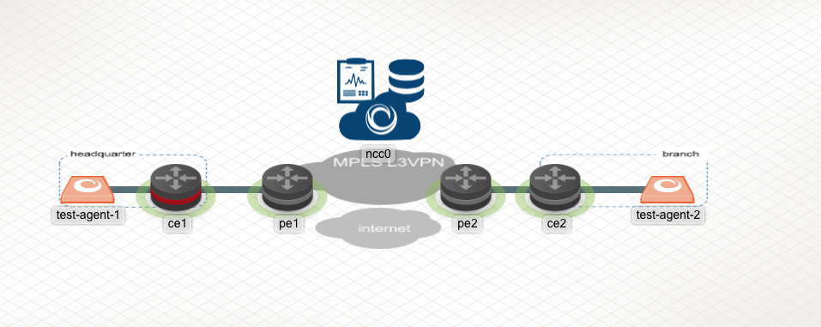
Adding 10% One-way Packet Loss in Best Effort
10% loss

Slide 27
Demo Step 2: Troubleshoot
Service Operation
Active SLA Monitoring
Service Restoration
Test Service
Service Troubleshooting
Analyze
Issue
Fix
Test Service
No configuration issue
*Blue sections = Manual efforts
Policy in
NSO triggered
NSO
Check config
(redeploy?)
NSO
NSO
Troubleshooting report
Run activation
test
Run troubleshooting test
SLA violation
Netrounds Control Center
Netrounds Control Center
Netrounds Control Center
Notes:
ORANGE = MANUAL

Slide 28
Poll 3

Slide 29
Summary

Slide 30
Wrapping It All Up
Service design
Test design
Create, modify & delete service instance
Run activation tests
VERIFY PACKAGE
MONITOR
Service model
Service logic
Netrounds
templates
CREATE PLAN
RELEASE CONFIGURE
DEV
OPS
Ongoing service monitoring
Detect SLA violation
Troubleshoot
Heal
Retest
Execute
service tests
NSO package
Publish Netrounds
template

Slide 31




What You Gain with Cisco Automation
Agility throughout service lifecycle
Full automation
Robust and proven in tier-1 deployments
Industry’s broadest multivendor support
Most scalable service orchestration
ETSI MANO compliant NFVO, VNFM
Relevant in today’s and tomorrow’s networks
Notes:
Let’s review what you gain with Cisco NSO and Netrounds.
First, I hope I’ve demonstrated the kind of agility you can achieve with this solution. That agility extends across the service lifecycle—not just when you implement a service, but when you refine it over its lifetime as well.
We do this through our model-driven approach, with strict YANG-YANG service-to-device mapping, which allows you to model and automate just about any device or service you can imagine.
This is something you’re not going to get with other orchestration solutions, which are based on much less flexible CLI templates that limit what you can model and create a lot of complexity.
Our patented FASTMAP technology enables NSO to render business logic for all of the devices and services in your environment automatically. Which translates to greatly increased speed, and 90% less code that you have to manage.
And our minimum diff engine makes re-deploying and updating service and device models effortless, with no service interruption.
We can support new ways of working, and provide an ideal platform for DevOps environments.
From the perspective of your network operations teams, we give them access to all of the advanced features and functions in their multivendor network devices.
Unlike today, where it’s common to invest in a new physical or virtual device, only to find that you can’t implement all the features you want because your management and orchestration systems are hard-coded and inflexible.
And this has a direct effect on your ability to differentiate, because it means you can offer the most advanced capabilities, as well as create unique bundles with value-added services that your competitors relying on less advanced orchestration can’t support.
We’ve talked about how we can deliver true end-to-end automation, even in complex environments and for complex services.
This is what allows you to give your customers self-service network provisioning on demand.
And it’s what brings your cycle times down from weeks or months to days or minutes.
We discussed how NSO is a robust, proven solution that’s running today in large, Tier-1 operator environments around the world.
And I showed you how we provide the broadest multivendor support in industry, which is so crucial to your ability to automate network services in real-world networks.
Last but not least, NSO is equally relevant in today’s operator environments as well as tomorrow’s.
We can automate the programmable networks of today, and deliver significant improvements in speed, efficiency, and agility.
But we can bring the same benefits to the virtualized and elastic environments of the future as well.
This is so important, because the last thing you want to do is build a silo of new equipment and OSSs on top of an isolated legacy environment.
NSO can help you dramatically improve your agility with your legacy environment right now, and integrate newer NFV and SDN technologies whenever you choose.

Slide 32
For More Information
Visit:
www.cisco.com/go/nso
www.orchestratedassurance.net
and contact your Cisco and Netrounds account representatives
Notes:
Thank you for spending time with us today. We look forward to working with you in this fast growing market.
To learn more visit the Cisco and Netrounds sites below or contact your Cisco and Netrounds account representatives
representatives

Slide 33

Questions

