Slide 1
ACI Multi-Site Architecture and Deployment
Max Ardica
Principal Engineer - INSBU

Slide 2
Agenda
ACI Network and Policy Domain Evolution
ACI Multi-Site Deep Dive
    Overview and Use Cases
    Introducing ACI Multi-Site Policy Manager
    Inter-Site Connectivity Deployment Considerations
    Migration Scenarios
Conclusions and Q&A

Slide 3
ACI Network and Policy Domain Evolution

Slide 4


Cisco ACI
Fabric and Policy Domain Evolution
ACI Single Pod Fabric
ACI Stretched Fabric
ACI Multi-Pod Fabric
ACI Multi-Site
Pod ‘A’
IPN
Pod ‘n’
Fabric ‘A’
IP
Fabric ‘n’
DC1
APIC Cluster
DC2
MP-BGP - EVPN
MP-BGP - EVPN
…
…
APIC Cluster
ACI 1.0 Leaf/Spine Single Pod Fabric
ACI 1.1 Geographically Stretch a single fabric
ACI 2.0 - Multiple Networks (Pods) in a single Availability Zone (Fabric)
ACI 3.0 - Multiple Availability Zones (Fabrics) in a Single Region ’and’ Multi-Region Policy Management
…more to come!

Slide 5
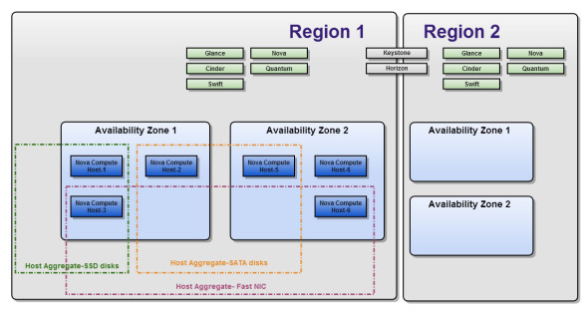
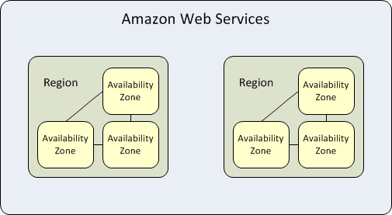
Regions and Availability Zones
OpenStack and AWS Definitions
OpenStack
Regions - Each Region has its own full OpenStack deployment, including its own API endpoints, networks and compute resources
Availability Zones - Inside a Region, compute nodes can be logically grouped into Availability Zones, when launching new VM instance, we can specify AZ or even a specific node in a AZ to run the VM instance
Regions – Separate large geographical areas, each composed of multiple, isolated locations known as Availability Zones
Availability Zones - Distinct locations within a region that are engineered to be isolated from failures in other Availability Zones and provide inexpensive, low latency network connectivity to other Availability Zones in the same region
Amazon Web Services

Slide 6
Terminology
Pod – A Leaf/Spine network sharing a common control plane (ISIS, BGP, COOP, …)
  Pod == Network Fault Domain
Fabric – Scope of an APIC Cluster, it can be one or more Pods
  Fabric == Availability Zone (AZ) or Tenant Change Domain
Multi-Pod – Single APIC Cluster with multiple leaf spine networks
  Multi-Pod == Multiple Networks within a Single Availability Zone (Fabric)
Multi-Fabric – Multiple APIC Clusters + associated Pods (you can have Multi-Pod with Multi-Fabric)*
  Multi-Fabric == Multi-Site == a DC infrastructure Region with multiple AZs
* Available from ACI release 3.1
6

Slide 7



Typical Requirement
Creation of Two Independent Fabrics/AZs
Fabric ‘A’ (AZ 1)
Fabric ‘B’ (AZ 2)
Application workloads deployed across availability zones

Slide 8

Creation of Two Independent Fabrics/AZs
Deployment of Two (or More) Pods per Fabric/AZ
Fabric ‘A’ (AZ 1)
‘Classic’ Active/Active
Pod ‘1.A’
Pod ‘2.A’
Fabric ‘B’ (AZ 2)
‘Classic’ Active/Active
Pod ‘1.B’
Pod ‘2.B’

Slide 9
ACI Multi-Site Deep Dive

Slide 10
Overview and Use Cases

Slide 11


ACI 3.0 Release
ACI Multi-Site
Overview
VXLAN
IP Network
MP-BGP - EVPN
REST
API
GUI
Availability Zone ‘A’
Availability Zone ‘B’
Region ‘C’
Separate ACI Fabrics with independent APIC clusters
ACI Multi-Site pushes cross-fabric configuration to multiple APIC clusters providing scoping of all configuration changes
MP-BGP EVPN control plane between sites
Data Plane VXLAN encapsulation across sites
End-to-end policy definition and enforcement

Slide 12

ACI Multi-Site
Network and Identity Extended between Fabrics
Network information carried across Fabrics (Availability Zones)
Identity information carried across Fabrics (Availability Zones)
VTEP IP
VNID
Class-ID
Tenant Packet
No Multicast Requirement in Backbone, Head-End Replication (HER) for any Layer 2 BUM traffic)
IP Network
MP-BGP - EVPN

Slide 13
ACI Multi-Site
Namespace Normalization
Translation of Class-ID, VNID (scoping of name spaces)
Translation of Source VTEP address
IP Network
MP-BGP - EVPN
…
Site 1
Site to Site VTEP traffic (VTEPs, VNID and Class-ID are mapped on spine)
Site n
Leaf to Leaf VTEP, Class-ID is local to the Fabric
Leaf to Leaf VTEP, Class-ID is local to the Fabric
VTEP IP
VNID
Class-ID
Tenant Packet
VTEP IP
VNID
Class-ID
Tenant Packet
VTEP IP
VNID
Class-ID
Tenant Packet
Maintain separate name spaces with ID translation performed on the spine nodes
Requires specific HW on the spine to support for this functionality

Slide 14


ACI Multi-Site
Hardware Requirements
Support all ACI leaf switches (1st Generation, -EX and -FX)
Only -EX spine nodes (or newer) to connect to the inter-site network
New FX non modular spine (9364C, 64x40G/100G ports) will be supported for Multi-Site in Q1CY18 timeframe
1st generation spines (including 9336PQ) not supported
  Can still leverage those for intra-site leaf to leaf communication
IP Network
Can have only a subset of spines connecting to the IP network
1st Gen
1st Gen
-EX
-EX

Slide 15

ACI Multi-Site
The Easiest DCI Solution in the Industry!
Communication between endpoints in separate sites (Layer 2 and/or Layer 3) is enabled simply by creating and pushing a contract between the endpoints’ EPGs
IP
Site 1
Site 2
DP-ETEP A
DP-ETEP B
S1
S2
S3
S4
S5
S6
S7
S8
EP1
EP2
Define and push inter-site policy
= VXLAN Encap/Decap
EP1 EPG
C
EP2 EPG

Slide 16

ACI Multi-Site
CloudSec Encryption for VXLAN Traffic
Encrypted Fabric to Fabric Traffic
[ GCM-­AES-­128 (32-bit PN), GCM--AES-­256 (32-bit PN), GCM-AES-128­-XPN (64-bit PN), GCM-AES-­256­-XPN (64-bit PN)])
VTEP Information Clear Text
VTEP IP
MACSEC
VXLAN
Tenant Packet
IP Network
MP-BGP - EVPN
Future Support planned in CY18 for FX line cards and 9364C platform

Slide 17

ACI Multi-Site Networking Options
Per Bridge Domain Behavior
Layer 3 only across sites
IP Mobility without L2 flooding
Full Layer 2 and Layer 3 Extension
L3
L3
L3
Site 1
Site 2
Site 1
Site 2
Site 2
Site 1
Site 2
Bridge Domains and subnets not extended across Sites
Layer 3 Intra-VRF or Inter-VRF communication only
Same IP subnet defined in separate Sites
Support for IP Mobility (‘cold’ VM migration) and intra-subnet communication across sites
No Layer 2 flooding across sites
Interconnecting separate sites for fault containment and scalability reasons
Layer 2 domains stretched across Sites (Support for ‘hot’ VM migration)
Layer 2 flooding across sites

Slide 18
Introducing ACI Multi-Site Policy Manager

Slide 19
ACI Multi-Site
Multi-Site Policy Manager
Micro-services architecture
  Multiple VMs are created and run concurrently (active/active)
  vSphere only support at FCS (KVM and physical appliance support scoped for future releases)
OOB Mgmt connectivity to the APIC clusters deployed in separate sites
  Support for 500 msec to 1 sec RTT
Main functions offered by ACI Multi-Site:
  Monitoring the health-state of the different ACI Sites
  Provisioning of day-0 configuration to establish inter-site EVPN control plane
  Defining and provisioning policies across sites (scope of changes)
  Inter-site troubleshooting (post-3.0 release)
REST
API
GUI
ACI Multi-Site
VM
VM
VM
Hypervisor
…..
Site 1
Site 2
Site n

Slide 20
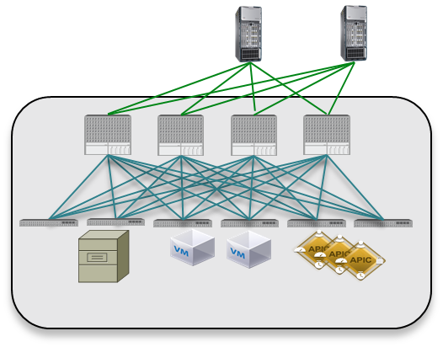
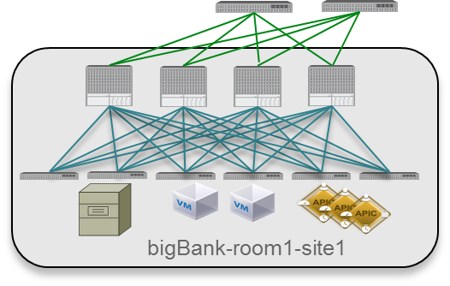

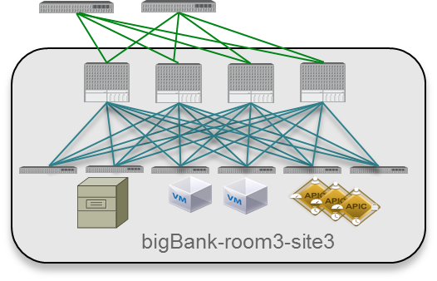

ACI Multi-Site
Deployment Considerations
Intra-DC Deployment
Interconnecting DCs over WAN
New York
Site3
IP Network
WAN
Milan
Site1
Rome
Site2
Hypervisor
Hypervisor
Hypervisor
VM
VM
VM
ACI Multi-Site
Hypervisor
ACI
Multi-Site
Hypervisor
VM
VM
VM
Hypervisors can be connected directly to the DC OOB network
Each ACI Multi-Site VM has a unique routable IP
Async calls from ACI Multi-Site to APIC
Moderate latency (~150 msec) supported between ACI Multi-Site nodes
Higher latency (500 msec to 1 sec RTT) between ACI Multi-Site nodes and remote APIC clusters
If possible deploy a node in each site for availability purposes (network partition scenarios)

Slide 21
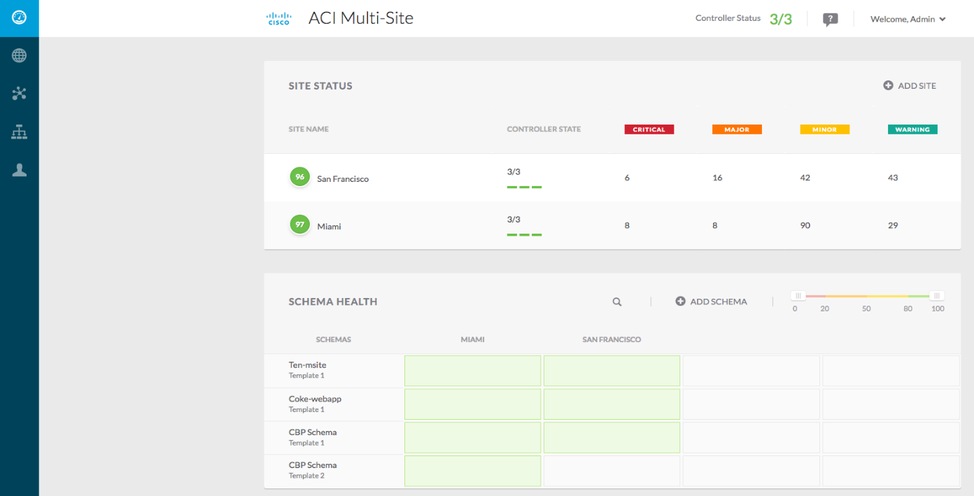
ACI Multi-Site
Dashboard
Health/Faults for all managed sites
Easily way to identify stretched policies across sites
Quickly search for any deployed inter-site policy
Provide direct access to the APIC GUIs in different sites

Slide 22
ACI Multi-Site
Templates and Profiles
Profile
Template = APIC policy definition
(App & Network)
Template is the scope/granularity
of what can be pushed to sites
Template is associated to all managed sites or a subset of sites
Profile = Group of Templates sharing a common use-case
Scope of change: policies can be pushed to separate sites at different times
Template
Template
POLICY
DEFINITION
EP1 EPG
C
EP2 EPG
SITE
LOCAL
Site 1
Site 2
EFFECTIVE
POLICY
EFFECTIVE
POLICY

Slide 23


APIC vs. ACI Multi-Site Functions
Central point of management and configuration for the Fabric
Responsible for all Fabric local functions
  Fabric discovery and bring up
  Fabric access policies
  Service graphs
  Domains creation (VMM, Physical, etc.)
  …
Integration with third party services
Maintains runtime data (VTEP address, VNID, Class_ID, GIPo, etc.)
No participation in the fabric control and data planes
Complementary to APIC
Provisioning and managing of “Inter-Site Tenant and Networking Policies”
Scope of changes
  Granularly propagate policies to multiple APIC clusters
Can import and merge configuration from different APIC cluster domains
End-to-end visibility and troubleshooting
No run time data, configuration repository
No participation in the fabric control and data planes

Slide 24
Inter-Site Connectivity Deployment Considerations

Slide 25


ACI Multi-Site
Inter-Site IP Network Requirements
Site ‘A’
IP
Site ‘n’
MP-BGP EVPN
…
Not managed by APIC, must be separately configured (day-0 configuration)
IP topology can be arbitrary, not mandatory to connect to all spine nodes, can extend long distance (across the World)
Main requirements:
  OSPF on the first hop routers to peer with the spine nodes and exchange site specific E-TEP reachability
  Increased MTU support to allow site-to-site VXLAN traffic

Slide 26
Connecting to the External Layer 3 Domain

Slide 27

Connecting ACI to Layer 3 Domain
‘Traditional’ L3Out on the BL Nodes
Client
PE
PE
WAN
L3Out
PE
PE
Connecting to WAN Edge devices at Border Leaf nodes
  Definition of a L3Out logical construct
VRF-lite hand-off for extending L3 multi-tenancy outside the ACI fabric
  Each tenant defines one (or more) L3Out with a set of Logical Nodes, Logical Interfaces, peering protocol
VRF-Lite Hand-off
Border Leafs

Slide 28





Multi-Site and Traditional L3Out
BD1
L3Out-1
BD2
Basic assumption: every site defines its local L3Out connection
EPG Web1
L3Out-2
EPG Web2
3
C1
C2
2
4
2
IP Network
ExtEPG-1
ExtEPG-2
Site 1
Site 2
1
1
L3Out-1
BL Nodes
Routing Protocol
Route policy
ExtEPG-1
L3Out-2
BL Nodes
Routing Protocol
Route policy
ExtEPG-1
EPG Web1
C1
ExtEPG-1
EPG Web2
C2
ExtEPG-2
5
5

Slide 29
Multi-Site and Traditional L3Out
Stretched BD
BD
L3Out-1
L3Out-2
Basic assumptions: every site defines its local L3Out connection
EPG Web
C1
IP Network
ExtEPG-1
ExtEPG-2
Site 1
Site 2
EPG Web
C1
ExtEPG-1
EPG Web
C1
ExtEPG-2

Slide 30
For More Information on GOLF Deployment:
LABACI-2101
Connecting ACI to Layer 3 Domain
‘GOLF’ Design
Client
= VXLAN Encap/Decap
PE
PE
WAN
PE
PE
MP-BGP EVPN
DCI
GOLF Routers (ASR 9000, ASR 1000, Nexus 7000)
OpFlex
OTV/VPLS
Direct or indirect connection from spines to WAN Edge routers
Better scalability, one protocol session for all VRFs, no longer constraint by border leaf HW table
VXLAN handoff with MP-BGP EVPN
Simplified tenant L3Out configuration
Support for host routes advertisement out of the ACI Fabric
VRF configuration automation on GOLF router through OpFlex exchange

Slide 31

GOLF and Multi-Site Integration
Centralized and Distributed Models
Centralized GOLF Devices*
Distributed GOLF Devices
WAN
WAN
GOLF Routers
GOLF Routers
GOLF Routers
MP-BGP EVPN
MP-BGP EVPN
MP-BGP EVPN
MP-BGP EVPN
Common when ‘sites’ represent rooms/halls in the same physical DC
MP-BGP EVPN peering required from spines in each fabric and the centralized WAN Edge devices
‘Sites’ represent separate physical DCs
Local only MP-BGP EVPN peering between spines and GOLF router
*Supported post-FCS

Slide 32

GOLF and Multi-Site Integration
Inter-DC Scenario with Stretched BD
WAN Edge devices inject host routes into the WAN or register them in the LISP database
Host routes for endpoint belonging to public BD subnets in Pod ‘A’
Host routes for endpoint belonging to public BD subnets in Pod ‘B’
MP-BGP EVPN Control Plane
MP-BGP EVPN Control Plane
Site ‘A’
IPN
Site ‘B’

Slide 33

GOLF and Multi-Site Integration
Inter-DC Scenario with Stretched BD (2)
Remote Router Table
Granular inbound path optimization( host route advertisement into the WAN or integration with LISP)
10.10.10.10/32
G1,G2
10.10.10.11/32
G3,G4
G1,G2 Routing Table
10.10.10.0/24
A
WAN
G3,G4 Routing Table
10.10.10.10/32
A
10.10.10.0/24
B
10.10.10.11/32
B
IPN
Proxy A
Proxy B
10.10.10.10
10.10.10.11

Slide 34
Migration Scenarios

Slide 35




ACI Multi-Site
Migration Paths
Fabric 1
‘Brownfield’ ACI Fabric to Multi-Site
Site 1
Site 2
Pod ‘A’
Pod ‘B’
Multi-Pod to ‘Hierarchical Multi-Site’
Pod ‘A’
Pod ‘B’
Site 2
APIC Cluster
APIC Cluster
Multi-Pod
Planned for Q1CY18
Site 1
Fabric 1
Fabric 2
Multi-Fabric Design to Multi-Site
Inter-Site App
Site 1
Site 2
L2/L3 DCI
Multi-Fabric
Scoped for the future

Slide 36
Conclusions and Q&A

Slide 37

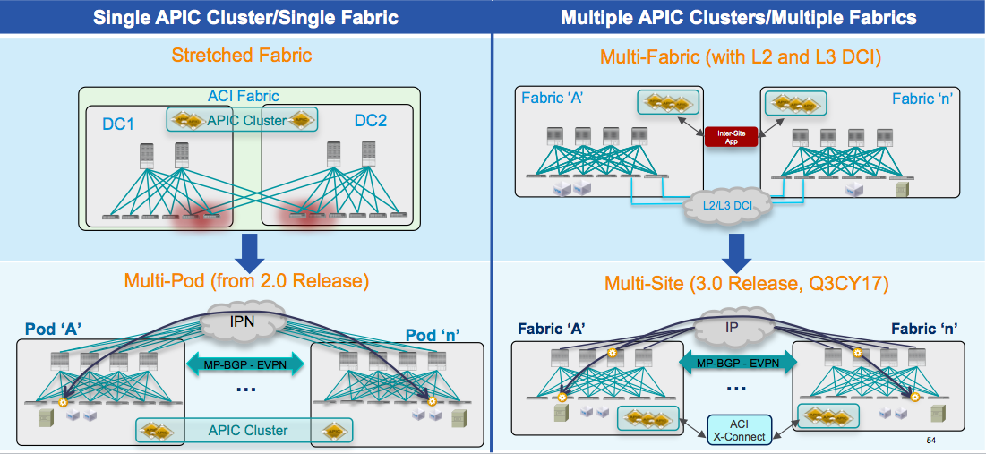

Conclusions
Cisco ACI offers different multi-fabric options that can be deployed today
There is a solid roadmap to evolve those options in the short and mid term
  Multi-Pod represents the natural evolution of the existing Stretched Fabric design
  Multi-Site will replace the Dual-Fabric approach
Cisco will offer migration options to drive the adoption of those new solutions
MP-BGP EVPN
MP-BGP EVPN

Slide 38


Where to Go for More Information
ACI Stretched Fabric White Paper
  http://www.cisco.com/c/en/us/td/docs/switches/datacenter/aci/apic/sw/kb/b_kb-aci-stretched-fabric.html#concept_524263C54D8749F2AD248FAEBA7DAD78
ACI Multi-Pod White Paper
  http://www.cisco.com/c/en/us/solutions/collateral/data-center-virtualization/application-centric-infrastructure/white-paper-c11-737855.html?cachemode=refresh
ACI Multi-Site Cisco Live Las Vegas 2017
  https://www.ciscolive.com/online/connect/sessionDetail.ww?SESSION_ID=95450&backBtn=true
ACI Multi-Site White Paper
  https://www.cisco.com/c/en/us/solutions/collateral/data-center-virtualization/application-centric-infrastructure/white-paper-c11-739609.html

