Slide 1



Three Keys to IP Transformation in Media and Entertainment: Agility, Simplicity, Security
Cisco Knowledge Network
Yoav Schreiber, Roger Sherwood, Samira Panah
May 17, 2017

Slide 2





Cisco at NAB 2017
Media Blueprint Solutions
Customer and Industry Momentum
IP Fabric for Media
Next Gen Data Center
Acquisition | Production | Security | Distribution | Consumer Experience
Security for Media
Virtualized Video Processing
Infinite Video Platform
Notes:
Global customer adoption of Cisco Media Blueprint solutions

Slide 3
The Media Industry by 2021
Media production shifting to IP and Cloud
Every screen becomes a TV
More premium content across more platforms
64%
8.4
82%
of cloud data center traffic will be video and storage*
billion connected video devices
of IP traffic from video*
Source: Cisco Visual Networking Index; Cisco Global Cloud Index, Cisco Mobile Visual Networking Index
* VNI Research for years 2015-2020
Notes:
Broadcast video functions and processes shifting to IP and cloud/virtualization
Every screen is now a TV; Increasingly personalized video experiences across devices
More video content and formats will be created and delivered across more platforms to reach more eyeballs

Slide 4





There’s Never Been a Better Time to Transform Entertainment
Migrate Live Production to IP
  Migrate Live Production to IP
Accelerate Media Operations
  Broadcast Centers and Studios
  Live Event Venues and Stadiums
  Outside Broadcast Trucks
www…
Evolve Satellite Distribution to IP
Adopt New Security Approaches
  Creation
  Delivery
  Processing
  IP
  Storage
Notes:
These are objectives for companies
The industry has already bought into the shift from SDI to IP. Everywhere we see the trends of moving to IP and Cloud for production to distribution.
The key question is how to make that transition. Customers want a reliable partner to take them there
http://wwwin.cisco.com/c/cec/news/global-employee-headlines/the-scoop-on-cisco-live-berlin.html

Slide 5
Cisco Strategy for IP Transition
  Comprehensive Approach
Business Outcomes
  Flexibly scale production
  and distribution
  Automated Architecture
  IP Foundation
  Rapidly deliver new services
  and reach new segments
  Multi-layered protection from cyber threats and online piracy
  Holistic Security
  Ecosystem
  Simplify configuration and operation
Notes:
Cisco is the only vendor that offers the most comprehensive approach for media’s transition to IP: from IP Fabric to data center to applications to ecosystem to security. No one else can offer as much in the transition to IP.
5 digital principals for how we will prioritize our company alignment and investments. They are:
· Simplification
· Automation
· Security
· Analytics
· Continuous Innovation

Slide 6



Cisco Open Network Architecture for Media
Live 4K
OTT
Mixed Reality
Cloud-based Applications and Services
Public | Private Cloud and/or On-Prem
Platforms
Security
Open APIs
Service Enablement
Infrastructure and Network Abstraction
Physical | Virtual
Notes:
Cisco takes a multi-layered approach (Infrastructure, Platforms, Applications) to developing technologies, accelerating enablement of media services.
Infrastructure: solutions for the media networking that enable key attributes such as high performance, low latency, reliability
Platforms: service enablement capabilities tied into the underlying infrastructure layer
Applications: create new experience & services only possible over an IP network.

Slide 7

Market Leadership Matters
No. 1
Routing
Edge/Core/ Access
No. 1
TelePresence
No. 1
Wireless LAN
50%
47%
50%
No. 2
x86 Blade Servers
No. 1
Web Conferencing
No. 1
Switching
Modular/Fixed
29%
65%
43%
No. 1
Storage Area Networks
No. 1
Voice
No. 1
Security
47%
41%
31%
Notes:
Cisco is the only company with market share leadership across all industry segments as shown on this slide. We have a diverse product portfolio from collaboration to data center to cloud to security to Unified Computing. And this touches on just a few of our product categories—all of which we deliver as integrated architectures, creating a platform for long-term stability and success. Not only for our Cisco, but our customers and partners as well.
We also offer a range of Services from strategic planning to superior product support—helping your plan, build, and manage the solutions you need to win in your market. We also touch the enterprise, service provider, and public sector.
Plus, our unmatched expertise in networking technology transitions makes us uniquely positioned to help customers capture the value of the Internet of Everything. And only Cisco connects the unconnected with an open standard, integrated architecture from the cloud to end devices.
Based on our rich history—and success in the market—connecting the unconnected is what we do best. And we will continue to strive to be No. 1 in all of our markets.

Slide 8
Cisco Media Blueprint Solutions
Acquisition
Production
Distribution
Consumer Experience
IP Fabric for Media
Next Gen Data Center
Virtualized Video
Processing
Infinite Video Platform
Infrastructure Security
VideoGuard Everywhere
Content & Service Protection
Notes:
Do we want to pitch VGE as brand for media or SPP?

Slide 9

Cisco at NAB 2017
Media Blueprint Solutions
IP Fabric for Media
Next Gen Data Center
Security for Media
Virtualized Video Processing
Infinite Video Platform

Slide 10













Future-Proof Foundation for Media Production
Migrate Live Production to IP
  Multiple Applications for Live Broadcasting
Simplified Operations with SDN Controller
Visibility into network flows from source to destination
Reliability with path optimization and non-blocking
Security through end-point admission
  Broadcast Centers and Studios
  Live Event Venues and Stadiums
  Outside Broadcast Production Trucks
Flexible Deployment Options
Any Environment and Scaling Requirement
Fast Implementation with Ecosystem Integration
Spine-Leaf
Modular Switch

Slide 11





Cisco IP Fabric for Media
High Level Architecture
Industry Broadcast Controller
Sources
Destinations
Open
standards-based
API
Network Orchestration
Network Abstraction
Cisco DCNM Network Controller
Robust IP Network Built on
Cisco Nexus

Slide 12

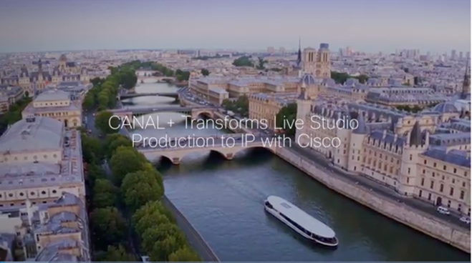
IP Fabric for Media
Customer Video
Live IP Production
Deployed in 4 months to rapidly bring studios on-air
Future-ready infrastructure
Cisco Nexus 9K
Cisco Data Center Network Manager
Advanced Services
Partners: Grass Valley, Videlio
Case Study

Slide 13
Cisco at NAB 2017
Media Blueprint Solutions
IP Fabric for Media
Next Gen Data Center
Security for Media
Virtualized Video Processing
Infinite Video Platform

Slide 14



Software-Defined Media Infrastructure
Model workloads and create workflows with a consistent set of operation policies across multiple clouds
4K Live Production
Scale-out Storage
Playout
Automated Transcode
Distribution
Next Gen Data Center
Security
Kubernetes
VMware
Open APIs
Cisco UCS
Bare Metal
IP Fabric for Media
Data Center Network Manager
Nexus Series
SDN Controller

Slide 15
Cisco UCS S-Series and SwiftStack
Scalable Object Storage for Media
Massive Capacity
600TB Data storage capacity in 4U
Accelerate Workflows
SwiftStack optimization to support distributed software-defined storage workflows
I/O Flexibility
40Gb Cisco Virtual Interface Card (VIC) Technology
Total Automation
Scale to Petabytes in minutes with UCS Manager
Significant Benefits Compared to Conventional 2RU Servers
    34%
    Lower
    CapEx
    80%
    Lower Ongoing
    Management
    70%
    Less
    Cabling
    60%
    Less
    Space
    59%
    Lower
    Power
Notes:
Massive 600TB data storage capacity
Scale to Petabytes in minutes with UCS Manager
Faster network access with 40Gb VIC support

Slide 16
Cisco at NAB 2017
Media Blueprint Solutions
IP Fabric for Media
Next Gen Data Center
Security for Media
Virtualized Video Processing
Infinite Video Platform

Slide 17
Growing Incentive for Attackers
Motivation
Execution
Impact
Exploit: $100K-$300K
Credit card data: $0.25-$60 / record
Pirate TV: $6-$25 / month subscription
15 minutes to build a botnet
100% of companies connect with malware hosting websites
HD to 400 clients on cloud Virtual Private Server with 1Gbps uplink
100-200 days to detect attacks
60% of data stolen in hours
Cybercrime market $450B – $1T
Notes:
Looking at the situation from the angle of the attackers, we see that the dynamics are in their favor – so we can expect the challenges for the media business to continue growing.
Motivation: attackers have financial incentive to hack and pirate.
A hacker can get up to $300K for finding and reporting a software exploit – a way to overcome the security defenses of a product or platform – either selling the information to a government or receiving a bounty from the company whose vulnerability has been identified for reporting it to them first – Apple and Google, for example, have such bounty programs.
Stolen consumer data also has a currency
And pirates can make significant profits selling video streaming services from stolen content – sometimes the consumers don’t even realize that the service is illegitimate.
Execution: easier than ever – there are many more ways in, and with tools and guidance available online, there’s no need to be a technical whiz to carry out an attack
[to complete]
Impact: Attacks today are stealthy and multi-pronged, meaning there’s a greater chance of success for hackers and negative impact on businesses.
First, companies are struggling to address the flood of security alerts they see, not to mention what they don’t see. The Cisco 2017 Security Capabilities Benchmark Study found that 44% percent of security alerts received by an organization any given day are not investigated. Among the investigated alerts, less than half of those deemed legitimate are remediated.
Hackers have devised ways to evade detection once they have found a way in, giving ample time to gather reconnaissance, improve their tactics and attack in the right way and time to achieve their goals. Some launch an attack as a decoy to hide a more significant attack.
Outside of the company network, looking at the piracy side, pirates also constantly evolving methods to avoid detection and downtime of their services
In summary, the things we just discussed are all reasons why cybercrime has become so big. The overall market for cybercriminals is estimated at anywhere from $450B to $1T, according to congressional testimony given by Ed Amoroso, Chief Security Officer from AT&T, and General Alexander, the former director of the NSA.
Sources:
Cisco security intelligence
How to build a botnet in 15 minutes: http://readwrite.com/2013/07/31/how-to-build-a-botnet-in-15-minutes/
The pirate cloud: The cloud is everywhere. Pirates love it, too! That’s because streaming exchange servers run best in the cloud, on VPS servers, which stands for “Virtual Private Servers.” Receiving streams from VPS exchange servers, then re-streaming those assets to paying clients and other servers — it’s all in the cloud. Various European providers of cloud-based solutions — such as a cloud-dedicated server (the aforementioned “Virtual Private Server”), include offers with 100 Mbps of traffic network speed, for as little as $3.49/month. Such a server can handle about 40 clients, simultaneously streaming in HD.
An enhanced offering includes a dedicated server with a 1 Gigabit per second (Gbps) uplink, 32 GB of RAM, and enough storage to host a pirate streaming server with 400 clients, hundreds of live channels, and a VOD library with thousands of HD-quality movies and TV series. No wonder it’s a favorite offer amongst professional pirates!
Source: http://blogs.cisco.com/sp/same-pirates-new-means-from-card-sharing-to-content-sharing

Slide 18
Cisco Security for Media
Infrastructure Security
Video Content &
Service Protection
VideoGuard™ Everywhere
Security Services
Advisory | Implementation | Managed | Technical | Operational
Next Gen Firewall
DDoS Protection
Next Gen Intrusion Prevention System
Cloud Security
OTT Service Protection (Multi-DRM)
Streaming Piracy Prevention
Advanced Malware Protection
Web & Email Security
Credential Sharing Piracy Prevention
Secure Primary
Distribution
Policy and Access
Network Visibility and Enforcement
Forensic Watermarking
Notes:
Our Security Services teams are there to help you all the way from assessing your situation to defining and implementing the right solutions for your business.
(Added detail on security services if needed):
Advisory services – our strategic and technical advisors will help you pursue the right strategy for protecting your digital business, including risk analysis, compliance, and incident response.
Implementation services – we will help you increase your security solution value by supporting product migration, integration, and usage optimization.
Managed services – we will help you manage your security devices and to detect and respond to threats quickly. Our service combines a breadth of security technologies, intelligence, analytics, and world-class experts.
Technical services – we will help you with product as well as overall solution support, if you are looking to reduce the burden on your internal IT organization.
Operational security services – our video operational security team will help you address piracy with ongoing global intelligence gathering as well as personalized research and advisory.

Slide 19




Prevent Live Streaming Piracy in Real Time
Rapid Detection and Response
Locate
Identify
Verify
Eliminate
VideoGuard Everywhere
Streaming Piracy Prevention
Automatic
and/or OpSec intelligence
Advanced watermarking techniques
Optional command to suspicious source
Deactivate service access on pirate source device
Pirate service
X
X

Slide 20


Security for Media
Multi-Layered Security
Secure IP Broadcast
Firepower Next-Generation Firewall
Next-Generation IPS
Advanced Malware Protection
Identity Services Engine
Partner: Italtel
Multi-layered security for RIO Olympics
ASA 5585-X Firewalls
FirePOWER Next-Generation IPS
Advanced Malware Protection (AMP)
Stealthwatch

Slide 21
Cisco at NAB 2017
Media Blueprint Solutions
IP Fabric for Media
Next Gen Data Center
Security for Media
Virtualized Video Processing
Infinite Video Platform

Slide 22
Addressing Media Customer Goals
Increase the scale and flexibility of video processing and distribution
Reduce the cost to deliver more content to more screens
Deliver the highest video quality
and reliability

Slide 23
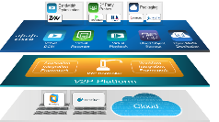




Video Processing Transformation
Cloud Native Software Architecture
Intelligent Edge Processing
Bandwidth Optimization
3rd Party Probes
Packaging
Virtual
DCM
Virtual
Recorder
Virtual
Playback
Cloud Object Storage
Open Media
Distribution
Service
Provider Cloud
Application
Integration
Framework
Workflow
Integration
Framework
V2P Controller
V2P Platform
Cloud
Content
Provider Cloud
Hosted
Cloud

Slide 24
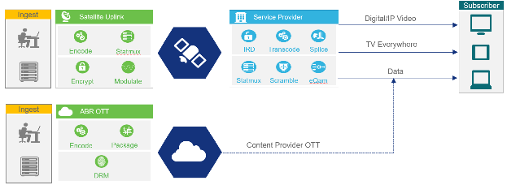
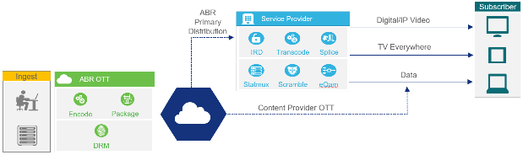
IP Migration for Video Distribution
D9800 Network Transport Receiver as platform to transition primary distribution from satellite to terrestrial IP
Improve operational and financial efficiency with converged workflow
for linear broadcast and OTT
Intelligent edge processing on a
micro-services architecture:
  ABR2TS – convert ABR streams to MPEG transport to serve legacy end-points
  JITP – leverage ABR technology for
  D2C distribution
Content Provider Distribution Today
Converged ABR Distribution
Notes:
Single origination and encode process
Single mezzanine stream for delivery
Single playlist for all workflows
Consolidate core network distribution on IP with resilient ABR technology for all services
Dynamically scale functions at the edge with distributed micro-services to support multiscreen and legacy

Slide 25





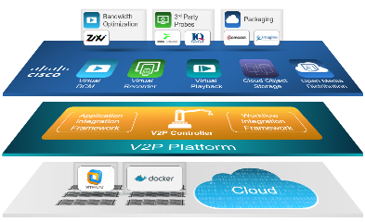
Smart Streaming for Video Quality of Experience
Stream
Video Quality
Smart
Rate Control
JIT-P
Up to 50% Bandwidth Reduction
8.70
00101111011101
00101111011101
7.80
CDN
Quality Defined Bit Rate Control
Optimized ABR Delivery
Quality Aware Packaging
ABR Encode with Stream Video Quality (SVQ) per frame and variable bit rate output based on perceived video quality
ABR delivery with up to 50% lower bandwidth, reducing CDN and storage costs
Replace/remove high bit-rate profiles to create quality optimized manifest for ABR delivery to clients

Slide 26

Virtualized Video Processing
IP Migration for Distribution – At-a-glance
HEVC StatMux
Flexibly expand satellite distribution with software-based Virtual DCM functionality
Distribute more content with less bandwidth
Extend DCM platform

Slide 27
Cisco at NAB 2017
Media Blueprint Solutions
IP Fabric for Media
Next Gen Data Center
Security for Media
Virtualized Video Processing
Infinite Video Platform

Slide 28
Infinite Video—Stop Worrying, Start Doing
  Simplify your operations
Build once for over 60 devices
Fast to implement new business models
Launch live and VoD, all from one platform
SIMPLIFY
UNDERSTAND
your operations
your audience
  Understand your audience
Integrated analytics for customer insight
Respond quickly to user feedback
Brandable UI to build and keep your identity
CHANGE
  Change your business
your business
SaaS model, use what you need, when you need it
Multiple monetisation and security options
Choose the devices and platforms you need

Slide 29


Infinite Video Platform
Existing OTT Sports Provider, providing niche content
Using IVP to extend reach to additional devices as well as audience
Supported by in-app billing
Millennial focused content provider
Using the IVP platform to achieve wide device range
Application is supported by advertising and used to build an entertainment brand

Slide 30














Cisco Media Blueprint Partner Ecosystem
In Collaboration with:
In Partnership with:
Proud Member
of:

Slide 32
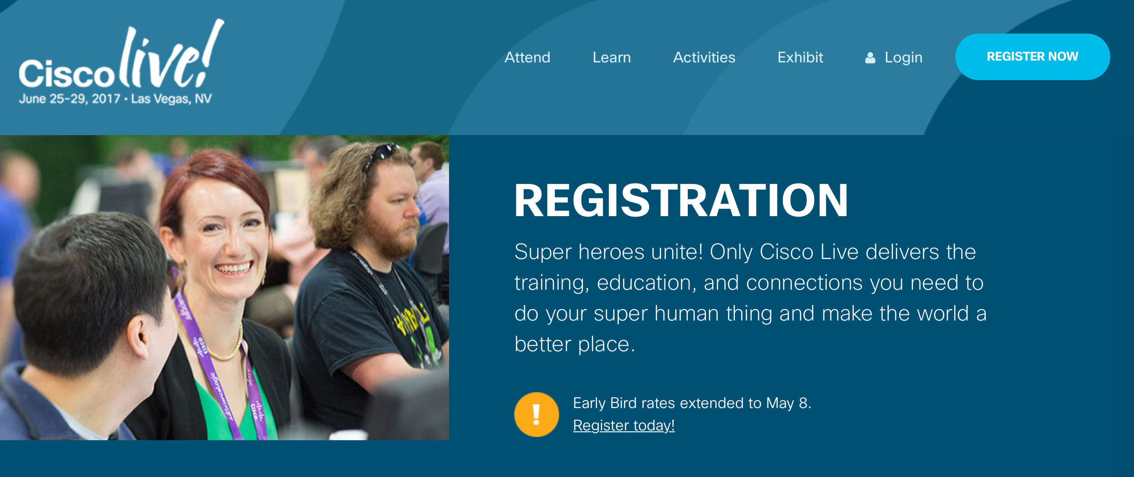



Want to know more?
http://www.cisco.com/go/media
http://blogs.cisco.com/sp
yschreib@cisco.com
rogsherw@cisco.com
spanah@cisco.com
@yschreiber
@rog
@samipanah

