Slide 1
New Service Provider IoT Solutions to Drive Digitization
Ron Malenfant Margaret Kaczmarska Brian Walsh
Cisco
25 April 2017
Notes:
To the writer: Replace the Title above with the name of the product series, solution, or architecture and use the subtitle for a tag line or overarching theme for the presentation.
If using a Value Proposition document: Include the unique “Cisco Point of View” (typically listed after the “Your Status Quo” section) for the product/solution/architecture as a subtitle.
Script/Speaker TEXT HERE:

Slide 2
Agenda
IoT Market Overview
LPWA Network Opportunity
Network Core Capabilities for IoT
New IoT Monetization Models

Slide 3
By 2020…
20% CAGR 2015–2020
12 billion Connected Devices (Cisco VNI)
Notes:
By 2020, IoT/M2M modules will be 46% (12.2 billion) of total global devices and connections and will account for 3% (6.2 EBs/month) of total global IP traffic.
M2Ms will grow at 20% CAGR to 12.2 billion connections by 2020.
APAC will have 43% of total M2M by 2020, NA will have 22%, WE : 18%, CEE: 7%, LATAM: 5%, MEA: 4%
MEA growing the fastest followed by NA

Slide 4
Digitization Leading Cloud, IoT, 5G
$2 Trillion
SP Economic Opportunity
More Cloudification
More IoT
5G Rollouts Begin
More Video
4X
HALF
4.7X
7X
Cloud Traffic Increase
Connected Devices Are M2M
Traffic of LTE
Mobile Traffic Increase
© 2016 Cisco and/or its affiliates. All rights reserved.
4
Notes:
Digitization or the digital business transformation is leading the path for several market dynamics: cloud, IoT, and 5G
First more applications and workloads will move to the cloud due to the scale and economic benefits. This will result in a 4 times increase in global cloud traffic through 2020, Cisco GCI
There will be more IoT. As data, people, processes, and devices become increasingly connected, through 2020 nearly half of total connected devices will be machine-2-machine (M2M). Cisco VNI
Video is already the majority of fixed and mobile traffic. This will continue to drive global mobile traffic to the tune of 8 times over the next four years. And as the transition to 5G occurs, video will be one of the primary beneficiaries with faster speed and improved quality. Cisco Mobile VNI
The blending of these dynamics leads to a $2 trillion economic opportunity for service providers over the next decade through new services and operational savings (Cisco Consulting Services). But there are more transitions at bay…

Slide 5
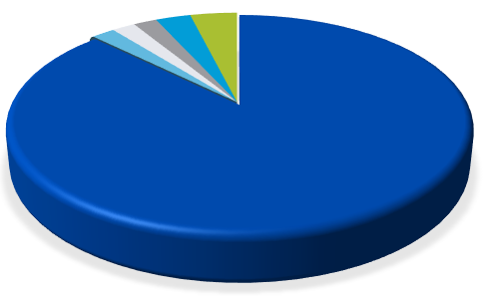
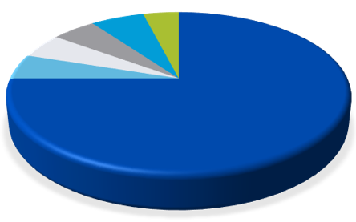
Operator Revenue Growth Opportunities
52%
Healthcare
46%
Healthcare
CAGR*
Enterprise
33%
Utilities
Enterprise
Utilities
Smart Cities
42%
Smart Cities
Connected Car
42%
Connected Car
Consumer
Consumer
Illustrative
Source: Cisco VNI Global Mobile Data Traffic Forecast, 2015–2020
© 2016 Cisco and/or its affiliates. All rights reserved.
Notes:
Today’s market share of Enterprise business is small compared to consumer.
Industry studies and our conversations with several service providers indicate that by year 2020 this the proportion of Enterprise originated business will grow significantly.
And while it will still be far less of a share than consumer, the profit margins are expected to be much better.
Why? Because many Enterprise services will be customized and complex – there are profits in complexity.

Slide 6
Multiple IoT Access Technologies
2G, 3G, LTE
Wi-Fi
LoRa
WAN
LTE/ CAT-M1
NB-IoT
Access Network Fragmentation a Reality
SPs Must Offer Customers Choices

Slide 7
4G and LPWA Networks Will Lead for IoT
Global M2M Connections by Network Type
46%
31%
16%
40%
29%
6%
23%
7%
Source: Cisco VNI Global Mobile Data Traffic Forecast, 2016–2021
Notes:
4G M2M connections will gain the highest share (46% of all M2M connections by 2021), 31% of all global devices and connections will be LPWA capable by 2021, 3G will be 16% of total M2M and 2G will be 6%. The global 4G M2M connections will grow from 182 million in 2016 to over 1.5 billion in 2021 at a CAGR of 53 percent. The global LPWA connections will grow from 58 million in 2016 to over 1 Billion in 2021 at a CAGR of 78 percent.

Slide 8
Decision Factors to Choose LPWA In Use Cases
Power Consumption
Distance Coverage
Data Rate
Cost
Is my use case applicable the low data rate?
10s bps to 100 kbps
Less latency sensitivity
Does my endpoint mandate low power consumption?
No external power supply around the endpoint
Over years life time powered by battery
Does my use case need to cover long distance ?
Massive deployment
Economy of last-mile access
Is my IoT solution scalable enough ?
Low cost chipset
Quick deployment
Easy maintenance

Slide 9
LPWA Use Cases
Notes:
With information for the Technical Decision Maker in mind – topics to be covered
Opportunity – provide examples
Definition – Total Adjustable Market, the market you are trying to penetrate

Slide 10
Source: GSMA

Slide 11
Poll #1

Slide 13
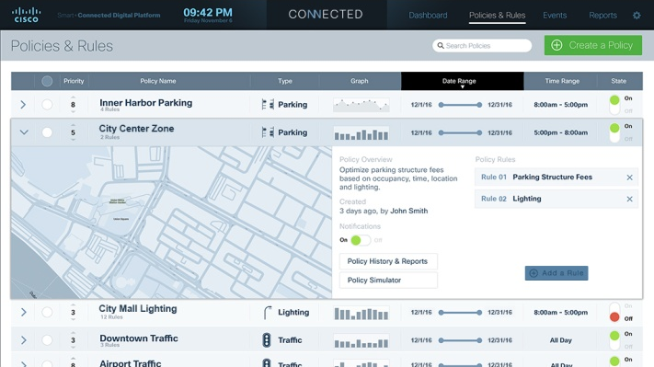
What Do Your Customers Want from IoT?
Productivity
Enhanced Customer Experience

Slide 14
What Do Your Customers Want from IoT?
Monetization
From Selling Cars
To Delivering Services
Single Revenue Source
Multiple Revenue Streams
Transaction-Based Engagement
On-going Engagement
In-vehicle Wi-Fi
Product-Centric
Infotainment
Navigation
Service-Centric
Shared Ownership
Diagnostics

Slide 15
Cisco Ultra Services Platform
Multi-Access Cloud Scale Mobile Core for IoT
Scalable
Elastic
Cisco Ultra Services Platform for IoT
Ultra Services Platform
2G, 3G, LTE
Ultra Packet Core
Ultra Policy Platform
Ultra Services Framework
Wi-Fi
Virtualized, 5G-Ready Core
Supports 2G, 3G, LTE, LTE-M, NB-IoT, Wi-Fi, LoRa
Simplifies, Automates IoT Connectivity
Network Slicing for Logical Networks
LoRa
WAN
LTE/ CAT-M1
NB- IoT
Service Provider
Virtualized network core resources can be automatically provisioned and optimized to meet widely varying requirements of IoT applications for bandwidth, speed, latency
Notes:
, Access Agnostic, mobile core to enable IOT for verticals.

Slide 16
Cisco Ultra IoT
New Ultra Capabilities for IoT
Cisco Ultra Services Platform for IoT
API
2G, 3G, LTE
Ultra Services Platform
Wi-Fi
Ultra Packet Core
Ultra Policy Platform
Ultra Services Framework
LoRa
WAN
LTE/ CAT-M1
CSGN
eSCEF
NB- IoT
Service Provider
Evolves Ultra Services Platform to CIoT architecture: CSGN, SCEF
New eSCEF function with network service capabilities:
Organizes device data, associates endpoints with apps
Open API to expose network capabilities to devices and apps
Complies with oneM2M architecture
Notes:
, Access Agnostic, mobile core to enable IOT for verticals.

Slide 17
Cisco Ultra IoT – Key Features
CSGN Key Functions
Terminates multiple access types
Uniform identity, authentication and security
Delivers Cellular IoT (CIoT) optimizations
Dynamic scalability
Deployment flexibility
Connectivity Mgmt Platform
Application Servers
eSCEF Key Functions
Standardized APIs to deliver IP and non-IP data
Expose network capabilities to apps for monetization
Mediates IoT protocols to hide complexity of transport networks
Associates endpoint app identity to transport identity
Rest APIs
API
Ultra Services Platform
Ultra Packet Core
Ultra Policy Platform
Ultra Services Framework
CSGN
eSCEF
Ultra IoT provides application level security, policy, authentication, access control
Notes:
Single packet core to support LTE eMTC, NB-IoT, LoRa, WiFi as well as other access technologies and following CIoT architecture
CIoT Serving Gateway Node (CSGN)
Core optimizations for eMTC and NB-IoT devices
Combo EPC node leveraging StarOS architectural advantages
Local policy on PGW as added advantage
NB-IoT device support
Evolve IoT Core to CIoT architecture: CSGN/SCEF
Introduce Network Service Capabilities (NSC) - Exposing network capabilities to the applications
LPWA support
Consistent policy and billing across IoT traffic
Unified device data handling and export towards the applications
Exposing network intelligence towards applications
Cisco IoT Core goes beyond standard 3GPP connectivity solutions (EPC IoT features, CSGN, NB-IoT)
Network Service Capability – value-add
NSC ingests and organizes device data with northbound APIs
NSC terminates multiple access types providing uniform identity, authentication and security framework
Proprietary link between NSC and EPC/CSGN for extra info about devices (status, location)
NSC based on Open Daylight allowing SPs/enterprises to develop plugins for specific devices
Multi-access core with unified policy, charging and service capability layer.
Network Service Capabilities (NSC) based on One M2M framework organizes the device data, includes adapters for different access types (eMTC, NB-IOT, LPWA, WiFi), provides APIs and exposes network capabilities to the applications servers
Interface between NSC and EPC/CSGN for extra device info
Additional – analytics, data exposure provide monetization opportunities
NSC Features:
Mapping endpoint application level identity to transport identity
Associate endpoints with application and map their identity into SIM/IMSI/MAC
Authorize endpoint to use the service
Verify that device identity matches network identity and that the device is authorized to connect to NSC (device already authenticated at the network)
Secure access to the IoT application
Communicating with infrequently connected device (buffering, triggering)
Device change notifications
Multicast of messages to the group of devices
Organizing device data
Monetizing the device data
Protecting the network from overload of signaling and/or throughput
Ability to “kill” the device
Updating FW, config on the NB-Iot device
C-SGN – Natural Progression for StarOS
C-SGN – A deployment option as specified by 3GPP.
C-SGN could be perceived as simplified combo of MME+SGW+PGW.
Control plane and bearer plane nodes today are running on the same platform and software already
StarOS architecture favors the combo mode approach.
C-SGN inherits all features available in StarOS today
C-SGN Deployment Flexibility
C-SGSN supports both NB-IoT and eMTC devices and even regular LTE devices if required.
Deployable in both centralized and distributed topology
C-SGN as NFV
C-SGSN as NFV leverages Cisco leadership in virtualization
C-CSGN as NFV dynamically scalable
Service Capability Exposure Function (SCEF)
oneM2M - Standards for M2M and the Internet of Things.
eMTC - which is also referred to as LTE-M, is a feature that will be fully standardised with 3GPP Release 13, will reportedly provide data rates of up to 1Mbps and up to four times better coverage, while reducing device complexity by up to 80%, in comparison with conventional LTE. (so is sort of a Medium Bandwidth rate).
Narrow-Band IOT (NB-IOT)
3GPP Protocol ----- Bandwidth ------- Maximum Data Rates
LTE Category 1 ---- 20 MHz ----- 10 Mbps down, 5 Mbps up
LTE Category 0 ----- 20 MHz ----- 1 Mbps down, 1 Mbps up
LTE Category M1 ---- 1.4MHz ------ 200 kbps down, 200 kbps up*
LTE Category M2 ----- 180 kHz ------ 40 kbps down, 55 kbps up*
Cisco’s Ultra (virtualized Mobile Core solutions) provides a complete, consolidated Evolved Packet Core (EPC) solution that runs on a single, virtual hardware instance for better performance, scalability, and cost. Ultra features fully-virtualized instances of each key Mobile Core function, including:
- 3GPP-compliant Serving GRPS Support Node (SGSN) and Mobile Entity Management (MME) functions to support large-scale network services for 2G, 3G, 4G, LTE, and VoLTE;
- 3GPP-compliant Gateway GPRS Support Node (GGSN), Serving Gateway (SGW), and PDN Gateway (PGW) functions with broad protocol support for external networks;
- 3GPP-compliant Combined Serving Gateway Node (CSGN), a simplified deployment combo of MME+SGW+PGW, which supports both NB-IoT and eMTC devices and even LTE devices if required.
Service Workflow Orchestration that enables operators to create and launch customized multi-service offerings in days (and not months);
WiFi Access: Evolved Packet Data Gateway (ePDG) and Trusted WLAN Access Point/Gateway (TWAP/TWAG) functions for secure access to trusted and untrusted WiFi networks, including support for WiFi calling services, and EPC to WiFi integration (also known as “Heterogeneous Networks” or “Het Nets”);

Slide 18
Cisco eSCEF
HSS
Connectivity Mgmt Platform
Application Servers
Leverages OneM2M framework with support for non-OneM2M devices/apps
Delivers service capabilities including exposing network data to the applications
Supports both IP and non-IP data converting it to Rest APIs terminating IoT protocols
Policy control extended to Enterprises
Plugin infrastructure for extensibility
Tenant/AS/ Device Onboarding
Rest APIs
S6t
Rest/JSON Client
Device External IDs
MME
API
T6a
LWM2M Client
NIDD client
eNB
Rx
PCRF
eSCEF
Ultra Services Platform
Rest/JSON
IoT Protocol Termination
Gx
Ultra Packet Core
Ultra Policy Platform
Ultra Services Framework
HTTPS
S/PGW
CSGN
eSCEF
LWM2M Client
COAP/DTLS
Protocol Mediation
Data Buffering
Device Authentication
Connectivity Hiding
Event Notifications
Security/Encryption
AS authentication and policy control
Grouping
SLA/QoS enforcement
Notes:
Single packet core to support LTE eMTC, NB-IoT, LoRa, WiFi as well as other access technologies and following CIoT architecture
CIoT Serving Gateway Node (CSGN)
Core optimizations for eMTC and NB-IoT devices
Combo EPC node leveraging StarOS architectural advantages
Local policy on PGW as added advantage
NB-IoT device support
Evolve IoT Core to CIoT architecture: CSGN/SCEF
Introduce Network Service Capabilities (NSC) - Exposing network capabilities to the applications
LPWA support
Consistent policy and billing across IoT traffic
Unified device data handling and export towards the applications
Exposing network intelligence towards applications
Cisco IoT Core goes beyond standard 3GPP connectivity solutions (EPC IoT features, CSGN, NB-IoT)
Network Service Capability – value-add
NSC ingests and organizes device data with northbound APIs
NSC terminates multiple access types providing uniform identity, authentication and security framework
Proprietary link between NSC and EPC/CSGN for extra info about devices (status, location)
NSC based on Open Daylight allowing SPs/enterprises to develop plugins for specific devices
Multi-access core with unified policy, charging and service capability layer.
Network Service Capabilities (NSC) based on One M2M framework organizes the device data, includes adapters for different access types (eMTC, NB-IOT, LPWA, WiFi), provides APIs and exposes network capabilities to the applications servers
Interface between NSC and EPC/CSGN for extra device info
Additional – analytics, data exposure provide monetization opportunities
NSC Features:
Mapping endpoint application level identity to transport identity
Associate endpoints with application and map their identity into SIM/IMSI/MAC
Authorize endpoint to use the service
Verify that device identity matches network identity and that the device is authorized to connect to NSC (device already authenticated at the network)
Secure access to the IoT application
Communicating with infrequently connected device (buffering, triggering)
Device change notifications
Multicast of messages to the group of devices
Organizing device data
Monetizing the device data
Protecting the network from overload of signaling and/or throughput
Ability to “kill” the device
Updating FW, config on the NB-Iot device
C-SGN – Natural Progression for StarOS
C-SGN – A deployment option as specified by 3GPP.
C-SGN could be perceived as simplified combo of MME+SGW+PGW.
Control plane and bearer plane nodes today are running on the same platform and software already
StarOS architecture favors the combo mode approach.
C-SGN inherits all features available in StarOS today
C-SGN Deployment Flexibility
C-SGSN supports both NB-IoT and eMTC devices and even regular LTE devices if required.
Deployable in both centralized and distributed topology
C-SGN as NFV
C-SGSN as NFV leverages Cisco leadership in virtualization
C-CSGN as NFV dynamically scalable
Service Capability Exposure Function (SCEF)
oneM2M - Standards for M2M and the Internet of Things.
eMTC - which is also referred to as LTE-M, is a feature that will be fully standardised with 3GPP Release 13, will reportedly provide data rates of up to 1Mbps and up to four times better coverage, while reducing device complexity by up to 80%, in comparison with conventional LTE. (so is sort of a Medium Bandwidth rate).
Narrow-Band IOT (NB-IOT)
3GPP Protocol ----- Bandwidth ------- Maximum Data Rates
LTE Category 1 ---- 20 MHz ----- 10 Mbps down, 5 Mbps up
LTE Category 0 ----- 20 MHz ----- 1 Mbps down, 1 Mbps up
LTE Category M1 ---- 1.4MHz ------ 200 kbps down, 200 kbps up*
LTE Category M2 ----- 180 kHz ------ 40 kbps down, 55 kbps up*
Cisco’s Ultra (virtualized Mobile Core solutions) provides a complete, consolidated Evolved Packet Core (EPC) solution that runs on a single, virtual hardware instance for better performance, scalability, and cost. Ultra features fully-virtualized instances of each key Mobile Core function, including:
- 3GPP-compliant Serving GRPS Support Node (SGSN) and Mobile Entity Management (MME) functions to support large-scale network services for 2G, 3G, 4G, LTE, and VoLTE;
- 3GPP-compliant Gateway GPRS Support Node (GGSN), Serving Gateway (SGW), and PDN Gateway (PGW) functions with broad protocol support for external networks;
- 3GPP-compliant Combined Serving Gateway Node (CSGN), a simplified deployment combo of MME+SGW+PGW, which supports both NB-IoT and eMTC devices and even LTE devices if required.
Service Workflow Orchestration that enables operators to create and launch customized multi-service offerings in days (and not months);
WiFi Access: Evolved Packet Data Gateway (ePDG) and Trusted WLAN Access Point/Gateway (TWAP/TWAG) functions for secure access to trusted and untrusted WiFi networks, including support for WiFi calling services, and EPC to WiFi integration (also known as “Heterogeneous Networks” or “Het Nets”);

Slide 19
Cisco eSCEF API Gateway
Single GW for all API Management
Client Authentication, e.g., Oauth2
API versioning
API documentation and schema
Rate limiting/Policing
Accounting
Internal routing to API endpoints
eSCEF API GW
Tenant and AS Provisioning APIs
Event Notifications
Device and Identity Provisioning APIs
3GPP SCEF APIs
Device MO/MT Data APIs
(Non-IP + IP)
Session State APIs

Slide 20
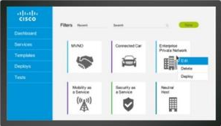
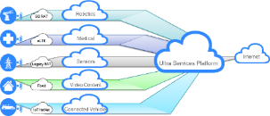
Cisco Ultra Services Platform
5G Ready Architecture
Simplify, Automate
Network Slicing
Distributed Architecture Control, User Plane Separation (CUPS)
Management Plane
Control Plane
User Plane
User Plane
35%
“…Cisco’s approach of integrating SDN into the mobile services core will enable our customers to be served better with exactly what they want, when they want it.”
OpEx Savings
*IDC Research
Notes:
Cisco’s Ultra Service Platform is a fully virtualized, 5G-ready services core. It’s unique in several ways:
It simplifies and automates provisioning of services. We have taken our industry leading NSO solution and enhanced it so that building and managing a virtualized mobile network is simple. Our approach is a lifecycle approach. The system contains a database of recipes for different types of services. To deploy an additional MVNO, just take the MVNO recipe, make any required updates to customize it and then press deploy. The service deploys on NFVI, across the infrastructure in minutes. Creating a new service is almost equally simple as it can be composed from the templates from existing services, updated as required. However, simplifying service creation and deployment is only part of what it takes to make operating a virtual mobile network simple. Our system also has the test, reporting and analytical tools we have learnt mobile operators require.
Ultra also provides end-to-end network slicing which is a requirement of 5G. Leveraging the powerful provisioning and management capabilities, service providers can deploy new turnkey services in minutes including MVNO, IoT/Connected Car, Enterprise/Premium Mobile Broadband, and more. These slices can be customized at the business, customer, region, or application level. Secure, highly reliable dedicated mobile connectivity that can support their specialized apps (e.g. telematics, meter reading, monitors, vehicle management)
We also have a unique distributed architecture which separates the user plane from the control plane using SDN. This allows the user plane services such as video to be deployed at the edge of the network while the control capabilities is maintained in the core. This allows traffic to go directly to the Internet without costly backhaul. The reduction in backhaul leads to an OpEx savings of us to 35%.

Slide 21
Cisco Ultra Services Platform
Deliver Instant Mobile Networks with Network Slicing
The Outcome
Focus existing core on mass market traffic
Add Virtualized slice(s) for verticals and introduction of new mass market services
Immediate set up — Enterprises on-boarded in minutes
Highly customizable
Self-service reduces OpEx
With Ultra
Each enterprise or IoT service gets its own virtualized Core
IaaS

Slide 22
SPs Must Move to Value-Centric Business Models
Monetize outcomes, not usage
100 Bytes
Usage
Smart City Applications
“I am full – send attendant”
Outcomes

Slide 23
Poll #2

Slide 24
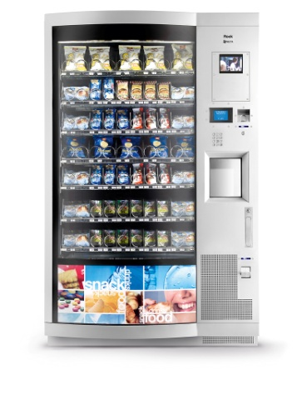
Cisco Ultra IoT – New Monetization Models
Auto-Stock, Notifications
“You are What You Eat”
Location, Habits, Interaction
API for Application and Data Monetization
Connectivity Mgmt Platform
Vending Services
Advertising
Social Media
Rest APIs
Use Case: Smart Vending
API
Social Media
Services
Advertising
Ultra Services Platform
Ultra Packet Core
Ultra Policy Platform
Ultra Services Framework
CSGN
eSCEF
Notes:
Health Insurance / Corporate Wellness program benefits
Personalize our world – “You Are What You Do”
Retailers can message calorie meal specials based upon activity
Social Media monetization – location, habits, calorie / weight

Slide 25
Cisco Ultra IoT – New Monetization Models
Corp. Wellness Program
“You are What You Do”
Location, Habits, Events
API for Application and Data Monetization
Connectivity Mgmt Platform
Insurance Company
Wellness Aggregator
Social Media
Rest APIs
Use Case: Wearable Wellness
API
Ultra Services Platform
Ultra Packet Core
Ultra Policy Platform
Ultra Services Framework
CSGN
eSCEF
Notes:
Health Insurance / Corporate Wellness program benefits
Personalize our world – “You Are What You Do”
Retailers can message calorie meal specials based upon activity
Social Media monetization – location, habits, calorie / weight

Slide 26
Cisco Ultra IoT Opens New Opportunities for Operators
Intelligent Buildings
Utilities
Smart Cities
Agriculture
API
Logistics
Cisco Ultra Services Platform
Transportation
Service Provider
2G, 3G, LTE
Wi-Fi
LTE/ CAT-M1
LoRa
WAN
NB- IoT
C97-738596-01 © 2017 Cisco and/or its affiliates. All rights reserved.
26

Slide 27
Cisco Ultra IoT Differentiation
Capability | Business Value
Hides network complexity (IP/non-IP, others) with uniform northbound API layer | Ease and speed of application development; stickiness; new monetization
Data management, network services and information exposed to the applications | Service Provider becomes IoT provider – additional monetization
Policy control and customizations | Flexibility to support diverse verticals
Network slicing | Speed and flexibility of IoT deployment
Automation and life cycle framework | Speed of IoT deployment, manageability
Cloud scale | Ready to support exponential IoT growth

Slide 28
Cisco Ultra Packet Core ~80 Wins
35%
OpEx Savings
CISCO Ultra Services Platform

Slide 29
Cisco and Operators Can Help Customers On the IoT Journey
Cisco Ultra IoT
Cisco Ultra Services Platform
Digital Business Transformation
Service Centric Business
C97-738596-01 © 2017 Cisco and/or its affiliates. All rights reserved.
29

Slide 31
Cisco IoT Solutions for Key Vertical Markets
Cisco Smart+Connected Communities
Cisco Asset Management
Cisco Connected Transportation
Pervasive Connectivity Management
Operator and Customer
Dashboards
Cisco Ultra Services Platform
Cisco Jasper Control Center
Multi-Access Mobile Core Network
Security
Licensed and Unlicensed Access Solutions
Mobile Apps
2G, 3G, LTE
Wi-Fi
LTE/ CAT-M1
LoRa
WAN
NB- IoT
C97-738596-01 © 2017 Cisco and/or its affiliates. All rights reserved.
31

