Slide 1
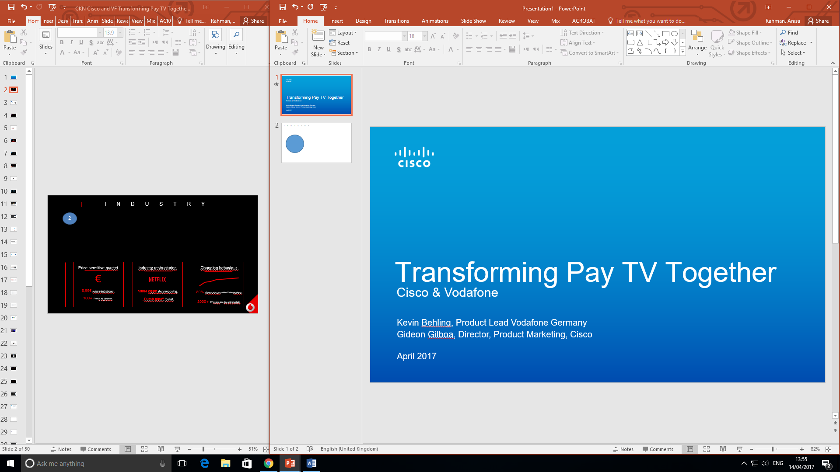

INTRODUCTION
THE PAY TV MARKET IS CHANGING.
Agile, DevOps, Cloud; anyone can use these buzzwords.
Today’s session is about what happens when these buzzwords are put into action. It’s about using the right technologies and methods to create a new type of pay TV service; one that can successfully compete on consumer’s attention in today’s crowded video marketplace.
Notes:
Y

Slide 2
TRANSFORMING
PAY TV TOGETHER
Cisco & Vodafone
Kevin Behling Product Lead Vodafone Germany
Gideon Gilboa Director, Product Marketing Cisco
April 2017
Notes:
Y

Slide 3

THE GERMAN PAY TV MARKET
PRICE SENSITIVE MARKET
INDUSTRY RESTRUCTURING
CHANGING BEHAVIOUR
€
8,99€
Subscription for Legacy
100+
Free to Air Channels
Value Chain Decomposing
“Dumb Pipe”
Threat
80%
of Youngsters Use Online Video Regularly
2000+
TV Events per day and Household
Notes:
K

Slide 4













A FRAGMENTED, CONSTANTLY EVOLVING MARKETPLACE
Content Production
Consumer Devices
Content Packaging
Content Aggregation & Distribution
Notes:
K

Slide 5


VODAFONE & VIDEO
VIDEO AS
CASH COW
SLOW IN INNOVATION
BOUND TO FOOTPRINT
~20%
EBITDA
7.8 Mn
Fixed Subs
3y
Average Development Cycle
1-2 Mn€
Testing Expenses
14/13 Mn
HHS Addressable
32/83 Mn
Mobile Subs Addressable
Notes:
K

Slide 6









NEXT GEN VIDEO PLAYBOOK
Network Agnostic
Off-net, in-home and out-of-home
Drive customer satisfaction
Drive ARPU
Personalized video experience
3rd parties
Continuous stream of features
Complementary contents
Right technology partner
Notes:
K

Slide 7






FOOTPRINT
DVB-C DVR
FROM A STOVE PIPE APPROACH
TO A SCALABLE PLATFORM
WEB
160% UPLIFT
IN ADDRESSABLE MARKET
STANDALONE APP
from 32m to 83m Mobile User
from 16m to 38m Households
DSL
COMPANION APP
Notes:
K

Slide 8
DECISION
After 12 months of market evaluation and two discovery phases we decided to go with Cisco which is the only technology partner who is able
to execute our requirements.
Notes:
K

Slide 9








INTRODUCING GIGATV
TIMESHIFT TV & INSTANT RESTART
CATCH UP
MULTISCREEN
APPS
RECOMMENDATIONS
ULTRA HD (4K)
BACKWARDS EPG
VOICE CONTROL
Notes:
K

Slide 10

GIGATV LAUNCHING IN GERMANY
Notes:
K

Slide 11






MARKETING GIGATV
Vodafone
GIGATV
GIGATV THE NEW TV- AND CONTENT PLATFORM
Multiscreen Entertainment
Personalized Recommendations
Timeshift TV
Content Choice
UHD Quality
Notes:
K

Slide 12





MARKETING GIGATV
Notes:
K
Iphone and qndroid

Slide 13
PACKAGING GIGATV
Notes:
K

Slide 14

KAIZEN
KAIZEN IS THE JAPANESE WORD FOR “CONTINUOUS IMPROVEMENTS”.
In business, kaizen refers to activities that continuously improve all functions and involve all employees from the CEO to the assembly line workers.
Notes:
G

Slide 15



CISCO TRANSFORMATION
CLOUD
Moved business logic from the CPE to a single cloud platform
Usage of Features and Functions in Typical System
 | Never used 45%
 | Rarely 19%
 | Sometimes 16%
 | Often 13%
 | Always 7%
AGILE
Created feature teams with bi-weekly releases
DevOps
Integrated development and delivery with common goals and metrics, automated deployment all the way to our customer site
Source: Standish Group
Study of 2000 projects at 1000 companies
Notes:
G

Slide 16
INFINITE VIDEO PLATFORM
Processing | Protection | Distribution | Cable | Satellite | Telecom | OTT
Cloud services platform for operators and broadcasters to process, secure, distribute and
monetize premium video on any consumer device
One Platform
for All Devices
Best Video Experience
World-Class
Scale
Uncompromising Security
Notes:
G

Slide 17











GLOBAL COMMUNITY OF CUSTOMERS
A global roadmap with input from leading TV service providers.
IVP Roadmap
Notes:
G

Slide 18
IVP LABS
Community
Co-innovate
Validate
Customers, Cisco partners and 3rd parties
Conceive and develop features
To be published to user populations for evaluation
Notes:
G

Slide 19

SPs ADOPTING NEW KPIs FOR MEASURING
SUCCESS OF THEIR VIDEO PRODUCT
DETRACTORS
PASSIVES
PROMOTERS
0
1
2
3
4
5
6
7
8
9
10
NPS = % of PROMOTERS - % of DETRACTORS
Notes:
K

Slide 20
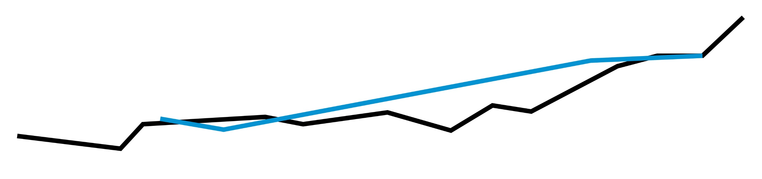
AGILE IMPROVEMENT
NPS as main KPI
Alpha Community with 80 Users
Beta Community with 300 Users
+80%
NPS Increase
 | Beta-Community
 | Alpha-Community
Notes:
K

Slide 21
AGILE IMPROVEMENT
Major NPS Uplift through
Channel Sorting Feature
 | Beta-Community
 | Alpha-Community
NPS TURNAROUND
Notes:
K

Slide 22

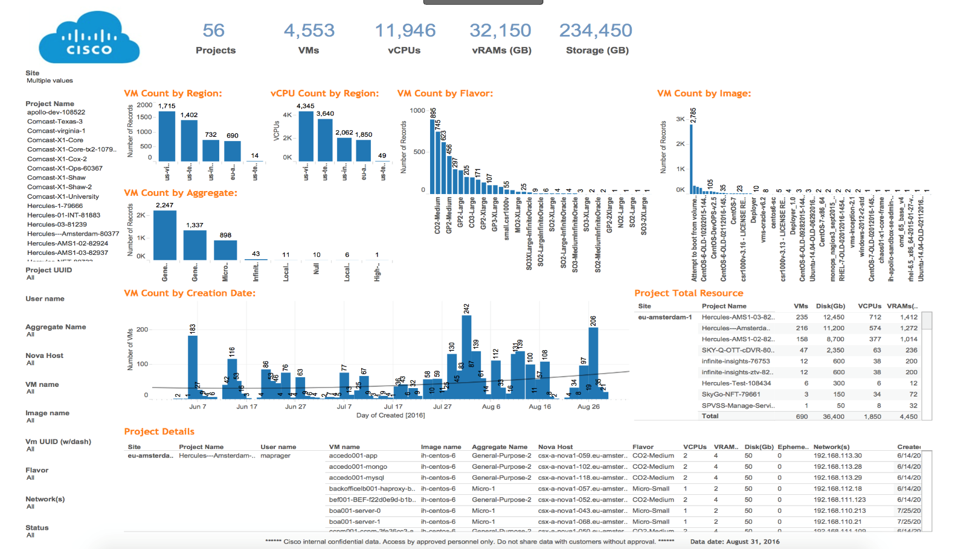


SaaS WITH CLASS
Service Delivery & Assurance
Cloud DevOps
Customer Ops
Notes:
G

Slide 23




KEY TAKEAWAYS
It’s Possible!
New type of Service Provider & vendor collaboration required
Build a platform not hard coded features
Measurable KPIs
Notes:
G

Slide 24
THANK YOU
Visit us cisco.com/go/infinitevideo
Kevin Behling Product Lead Vodafone Germany
Gideon Gilboa Director, Product Marketing ggilboa@cisco.com, @gngilboa
April 2017
Notes:
Y

