Slide 1
SP Orchestration & Automation: Connected Car Analytics with Machine Learning
Dr. Mehdi Nikkhah, Research Software Engineer – Data Scientist, Innovations Lab - CTAO
Patricia Sampedro Garcia, Software Engineer, CTAO
Chris Metz, Distinguished Engineer, CTAO
April 5, 2017

Slide 2
Additional Team Members
Herb Wildfeuer, Principle Engineer, Innovations Lab - CTAO
Tyler Levine, Sr. Software Engineer, CTAO
Quentin Chen, Software Engineer, CTAO
Daniel Malachovsky, Sr. Software Engineer, CTAO
Stanislav Jamrich, Software Engineer, CTAO
Lubomir Balogh, Software Engineer, CTAO
Andrej Vanko, Project Manager, CTAO

Slide 3
Problem Statement (1)
Connected Cars will generate 25GB of Sensor Data per Day per Car for cloud ingestion and processing
WAIT … WHAT?!?
Automakers/OEMs, drivers, smart cars, etc. want to avoid “problems”
Problems → Higher Costs → Unhappiness
Notes:
FLEET OF 250K vehicles 6.25Petabytes/hr, aggregate bit rate of 13.89 Tbs

Slide 4
Problem Statement (2)
All of this Car BIG DATA in the cloud might have SMALL DATA telling us about current and future problems
Avoid Problems → Lower Costs → Happiness
So what is needed here to find the small data pointing to current and future problems
Machine Learning!!

Slide 5
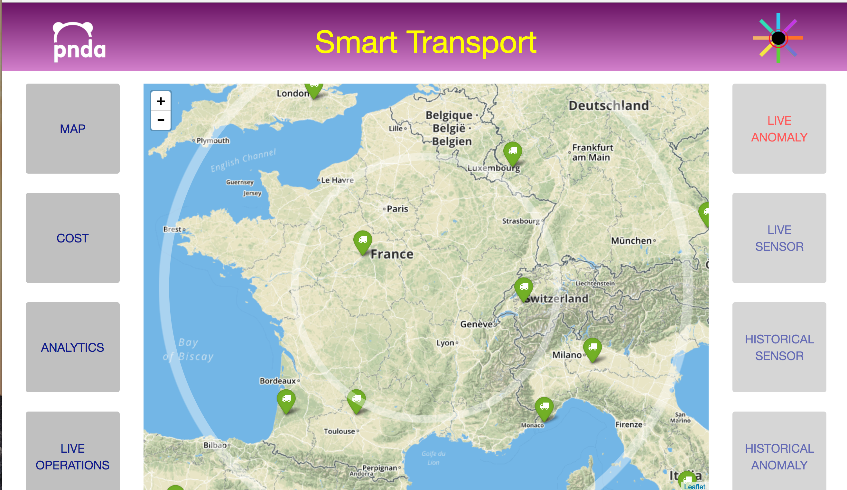
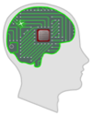
CC Analytics Cloud, Machine Learning and the “Virtuous Circle”
Machine Learning
Smart Transport Controller

Slide 6
Machine Learning

Slide 7
Machine Learning vs. Classical Approach
Classical Approach
Given
Wanted
Model
Input
Output
Machine Learning Approach
Model
Input
Output

Slide 8
How Machine Learning Works
Machine Learning builds a model from the data
Supervised: Data and Labels
Unsupervised: Data with no label
The model is used then to:
Predict the outcome of a system
Recognize complicated patterns in the new data points
Classify inputs

Slide 9
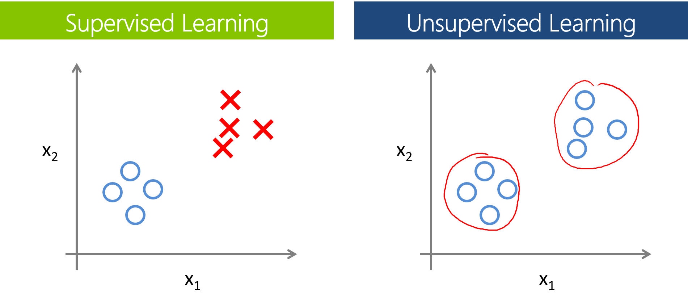
Supervised vs Unsupervised Learning

Slide 10
Supervised Learning

Slide 11
Example: Neural Network for Prediction

Slide 12
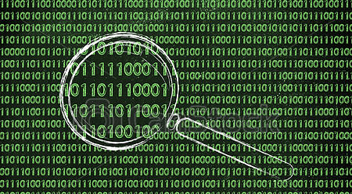
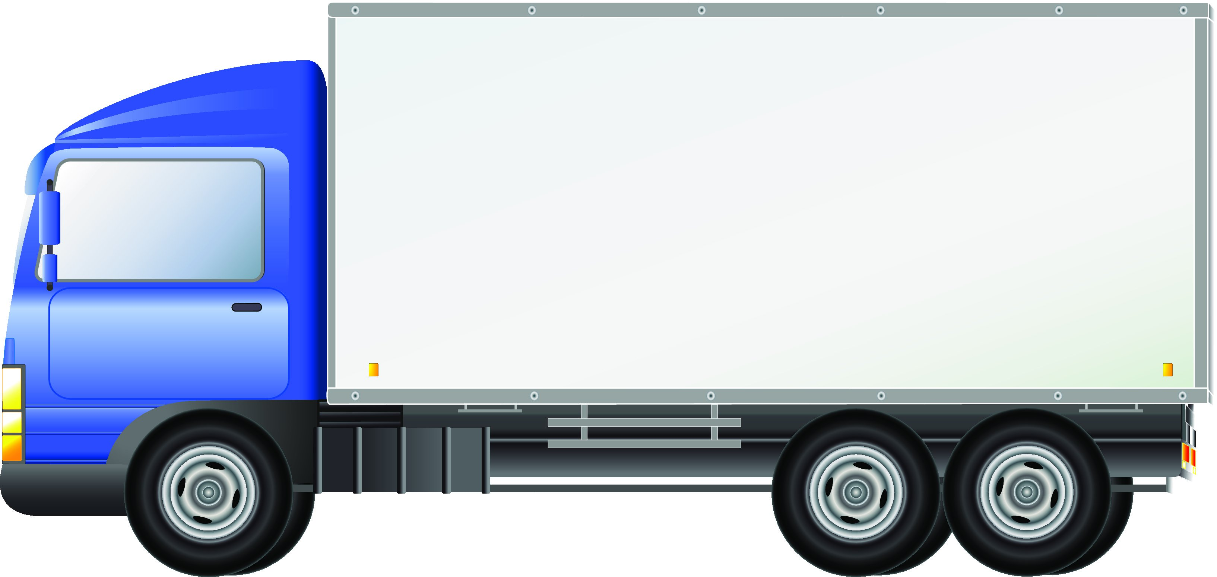
Example: Neural Network for Pattern Recognition
Data Collection
Infrastructure
Recognized Pattern
e.g., Excessive Braking
Sensor Data
Neural Network

Slide 13
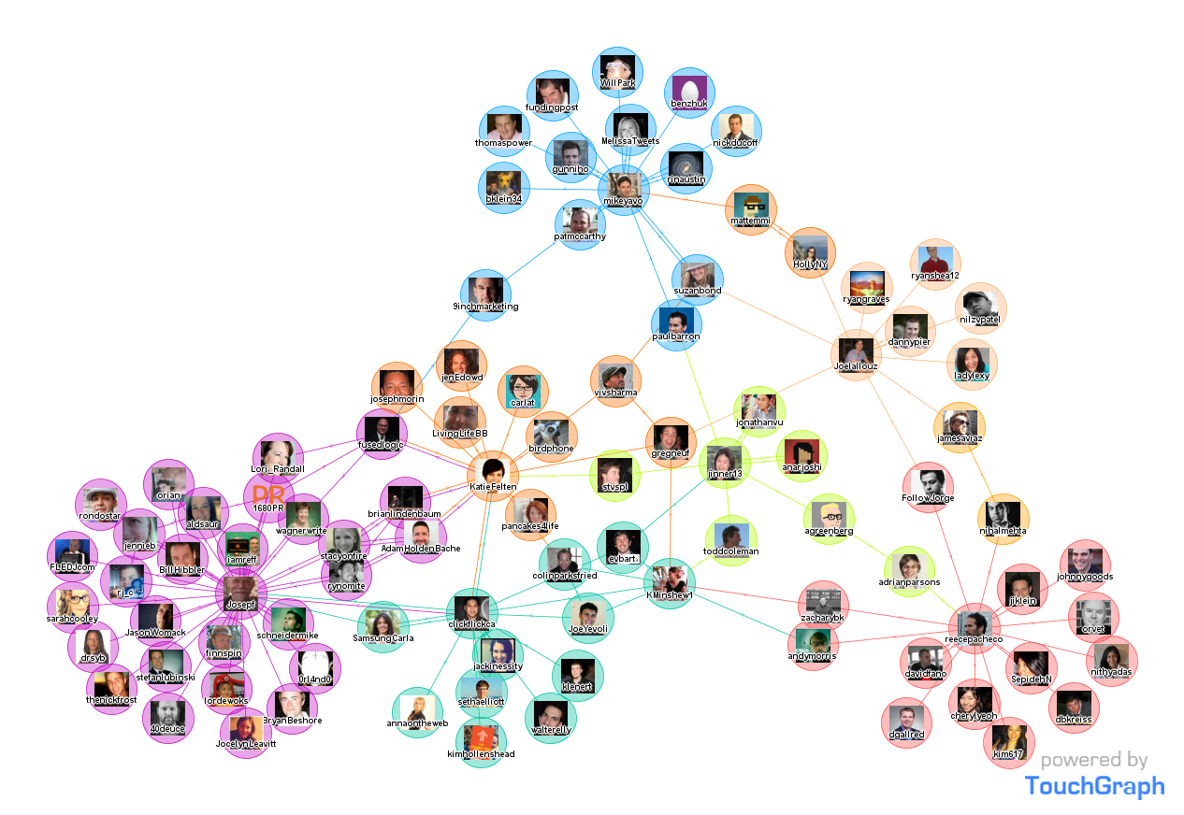
Example: Clustering (Unsupervised)

Slide 14
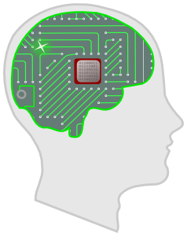
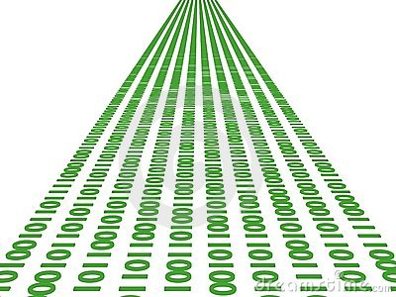
Automation Use Case: Connected Car
Intelligence
Actuation Loop
Streaming Sensor Data

Slide 15
Automation Use Case: Connected Car
Intelligence
Actuation Loop
Streaming Sensor Data

Slide 16
Do we always need ML?
When not to use ML?
If the problem is easily solved with simple algorithms
e.g., Thresholding, regression, etc. work better
When to use ML?
If the problem is non-linear, features that affect the outcome are not completely known, complicated patterns, data is ample

Slide 17
Rule-based Analytics
Driving in dangerous conditions is a complex problem
There is no strict definition of “unsafe”
e.g., some consider driving 55 mph on a rainy day dangerous, some don’t!
However, there is consensus about driving “fast” on a rainy day being dangerous
The variability lies in the definition of “fast”

Slide 18
Fuzzy Logic
Fuzzy Logic variables:
Speed of the car (high, average, decent, poor)
Current conditions of the road (high, average, decent, poor)
Current weather (sunny, cloudy, foggy, rainy, snowy)
Examples:
If speed is HIGH and conditions of the road are POOR and the weather is SUNNY then UNSAFE.
If speed is AVERAGE and conditions of the road are GOOD and the weather is FOGGY then SAFE.

Slide 19
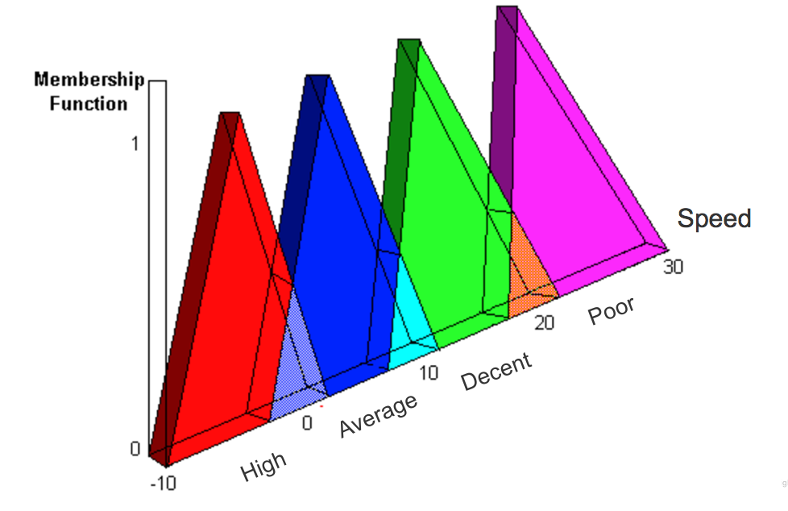
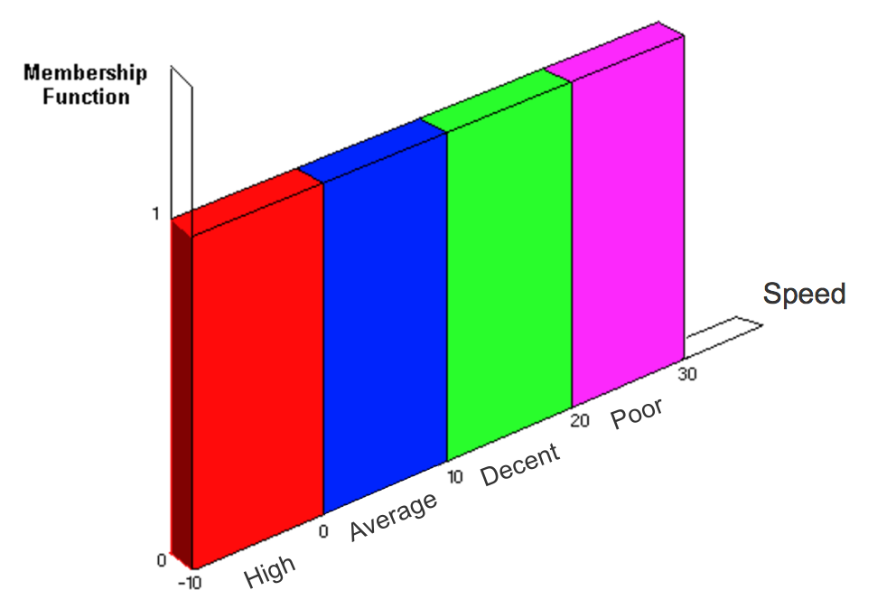
Fuzzy Logic contd.
Fuzzy Logic goal: to model logic reasoning with imprecise statements
e.g., ‘speed is High’, is a vague sentence that is determined by the true value of the variable speed
Variables on Fuzzy Logic
Variables on Boolean Logic

Slide 20
Machine Learning and Connected Cars Discussion

Slide 21
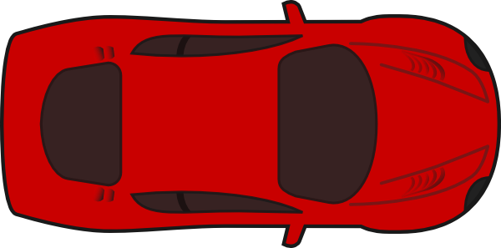
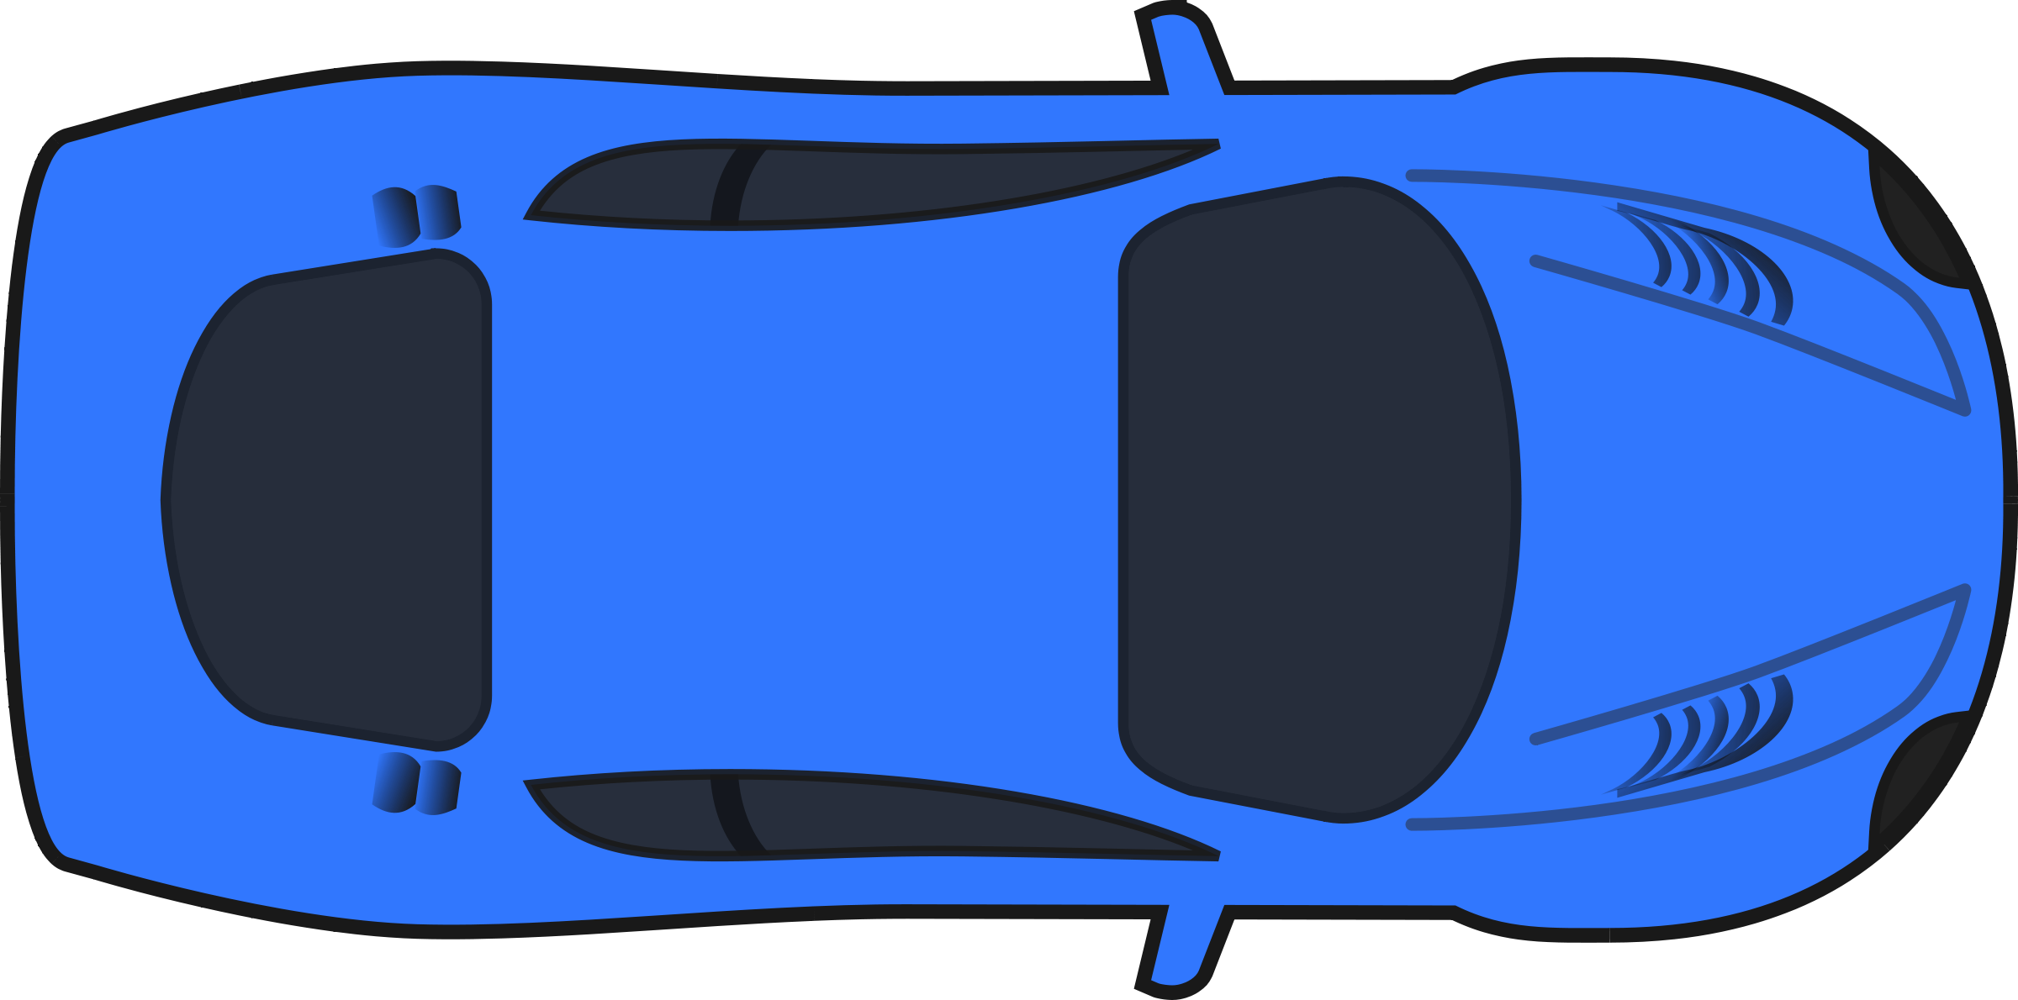
Complicated Pattern Recognition
Brakes
Brakes
Labeling Criteria:
When tailgating, one brakes too frequently
The speeds are usually in 50s and higher
Faster reactions/maneuvers
An expert can detect this
All of this can be captured locally from Speed and Brake sensors
Slows down
Brakes
Speeds up
Speeds up

Slide 22
Tailgating Detection cont’d.
Collecting speed and brake sensory data from a car
An expert supervises the labeling
A Neural Network is trained to classify driving patterns
The model built by the NN is used to detect tailgating in unlabeled and unseen future data

Slide 23
Automation Use Case: Connected Car
Intelligence
Actuation Loop
Streaming Sensor Data

Slide 24
Closing the Loop
Decision making and actuation
Dangerous driving or Tailgating:
Give feedback to driver
Inform the insurance company, and/or law enforcement if repeated and necessary
High fuel consumption:
Schedule check up and/or maintenance
Weather changes that potentially affect tire pressure
Inform the driver in advance (for planning)

Slide 25
Automation Use Case: Connected Car
Intelligence
Actuation Loop
Streaming Sensor Data

Slide 26
Data Collection
This is challenging for cars
Large amount of data generated
Usually slow wireless networks
Inherently distributed
Scalability is an issue
Fast processing is important
Security and policy compliance needs to be checked frequently

Slide 27
Scalability
Built on Scalable and Programmable BIG Data and Policy Control platforms
Key Scaling Components:
Ingestion of vehicle (and contextual) Data into BIG Data platform
High performance “Sensor Bus” enabling multiple applications (database, ML, etc.)
Real time Machine Learning (ML) detects anomalies and automates distribution of policy data down into the network
“Big Data” queries to database
Operates in private, hybrid or public clouds → Rapid prototyping, rapid deployment
Can be adapted for any Sensor/policy-driven Vehicle Network

Slide 28
Machine Learning is an Application
Machine Learning
Smart Transport Controller

Slide 29
Possible Innovation in Connected Cars
Correlating driving patterns with fuel consumption/cost, and providing feedback to driver for improvement
Shaping traffic pattern using connected cars + connected city (traffic lights, etc.)
Detecting potholes/road deficiencies from on-board car sensors (accelerometer, etc.)
Detecting impaired driver (under influence, sleepy, etc.) from car sensors (steering, speed, brake, etc.)
Detecting aggressive drivers and informing other drivers/insurance companies/authorities
Distributed Machine Learning deployed (for anomaly detection) in the car (as opposed to central cloud) for faster pattern recognition, less data transfer, privacy, etc.

Slide 30
Innovation in Large-scale IoT Deployments
Pattern recognition
Anomaly detection (for security, policy change, etc.)
Repetitive patterns and seasonality analysis
Trend analysis
Root cause analysis
Policy enforcement
Decision making (closing feedback loop)

Slide 31
Other Potential Use Cases and Data Sources
Containers (monitoring, anomaly detection, decision making)
data: CPU, memory, storage usage data
Routers (pattern recognition, decision making)
data: TX/RX data rates, NetFlow data
Home appliances (monitoring, anomaly detection, root cause analysis, policy enforcement)
data: Energy consumption, network access
Wearable devices (monitoring, decision making)
data: Activity data

Slide 32
ML Libraries
Theano
TensorFlow
Scikit Learn
Caffe
MLlib

Slide 33
Demonstration
https://pndablog.wordpress.com/2017/03/23/smart-transport-analytics-and-machine-learning-using-pnda/

Slide 34
Summary

Slide 35
Summary
Entering the age of IOT generating BIG DATA
Connected Cars are the most visible example
Connected Car Clouds will ingest massive amounts of car data
Machine Learning easily detects complicated data patterns regardless of scale
Machine Learning remove humans from the loop
Machine Learning makes our life easier

Slide 36
Any follow ups/ questions send to:
Dr. Mehdi Nikkhah, mnikkha2@cisco.com
Patricia Sampedro Garcia, psampedr@cisco.com
Chris Metz, chmetz@cisco.com

Slide 37
References
Machine Learning, Ebert, C., Louridas, P. IEEE Software ( Volume: 33, Issue: 5, Sept.-Oct. 2016 )
https://blogs.cisco.com/tag/machine-learning
Python Machine Learning, Sebastian Raschka
https://www.udemy.com/scala-and-spark-for-big-data-and-machine-learning/
Cisco Blog on Machine Learning, Mehdi Nikkhah

Slide 38
Questions
?

