Slide 1
Economic View from Cisco Treasury
Mohit Badlani & Nathan Andros
March 28, 2017

Slide 2
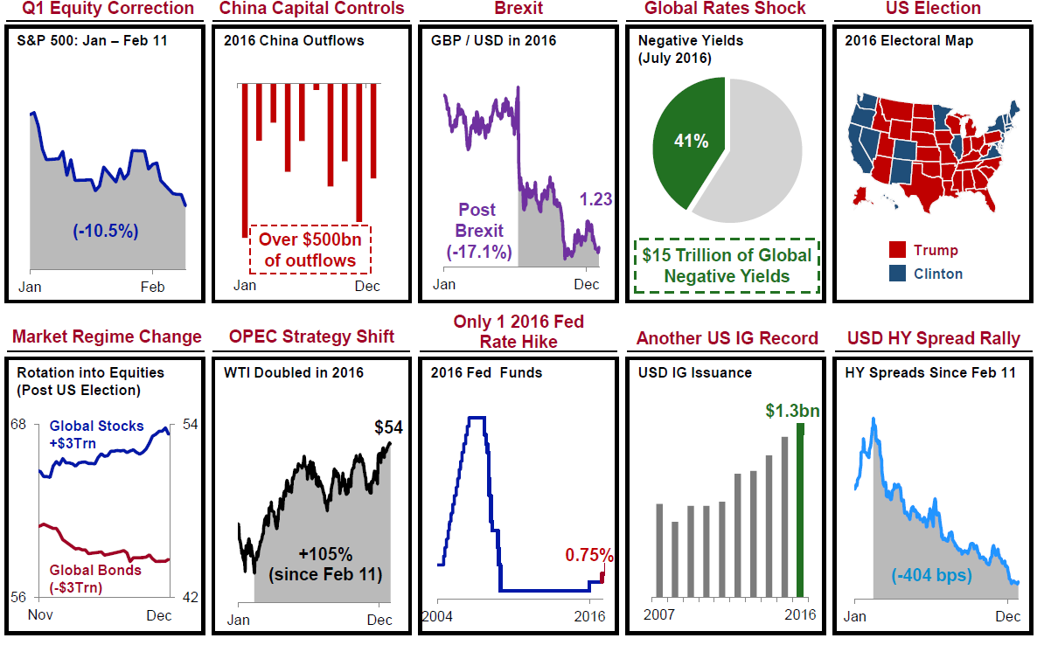
2016: A Year of Surprises

Slide 3
Poll Question #1

Slide 4
Key Market Themes for 2017
Politics and Policy
US as G10 Outlier
  Fiscal easing, monetary tightening, deregulation bias
Deflation to reflation shift globally
Political risk as an important driver of markets
Rising nationalism & inward-looking policy
  Trade, immigration
China policy toolkit constraints
  Fiscal easing, FX policy, capital controls, reform agenda
Notes:
Deflation to reflation: Pro growth agenda. Tax Reform, Deregulation and Infrastructure- as reflected in higher US treasury yields, higher inflation break evens, price of gold, consumer confidence (up 13 points since the US election) and small business optimism
Political Risk - According to the IMF's World Economic Outlook, political risk in advanced economies has become the largest risk to global growth. Italy, for example, has had 64 governments in 70 years. If 2016 was the year of the referenda in Europe, 2017 will be a year of pivotal elections: Netherlands (Q1), France (Q2), Germany (Q3), and possible early elections in both Italy and the UK. Sluggish growth, the migrant challenge and a busy election schedule will all pose significant challenges for the European project in 2017.
Rising nationalism & inward-looking policy – Backup: Channeling populism, tough on trade

Slide 5
Key Market Themes for 2017
Markets
Market regime change
  Rotations into equities and financials, earnings-driven equities, rate & yield curve paradigm shift
Animal spirits re-awakened in markets
Rising rates and steeper yield curve
Resurgent US Dollar strength
Higher and more episode volatility
Notes:
Market Regime Change: Market transition from rates driven equities to earnings-driven. Outperformance: Financials, Underpeformance: Consumer staples, energy, industrials and materials. Equity earnings revival - The S&P 500 returned 12% in 2016, above the 10.1% annual average return since 1926. Meanwhile, Q3 2016 S&P 500 earnings rose 2.9%, the first quarter of Y/Y growth after 5 consecutive quarters of contraction. Tax reform can partially drive future earnings growth. CY17 EPS growth of 19% ( mostly led by energy)
Animal Spirits Awaken – Benchmarks close to record highs – Dow, S&P 500, Russell. Trump’s pro-growth agenda has sparked a reawakening in markets to new historic highs with central banks receding to the backdrop as the primary driver of markets
Rising rates and steeper yield curve – US 3 M libor at 1.15%. Higher rates across the board since elections , 2 yr, 10yr, 3m LIBOR.
US Dollar resurgence – GDP growth differentials , rate divergence. If border tax proposal takes shape and form, highly bullish for US dollar
Higher and more episode volatility – depending on reforms, reflation etc. one is likely to see higher volatility in the markets. This is the only thing that can be said with certainity.

Slide 6
Key Risks to Watch in 2017
Dovish Fed falling behind rate curve
Stagflation if US growth slow to materialize
Fed or USD induced tightening of financial conditions
Escalating US-China trade disputes / retaliatory measures
US Dollar contagion
  EM, China, oil, exports, earnings
European politics
  Brexit, elections, migrant crisis
Republican failure to pass “comprehensive” tax reform
Oil supply glut
  US production upside; OPEX production cut enforcement
Recovery delays for commodity exporters
Geo-political escalation
  Cyber security, failed states, terrorism
Notes:
2 more hikes priced this year

Slide 7
Poll Question #2

Slide 8
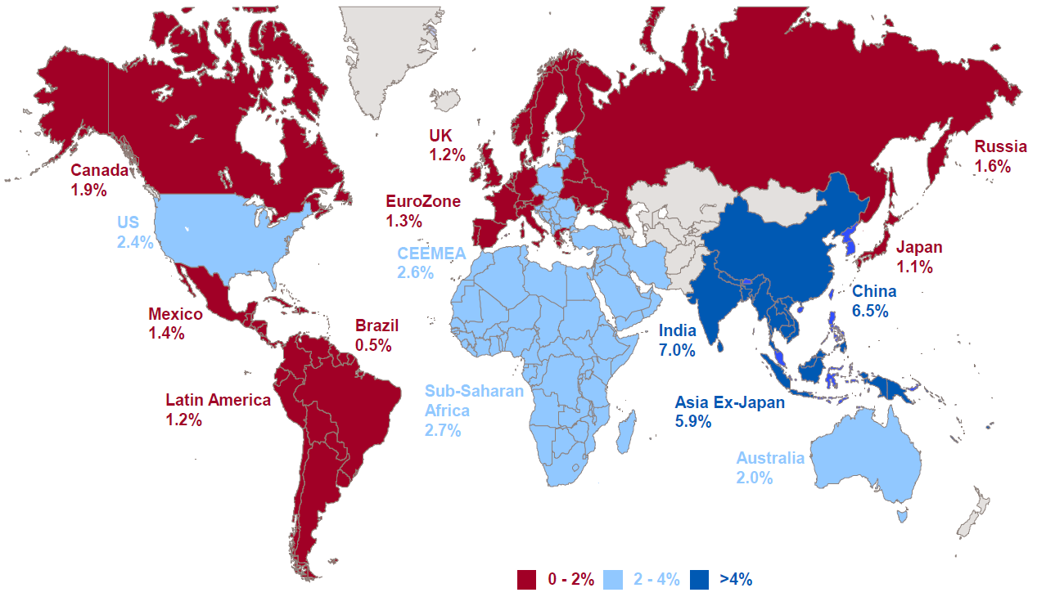
The World in 2017: GDP Forecasts

Slide 9
Key Policy Initiatives
Key Policy Initiative
Tax Reform / Repatriation | Key Features: System, Tax rate, Cap Ex depreciation, Interest expense, Overseas earnings
Dodd – Frank ( Deregulation) | Substantive changes to Dodd-Frank are likely to be limited. Most financial regs are statutes, not executive orders, and so not easily repealed.
ObamaCare | Repealing ObamaCare tax and spending provisions is the #1 priority of the GOP in 2017. The path to replace is less clear, could be 1-3 years, and remains a concern for many GOP leaders.
Infrastructure Spending | $1 Trillion proposed Infrastructure spending. Likely to fall short as fiscally conservative republicans are high unlikely to fund it
Immigration Policy
Trade | Withdraw from the Trans-Pacific Partnership (TPP) and renegotiate NAFTA
Energy Policy | Pipeline approvals, Repeal the clean Power Plan (coal)
Notes:
Tax Reform- $2.5trn of unrepatriated earnings. System change is from worldwide to territorial. Lowering the tax rate from 35% to 20% or something else. Cap ex depreciation change from overtime to immediately. Interest expense from deductible to non – deductible. Border adjustment from none to on imports only and to promote exports. Very few countries are now worldwide. Mostly are territorial. Coming through Reconciliation as that requires a simple majority
As a result of the worldwide tax system, U.S. businesses are expected to pay the same amount of tax on income that they earn abroad as they would if they earned that income in the U.S.
Obamacare: While Republicans will seek to shift from an open-ended defined benefit structure, to a more cost-mitigating defined contribution scheme, the bridge to replace poses enormous political risks. In 2016 alone, subsidies to consumers and health plans totaled $43 bn as nearly 20mm Americans have added insurance since 2010.
Dodd Frank - While the House may pass some version of the Financial Choice Act 2.0, DF repeal in the Senate is unlikely (given 60 vote filibuster proof threshold required) . Where DF rules have been finalized, unwind also becomes difficult. Look for most change to occur through more accommodative enforcement and high turnover among senior regulatory staff (as happening now at SEC).
Trade: Trump’s rejection of the TPP deal is a watershed moment in US trade policy, as the US has never previously failed to ratify a major negotiated trade agreement. It is also worth noting that while Congress is required to ratify new trade deals, a US President may terminate such deals unilaterally without Congressional approval. Getting behind “border-adjusted taxes” in the US tax reform agenda may offer a more attractive path to Trump than the WTO and temporary tariffs.
Energy Independence: Net US oil imports have been in decline for a decade (2006). The US is closer today to energy independence than at any time since the early 1970s. Further, the most significant obstacles to increased production are less political and technological than economic (i.e., oil prices). In theory, the Iran nuclear deal is vulnerable because Obama completed it via executive order, without Congressional ratification. Doing so, however, could be challenging given lack of P5+1 support.

Slide 10
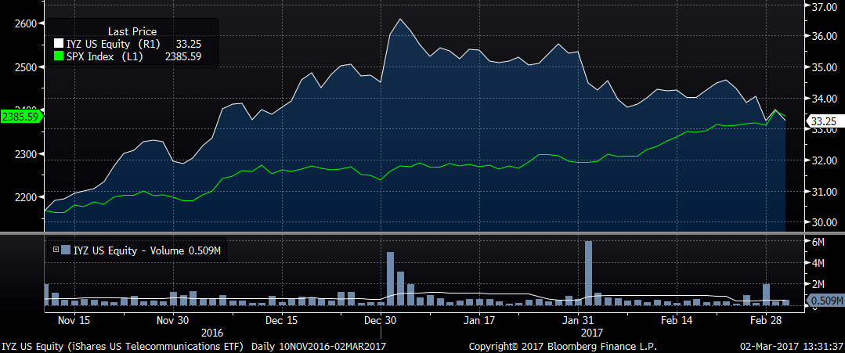
Stock Price Performance of Service Providers (IYZ)
Since Election
Notes:
IYZ: Ishares Telecommunications ETF. Major holdings are AT&T, Verizon, T Mobile, Level 3 communications

Slide 11
Poll Question #3

Slide 12
Industry perspective: Impact of Tax Reform
Lower corporate tax rate should result in significant cash flow benefits.
  Need to be balanced against removal of certain deductions
Impact on financial statements can be pretty substantial.
  If tax rate gets lowered, SPs will be able to write down the liability and create ton of net worth
Immediate expensing of tangible and intangible assets will also be cash flow positive.
  However, SPs could consider delaying large capex until investment expensing proposals are further developed
Limitations on interest deductibility will be cash flow negative.
  Could lead to exploration of preferred stock in lieu of debt to obtain rating agency equity credit given loss of interest deduction makes preferred relatively less costly
Notes:
SP’s can have deferred tax liability because of capital intensity. SP’s take a lot of depreciation expense for tax purposes, creating this massive deferred tax liability.

Slide 13
Industry perspective: Deregulation
Most compelling policy-related outcome remains the de-regulatory aspect
The biggest target will be net neutrality, a rule created in 2015 that prevents internet service providers from blocking or discriminating against internet traffic
    Most compelling would be changes in privacy rules, giving carriers the same abilities and a level playing field as Google and Facebook for digital advertising/ data
    Expectations will be for industry capex to pick up should there be a net neutrality repeal or other pro-capex policies
Notes:
Ajit Pai picked as next chairman of FCC ( federal communications commision)
Pai is opposed top net neutrality
The net neutrality rules, approved by the FCC in 2015 amid an outpouring of online support, are intended to keep the Internet open and fair. As written, the rules prevent Internet providers like Comcast (CCV) and AT&T (T, Tech30) from deliberately speeding up or slowing down traffic from specific websites and apps. In short, they're intended to prevent providers from playing favorites.

Slide 14
Industry perspective: Other Key Policy Initiatives
M&A: Borrowing costs could get less appealing but regulators maybe open for large (or even horizontal) consolidation
Sprint/ T-Mobile: In a capital intensive industry such as wireless, the market could be more stable with three players vs four players
Infrastructure spending: should be positive for the overall economy
Obamacare: If the initial focus is on ACA, could lead to potential delays on the de-regulation front, tax reform and infrastructure spending

Slide 15
Poll Question #4

Slide 16
Back Up

Slide 17
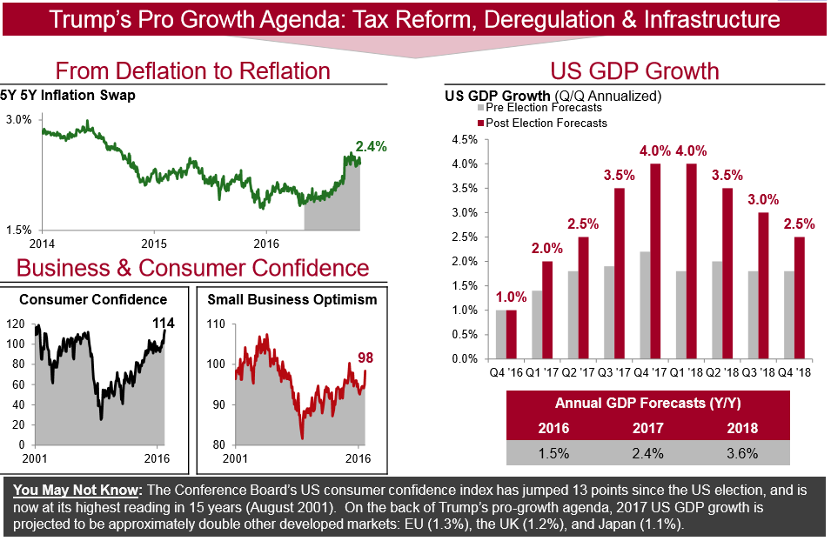
Make Growth Great Again

Slide 18
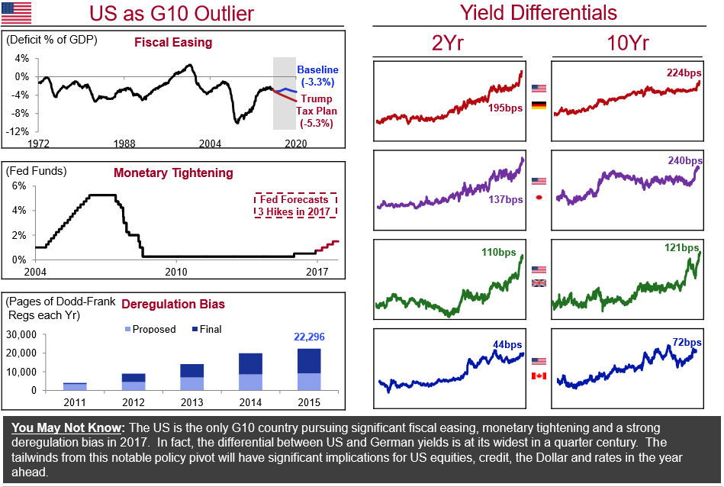
US as G10 Outlier

Slide 19
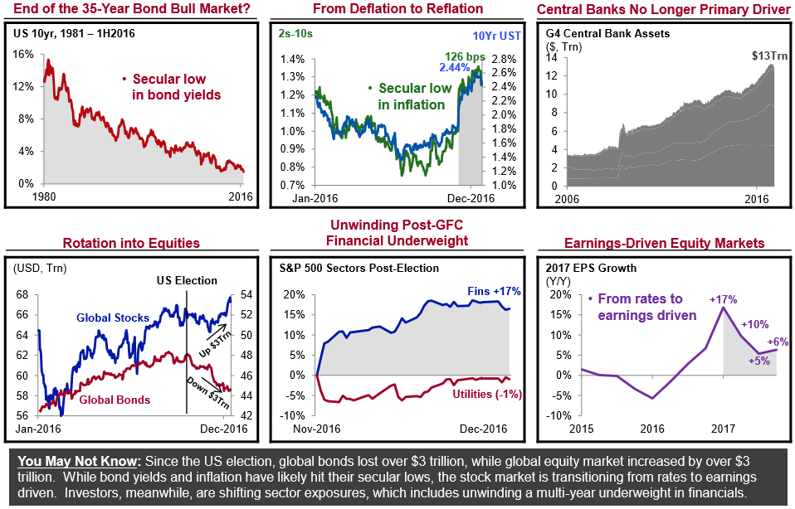
Market Regime Change

Slide 20
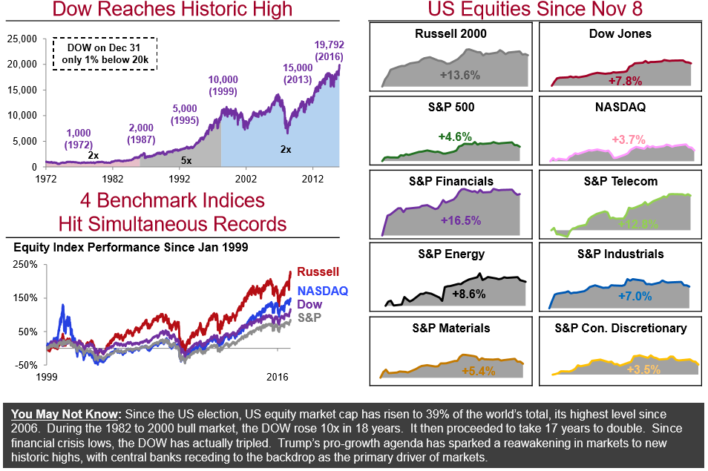
Animal Spirits Awaken

Slide 21
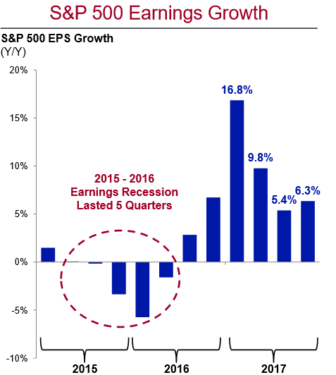
Equity Earnings Revival

Slide 22
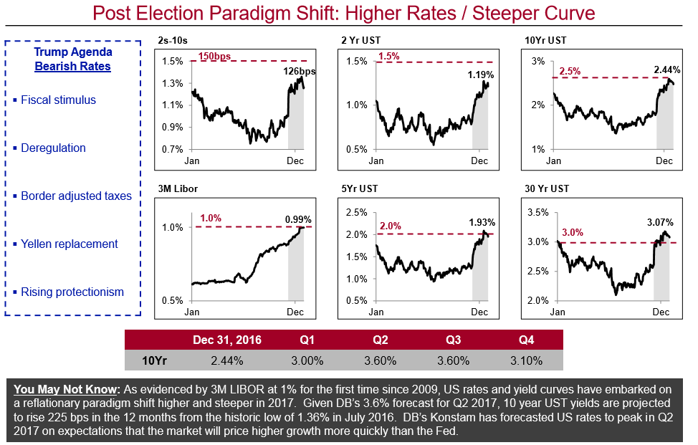
Rates Paradigm Shift

Slide 23
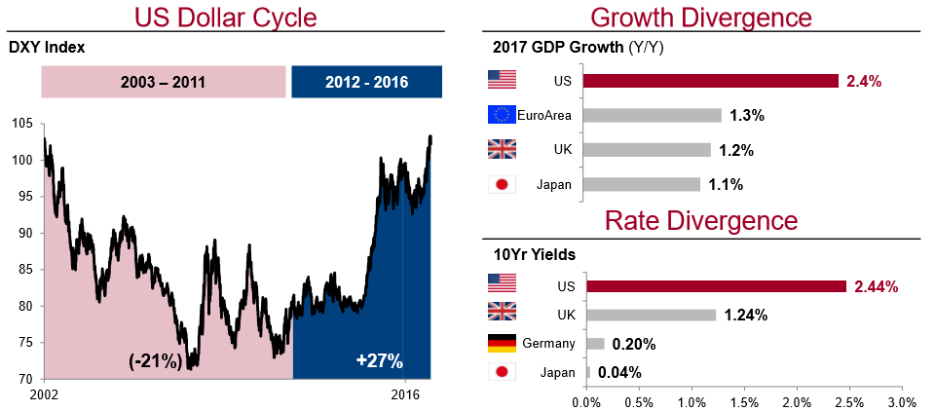
Resurgent US Dollar

Slide 24
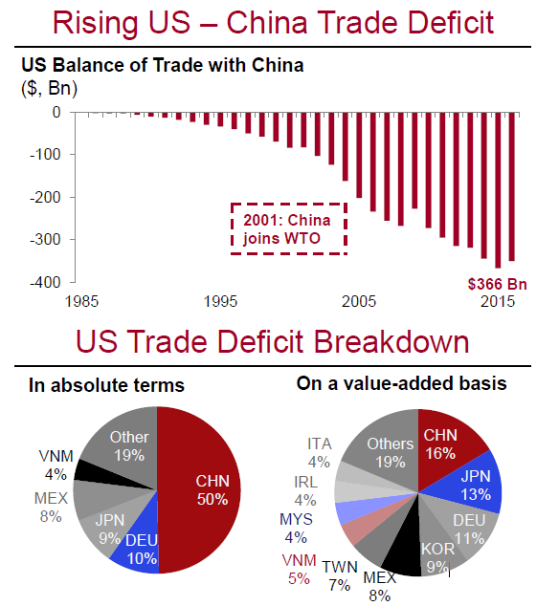
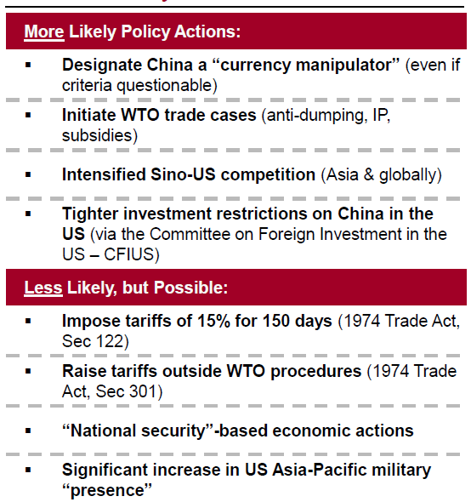
Rebalance US – China Relations
Policy Considerations
Notes:
The US last labeled China a currency manipulator in 1994. We think it is very possible that Trump will do so in his first 100 days (even if criteria not technically met). Doing so is largely symbolic, and triggers a lengthy, multi-step negotiation. By comparison, WTO cases or punitive tariffs are more likely to garner retaliatory actions from China (countervailing tariffs, order cancelations, investment restrictions, CNY devaluation, UST sales, civil and criminal cases).

Slide 25
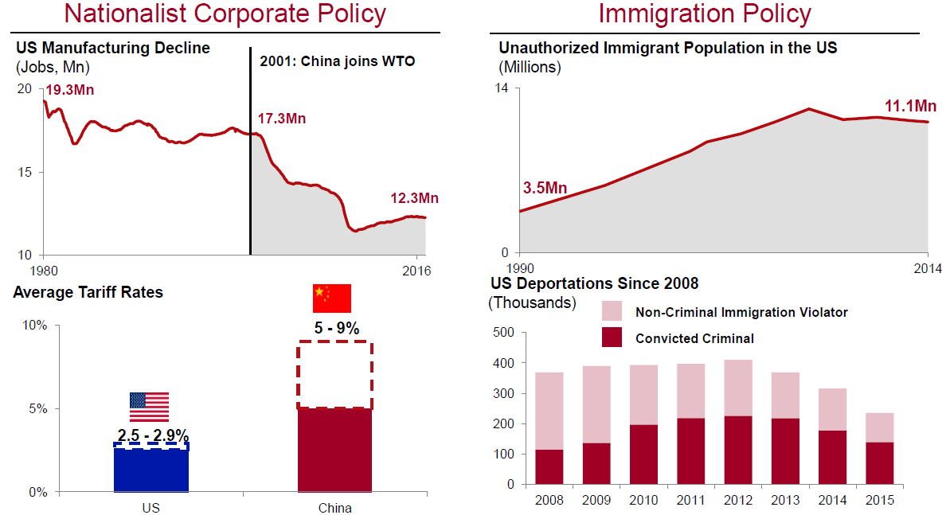
Channeling Populism
Notes:
Over 2.75mm immigrants have been deported over President Obama’s two terms, the most of any US President. President-Elect Trump’s inner circle of economic advisors includes an interesting mix of hard-core fiscal conservatives (Mulvaney) and populists (Bannon), free trade proponents (Kudlow) and those more vocally critical of trade policy (Ross), experienced internationalists (Tillerson) and more active proponents of a more inward looking economic policy (Navarro).

Slide 26
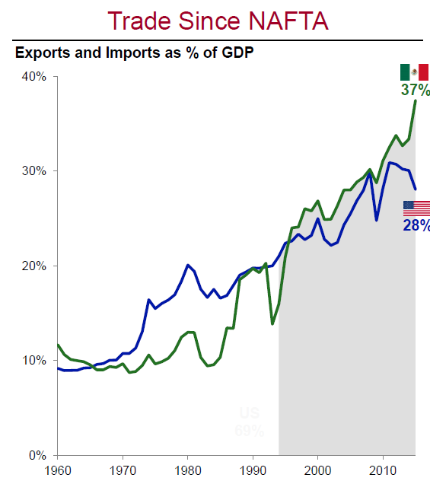
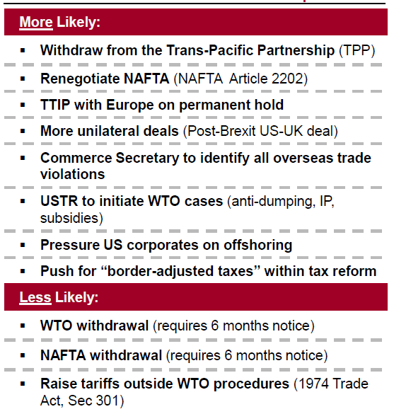
Tough on Trade
Expectations
Notes:
Trump’s rejection of the TPP deal is a watershed moment in US trade policy, as the US has never previously failed to ratify a major negotiated trade agreement. It is also worth noting that while Congress is required to ratify new trade deals, a US President may terminate such deals unilaterally without Congressional approval. Getting behind “border-adjusted taxes” in the US tax reform agenda may offer a more attractive path to Trump than the WTO and temporary tariffs.

