Slide 1
Cisco Recap @MWC 2017

Slide 2
Agenda
Introduction / Show Overview
Demonstration/Solution Highlights:
Simplify, Automate, Virtualize
Create Video Services
Create IoT Services
Create Business Services
Protect/Secure

Slide 3
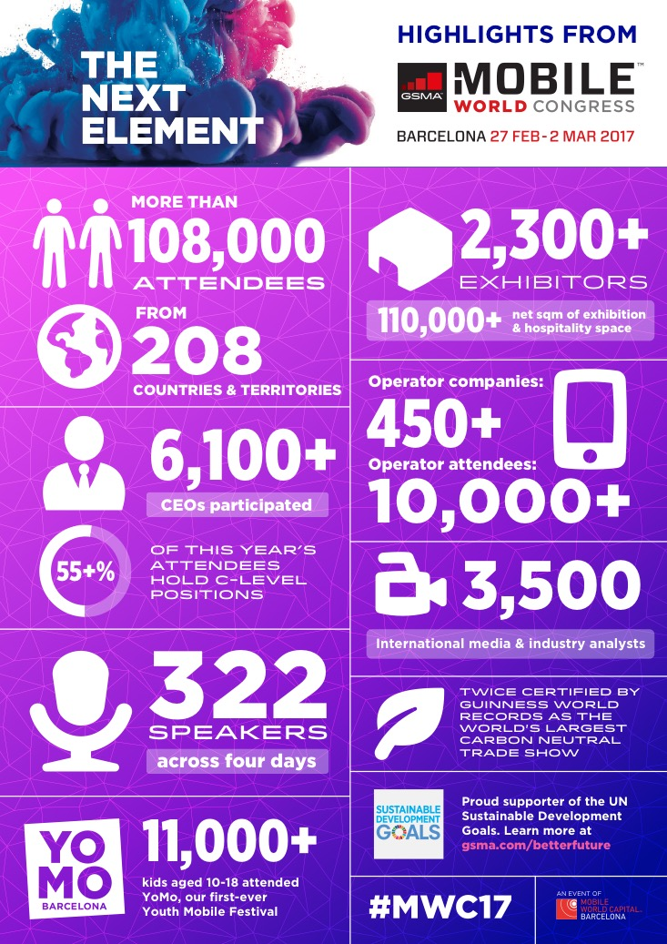
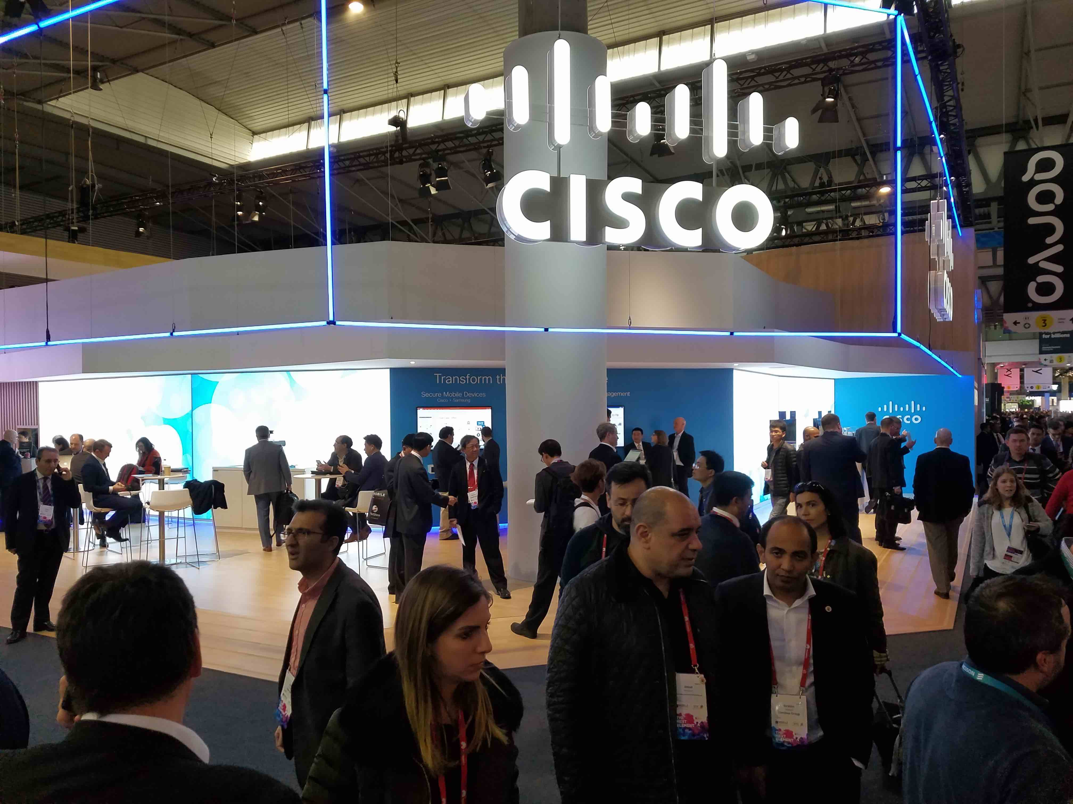

Slide 4
Cisco Press Releases at MWC 2017
February 23, 2017: Cisco to Automate NTT DOCOMO’s Network Device Provisioning
February 26, 2017: Cisco and Ericsson to Help You Work Better From Your Mobile Phone
February 27, 2017: Altice Makes Bold Moves to Virtualize Its Global Mobile Network With Cisco
February 27, 2017: Cisco Keeps Steady Drumbeat on Security With New Solutions for Mobile Networks
February 27, 2017: Verizon and Cisco Bring 5G Innovations to the Enterprise
February 28, 2017:Cisco and Reliance Jio Build World’s Largest All-IP Digital Services Platform
February 28, 2017:Cisco Network Services Orchestrator a Key Technology Enabler for Telstra’s Network of the Future
February 28, 2017:Saudi Telecom Company and Cisco Sign Managed Services Agreement to Drive Network Capabilities for Digital Era
February 28, 2017:Vodafone Launches GigaTV with Cisco
March 1, 2017:Ericsson and Cisco Transform Korek Telecom’s core UP network
March 1, 2017:Innovation to Cisco’s Network Services Orchestrator (NSO) Offers Service Providers Future Horizontal Scalability

Slide 5
Digitization Leading Cloud, IoT, 5G
$2 Trillion
SP Economic Opportunity
More Cloudification
More IoT
5G Rollouts Begin
More Video
4X
HALF
4.7X
7X
Cloud Traffic Increase
Connected Devices Are M2M
Traffic of LTE
Mobile Traffic Increase
© 2017 Cisco and/or its affiliates. All rights reserved. Cisco Confidential
5
Notes:
Digitization or the digital business transformation is leading the path for several market dynamics: cloud, IoT, and 5G
First more applications and workloads will move to the cloud due to the scale and economic benefits. This will result in a 4 times increase in global cloud traffic through 2020, Cisco GCI
There will be more IoT. As data, people, processes, and devices become increasingly connected, through 2020 nearly half of total connected devices will be machine-2-machine (M2M). Cisco VNI
Video is already the majority of fixed and mobile traffic. This will continue to drive global mobile traffic to the tune of 8 times over the next four years. And as the transition to 5G occurs, video will be one of the primary beneficiaries with faster speed and improved quality. Cisco Mobile VNI
The blending of these dynamics leads to a $2 trillion economic opportunity for service providers over the next decade through new services and operational savings (Cisco Consulting Services). But there are more transitions at bay…

Slide 6
Transforming for the Future
Transforming for the Future Enabled by Cisco Open Network Architecture
Transform
Transform
Increase Speed
Accelerate Growth
Improve Efficiency
Mitigate Risk
SIMPLIFY
AUTOMATE
VIRTUALIZE
Notes:
Cisco’s vision for SPs is to transform the business, experience, and architecture.
SPs need to Simplify business operations and consumer offers. By Automating complex tasks through Virtualization, Cisco provides efficiency to our SP customers, enabling them to deliver value to their consumers. More on our Cisoc Open Network Architecture tenets:
Virtualization – grow services and reduce cost by decoupling network functions from hardware, separating control and user plane functions, and leveraging network slicing
Automation – innovate faster and reduce complexity by utilizing orchestration to rapidly create and manage services. Optimizing the network using telemetry and analytics
Simplification – expand business models by flattening the network and converging technology siloes.

Slide 7
MWC2017 Solution Zones
Zone 5 – Protect
Zone 4 – Create Business Services
Zone 3 – Create IoT Services
Zone 1 – Simplify, Automate, Virtualize
Zone 2 – Create Video Services

Slide 8
MWC2017 Demo Zone 1 – Simplify, Automate, Virtualize
Key Takeaway…
Zone 5 – Protect
Cisco’s Open Network Architecture and Cloud Scale Networking helps Mobility Providers make the digital transformation to 5G, cloud and IP Networking.
Zone 4 – Create Business Services
Zone 3 – Create IoT Services
Zone 1 – Simplify, Automate, Virtualize
Zone 2 – Create Video Services

Slide 9
Serving 5G-Ready Opportunities Today
$151B
Combined AR/VR Market by 2022
AR/VR Collaboration
New business opportunities can be served through existing radio access
–
if you have a 5G-ready network foundation in place
$1.45T
Global Smart City Market by 2020,
CAGR of almost 20%
Smart Cities
$141B
Global Connected Car Market by
2020, 32.7% CAGR
Connected Car
$115B
Global Mobile Video Gaming by 2020
Mobile Gaming
200M
Global VR Headsets Sold by 2020
Consumer Video
Notes:
You can go after new services business opportunity today if you have a network that is more efficient, more automated, more agile.
In other words, a network that is 5G ready.

Slide 10
What’s 5G for Cisco?
Quite Simply …
Open Network Architecture forms an
enablement platform for innovative services and applications.
Our unifying network fabric simplifies through advanced automation.
The key phrase: Unified Enablement Platform
Notes:
What do we mean by a “unifying network fabric” and what is an “Enablement Platform”?
Unifying network fabric:
Today the SP network is made up of domains; Mobile Backhaul, Edge and Core, Packet core, services, Data Centers, OSS/BSS, Management and Orchestration, etc.
Cisco’s 5G strategic offering unifies these domains into a single network operated by advanced automation, orchestration, telemetry and machine learning management.
Enablement Platform:
With all former domains communicating and interoperating as one, your network will be an enablement platform as it will be enabled to provide end-to-end network slices providing the exacting requirements of mission critical services like connected transportation, tele-robotic surgery, remote drone fleet management, etc.
The open APIs, management and orchestration will make service creation fast and easy.
Advanced analytics, telemetry, and machine learning will provide hands-free operations and service assurance.

Slide 11
3 Phase Transformation to 5G Network Offering 5G Ready Services Today
1) BUILD 5G CAPABILITIES INTO
EXISTING IP TRANSPORT NETWORK
Densification
Higher Throughout
Virtualization
Cloud-scale Simplified
NSO
Analytics/ Telemetry
Ultra- Automate
2) EVOLVE TRADITIONAL PACKET CORE TO VIRTUAL (OR HYBRID) SOLUTION
Control Plane
CUPS
Distributed Functions
Edge Compute
WAE
Policy Suite
Packet Core
User Plane
Internet
3) AUTOMATE AND SIMPLIFY
Small Cell
User Plane/ Service Func.
Service Orchestration
Automation
Analytics and Telemetry
Predictive Management
LTE
4) UNIFIED WIRELESS
SR
SR
SR
Seamless HetNet
SON
Inter-domain Cloud Management
SP Wi-Fi
IP Edge and Core
Fronthaul
vRAN
Backhaul
Central Data Center

Slide 12
Real Products, Solving Real Problems
Delivering below 1ms latency
Cloud Native Ultra Service Platform
Total Automation of multi-vendor, physical and virtual networks
Network Service Orchestration and Automation
Simplification, Real-time Visibility And Control
Cloud-Scale Segment Routing, xHaul and Model-driven Telemetry
5G Innovations for simplifications, automation and Virtualization
Hybrid Information Centric Networking
5G Ready F r Business
Notes:
HICN working natively with IP, delivering 5G experience over existing radio

Slide 13
Verizon and Cisco Bring 5G Innovations to the Enterprise
Verizon is seizing the opportunity by building one of the largest 5G proving grounds in the world with collaboration from Cisco.
“The technology partnership with Cisco is helping us accelerate the deployment of new enterprise 5G services to support our enterprise customers with improved security, scalability, and agility in their digitization journey.”
Ed Chan, SVP of Technology Strategy & Planning at Verizon

Slide 14
5G Transformation – More Info
Cisco Blogs, Releases, etc.
Verizon and Cisco Bring 5G Innovations to the Enterprise
5G Security
For more information, visit:
Cisco Mobile Internet
Cisco 5G Infographic
Mobile Video Delivery with Hybrid ICN
5G Security (white paper)
5G Papers and other information

Slide 15
MWC2017 Demo Zone 2 – Create Video Services
Key Takeaway…
Zone 5 – Protect
Cisco’s Infinite Video Platform helps SPs deliver enhanced video experiences to users on any device, including optimized user experiences over mobile networks
Zone 4 – Create Business Services
Zone 3 – Create IoT Services
Zone 1 – Simplify, Automate, Virtualize
Zone 2 – Create Video Services

Slide 16
Mobile Video – An Integrated Solution

Slide 17
Holistic Security and Protection

Slide 18
Support for Multiple Business Models

Slide 19
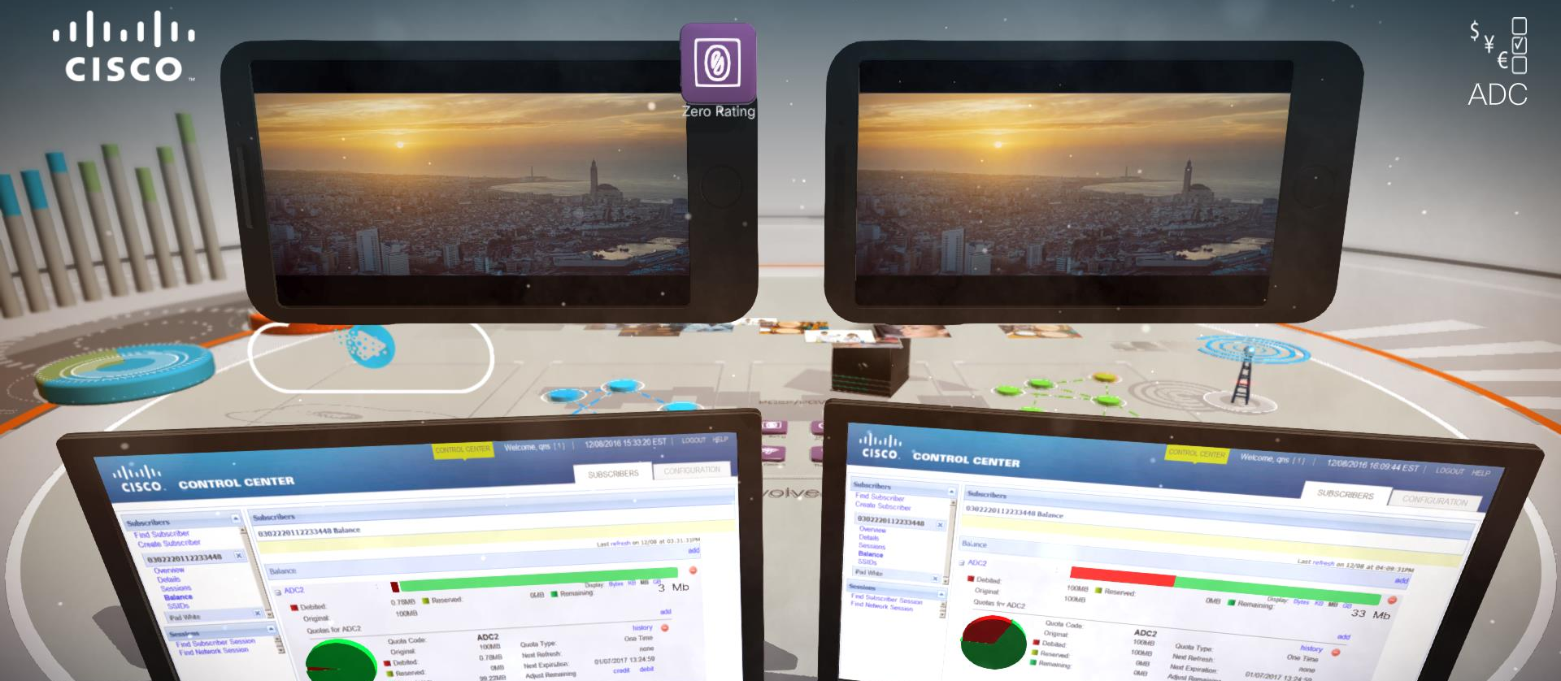
Simple Monetisation capability

Slide 20
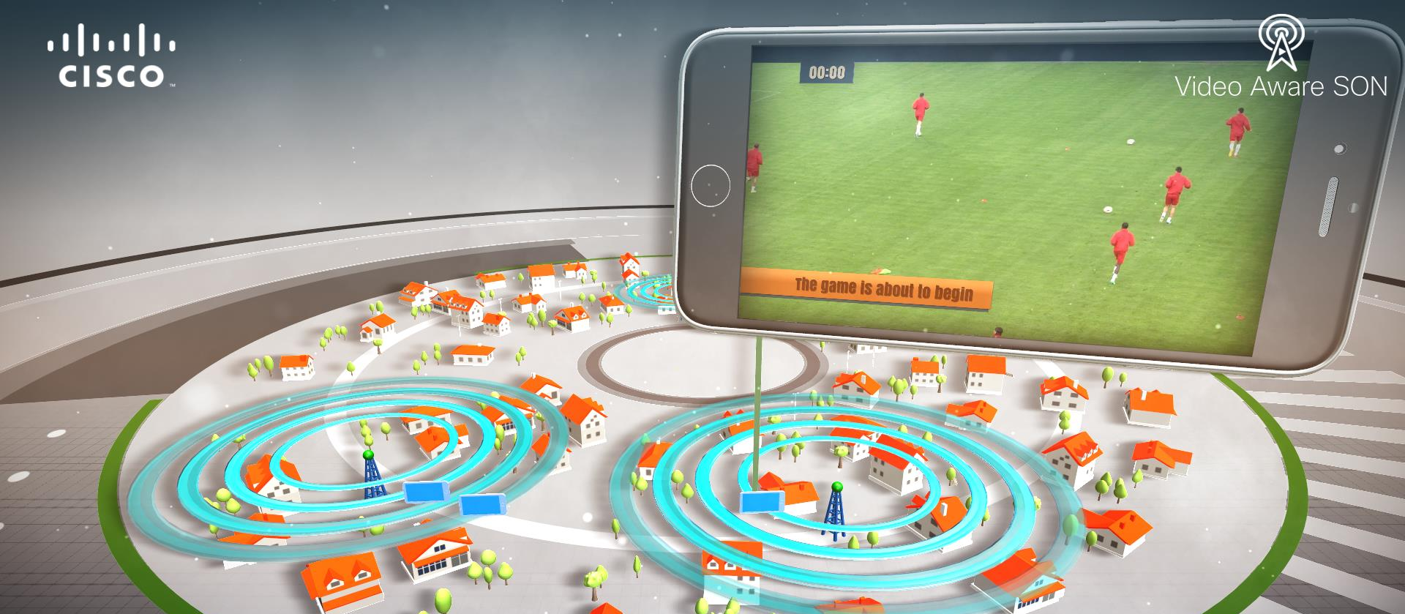
Quality Assured Video Delivery

Slide 21
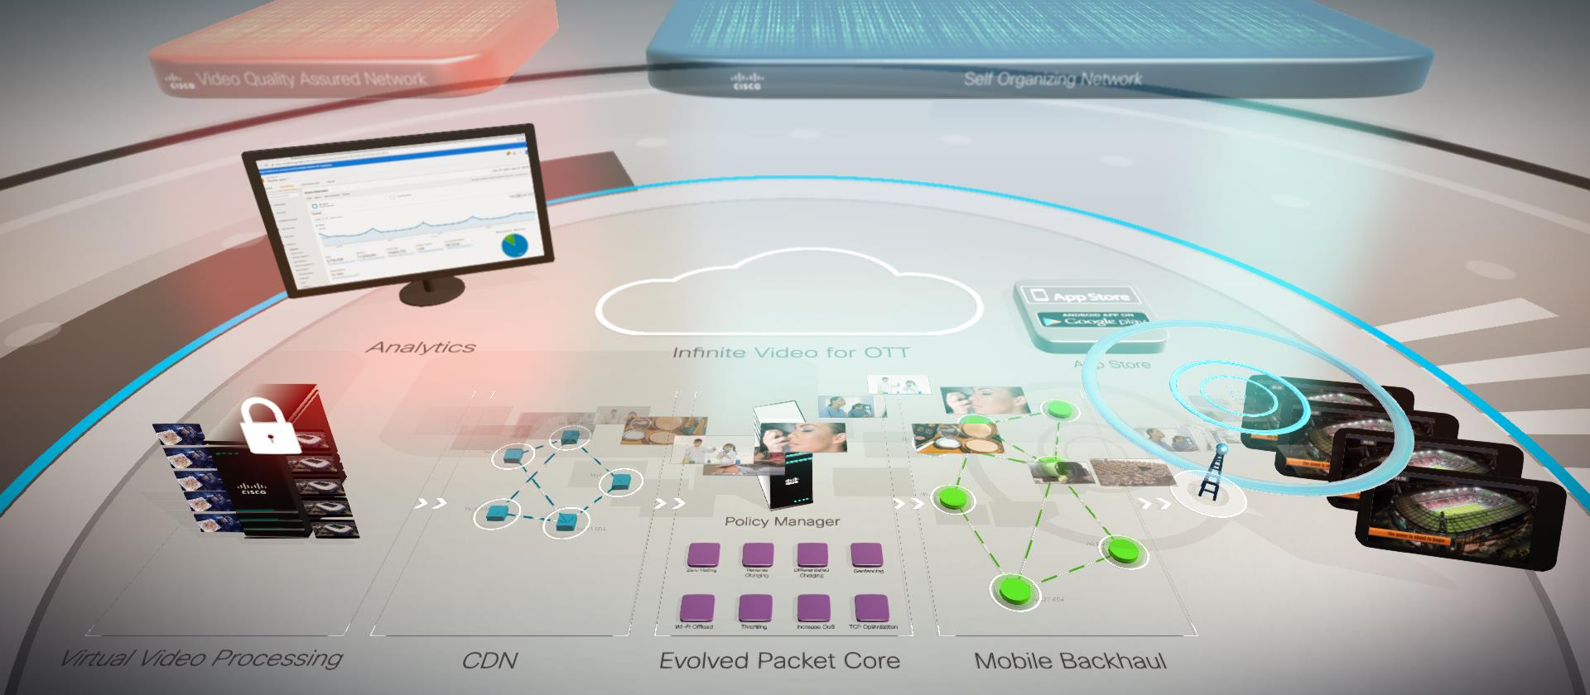
End to end platform

Slide 22
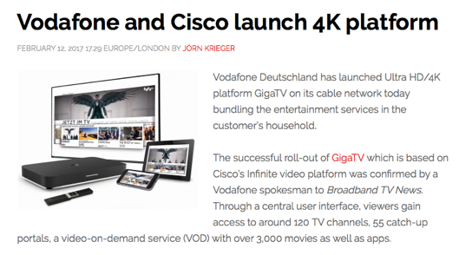
Vodafone Launches GigaTV with Cisco
About Vodafone
8M+ Pay TV Homes in Germany
Wanted to launch transformative service to become main hub for digital content in the home.
Customer Business Need
Increase ARPU in a predominantly Free-to-Air Market
Increase subscriber stickiness
Service Velocity
Solution Scope
Transformational move to Cloud, As-a-Service, & DevOps for speed & agility
Hybrid Gateway
Multiscreen OTT TV Everywhere
Notes:
Service is designed to significantly increase the ARPU VF generates from video services in a TV market that is predominantly free to air

Slide 23
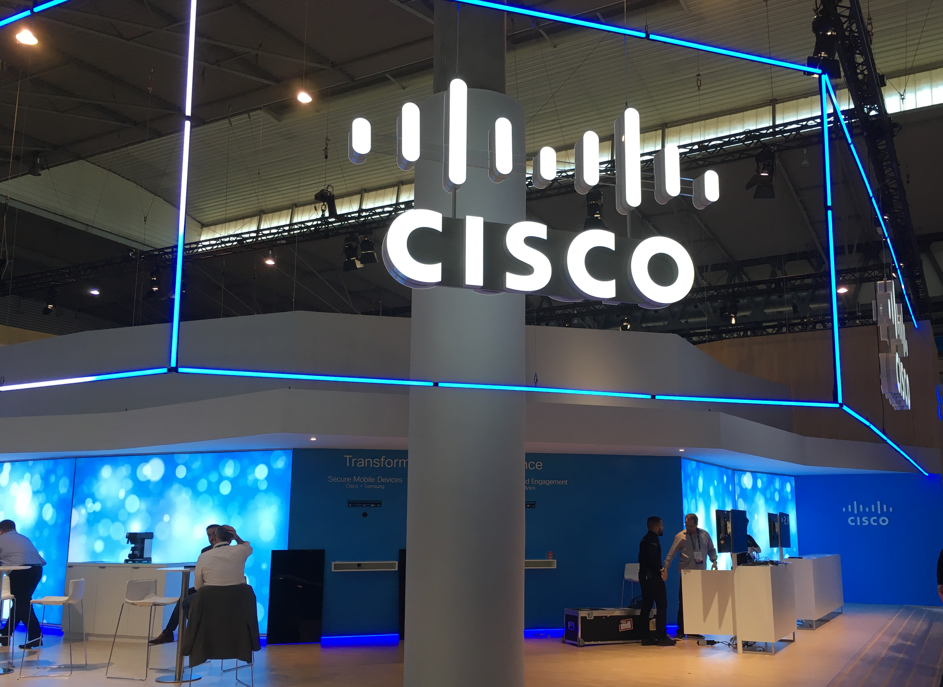
Video Services – More Info
http://www.cisco.com/go/infinitevideo
Visit us at TV Connect, Anga, NAB
http://blogs.cisco.com/sp
@CiscoSPVideo
addavies@cisco.com, jafield@cisco.com

Slide 24
MWC2017 Demo Zone 3 – Create IoT Services
Key Takeaway…
Zone 5 – Protect
Cisco’s solutions for IoT, Multi-Access Networks, Virtualized Mobile Core, and Connectivity Management create new SP opportunities to drive Digital Transformation for their customers.
Zone 4 – Create Business Services
Zone 3 – Create IoT Services
Zone 1 – Simplify, Automate, Virtualize
Zone 2 – Create Video Services

Slide 25
What Role Can SPs Play to Help Enterprise Customers?
Securely Connect New Things with Cisco Access Solutions
Cisco Ultra Services Platform
2G, 3G, LTE
By 2020…
12 billion connected devices (Cisco VNI)
Wi-Fi
LoRa
WAN
LTE/ CAT-M1
NB-IoT
Access Network Fragmentation a Reality
SPs Must Offer Customers Choices

Slide 26
Cisco Ultra Services Platform
Multi-Access Cloud Scale Mobile Core for IoT
Scalable
Elastic
Cisco Ultra Services Platform for IoT
Ultra Services Platform
2G, 3G, LTE
Ultra Packet Core
Ultra Policy Platform
Ultra Services Framework
Wi-Fi
Virtualized, 5G-Ready Core
Supports 2G, 3G, LTE, LTE-M, NB-IoT, Wi-Fi, LoRa
Simplifies, Automates IoT Connectivity
Network Slicing for Logical Networks
LoRa
WAN
LTE/ CAT-M1
NB- IoT
Service Provider
Virtualized network core resources can be automatically provisioned and optimized to meet widely varying requirements of IoT applications for bandwidth, speed, latency
Notes:
, Access Agnostic, mobile core to enable IOT for verticals.

Slide 27
Cisco Ultra IoT
New Ultra Capabilities for IoT
Cisco Ultra Services Platform for IoT
API
2G, 3G, LTE
Ultra Services Platform
Wi-Fi
Ultra Packet Core
Ultra Policy Platform
Ultra Services Framework
LoRa
WAN
LTE/ CAT-M1
CSGN
eSCEF
NB- IoT
Service Provider
Evolves Ultra Services Platform to CIoT architecture: CSGN, SCEF
New eSCEF function with network service capabilities:
organizes device data, associates endpoints with apps
Open API to expose network capabilities to devices and apps
Complies with oneM2M architecture
Notes:
, Access Agnostic, mobile core to enable IOT for verticals.

Slide 28
Cisco Ultra IoT – Key Features
CSGN Key Functions
Terminates multiple access types
Uniform identity, authentication and security
Delivers Cellular IoT (CIoT) optimizations
Dynamic scalability
Deployment Flexibility
Connectivity Mgmt Platform
Application Servers
eSCEF Key Functions
Standardized APIs to deliver IP and non-IP data
Expose network capabilities to apps for monetization
Mediates IoT protocols to hide complexity of transport networks
Associates endpoint app identity to transport identity
Rest APIs
API
Ultra Services Platform
Ultra Packet Core
Ultra Policy Platform
Ultra Services Framework
CSGN
eSCEF
Ultra IoT provides application level security, policy, authentication, access control

Slide 29
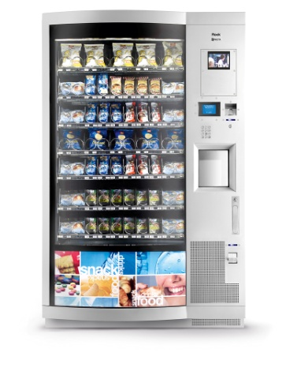
Cisco Ultra IoT – New Monetization
Auto-Stock, Notifications
“You are What You Eat”
Location, Habits, Interaction
API for Application and Data Monetization
Connectivity Mgmt Platform
Vending Services
Advertising
Social Media
Rest APIs
Use Case: Smart Vending
API
Social Media
Services
Advertising
Ultra Services Platform
Ultra Packet Core
Ultra Policy Platform
Ultra Services Framework
CSGN
eSCEF

Slide 30
Cisco IoT Solutions for Key Vertical Markets
Cisco Smart+Connected Communities
Cisco Asset Management
Cisco Connected Transportation
Pervasive Connectivity Management
Operator and Customer
Dashboards
Cisco Ultra Services Platform
Cisco Jasper Control Center
Multi-Access Mobile Core Network
Security
Licensed and Unlicensed Access Solutions
Mobile Apps
2G, 3G, LTE
Wi-Fi
LTE/ CAT-M1
LoRa
WAN
NB- IoT
C97-738596-00 © 2017 Cisco and/or its affiliates. All rights reserved. Cisco Confidential
30

Slide 31
Cisco & SPs Enabling New Smart City Adoption
GLOBAL DEPLOYMENTS
Copenhagen
Schenectady
Trencin
Paris
Budapest
Kansas City
Dubrovnik
Jaipur
Dubai
Mumbai
Adelaide
SERVICE PROVIDER PARTNERS

Slide 32
IoT – More Info
Cisco Blogs, Releases, etc.
Service Provider IoT Solutions Can Drive Digitization
How Service Providers are Helping to Enable the Next Phase of Smart City Adoption
For more information, visit:
Cisco Ultra Services Platform – reinventing the Evolved Packet Core
Cisco Ultra IoT – New Capabilities for the Internet of Things
Cisco Smart+Connected Digital Platform
Cisco Asset Management Suite
Cisco Solution for LoRaWAN
Cisco Universal Wi-Fi Solutions for Service Providers

Slide 33
MWC2017 Demo Zone 4 – Create Business Services
Key Takeaway…
Zone 5 – Protect
SPs can expand market reach delivering compelling end-customer experiences with Cisco cloud-based & managed services for SMBs, large enterprises, public sector
Zone 4 – Create Business Services
Zone 3 – Create IoT Services
Zone 1 – Simplify, Automate, Virtualize
Zone 2 – Create Video Services

Slide 34
Your business customers are embracing
digital transformation now.
This is a large and ready opportunity for
service providers.
Notes:
We can see that your business customers are embracing digital transformation now.
All businesses in all industries will be effected.
We further believe that the extent of the transformation means that this is a large and ready opportunity for service providers.

Slide 35
Digital Disruption Impact to Businesses
40%
$14T
26%
Incumbents at risk
of being displaced in
next 5 years.
Value at stake across
industries 2013-2022
Profitability increase for
organizations that
master digital
Source: Cisco
Notes:
Digital transformation has a large impact on businesses world-wide
40% of incumbents are at risk of being displaced if they don’t develop a strategy and start executing immediately.
We have estimated that through 2022, the economic value of this disruption is $14 Trillion.
But let’s narrow the scope to just network-based business IT services that you can participate in.

Slide 36
What Your Business Customers Want … And What They Will Do When They Get It
A Personalized Experience
NA
LATAM
MEA
APJC
WE
CEE
Turn service on or off on demand
Scale capacity up or down as needed
Simple, easy service ordering and self-provisioning
Consumption-based billing
Add other online IT services
54%
49%
51%
44%
42%
41%
71%
70%
69%
63%
Expand to more users
56%
59%
78%
82%
64%
60%
71%
Recommend to users
57%
68%
Switch providers
47%
47%
44%
34%
31%
Source AMI
Notes:
Putting aside the specific IT services and the obvious affordability for your business customers, we wanted to understand what business customers around the world wanted or needed from their network IT operations as they fully embrace digital transformation.
So we contracted a survey of small, medium and large businesses in all regions of the world. They very clearly want a more personalized experience. They want:
The ability to turn service on or off on demand
The ability to scale the service capacity up or down as they need
The ability to do self-service in procuring and managing services
And the ability to pay for what they consume rather than have idle capacity anytime.
Important also, is what they are willing to do if they can get these attributes across the IT services.
This chart shows for the respective regions that significant numbers of them will:
Add more services
Expand to more of their users
Recommend to others, their peers
And switch providers to get these attributes

Slide 37
How You Can Help Enterprise Customers
Speed Deployments
Scale on Demand
Enable Self-service
Provisioning
Amplify Customer
Experience
Secure Services
Applications
Automation
and Assurance
Security and
Compliance
Insights and
Experiences
Notes:
So how can you help:
Putting this collection of requirements, that we discussed, together looks like this:
For the human experience:
Speed deployments
Scale of demand
Enable self-provisioning
Amplify customers experience
Last but not least and on everyone business customer’s mind is secure the services and applications including all data
For the underlying network:
Automation and assurance
Security and compliance
Insights and experiences

Slide 38
How Cisco Can Help: Digital Network Architecture
Digital Network Architecture (DNA) Enables Enterprises to Accelerate Digital Transformation
Network-Enabled Applications
Cloud Service Management
Automation
& Assurance
Policy | Orchestration
Open APIs | Developers Environment
Automation
Analytics
Security
& Compliance
Abstraction & Policy Control
from Core to Edge
Network Data,
Contextual Insights
Open & Programmable | Standards-Based
Virtualization
Insights
& Experiences
Physical & Virtual Infrastructure | App Hosting
Cloud-Enabled | Software-Delivered
Notes:
Now, how can we help you?
First, we have developed for businesses of all sizes a network blueprint to enable them to accelerate their digital transformation.
We call this the Digital Network Architecture or DNA for short.
This is the story that we tell our business customers and a story that you can use too for your business customers, our mutual customers.
It consists of three main layers:
Cloud Services Management
Automation and Analytics
Virtualization
This architecture is designed to deliver to those network requirements we covered earlier.
You can leverage Cisco’s brand strength and presence in enterprise and commercial markets to better position yourselves to expand your presence in those markets of your choosing.
One thing to note though, is that this is a single organization architecture which you can use as is, however what might be more suitable for you is to be able to deliver these capabilities on a multi-tenant infrastructure.

Slide 39
How Cisco Can Help: Open Network Architecture
Positions service providers to deliver DNA services
Service Creation
OSS | BSS
Open APIs
Services
Software-defined WAN
Virtual Managed Services
Meraki Cloud Managed Services
Collaboration Mobile Convergence
Public • Private Cloud and/or On-Prem
Business • IoT • Video • Mobile • Collaboration
Open APIs
Network Abstraction
Orchestration • Automation • Assurance
Open APIs
Streaming Telemetry
Infrastructure
Physical & Virtual
Notes:
So, as a companion to our DNA, we developed an architectural framework suitable for service providers that can position you to deliver DNA services.
We call this the open network architecture. It is open not just in its APIs but also in accommodating your need to have multi-vendor support.
The open network architecture consists of three primary layers:
Infrastructure which contains physical and virtual components
Network Abstraction which comprises orchestration, automation and assurance components
Services which consist of your various offers across al types including business, Video, Mobility etc.
Rounding out the architecture are the service creation capabilities, the inherent rich security capabilities across all layers and of course the professional expertise that we can offer alongside.
Within this zone, we are showcasing just a few capabilities this architecture can offer. We will demostrate Software-defined WAN capabilities and we we showcase three of our solution offers:
Virtual Managed Services
Meraki Services
Collaboration Services with converged mobility

Slide 40
New SP Business Services
February 28, 2017 Blog SP360: Service Provider
February 26, 2017 Press Release

Slide 41
Business Services – More Info
Cisco Blogs, Releases, etc.
SP360 Blog: Creating Business Services and the Next Element
For more information, visit:
Collaboration Mobile Convergence
Meraki cloud managed services
Cisco Virtual Managed Services
ngena – The Shared Network
Cloud and Network Services Solutions
Cisco Spark

Slide 42
MWC2017 Demo Zone 5 – Protect
Key Takeaway…
Zone 5 – Protect
Cisco’s holistic security solutions across the network, cloud and device enable service providers to protect their business, protect their customers and monetize new opportunities
Zone 4 – Create Business Services
Zone 3 – Create IoT Services
Zone 1 – Simplify, Automate, Virtualize
Zone 2 – Create Video Services

Slide 43
See Once, Enforce Everywhere
Threat Intelligence
Analytics
Visibility
Enforcement
Device
Network
Cloud
Notes:
We have visibility and effectively enforce everywhere
We can share the analytics findings (Talos, etc.) and learn from experiences of other analytics and then drive enforcement actions holistically – and across the device, network, and cloud

Slide 44
Protecting Network, Cloud, Device for 5G, IoT, Beyond
Protecting Network, Cloud, Device for 5G, IoT, Beyond Security Gateway (SecGW) Solutions for Secure Mobile Backhaul
Centralized SecGW
Distributed SecGW
Device
Device
Network
Network
Firepower 9300
ASR 900 Series
Cloud
Firepower 4100 Series
Cloud
ASAv
ASAv
Superior Performance and Scale
High throughput IPsec VPN and Security Gateway processing
Exceptional Flexibility
Right sized with pay-as-you-grow options; unique clustering technology on Firepower to optimize performance while reducing rack space, power and cooling costs
Future Proof
Physical and virtual options to address architectural requirements
Notes:
For mobile operators, Cisco is introducing physical and virtual Security Gateway (SecGW) solutions for secure mobile backhaul.
As your customers evolve their macro networks, they run the risk of data interception at few key areas:
For example, Unsecured backhaul is a primary attack vector. The data has the potential to be pulled down at any stage in the transmission between the mobile device and Evolved Packet Core (EPC).
In addition, the proliferation of cell towers presents an explosion in the number of staging points for an attack that could bring down your customer’s mobile packet core network.
To protect against these types of threats, your customers need a security gateway that authenticates and encrypts traffic to protect the EPC and reduce the potential for network disruption.
Cisco has a long heritage of selling Cisco Security Gateway solutions to Mobile Operators (such as the SAMI module on the Cisco 7600 Router Series). Cisco is now offering new Security Gateway capabilities on physical appliances including Firepower 9300, Firepower 4100, ASR 900 series as well as virtual form factors on ASAv.
These solutions enable your customers to confidently drive forward with LTE, LTE-advanced and future proofing their journey to 5G.
Security Gateway minimizes the potential damage of interception by providing end-to-end encryption, securing IPsec Tunnels and strengthening the perimeter between the radio access network (RAN) and the EPC.
With Cisco Security Gateway solutions, Service Providers get the following unique capabilities:
Clustering technology on Firepower enables mobile SPs to scale high-throughput IPsec and security gateway functionality across multiple processing modules on Firepower 9300 or across multiple Firepower 4100 series platforms as needed, to predictably pay as your needs grow.
These capabilities allow mobile SPs to optimize security gateway performance while also reducing power and cooling costs.
With Cisco Security Gateway, Service Providers get superior performance, exceptional flexibility, and enduring reliability.
We are already seeing customer adoption. Cisco and Ericsson announced recently that Vodafone Hutchinson Australia (VHA) selected security gateway on Firepower as part of their Virtualized Packet Core architecture towards 5G.

Slide 45
Protecting Network, Cloud, Device for 5G, IoT, Beyond Cisco Umbrella for New Revenue Opportunities
Cisco Umbrella
for Service Providers
Device
Network
Cloud
Learn
Intelligence to see attacks before they launch
See
Visibility to protect access everywhere
Block
Stop threats before connections are made
Consumer
SMB Connectivity
MSSP Enterprise
Notes:
Cisco Umbrella for Service Providers is a new cloud delivered managed security service that helps service providers to protect their customers while allowing Service Providers to monetize new business opportunities.
This new solution is extremely simple for Service Providers to attach, configure, and manage.
With Cisco Umbrella, SPs gain unmatched visibility and threat intelligence driven by Cisco’s view of the Internet that spans across 100 billion DNS request a day, 160 countries, and over 85 million users who use Cisco Umbrella on a daily basis.
With Cisco Umbrella for Service Providers, SPs can now offer a ‘clean pipe’ for SMB customers that can easily extend to a full MSSP offering for enterprises.
Also, we are seeing significant interest for Cisco Umbrella from Mobile Operators who are looking to deliver network based security for the consumer market.
Mobile SPs can take advantage soon with the new Umbrella integration with the Evolved Packet Core (EPC).

Slide 46
Protecting Network, Cloud, Device for 5G, IoT, Beyond Secure Enterprise Mobility
Device
Network
Trusted Device
Visibility
Collection & Analytics
Cloud
Samsung and Cisco are working together to provide the most secure mobile device platform with unmatched visibility for the enterprise
Notes:
At Mobile World Congress, Cisco, the world’s leading cyber security vendor, and Samsung, the world’s leading mobile device manufacturer, are announcing a new strategic partnership to redesign secure enterprise mobility.
Cisco and Samsung will enable enterprises and service providers to extend visibility and device level protection to offer the most robust mobile device security platform for the enterprise.
Samsung Knox, the award-winning defense-grade mobile security platform, together with Cisco AnyConnect and Stealthwatch, will offer enterprises unparalleled endpoint visibility and intelligence for the most secure enterprise mobile security solution available.

Slide 47
Security Press Coverage
Cisco Intros Security Architecture for Mobile Operators: Converge! Network Digest
Cisco Unveils New Mobile Data Security Solution: Investopedia
MWC 2017: Cisco unveils security architecture for mobile operators: Telecomlead
Cisco introduces security 'umbrella' for mobile operators: Telecompaper
Cisco brings Security Architecture for telecom operators: The Technews
Cisco’s OpenDNS Unfolds Into a Managed Security Service: SDX Central
Cisco Scales Mobile Security for 5G: eWEEK
Cisco brings 5G architecture to Verizon’s mobile network trials: ZDNet
Cisco: Security leaders 'going crazy' under a pile of vendors: Channelnomics
Mobile Workforce Strategies (MWS) @ MWC 2017: VoLTE, Enterprise Mobility Management, and Mobile Security: Strategy Analytics
MWC | Cisco Enhances Security for Mobile Networks: B!T Magazine
Cisco presents an assortment of security solutions on 5G arrival: Diario Vasco
Cisco presents an assortment of security solutions on 5G arrival: Diario SUR
Cisco presents security solutions on 5G arrival: EFE Futuro
Cisco presents an assortment of security solutions on 5G arrival: El Comercio
Cisco presents an assortment of security solutions on 5G arrival: El Día
Cisco presents an assortment of security solutions on 5G arrival: El Diario
Cisco presents an assortment of security solutions on 5G arrival: El Diario Montañés
Cisco presents an assortment of security solutions on 5G arrival: El Norte de Castilla
Cisco presents an assortment of security solutions on 5G arrival: Finanzas
Cisco strengthens mobile networks security: Hay Canal
Cisco presents an assortment of security solutions on 5G arrival: Hoy
Cisco presents an assortment of security solutions on 5G arrival: Invertia
Cisco presents an assortment of security solutions on 5G arrival: La Rioja
Cisco presents an assortment of security solutions on 5G arrival: La Vanguardia
Cisco presents an assortment of security solutions on 5G arrival: La Verdad
Cisco presents an assortment of security solutions on 5G arrival: Las Provincias
Cisco strengthens mobile networks security: MuyComputer PRO
Cisco strengthens mobile networks security: Noticias 2D

Slide 48
Security – More Info
Cisco Blogs, Releases, etc.
Cisco Enables a Secure Path to Network Transformation for Mobile Operators
Cisco and Ericsson Enable Service Providers and Enterprises to Embrace NFV and Deliver Cloud Security Services
Mobile Network Security Paves the Road to 5G
Be the First to Deliver a Secure Network
Cisco and Samsung Are Redefining Secure Mobility
Service Provider Security Architecture – Part 1
Service Provider Security Architecture – Part 2
For more information, visit:
SP Security Solutions
Cisco Umbrella for Service Providers

