Slide 1
The Guides of March
Cisco Knowledge Network
Adam Davies, James Field
March 15, 2016

Slide 2


Themes @ MWC 2017
5G
Internet of Things
Video – everywhere
The 3110
Notes:
So, this is a good talking point slide to start with:
What will 5G mean for video
And the same for IOT. Autonomous cars provide an opportunity for content consumption
Video, as we previously discussed, embedded in the fabric of mobility
3110 brickphone vs Sony Experia 4K phone

Slide 3
Poll
Question…
Notes:
Which technology will make the most impact on Video consumption in the next 18 months?
4K video
Mobile Video
Internet of things
Metro Wifi
LTE B

Slide 4
Video Consumption Shifting to IP and Mobile
  Millennials consume 2x more mobile video than
  25-39 year olds
  Millennials view 70%
  of TV online
Video will drive
82% of IP traffic
by 2020
Mobile video traffic will increase 8.7x
by 2021
Source: Cisco VNI, Nielsen, Deloitte
Notes:
This is the underlying trend
- Cisco numbers from Visual Networking Index

Slide 5




Mobile Services Today
T-Mobile Binge-On
Ad-Funded
Unlimited, zero-rated
Need Qualifying rate plan
Vodafone Mobile TV
Free Sky Sports with
“RED Extra” Data Plans
Max Stream of 400kb/s
Verizon Go90
Bell Mobility / Mobile TV
Only Available on mobile
Mobile Data usage applies
OTT on any mobile network
45 Live and On Demand TV Channels for $8/mo
Mobile Data usage applies
5 hours Wi-Fi viewing included
Notes:
So, lets go back to Video
Proliferation of mobile video services
The year on year change in perception/relevance of video. We don’t have to make the argument that you should do video

Slide 6
Solutions To Drive Digital Transformation
SIMPLIFY
AUTOMATE
VIRTUALIZE
Drive Profitable Business Outcomes
Notes:
So lets talk about what Cisco is doing to help our customers win
Open Network architecture – AD
Finish on how ONA is helping us bring integrated solutions, such as mobile video – to market

Slide 7

Mobile Video Opportunity for Service Providers
Grow Video Subscriber Base
Extend Video Experiences
New Business Models
Reach larger mobile subscriber footprint
In the home and on the go use cases
Monetize content and OTT traffic
Notes:
3rd box – deal with competition from OTT. Monetize millennials. Facebook Live, Snapchat – look at reverse charging models
2nd box – focus on video quality and data plans
1st box – deploy your apps and services everywhere - mobile, smart TV, streaming players and games platforms

Slide 8



Extend Video Experiences to Every Screen
Catch-up
Live
VOD
Re-start
Record
Discover
Recommend
Follow
me
Second Screen
Personalized and localized experiences
Premium video
with QoE
Rich feature set for
mobile experiences

Slide 9
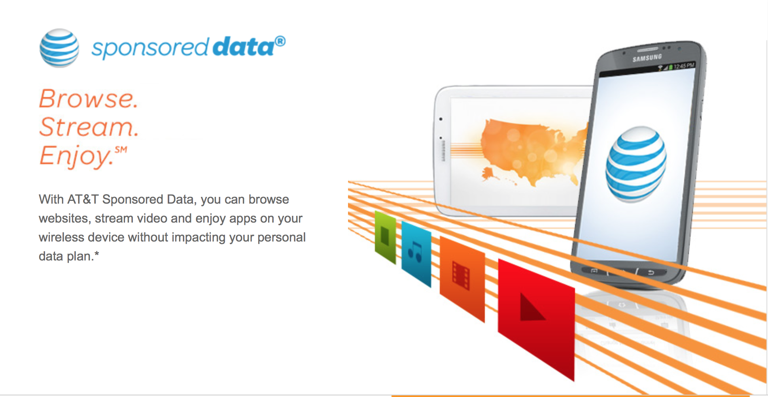
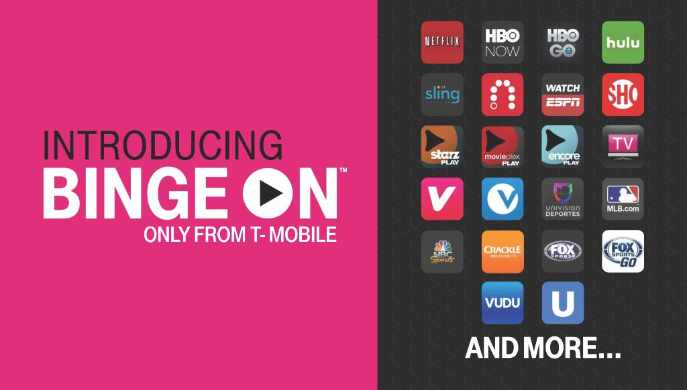


New Business Models
Sponsored
Data
Reverse
Charging
Ad
Supported
Social
Supported
Notes:
Zero rating
Reverse Charging
Differentiated charging
Geo fencing
Wi-Fi off load
Throttling
Increase QoS

Slide 10
Cisco Mobile Video Service Architecture
Cisco Mobile Video Service Architecture
Notes:
AD to talk through Apregon demo

Slide 11
Uncompromising Security for Video
Security Services
Advisory | Implementation | Managed | Operational
Video Content & Revenue Security
VideoGuard™ Everywhere
Best-of-breed products and services
Holistic architectural approach
Industry leading security intelligence
Comprehensive
Video Service Protection
Anti-piracy Solutions
Integrated
Combined video security and cybersecurity capabilities
Unified threat visibility and intelligence
Conditional Access
Streaming Piracy Prevention
Multi-DRM
Security Policy
Security Intelligence & Visibility
Security Analytics
Infrastructure Security
Ecosystem support for partners across broadcast, media and service provider
Easy integration with open APIs
Open standards and open source
Open
Next Gen Firewall
DDoS Protection
Next Gen Intrusion Prevention
Email Security
Policy and Access
Web Security
Cloud-based operations
Unified solution for any network / screen
Full life cycle services support from advisory to operations
Advanced Malware
Network Behavior Analysis
Simple
Notes:
JF talking points
Not just ‘check box DRM’ – Jailbreak, App integrity, watermarking/fingerprinting, secure download, key rotation as well including operational security features like SPP

Slide 12





Digitization Opportunity with 5G
Business Opportunities
5G Capabilities
IoE & Enterprise Digitization
Edge
Computing
$2 Trillion
Network
Slicing
Low
Latency
Smart Cities & Intelligent Industries
High
Reliability
SP Economic Opportunity
Connection
Density
Immersive Content Experiences
High
Data Rate
Massive
Capacity
Notes:
More than just 5G data rate
Digital transformation to 5G, cloud and IP Networking for massive scale of innovative services
Spectrum of activities from low power long range low density (for IOT) to high bandwidth short range high density (for video)

Slide 13
Infinite Video Platform Differentiation
One Platform
for All Devices
Best Video Experience
World-Class
Scale
Uncompromising Security
Publish any experience to any device
Rapidly create and deliver mobile video applications
Best ABR video quality with intelligence across network, encoding, and clients
Differentiate your brand with UX flexibility
Built to scale for the largest SPs globally
80+ deployments, 60+ customers, 30+ trials, 20+ partners
Global community of customers contributing to our roadmap
World’s leader in video security and cyber security
Protect video content, applications and infrastructure from all threats
Best of breed and architectural approach
Notes:
JF talking points – feel free to change, this is our chance to pitch/summarise the solution

Slide 14
Your Strategy for Mobile Video
Rapidly launch
mobile video applications
Enhance mobile video experience
Evolve to 5G for service scale and innovation

Slide 15
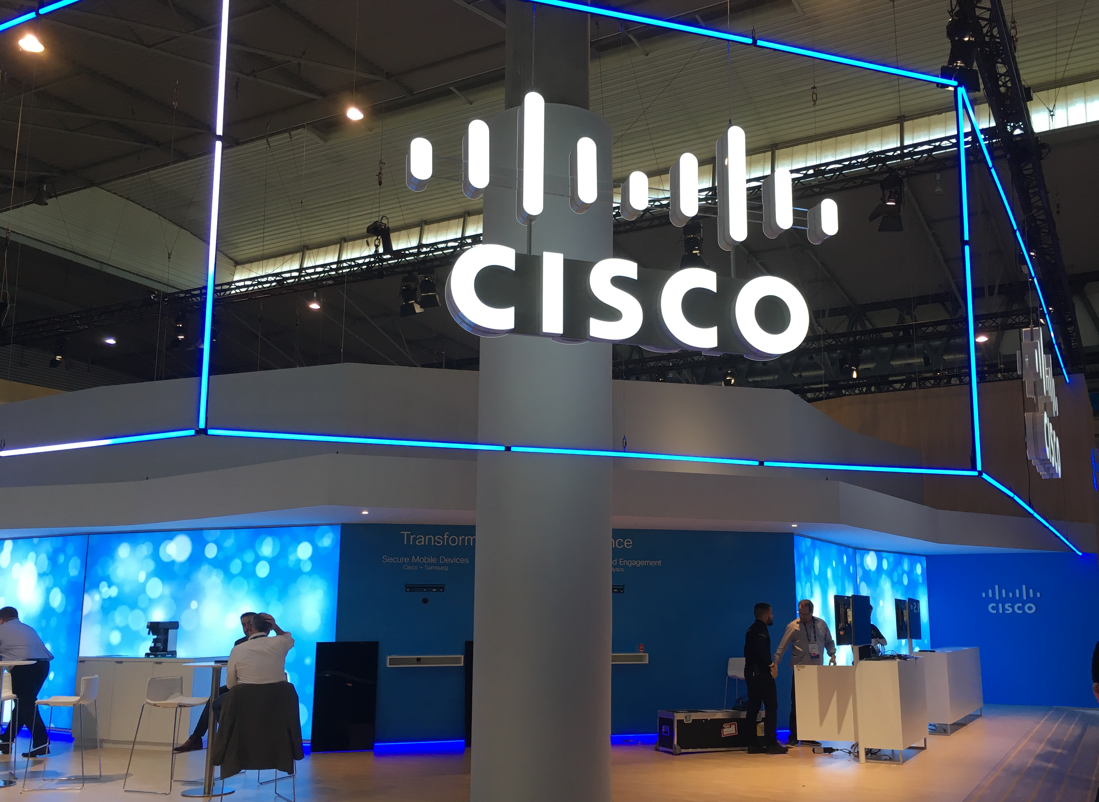



Want to know more?
http://www.cisco.com/go/infinitevideo
Visit us at TV Connect, Anga, NAB
http://blogs.cisco.com/sp
@CiscoSPVideo
addavies@cisco.com, jafield@cisco.com

Slide 16
Thank You

